Slide 1
Topologist sine curve

Slide 2
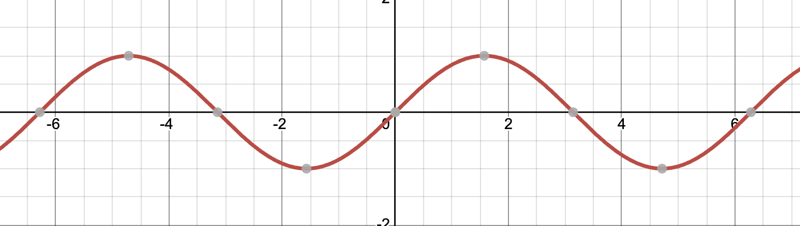
(x, sinx)

Slide 3
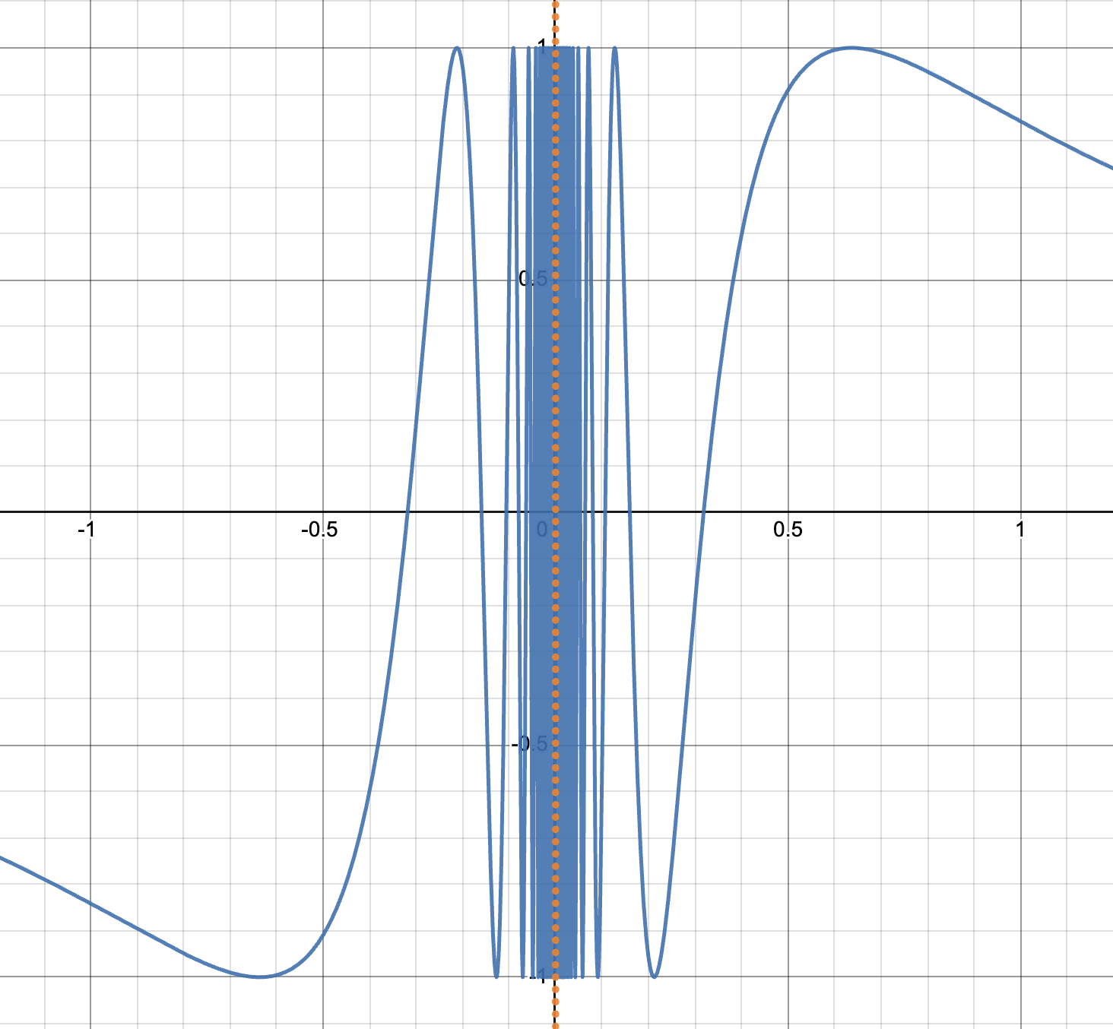

$$(x, sin\frac{1}{x})$$

Slide 4
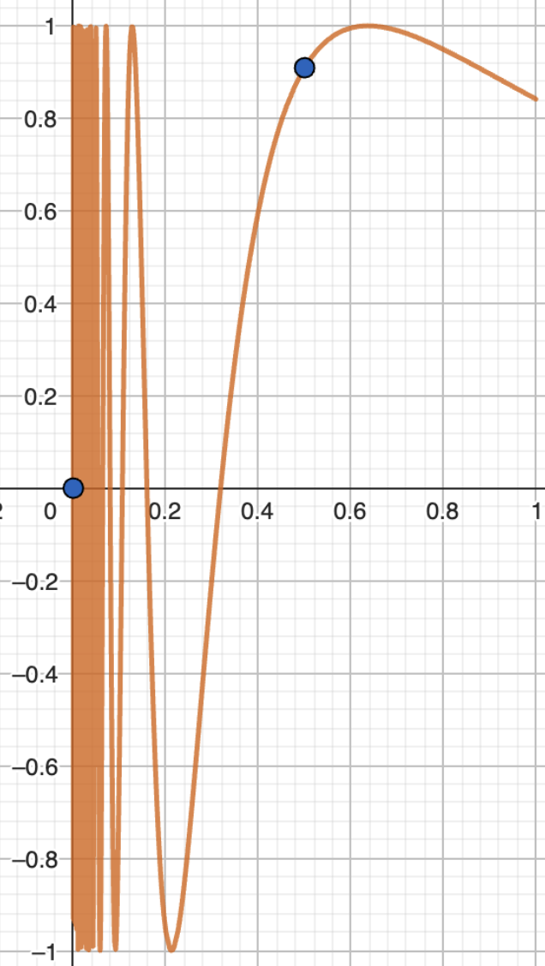
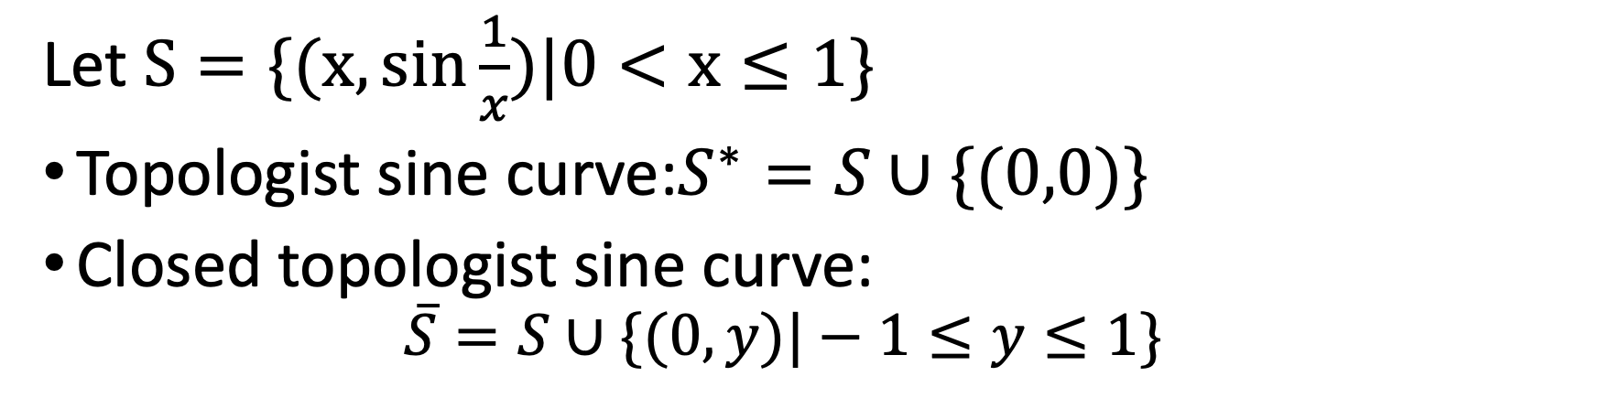
Let $S=\{(x, sin\frac{1}{x})|0<x≤1\}$
Topologist sine curve:$S^{∗}=S∪\{(0,0)\}$
Closed topologist sine curve:
$$\overline{S}=S∪\{(0,y)|−1≤y≤1\}$$
If S is connected, $S⊆A⊆\overline{S}$, then A is connected

Slide 5
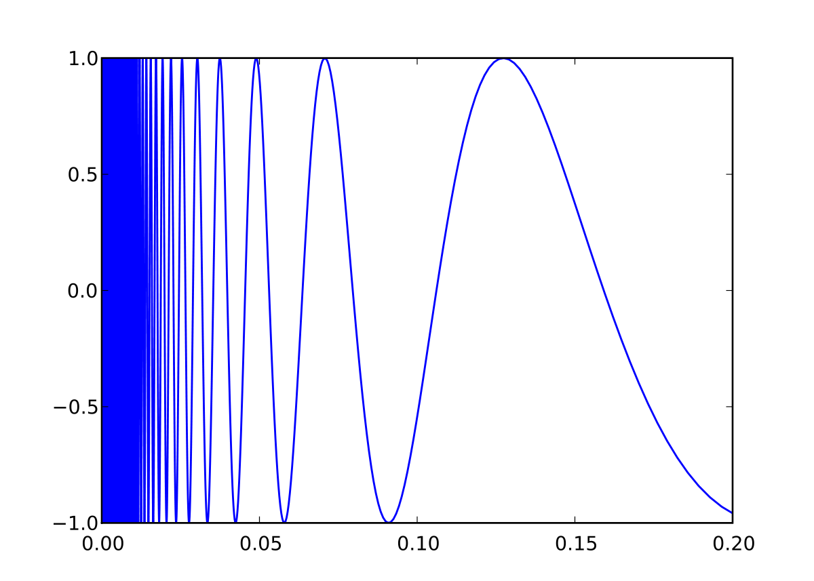
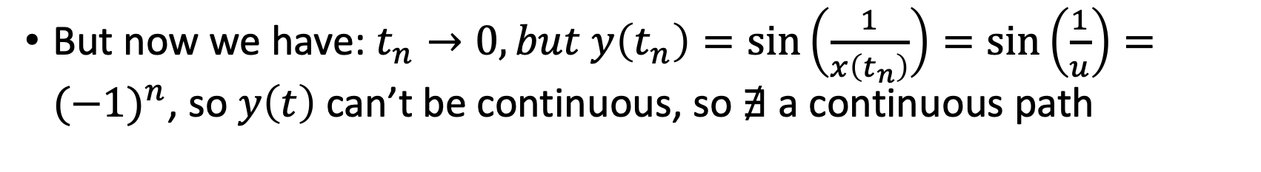
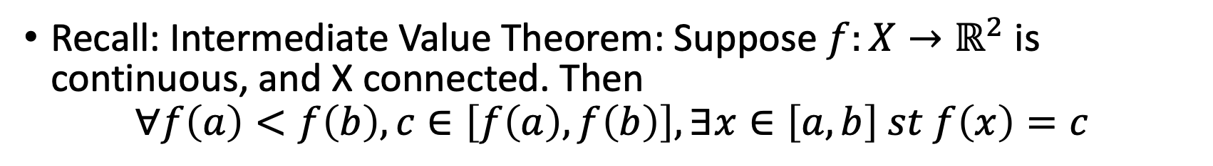
Recall: if $f$ is continuous, then $t_{n}→t⇒f\left(t_{n}\right)→f(t)$
Recall: Intermediate Value Theorem: Suppose $f:X→ℝ^{2}$ is continuous, and X connected. Then
$$∀f\left(a\right)<f\left(b\right), c∈\left[f\left(a\right),f\left(b\right)\right], ∃x∈\left[a,b\right] st f\left(x\right)=c$$
But now we have: $t_{n}→0, but y\left(t_{n}\right)=\sin\left(\frac{1}{x\left(t_{n}\right)}\right)=\sin\left(\frac{1}{u}\right)={(−1)}^{n}$, so $y\left(t\right)$ can’t be continuous, so $∄$ a continuous path

Slide 6
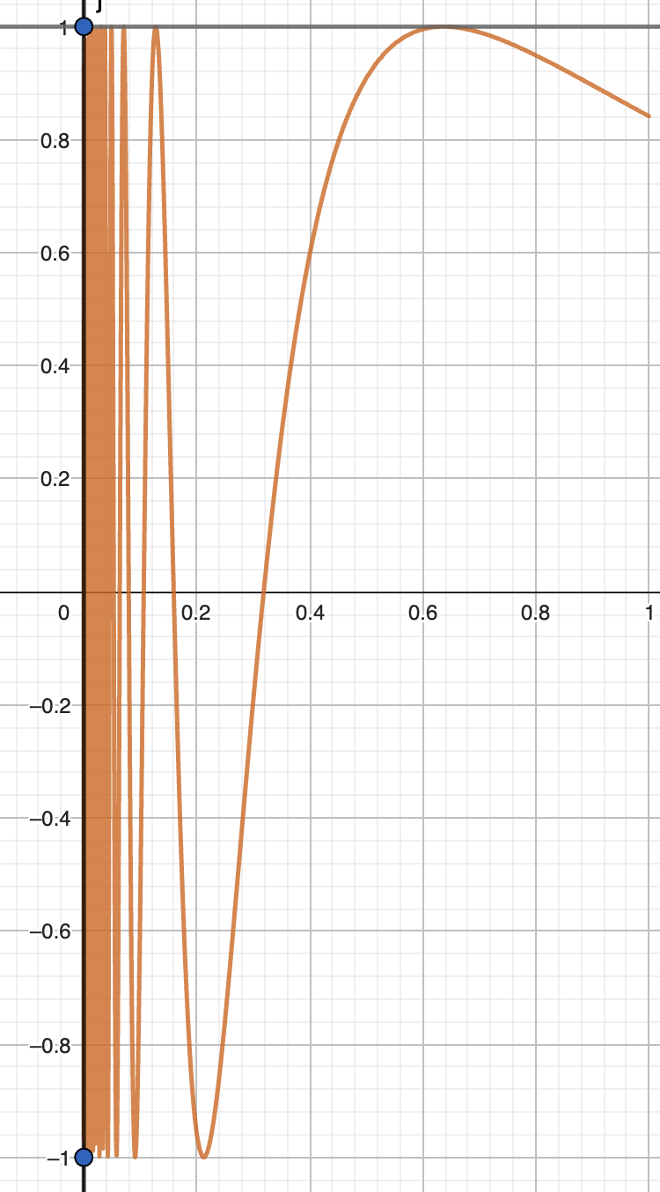
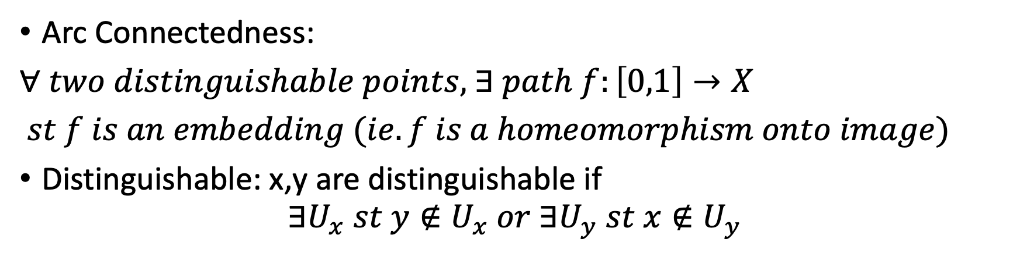
Extended topologist sine curve: $T=\overline{S}∪\{(x,1)|0≤x≤1\}$
Arc Connectedness:
$∀ two distinguishable points,$ $∃ path f:\left[0,1\right]→X$
$st f is an embedding (ie. f is a homeomorphism onto image)$
Distinguishable: x,y are distinguishable if
$$∃U_{x} st y∉U_{x} or ∃U_{y} st x∉U_{y}$$
Any path connected Hausdorff space is arc connected

Slide 7
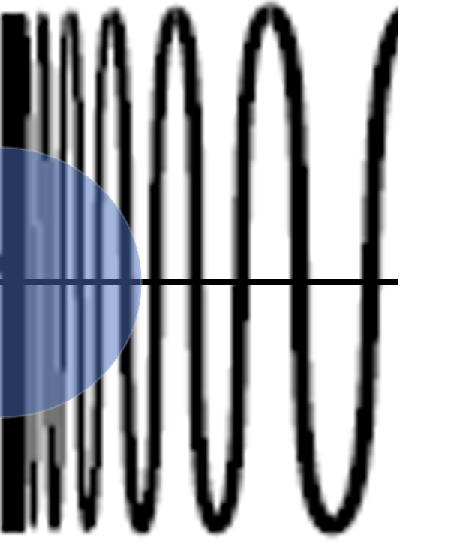

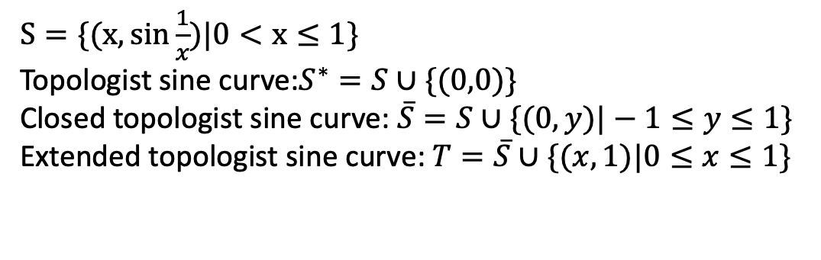
Recall: Local Connectedness:
$$∀x∈X, ∀U_{x}, ∃V_{x} st x∈V_{x}⊆U_{x}, V_{x} connected$$
$S=\{(x, sin\frac{1}{x})|0<x≤1\}$
Topologist sine curve:$S^{∗}=S∪\{(0,0)\}$
Closed topologist sine curve: $\overline{S}=S∪\{(0,y)|−1≤y≤1\}$
Extended topologist sine curve: $T=\overline{S}∪\{(x,1)|0≤x≤1\}$

Slide 8

$f:\left\{−1\right\}∪\left(0,1\right]→S^{∗}=S∪\left\{\left(0,0\right)\right\}$ st
$$f\left(−1\right)=\left(0,0\right)$$
$$f\left(x\right)=\left(x, sin\frac{1}{x}\right), x∈(0,1]$$
Continuous maps don’t necessarily send locally connected set to locally connected set
What about locally compactedness?

Slide 9
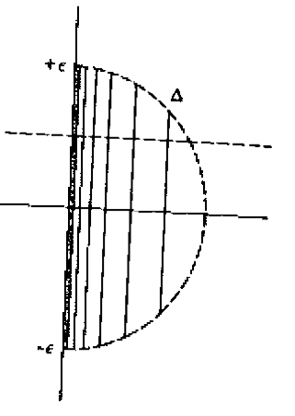

Locally Compactedness:
$$∀x∈X,∃U_{x} st ∃K⊆X compact, x∈U_{x}⊆K$$
If K is compact, then any sequence in K has some accumulation point in K

Slide 10
$f:\left\{−1\right\}∪\left(0,1\right]→S^{∗}=S∪\left\{\left(0,0\right)\right\}$ st
$$f\left(−1\right)=\left(0,0\right)$$
$$f\left(x\right)=\left(x, sin\frac{1}{x}\right), x∈(0,1]$$
Continuous maps don’t necessarily send locally connected set to locally connected set
What about locally compactedness?
Continuous maps don’t necessarily send locally compact set to locally compact set

Slide 11
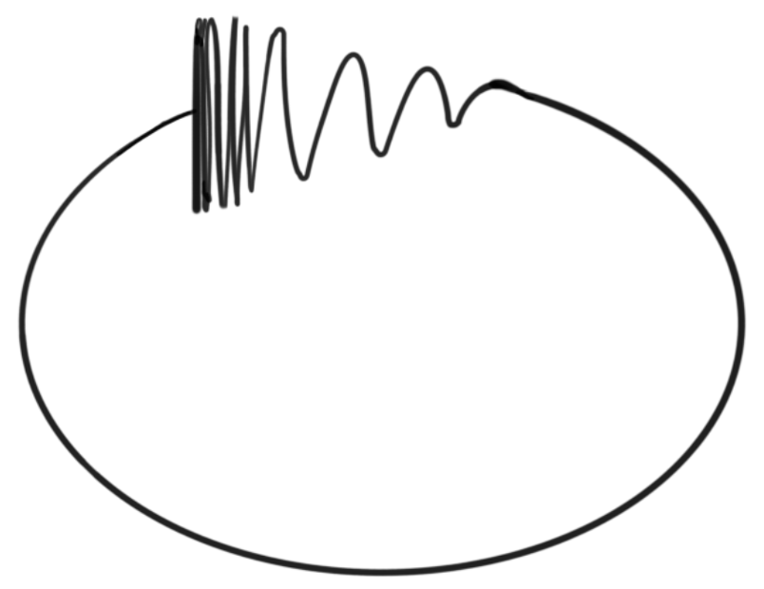
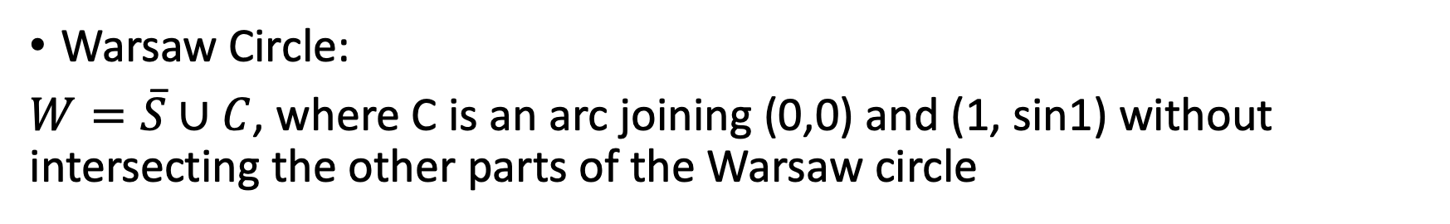
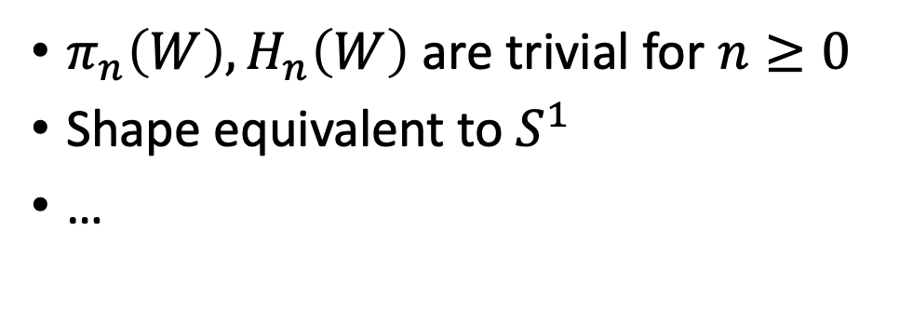
Warsaw Circle:
$W=\overline{S}∪C$, where C is an arc joining (0,0) and (1, sin1) without intersecting the other parts of the Warsaw circle
$π_{n}\left(W\right), H_{n}\left(W\right)$ are trivial for $n≥0$
Shape equivalent to $S^{1}$
…

