Slide 1


HEALTHCARE READMISSION ANALYSIS PROJECT
MILESTONE 3
PRESENTATION
Presented by :
Liu Jinyu(A0310026B)
Dylan Ng(A0200137Y)
Gao Yanming(A0309983M)
Jonathan Lee Jia Jun(A0155122U)

Slide 2
INTRODUCTION
01
Dataset: Diabetes 130-US Hospitals (1999–2008)
02
Goal: Predict 30-day hospital readmissions for diabetic patients
05
Focus: Build ML models → derive actionable insights for hospital management
03
Motivation: High readmission rates → increased costs & lower care quality
04
Framework: CRISP-DM (From Business Understanding to Model Evaluation)

Slide 3

DATA PREPROCESSING
DATASET OVERVIEW
Source: UCI Machine Learning Repository - Diabetes 130-US Hospitals dataset
Domain: Healthcare/Hospital Management
Size: 101,766 patient encounters across 130 hospitals
Time Period: 1999-2008
Features: 50+ attributes covering demographics, clinical data, medications, and outcomes
HANDLING MISSING VALUES
Removed features with high missing rates (e.g., weight, max_glu_serum).
Race had only 2% missing data, which was filled using the mode.
Medical_specialty and payer_code were filled using the 'Unknown' placeholder .
THE DATASET SIZE WAS REDUCED FROM 101,766 TO 100,244.

Slide 4
FEATURE ENGINEERING
DIAGNOSIS CODE REDUCTION
Original diagnosis codes contained 700+ categories, leading to dimensionality curse upon direct encoding.
Codes were categorized into 9 Major Disease Categories (e.g., Circulatory, Respiratory, Diabetes) based on the ICD-9 standard.
NEW COMPOSITE FEATURE CREATION
total_prior_visits:
Combines outpatient, emergency, and inpatient visits in the preceding year.
REFINING THE DISCHARGE TARGET
The original target(discharge_disposition_id) was regrouped into 3 core operational classes.
Discharged Home
Transferred to Another Hospital
Transferred to Facility-Based Care
Removed death and irrelevant categories to focus the variable on Discharge Logistics.
FINAL RECORD COUNT FOR MODELING : 89819

Slide 5
FEATURE ENCODING
HYBRID FEATURE ENCODING STRATEGY
ORDINAL ENCODING
Feature: Age
Method: Mapped 10-year age intervals to an integer sequence from 0 to 9, preserving the inherent order
BINARY ENCODING
Feature: change, diabetesMed
Method: Direct mapping for features into 1 and 0 which have only two possible categories
ONE-HOT ENCODING
Feature: remaining nominal features like race, medical_specialty
Method: Creating dummy variables ensures that each category will be recognized as an independent element without any hierarchical order.

Slide 6
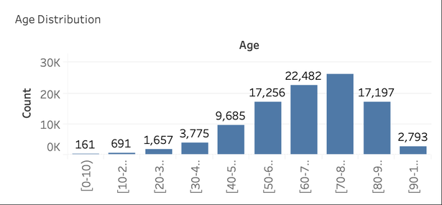
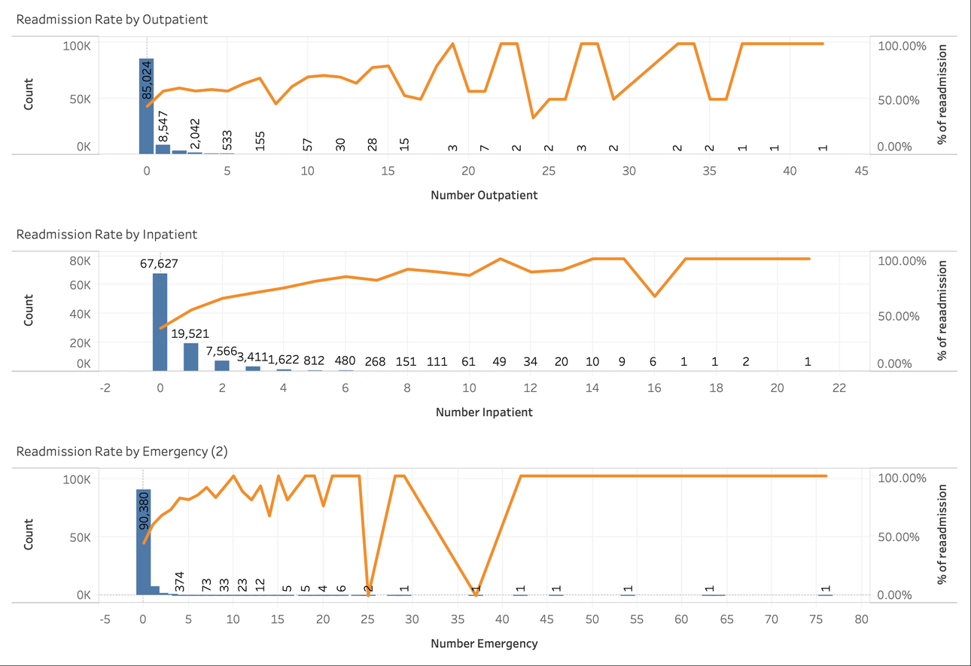
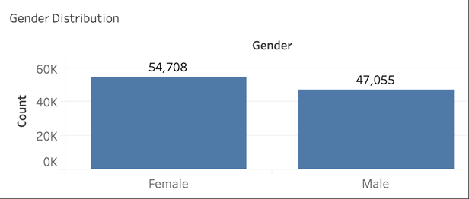
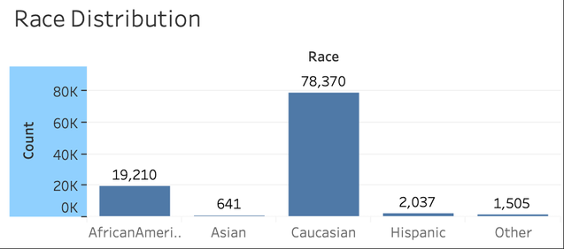
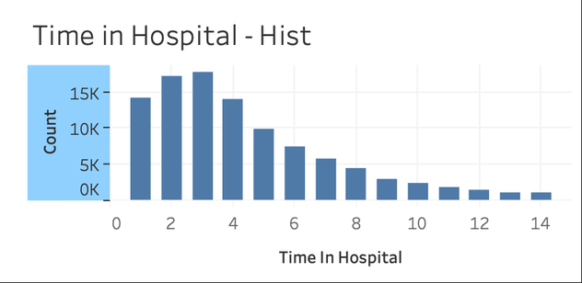
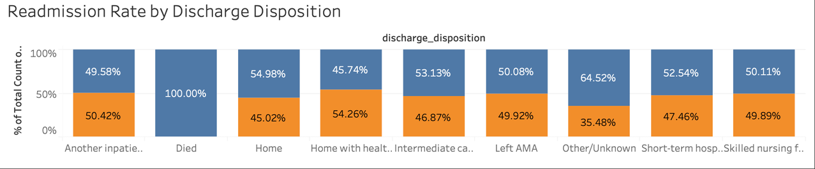
EDA

Slide 7
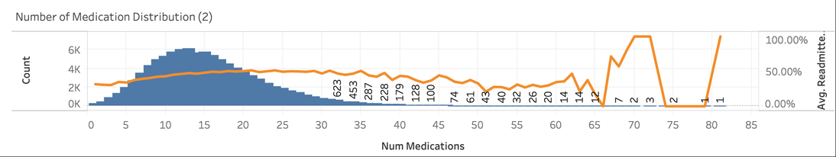
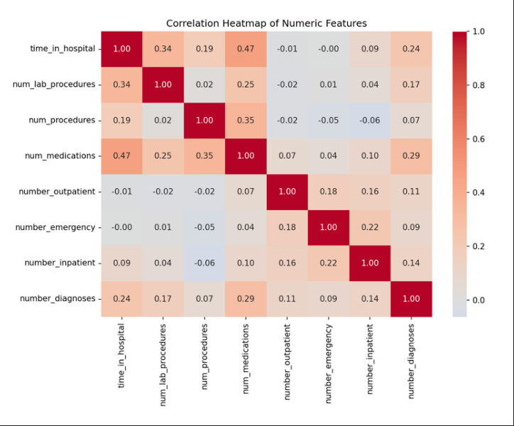
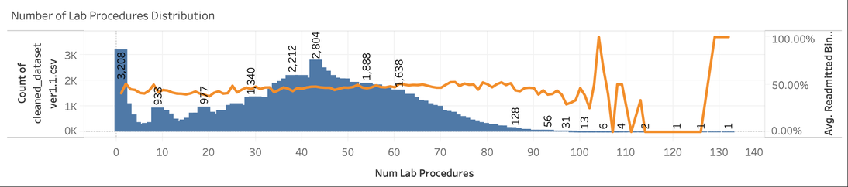
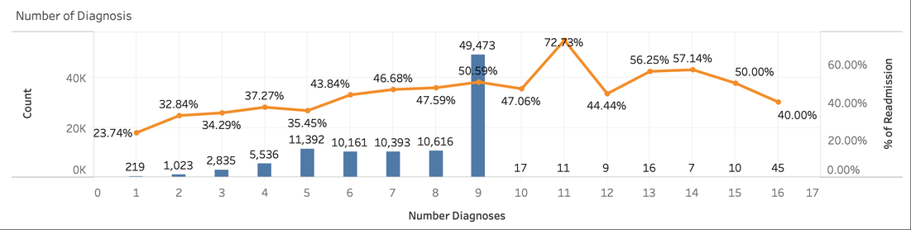
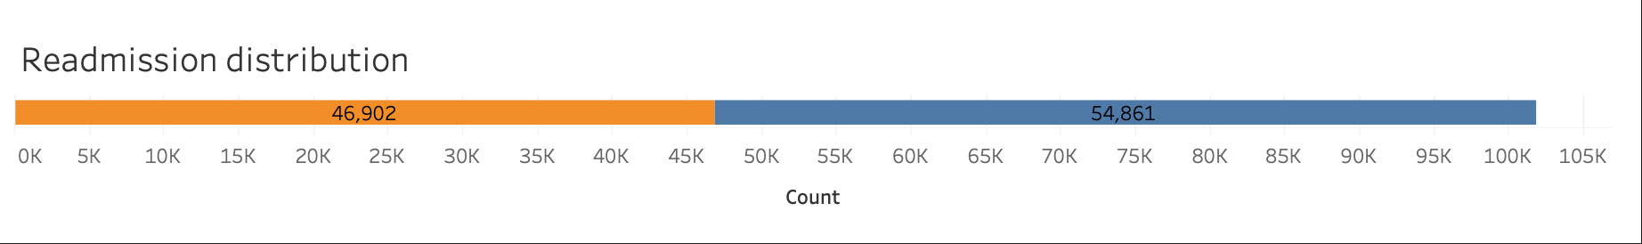
EDA

Slide 8
METHODOLOGY
MODELING STRATEGY
Employed a gradual approach from simple linear models to complex ensemble learning models.
Use simple models for Baseline, and ensemble models to capture non-linearity in healthcare data.
REGRESSION TASK
CLASSIFICATION TASK
Linear Regression (Baseline)
Random Forest Regressor
HistGradientBoostingRegressor
Logistic Regression (Baseline)
Decision tree Classifier
Random Forest Classifier
XGBoost Classifier
GENERALIZATION FRAMEWORK
Data Split: 80% for training and 20% for testing.
Reproducibility: Fixed random seeds were set for all experimental results.

Slide 9
PREDICTING LENGTH OF HOSPITAL STAY
REGRESSION PROBLEM

Slide 10
PREDICTING LENGTH OF HOSPITAL STAY
REGRESSION
Objective: Predict patient’s length of hospital stay ahead of time to allow for proactive management of hospital resources.
Studio Shodwe
Project.
Business Value:
Bed turnover management
Staffing management
Proactive Resource Management

Slide 11
PROBLEM ASSUMPTIONS AND SCOPE
D
Regression
Features:
Race
Gender
Age
Admission type/source
Primary Diagnosis
Total Prior Visits
Number of Medication/Procedures
Number of inpatient/outpatient/emergency
Target Variable: length_of_stay
F

Slide 12
1
Linear Regression
2
Random Forest Regressor
MODELS
REGRESSION TASK
3
HistGradientBoostingRegressor
4
XGBoost
Classifier

Slide 13
MODEL RESULTS
Linear Regression
1
Regression
Regression Metrics | TEST | TRAIN
R-squared | 0.3256 | 0.3305
Mean Absolute Error | 1.8321 | 1.824
Root Mean Squared Error | 2.4182 | 2.4011
Studio Shodwe
Project.
Notes:
The model shows high recall for both minority classes: 0.48 and 0.68 respectively. This means they are highly effective at identifying the patients who genuinely need complex acute care post discharge. This is a result of using class_weight = ‘balanced’ parameter which tunes the model to handle the class imbalance.

Slide 14
MODEL RESULTS
Random Forest Regressor
2
Regression
 | Original Random Forest |  | Tuned Random Forest
Regression Metrics | TEST | TRAIN | TEST | TRAIN
R-squared | 0.3728 | 0.9127 | 0.3742 | 0.7704
Mean Absolute Error | 1.7547 | 0.6474 | 1.7649 | 1.0614
Root Mean Squared Error | 2.3321 | 0.8668 | 2.3295 | 1.4062
Studio Shodwe
Project.
Notes:
The model shows high recall for both minority classes: 0.48 and 0.68 respectively. This means they are highly effective at identifying the patients who genuinely need complex acute care post discharge. This is a result of using class_weight = ‘balanced’ parameter which tunes the model to handle the class imbalance.

Slide 15
MODEL RESULTS
HistGradientBoostingRegressor
3
Regression
Regression Metrics | TEST | TRAIN
R-squared | 0.4009 | 0.4455
Mean Absolute Error | 1.7081 | 1.644
Root Mean Squared Error | 2.2792 | 2.1852
Studio Shodwe
Project.
Notes:
The model shows high recall for both minority classes: 0.48 and 0.68 respectively. This means they are highly effective at identifying the patients who genuinely need complex acute care post discharge. This is a result of using class_weight = ‘balanced’ parameter which tunes the model to handle the class imbalance.

Slide 16
MODEL RESULTS
Summay
Regression
Regression Metrics | HistGradientBoosting | Random Forest | Linear
R-squared | 0.4009 | 0.3742 | 0.3256
Mean Absolute Error | 1.7081 | 1.7649 | 1.8321
Root Mean Squared Error | 2.2792 | 2.3295 | 2.4182
Studio Shodwe
Project.
Notes:
The model shows high recall for both minority classes: 0.48 and 0.68 respectively. This means they are highly effective at identifying the patients who genuinely need complex acute care post discharge. This is a result of using class_weight = ‘balanced’ parameter which tunes the model to handle the class imbalance.

Slide 17
OVERALL EVALUATION
Length of Stay Regression model
Recommended Model: HistGradientBoostingRegressor
Highest R-squared, lowest MAE and RMSE ⟶
Agrees with various literatures that Gradient Boosting models performed better than Random Forest.
Consistent with our theoretical understanding of the gradient boosting algorithm
Iteratively train model to correct previous mistakes
Captures complex relationships between features
Important for real-life, complex indicators in healthcare that are not necessarily independent
Studio Shodwe
Project.
The Baseline: Linear Regression
Simplistic approach to something complex in nature
Poor performance can be attributed to the non-linearity of the features and its effect on length of hospital stay.

Slide 18
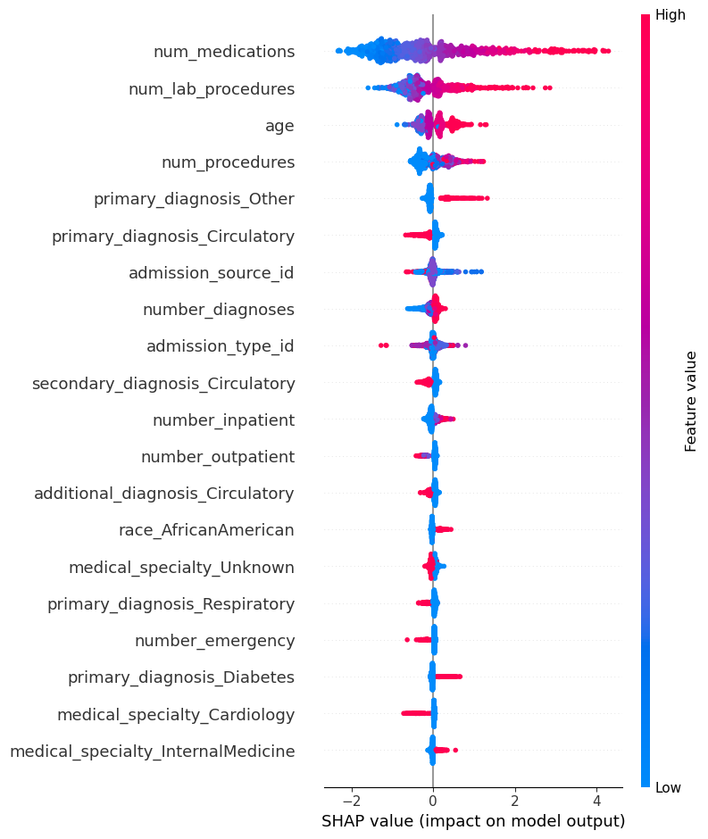
FEATURE CONTRIBUTION - SHAP ANALYSIS
Regression
Top 3 features for "Length of Stay" Prediction
Number of Medication
Number of Lab Procedures
Age
Feature Value | Impact on Length of Stay | Interpretation
Number of Medication ↑ | ↑ | More medication required ⟶ Longer length of stay
Number of Lab procedures ↑ | ↑ | More lab procedures prescribed ⟶ Longer length of stay
Age ↑ | ↑ | Older patients ⟶ Longer length of stay
Feature importance through SHAP analysis
Logically sound
Clinically interpretable
Provides confidence

Slide 19
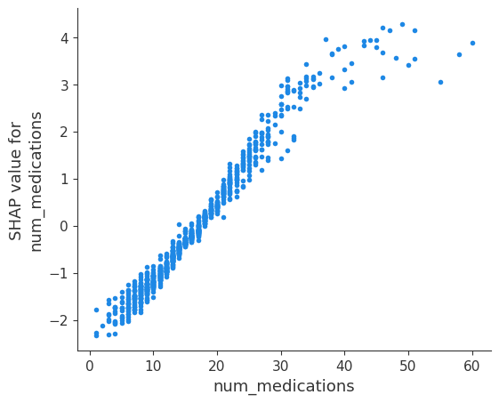
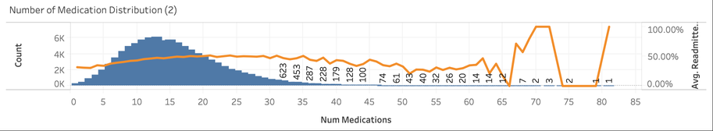
FEATURE CONTRIBUTION - SHAP ANALYSIS
Understanding the top feature
Effect of Number of Medication on Length of Stay
Generally Linear
Beyond threshold of 40, further increase does not cause significant change to prediction
Could be attributed to data sparsity (see below extract from EDA)
The analysis confirms that suggests that the model may not have enough samples in high range of medication to provide meaningful adjustments to prediction
Potential improvement to dataset

Slide 20
PREDICTING DISCHARGE DESTINATION
CLASSIFICATION PROBLEM

Slide 21
PREDICTING DISCHARGE DESTINATION
MULTI-CLASS CLASSIFICATION
Objective: Predict patient’s discharge destination ahead of time to allow for proactive management of hospital resources, particularly regarding bed turn over and post-discharge logistics
Studio Shodwe
Project.
Business Value:
Premptive arrangement of post discharge care
Minimise discharge delays
Proactive Resource Management

Slide 22
PROBLEM ASSUMPTIONS AND SCOPE
D
Multi-Class Classification
Target Variable: discharge_dispostion
Independent Variables:
Demographic Characteristics (age, gender, race)
Admission Information (admission type)
Previous Hospital Stays
Drug Profile
Diagnostic Categoires
Classes:
Discharged Home
Transferred to Another Hospital
Transferred to Facility-Based Care
F

Slide 23
1
Logistic Regression
2
Decision Tree Classifiers
MODELS
MMULTI-CLASS CLASSIFICATION
3
Random Forest Classifier
4
XGBoost
Classifier

Slide 24
MODEL RESULTS
Logistic Regression
1
Multi-Class Classification
Train Accuracy: 54.01%
Test Accuracy: 53.81%
 | Precision | Recall | F1-score | Support
Discharge Home | 0.92 | 0.51 | 0.66 | 14,367
Transferred to Another Hospital | 0.07 | 0.48 | 0.12 | 656
Transferred to Facility-Based Care | 0.37 | 0.68 | 0.48 | 2,941
Studio Shodwe
Project.
Notes:
The model shows high recall for both minority classes: 0.48 and 0.68 respectively. This means they are highly effective at identifying the patients who genuinely need complex acute care post discharge. This is a result of using class_weight = ‘balanced’ parameter which tunes the model to handle the class imbalance.

Slide 25
CONFUSION MATRIX
Logistic Regression
1
Multi-Class Classification
Actual\Predict | Discharge Home | Transferred to Another Hospital | Transferred to Facility-Based Care
Discharge Home | 7,344 | 3,781 | 3,242
Transferred to Another Hospital | 196 | 315 | 145
Transferred to Facility-Based Care | 433 | 500 | 2008
Studio Shodwe
Project.
Notes:
The model shows high recall for both minority classes: 0.48 and 0.68 respectively. This means they are highly effective at identifying the patients who genuinely need complex acute care post discharge. This is a result of using class_weight = ‘balanced’ parameter which tunes the model to handle the class imbalance.

Slide 26
MODEL RESULTS
Decision Tree Classifiers
2
Multi-Class Classification
Train Accuracy: 49.76%
Test Accuracy: 47.7%.
 | Precision | Recall | F1-score | Support
Discharge Home | 0.92 | 0.44 | 0.59 | 14,367
Transferred to Another Hospital | 0.06 | 0.45 | 0.11 | 656
Transferred to Facility-Based Care | 0.32 | 0.67 | 0.43 | 2,941
Studio Shodwe
Project.
Notes:
The Decision Tree exhibits poor overall performance with an accuracy of 0.474 of all model tested. Furthermore, this model has the worst precision (0.06) for the “Transfer to Another Hospital Class”. While this model achieves high Recall for both minority classes (0.46 for Hospital Transfer and 0.68 for Facility Care). This high Recall is misleading; the DT simply predicts these minority classes so often (to avoid the penalty of False Negatives) that it catches a high percentage of them, but at the cost of precision.

Slide 27
MODEL RESULTS
Decision Tree Classifiers
2
Multi-Class Classification
Actual\Predict | Discharge Home | Transferred to Another Hospital | Transferred to Facility-Based Care
Discharge Home | 6,311 | 3959 | 4,097
Transferred to Another Hospital | 178 | 296 | 182
Transferred to Facility-Based Care | 373 | 595 | 1975
Studio Shodwe
Project.
Notes:
The majority of “Discharge Home” patients (8145) were incorrectly flagged as needing a hospital transfer or facility care, driving the precision of the minority classes into the ground. While the model predicts a high number of “Transferred to Facility-Based Care” correctly, the high volume of False Positive elsewhere makes these predictions unreliable for the real-world use.

Slide 28
MODEL RESULTS
Random Forest Classifier
3
Multi-Class Classification
Train Accuracy: 79.74%
Test Accuracy: 71.41%
 | Precision | Recall | F1-score | Support
Discharge Home | 0.89 | 0.75 | 0.82 | 14,367
Transferred to Another Hospital | 0.13 | 0.22 | 0.17 | 656
Transferred to Facility-Based Care | 0.39 | 0.66 | 0.49 | 2,941
Studio Shodwe
Project.
Notes:
The Random Forest model is the most effective model for proactive discharge planning and resource allocation. Particularly due to its performance on “Transfer to Facility-Based Care” class achieving the best F1-score (0.49) and highest recall (0.66). This means that the Random Forest model was able to correctly identify the majority of the patients who actually require facility services, providing the greatest value for proactive planning.
However, precision for the “Transfer to Another Hospital” class is low (0.13). Such a high rate for False Positives will lead to wasted resources if patients who were predicted to be discharged to another hospital eventually get sent home or transferred to facility based care. Furthermore, white recall is an improvement from the XGBoost model, it remains low and will not significantly improve resource allocation operations.

Slide 29
MODEL RESULTS
Random Forest Classifier
3
Multi-Class Classification
Actual\Predict | Discharge Home | Transferred to Another Hospital | Transferred to Facility-Based Care
Discharge Home | 10,756 | 826 | 2,785
Transferred to Another Hospital | 365 | 143 | 148
Transferred to Facility-Based Care | 907 | 105 | 1,929
Studio Shodwe
Project.
Notes:
Confusion matrix highlights the model’s willingness to prioritize recall by siding the minority class. While this leads to model misclassifying “Discharge Home” class, this willingness allowed the model to correctly identify a large number of crucial “Transferred to Facility-Based Care” classes.

Slide 30
MODEL RESULTS
XGBoost
Classifier
4
Multi-Class Classification
Train Accuracy: 84.52%
Test Accuracy: 82.14%.
 | Precision | Recall | F1-score | Support
Discharge Home | 0.84 | 0.97 | 0.9 | 14,367
Transferred to Another Hospital | 0.27 | 0 | 0.01 | 656
Transferred to Facility-Based Care | 0.63 | 0.29 | 0.4 | 2,941
Studio Shodwe
Project.
Notes:
This model achieves the highest Overall Accuracy (0.821). This strong performance is driven by its ability to predict the majority “Discharge Home” class (97% recall). However, the model achieves this overall accuracy at the expense of the other classes.
The model shows catastrophic failure on the highest risk-groups, “Transferred to Another Hospital” and “Transferred to Facility-Based Care”. Particularly for the “Transferred to Another Hospital” class, recall of 0.00 with only 3 true positives out of 656 total, the model essentially misses all of the acute transfer cases. This high False Negative rate contradicts the purpose of our project to predict transfers on discharge to improve hospital’s operational efficiencies.

Slide 31
MODEL RESULTS
XGBoost
Classifier
4
Multi-Class Classification
Actual\Predict | Discharge Home | Transferred to Another Hospital | Transferred to Facility-Based Care
Discharge Home | 13,902 | 5 | 460
Transferred to Another Hospital | 615 | 2 | 39
Transferred to Facility-Based Care | 2,805 | 5 | 851
Studio Shodwe
Project.
Notes:
Confusion matrix confirms our analysis above with the vast majority of “Transferred to Another Hospital” class being misclassified as “Discharged Home”.
The XGBoost model, in this configuration, is too optimized for overall accuracy by heavily predicting the majority class and needs to be tuned to prioritize the recall for minority classes.

Slide 32
Poor test accuracy (53.81%)
Relatively high recall for both minority class (Transfer to Hosp: 0.48; Transfer to Fac: 0.68)
1
Logistic Regression
Baseline Models
Worst test performance (47.7%)
Reletively high recall but poor pricision for minority class
Majority of discharge home patients (8056) were incorrectly flagged as needing a hospital transfer
2
Decision Tree Classifier
Good test performance of 71.41%
Strong performance on “Transfer to Facility-Based Care”, best Recall (0.66) and F1-scoure (0.49)
Signs of possible overfitting (71.41% vs 79.74%)
MODEL EVALUATION
Random Forest Classifer
3
Ensemble Models
Best test performance 82.14%
Catastrophic failure on highest risk groups, model misses all accute transfer cases (recall: 0.00, f1-score: 0.01)
Confusion Matrix shows that vast majority of “Transferred to Hospital” class misclassified as “Discharged Home”
4
Logistic Regression

Slide 33
OVERALL EVALUATION
Multi-Class Classification
Recommended Model: Random Forest Classifier
Key Advantages: Provides the greatest immediate operational benefit due to its superior performance on the "Transferred to Facility-Based Care" class.
Challenges: Low recall (0.22) for Transferred to Another Hospital (High False Negatives)
Next Steps (Focus on Random Forest):
Hyperparameter Tuning: Explicitly target maximizing the Macro Average F1-Score.
Cost-Sensitive Learning: Implement this technique to reduce False Negatives on the acute transfer class.
Crucial Note: Be careful to implement these steps without overfitting the model to the training data.
Studio Shodwe
Project.
The Baseline: Logistic Regression
Role: Provides a necessary interpretable baseline and achieves strong recall for both transfer types.
Limitation: Suffers from low Precision, which would lead to significant operational waste if deployed.

Slide 34
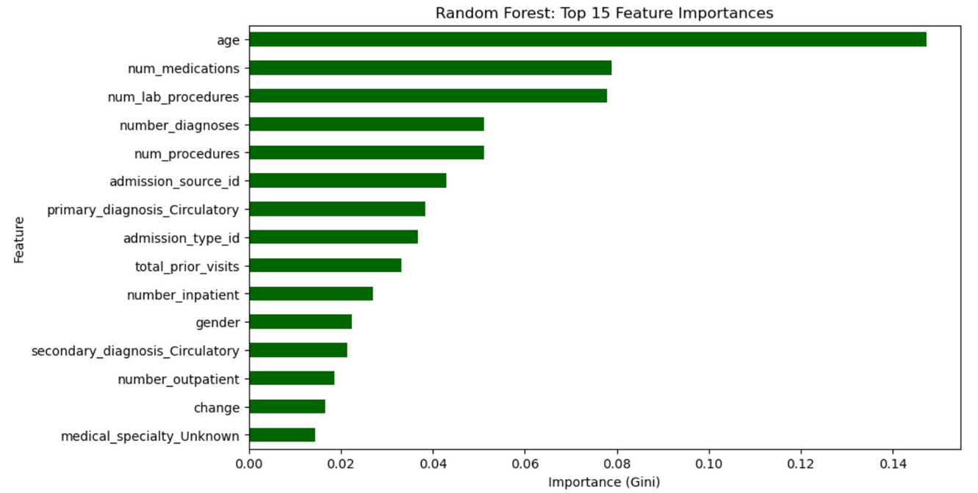
RANDOM FOREST FEATURE IMPORTANCE
Multi-Class Classification
Age accounts for approximately 15% of model’s predictive power
Volume of care and complexity of patient’s condition are also risk factors when it comes to their discharge destination

Slide 35
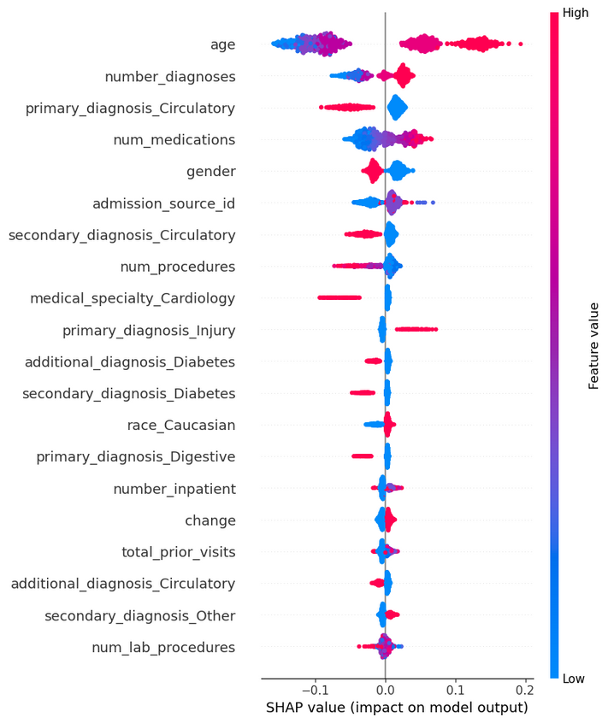
FEATURE CONTRIBUTION - SHAP ANALYSIS
Multi-Class Classification
Key Drivers for "Facility-Based Care" Prediction
Age and Number of Diagnoses are the primary drivers, exerting the widest influence on the model's output.
Feature Value | Impact on Prediction | Interpretation
High Age & High Number of Diagnoses | Significantly IncreasesLikelihood | Strong indicator for Facility-Based Care.
Low Age & Low Number of Diagnoses | Significantly Decreases Likelihood | Strong indicator for Discharge Home.
The analysis confirms that patient frailty (Age) and chronicity (Number of Diagnoses) are the strongest factors that determine a patient's final discharge disposition.

Slide 36
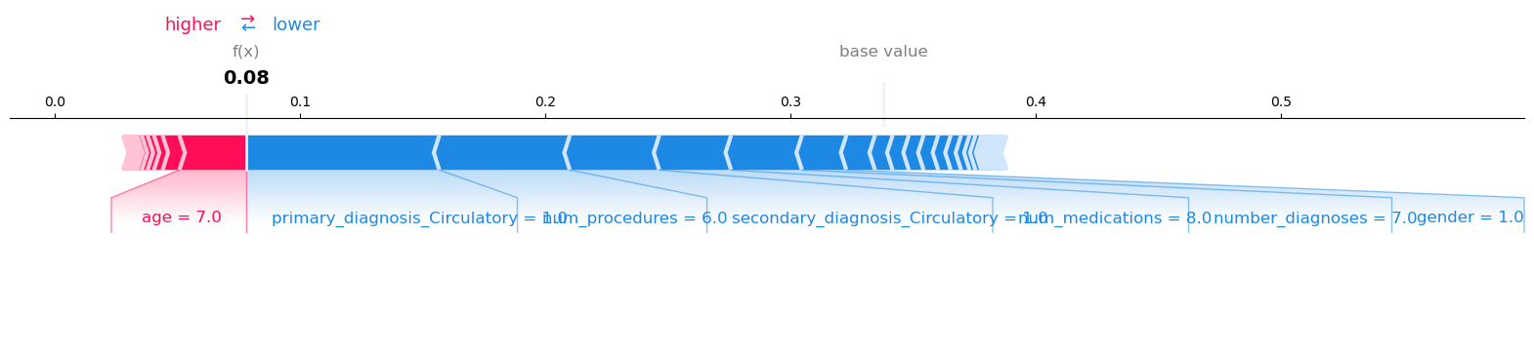
LOCAL SHAP ANALYSIS
Multi-Class Classification
Prediction: Discharge Home (f(x) = 0.1) – Strong prediction.
Key Feature Dynamics:
The patient's high Age (7.0) exerted a clear positive push TOWARDS Facility Care
This risk was successfully overridden by a low Number of Diagnoses, which was the strongest factor pushing the prediction TOWARDS Home.
Model Utility:
The analysis confirms the model's crucial sophistication: it does not rely on any single variable.
It effectively differentiates between age-based demographic risk and true clinical need/acute instability, validating its utility in real-world decision-making.

Slide 37
High-risk profiles: patients with high A1C or glucose levels, frequent visits.
Medication changes: Frequent insulin adjustments ↑ readmission risk.
Admission type & discharge status: Emergency admissions & home-care patients show higher risk.
Action: Implement post-discharge follow-ups and education programs.
Benefit: Better resource allocation & improved care continuity.
BUSINESS INSIGHTS
FUTURE PLANS AND ASPIRATIONS

Slide 38
CONCLUSION & IMPACT
ML models effectively predict readmission risk (XGBoost & Random Forest perform best)
Predictive insights support proactive patient management
Enable data-driven hospital planning and policy decisions
Future work: Integrate real-time data & improve model explainability

Slide 39
THANK YOU!

