Slide 1

Statistical physics phy301
Liouville’s theorem, ensemble theory
Lecturer: Kok Wee Song

Slide 2
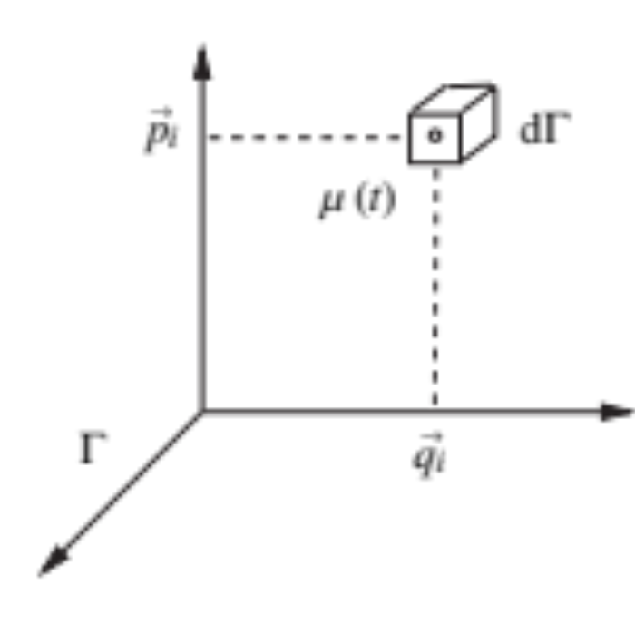

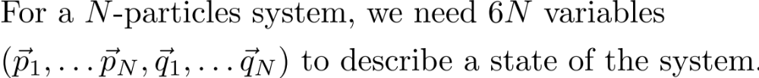

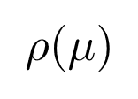
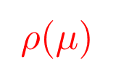
Building a statistical model for a many-particles system
Phase space: collection of all available states
The microstates of a large system.
=
We only interested in the macroscopic behavior.
⇒ What is the correct statistical model?
Each point represent a state.
It is a huge space
⇒ How to build the distribution of the microstates ?
The physical law for each particles MUST not be violated ⇒ is not arbitrary.

Slide 3



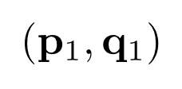
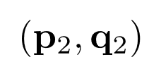
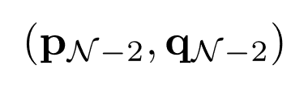
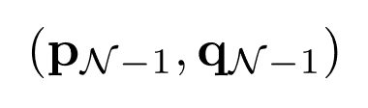


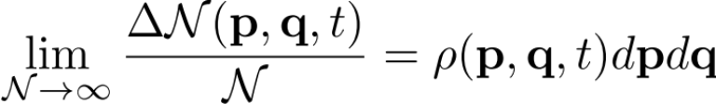
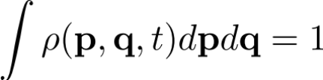
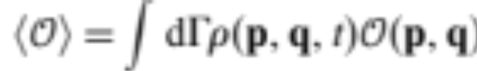

Building a statistical model for a many-particles system
Ensemble theory
……

Slide 4
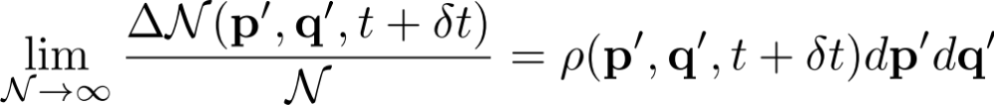
Building a statistical model for a many-particles system
Ensemble theory
……
change

Slide 5

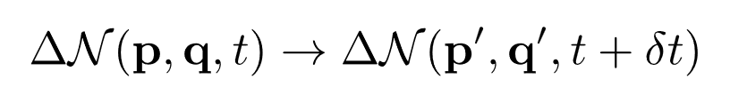
Building a statistical model for a many-particles system
Ensemble theory
……

Slide 6

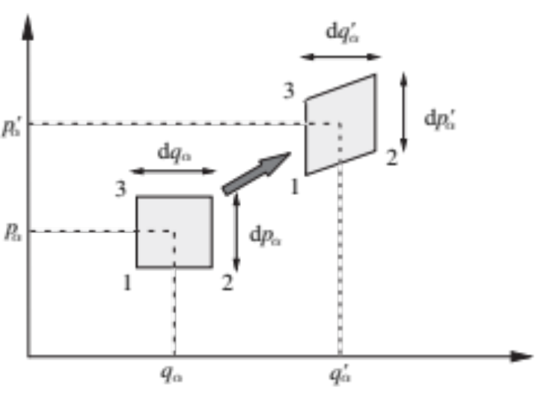
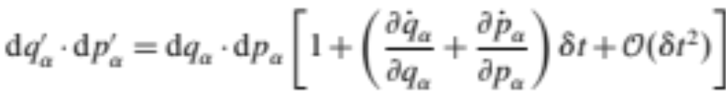


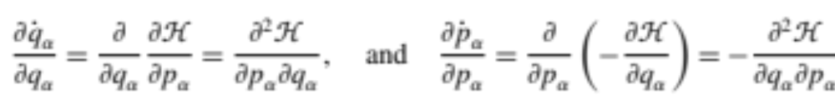
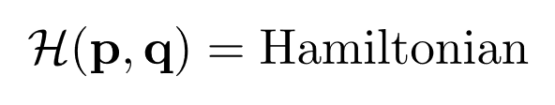
Building a statistical model for a many-particles system
?
Each particle has to follow the Hamiltonian mechanic (Newton law)

Slide 7
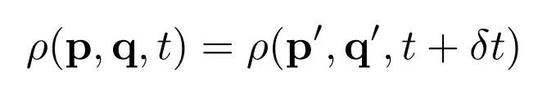
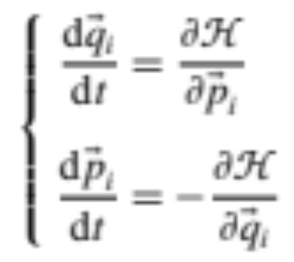
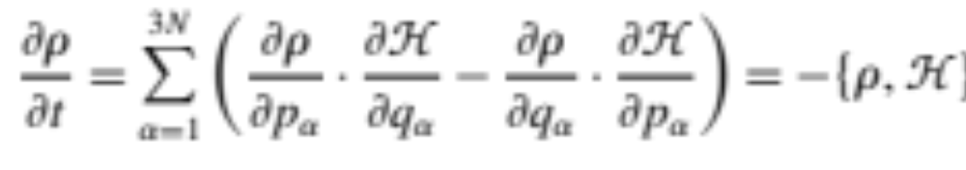
Building a statistical model for a many-particles system
Time variation:
Hamiltonian equation of motion:
Equation of motion for the distribution (Liouville’s theorem):

Slide 8
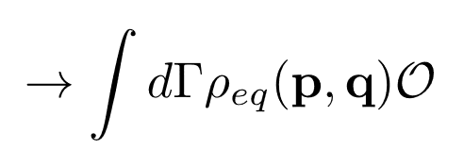
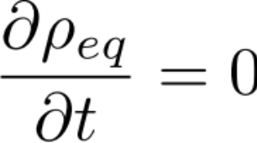

Building a statistical model for a many-particles system
Liouville’s theorem:
At equilibrium, the ensemble average must be independent in time.
total energy
The distribution of the statistical model must depends on total energy ONLY.

Slide 9

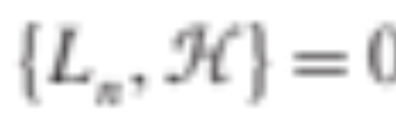
Building a statistical model for a many-particles system
If there are some conserved quantities
Generalized the result to
Liouville’s theorem still hold in this form
If each particle follows the Newton’s law,
the distribution must look like this.

Slide 10
Building a statistical model for a many-particles system
“Weird” property in ensemble theory
Cannot stay at equilibrium forever, no time direction in Newtonian mechanics.

Slide 11
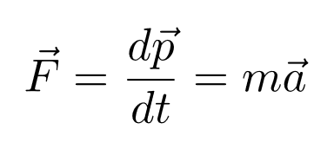

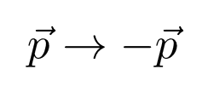
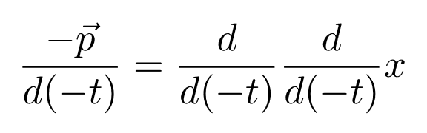
Time-reversal symmetry
If the laws of physics have time-reversal symmetry. The backward-time evolution follows exactly the same laws in forward-time evolution.
Example: Newton’s Law
Change the time direction:
As you can see the 2nd law remain the same.

Slide 12


Time-reversal symmetry
Consider a the following motion
Case 1
Case 2
move to the RIGHT, forward in time
move to the LEFT, forward in time
Indistinguishable
If we reverse the above motion
If we reverse the above motion
If we see something move from left to right, we cannot tell the time direction.

Slide 13

Example for Time-reversal symmetry breaking
Weak interaction between elementary particles in the standard model.
Hall effects. Magnetic field break time reversal symmetry.
etc ….
AMS detector
The example in the class: AMS experiment. The large magnetic field in the detector is to break the time-reversal symmetry of the particle motion. This will help to tell the charges, whether it is a particle or a anti-particle.

Slide 14
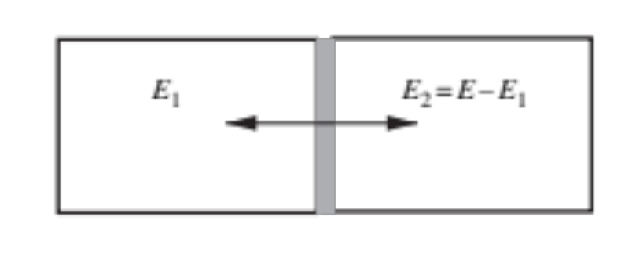
Building a statistical model for a many-particles system
“Weird” property in ensemble theory
Cannot stay at equilibrium forever, no time direction in Newtonian mechanics.
Combining two systems
T₁
T₂
Can they stay at equilibrium forever?
Liouville theorem cannot guarantee this.

Slide 15
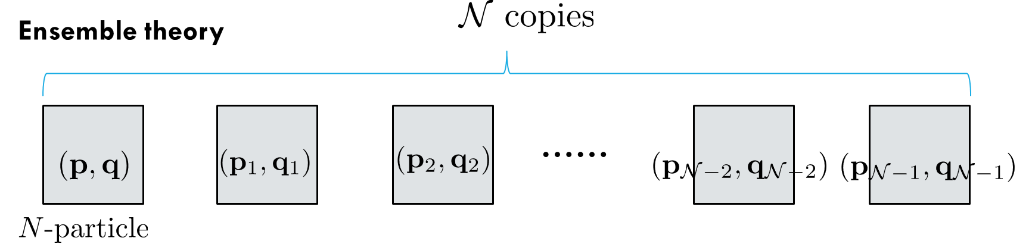
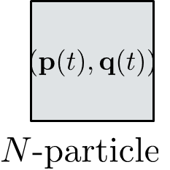
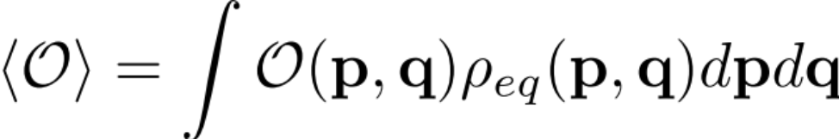
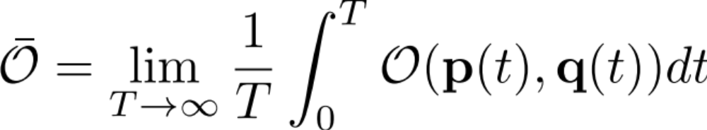
Building a statistical model for a many-particles system
Ergodicity
“Weird” property in ensemble theory
Cannot stay at equilibrium forever, no time direction in Newtonian mechanics.
Sometime, the statistical behavior may be convenient to be described by time average
(Ensemble average)
(time average)

Slide 16
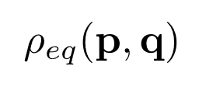
Questions?
Liouville’s theorem:
So far we only have a very general statistical model.
Relation with thermodynamics
Next, a specific form of ⇒ Microcanonical ensemble

