Slide 1
Statistical physics phy301
Microcanonical, canonical, grand canonical ensemble
Laws of thermodynamic and idea gas

Slide 2

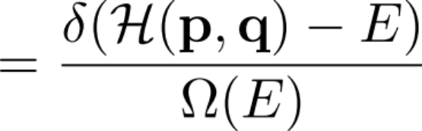



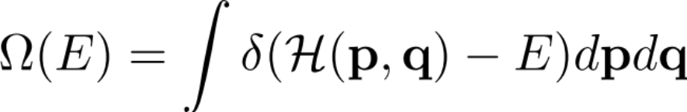

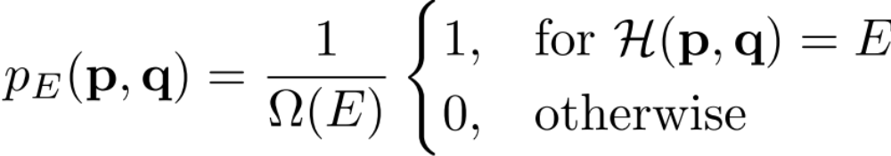


Microcanonical ensemble
Isolated system with total energy
Total number of microstates:
Conserve
The very 1st statistical model: microcanonical ensemble
We postulate uniform probability distribution. All microstates with E are equally probable.
Function of total energy
Can we get the laws of thermodynamic from this model?
YES!

Slide 3
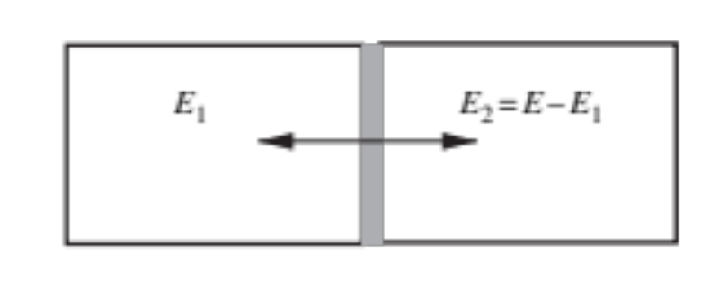


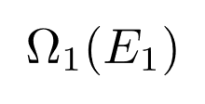
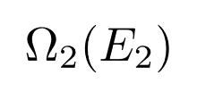
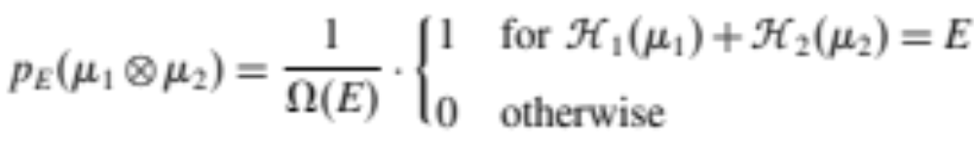

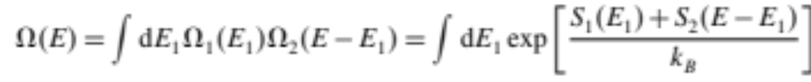
Microcanonical ensemble
0th Law of thermodynamic
⇒ concept of temperature
Total energy:
Combining two systems
Separate microstates:
Total microstates:
The distribution for the total system:
Total number of microstates?
(Entropy)

Slide 4
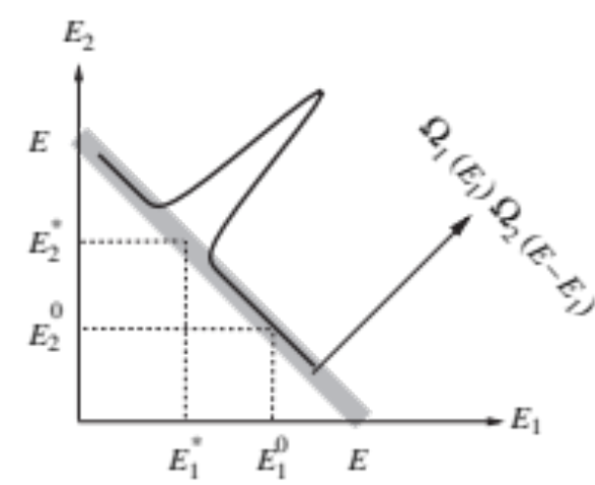
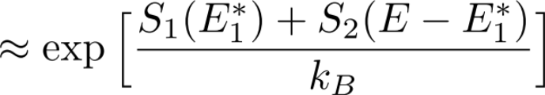
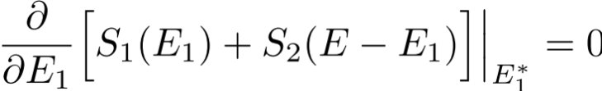
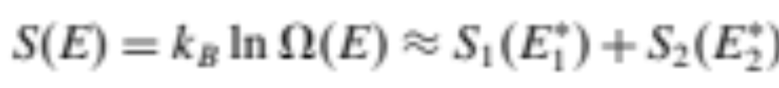
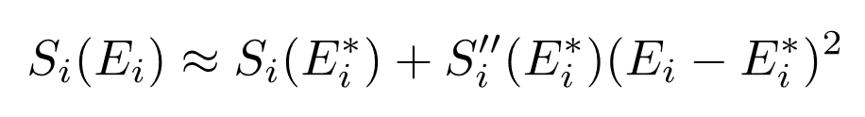
Microcanonical ensemble
0th Law of thermodynamic
=> concept of temperature
Total energy:
Combining two systems
Most probable states
(equilibrium)
The major contribution is from saddle point:
(Entropy)
Maximum entropy

Slide 5
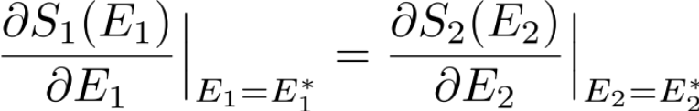
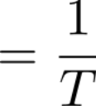

Microcanonical ensemble
0th Law of thermodynamic
=> concept of temperature
Total energy:
Combining two systems
(Entropy)
Most probable states
(equilibrium)
Temperature

Slide 6
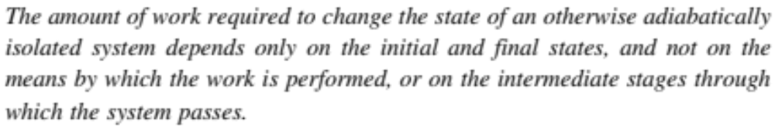



Microcanonical ensemble
1st Law of thermodynamic
Isolated system with total energy
Total number of microstates:
Conserve
The very 1st statistical model (microcanonical ensemble)
The available positions depends on

Slide 7
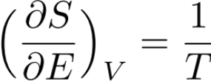



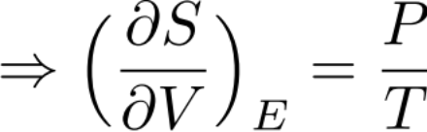
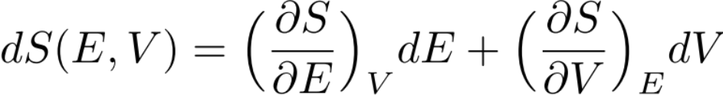
Microcanonical ensemble
1st Law of thermodynamic
In a REVERSIBLE process with
All the work done on the system turn into:
reversibility
1st law
(Heat)

Slide 8


Microcanonical ensemble
2nd Law of thermodynamic
equilibrium

Slide 9



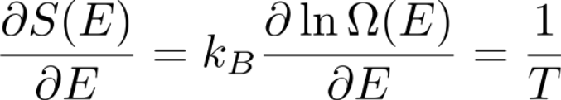

Microcanonical ensemble
3rd Law of thermodynamic
More Examples

Slide 10

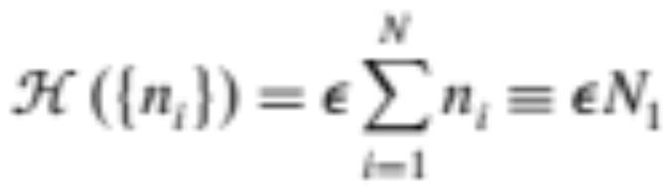




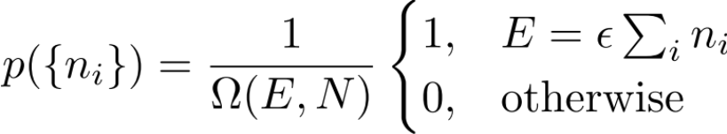
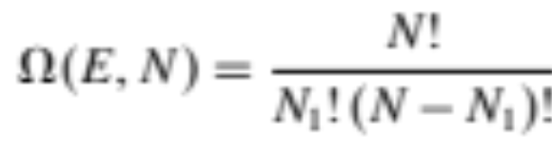

Microcanonical ensemble: two level system
Number of excited states
Microstates:
(Microcanonical ensemble)
Microstates distribution:

Slide 11
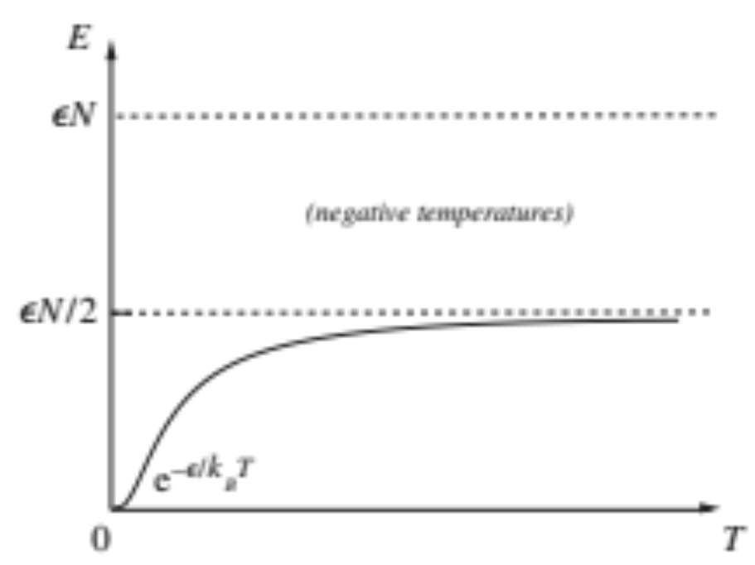

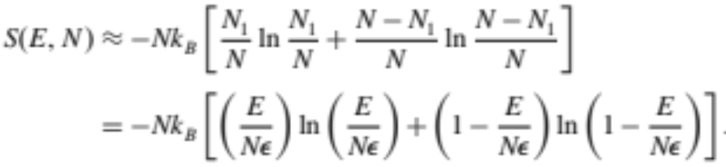
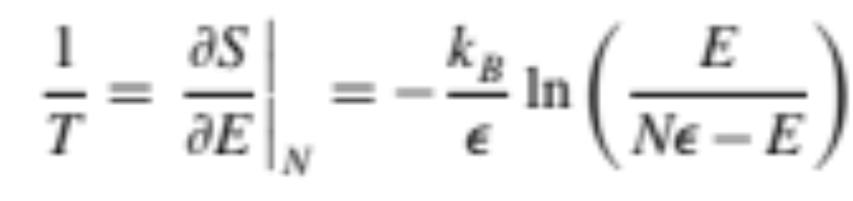
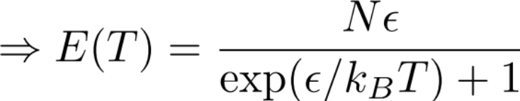
Microcanonical ensemble: two level system
Number of excited states
3rd law

Slide 12
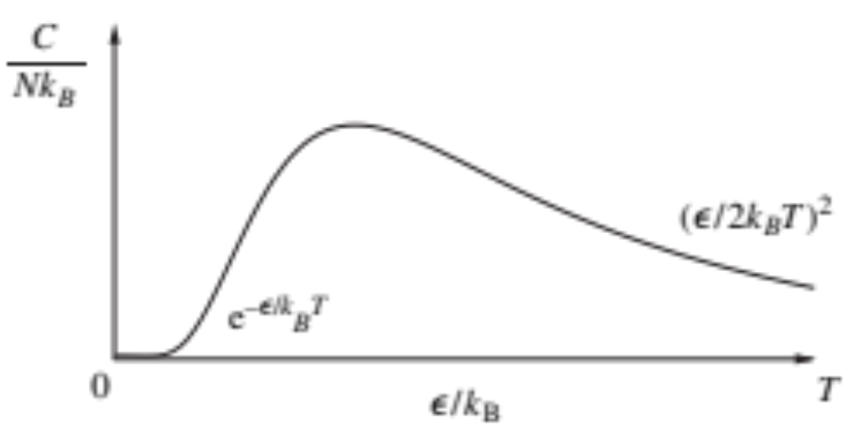

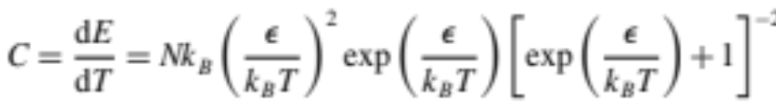
Microcanonical ensemble: two level system
Number of excited states
Energy gap (minimum excitation energy)
Started to deplete the excited states
Heat capacity:

Slide 13
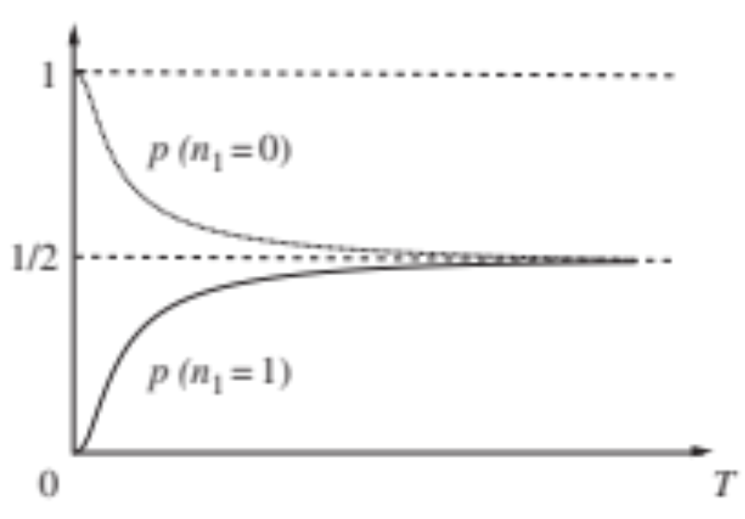

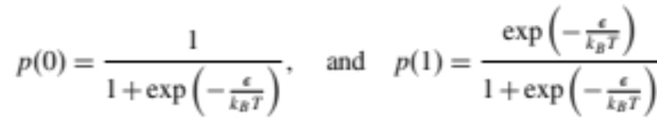
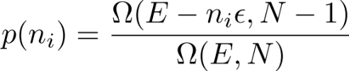
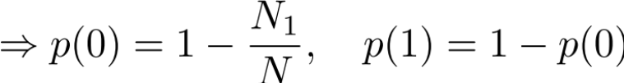
Microcanonical ensemble: two level system
Number of excited states
Lowest energy state
Randomize
At each site, what is the probability to find a or
energy state:

Slide 14
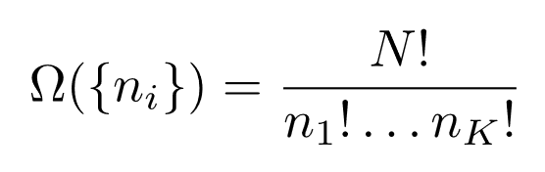









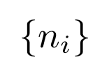
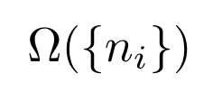
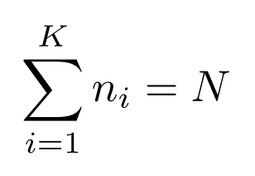
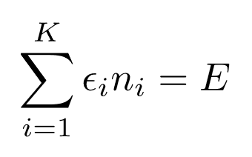
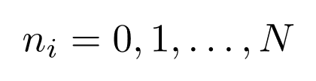

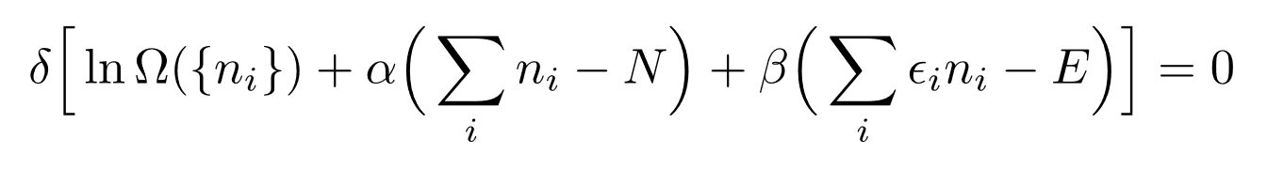

Lagrange Multiplier and the most probable distribution.
N particles in K levels
2 level it is easy to fix the energy
……
What distribution of give largest ?
with the constraint:
Monotonic function
Maximize without constraint:
Varying independently
Lagrange multipliers

Slide 15
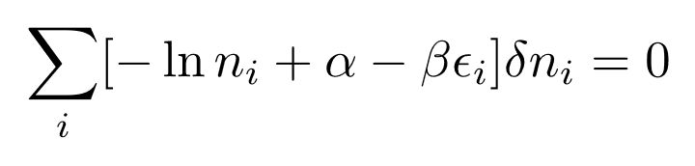
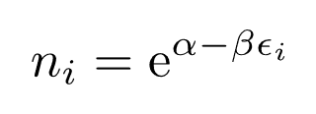
Lagrange Multiplier and the most probable distribution.
N particles
……
What distribution of give largest ?
with the constraint:
Solve for the multipliers
(Most probable distribution)
We may want this technique later.

Slide 16
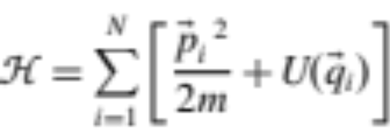
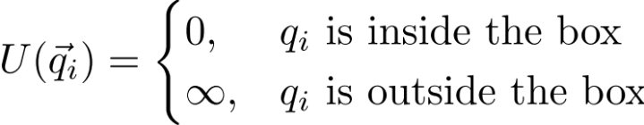

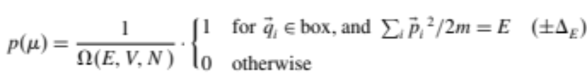
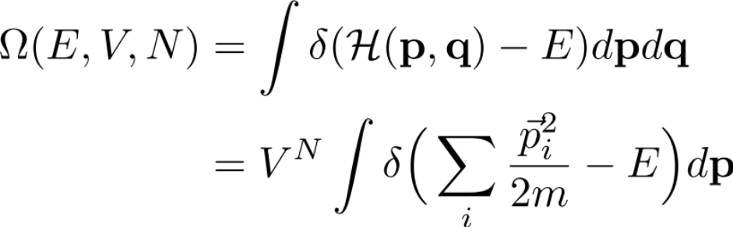
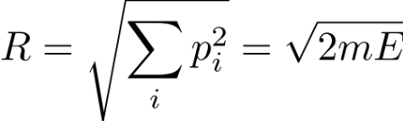
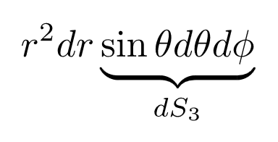
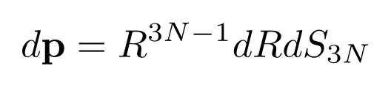
Microcanonical ensemble: Ideal Gas
Hypersurface of a 3N-dimensial sphere with radius
Similar to 3D, we write the differential volume using solid angle:

Slide 17
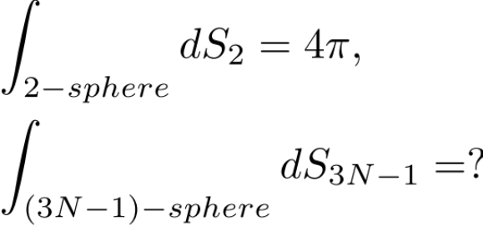




Microcanonical ensemble: Ideal Gas
Hypersurface of a 3N-dimensial sphere with radius

Slide 18






Microcanonical ensemble: Ideal Gas
Gaussian integral
On the other hand
Let
and
(Gamma function)

Slide 19




Microcanonical ensemble: Ideal Gas
Entropy:
(assume N is large)
equipartition of energy

Slide 20


Microcanonical ensemble: Ideal Gas
Internal energy
Heat capacity
Ideal gas law
From the proof of 1st Law
Maxwell–Boltzmann distribution ?

Slide 21





Microcanonical ensemble: Ideal Gas
Probability of getting a particle with momentum :
Maxwell–Boltzmann distribution

Slide 22

Questions
Microcanonical ensemble:
Study cases: 2 level system and Ideal gas
All the thermodynamic phenomena can be understand as statistical (thermal) fluctuation.
The energy fluctuation of each particles is

Slide 23




Microcanonical ensemble
Isolated system with total energy
Not Unique
Total number of microstates:
Conserve
The very 1st statistical model: microcanonical ensemble
Up to an unimportant constant
Function of total energy
Kerson Huang, Statistical Mechanics, Wiley (1991)
the laws of thermodynamic?

Slide 24








Gibbs paradox
equilibrium
Initial:
Not a extensive quantity:
final:
(increase)
If gas 1 = gas 2, we have problem!

Slide 25



Gibbs paradox
equilibrium
Distinguishable
2 configurations
Initial:
final:
Indistinguishable
1 configuration
(Identical particle)
Overcounting
(increase)
If gas 1 = gas 2, we have problem!

Slide 26



Gibbs paradox
equilibrium
Initial:
final:
Density is the same.
(increase)
If gas 1 = gas 2, we have problem!

Slide 27







Gibbs paradox
equilibrium
Initial:
final:
gas 1 ≠ gas 2?
(increase)

