Slide 1
Statistical physics phy301
canonical, grand canonical ensemble
Lecturer: Kok Wee Song

Slide 2

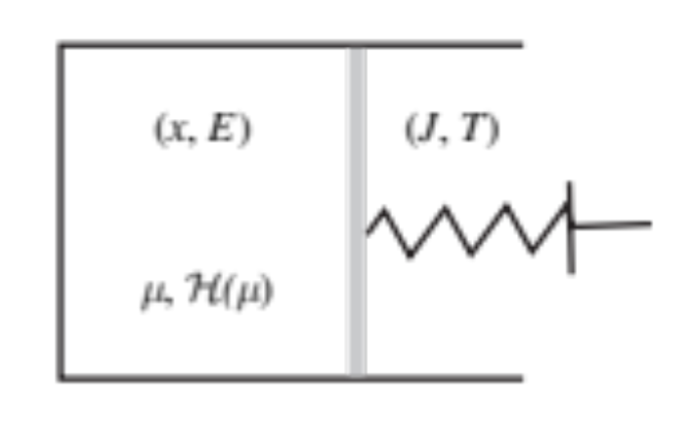

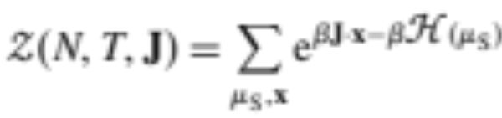
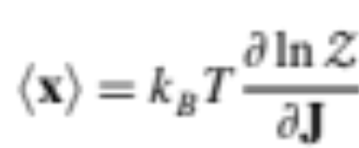


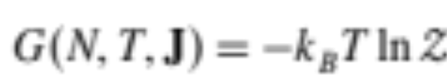
Gibbs canonical ensemble
System energy
Average position:
Average Energy:
Gibbs free energy:
Connect to the thermodynamics quantities.

Slide 3
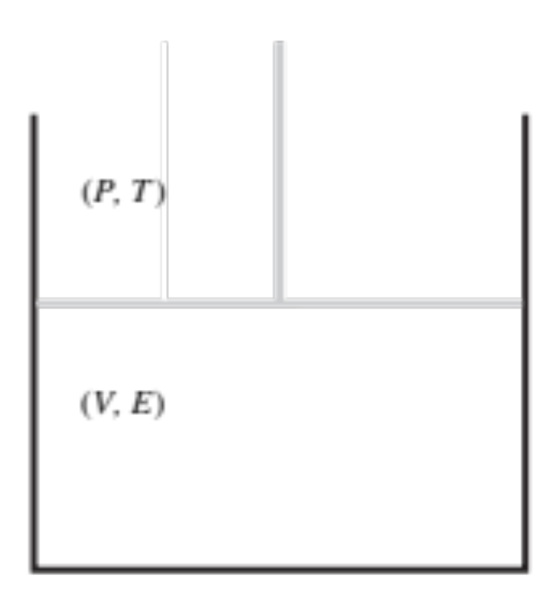
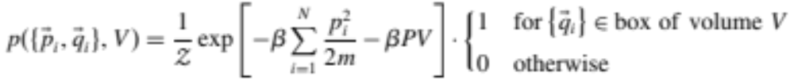
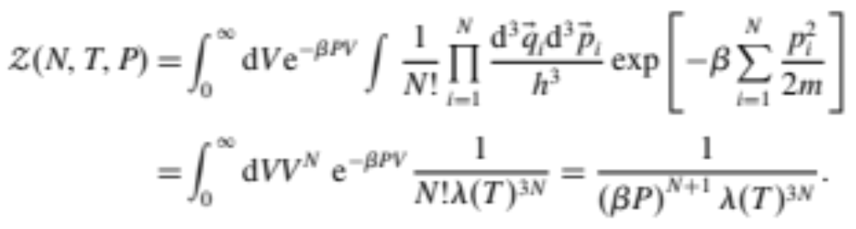

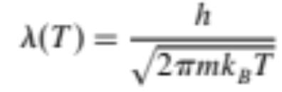
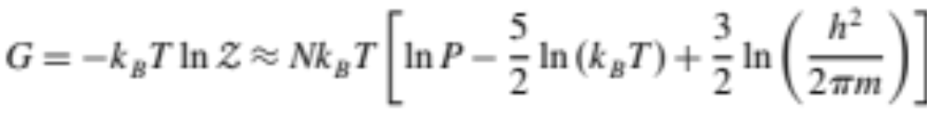
Gibbs canonical ensemble
Idea gas:
1. Partition function
2. Free energy

Slide 4


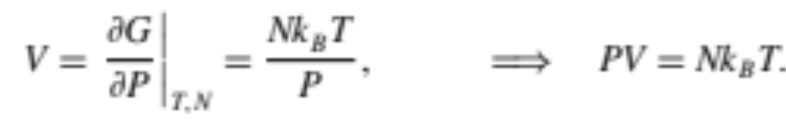
Gibbs canonical ensemble
Idea gas:
On the other hand

Slide 5
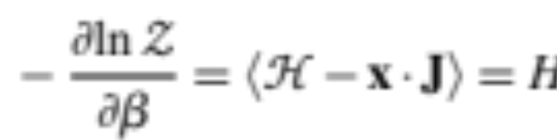
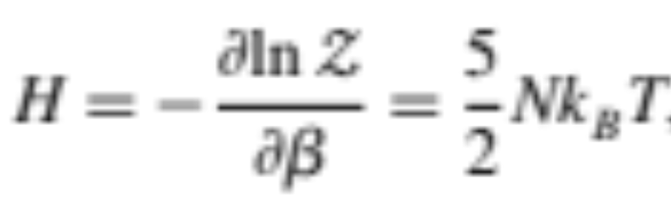


Gibbs canonical ensemble
Idea gas:
(Total energy)

Slide 6
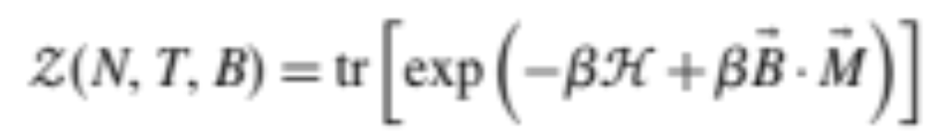
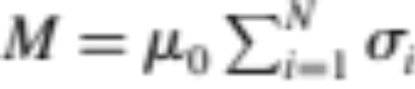
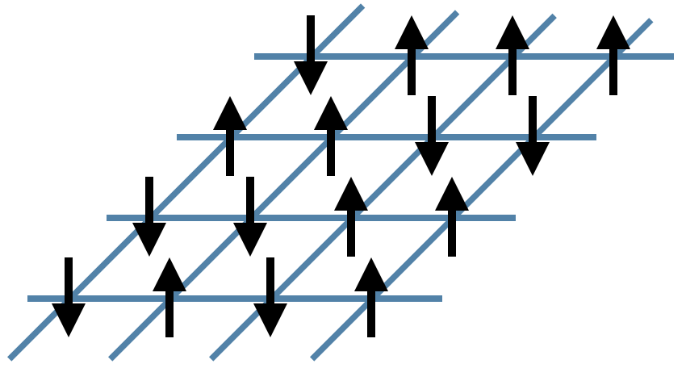
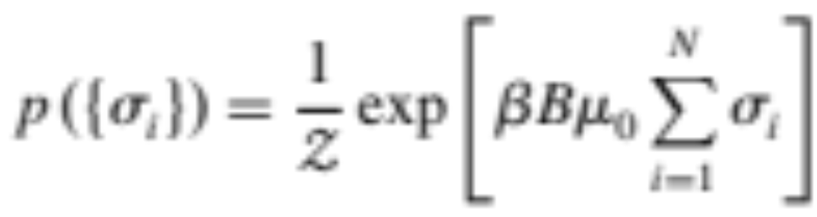

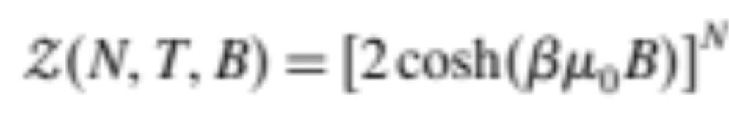

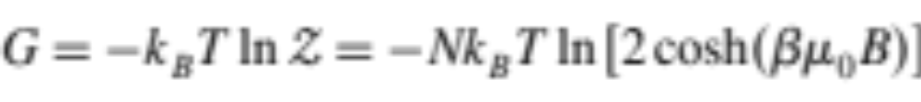
Gibbs canonical ensemble
1. Partition function
Spin system
2. Free energy

Slide 7
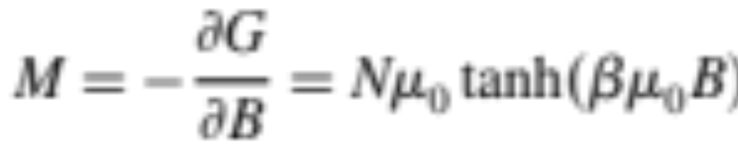
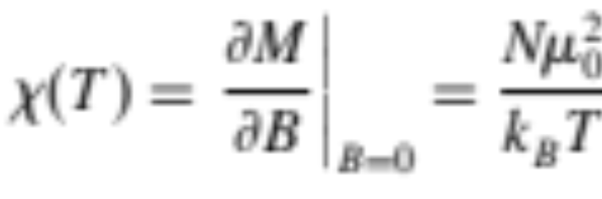

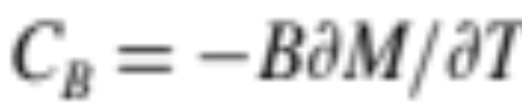
Gibbs canonical ensemble
Spin system
(Average magnetic moment)
(Magnetic susceptibility)
Total energy
Heat Capacity

Slide 8
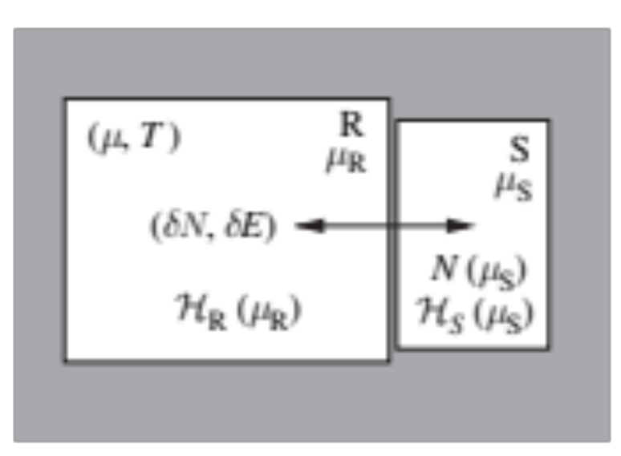
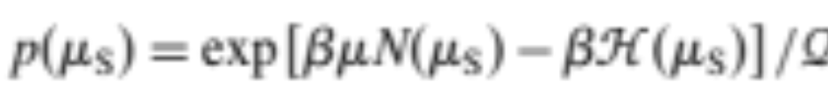
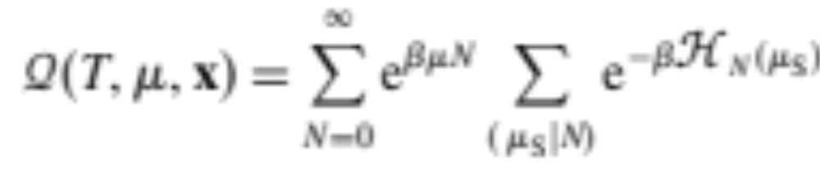
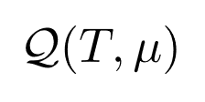
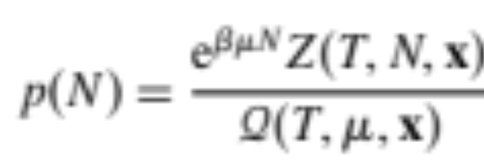
Grand canonical ensemble
Similarly, the total number of particles can fluctuate just like the energy in Canonical ensemble.
Total energy
Chemical potential = the energy needs to add a particle
Grand Partition function
Partition function
Prob for finding N particle

Slide 9

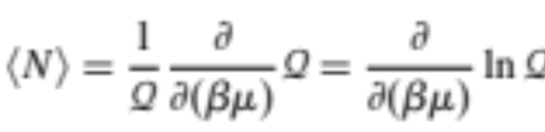

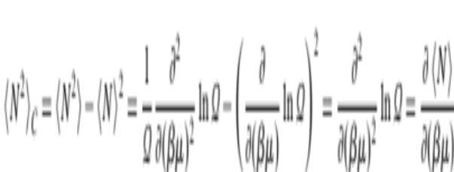


Grand canonical ensemble
?
Most probable
Average
Average particle number:
Use the one that help your calculation
particle number fluctuation:
Relative error

Slide 10
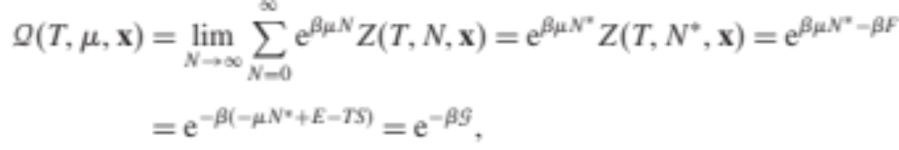




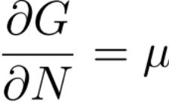

Grand canonical ensemble
Connect to the thermodynamics quantities.
Gibb free energy:
?
(1st law)
(Extensive)

Slide 11


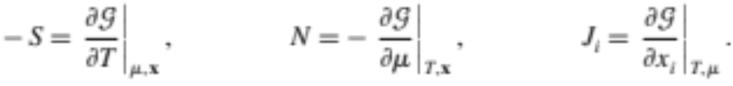
Grand canonical ensemble
Connect to the thermodynamics quantities.

Slide 12
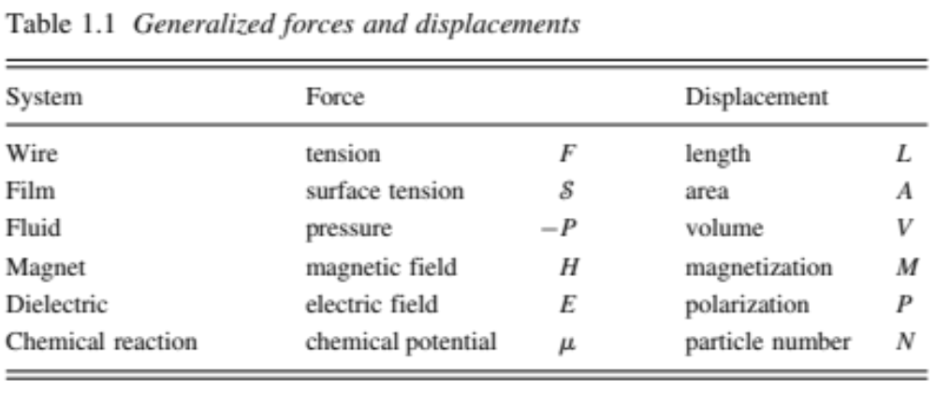
Grand canonical ensemble
Connect to the thermodynamics quantities.

Slide 13
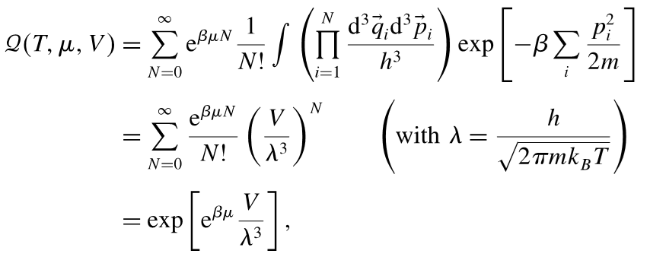
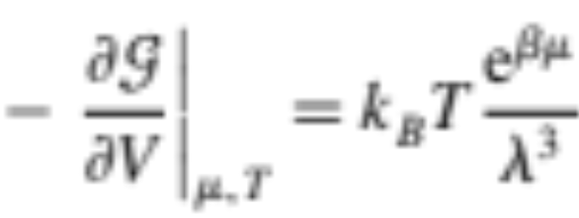
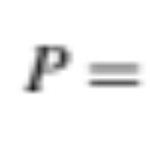
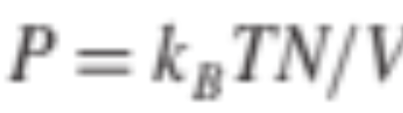
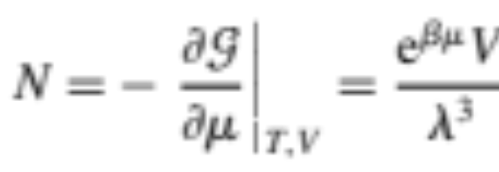
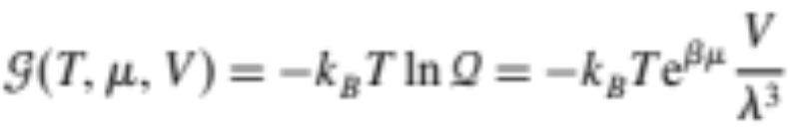
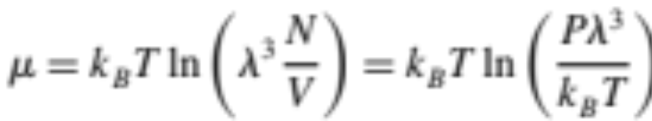
Grand canonical ensemble
Idea gas:
1. Grand partition function
Again:
Grand potential

