Slide 1
Statistical physics phy301
Interactions and phase transition
Lecturer: Kok Wee Song

Slide 2

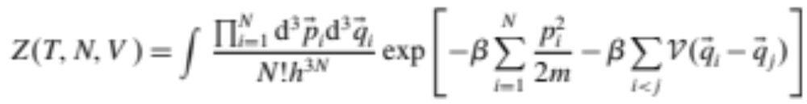
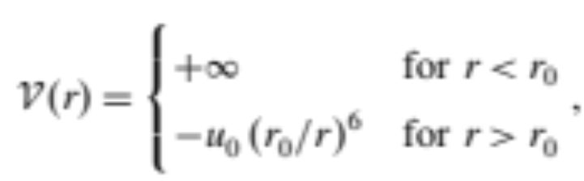
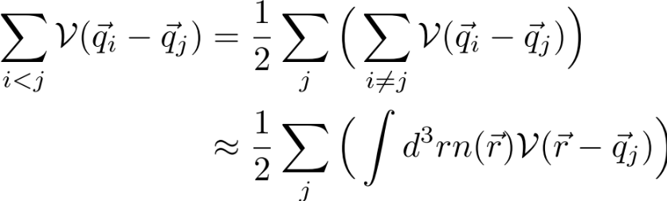
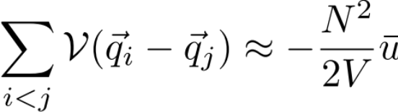

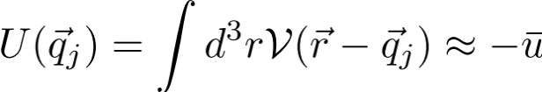
Interaction and phase transition
Beyond idea gas
Interaction
Mean-field approximation (a very common technique to tackle interaction, but not always work.)
Mean-field
Assuming uniformity of the gas:
(attractive)

Slide 3
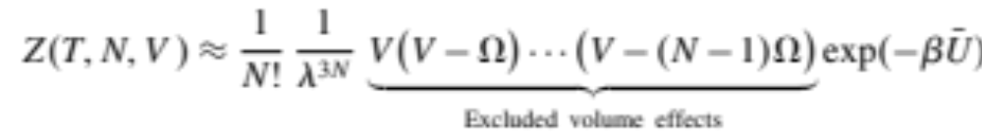
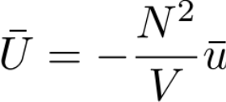
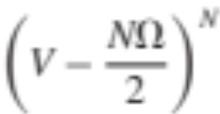
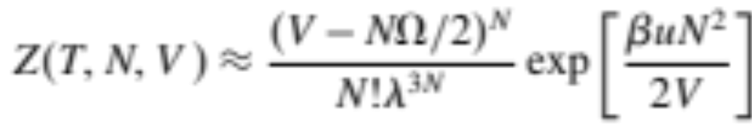
Interaction and phase transition
Beyond idea gas
Interaction
Mean-field

Slide 4
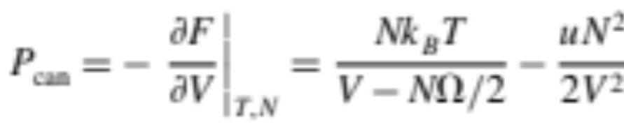
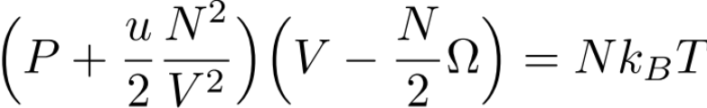
Interaction and phase transition
Beyond idea gas
Interaction
Mean-field
Van der Waal gas equation.

Slide 5
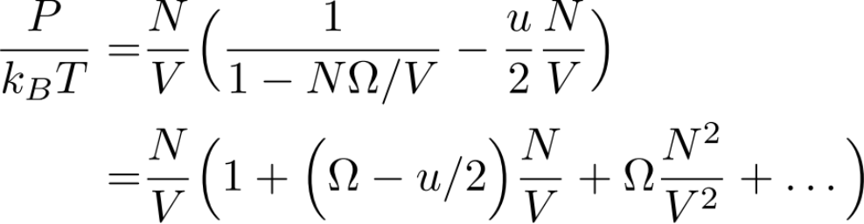
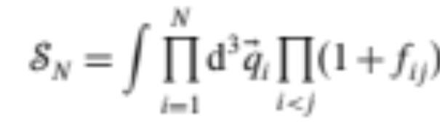
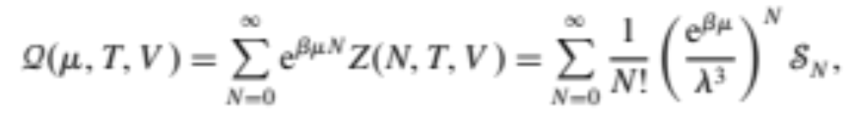
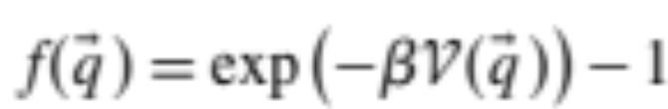
Interaction and phase transition
Virial expansion
Other method cluster expansion:

Slide 6
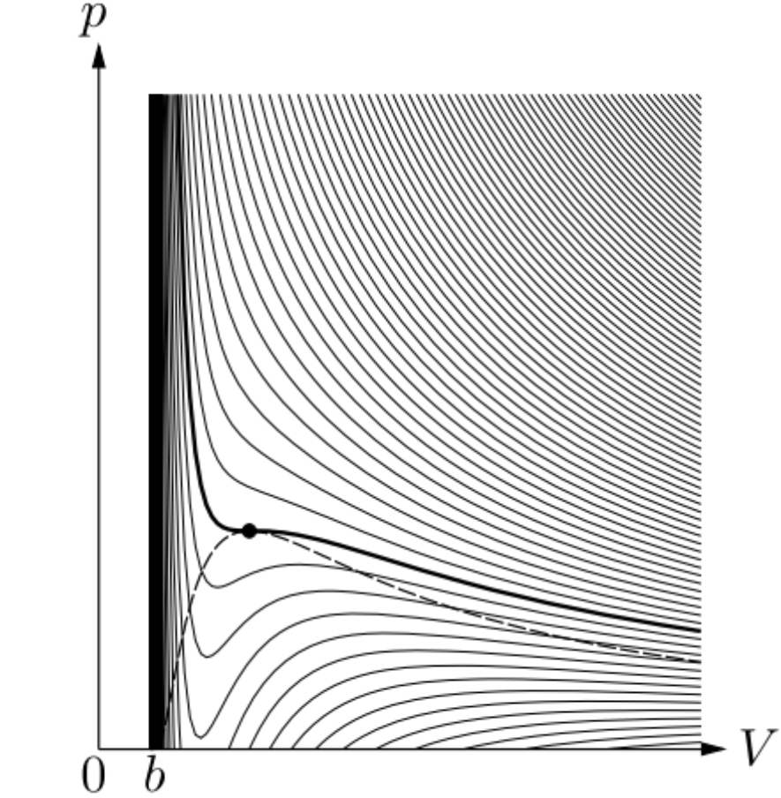
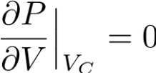
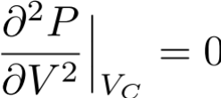





Interaction and phase transition
Break down of the gas equation
T decrease
Critical points
Normally, pressure should increase as volume decrease
Phase transition because of the van der Waal attraction
Not correct, Coexistence
The gas phase is unstable

Slide 7
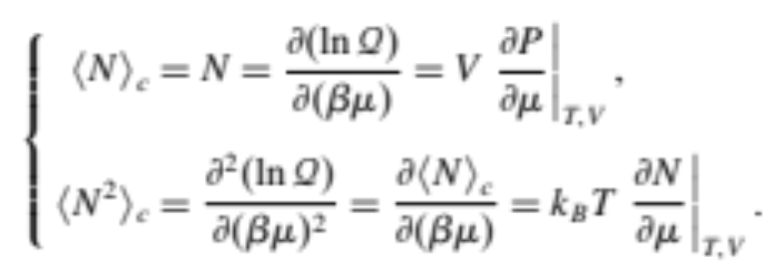

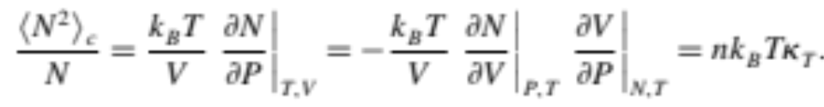
Interaction and phase transition
Break down of the gas equation
T decrease
Critical points
Critical points
(diverge at critical point)
Response function divergence is a hallmark of phase transition.
Particle # fluctuations diverges => Macroscopic changes of the system.
Not correct, Coexistence
The gas phase is unstable

Slide 8
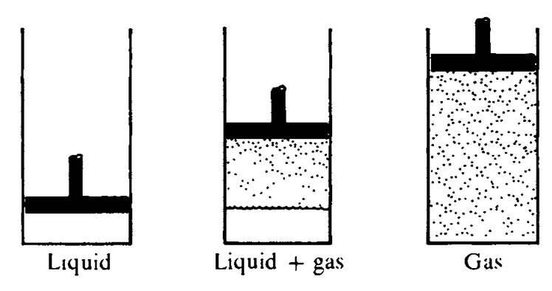
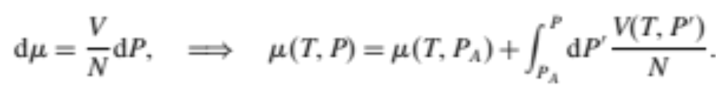
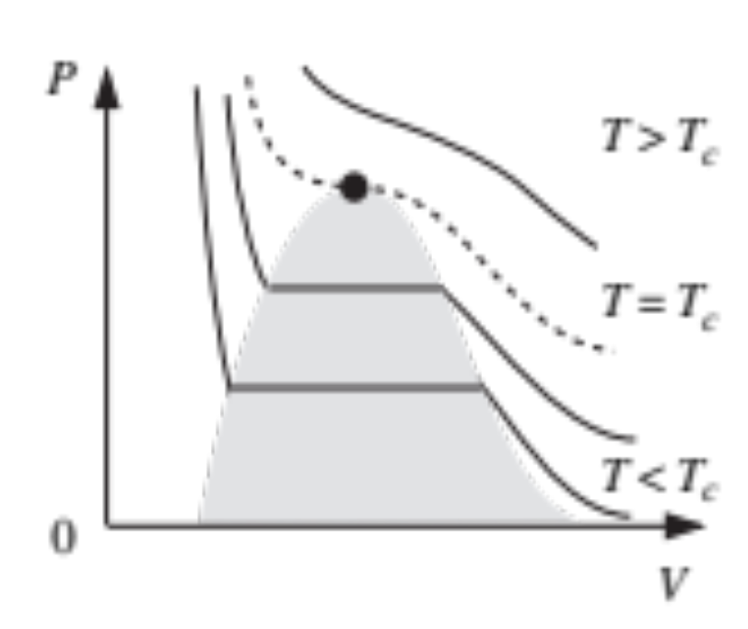
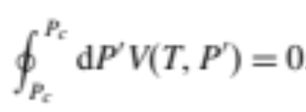

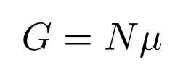
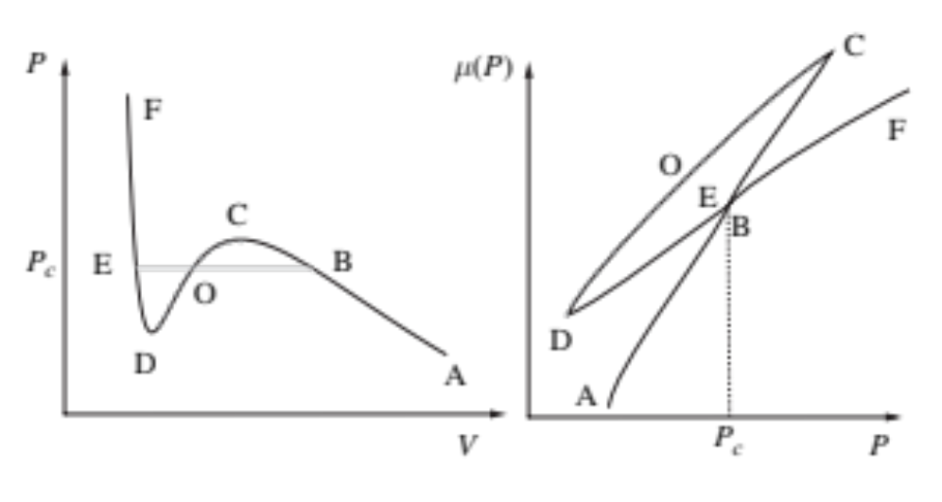

Interaction and phase transition
Break down of the gas equation
T decrease
(Gas-liquid coexistence)
unstable
liquid
Coexistence
gas
Not correct, Coexistence
The gas phase is unstable
Vapor pressure (T-dependent)

Slide 9
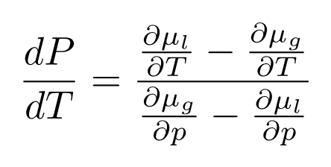
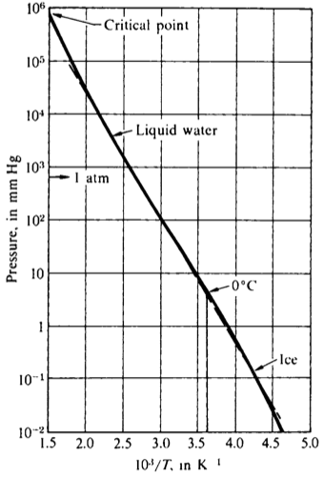
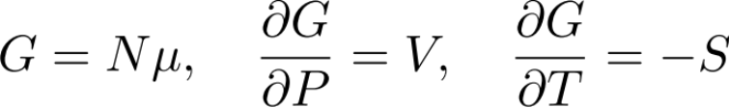
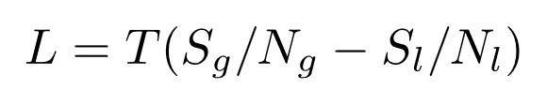
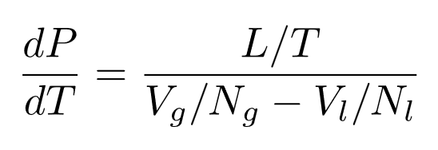
Interaction and phase transition
(Gas-liquid coexistence)
Change in the coexistent region:
liquid
gas
?
Vapor pressure (T-dependent)
Latent heat of vaporization
(Clausius-Clapeyron equation)

Slide 10
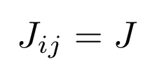
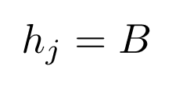

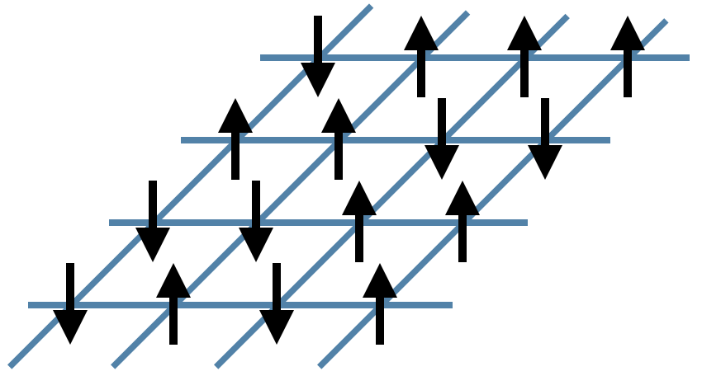
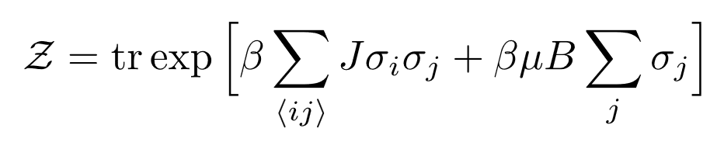
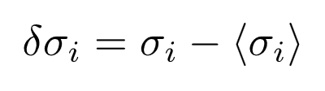
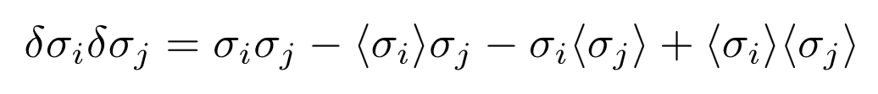

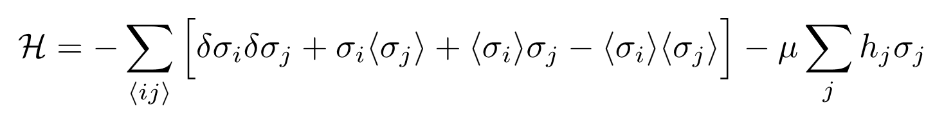
ISING Model
How to do the sum all possible configuration?
Highly non-trivial!
Mean-field approach:
Mean-field Hamiltonian
Small fluctuation

Slide 11
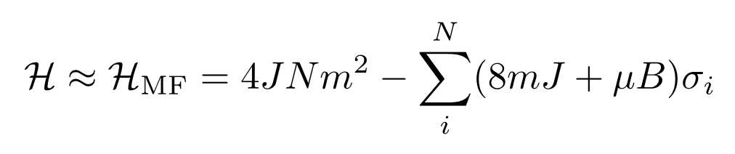
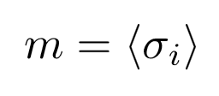
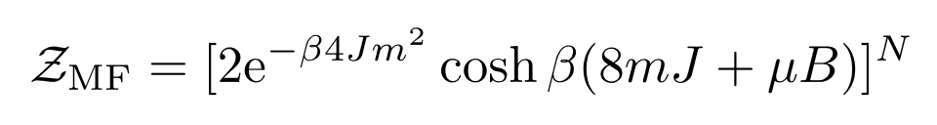
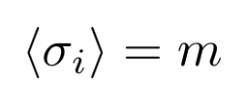
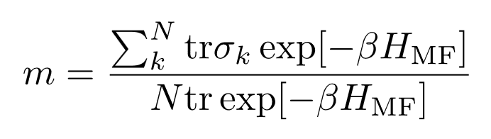
ISING Model
(self consistent condition)
Self-consistent equation

Slide 12
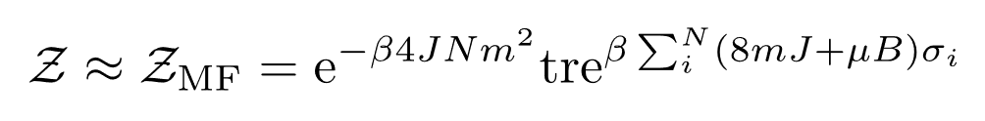
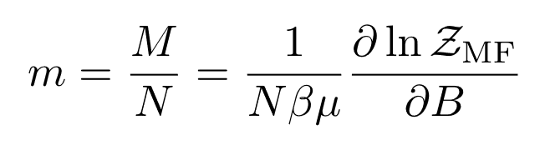
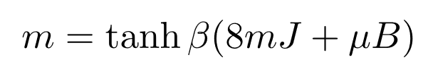
ISING Model
Self-consistent equation
Solve this to get the mean-field ansatz for Ising model Z

Slide 13
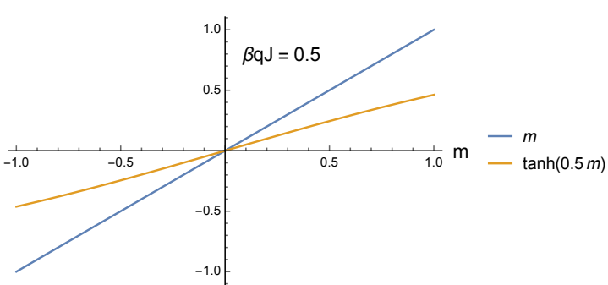
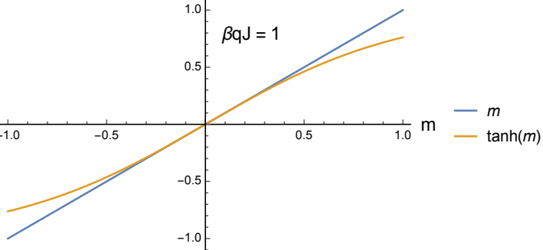
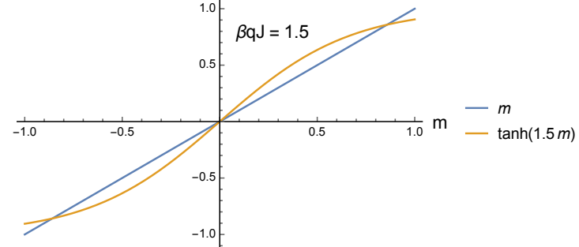
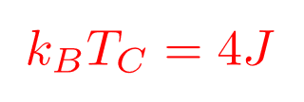
ISING Model
Self-consistent equation
Note: Mean field breakdown in 1D, not phase transition.

Slide 14



ISING Model

Slide 15




ISING Model
Self-consistent equation
Magnetic susceptibility (response function):
Near
The sensitivity of the magnetization with B
Diverges, a tiny field can flip all the spins

Slide 16

ISING Model Critical point fluctuation
Distribution of the cluster size
=> variance is diverges ~L
=> Power-law distribution.
The statistics of a critical system => power-law distribution => scale invariant
Distribution function can only depend on scale invariant quantities: dimensionality, symmetry, …

Slide 17









ISING Model
Symmetry:
Invariant under some transformation P
In quantum mechanics:
We say the system has P symmetry
(parity)
degeneracy
Self-consistent equation
Study phase transition using free energy

Slide 18





ISING Model
Exactly the same as Mean field result near T_{C}
Disorder phase
Critical phase
Order phase
flat
Self-consistent equation
Inverse of susceptibility
Free Energy

Slide 19



Landau theory of phase transition
Order parameters
Order parameter: ZERO in the disorder phase
NON-ZERO in the order phase
Landau free energy (very useful phenomenological model)
Near
Free must have the symmetry in the Hamiltonian

Slide 20







Landau theory of phase transition
Order parameters
We don’t know the microscopic Hamiltonian
Landau theory of free energy: we expand the order parameters near T_{C}
Energy penalty for inhomogeneity
Magnet
(Mean field approximation)

Slide 21








Landau theory of phase transition
2nd order phase transition
1st order phase transition
Order parameters
Magnet
(Mean field approximation)
Order parameter do not go to zero smoothly

Slide 22



Superconductivity
Nobel prize 1972
Zero resistance
Meissner effects:
They write down the ground state wavefunction for N-Cooper pairs
Below T_{C} the electrons form Cooper pairs due to the interaction with lattice (phonon).

Slide 23





Ginzburg-Landau theory
Order parameter
(Cooper pairs wavefunction)
Symmetry in electromagnetism (gauge transformation)
the argument is similar to quantum mechanics.
Derived the α, β from Hamiltonian
One of the very successful theory

Slide 24




Abrikosov lattice
Abrikosov
Minimizing the free-energy:
Nobel prize 2003
Non-uniform stable solution in type-II superconductor
Magnetic field can penetrate

Slide 25








ISIng Model in 1D
Transfer matrix:

Slide 26



ISIng Model in 1D
Transfer matrix:

Slide 27




ISIng Model in 1D
Transfer matrix:
as
No phase transition

Slide 28









ISIng Model in 1D
(Zero magnetic field)
Transfer matrix:

Slide 29




ISIng Model in 1D
(Zero magnetic field)
Cluster size / correlation length
It only diverges at zero temperature. => no phase transition

