Slide 1
Statistical physics phy301
Conclusion for classical statistical mechanics

Slide 2

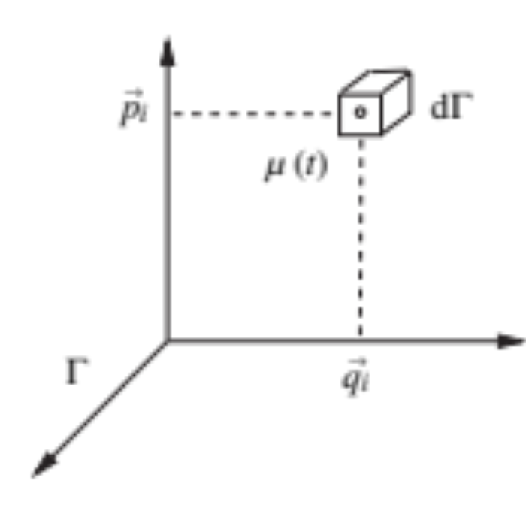

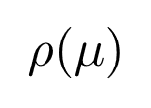
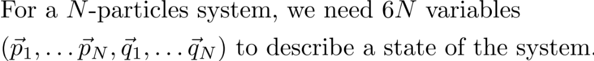
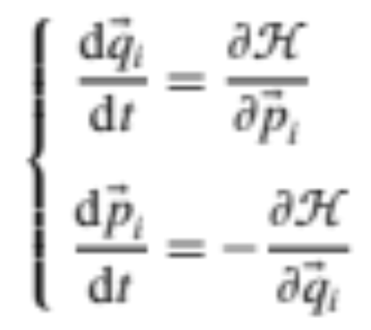

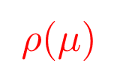
Building a statistical model for a many-particles system
Phase space: collection of all available states
The microstates of a large system.
=
Probability distribution?
Hamiltonian equation of motion:
Each point represent a state.
It is a huge space
The physical law for each particles MUST not be violated ⇒ is not arbitrary.

Slide 3




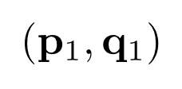
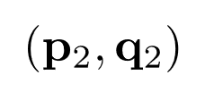
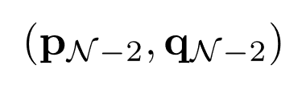
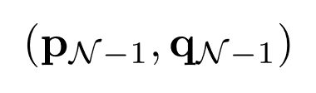


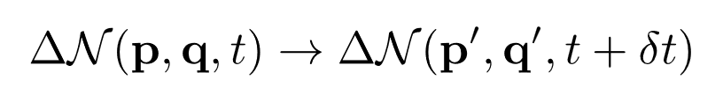
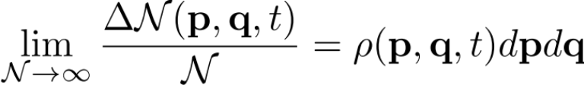
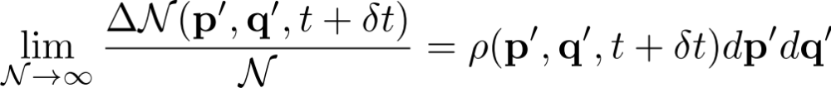
Building a statistical model for a many-particles system
Ensemble theory
……

Slide 4
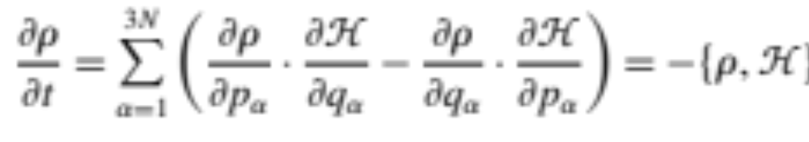
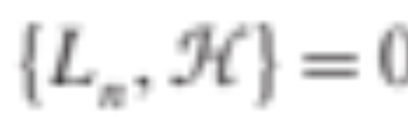
The form of distribution
Hamiltonian equation of motion:
Liouville’s theorem:
Conserve quantities
N, V, total momentum, …

Slide 5

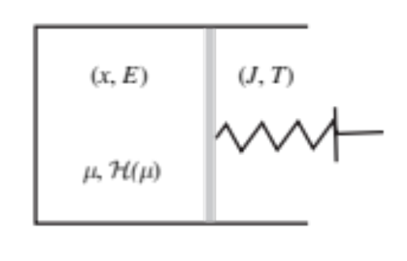

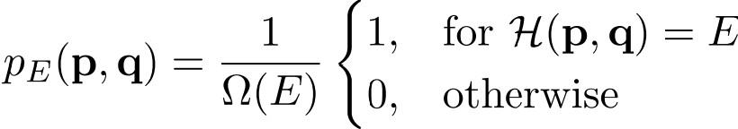


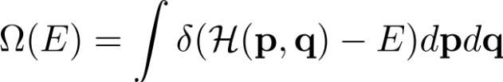
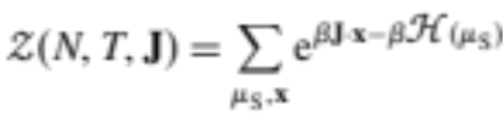
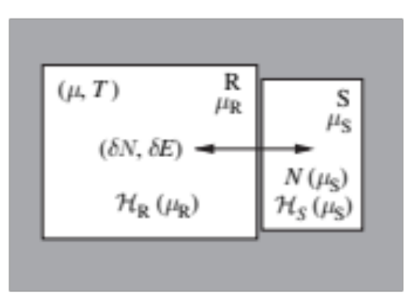

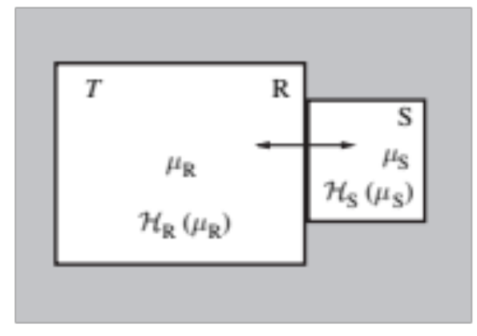
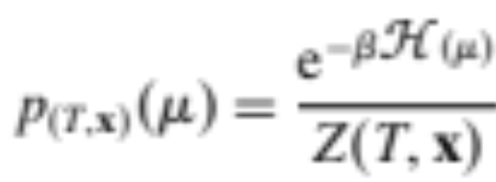

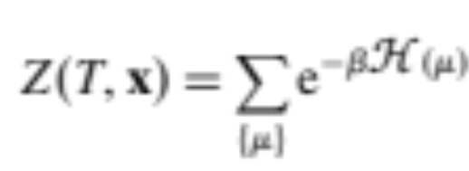
Ensemble models
Microcanonical ensemble
Gibbs Canonical ensemble
Conserve
Canonical ensemble
Grand Canonical ensemble
Fluctuate
Partition function
Grand Partition function

Slide 6

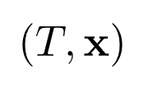
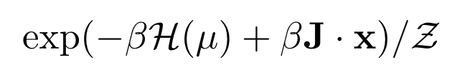

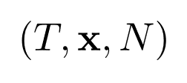
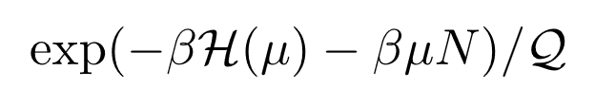


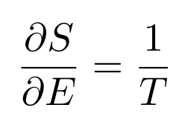


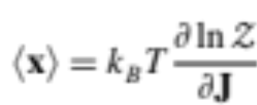

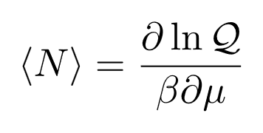
Comparison between ensemble models
Gibbs Canonical
Grand Canonical
Connection to thermodynamics:
Microcanonical
Gibbs Canonical
Grand Canonical
Canonical

Slide 7
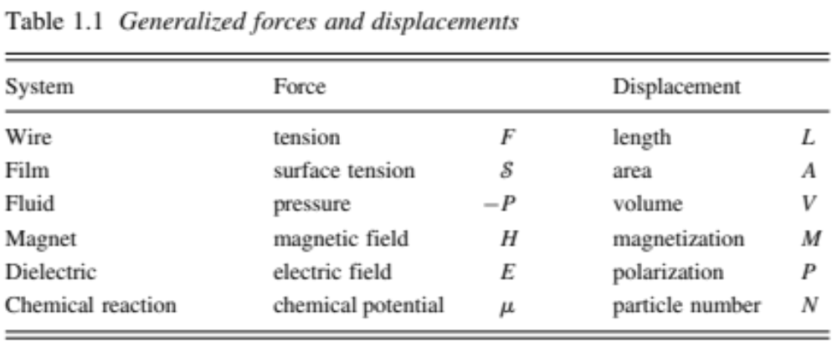

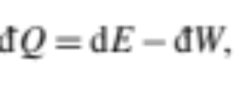
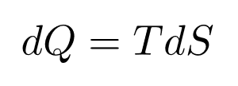

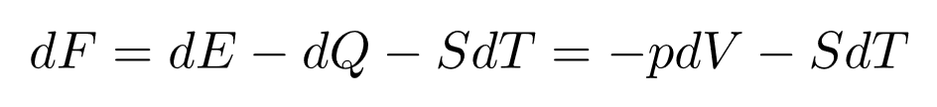
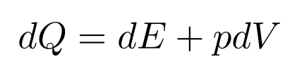
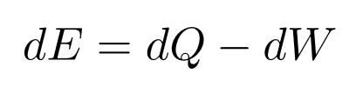
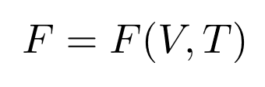
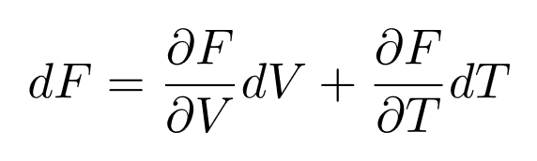
Connection to Thermodynamics
First Law:
Sign convention
(Clausius)

Slide 8
Conclusions
We derive the laws of thermodynamics from statistical ensemble model.
Ideal gas (non-interaction), 2-level system, different ensemble models give the same thermodynamics result.
Gibbs paradox: correction factor for identical particles.
Virial theorem: Generalized equipartition of energy.
Interaction and phase transition: van der Waal gas and Ising model.
Mean-field method and Landau Free energy.

Slide 9
Statistical physics phy301
Statistical formalism in quantum system.
Lecturer: Kok Wee Song

Slide 10
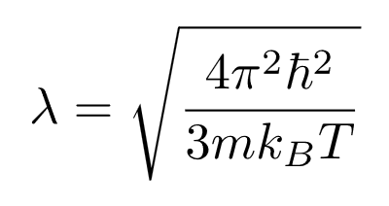
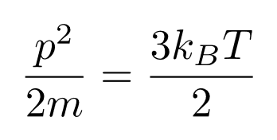
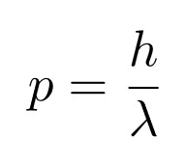
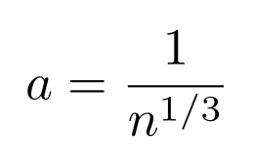
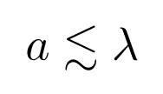
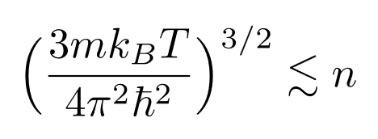
Quantum regime
Statistical mechanics
Quantum mechanics
The average de Broglie wave length of each particles
Condition for quantum statistic
Inter-particle distance
Classical statistical mechanics breakdown in very low temperature or high-density system

Slide 11
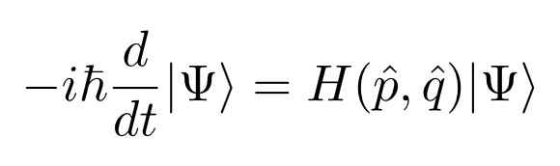
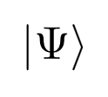
Classical vs Quantum
Phase space: collection of all available states
Hamiltonian equation of motion:
Each point represent a state.
It is a huge space
Schrodinger equation:
Hilbert space (n-dimensional complex vector space):
n is the number of the Hamiltonian eigenstates
Each wavefunction (vector) represent a state.
n can be infinity.
How to model the quantum microstates statistically that is compatible with quantum mechanics?

Slide 12
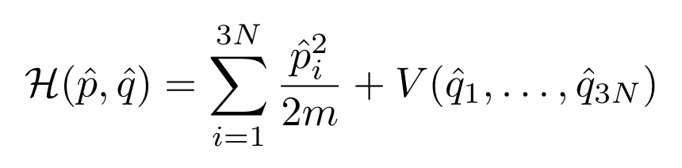
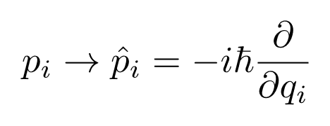
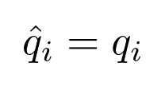
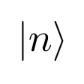
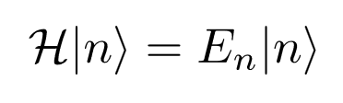













Quantum Mechanics
(Real space representation)
Energy eigenstates of the Hamiltonian:
Energy of state
(n can be continuous)
Eigenstates projectors:
Scalar product
Completeness of Eigenstates projectors:
= probability to find in state
Not all the vectors are physical

Slide 13








Quantum Mechanics
1)
(Real space representation)
2)
Energy eigenstates of the Hamiltonian:
(Completeness)
= probability to find in state
(Normalization)
3)
We can only access the quantum state by measuring the observable
function of
Hermitian
Measure in experiment
Measure in experiment
Example:

Slide 14




Quantum Mechanics
1)
(Real space representation)
2)
Energy eigenstates of the Hamiltonian:
(Completeness)
= probability to find in state
(Normalization)
3)
Observable
Measure in experiment
4)
Dynamics
Formally:
Unitary: preserving probability

Slide 15







Density matrix
Schrodinger equation:
Hilbert space (n-dimensional complex vector space):
with probability
How to model the quantum microstates statistically that is compatible with quantum mechanics?
Experiment measurement:
(Completeness)
play the role like in classical case.
Density matrix
In basis-free form:
Is the tool to build statistical model in quantum mechanics
What form is allow?

Slide 16








Density matrix
Density matrix
In basis-free form:
1)
(pure state)
2)
Hermiticity

Slide 17


Density matrix
Density matrix
In basis-free form:
1)
2)
Hermiticity
3)
Positivite
For any states in the Hilbert space

Slide 18




Density matrix
Density matrix
In basis-free form:
1)
2)
Hermiticity
3)
Positivity
For any states in the Hilbert space
4)
Time evolution: Liouville’s theorem for quantum system
(Conservation of probability)

Slide 19












Equilibrium in quantum system
In thermal equilibrium:
Independent random phases assumption.
It is okay to have off diagonal terms.
Density matrix
Normalization
Energy eigenstate representation
Microcanonical ensemble:
Canonical ensemble:
How to count?
Grand canonical ensemble:

