Slide 1

Thermodynamics and Statistical physics phy301
Lecturer: Kok Wee Song

Slide 2
Before we start
Attendance is mandatory. Please sign in.
3 assignments
[moodle, online submission]
Evaluation: Assignment (30%),
Mid-term exam (30%),
Final exam (40%)
week 8
Exam week

Slide 3
My Office
OFFICE (A1 379)
Wed 12 pm – 2 pm
Thu 2 pm – 4 pm
Email: kokwee.song@xmu.edu.my

Slide 4

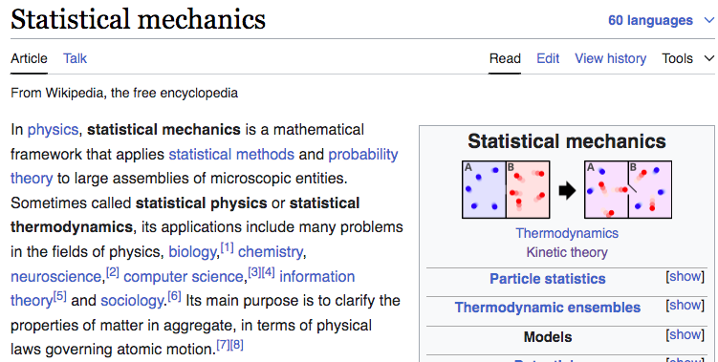
What is statistical Physics/mechanics?
- Mehran Kardar
Wikipedia:
Notes:
You already learn many of them in the high school. You know how to solve those problem. Today, I will give you a little perspective, Not just teach you how to solve problem

Slide 5
Why statistics?
Statistics allows us to learn certain properties of a complex phenomena.
Problem in a large system:
~10²³ particles, impossible to keep track
→ Macroscopic behavior, we do not care the details of each particles.
Statistics DOES NOT tell you why, but the behavior/pattern of your observation.
Statistical physics/mechanics = statistical model + law of physics /mechanics
Notes:
You already learn many of them in the high school. You know how to solve those problem. Today, I will give you a little perspective, Not just teach you how to solve problem

Slide 6
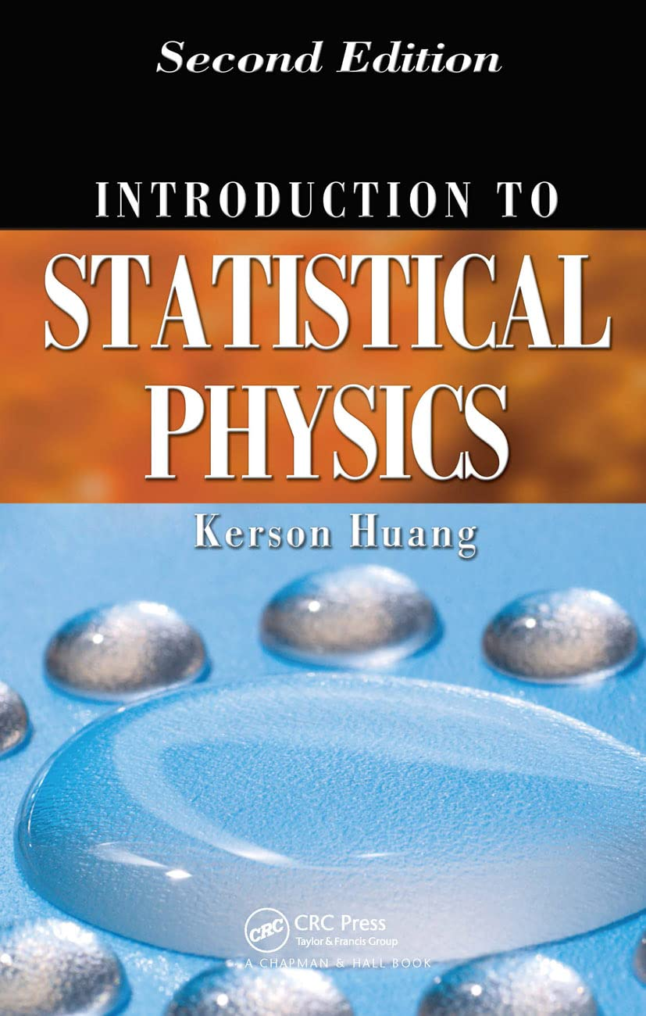
Sketch of PHY301
Thermodynamic and its statistical approach (in classical systems)
Statistical formulation for large quantum systems
Phase transition for classical and quantum systems
Non-equilibrium phenomena
Kerson Huang,
Introduction to statistical physics,
‎ CRC press (2009)

Slide 7
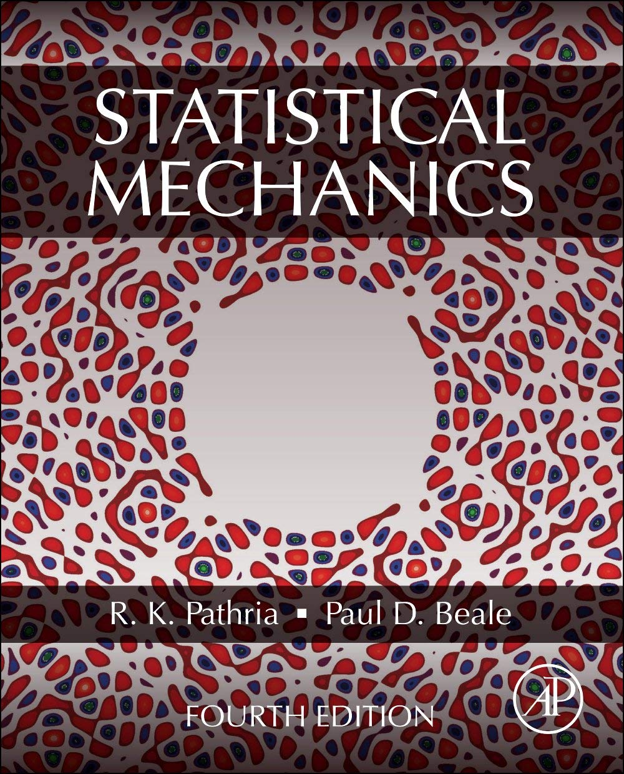
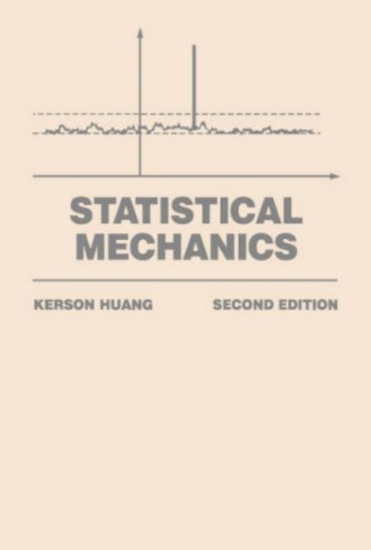
Additional References
Mehran Kardar,
Statistical Physics of Particles,
Cambridge University press (2007)
R.K. Pathria, Paul D. Beale,
Statistical Mechanics,
‎ Academic Press (2021)
Kerson Huang,
Statistical Mechanics,
‎ Wiley (1991)
(Dated, old style, but good)
Statistical mechanics has a non-uniform viewpoints across difference textbooks.

Slide 8
Statistical physics phy301
Recap of thermodynamic and kinetic theory of (idea) gas
Lecturer: Kok Wee Song

Slide 9
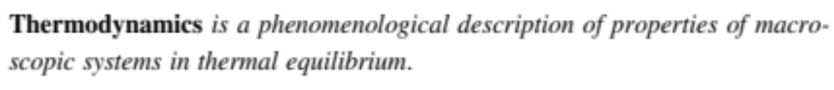










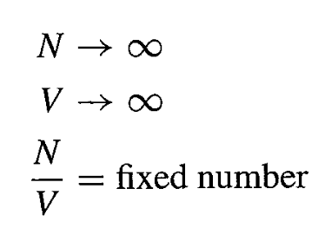


Thermodynamics system
- Mehran Kardar
Mechanics
Thermodynamics
Equilibrium:
Measurement doesn’t change in time
or
(generalized force)
State
(measurable)
Macro-State
(thermodynamics coordinate)
Newton’s laws
Laws of thermodynamics

Slide 10
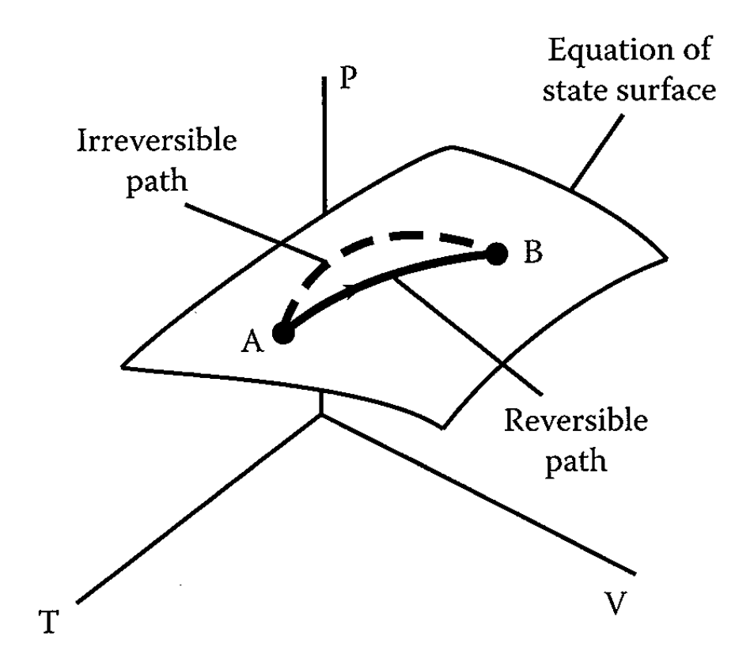

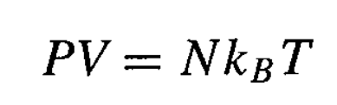
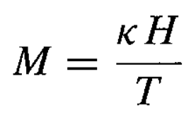
Thermodynamics system
Equilibrium:
Not all thermodynamic quantities are independent.
Equation of states
Examples: 1) Ideal gas
Examples: 2) Magnetic system
These macroscopic phenomena can be derived microscopically by using statistics.
(magnetic field)
(magnetization)

Slide 11
Laws of Thermodynamics
0th Law of thermodynamic
A
B
Must be in
equilibrium
Seem trivial but very important ⇒ concept of temperature
The two system is in equilibrium ⇒ both have same temperature
C
⇒ How to measure temperature
equilibrium
equilibrium

Slide 12
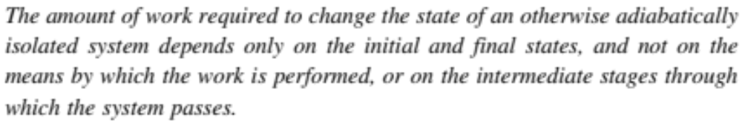
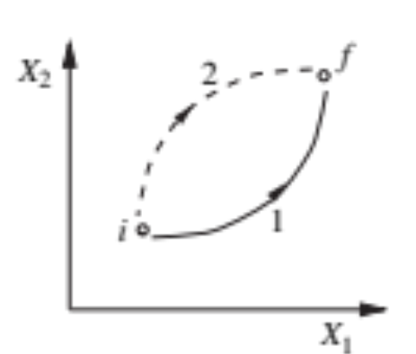
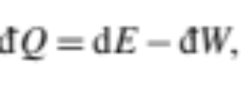

Laws of Thermodynamics
1st Law of thermodynamic
It is the statement of energy conservation
Similar to work-Energy theorem in mechanics
(open)
The convention of the sign
(closed)

Slide 13
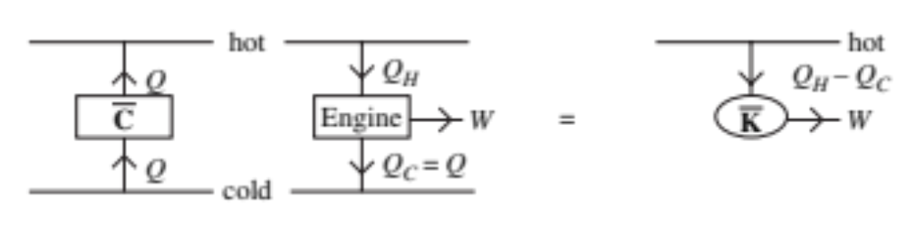
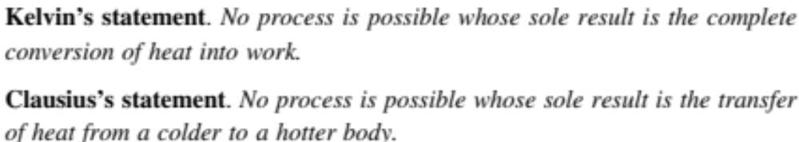
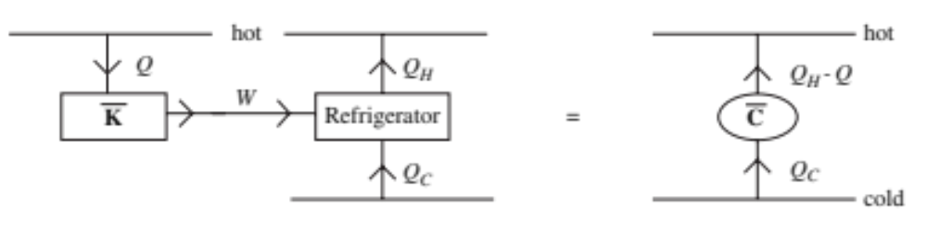
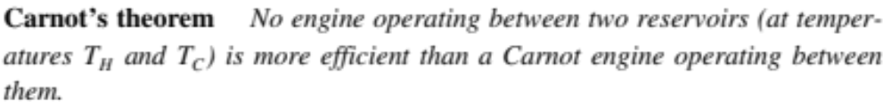
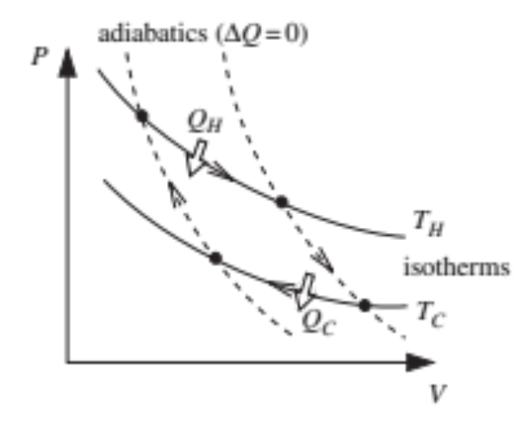
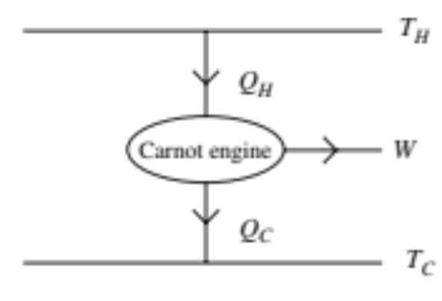
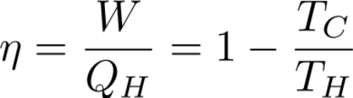
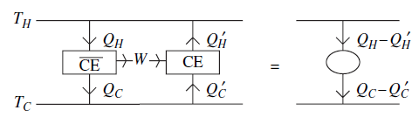

Laws of Thermodynamics
2nd Law of thermodynamic
equivalent
equivalent
Engine efficiency:
Reversible process
Proof

Slide 14











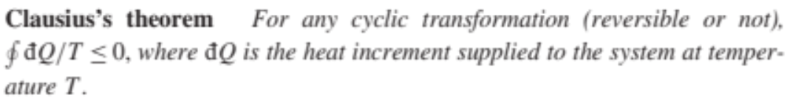
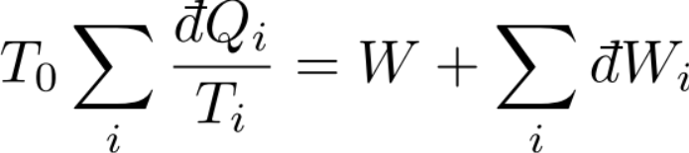

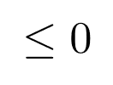
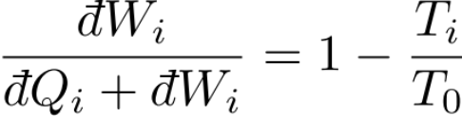
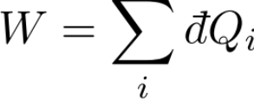
Laws of Thermodynamics
Carnot
Carnot
2nd Law of thermodynamic
equivalent
Engine Cycle
equivalent
equivalent
Engine efficiency:
Reversible ⇒ Equality
Net work done to the environment ≤ 0 (Kelvin: cannot turn all the heat to +work)

Slide 15
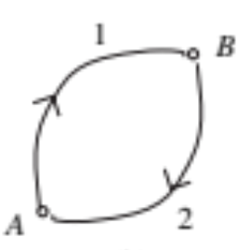

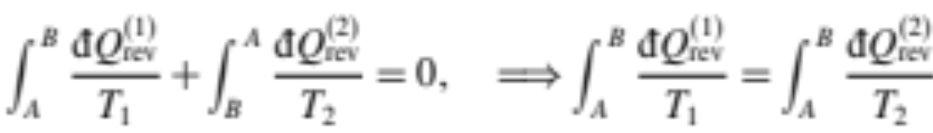
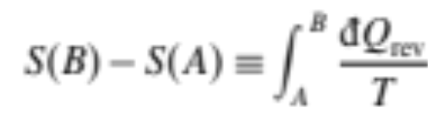
Laws of Thermodynamics
Reversible cycle
2nd Law of thermodynamic
Path independent
Entropy
⇒ concept of entropy

Slide 16
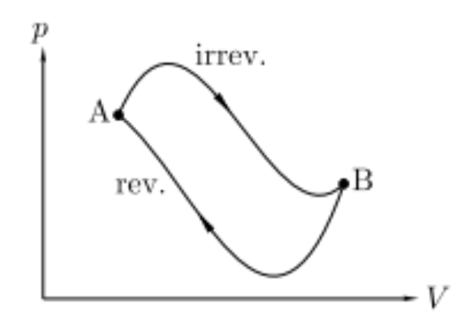

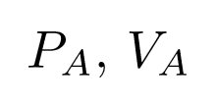
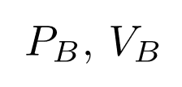

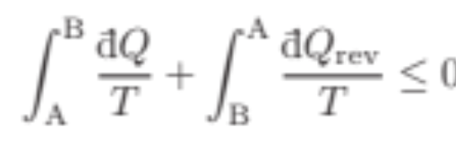
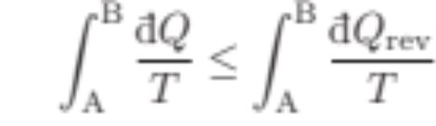
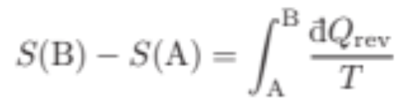
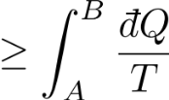
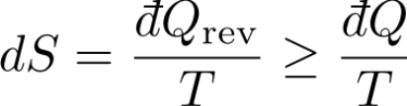


Laws of Thermodynamics
isolated
2nd Law of thermodynamic
⇒ concept of entropy
Entropy always increase in a isolated system.
⇒ Determine the evolution of the system. Equilibrium state has the maximum entropy.

Slide 17


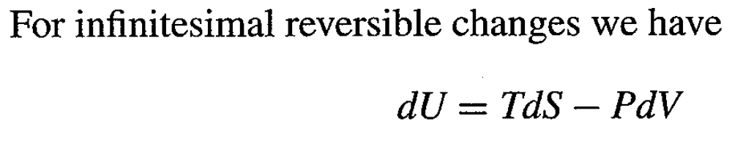

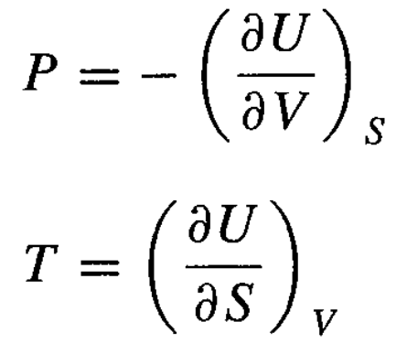

Thermodynamics potential
Condition for equilibrium?
watch the sign
2nd law
1st law
Each steps are in equilibrium
May not convenient for measurements
Function of entropy
Instead of described by internal energy,
we use thermodynamics potential.

Slide 18
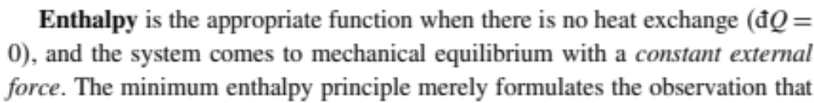
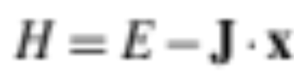
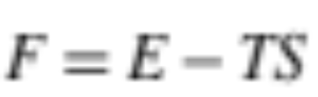
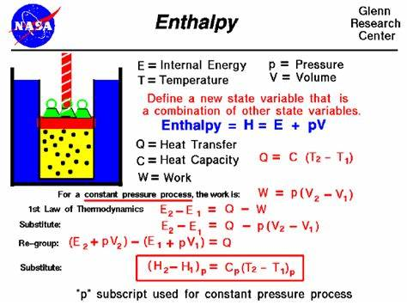
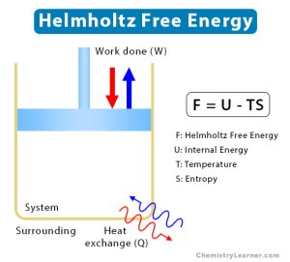
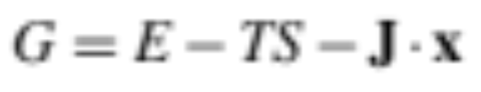
Thermodynamics potential
How to reach equilibrium?
External force
Minimize the potentials ⇒ equilibrium
…….
Minimize the potentials ⇒ equilibrium

Slide 19
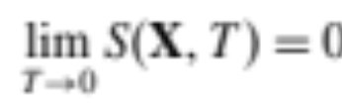
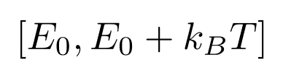
Laws of Thermodynamics
3rd Law of thermodynamic
Every particles stay exactly at its lowest energy state. No thermal fluctuations is allowed.
In a thermal system, a single particle energy fluctuation ~ in the range
Ground state energy

Slide 20
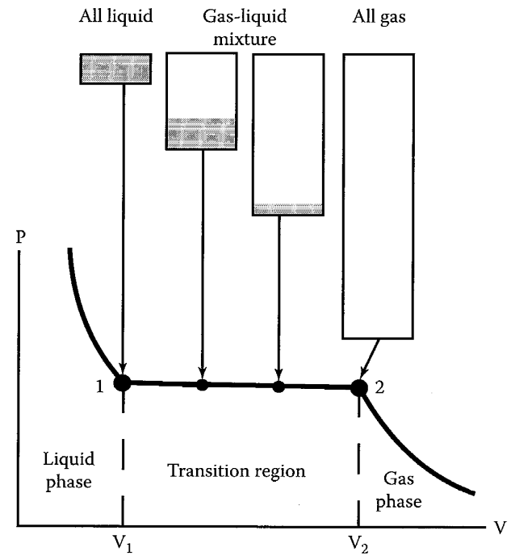
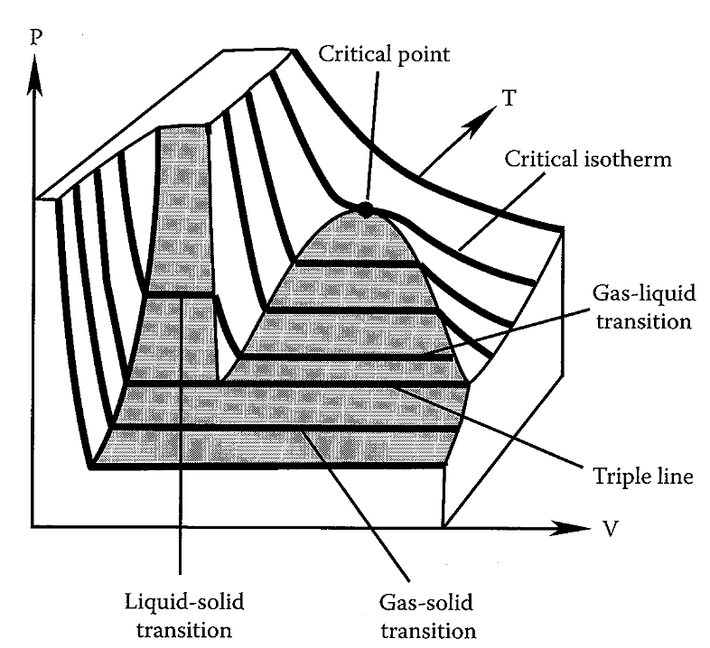
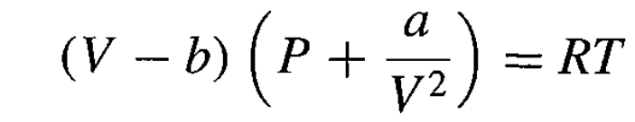
Phase transition
Phase diagram of water
Changing temperature
Equation of state
(van der Waal gas)
All the laws and equation of states are the statistical result of many-particles system

Slide 21
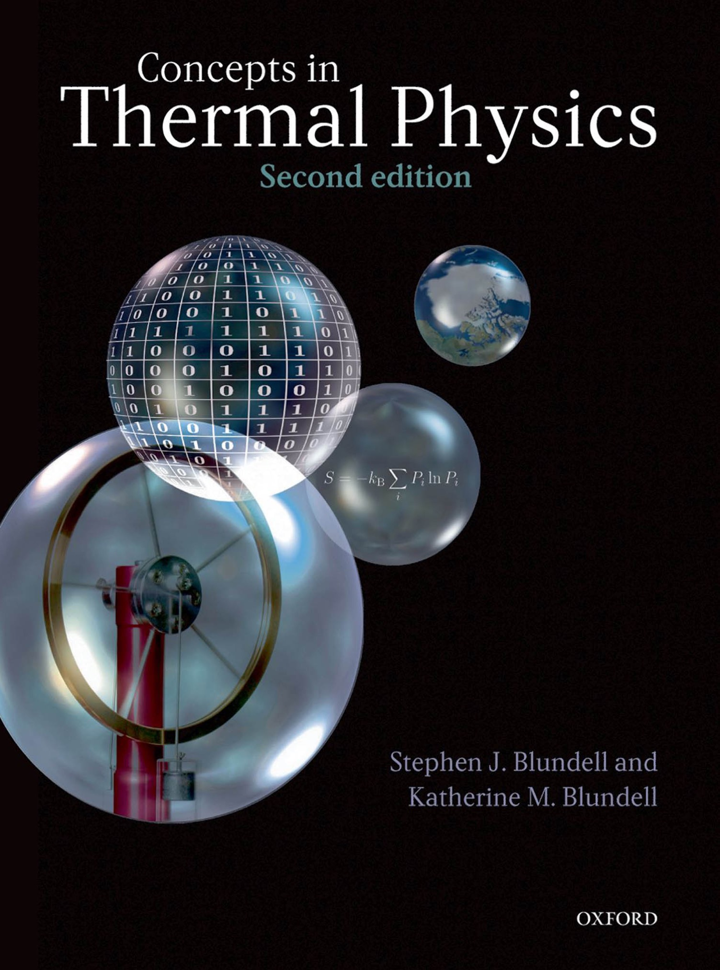






Kinetic theory of gas
(1st statistical approach)
Velocity distribution in x-direction
Part II
S. J. Blundell and K. M. Blundell,
Concepts in thermal physics,
Oxford University Press, (2010)
Equilibrium
Maxwell–Boltzmann distribution
Same distribution for
(isotropic)
James Clerk Maxwell
Ludwig Boltzmann

Slide 22







Kinetic theory of gas
Probability of finding a particle with VELOCITY between
and
Probability of finding a particle with SPEED between and

Slide 23



Kinetic theory of gas
Probability of finding a particle with SPEED between and
⇒ equipartition of energy

Slide 24








Kinetic theory of gas
D. Halliday, R. Resnick, J. Walker,
Fundamentals of Physics,
10th Ed, Wiley (2013)
Taking average
⇒ Ideal gas law
(previous slide)

Slide 25
Kinetic theory of gas
Ideal gas law and equipartition of energy are
the result of statistical behavior of a large system.
Maxwell–Boltzmann distribution ⇒
Statistical model for ideal (non-interacting) gas
A more general statistical model ⇒ ensemble theory

