Slide 1
Statistical physics phy301
canonical, grand canonical ensemble
Lecturer: Kok Wee Song

Slide 2

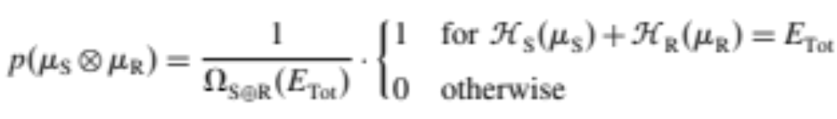
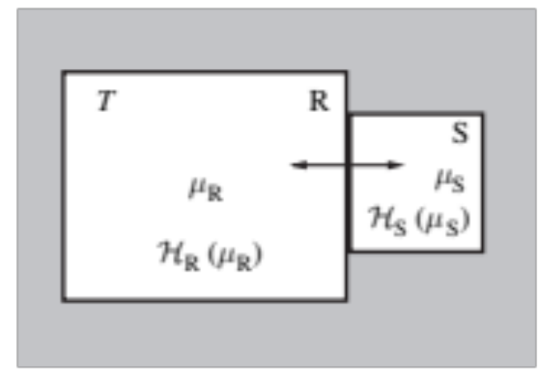

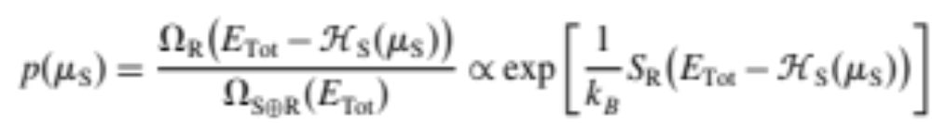


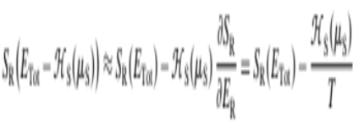

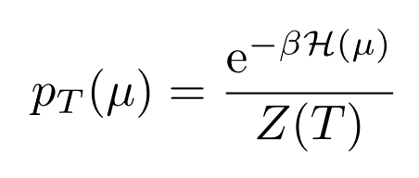
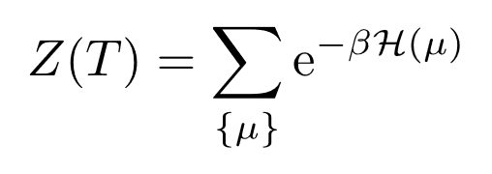
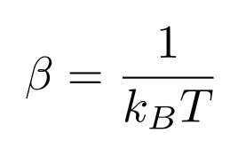
canonical ensemble
Microcanonical ensemble is not convenient,
we can easily measure T but not E.
Canonical distribution of the microstates in S:
is not a constant.
It fluctuates as a random variable
Partition function

Slide 3

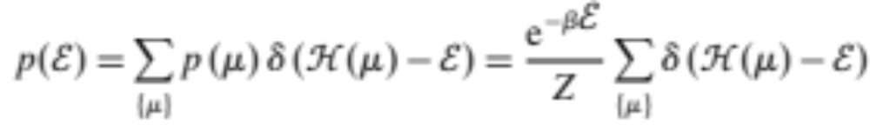
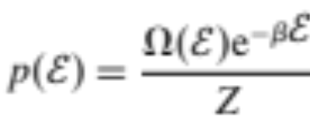
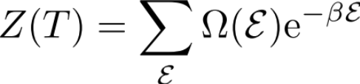
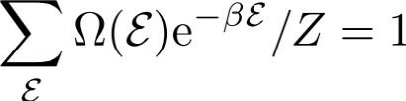
canonical ensemble
Microcanonical ensemble is not convenient,
we can easily measure T but not E.
Canonical distribution of the microstates in S:
Partition function
Canonical distribution of :
Partition function
How are these distributions related to thermodynamic?
What is the internal energy?

Slide 4
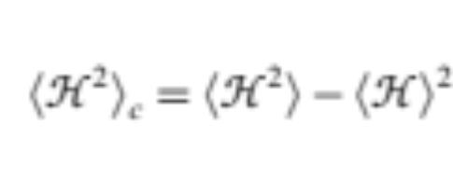
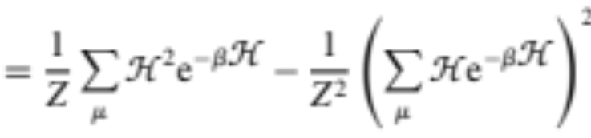



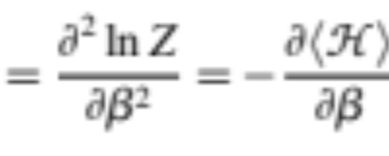
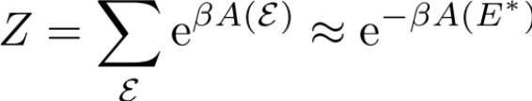
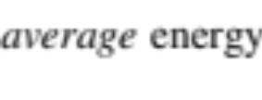

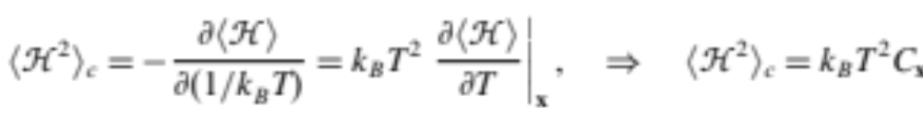
canonical ensemble
Helmholtz free energy:
Canonical distribution of the microstates in S:
Canonical distribution of :
Partition function
Partition function
we let
The
gives minimum A
Which one should I use?
Is that really matter?
The
Heat capacity

Slide 5
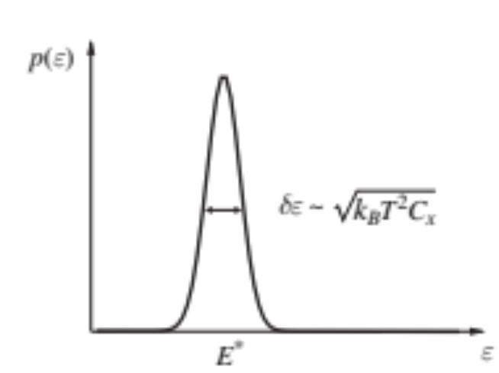
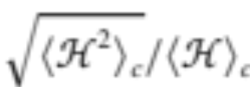


canonical ensemble
Helmholtz free energy:
Canonical distribution of the microstates in S:
Canonical distribution of :
Partition function
Partition function
Relative error:
we let
The
gives minimum A
The
Heat capacity

Slide 6
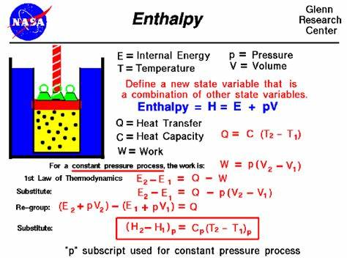
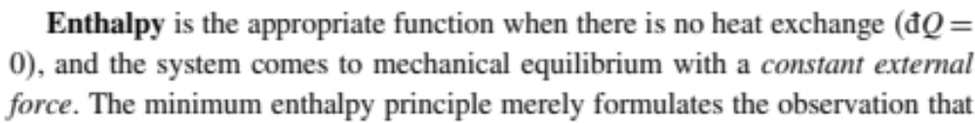
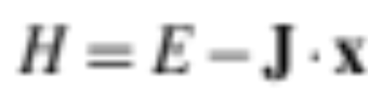
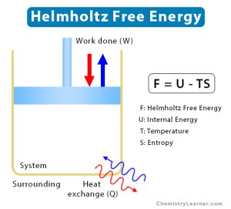
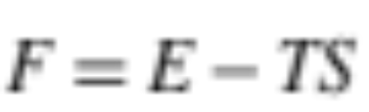
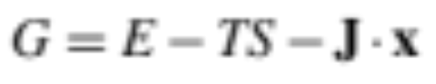
Thermodynamics potential
External force
How to reach equilibrium?
…….

Slide 7
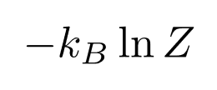
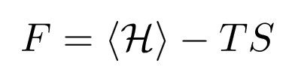
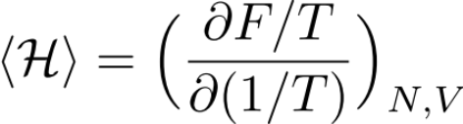
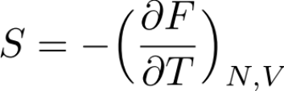

canonical ensemble
Canonical distribution of the microstates in S:
Canonical distribution of :
Partition function
Partition function
The
Helmholtz free energy:
(using 1st law in F.)
Average energy == Internal Energy
Connect to the thermodynamics quantities.

Slide 8

canonical ensemble
Helmholtz free energy:
Canonical distribution of the microstates in S:
Canonical distribution of :
Partition function
Partition function
The
Helmholtz free energy:
Connection to the thermodynamic

Slide 9

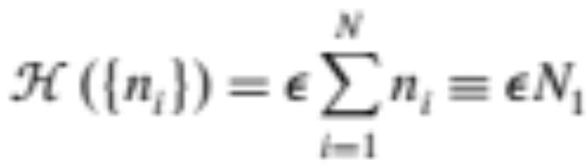


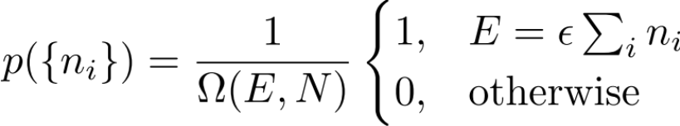

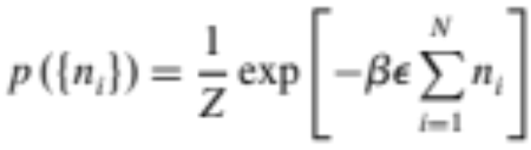
canonical ensemble: two level system
Number of excited states
Microcanonical:
Canonical:

Slide 10
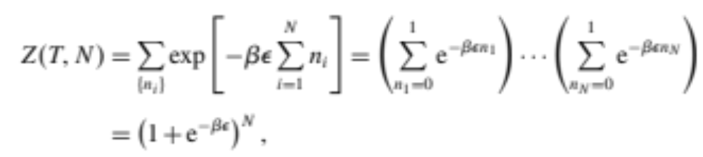

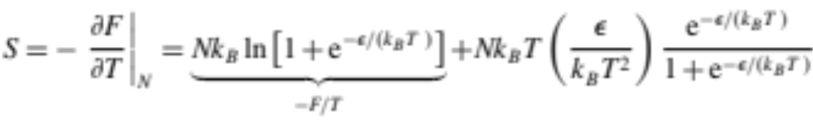
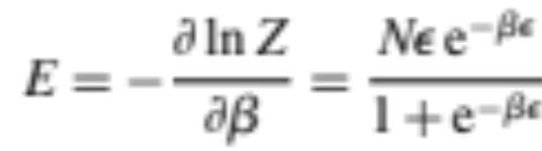
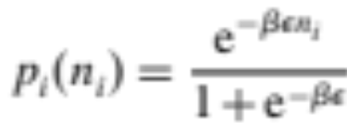
canonical ensemble: two level system
Canonical:
Much straightforward than microcanonical ensemble
1. Partition function
2. Free energy
3. Get the thermodynamic quantities

Slide 11
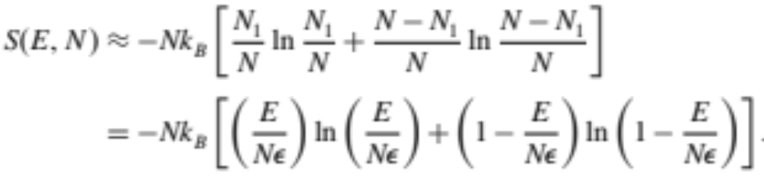
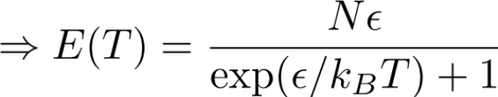
canonical ensemble: two level system
Canonical:
Mircocanonical:

Slide 12
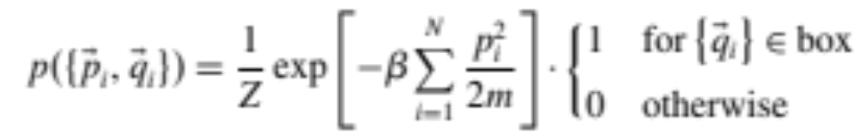
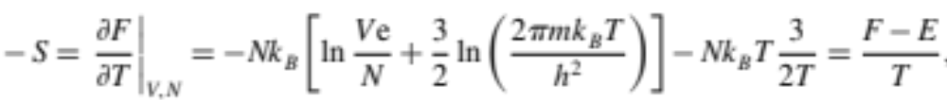
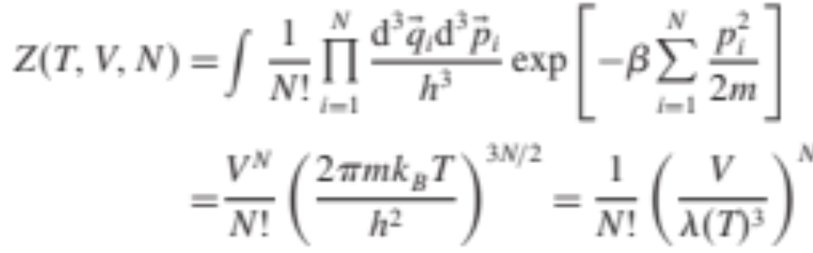

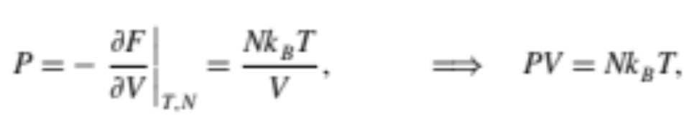

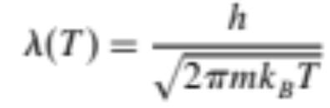

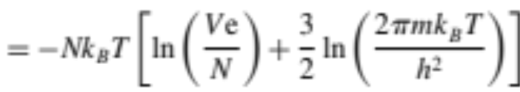
Canonical Ensemble: Idea gas
Canonical:
3. Get the thermodynamic quantities
1. Partition function
equipartition of energy
Idea gas law
2. Free energy
Microcanonical and Canonical ensemble gives the same thermodynamic properties.

Slide 13
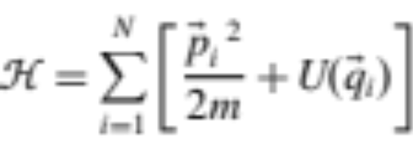
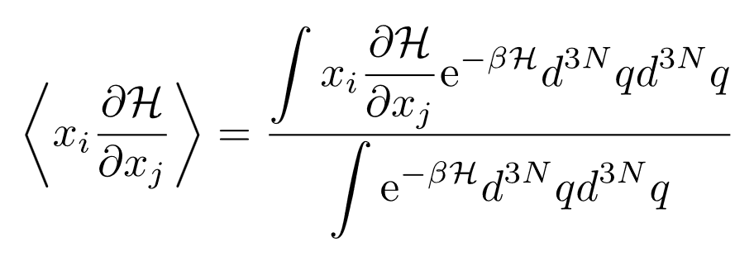

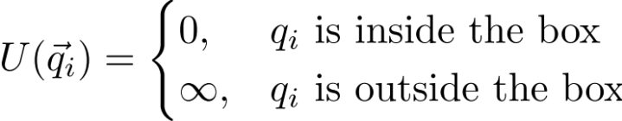
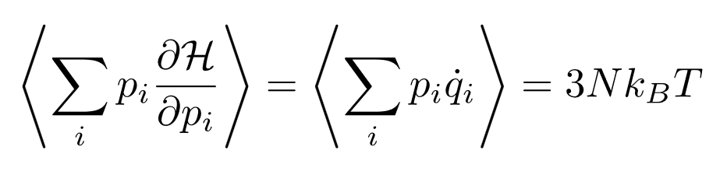
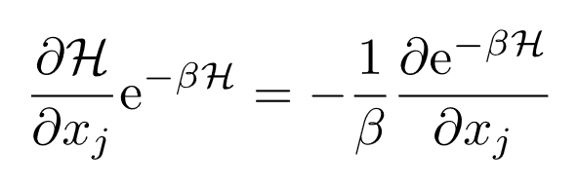
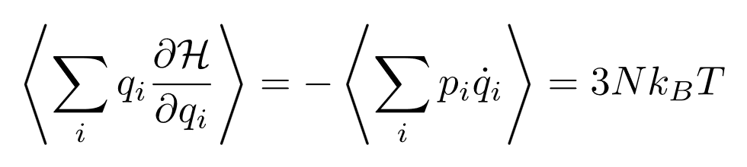

Virial theorem and equipartition of energy
Easy to check with ideal gas
Virial theorem:
Integrating by part,
Generalized equipartition of energy.

