Slide 1
Statistical physics phy301
Non-interacting bosons
Idea gas, black body radiation and phonon.
Lecturer: Kok Wee Song

Slide 2

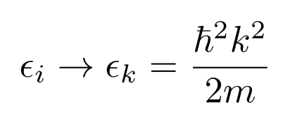
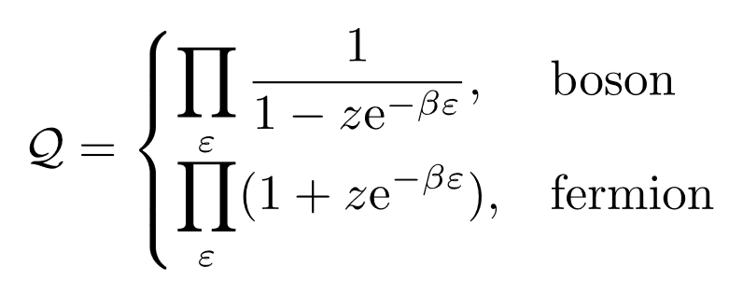
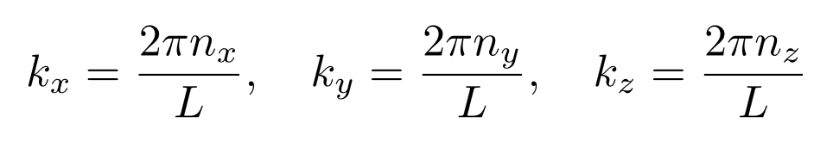


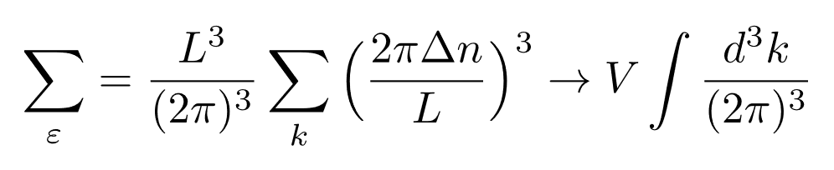
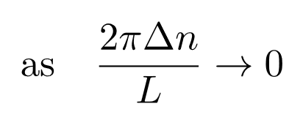
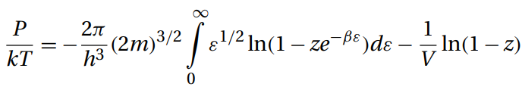
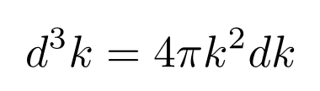
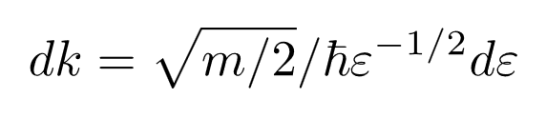

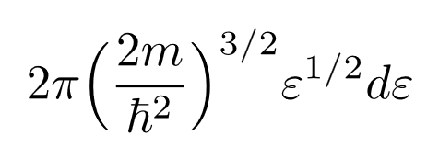

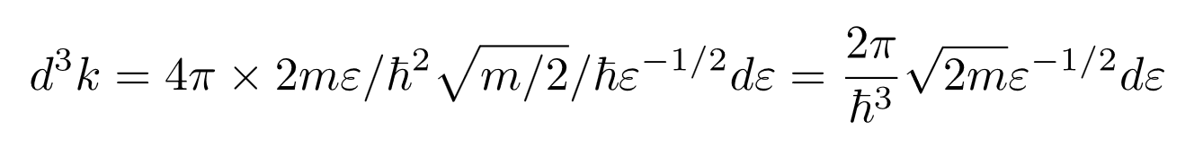
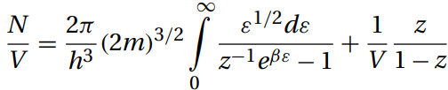
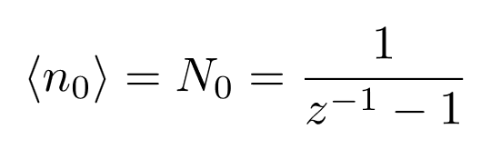
Non-interacting: bose gas (Nonrelativistic)
Non-relativistic
terms

Slide 3




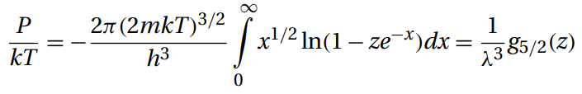
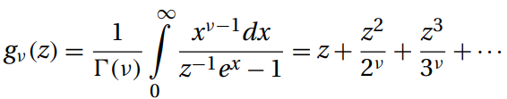

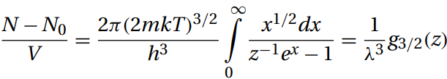
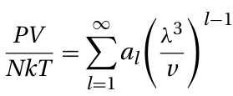
Non-interacting: bose gas (Nonrelativistic)
Non-relativistic
For small

Slide 4

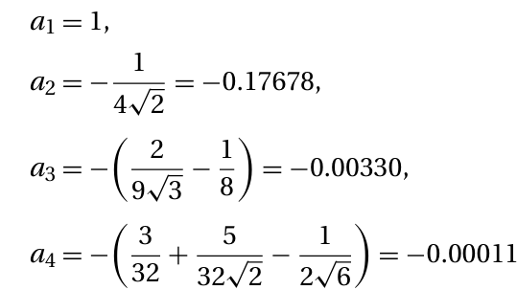
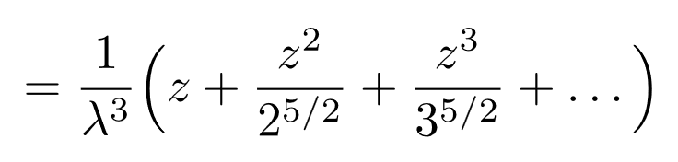

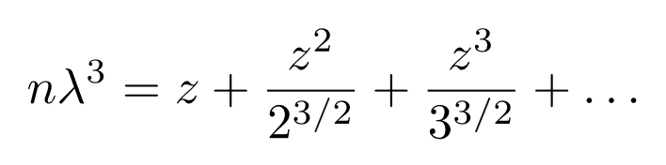
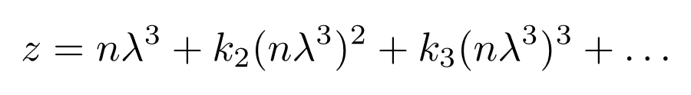
Idea bose gas: Thermodynamics
(High-temperature, low density)
For small

Slide 5
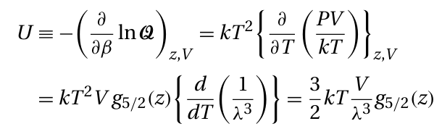

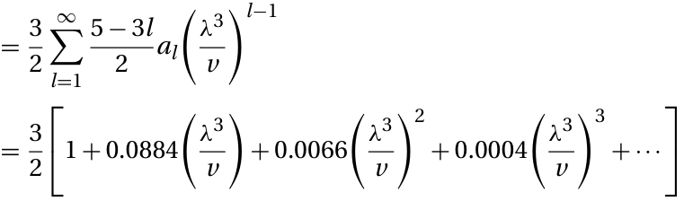

Idea bose gas: Thermodynamics
(High-temperature, low density)
Internal energy
Heat capacity

Slide 6

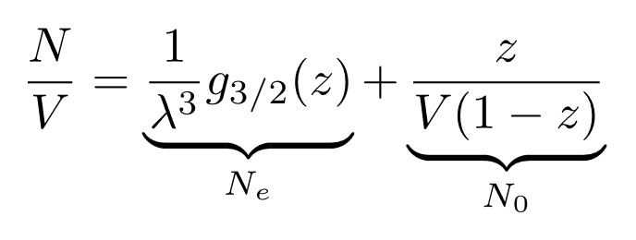
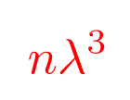
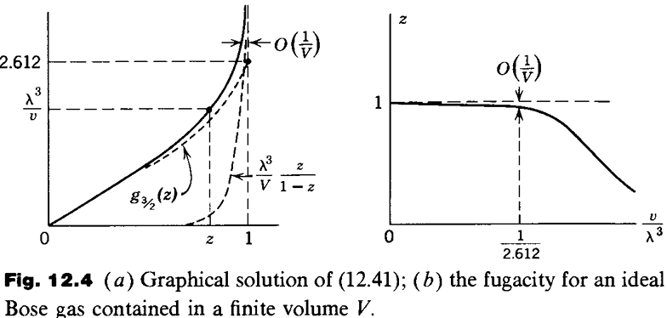

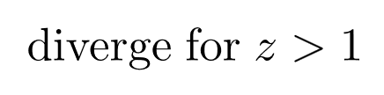


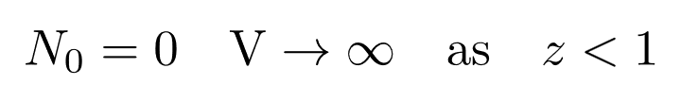
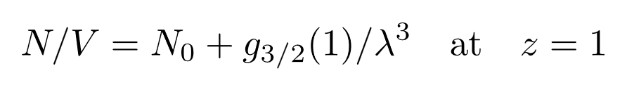
Non-interacting bose gas: Bose-einstein condensation
(Low-temperature, high density)
Fixed number
No solution for z
K. Huang
Positive:
stuck at 1
For finite small volume, it may not has solution for all z. (z≠1)
In therm0dynamics limit a V, N → ∞.
Macroscopic number of particles occupy the ground state.
BEC phase!

Slide 7
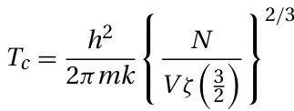
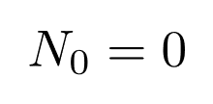
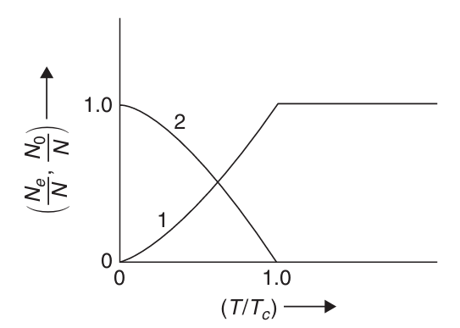

Non-interacting bose gas: Bose-einstein condensation
(Low-temperature, high density)
At transition point:
Fixed number
In therm0dynamics limit a V, N → ∞.
BEC phase!
Macroscopic number of particles occupy the ground state.

Slide 8
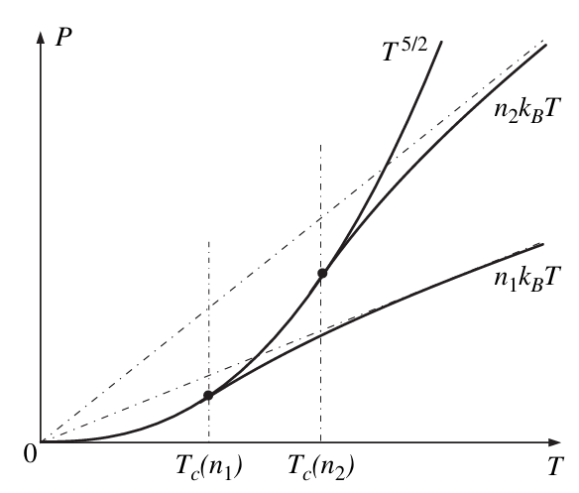


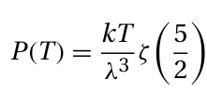

Non-interacting: bose gas Bose-einstein condensation
(Condensate)
(Normal gas)
(Normal gas)
Volume independent
=> Infinite compressibility
z depends on V
(Condensate)

Slide 9
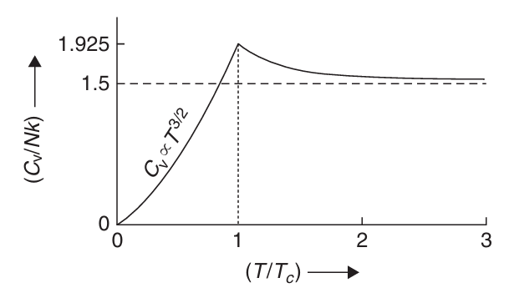


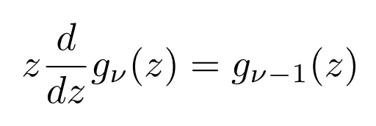

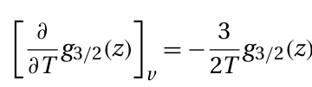

Non-interacting: bose gas Bose-einstein condensation
(Normal gas)
(Condensate)

Slide 10
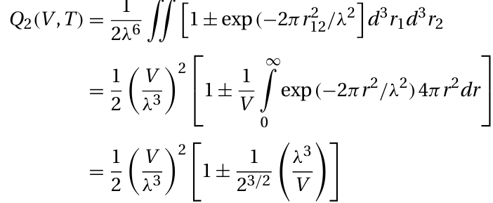

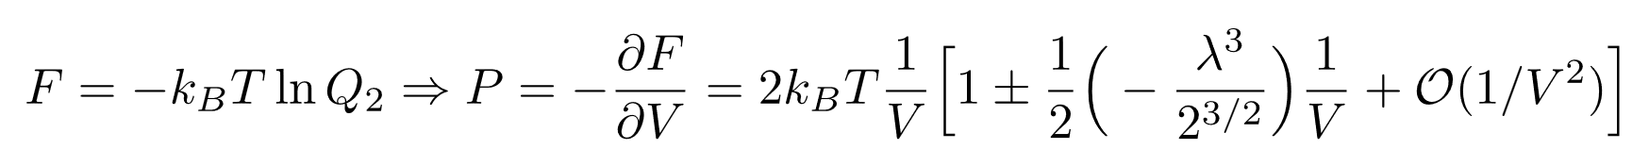
Possible reason for bose-Einstein condensation
N=2 system
Density matrix in real space
Attractive for boson
Repulsive for fermion
Statistical force
Virial expansion, just like interacting gas!

Slide 11
What is the condition for BEC
2. must be upper bounded at z=1
1. Number of particle must be conserved
At transition point:
Fixed number
In therm0dynamics limit a V, N → ∞.
3. In BEC phase, z=1,
N₀ can be any nonzero number

Slide 12

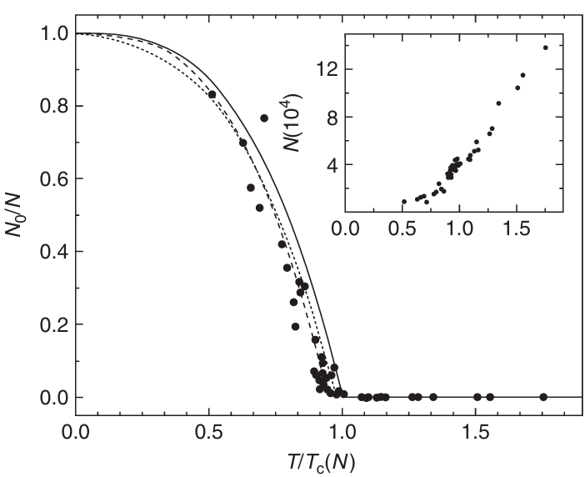
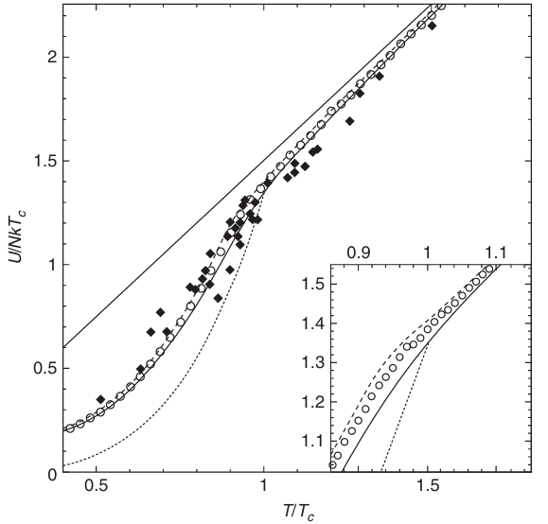

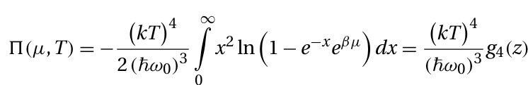

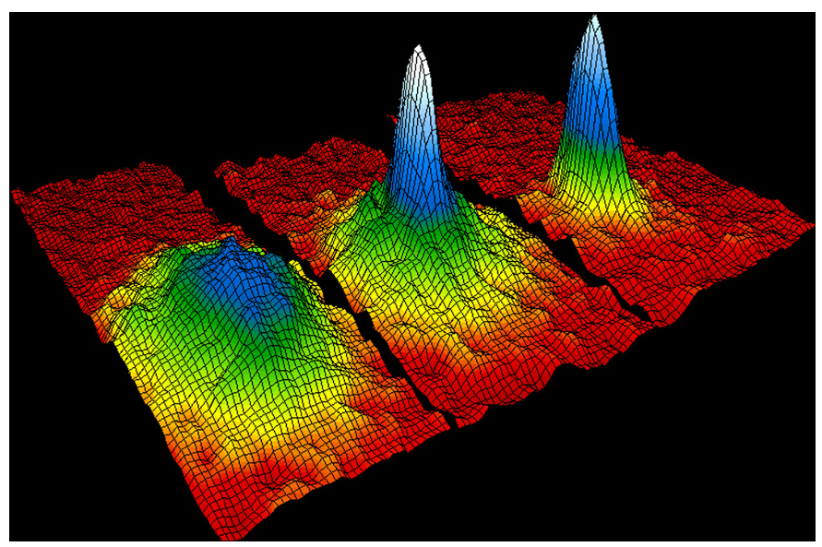
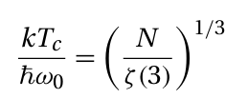


Atomic gas in optical trap
Weakly interacting
100n K for Rb

Slide 13
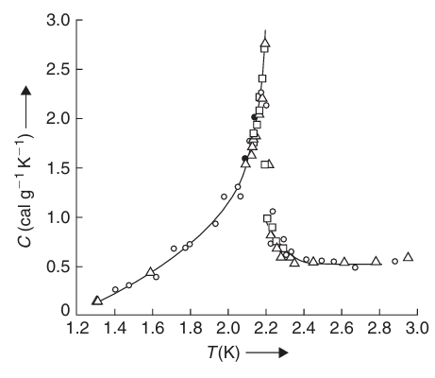
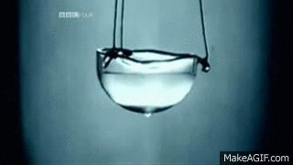
Superfluid in He₄
Strongly interacting system
Very hard problem!
Tc = 2.17 K
(much larger Tc due to interaction)
Zero viscosity

Slide 14
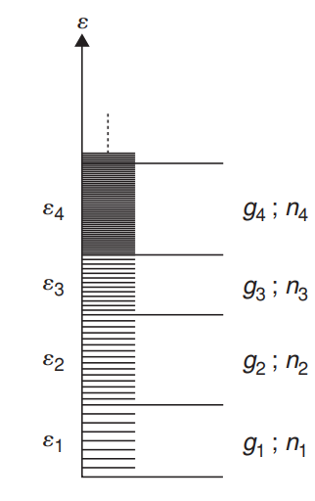

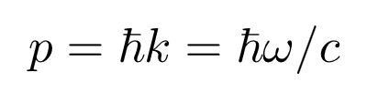
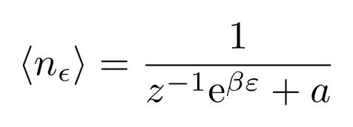
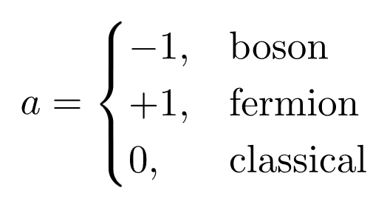
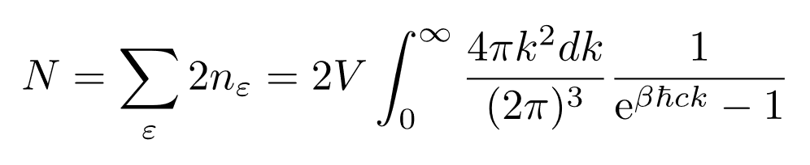








Non-interacting bosons: Black body (cavity EM fields)
Photon energy:
Occupation number:
μ=0! Number of particles is NOT conserved.
2 polarizations
continuous in k
Photon density:
N is the Lagrange multiplier arise from the constraint of N.
Energy density:
Stefan’s law:

Slide 15








Non-interacting bosons: Phonon (Lattice vibrations)
Phonon energy:
3 vibrational directions
All possible vibrating modes
Density of states
Cut off frequency: Debye frequency

Slide 16










Non-interacting bosons: Phonon (Lattice vibrations)
Phonon energy:
Total energy:
Debye frequency
Change of variable
where
with

Slide 17
Statistics for Non-interacting bosons
We have consider the simple system:
Ideal Bose gas:
Photon energy:
Phonon energy:
In real cases:
Real system has a much more complicated energy spectrum
Interactions between bosons? Advanced topic: Quantum many-body/ fields theoretic techniques.

Slide 18

Phonon in real materials
Real materials
Our model:

Slide 19
Statistical physics phy301
Non-interacting fermions
Idea gas, electrons in solid

Slide 20








Non-interacting Fermi gas (Nonrelativistic)
Non-relativistic
degeneracy: spin

Slide 21




Thermodynamics of idea Fermi gas (Any temperature)
Non-relativistic
Total Energy
degeneracy: spin
Equation of state
Heat capacity

Slide 22


Thermodynamics of idea Fermi gas
(High-temperature, low density)
Non-relativistic
Virial expansion
degeneracy: spin
Heat capacity

Slide 23









Thermodynamics of idea Fermi gas (T=0)
Non-relativistic
T=0 limit

Slide 24




Thermodynamics of idea Fermi gas (T=0)
Non-relativistic
T=0 limit
Total energy at T=0
Pressure

Slide 25






Thermodynamics of idea Fermi gas (Low-temperature)
Non-relativistic
T=0 limit
(Low-temperature)
Sommerfeld expansion
Relevant fluctuations (thermal average)

Slide 26








Sommerfeld expansion

Slide 27

Thermodynamics of idea Fermi gas (T ≠ 0)
Non-relativistic
T=0 limit
Sommerfeld expansion
Relevant fluctuations (thermal average)

Slide 28



Thermodynamics of idea Fermi gas (T ≠ 0)
(zeroth order)
Chemical potential is very close to Fermi energy.

Slide 29




Thermodynamics of idea Fermi gas (T ≠ 0)
Internal energy:

Slide 30
Thermodynamics of idea Fermi gas (T ≠ 0)

Slide 31







The electron gas in metals
electron
Total:
phonon

Slide 32





Non-interacting Fermion: electrons in metal
Pauli paramagnetism (T=0)
Magnetization:
Splitting of Fermi energy:
Susceptibility:

Slide 33





Non-interacting Fermion: electrons in metal
Pauli paramagnetism (T≠0)

Slide 34





Non-interacting Fermion: electrons in metal
Pauli paramagnetism (T≠0)
Keep the largest term in the sum

Slide 35






Non-interacting Fermion: electrons in metal
Pauli paramagnetism (T≠0)
The most probable N⁺ term
Magnetization

