Slide 1
Statistical physics phy301
Fluctuation, Brownian motion and diffusion, fluctuation and dissipation

Slide 2

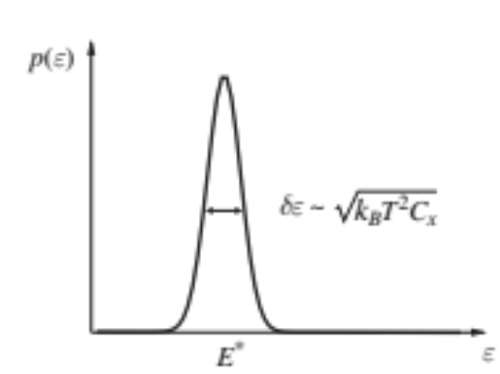


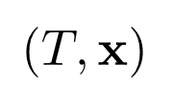
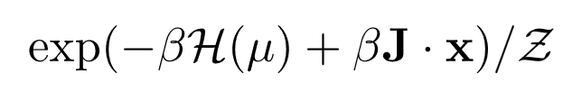

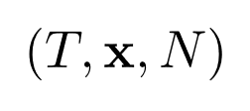
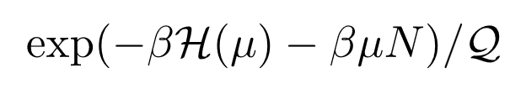



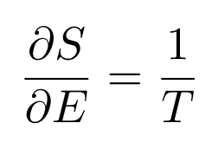


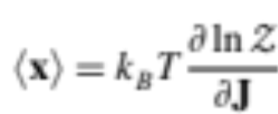

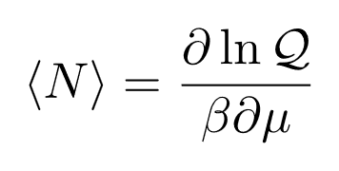
Comparison between ensemble models
The details of the fluctuation is not important:
Energy:
Particles:
Gibbs Canonical
Thermodynamics (quantum or classical) => Macrostates
=> Average
Grand Canonical
Connection to thermodynamics:
Microcanonical
Gibbs Canonical
Grand Canonical
Canonical

Slide 3
Thermodynamics vs Fluctuations
Fluctuations are important in
Small scale => Brownian motions: thermal effects on single particle system
Out-of-equilibrium => transport phenomena: thermal motion of the underlying particles

Slide 4
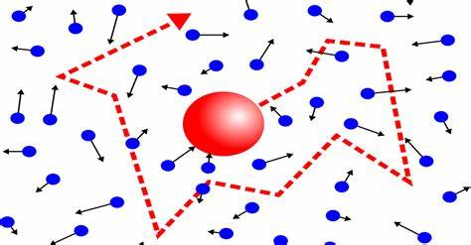
Brownian motion
Background is the reservoir in thermal equilibrium.
We want to model the fluctuation of the motion due to the interaction with the thermal system.
For 1 particle system is obviously not describe by thermodynamics.
Average behaviour is boring and do not tell us much information.

Slide 5
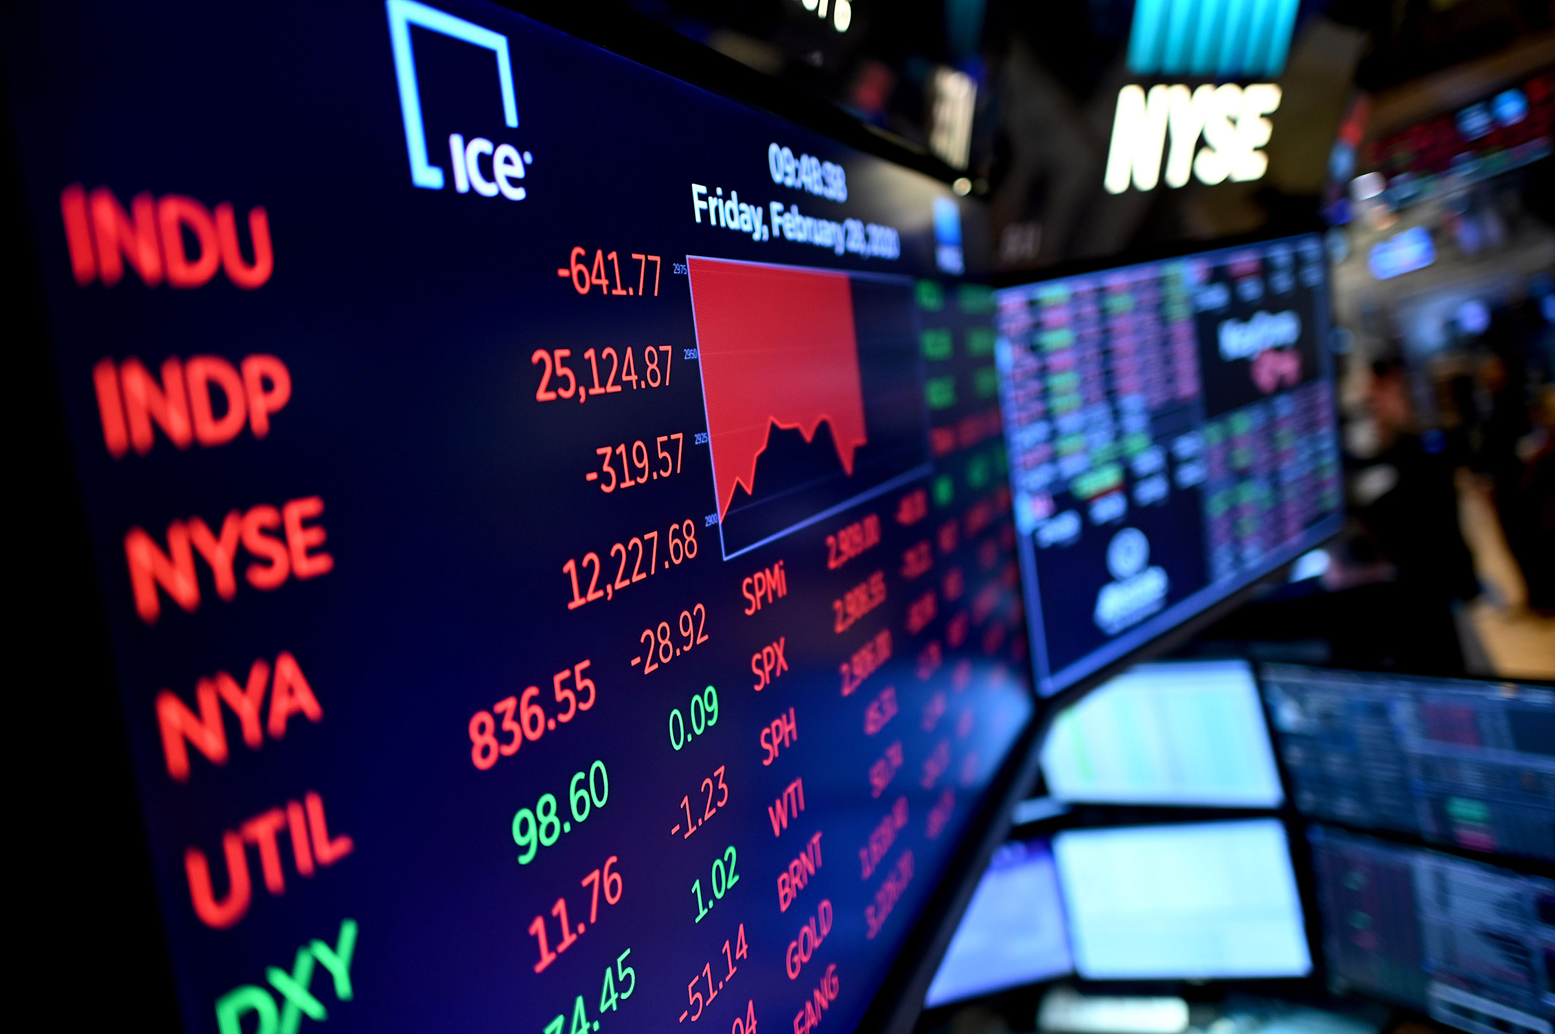

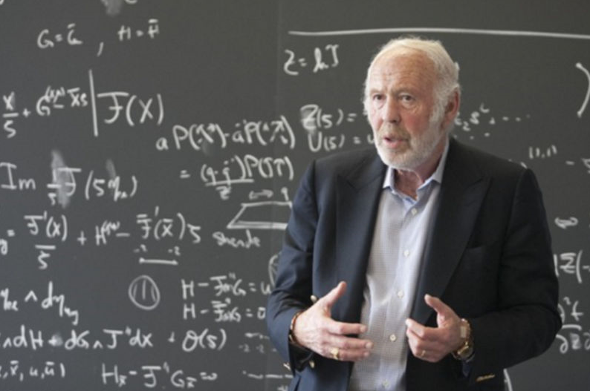

Real-world example:
The fluctuations of the stock price is driven by million of transaction in the background.
Jim Simons
(Mathematician)
Black-Scholes price model use the concept of Brownian motion.

Slide 6

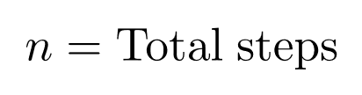
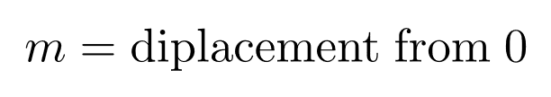


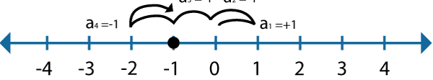
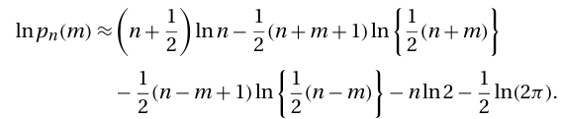



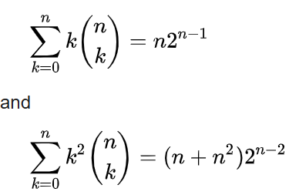


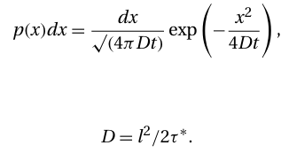


Einstein-Smoluchowski theory
Grow with time
=> diffusion.
1/2
1/2

Slide 7
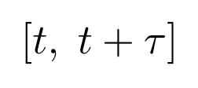
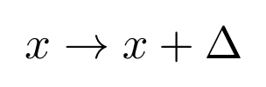

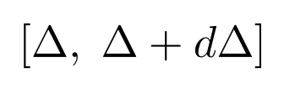
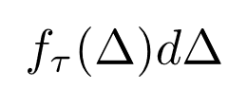
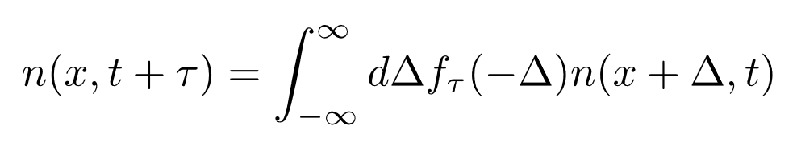



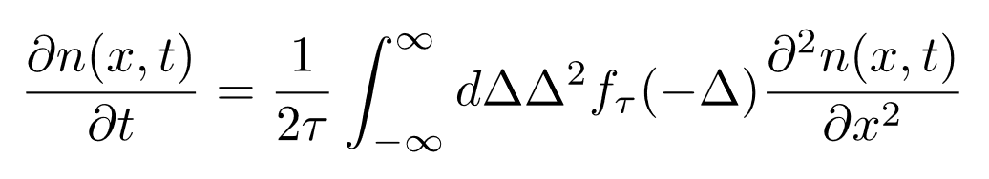
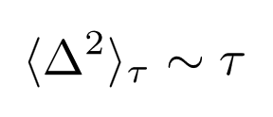
Einstein-Smoluchowski theory
Derive diffusion from the perspective of distribution
In the time interval
The particle is displaced by
3D
Density diluted in time.
The probability to be displaced by
Particle density
Therefore, the time evolution of the particle density is
Random walk ⇒ Diffusion equation:
and are small
If ⇒ Diffusion equation

Slide 8
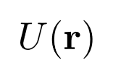
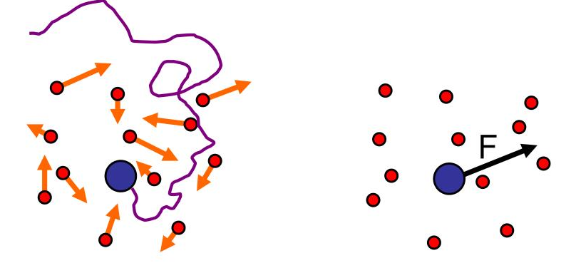
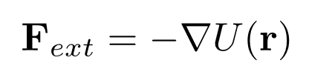


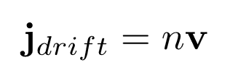
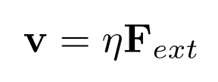
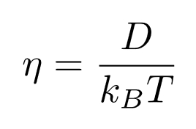
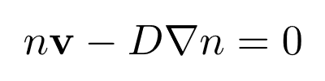
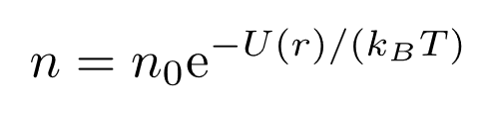
Einstein-Smoluchowski theory
Driving potential:
Density diluted in time.
Particle density
Diffusion equation
From continuity:
Due to constant interaction with the background. The particle reach a “drift” velocity:
current
reaching equilibrium: drift in + diffusing out=0
Einstein relation:
(Fluctuation-Dissipation theorem)
v² is also fine, it is still a dissipative force with different distribution

Slide 9


Langevin theory
Background is the reservoir in thermal equilibrium.
We want to model the fluctuation of the motion due to the interaction with the thermal system.
Do not average to zero (drag)
Random motion originate from a random force in the background.
For 1 particle system is obviously not describe by thermodynamics.
Average behaviour is boring and do not tell us much information.

Slide 10
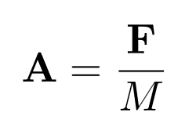



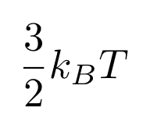





Langevin theory
Average velocity
No net drift velocity in t>>0
(Diffusion)

Slide 11
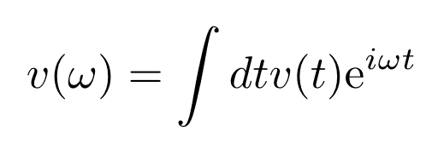
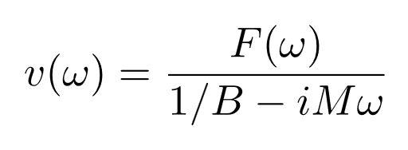
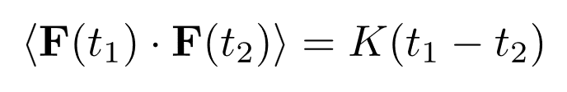
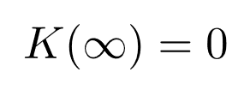
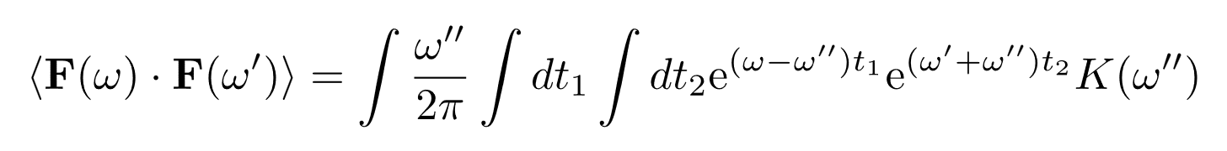
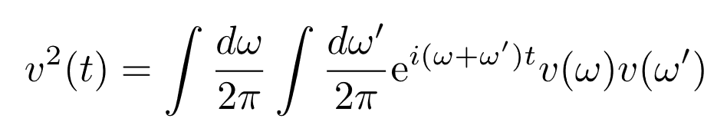
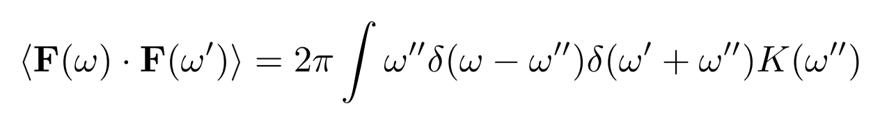
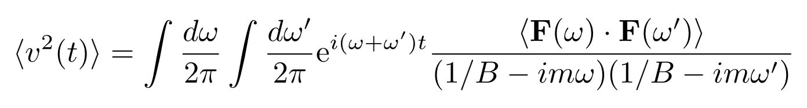
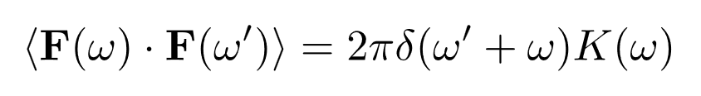
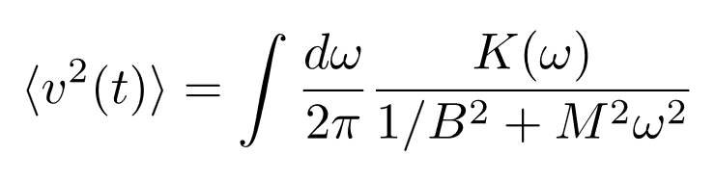
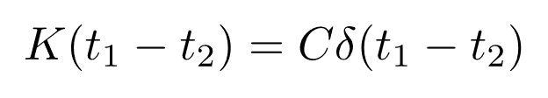
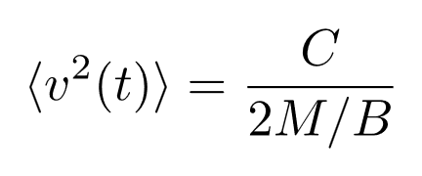
Langevin theory
Basic assumption: Do not have memory of the past history.
(Fluctuation-Dissipation theorem)

Slide 12


Fokker-Planck equation: evolution of distribution
Turn the stochastic equation into differential equation of distribution
Master equation:
Determine how the system reach equilibrium
Transition rate from a’→a
(From the stochastic process)
In equilibrium:
Details balanced:

Slide 13

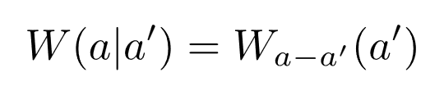
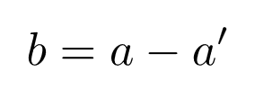
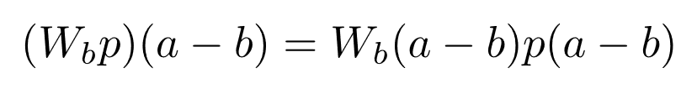
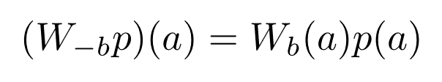




Fokker-Planck equation: evolution of distribution
Master equation:
Fokker-Planck equation:
Drift
Diffusion

Slide 14






Fokker-Planck equation: evolution of distribution
Fokker-Planck equation:
Drift
Diffusion

Slide 15



Fokker-Planck equation: evolution of distribution
Fokker-Planck equation:
Drift
Diffusion
Drift
Diffusion
Diffusion equation:

Slide 16

Further topics
Interacting system:
Condensed Matter Field Theory
by Alexander Altland (Author), Ben D. Simons
Classical => Cluster expansion
Quantum => second quantization or field theory
Phase transition:
Critical phenomena and renormalization group.

Slide 17
Further topics
Out-of-equilibrium
Density matrix formalism:
Boltzmann equation (classical/semi-classical),
Lindbladian (quantum)
Keldysh path integral (quantum)

Slide 18

Further topics
“Statistical Inference”
George Casella, Roger Berger
Mathematics:
Statistics
Stochastic Calculus (non-equilibrium)
Computer simulations:
Monte Carlo
Molecular Dynamics

