Slide 1
Statistical physics phy301
Quantum statistics with identical particles
Fermi and Bose statistics
Lecturer: Kok Wee Song

Slide 2

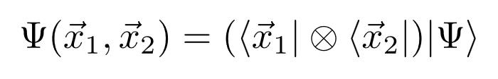
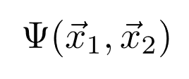
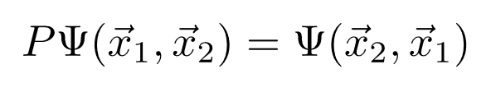
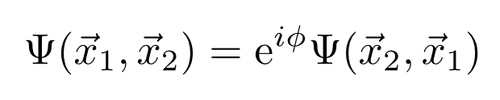
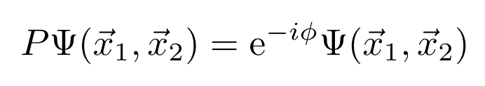
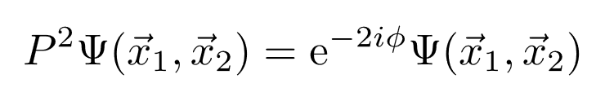
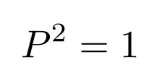
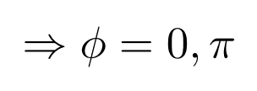
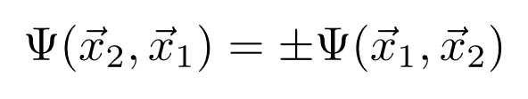
Quantum mechanics with N-particles
Boson v.s. Fermi
Consider a two identical particle system:
Exchange 1 and 2
(1)
Must be the same state
Substitute into (1)
Exchange again:
But
(+) Boson is symmetry
(-) Fermion is anti-symmetry
Anyon. (only in 2D system)

Slide 3
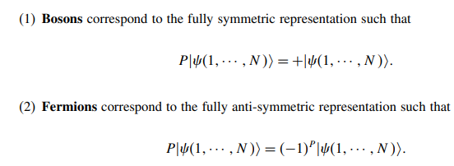
Quantum mechanics with N-particles
Boson v.s. Fermi
(+) Boson is symmetry
(-) Fermion is anti-symmetry
Boson like to share the same state
Fermion does not share the same state
Bose-Einstein statistics
Fermi-Dirac statistics

Slide 4
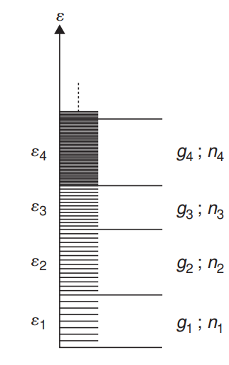
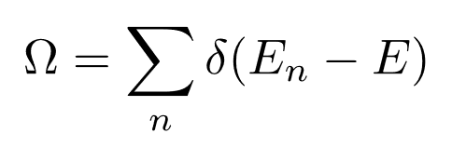

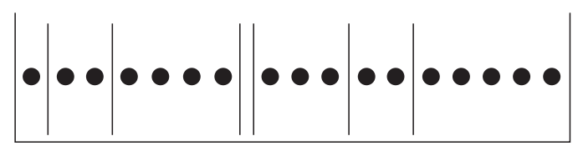


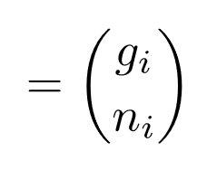

Quantum statistics of non-interacting particles
Microcanonical ensemble:
degeneracy
# of particles with
Bose-Einstein statistics
R balls in N boxes problem
Fermi-Dirac statistics
Quantum states

Slide 5
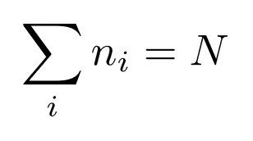

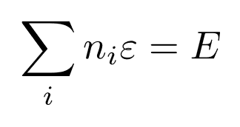
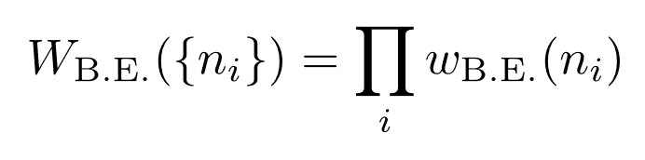
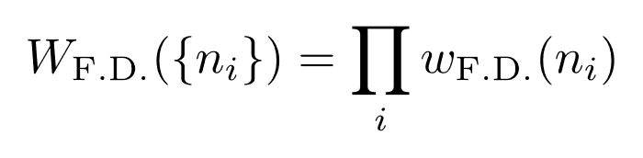



Quantum statistics of non-interacting particles
Microcanonical ensemble:
Constraint
(difficulty)
degeneracy
# of particles with
Bose-Einstein statistics
Total number of states:
9
8
Fermi-Dirac statistics
Quantum states
3
2
7
4
5
Maxwell-Boltzmann statistics
1
1
6
1
2
3
4
5
6
7
8
9

Slide 6
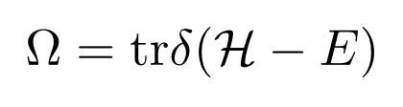
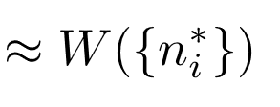

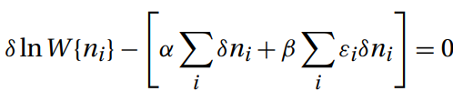
Quantum statistics of non-interacting particles
Microcanonical ensemble:
degeneracy
Keep the most probable term:
# of particles with
Constraint
Method of Lagrange multiplier:
Quantum states

Slide 7
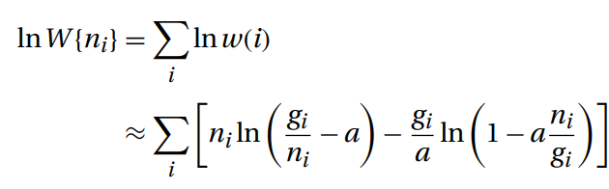


Quantum statistics of non-interacting particles
(Non-interacting particles)

Slide 8

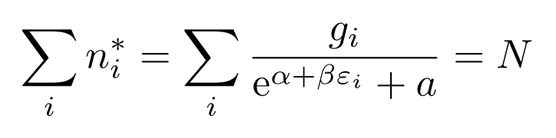
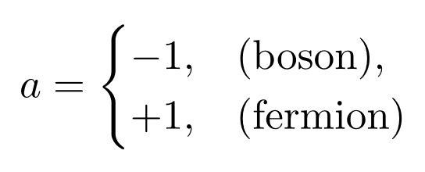
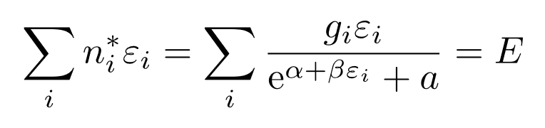
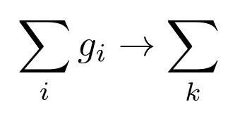
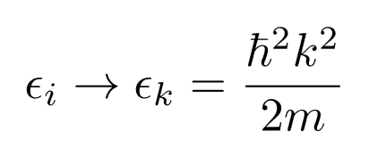
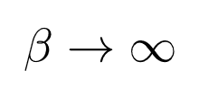
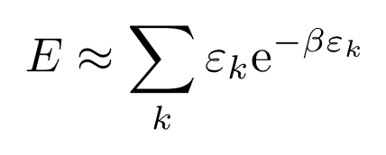

Quantum statistics of non-interacting particles
Microcanonical ensemble:
degeneracy
# of particles with
Constraint:
Quantum states
In continuous quantum number:
If
, we recover Maxwell-Boltzmann
From K. Huang, not good for me.

Slide 9
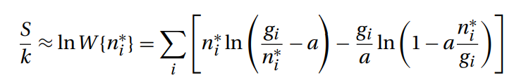

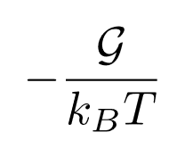
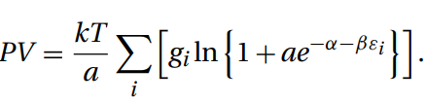

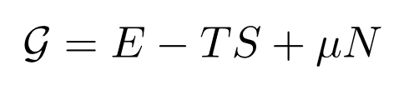
Quantum statistics of non-interacting particles
Microcanonical ensemble:
degeneracy
# of particles with
Quantum states
Quantum gas equation
Grand potential:

Slide 10

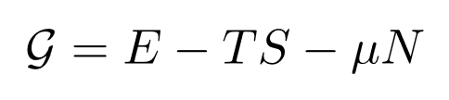
Quantum statistics of non-interacting particles
Constraint:
Microcanonical ensemble:
degeneracy
# of particles with
Quantum states
Maxwell-Boltzmann:
Grand potential:

Slide 11
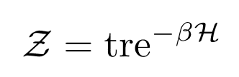
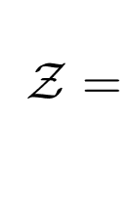
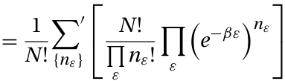

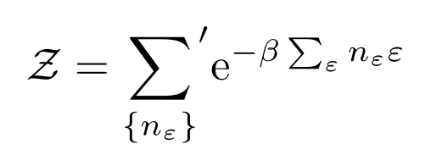
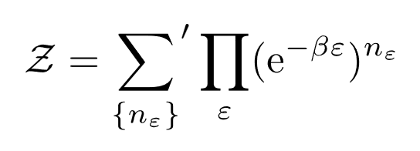
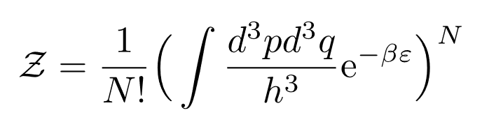
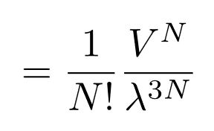
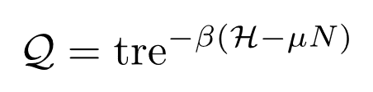
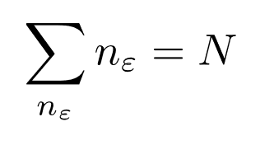
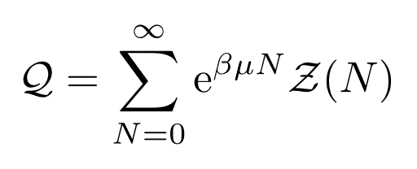
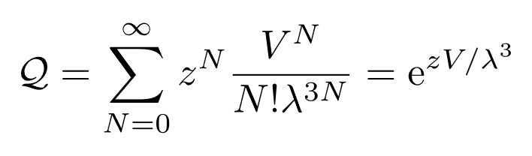
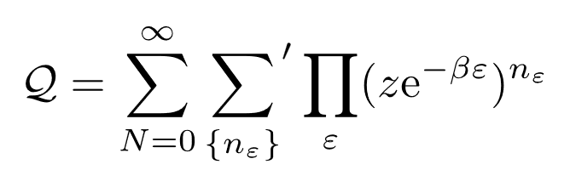
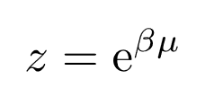
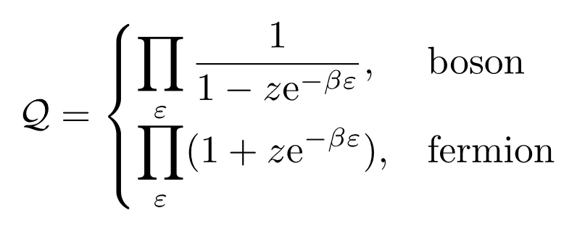
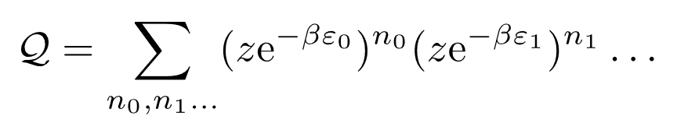
Quantum statistics of non-interacting particles
Canonical ensemble:
Quantum
Classical
degeneracy
# of particles with
Grand canonical ensemble:
Difficult to proceed.
Quantum states
classical

Slide 12
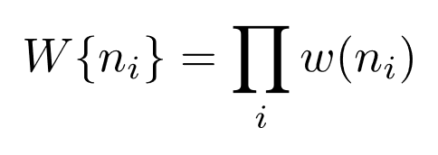










Quantum statistics of non-interacting particles
Microcanonical ensemble:
Canonical ensemble:
Grand canonical ensemble:
Difficult to proceed.
Occupation number
In classical regime

Slide 13




Quantum statistics of non-interacting particles
Grand canonical ensemble:
Classical
Occupation number statistics:
Occupation number
Classical

Slide 14




Quantum statistics of non-interacting particles
Grand canonical ensemble:
Classical
Probability for finding n_{i} particle in e_{i}:
General result for noninteracting particles.

Slide 15




















Quantum Mechanics
1)
(Real space representation)
2)
Energy eigenstates of the Hamiltonian:
(Completeness)
= probability to find in state
(Normalization)
3)
Observable
Measure in experiment
4)
Dynamics
Formally:
Unitary: preserving probability

Slide 16







Density matrix
Schrodinger equation:
Hilbert space (n-dimensional complex vector space):
with probability
How to model the quantum microstates statistically that is compatible with quantum mechanics?
Experiment measurement:
(Completeness)
play the role like in classical case.
Density matrix
In basis-free form:
Is the tool to build statistical model in quantum mechanics
What form is allow?

Slide 17










Density matrix
Density matrix
In basis-free form:
1)
2)
Hermiticity
3)
Positivity
For any states in the Hilbert space
4)
Time evolution: Liouville’s theorem for quantum system
(Conservation of probability)

Slide 18









Equilibrium in quantum system
In thermal equilibrium:
Independent random phases assumption.
It is okay to have off diagonal terms.
Density matrix
Normalization
Energy eigenstate representation
Microcanonical ensemble:
Canonical ensemble:
Grand canonical ensemble:

Slide 19
Quantum statistics of non-interacting particles
Microcanonical ensemble:
Canonical ensemble:
Grand canonical ensemble:
Too complicated.
Occupation number
Most probable
Average

