Slide 1
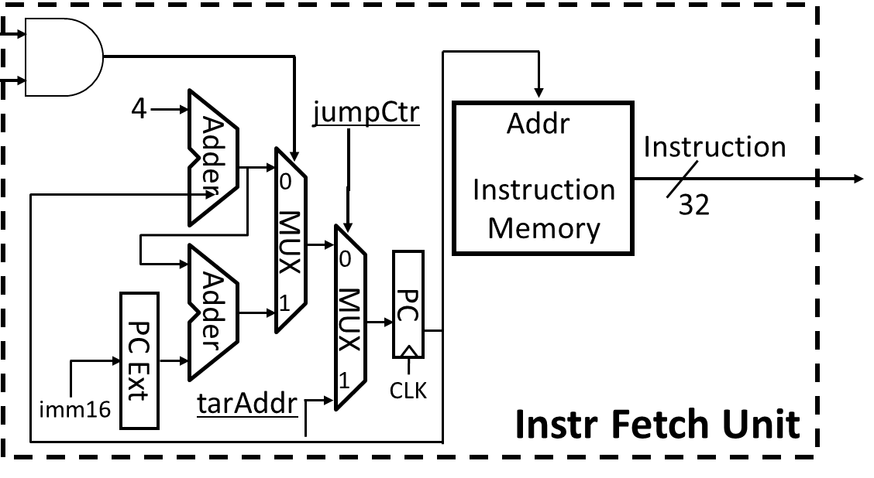
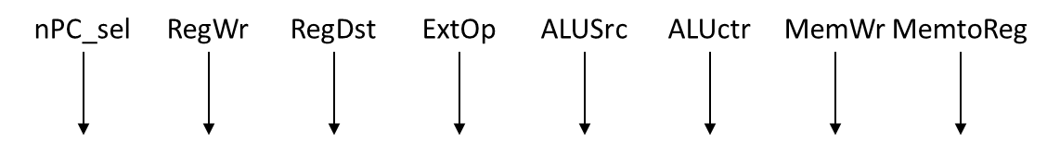
Datapath
rt
rd
nPC_sel
rs
<25:21>
<20:16>
<15:11>
ADDU
zero
1
Instruction<31:0>
<31:26>
<5:0>
<15:0>
<25:0>
rd
rt
rs
opcode
funct
RegDst
rd
rt
Controller
1
0
RegWr
rs
rt
ALUctr
5
5
5
MemtoReg
nPC_sel
RegWr
RegDst
ExtOp
ALUSrc
ALUctr
MemWr
MemtoReg
jumpCtr
RW
RA
RB
busA
32
MemWr
busW
RegFile
=
ALU
32
32
busB
0
0
CLK
32
32
WrEn
Addr
Data
Memory
imm16
Extender
1
Data In
1
16
32
CLK
tarAddr
ExtOp
ALUSrc
imm16

Slide 2
Datapath
rt
rd
nPC_sel
rs
<25:21>
<20:16>
<15:11>
SUBU
zero
1
Instruction<31:0>
<31:26>
<5:0>
<15:0>
<25:0>
rd
rt
rs
opcode
funct
RegDst
rd
rt
Controller
1
0
RegWr
rs
rt
ALUctr
5
5
5
MemtoReg
nPC_sel
RegWr
RegDst
ExtOp
ALUSrc
ALUctr
MemWr
MemtoReg
jumpCtr
RW
RA
RB
busA
32
MemWr
busW
RegFile
=
ALU
32
32
busB
0
0
CLK
32
32
WrEn
Addr
Data
Memory
imm16
Extender
1
Data In
1
16
32
CLK
tarAddr
ExtOp
ALUSrc
imm16

Slide 3
Datapath
rt
rd
nPC_sel
rs
<25:21>
<20:16>
<15:11>
LUI
zero
1
Instruction<31:0>
<31:26>
<5:0>
<15:0>
<25:0>
rd
rt
rs
opcode
funct
RegDst
rd
rt
Controller
1
0
RegWr
rs
rt
ALUctr
5
5
5
MemtoReg
nPC_sel
RegWr
RegDst
ExtOp
ALUSrc
ALUctr
MemWr
MemtoReg
jumpCtr
RW
RA
RB
busA
32
MemWr
busW
RegFile
=
ALU
32
32
busB
0
0
CLK
32
32
WrEn
Addr
Data
Memory
imm16
Extender
1
Data In
1
16
32
CLK
tarAddr
ExtOp
ALUSrc
imm16

Slide 4
Datapath
rt
rd
nPC_sel
rs
<25:21>
<20:16>
<15:11>
ORI
zero
1
Instruction<31:0>
<31:26>
<5:0>
<15:0>
<25:0>
rd
rt
rs
opcode
funct
RegDst
rd
rt
Controller
1
0
RegWr
rs
rt
ALUctr
5
5
5
MemtoReg
nPC_sel
RegWr
RegDst
ExtOp
ALUSrc
ALUctr
MemWr
MemtoReg
jumpCtr
RW
RA
RB
busA
32
MemWr
busW
RegFile
=
ALU
32
32
busB
0
0
CLK
32
32
WrEn
Addr
Data
Memory
imm16
Extender
1
Data In
1
16
32
CLK
tarAddr
ExtOp
ALUSrc
imm16

Slide 5
Datapath
rt
rd
nPC_sel
rs
<25:21>
<20:16>
<15:11>
LW
zero
1
Instruction<31:0>
<31:26>
<5:0>
<15:0>
<25:0>
rd
rt
rs
opcode
funct
RegDst
rd
rt
Controller
1
0
RegWr
rs
rt
ALUctr
5
5
5
MemtoReg
nPC_sel
RegWr
RegDst
ExtOp
ALUSrc
ALUctr
MemWr
MemtoReg
jumpCtr
RW
RA
RB
busA
32
MemWr
busW
RegFile
=
ALU
32
32
busB
0
0
CLK
32
32
WrEn
Addr
Data
Memory
imm16
Extender
1
Data In
1
16
32
CLK
tarAddr
ExtOp
ALUSrc
imm16

Slide 6
Datapath
rt
rd
nPC_sel
rs
<25:21>
<20:16>
<15:11>
SW
zero
1
Instruction<31:0>
<31:26>
<5:0>
<15:0>
<25:0>
rd
rt
rs
opcode
funct
RegDst
rd
rt
Controller
1
0
RegWr
rs
rt
ALUctr
5
5
5
MemtoReg
nPC_sel
RegWr
RegDst
ExtOp
ALUSrc
ALUctr
MemWr
MemtoReg
jumpCtr
RW
RA
RB
busA
32
MemWr
busW
RegFile
=
ALU
32
32
busB
0
0
CLK
32
32
WrEn
Addr
Data
Memory
imm16
Extender
1
Data In
1
16
32
CLK
tarAddr
ExtOp
ALUSrc
imm16

Slide 7
Datapath
rt
rd
nPC_sel
rs
<25:21>
<20:16>
<15:11>
BEQ
zero
1
Instruction<31:0>
<31:26>
<5:0>
<15:0>
<25:0>
rd
rt
rs
opcode
funct
RegDst
rd
rt
Controller
1
0
RegWr
rs
rt
ALUctr
5
5
5
MemtoReg
nPC_sel
RegWr
RegDst
ExtOp
ALUSrc
ALUctr
MemWr
MemtoReg
jumpCtr
RW
RA
RB
busA
32
MemWr
busW
RegFile
=
ALU
32
32
busB
0
0
CLK
32
32
WrEn
Addr
Data
Memory
imm16
Extender
1
Data In
1
16
32
CLK
tarAddr
ExtOp
ALUSrc
imm16

Slide 8
Datapath
rt
rd
nPC_sel
rs
<25:21>
<20:16>
<15:11>
J
zero
1
Instruction<31:0>
<31:26>
<5:0>
<15:0>
<25:0>
rd
rt
rs
opcode
funct
RegDst
rd
rt
Controller
1
0
RegWr
rs
rt
ALUctr
5
5
5
MemtoReg
nPC_sel
RegWr
RegDst
ExtOp
ALUSrc
ALUctr
MemWr
MemtoReg
jumpCtr
RW
RA
RB
busA
32
MemWr
busW
RegFile
=
ALU
32
32
busB
0
0
CLK
32
32
WrEn
Addr
Data
Memory
imm16
Extender
1
Data In
1
16
32
CLK
tarAddr
ExtOp
ALUSrc
imm16

Slide 9
MIPS-lite Control Signals
See MIPS
func
10 0001
10 0011
n/a
Green Sheet
op
00 0000
00 0000
00 1101
10 0011
10 1011
00 0100
00 0010
00 1111
addu
subu
ori
lw
sw
beq
j
lui
RegDst
1
1
0
0
X
X
X
0
ALUSrc
0
0
1
1
1
0
0
1
MemtoReg
0
0
0
1
X
X
X
0
RegWrite
1
1
1
1
0
0
0
1
Control Signals
MemWrite
0
0
0
0
1
0
0
0
nPC_sel
0
0
0
0
0
1
0
0
ExtOp
X
X
0
1
1
X
X
0
ALUctr<2:0>
Add
Subtract
Or
Add
Add
Subtract
X
Lui
JumpCtr
0
0
0
0
0
0
1
0

