Slide 1
21CSS201T COMPUTER ORGANIZATION AND ARCHITECTURE UNIT-4

Slide 2
Contents
Basic processing unit
ALU operations
Instruction execution
Branch instruction
Multiple bus organization
Hardwired control
Generation of control signals,
Micro-programmed control
Pipelining: Basic concepts of pipelining
Performance
Hazards-Data, Instruction and Control
Influence on instruction sets.

Slide 3
Overview
Instruction Set Processor (ISP)
Central Processing Unit (CPU)
A typical computing task consists of a series of steps specified by a sequence of machine instructions that constitute a program.
An instruction is executed by carrying out a sequence of more rudimentary operations.

Slide 4
Fundamental Concepts
Processor fetches one instruction at a time and perform the operation specified.
Instructions are fetched from successive memory locations until a branch or a jump instruction is encountered.
Processor keeps track of the address of the memory location containing the next instruction to be fetched using Program Counter (PC).
Instruction Register (IR)

Slide 5
Executing an Instruction
Fetch the contents of the memory location pointed to by the PC. The contents of this location are loaded into the IR (fetch phase).
IR ← [[PC]]
Assuming that the memory is byte addressable, increment the contents of the PC by 4 (Fetch phase).
PC ← [PC] + 4
Carry out the actions specified by the instruction in the IR (Execution phase).

Slide 6
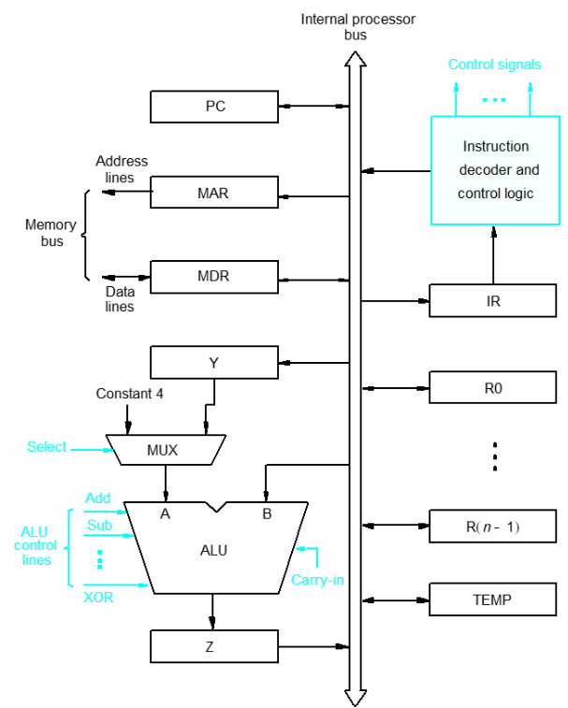
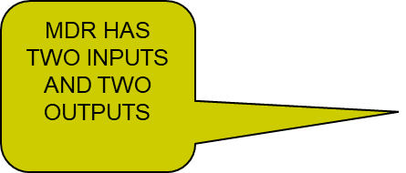

Processor Organization
Figure. Single Bus Organization of the Datapath Inside a Processor

Slide 7
Executing an Instruction
An instruction can be executed by performing one or more of the following operations:
Transfer a word of data from one processor register to another or to the ALU.
Perform an arithmetic or a logic operation and store the result in a processor register.
Fetch the contents of a given memory location and load them into a processor register.
Store a word of data from a processor register into a given memory location

Slide 8
Single Bus Organization
ALU
Registers for temporary storage
Various digital circuits for executing different micro operations.(gates, MUX, decoders, counters).
Internal path for movement of data between ALU and registers.
Driver circuits for transmitting signals to external units.
Receiver circuits for incoming signals from external units.

Slide 9
Single Bus Organization - contd.
Program Counter (PC)
Keeps track of execution of a program
Contains the memory address of the next instruction to be fetched and executed.
Memory Address Register (MAR)
Holds the address of the location to be accessed.
I/P of MAR is connected to Internal bus and an O/P to external bus.
Memory Data Register (MDR)
It contains data to be written into or read out of the addressed location.
It has 2 inputs and 2 outputs.
Data can be loaded into MDR either from memory bus or from internal processor bus.
The data and address lines are connected to the internal bus via MDR and MAR

Slide 10
Single Bus Organization - contd.
Registers
The processor registers R₀ to R_{n-1} vary considerably from one processor to another.
Registers are provided for general purpose used by programmer.
Special purpose registers-index & stack registers.
Registers Y, Z & TEMP are temporary registers used by processor during the execution of some instruction.
Multiplexer
Select either the output of the register Y or a constant value 4 to be provided as input A of the ALU.
Constant 4 is used by the processor to increment the contents of PC.

Slide 11
Single Bus Organization - contd.
ALU
B input of ALU is obtained directly from processor-bus.
As instruction execution progresses, data are transferred from one register to another, often passing through ALU to perform arithmetic or logic operation.
Data Path
The registers, ALU and interconnecting bus are collectively referred to as the data path.

Slide 12
Register Transfers
The input and output gates for register Ri are controlled by signals is Ri_{in} and Ri_{out}
Ri_{in} is set to 1 – data available on common bus are loaded into Ri.
Ri_{out} is set to 1 – the contents of register are placed on the bus.
Ri_{out} is set to 0 – the bus can be used for transferring data from other registers .
All operations and data transfers within the processor take place within time-periods defined by the processor clock.
When edge-triggered flip-flops are not used, 2 or more clock-signals may be needed to guarantee proper transfer of data. This is known as multiphase clocking.

Slide 13
Data Transfer Between Two Registers
Example:
Transfer the contents of R1 to R4.
Enable output of register R1 by setting R1_{out}=1. This places the contents of R1 on the processor bus.
Enable input of register R4 by setting R4_{in}=1. This loads the data from the processor bus into register R4.

Slide 14
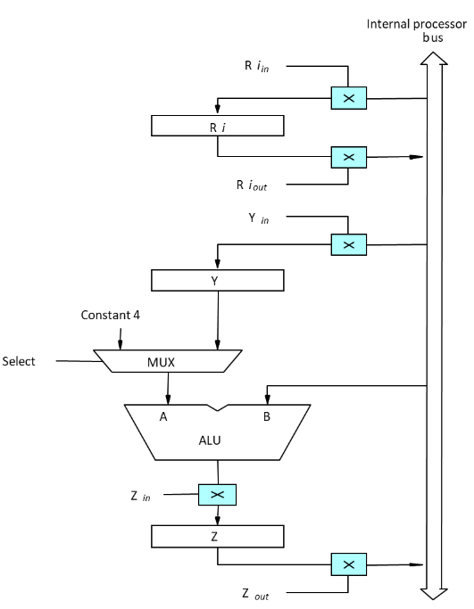
Input and Output Gating for Registers
Figure. Input and Output Gating for the Registers

Slide 15
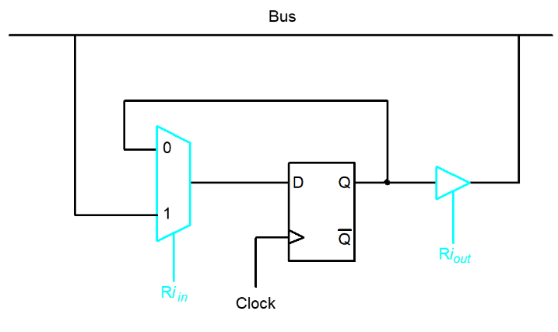
Input and Output Gating for One Register Bit
Figure. Input and Output Gating for One Register Bit

Slide 16
Input and Output Gating for One Register Bit - contd
A 2-input multiplexer is used to select the data applied to the input of an edge-triggered D flip-flop.
When Ri_{in}=1, mux selects data on bus. This data will be loaded into flip-flop at rising-edge of clock.
When Ri_{in}= 0, mux feeds back the value currently stored in flip-flop.
Q output of flip-flop is connected to bus via a tri-state gate.
When Ri_{out}= 0, gate's output is in the high-impedance state. (This corresponds to the open circuit state of a switch).
When Ri_{out}=1, the gate drives the bus to 0 or 1, depending on the value of Q.

Slide 17
2. Performing an ALU Operation
The ALU is a combinational circuit that has no internal storage.
ALU gets the two operands from MUX and bus. The result is temporarily stored in register Z.
What is the sequence of operations to add the contents of register R1 to those of R2 and store the result in R3?
R1_{out}, Y_{in}
R2_{out}, SelectY, Add, Z_{in}
Z_{out}, R3_{in}

Slide 18
ALU Operation - contd
The sequence of operations for [R3] [R1]+[R2] is as follows
Step 1: Output of the register R1 and input of the register Y are enabled, causing the contents of R1 to be transferred to Y.
Step 2: The multiplexer select signal is set to select Y causing the multiplexer to gate the contents of register Y to input A of the ALU.
Step 3: The contents of Z are transferred to the destination register R3.

Slide 19
3.Fetching a Word from Memory
The response time of each memory access varies (cache miss, memory-mapped I/O,…)
To accommodate this, the processor waits until it receives an indication that the requested operation has been completed (Memory-Function-Completed, MFC).
Move (R1), R2
MAR ← [R1]
Start a Read operation on the memory bus
Wait for the MFC response from the memory
Load MDR from the memory bus
R2 ← [MDR]

Slide 20
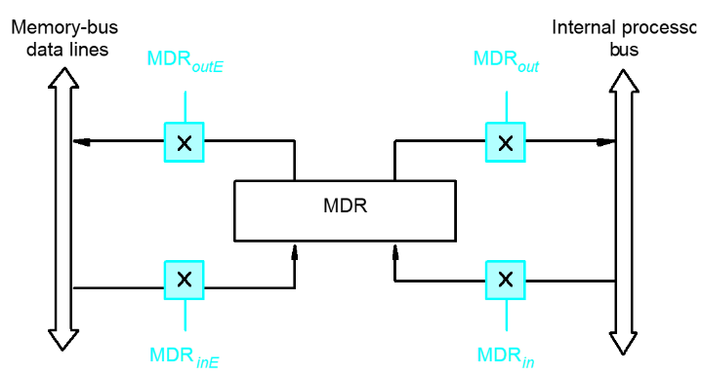
Fetching a Word - contd.
Address into MAR; issue Read operation; data into MDR
Figure. Connection and Control Signals for Register MDR

Slide 21
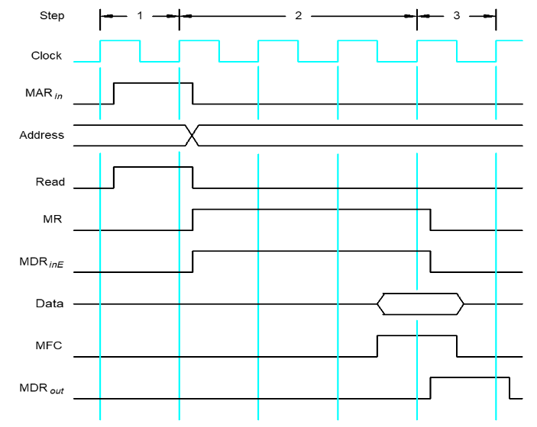
Timing
Assume MAR is always available on the address lines of the memory bus
Figure. Timing of a Memory Read Operation
Move (R1), R2
1.R1_{out}, MARin, Read
2.MDR_{in}E, WMFC
3.MDR_{out}, R2_{in}

Slide 22
4.Storing a Word from Memory
Address is loaded into MAR
Data to be written loaded into MDR.
Write command is issued.
Example: Move R2,(R1)
R1_{out},MAR_{in}
R2_{out},MDR_{in},Write
MDR_{out}E, WMFC

Slide 23
Execution of a Complete Instruction
Add (R3), R1
Fetch the instruction
Fetch the first operand (the contents of the memory location pointed to by R3)
Perform the addition
Load the result into R1

Slide 24
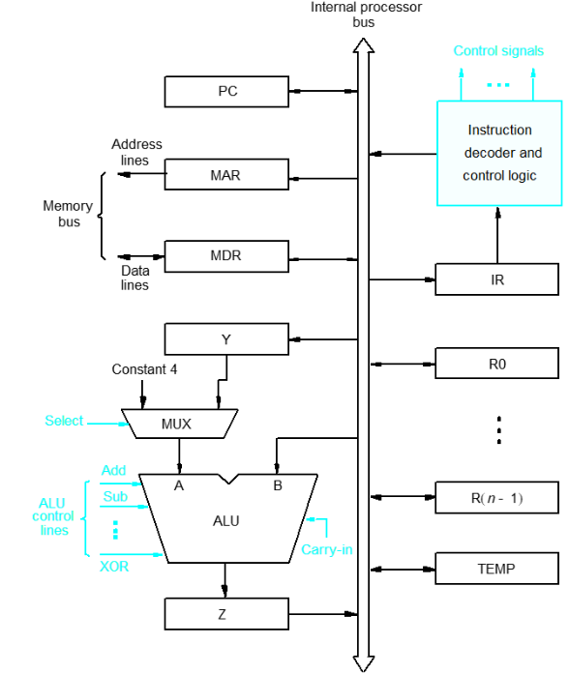
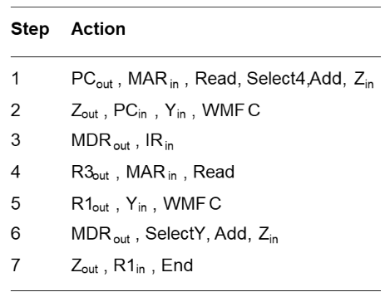
Execution of a Complete Instruction
Add (R3), R1
Figure. Control Sequence for Execution Figure. Single Bus Organization of the Datapath inside a processor

Slide 25
Execution of Branch Instruction
A branch instruction replaces the contents of PC with the branch target address, which is usually obtained by adding an offset X given in the branch instruction.
The offset X is usually the difference between the branch target address and the address immediately following the branch instruction.
UnConditional branch

Slide 26
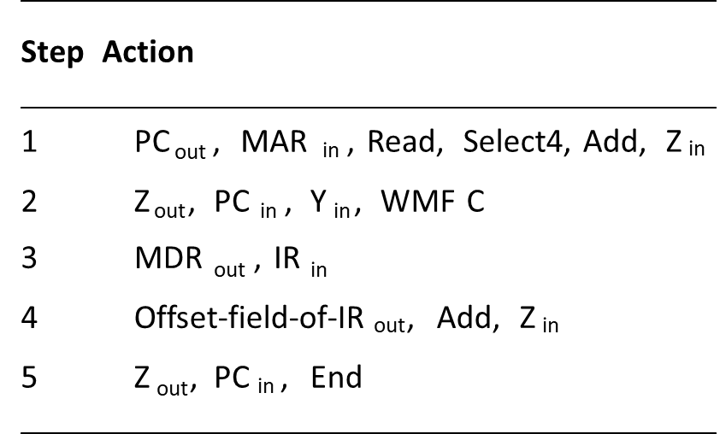
Execution of Branch Instruction
Figure. Control Sequence for Unconditional Branch Instructions

Slide 27
Simple single-bus structure
Has one common bus for data transfer.
Interconnected circuits/devices which has varying speed of execution like CPU and memory.
Results in long control sequences, because only one data item can be transferred over the bus in a clock cycle.
Multi-bus structure
Most commercial processors provide multiple internal paths to enable several transfers to take place in parallel.
Data transfer requires less control sequences.
Mutiple data transfer can be done in a single clock cycle

Slide 28
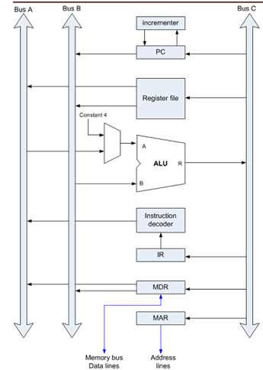
Multibus Architecture
Image from Computer Organization By Carl Hamacher

Slide 29
Multi-Bus Organization
Three-bus organization to connect the registers and the ALU of a processor.
All general-purpose registers are combined into a single block called register file.
Register file has three ports.
Two outputs ports connected to buses A and B, allowing the contents of two different registers to be accessed simultaneously, and placed on buses A and B.
Third input port allows the data on bus C to be loaded into a third register during the same clock cycle.
Inputs to the ALU and outputs from the ALU:
Buses A and B are used to transfer the source operands to the A and B inputs of the ALU.
Result is transferred to the destination over bus C.

Slide 30
ALU can also pass one of its two input operands unmodified if needed:
Control signals for such an operation are R=A or R=B.
Three bus arrangement obviates the need for Registers Y and Z in the single bus organization.
Incrementer unit: Used to increment the PC by 4.
Source for the constant 4 at the ALU multiplexer can be used to increment other addresses such as the memory addresses in multiple load/store instructions.

Slide 31
Input Output Specifications
Component | Input | Output
Program Counter | PC_{IN} | PC_{OUT}
Register File | R1_{IN} | R1_{OUT}
ALU | A ,B 4 | R=B for selecting B Select A for selecting A Select 4 – for fetching consecutive memory locations
Instruction Register | IR_{IN} | IR_{OUT}
Memory Data Register | MDR_{IN} | MDR_{OUTA/OUTB}
Memory Address Register | MAR_{IN} | MAR_{OUT}

Slide 32
Execution of the Statement “Add R4 R5 R6” in multibus environment
Step | Action | Remarks
1 | PC_{out} R=B MAR_{in} Read , IncPC | Pass the contents of the PC through ALU and load it into MAR. Increment PC.
2 | WMFC | Wait for Memory Function Complete.
3 | MDR_{outB} R=B IR_{in} | Load the data received into MDR and transfer to IR through ALU.
4 | R4_{outA} R5_{outB ,} SELECTA ADD R6_{IN} END | Output the Register R4 and R5 contents to Bus A and Bus B respectively. Add R4 and R5 and input the result from ALU in register R6

Slide 33
Control Unit Signals
To execute instructions the processor must generate the necessary control signals in proper sequence.
Hardwired control
Control signals are produced by appropriate circuitries.
Control unit is designed as a finite state machine.
Inflexible but fast.
Appropriate for simpler machines (e.g. RISC machines)
Microprogrammed control
Control signals are generated as a micro program consisting of 0s and 1s.
Control path is designed hierarchically using principles identical to the CPU design.
Flexible, but slow.
Appropriate for complex machines (e.g. CISC machines)

Slide 34
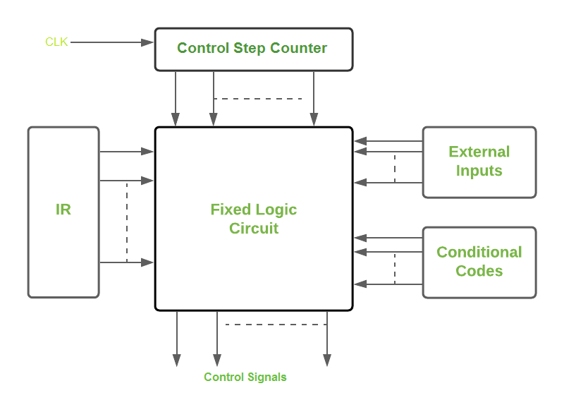
Hardwired Control
Required control signals are determined by the following information:
Contents of the control step counter- Determines which step in the sequence.
Contents of the instruction register - Determines the actual instruction.
Contents of the condition code flags - Used for example in a BRANCH instruction.
External input signals such as MFC.
The decoder/encoder block in the Figure is a combinational circuit that generates the required control outputs, depending on the state of all above inputs.

Slide 35
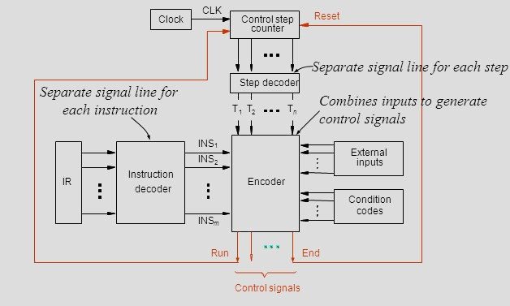
Hardwired Control

Slide 36
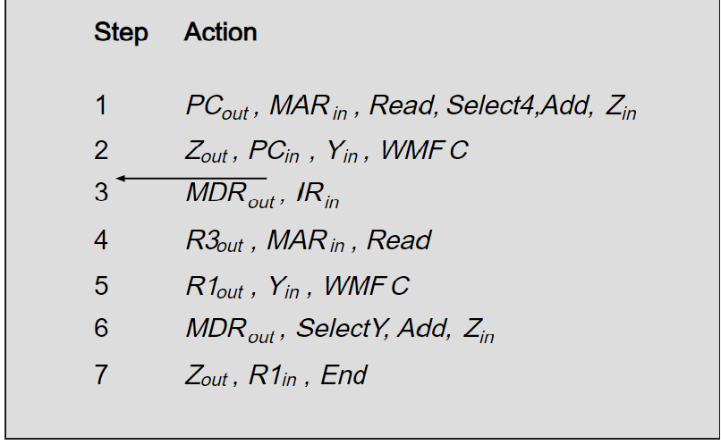
Each step in this sequence is completed in one clock cycle.
A counter is used to keep track of the control steps.
Each state or count, of this counter corresponds to one control step.

Slide 37
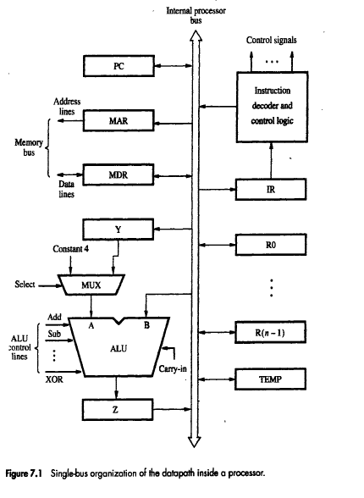
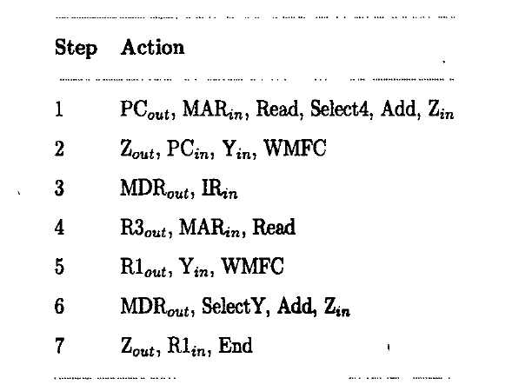
Control Sequences for “Add (R3), R1” in a single bus architecture

Slide 38
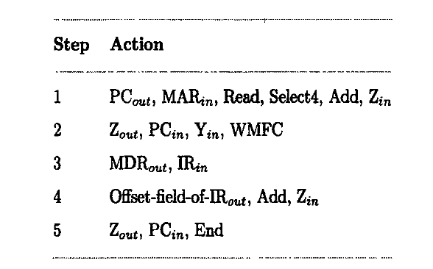
Control Sequences for Unconditional Branch in a single bus architecture

Slide 39
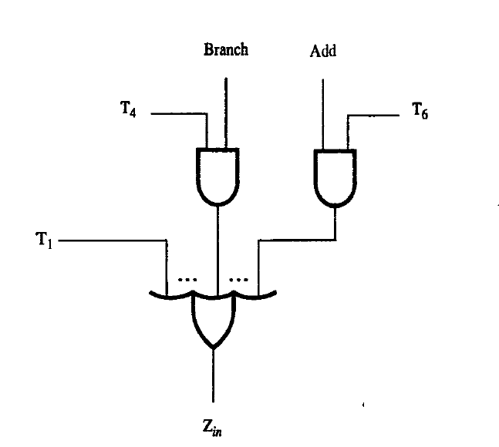
Logic Function for signal Z_{IN}
Z_{IN} = T1 + T6.ADD +T4.Br+…..
The above function is arrived by considering both ADD and BRANCH statements.
The equation can be extended if more instructions are there to be executed.
Here Z_{IN} occurs in the following steps.
first step of both the statements.
in step 6 along with add instruction.
In step 4 along with branching in the unconditional branching.

Slide 40
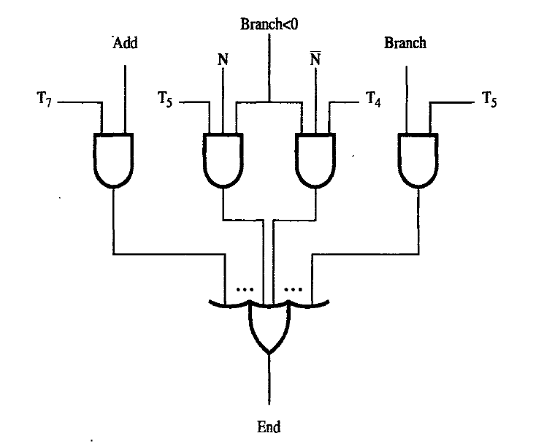
Logic Function for signal END
END = T7.ADD+T5.BR+(T5.N+T4Ň).BRN+…..
The above function is arrived by considering both ADD and BRANCH statements.
The equation can be extended if more instructions are there to be executed.
The end signal starts a new instruction fetch cycle by resetting the control step counter to its starting value.
Here END occurs in the following steps.
in step 7 along with add instruction.
In step 5 along with branching
Either in Step 4 or step 5 in the unconditional branching along with the conditional inputs.

Slide 41
END and RUN signals
The end signal starts a new instruction fetch cycle by resetting the control step counter to its starting value.
The run signal will make the step counter count up every time but when set to 0 this signal will make the counter to hold irrespective of the clock pulse. This is done WMFC signal is issued.

Slide 42
Microprogrammed Control
The Control signals are generated through a program similar to machine language programs.
Here we use a sequence of bits to notify, the signals that are to be set for a particular action.
For example if PC_{out} is used in a particular step then the bit allocated for PC_{out} will be set to 1.

Slide 43
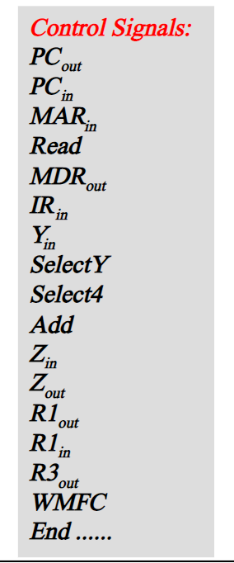
Control Word

Slide 44
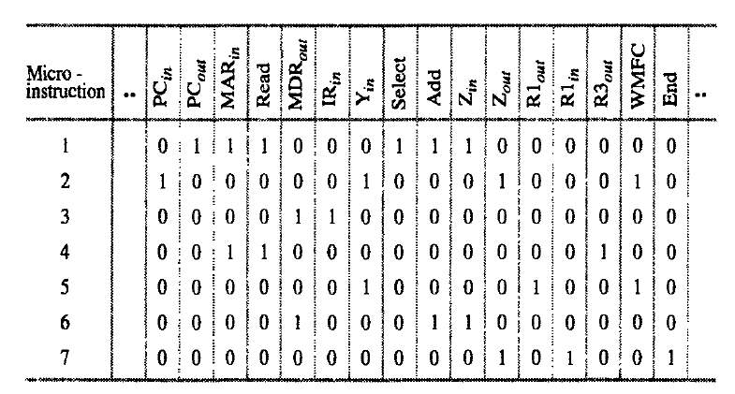
Sample micro instructions for the listing
At every step, a Control Word needs to be generated.
Every instruction will need a sequence of CWs for its execution.
Sequence of CWs for an instruction is the micro routine for the instruction.
Each CW in this microroutine is referred to as a microinstruction.

Slide 45
Control words/Microroutines/Control store
At every step, a Control Word needs to be generated.
Every instruction will need a sequence of CWs for its execution.
Sequence of CWs for an instruction is the micro routine for the instruction.
Each CW in this microroutine is referred to as a microinstruction
Every instruction will have its own microroutine which is made up of microinstructions.
Microroutines for all instructions in the instruction set of a computer are stored in a special memory called Control Store.
The Control Unit generates the control signals: by sequentially reading the CWs of the corresponding microroutine from the control store.

Slide 46
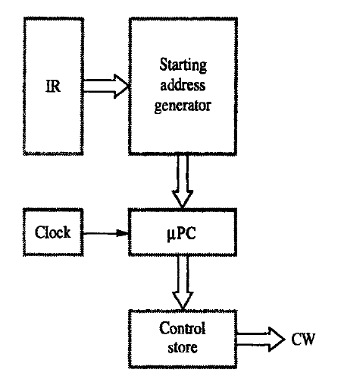
Basic organization of microprogrammed control unit
Microprogram counter (µPC) is used to read CWs from control store sequentially.
When a new instruction is loaded into IR, Starting address generator generates the starting address of the microroutine.
This address is loaded into the µPC.
µPC is automatically incremented by the clock, so successive microinstructions are read from the control store.

Slide 47
Status Code and External Inputs
Basic organization of the microprogrammed control unit cannot check the status of condition codes or external inputs to determine what should be the next microinstruction.
In the hardwired control, this was handled by an appropriate logic function.
In microprogrammed control this is handled as:
Use conditional branch microinstructions.
These microinstructions, in addition to the branch address also specify which of the external inputs, condition codes or possibly registers should be checked as a condition for branching.

Slide 48
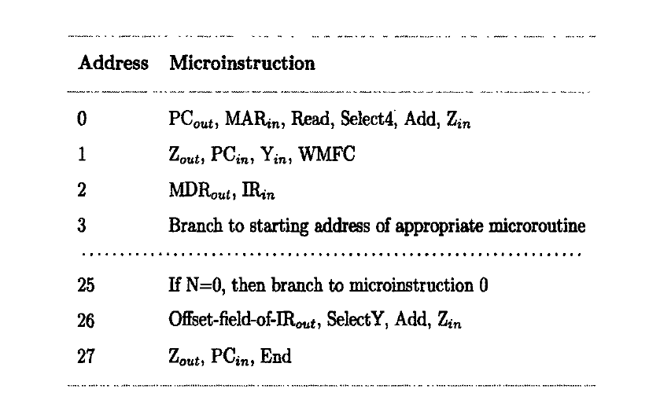
Branching in Microinstructions
The listing shows that a conditional jump is required to the location 25 from 3.
This target address should be generated from the starting address generator.
Some improvements will be done to the control units to accommodate external inputs and condition codes.

Slide 49
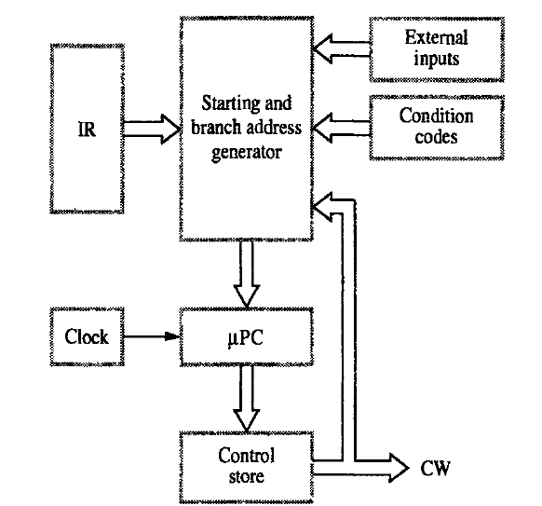
Changes in starting address generator

Slide 50
Micrprogammed Control Unit
Starting and branch address generator accepts as inputs
Contents of the Instruction Register IR (as before).
External inputs
Condition codes
Generates a new address and loads it into microprogram counter (µPC) when a microinstruction instructs it do so.
µPC is incremented every time a microinstruction is fetched except:
New instruction is loaded into IR, µPC is loaded with the starting address of the microroutine for that instruction.
Branch instruction is encountered and branch condition is satisfied, µPC is loaded with the branch address.
End instruction is encountered, µPC is loaded with the address of the first CW in the microroutine for the instruction fetch cycle.

Slide 51
Reducing the size of the microinstructions
Simple approach is to allocate one bit for each control signal- Results in long microinstructions, since the number of control signals is usually very large.
Few bits are set to 1 in any microinstruction, resulting in a poor use of bit space.
Reduce the length of the microinstruction by taking advantage of the fact that most signals are not needed simultaneously,
Many signals are mutually exclusive. For example:- Only one ALU function is active at a time.- Source for a data transfer must be unique.- Read and Write memory signals cannot be active simultaneously.
Group mutually exclusive signals in the same group. At most one microperation can be specified per group.
Use binary coding scheme to represent signals within a group.
Examples:
If ALU has 16 operations, then 4 bits can be sufficient.
Group register output signals into the same group, since only one of these signals will be active at any given time.
If the CPU has 4 general purpose registers, then PCout, MDRout, Zout,Offsetout, R0out, R1out, R2out, R3out and Tempout can be placed in a single group, and 4 bits will be needed to represent these.

Slide 52
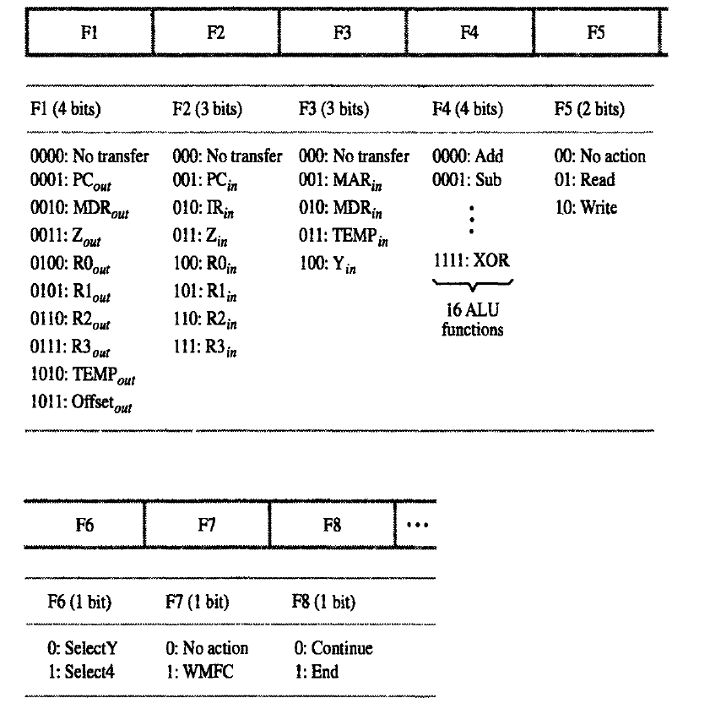
Inserts smallest number of bits that is large enough to fit.
Most fields include one inactive code specifying no action needed.

Slide 53
Basic Concepts of pipelining
How to improve the performance of the processor?
By introducing faster circuit technology
Arrange the hardware in such a way that, more than one operation can be performed at the same time.
What is Pipeining?
It is the process of arrangement of hardware elements in such way that, simultaneous execution of more than one instruction takes place in a pipelined processor so as to increase the overall performance.
What is Instruction Pipeining?
The number of instruction are pipelined and the execution of current instruction is overlapped by the execution of the subsequent instruction.
It is a instruction level parallelism where execution of current instruction does not wait until the previous instruction has executed completely.

Slide 54
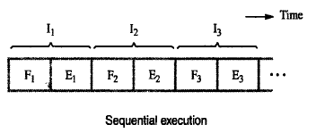
Basic idea of Instruction Pipelining
Sequential Execution of a program
The processor executes a program by fetching(Fi) and executing(Ei) instructions one by one.

Slide 55
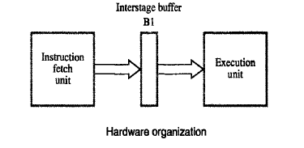
Consists of 2 hardware units one for fetching and another one for execution as follows.
Also has intermediate buffer to store the fetched instruction

Slide 56
2 stage pipeline
Execution of instruction in pipeline manner is controlled by a clock.
In the first clock cycle, fetch unit fetches the instruction I1 and store it in buffer B1.
In the second clock cycle, fetch unit fetches the instruction I2 , and execution unit executes the instruction I1 which is available in buffer B1.
By the end of the second clock cycle, execution of I1 gets completed and the instruction I2 is available in buffer B1.
In the third clock cycle, fetch unit fetches the instruction I3 , and execution unit executes the instruction I2 which is available in buffer B1.
In this way both fetch and execute units are kept busy always.

Slide 57
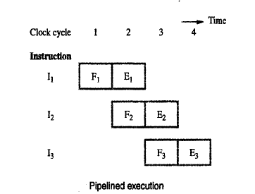
2 stage pipeline

Slide 58
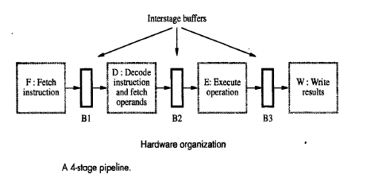
Hardware organization for 4 stage pipeline
Pipelined processor may process each instruction in 4 steps.
Fetch(F): Fetch the Instruction
Decode(D): Decode the Instruction
Execute (E) : Execute the Instruction
Write (W) : Write the result in the destination location
4 distinct hardware units are needed as shown below.

Slide 59
Execution of instruction in 4 stage pipeline
In the first clock cycle, fetch unit fetches the instruction I1 and store it in buffer B1.
In the second clock cycle, fetch unit fetches the instruction I2 , and decode unit decodes instruction I1 which is available in buffer B1.
In the third clock cycle fetch unit fetches the instruction I3 , and decode unit decodes instruction I2 which is available in buffer B1 and execution unit executes the instruction I1 which is available in buffer B2.
In the fourth clock cycle fetch unit fetches the instruction I4 , and decode unit decodes instruction I3 which is available in buffer B1, execution unit executes the instruction I2 which is available in buffer B2 and write unit write the result of I1.

Slide 60
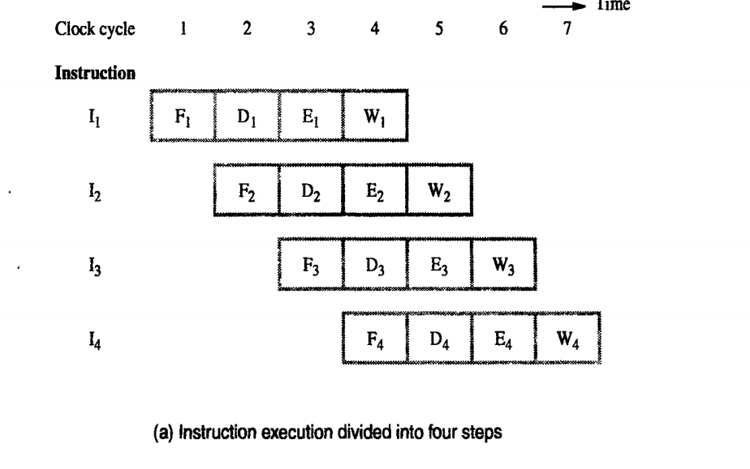
4- stage pipeline

Slide 61
Role of cache memory in Pipelining
Each stage of the pipeline is controlled by a clock cycle whose period is that the fetch, decode, execute and write steps of any instruction can each be completed in one clock cycle.
However the access time of the main memory may be much greater than the time required to perform basic pipeline stage operations inside the processor.
The use of cache memories solve this issue.
If cache is included on the same chip as the processor, access time to cache is equal to the time required to perform basic pipeline stage operations .

Slide 62
Pipeline Performance
Pipelining increases the CPU instruction throughput - the number of instructions completed per unit time.
The increase in instruction throughput means that a program runs faster and has lower total execution time.
Example in 4 stage pipeline, the rate of instruction processing is 4 times that of sequential processing.
Increase in performance is proportional to no. of stages used.
However, this increase in performance is achieved only if the pipelined operation is continued without any interruption.
But this is not the case always.

Slide 63
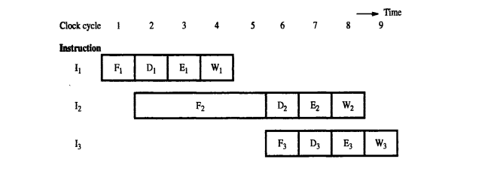
Instruction Execution steps in successive clock cycles

Slide 64
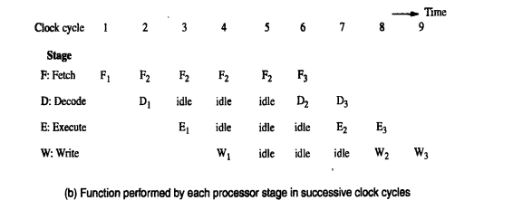
Pipeline stall caused by cache miss in F2

Slide 65
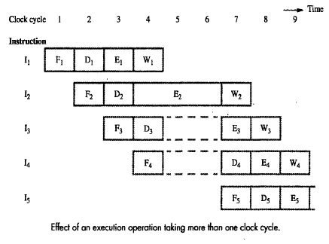
Consider the scenario, where one of the pipeline stage may require more clock cycle than the other.
For example, consider the following figure where instruction I2 takes 3 cycles to completes its execution(cycle 4,5,6)
In cycle 5,6 the write stage must be told to do nothing, because it has no data to work with.

Slide 66
The Major Hurdle of Pipelining—Pipeline Hazards
These situations are called hazards, that prevent the next instruction in the instruction stream from executing during its designated clock cycle.
Hazards reduce the performance from the ideal speedup gained by pipelining.
There are three classes of hazards:
1. Structural hazards
arise from resource conflicts when the hardware cannot support all possible combinations of instructions simultaneously in overlapped execution.
2. Data hazards
arise when an instruction depends on the results of a previous instruction
3.Control/Instruction hazards
The pipeline may be stalled due to unavailability of the instructions due to cache miss and instruction need to be fetched from main memory.
arise from the pipelining of branches and other instructions that change the PC.
Hazards in pipelines can make it necessary to stall the pipeline

Slide 67
Structural Hazards
If some combination of instructions cannot be accommodated because of resource conflicts, the processor is said to have a structural hazard.
When a sequence of instructions encounters this hazard, the pipeline will stall one of the instructions until the required unit is available. Such stalls will increase the CPI from its usual ideal value of 1.
Some pipelined processors have shared a single-memory pipeline for data and instructions. As a result, when an instruction contains a data memory reference, it will conflict with the instruction reference for a later instruction
To resolve this hazard, we stall the pipeline for 1 clock cycle when the data memory access occurs. A stall is commonly called a pipeline bubble or just bubble

Slide 68
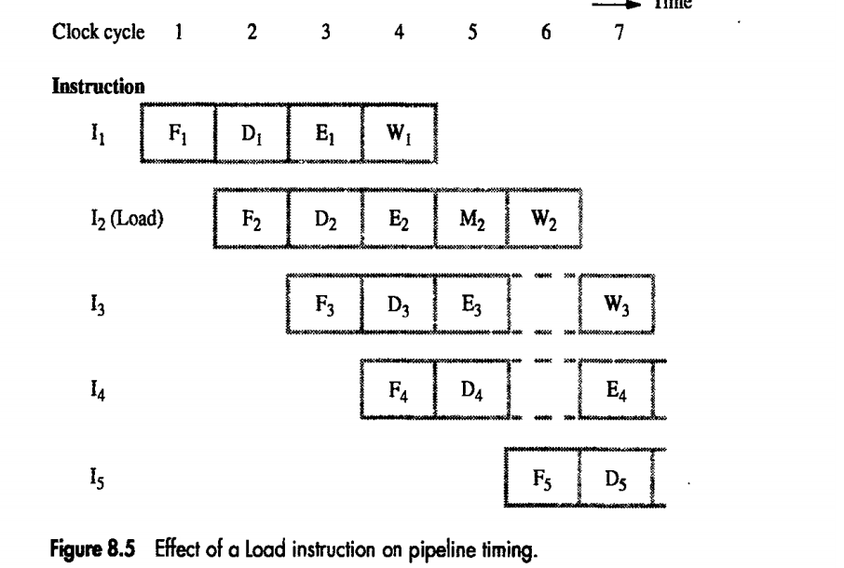

Slide 69
Load x(r1),r2

Slide 70
Data Hazards
Data hazards arise when an instruction depends on the results of a previous instruction in a way that is exposed by the overlapping of instructions in the pipeline.
Consider the pipelined execution of these instructions:
ADD R2,R3,R1
SUB R4,R1,R5

Slide 71
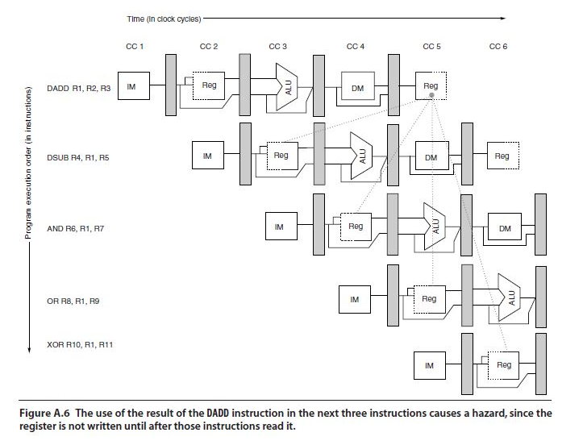
DADD instruction writes the value of R1 in the WB pipe stage, but the DSUB instruction reads the value during its ID stage. This problem is called a data hazard

Slide 72
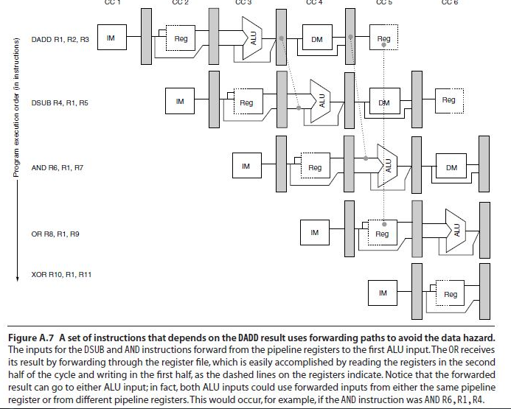
Minimizing Data Hazard Stalls by Forwarding
Forwarding (also called bypassing and sometimes short-circuiting

Slide 73
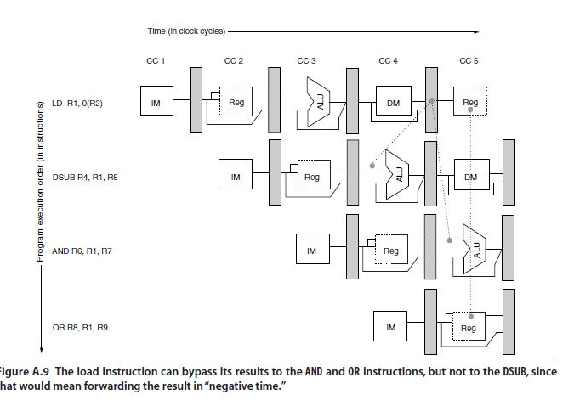
Data Hazards Requiring Stalls
Consider the following sequence of instructions:
LD 0(R2),R1
DSUB R4,R1,R5
AND R6,R1,R7
OR R8,R1,R9

Slide 74
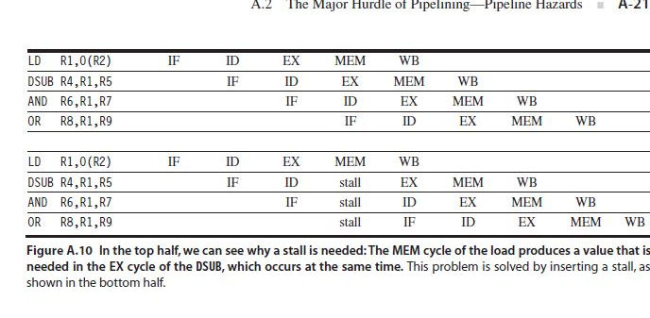

Slide 75
Instruction Hazards
Whenever the stream of instructions supplied by the instruction fetch unit is interrupted, the pipeline stalls.

Slide 76
Unconditional Branches
If Sequence of instruction being executed in two stages pipeline instruction I1 to I3 are stored at consecutive memory address and instruction I2 is a branch instruction.
If the branch is taken then the PC value is not known till the end of I2.
Next third instructions are fetched even though they are not required
Hence they have to be flushed after branch is taken and new set of instruction have to be fetched from the branch address

Slide 77
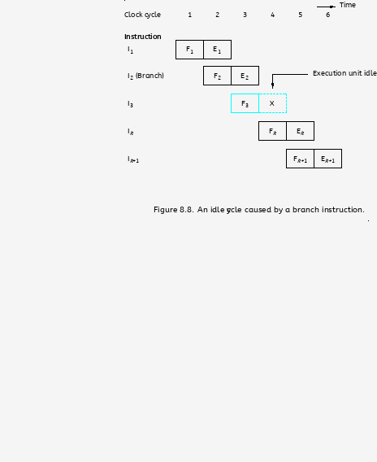
Unconditional Branches

Slide 78
Branch Timing
Branch penalty
The time lost as the result of branch instruction
Reducing the penalty
The branch penalties can be reduced by proper scheduling using compiler techniques.
For longer pipeline, the branch penalty may be much higher
Reducing the branch penalty requires branch target address to be computed earlier in the pipeline
Instruction fetch unit must have dedicated hardware to identify a branch instruction and compute branch target address as quickly as possible after an instruction is fetched

Slide 79
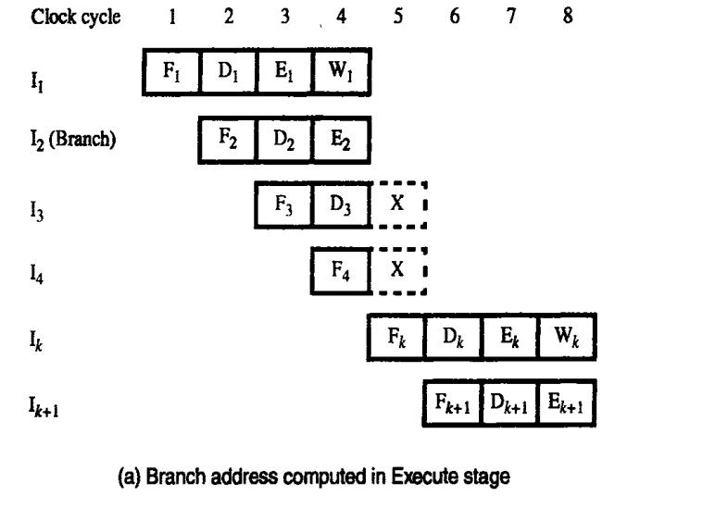

Slide 80
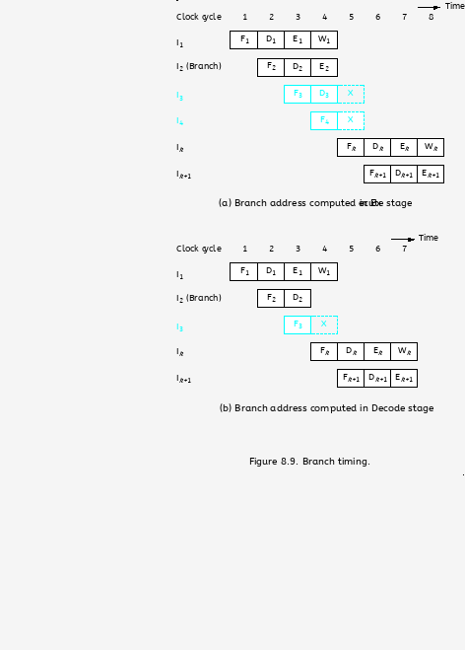

Slide 81
Instruction Queue and Prefetching
Either a cache miss or a branch instruction may stall the pipeline for one or more clock cycle.
To reduce the interruption many processor uses the instruction fetch unit which fetches instruction and put them in a queue before it is needed.
Dispatch unit-Takes instruction from the front of the queue and sends them to the execution unit, it also perform the decoding operation
Fetch unit keeps the instruction queue filled at all times.
If there is delay in fetching the instruction, the dispatch unit continues to issue the instruction from the instruction queue

Slide 82
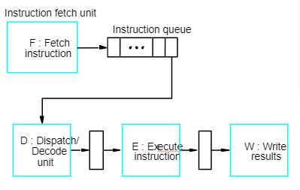
Instruction Queue and Prefetching

Slide 83
Conditional Branches
A conditional branch instruction introduces the added hazard caused by the dependency of the branch condition on the result of a preceding instruction.
The decision to branch cannot be made until the execution of that instruction has been completed.

Slide 84
Delayed Branch
The location following the branch instruction is branch delay slot.
The delayed branch technique can minimize the penalty arise due to conditional branch instruction
The instructions in the delay slots are always fetched. Therefore, we would like to arrange for them to be fully executed whether or not the branch is taken.
The objective is to place useful instructions in these slots.
The effectiveness of the delayed branch approach depends on how often it is possible to reorder instructions.

Slide 85
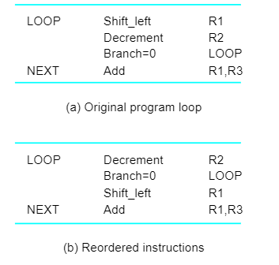
Delayed Branch

Slide 86
Branch Prediction
To predict whether or not a particular branch will be taken.
Simplest form: assume branch will not take place and continue to fetch instructions in sequential address order.
Until the branch is evaluated, instruction execution along the predicted path must be done on a speculative basis.
Speculative execution: instructions are executed before the processor is certain that they are in the correct execution sequence.
Need to be careful so that no processor registers or memory locations are updated until it is confirmed that these instructions should indeed be executed.

Slide 87
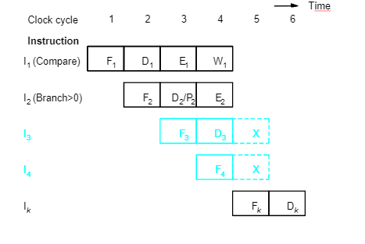
Incorrect Predicted Branch

Slide 88
Types of branch prediction
Static Prediction
Dynamic branch Prediction
Prediction is carried out by compiler and it is static because the prediction is already known before the program is executed.
Dynamic prediction in which the prediction decision may change depending on the execution history.

Slide 89
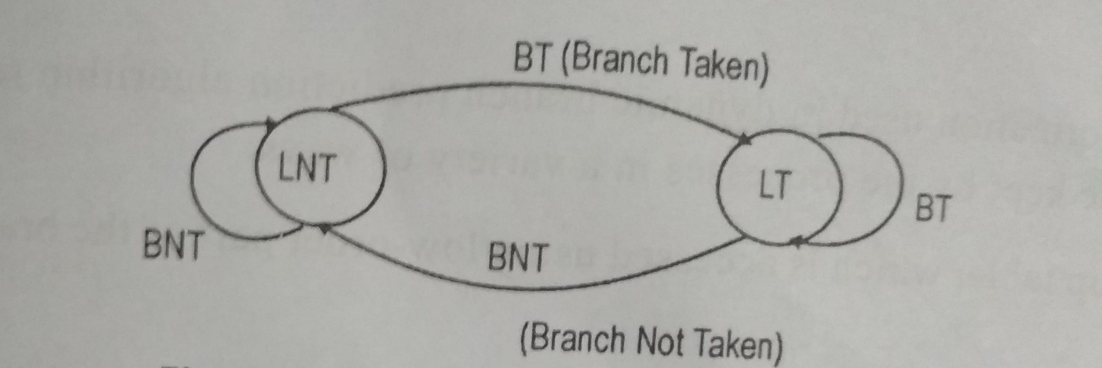
Branch Prediction Algorithm
If the branch taken recently,the next time if the same branch is executed,it is likely that the branch is taken
State 1: LT : Branch is likely to be taken
State 2: LNT : Branch is likely not to be taken
1.If the branch is taken,the machine moves to LT. otherwise it remains in state LNT.
2.The branch is predicted as taken if the corresponding state machine is in state LT, otherwise it is predicted as not taken

Slide 90
4 State Algorithm
ST-Strongly likely to be taken
LT-Likely to be taken
LNT-Likely not to be taken
SNT-Strongly not to be taken
Step 1: Assume that the algorithm is initially set to LNT
Step 2: If the branch is actually taken changes to ST, otherwise it is changed to SNT.
Step 3: when the branch instruction is encountered, the branch will taken if the state is either LT or ST and begins to fetch instruction at branch target address, otherwise it continues to fetch the instruction in sequential manner

Slide 91
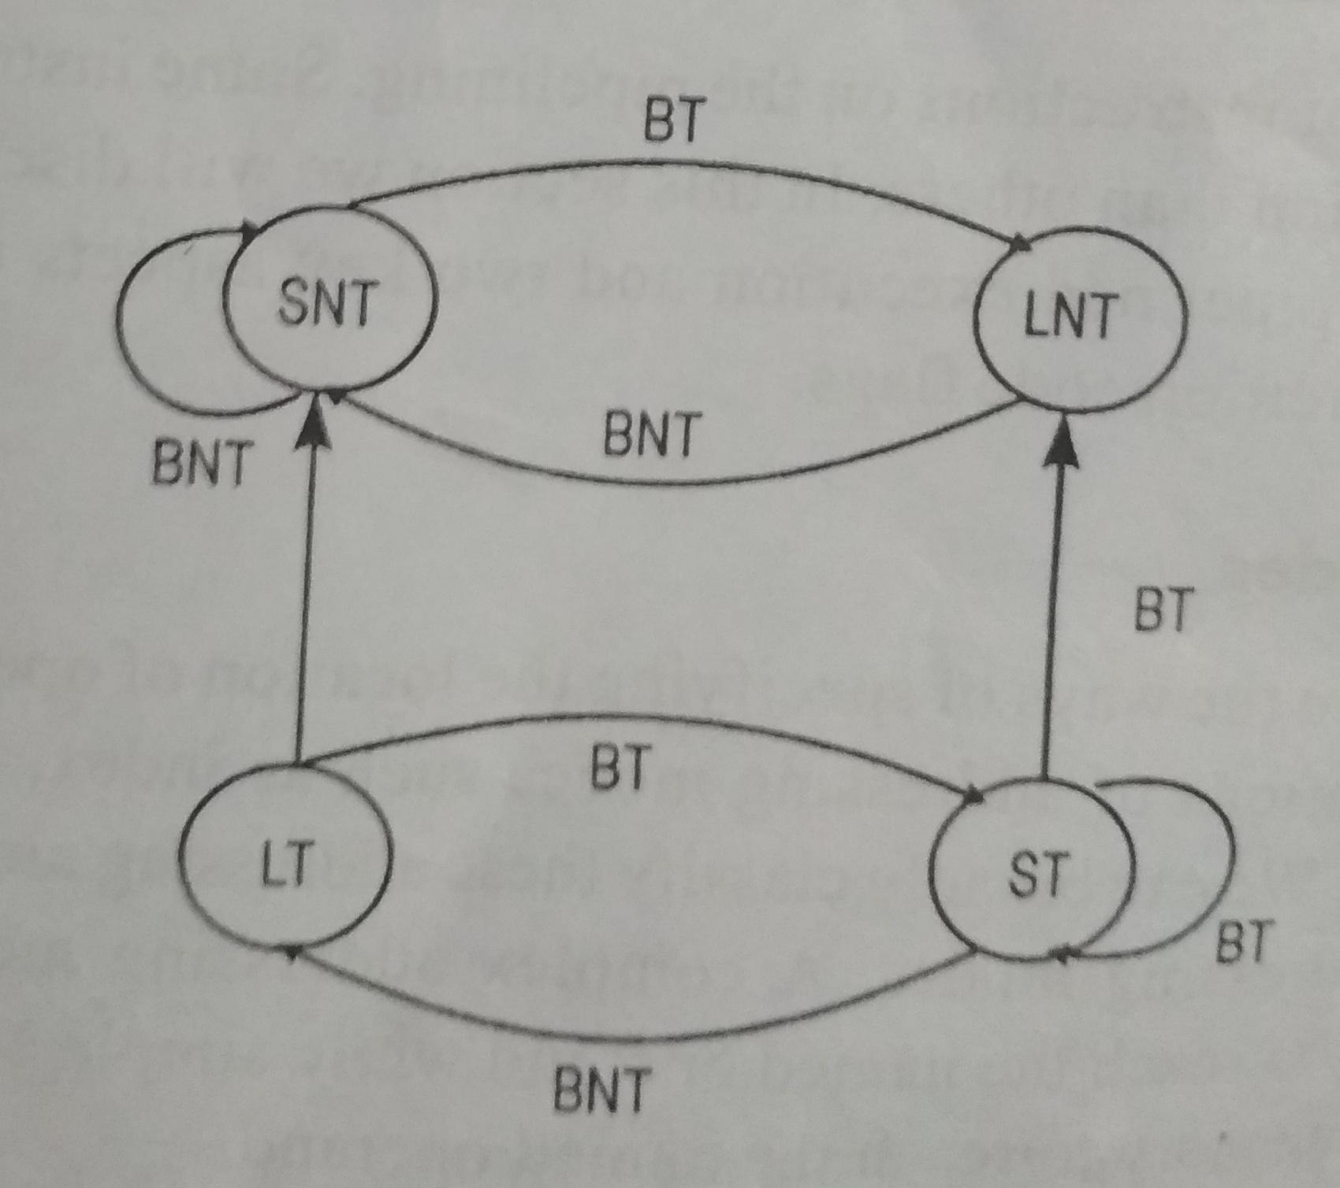
4 State Algorithm
When in state SNT, the instruction fetch unit predicts that the branch will not be taken
If the branch is actually taken, that is if the prediction is incorrect, the state changes to LNT

Slide 92
Influence on Instruction Sets
Some instructions are much better suited to pipeline
execution than others.
Addressing modes
Conditional code flags

Slide 93
Addressing Modes
Addressing modes include simple ones and complex
ones.
In choosing the addressing modes to be implemented in
a pipelined processor, we must consider the effect of
each addressing mode on instruction flow in the
pipeline:
- Side effects
- The extent to which complex addressing modes cause the pipeline to stall
- Whether a given mode is likely to be used by compilers

Slide 94
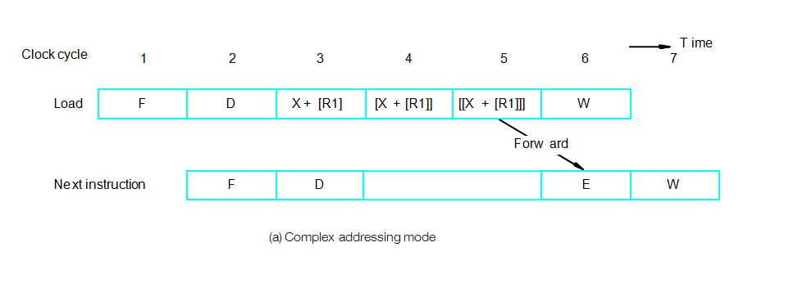
Complex Addressing Mode
Load (X(R1)), R2

Slide 95
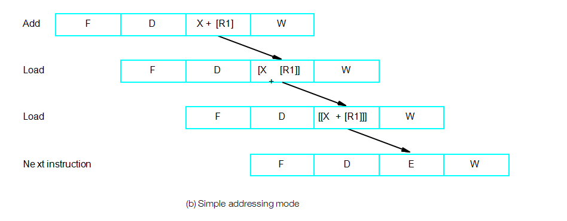
Simple Addressing Mode
Add #X, R1, R2
Load (R2), R2
Load (R2), R2

Slide 96
In a pipelined processor, complex addressing modes do
not necessarily lead to faster execution.
Advantage: reducing the number of instructions /
program space
Disadvantage: cause pipeline to stall / more hardware
to decode / not convenient for compiler to work with
Conclusion: complex addressing modes are not suitable
for pipelined execution.
Good addressing modes should have:
- Access to an operand does not require more than one access to the memory
- Only load and store instruction access memory operands
- The addressing modes used do not have side effects
Register, register indirect, index

Slide 97
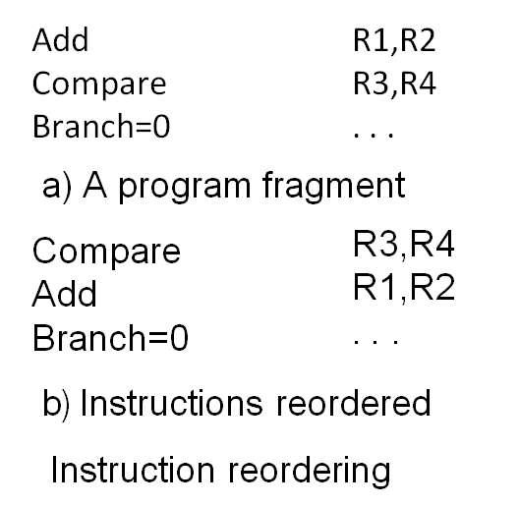
Conditional Codes
If an optimizing compiler attempts to reorder instruction to avoid stalling the pipeline when branches or data dependencies between successive instructions occur, it must ensure that reordering does not cause a change in the outcome of a computation.
The dependency introduced by the condition-code flags reduces the flexibility available for the compiler to reorder instructions.

Slide 98
Conditional Codes
Two conclusion:
To provide flexibility in reordering instructions, the condition-code flags should be affected by as few instruction as possible.
The compiler should be able to specify in which instructions of a program the condition codes are affected and in which they are not.

Slide 99
Thank You

