Slide 1

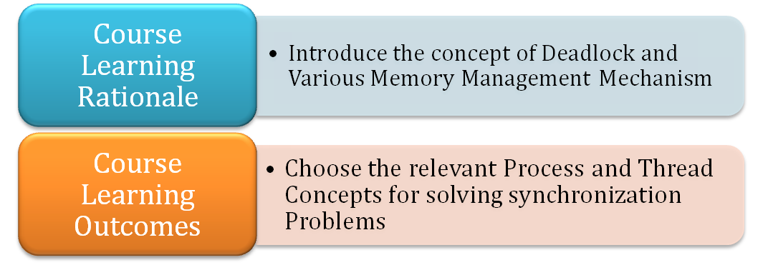
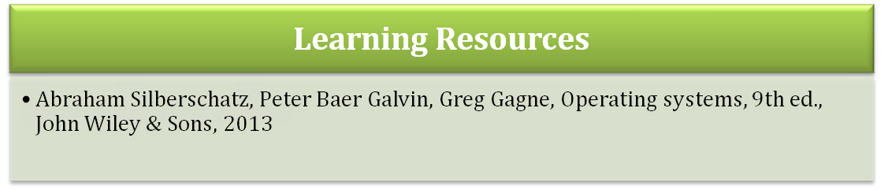
21CSC202J Operating Systems
UNIT 2 – Process Management
Notes:
‹#›

Slide 2
Processes
Process Concept
Process Scheduling
Operations on Processes
Interprocess Communication
Examples of IPC Systems
Communication in Client-Server Systems
*
21CSC202J Operating Systems UNIT 2
‹#›

Slide 3
Objectives
To introduce the notion of a process -- a program in execution, which forms the basis of all computation
To describe the various features of processes, including scheduling, creation and termination, and communication
To explore interprocess communication using shared memory and message passing
To describe communication in client-server systems
*
21CSC202J Operating Systems UNIT 2
‹#›

Slide 4
Process Concept
An operating system executes a variety of programs:
Batch system – jobs
Time-shared systems – user programs or tasks
Textbook uses the terms job and process almost interchangeably
Process – a program in execution; process execution must progress in sequential fashion
Multiple parts
The program code, also called text section
Current activity including program counter, processor registers
Stack containing temporary data
Function parameters, return addresses, local variables
Data section containing global variables
Heap containing memory dynamically allocated during run time
*
21CSC202J Operating Systems UNIT 2
‹#›

Slide 5
Process Concept (Cont.)
Program is passive entity stored on disk (executable file), process is active
Program becomes process when executable file loaded into memory
Execution of program started via GUI mouse clicks, command line entry of its name, etc
One program can be several processes
Consider multiple users executing the same program
*
21CSC202J Operating Systems UNIT 2
‹#›

Slide 6
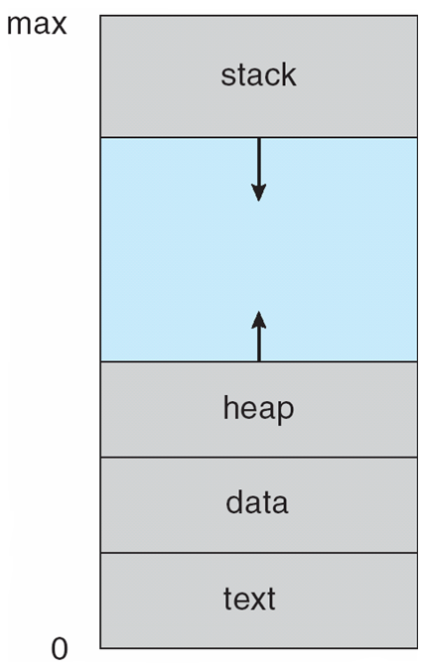
Process in Memory
*
21CSC202J Operating Systems UNIT 2
‹#›

Slide 7
Process State
As a process executes, it changes state
new: The process is being created
running: Instructions are being executed
waiting: The process is waiting for some event to occur
ready: The process is waiting to be assigned to a processor
terminated: The process has finished execution
*
21CSC202J Operating Systems UNIT 2
‹#›

Slide 8
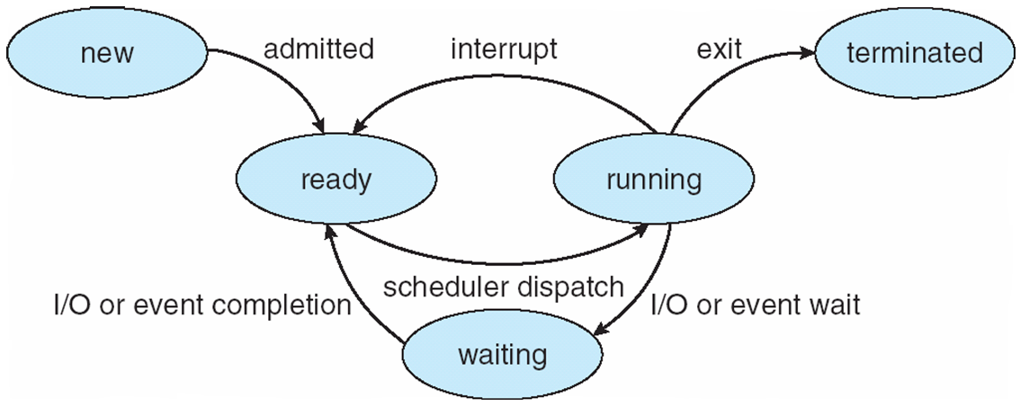
Diagram of Process State
*
21CSC202J Operating Systems UNIT 2
‹#›

Slide 9
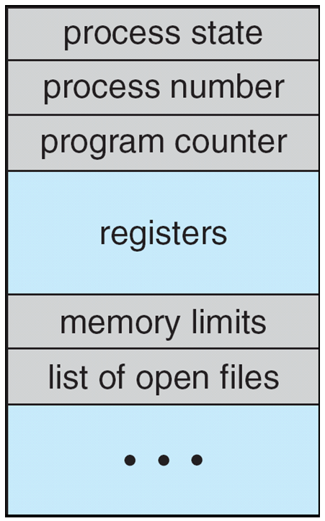
Process Control Block (PCB)
Information associated with each process
(also called task control block)
Process state – running, waiting, etc
Program counter – location of instruction to next execute
CPU registers – contents of all process-centric registers
CPU scheduling information- priorities, scheduling queue pointers
Memory-management information – memory allocated to the process
Accounting information – CPU used, clock time elapsed since start, time limits
I/O status information – I/O devices allocated to process, list of open files
*
21CSC202J Operating Systems UNIT 2
‹#›

Slide 10
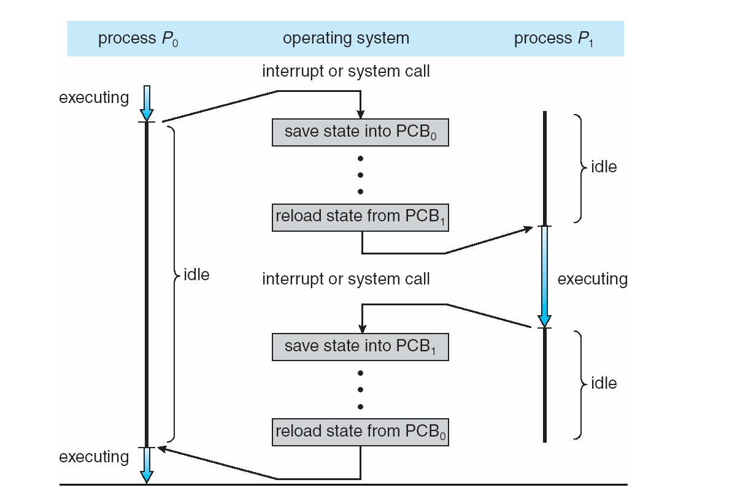
CPU Switch From Process to Process
*
21CSC202J Operating Systems UNIT 2
‹#›

Slide 11
Threads
So far, process has a single thread of execution
Consider having multiple program counters per process
Multiple locations can execute at once
Multiple threads of control -> threads
Must then have storage for thread details, multiple program counters in PCB
See next chapter
*
21CSC202J Operating Systems UNIT 2
‹#›

Slide 12
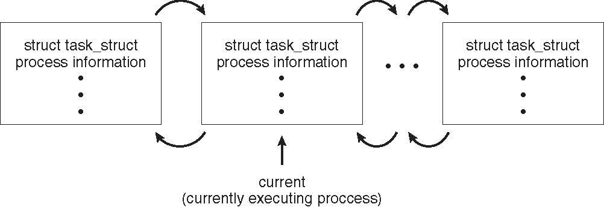
Process Representation in Linux
Represented by the C structure task_struct
pid t_pid; /* process identifier */ long state; /* state of the process */ unsigned int time_slice /* scheduling information */ struct task_struct *parent; /* this process’s parent */ struct list_head children; /* this process’s children */ struct files_struct *files; /* list of open files */ struct mm_struct *mm; /* address space of this process */
*
21CSC202J Operating Systems UNIT 2
‹#›

Slide 13
Process Scheduling
Maximize CPU use, quickly switch processes onto CPU for time sharing
Process scheduler selects among available processes for next execution on CPU
Maintains scheduling queues of processes
Job queue – set of all processes in the system
Ready queue – set of all processes residing in main memory, ready and waiting to execute
Device queues – set of processes waiting for an I/O device
Processes migrate among the various queues
*
21CSC202J Operating Systems UNIT 2
‹#›

Slide 14
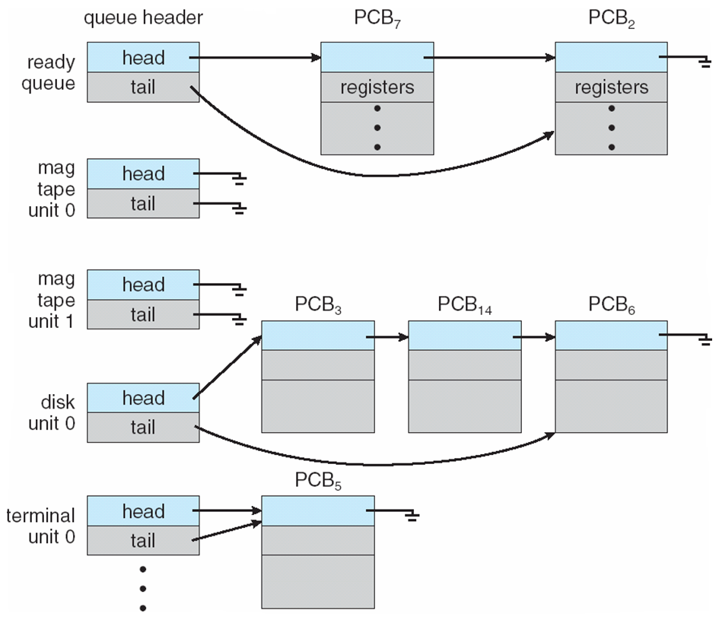
Ready Queue And Various I/O Device Queues
*
21CSC202J Operating Systems UNIT 2
‹#›

Slide 15
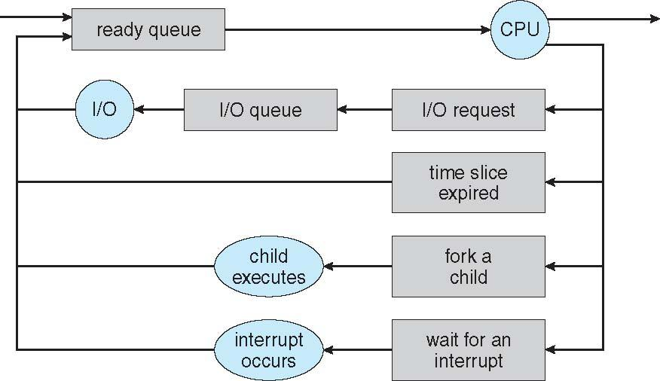
Representation of Process Scheduling
Queueing diagram represents queues, resources, flows
*
21CSC202J Operating Systems UNIT 2
‹#›

Slide 16
Schedulers
Short-term scheduler (or CPU scheduler) – selects which process should be executed next and allocates CPU
Sometimes the only scheduler in a system
Short-term scheduler is invoked frequently (milliseconds) ⇒ (must be fast)
Long-term scheduler (or job scheduler) – selects which processes should be brought into the ready queue
Long-term scheduler is invoked infrequently (seconds, minutes) ⇒ (may be slow)
The long-term scheduler controls the degree of multiprogramming
Processes can be described as either:
I/O-bound process – spends more time doing I/O than computations, many short CPU bursts
CPU-bound process – spends more time doing computations; few very long CPU bursts
Long-term scheduler strives for good process mix
*
21CSC202J Operating Systems UNIT 2
‹#›

Slide 17
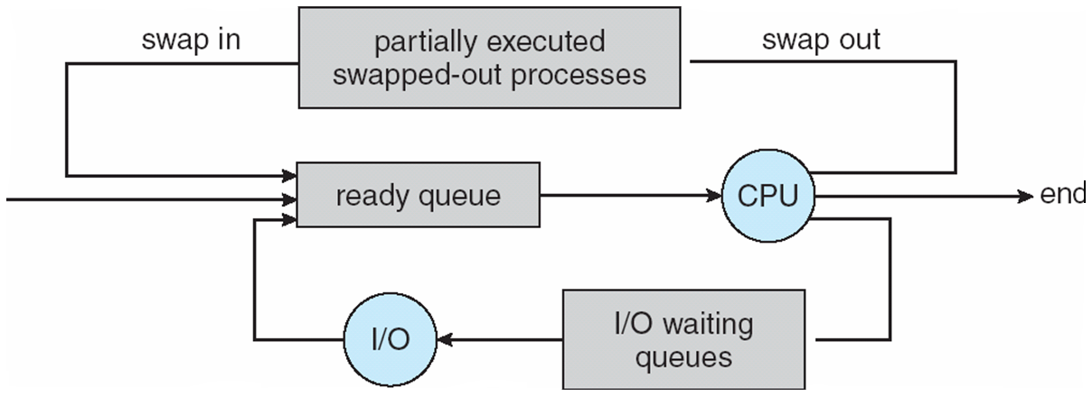
Addition of Medium Term Scheduling
Medium-term scheduler can be added if degree of multiple programming needs to decrease
Remove process from memory, store on disk, bring back in from disk to continue execution: swapping
*
21CSC202J Operating Systems UNIT 2
‹#›

Slide 18
Multitasking in Mobile Systems
Some mobile systems (e.g., early version of iOS) allow only one process to run, others suspended
Due to screen real estate, user interface limits iOS provides for a
Single foreground process- controlled via user interface
Multiple background processes– in memory, running, but not on the display, and with limits
Limits include single, short task, receiving notification of events, specific long-running tasks like audio playback
Android runs foreground and background, with fewer limits
Background process uses a service to perform tasks
Service can keep running even if background process is suspended
Service has no user interface, small memory use
*
21CSC202J Operating Systems UNIT 2
‹#›

Slide 19
Context Switch
When CPU switches to another process, the system must save the state of the old process and load the saved state for the new process via a context switch
Context of a process represented in the PCB
Context-switch time is overhead; the system does no useful work while switching
The more complex the OS and the PCB 🡺 the longer the context switch
Time dependent on hardware support
Some hardware provides multiple sets of registers per CPU 🡺 multiple contexts loaded at once
*
21CSC202J Operating Systems UNIT 2
‹#›

Slide 20
Operations on Processes
System must provide mechanisms for:
process creation,
process termination,
and so on as detailed next
*
21CSC202J Operating Systems UNIT 2
‹#›

Slide 21
Process Creation
Parent process create children processes, which, in turn create other processes, forming a tree of processes
Generally, process identified and managed via a process identifier (pid)
Resource sharing options
Parent and children share all resources
Children share subset of parent’s resources
Parent and child share no resources
Execution options
Parent and children execute concurrently
Parent waits until children terminate
*
21CSC202J Operating Systems UNIT 2
‹#›

Slide 22
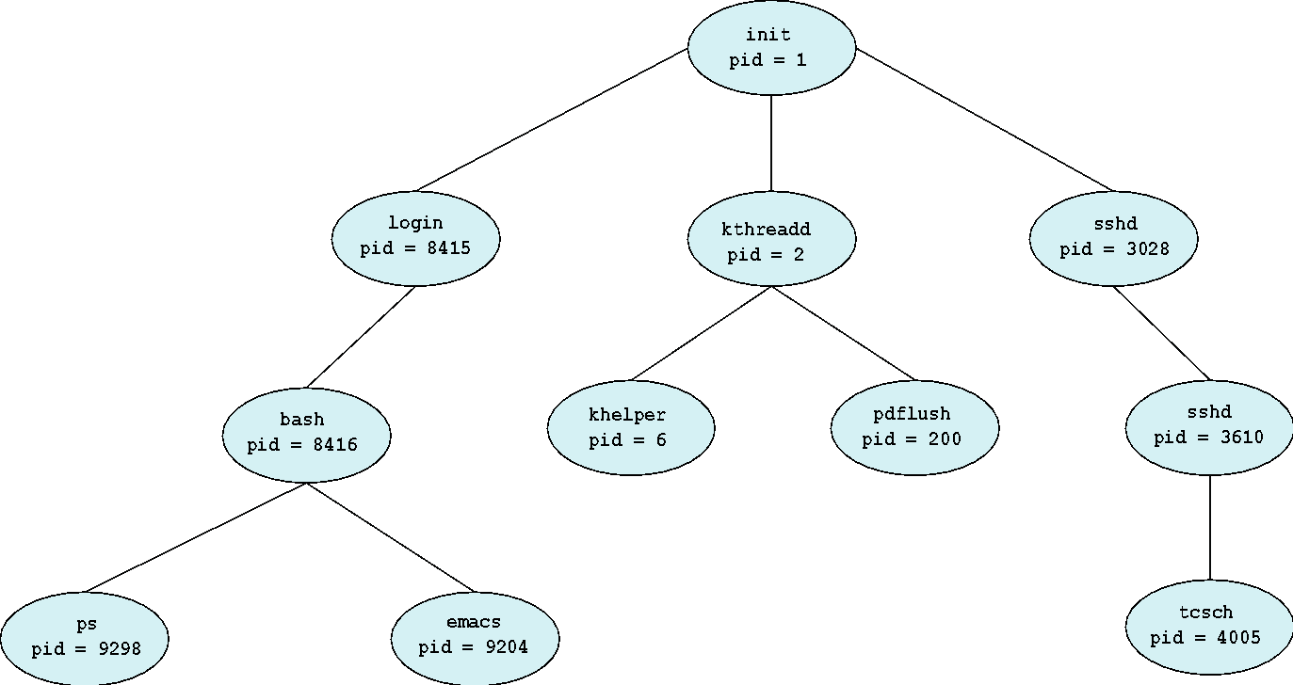
A Tree of Processes in Linux
*
21CSC202J Operating Systems UNIT 2
‹#›

Slide 23
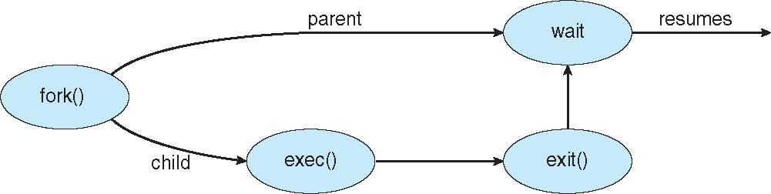
Process Creation (Cont.)
Address space
Child duplicate of parent
Child has a program loaded into it
UNIX examples
fork() system call creates new process
exec() system call used after a fork() to replace the process’ memory space with a new program
*
21CSC202J Operating Systems UNIT 2
‹#›

Slide 24
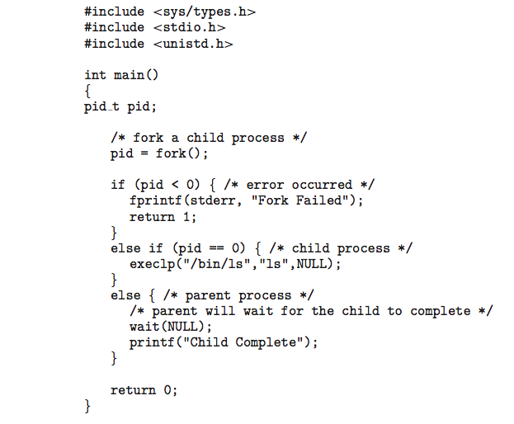
C Program Forking Separate Process
*
21CSC202J Operating Systems UNIT 2
‹#›

Slide 25
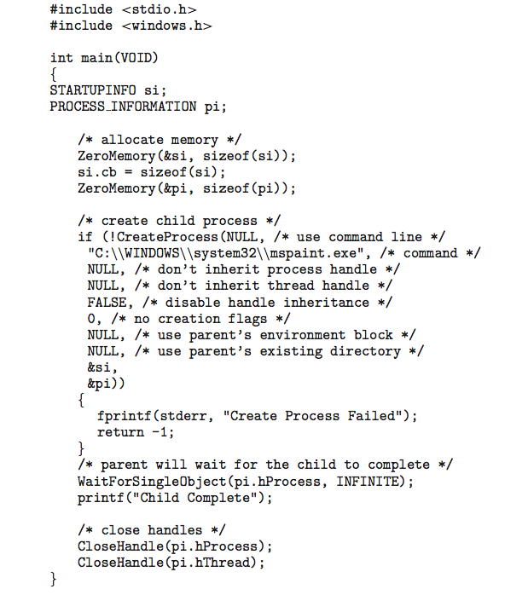
Creating a Separate Process via Windows API
*
21CSC202J Operating Systems UNIT 2
‹#›

Slide 26
Process Termination
Process executes last statement and then asks the operating system to delete it using the exit() system call.
Returns status data from child to parent (via wait())
Process’ resources are deallocated by operating system
Parent may terminate the execution of children processes using the abort() system call. Some reasons for doing so:
Child has exceeded allocated resources
Task assigned to child is no longer required
The parent is exiting and the operating systems does not allow a child to continue if its parent terminates
*
21CSC202J Operating Systems UNIT 2
‹#›

Slide 27
Process Termination
Some operating systems do not allow child to exists if its parent has terminated. If a process terminates, then all its children must also be terminated.
cascading termination. All children, grandchildren, etc. are terminated.
The termination is initiated by the operating system.
The parent process may wait for termination of a child process by using the wait()system call. The call returns status information and the pid of the terminated process
pid = wait(&status);
If no parent waiting (did not invoke wait()) process is a zombie
If parent terminated without invoking wait , process is an orphan
*
21CSC202J Operating Systems UNIT 2
‹#›

Slide 28

Multiprocess Architecture – Chrome Browser
Many web browsers ran as single process (some still do)
If one web site causes trouble, entire browser can hang or crash
Google Chrome Browser is multiprocess with 3 different types of processes:
Browser process manages user interface, disk and network I/O
Renderer process renders web pages, deals with HTML, Javascript. A new renderer created for each website opened
Runs in sandbox restricting disk and network I/O, minimizing effect of security exploits
Plug-in process for each type of plug-in
*
21CSC202J Operating Systems UNIT 2
‹#›

Slide 29
Interprocess Communication
Processes within a system may be independent or cooperating
Cooperating process can affect or be affected by other processes, including sharing data
Reasons for cooperating processes:
Information sharing
Computation speedup
Modularity
Convenience
Cooperating processes need interprocess communication (IPC)
Two models of IPC
Shared memory
Message passing
*
21CSC202J Operating Systems UNIT 2
‹#›

Slide 30
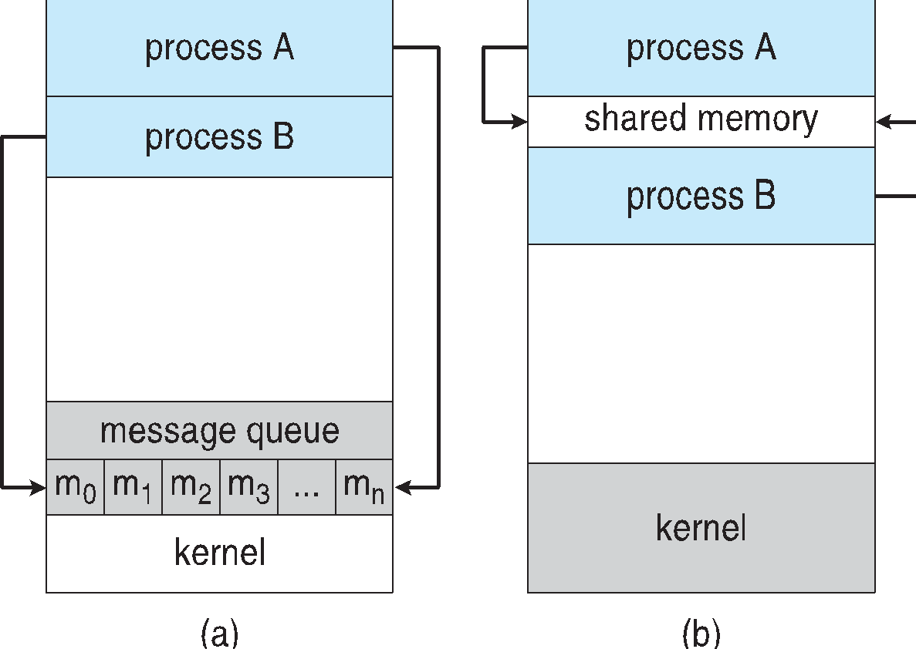
Communications Models
(a) Message passing. (b) shared memory.
*
21CSC202J Operating Systems UNIT 2
‹#›

Slide 31
Cooperating Processes
Independent process cannot affect or be affected by the execution of another process
Cooperating process can affect or be affected by the execution of another process
Advantages of process cooperation
Information sharing
Computation speed-up
Modularity
Convenience
*
21CSC202J Operating Systems UNIT 2
‹#›

Slide 32
Producer-Consumer Problem
Paradigm for cooperating processes, producer process produces information that is consumed by a consumer process
unbounded-buffer places no practical limit on the size of the buffer
bounded-buffer assumes that there is a fixed buffer size
*
21CSC202J Operating Systems UNIT 2
‹#›

Slide 33
Bounded-Buffer – Shared-Memory Solution
Shared data
#define BUFFER_SIZE 10
typedef struct {
. . .
} item;
item buffer[BUFFER_SIZE];
int in = 0;
int out = 0;
Solution is correct, but can only use BUFFER_SIZE-1 elements
*
21CSC202J Operating Systems UNIT 2
‹#›

Slide 34
Bounded-Buffer – Producer
item next_produced;
while (true) {
/* produce an item in next produced */
while (((in + 1) % BUFFER_SIZE) == out)
; /* do nothing */
buffer[in] = next_produced;
in = (in + 1) % BUFFER_SIZE;
}
*
21CSC202J Operating Systems UNIT 2
‹#›

Slide 35
Bounded Buffer – Consumer
item next_consumed;
while (true) { while (in == out)
; /* do nothing */ next_consumed = buffer[out];
out = (out + 1) % BUFFER_SIZE;
/* consume the item in next consumed */
}
*
21CSC202J Operating Systems UNIT 2
‹#›

Slide 36
Interprocess Communication – Shared Memory
An area of memory shared among the processes that wish to communicate
The communication is under the control of the users processes not the operating system.
Major issues is to provide mechanism that will allow the user processes to synchronize their actions when they access shared memory.
*
21CSC202J Operating Systems UNIT 2
‹#›

Slide 37
Interprocess Communication – Message Passing
Mechanism for processes to communicate and to synchronize their actions
Message system – processes communicate with each other without resorting to shared variables
IPC facility provides two operations:
send(message)
receive(message)
The message size is either fixed or variable
*
21CSC202J Operating Systems UNIT 2
‹#›

Slide 38
Message Passing (Cont.)
If processes P and Q wish to communicate, they need to:
Establish a communication link between them
Exchange messages via send/receive
Implementation issues:
How are links established?
Can a link be associated with more than two processes?
How many links can there be between every pair of communicating processes?
What is the capacity of a link?
Is the size of a message that the link can accommodate fixed or variable?
Is a link unidirectional or bi-directional?
*
21CSC202J Operating Systems UNIT 2
‹#›

Slide 39
Message Passing (Cont.)
Implementation of communication link
Physical:
Shared memory
Hardware bus
Network
Logical:
Direct or indirect
Synchronous or asynchronous
Automatic or explicit buffering
*
21CSC202J Operating Systems UNIT 2
‹#›

Slide 40
Direct Communication
Processes must name each other explicitly:
send (P, message) – send a message to process P
receive(Q, message) – receive a message from process Q
Properties of communication link
Links are established automatically
A link is associated with exactly one pair of communicating processes
Between each pair there exists exactly one link
The link may be unidirectional, but is usually bi-directional
*
21CSC202J Operating Systems UNIT 2
‹#›

Slide 41
Indirect Communication
Messages are directed and received from mailboxes (also referred to as ports)
Each mailbox has a unique id
Processes can communicate only if they share a mailbox
Properties of communication link
Link established only if processes share a common mailbox
A link may be associated with many processes
Each pair of processes may share several communication links
Link may be unidirectional or bi-directional
*
21CSC202J Operating Systems UNIT 2
‹#›

Slide 42
Indirect Communication
Operations
create a new mailbox (port)
send and receive messages through mailbox
destroy a mailbox
Primitives are defined as:
send(A, message) – send a message to mailbox A
receive(A, message) – receive a message from mailbox A
*
21CSC202J Operating Systems UNIT 2
‹#›

Slide 43
Indirect Communication
Mailbox sharing
P₁, P₂, and P₃ share mailbox A
P₁, sends; P₂ and P₃ receive
Who gets the message?
Solutions
Allow a link to be associated with at most two processes
Allow only one process at a time to execute a receive operation
Allow the system to select arbitrarily the receiver. Sender is notified who the receiver was.
*
21CSC202J Operating Systems UNIT 2
‹#›

Slide 44
Synchronization
Message passing may be either blocking or non-blocking
Blocking is considered synchronous
Blocking send -- the sender is blocked until the message is received
Blocking receive -- the receiver is blocked until a message is available
Non-blocking is considered asynchronous
Non-blocking send -- the sender sends the message and continue
Non-blocking receive -- the receiver receives:
A valid message, or
Null message
Different combinations possible
If both send and receive are blocking, we have a rendezvous
*
21CSC202J Operating Systems UNIT 2
‹#›

Slide 45
Synchronization (Cont.)
Producer-consumer becomes trivial
message next_produced;
while (true) { /* produce an item in next produced */
send(next_produced);
}
message next_consumed;
while (true) {
receive(next_consumed);
/* consume the item in next consumed */
}
*
21CSC202J Operating Systems UNIT 2
‹#›

Slide 46
Buffering
Queue of messages attached to the link.
implemented in one of three ways
1. Zero capacity – no messages are queued on a link. Sender must wait for receiver (rendezvous)
2. Bounded capacity – finite length of n messages Sender must wait if link full
3. Unbounded capacity – infinite length Sender never waits
*
21CSC202J Operating Systems UNIT 2
‹#›

Slide 47
Examples of IPC Systems - POSIX
POSIX Shared Memory
Process first creates shared memory segment shm_fd = shm_open(name, O CREAT | O RDWR, 0666);
Also used to open an existing segment to share it
Set the size of the object
ftruncate(shm fd, 4096);
Now the process could write to the shared memory
sprintf(shared memory, "Writing to shared memory");
*
21CSC202J Operating Systems UNIT 2
‹#›

Slide 48
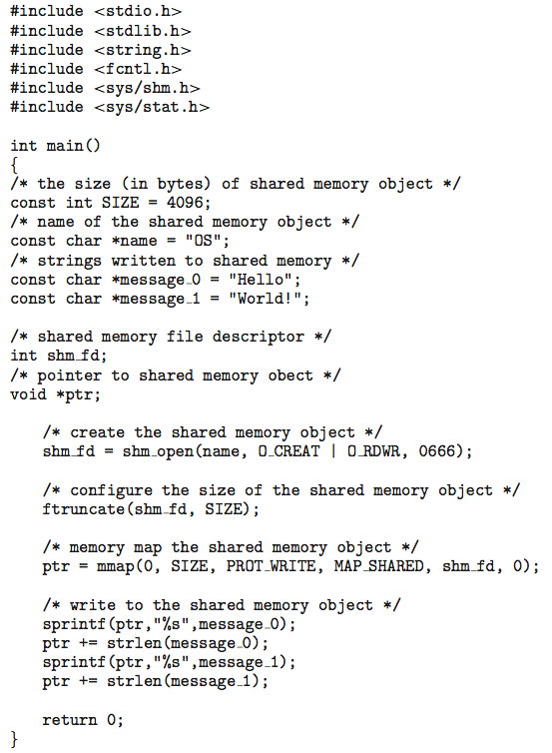
IPC POSIX Producer
*
21CSC202J Operating Systems UNIT 2
‹#›

Slide 49
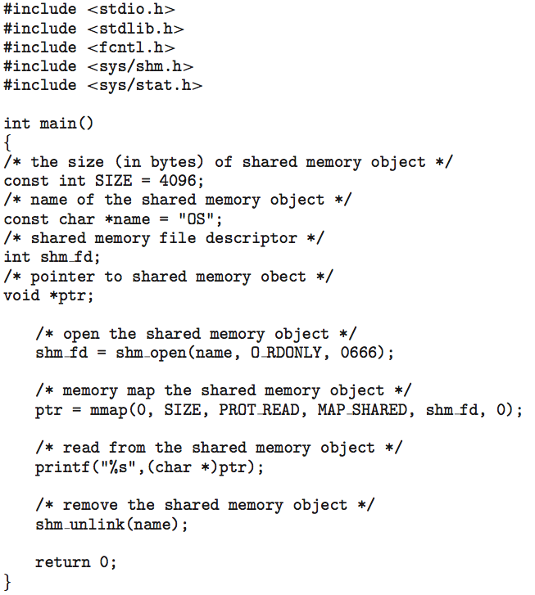
IPC POSIX Consumer
*
21CSC202J Operating Systems UNIT 2
‹#›

Slide 50
Examples of IPC Systems - Mach
Mach communication is message based
Even system calls are messages
Each task gets two mailboxes at creation- Kernel and Notify
Only three system calls needed for message transfer
msg_send(), msg_receive(), msg_rpc()
Mailboxes needed for commuication, created via
port_allocate()
Send and receive are flexible, for example four options if mailbox full:
Wait indefinitely
Wait at most n milliseconds
Return immediately
Temporarily cache a message
*
21CSC202J Operating Systems UNIT 2
‹#›

Slide 51
Examples of IPC Systems – Windows
Message-passing centric via advanced local procedure call (LPC) facility
Only works between processes on the same system
Uses ports (like mailboxes) to establish and maintain communication channels
Communication works as follows:
The client opens a handle to the subsystem’s connection port object.
The client sends a connection request.
The server creates two private communication ports and returns the handle to one of them to the client.
The client and server use the corresponding port handle to send messages or callbacks and to listen for replies.
*
21CSC202J Operating Systems UNIT 2
‹#›

Slide 52
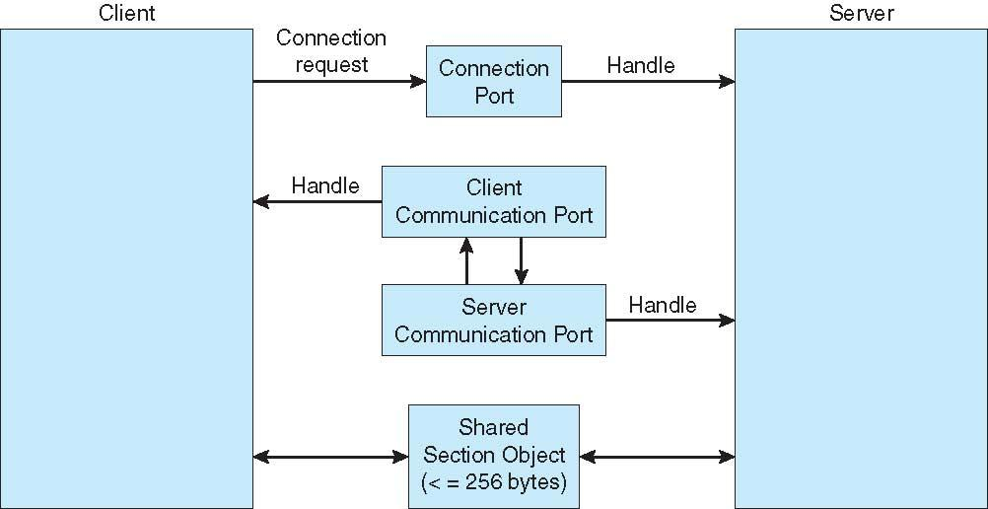
Local Procedure Calls in Windows
*
21CSC202J Operating Systems UNIT 2
‹#›

Slide 53
Communications in Client-Server Systems
Sockets
Remote Procedure Calls
Pipes
Remote Method Invocation (Java)
*
21CSC202J Operating Systems UNIT 2
‹#›

Slide 54
Sockets
A socket is defined as an endpoint for communication
Concatenation of IP address and port – a number included at start of message packet to differentiate network services on a host
The socket 161.25.19.8:1625 refers to port 1625 on host 161.25.19.8
Communication consists between a pair of sockets
All ports below 1024 are well known, used for standard services
Special IP address 127.0.0.1 (loopback) to refer to system on which process is running
*
21CSC202J Operating Systems UNIT 2
‹#›

Slide 55
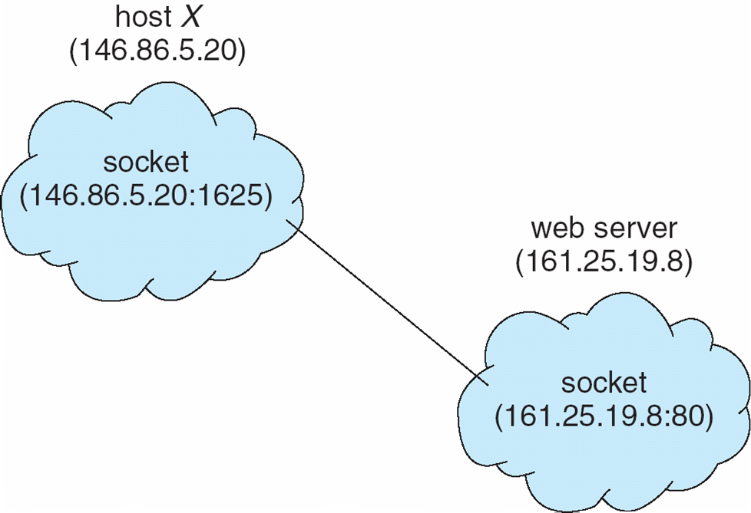
Socket Communication
*
21CSC202J Operating Systems UNIT 2
‹#›

Slide 56
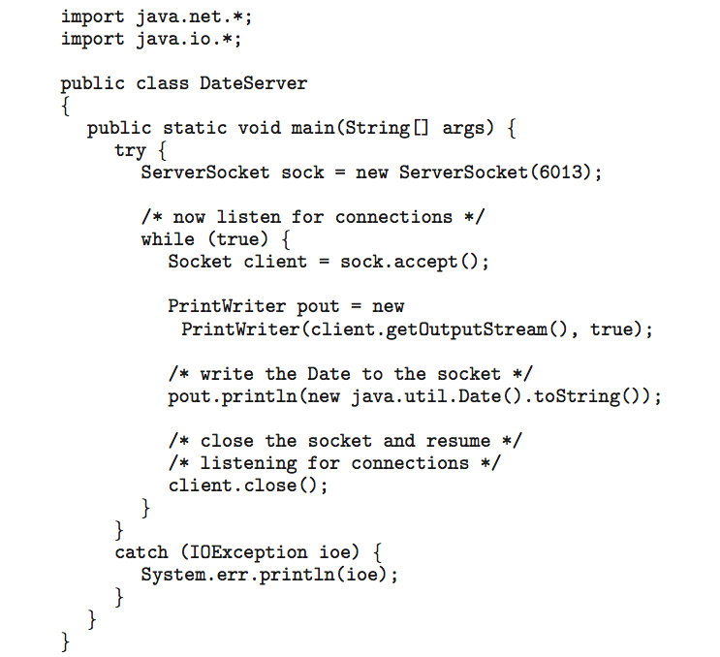
Sockets in Java
Three types of sockets
Connection-oriented (TCP)
Connectionless (UDP)
MulticastSocket class– data can be sent to multiple recipients
Consider this “Date” server:
*
21CSC202J Operating Systems UNIT 2
‹#›

Slide 57
Remote Procedure Calls
Remote procedure call (RPC) abstracts procedure calls between processes on networked systems
Again uses ports for service differentiation
Stubs – client-side proxy for the actual procedure on the server
The client-side stub locates the server and marshalls the parameters
The server-side stub receives this message, unpacks the marshalled parameters, and performs the procedure on the server
On Windows, stub code compile from specification written in Microsoft Interface Definition Language (MIDL)
*
21CSC202J Operating Systems UNIT 2
‹#›

Slide 58
Remote Procedure Calls (Cont.)
Data representation handled via External Data Representation (XDL) format to account for different architectures
Big-endian and little-endian
Remote communication has more failure scenarios than local
Messages can be delivered exactly once rather than at most once
OS typically provides a rendezvous (or matchmaker) service to connect client and server
*
21CSC202J Operating Systems UNIT 2
‹#›

Slide 59
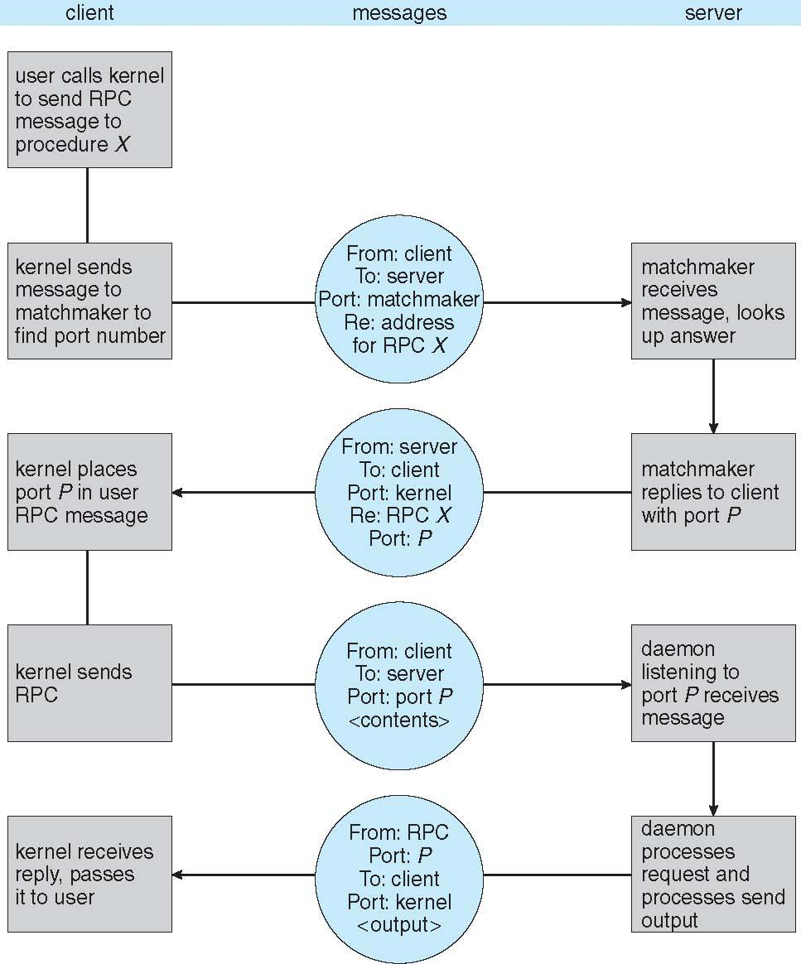
Execution of RPC
*
21CSC202J Operating Systems UNIT 2
‹#›

Slide 60
Pipes
Acts as a conduit allowing two processes to communicate
Issues:
Is communication unidirectional or bidirectional?
In the case of two-way communication, is it half or full-duplex?
Must there exist a relationship (i.e., parent-child) between the communicating processes?
Can the pipes be used over a network?
Ordinary pipes – cannot be accessed from outside the process that created it. Typically, a parent process creates a pipe and uses it to communicate with a child process that it created.
Named pipes – can be accessed without a parent-child relationship.
*
21CSC202J Operating Systems UNIT 2
‹#›

Slide 61
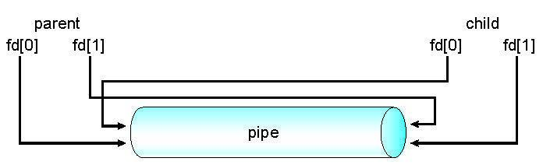
Ordinary Pipes
Ordinary Pipes allow communication in standard producer-consumer style
Producer writes to one end (the write-end of the pipe)
Consumer reads from the other end (the read-end of the pipe)
Ordinary pipes are therefore unidirectional
Require parent-child relationship between communicating processes
Windows calls these anonymous pipes
*
21CSC202J Operating Systems UNIT 2
‹#›

Slide 62
Named Pipes
Named Pipes are more powerful than ordinary pipes
Communication is bidirectional
No parent-child relationship is necessary between the communicating processes
Several processes can use the named pipe for communication
Provided on both UNIX and Windows systems
*
21CSC202J Operating Systems UNIT 2
‹#›

Slide 63
Threads

Slide 64
Threads
Overview
Multicore Programming
Multithreading Models
Thread Libraries
Implicit Threading
Threading Issues
Operating System Examples
*
21CSC202J Operating Systems UNIT 2
‹#›
Notes:
‹#›

Slide 65
Objectives
To introduce the notion of a thread—a fundamental unit of CPU utilization that forms the basis of multithreaded computer systems
To discuss the APIs for the Pthreads, Windows, and Java thread libraries
To explore several strategies that provide implicit threading
To examine issues related to multithreaded programming
To cover operating system support for threads in Windows and Linux
*
21CSC202J Operating Systems UNIT 2
‹#›

Slide 66
Motivation
Most modern applications are multithreaded
Threads run within application
Multiple tasks with the application can be implemented by separate threads
Update display
Fetch data
Spell checking
Answer a network request
Process creation is heavy-weight while thread creation is light-weight
Can simplify code, increase efficiency
Kernels are generally multithreaded
*
21CSC202J Operating Systems UNIT 2
‹#›

Slide 67
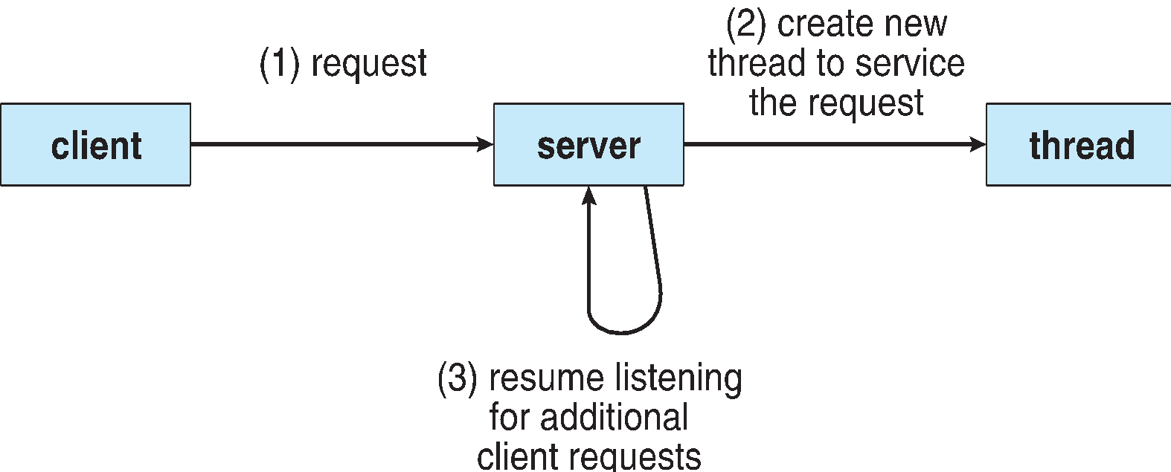
Multithreaded Server Architecture
*
21CSC202J Operating Systems UNIT 2
‹#›

Slide 68
Benefits
Responsiveness – may allow continued execution if part of process is blocked, especially important for user interfaces
Resource Sharing – threads share resources of process, easier than shared memory or message passing
Economy – cheaper than process creation, thread switching lower overhead than context switching
Scalability – process can take advantage of multiprocessor architectures
*
21CSC202J Operating Systems UNIT 2
‹#›
Notes:
‹#›

Slide 69
Multicore Programming
Multicore or multiprocessor systems putting pressure on programmers, challenges include:
Dividing activities
Balance
Data splitting
Data dependency
Testing and debugging
Parallelism implies a system can perform more than one task simultaneously
Concurrency supports more than one task making progress
Single processor / core, scheduler providing concurrency
*
21CSC202J Operating Systems UNIT 2
‹#›

Slide 70
Multicore Programming (Cont.)
Types of parallelism
Data parallelism – distributes subsets of the same data across multiple cores, same operation on each
Task parallelism – distributing threads across cores, each thread performing unique operation
As # of threads grows, so does architectural support for threading
CPUs have cores as well as hardware threads
Consider Oracle SPARC T4 with 8 cores, and 8 hardware threads per core
*
21CSC202J Operating Systems UNIT 2
‹#›

Slide 71
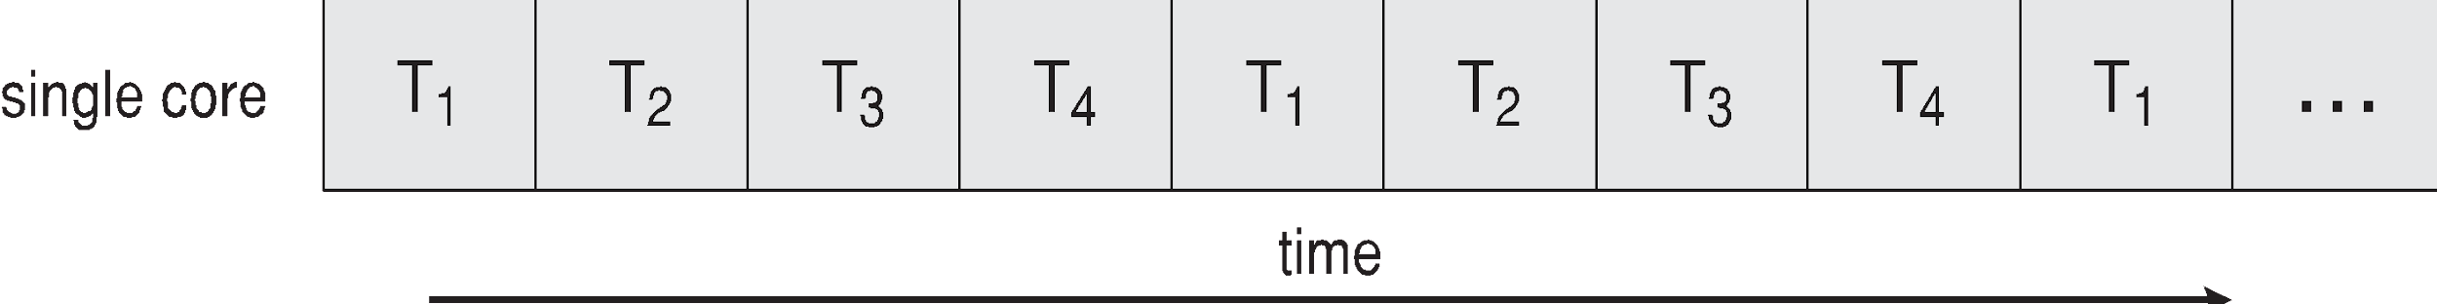
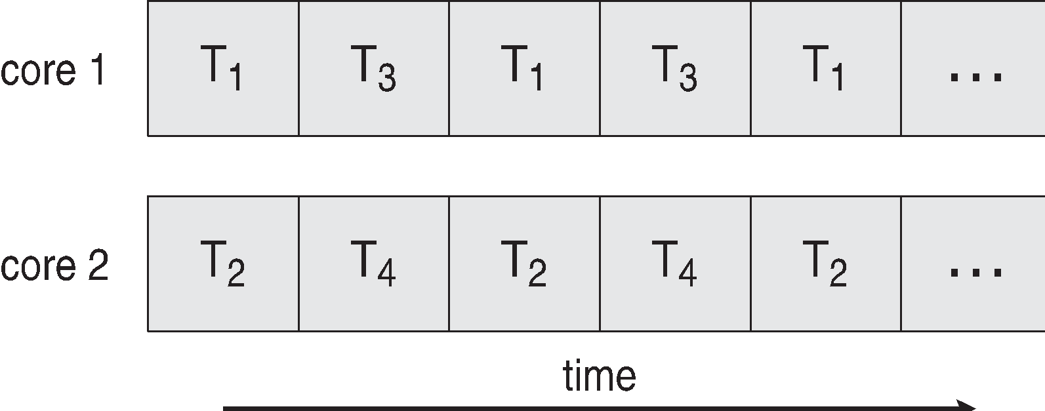
Concurrency vs. Parallelism
Concurrent execution on single-core system:
Parallelism on a multi-core system:
*
21CSC202J Operating Systems UNIT 2
‹#›

Slide 72
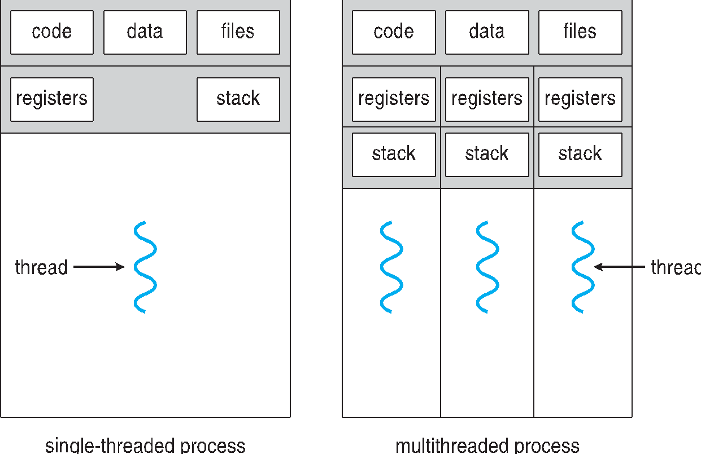
Single and Multithreaded Processes
*
21CSC202J Operating Systems UNIT 2
‹#›
Notes:
‹#›

Slide 73
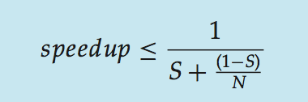
Amdahl’s Law
Identifies performance gains from adding additional cores to an application that has both serial and parallel components
S is serial portion
N processing cores
That is, if application is 75% parallel / 25% serial, moving from 1 to 2 cores results in speedup of 1.6 times
As N approaches infinity, speedup approaches 1 / S
Serial portion of an application has disproportionate effect on performance gained by adding additional cores
But does the law take into account contemporary multicore systems?
*
21CSC202J Operating Systems UNIT 2
‹#›
Notes:
‹#›

Slide 74
User Threads and Kernel Threads
User threads - management done by user-level threads library
Three primary thread libraries:
POSIX Pthreads
Windows threads
Java threads
Kernel threads - Supported by the Kernel
Examples – virtually all general purpose operating systems, including:
Windows
Solaris
Linux
Tru64 UNIX
Mac OS X
*
21CSC202J Operating Systems UNIT 2
‹#›
Notes:
‹#›

Slide 75
Multithreading Models
Many-to-One
One-to-One
Many-to-Many
*
21CSC202J Operating Systems UNIT 2
‹#›
Notes:
‹#›

Slide 76
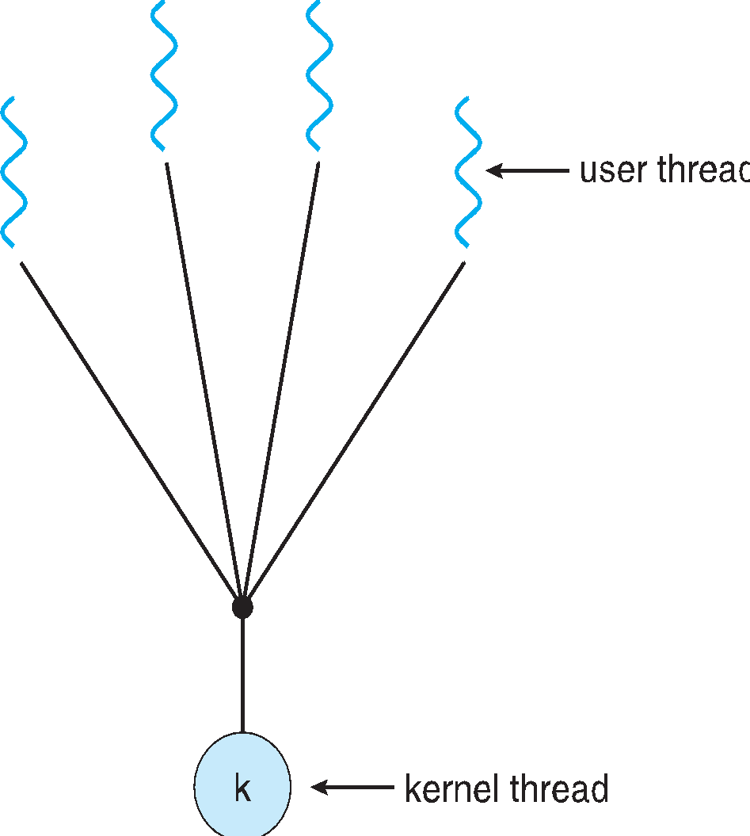
Many-to-One
Many user-level threads mapped to single kernel thread
One thread blocking causes all to block
Multiple threads may not run in parallel on muticore system because only one may be in kernel at a time
Few systems currently use this model
Examples:
Solaris Green Threads
GNU Portable Threads
*
21CSC202J Operating Systems UNIT 2
‹#›
Notes:
‹#›

Slide 77
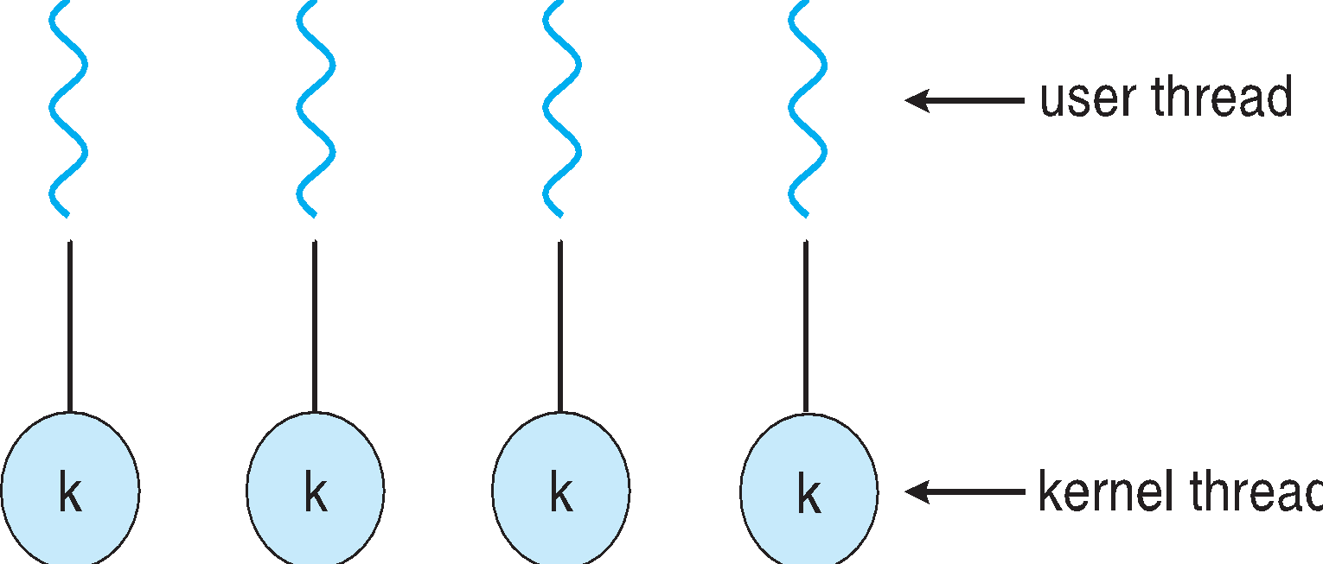
One-to-One
Each user-level thread maps to kernel thread
Creating a user-level thread creates a kernel thread
More concurrency than many-to-one
Number of threads per process sometimes restricted due to overhead
Examples
Windows
Linux
Solaris 9 and later
*
21CSC202J Operating Systems UNIT 2
‹#›
Notes:
‹#›

Slide 78
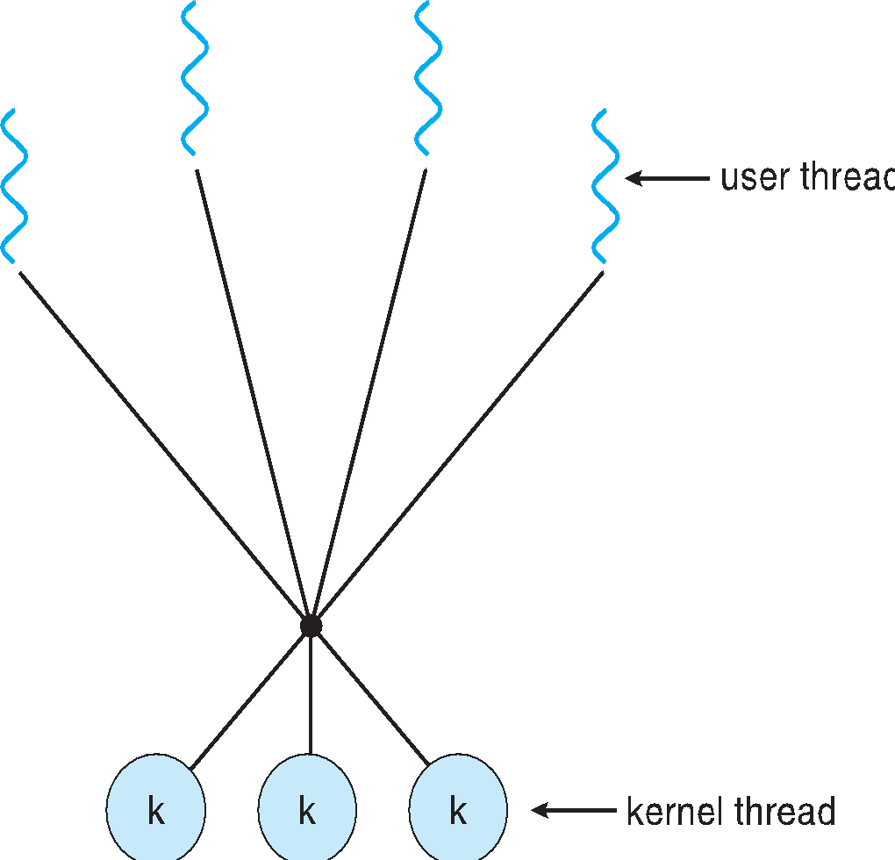
Many-to-Many Model
Allows many user level threads to be mapped to many kernel threads
Allows the operating system to create a sufficient number of kernel threads
Solaris prior to version 9
Windows with the ThreadFiber package
*
21CSC202J Operating Systems UNIT 2
‹#›
Notes:
‹#›

Slide 79
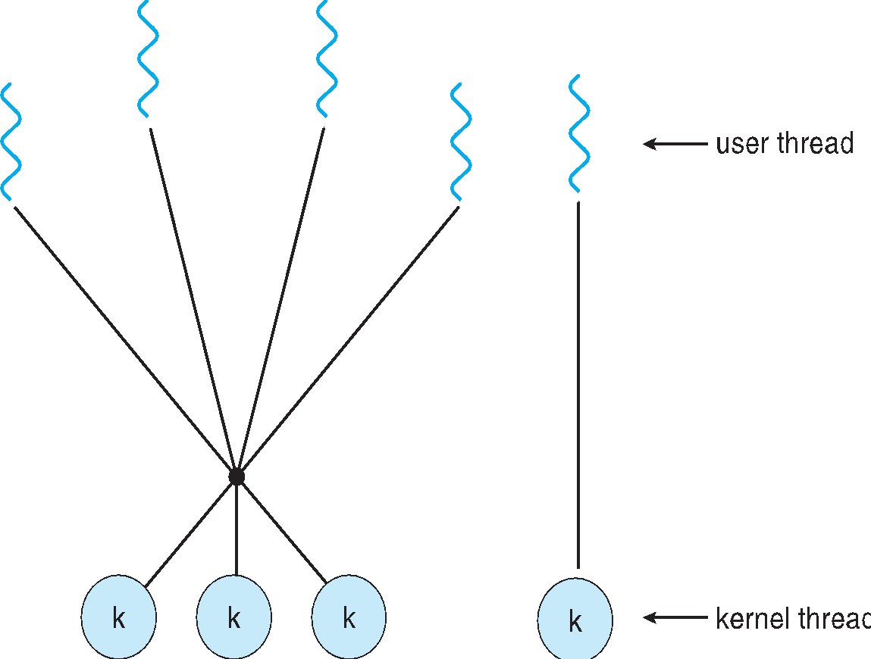
Two-level Model
Similar to M:M, except that it allows a user thread to be bound to kernel thread
Examples
IRIX
HP-UX
Tru64 UNIX
Solaris 8 and earlier
*
21CSC202J Operating Systems UNIT 2
‹#›
Notes:
‹#›

Slide 80
Thread Libraries
Thread library provides programmer with API for creating and managing threads
Two primary ways of implementing
Library entirely in user space
Kernel-level library supported by the OS
*
21CSC202J Operating Systems UNIT 2
‹#›

Slide 81
Pthreads
May be provided either as user-level or kernel-level
A POSIX standard (IEEE 1003.1c) API for thread creation and synchronization
Specification, not implementation
API specifies behavior of the thread library, implementation is up to development of the library
Common in UNIX operating systems (Solaris, Linux, Mac OS X)
*
21CSC202J Operating Systems UNIT 2
‹#›
Notes:
‹#›

Slide 82
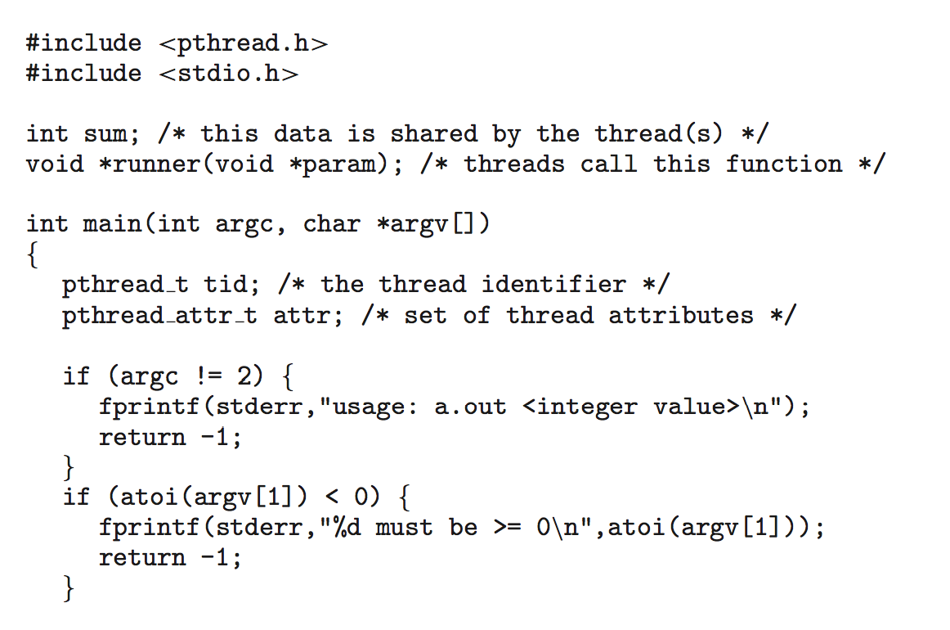
Pthreads Example
*
21CSC202J Operating Systems UNIT 2
‹#›

Slide 83
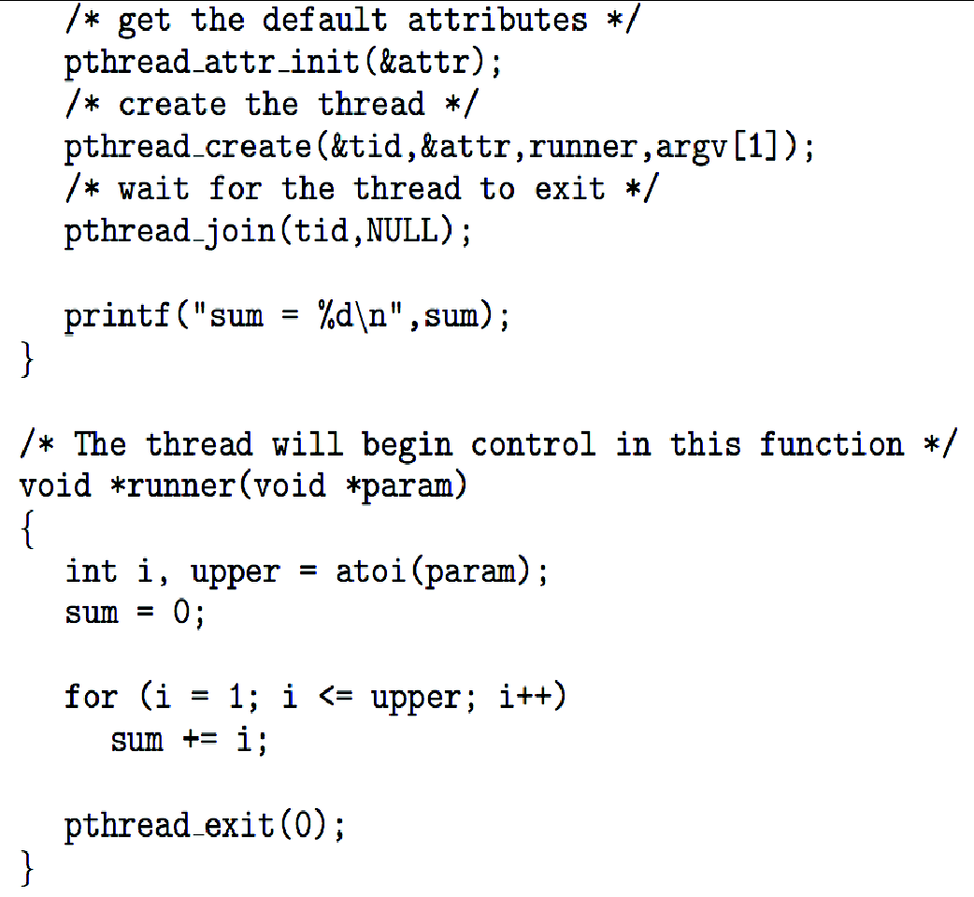
Pthreads Example (Cont.)
*
21CSC202J Operating Systems UNIT 2
‹#›

Slide 84
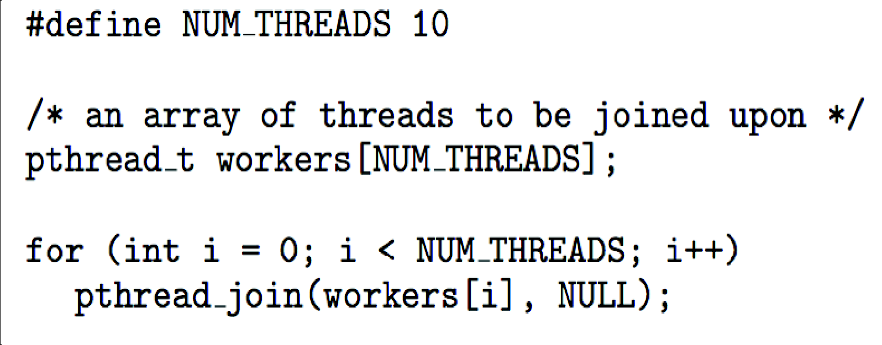
Pthreads Code for Joining 10 Threads
*
21CSC202J Operating Systems UNIT 2
‹#›

Slide 85
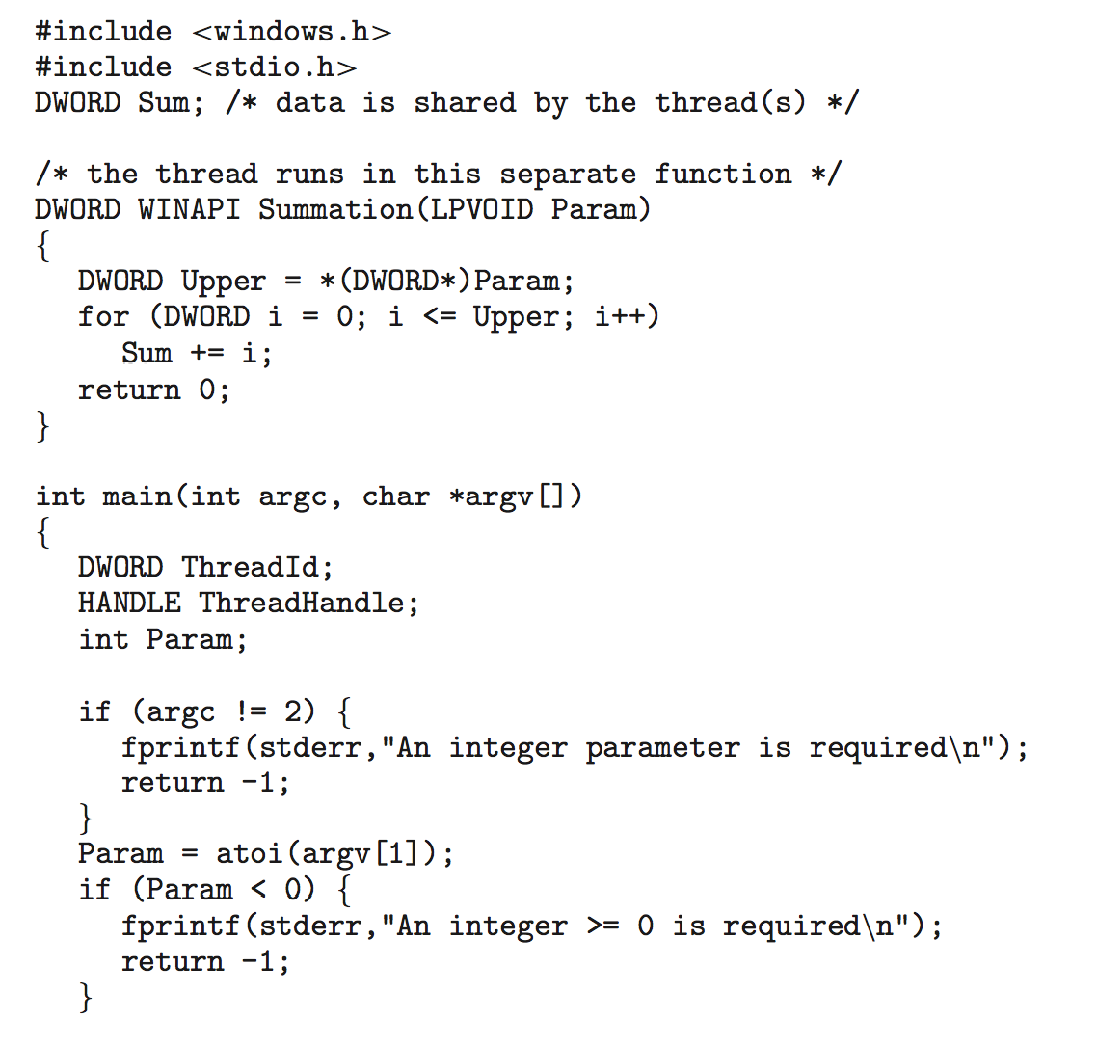
Windows Multithreaded C Program
*
21CSC202J Operating Systems UNIT 2
‹#›

Slide 86
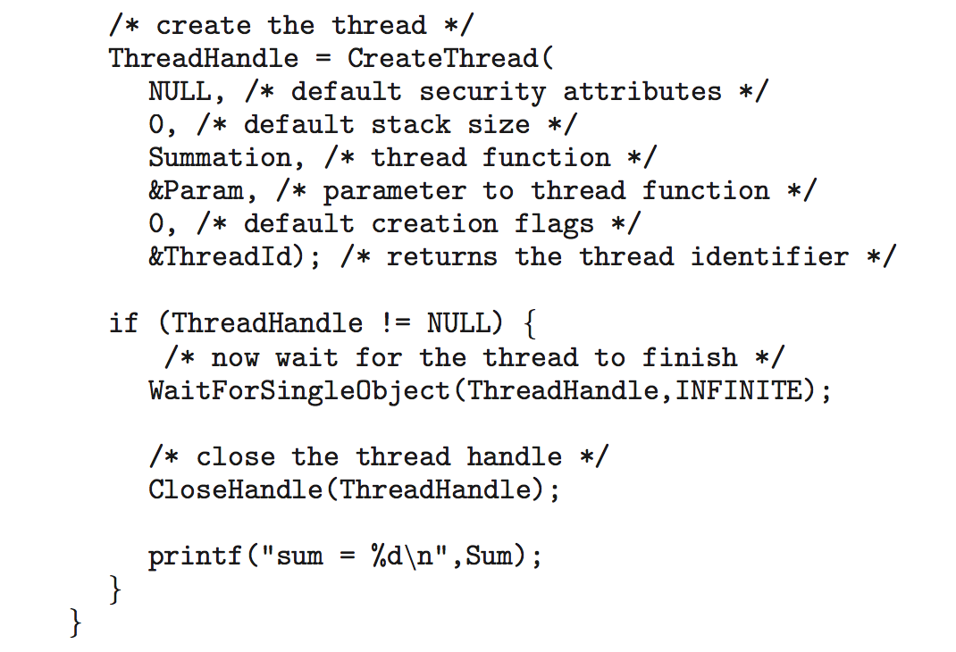
Windows Multithreaded C Program (Cont.)
*
21CSC202J Operating Systems UNIT 2
‹#›

Slide 87
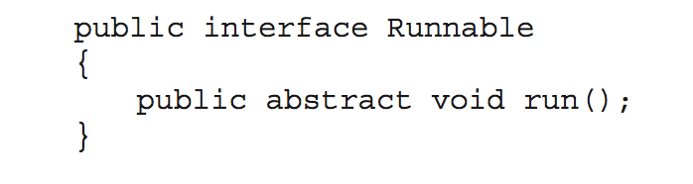
Java Threads
Java threads are managed by the JVM
Typically implemented using the threads model provided by underlying OS
Java threads may be created by:
Extending Thread class
Implementing the Runnable interface
*
21CSC202J Operating Systems UNIT 2
‹#›
Notes:
‹#›

Slide 88
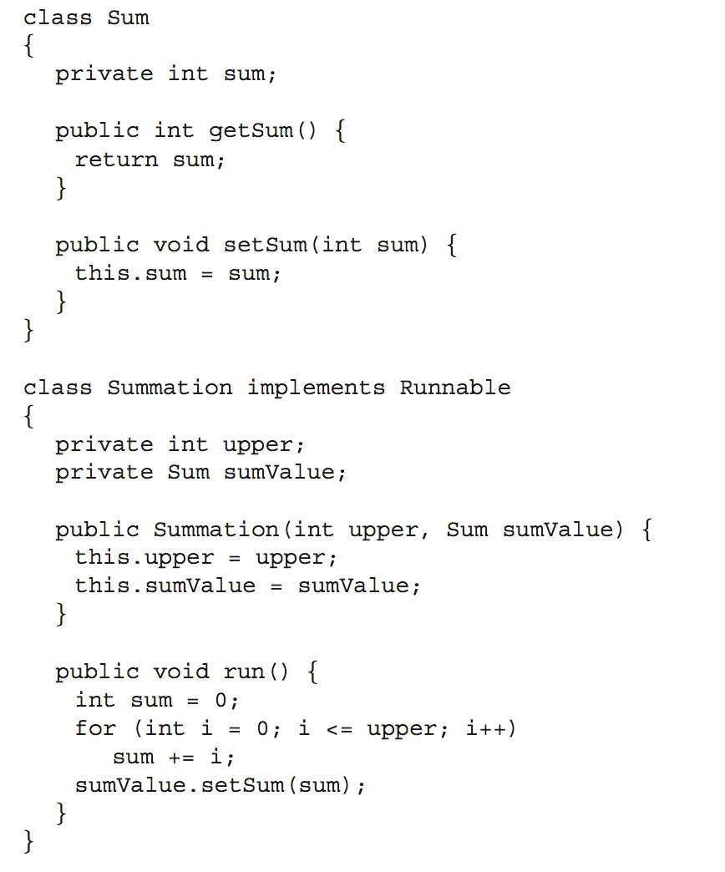
Java Multithreaded Program
*
21CSC202J Operating Systems UNIT 2
‹#›

Slide 89
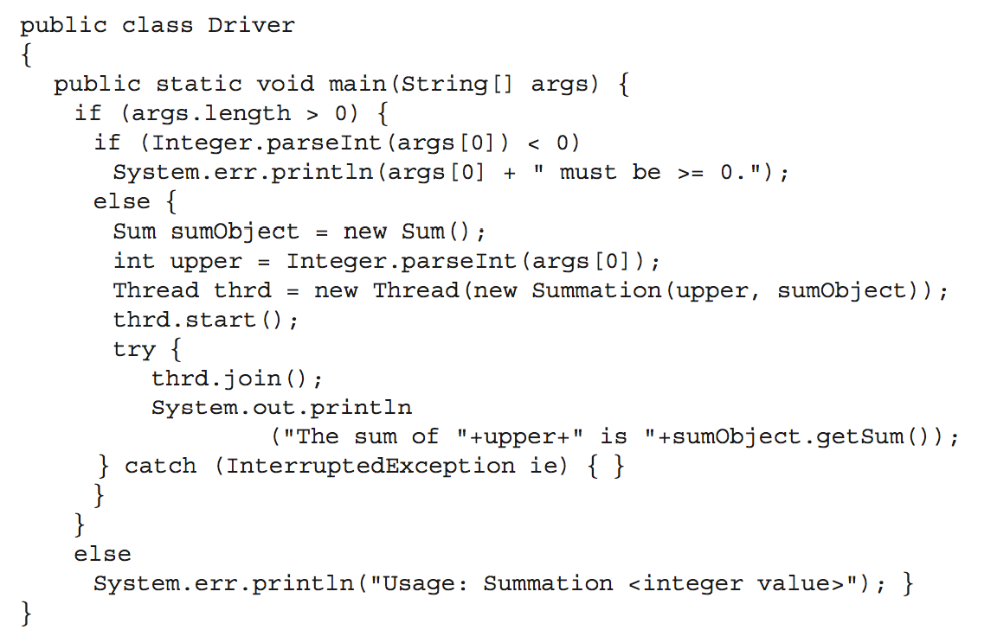
Java Multithreaded Program (Cont.)
*
21CSC202J Operating Systems UNIT 2
‹#›

Slide 90
Implicit Threading
Growing in popularity as numbers of threads increase, program correctness more difficult with explicit threads
Creation and management of threads done by compilers and run-time libraries rather than programmers
Three methods explored
Thread Pools
OpenMP
Grand Central Dispatch
Other methods include Microsoft Threading Building Blocks (TBB), java.util.concurrent package
*
21CSC202J Operating Systems UNIT 2
‹#›
Notes:
‹#›

Slide 91
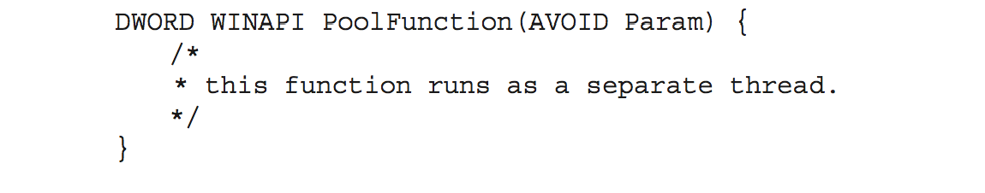
Thread Pools
Create a number of threads in a pool where they await work
Advantages:
Usually slightly faster to service a request with an existing thread than create a new thread
Allows the number of threads in the application(s) to be bound to the size of the pool
Separating task to be performed from mechanics of creating task allows different strategies for running task
i.e.Tasks could be scheduled to run periodically
Windows API supports thread pools:
*
21CSC202J Operating Systems UNIT 2
‹#›
Notes:
‹#›

Slide 92
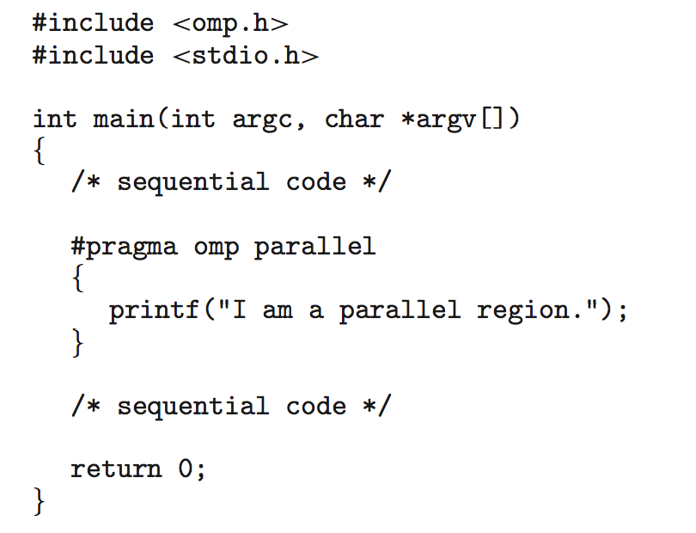
OpenMP
Set of compiler directives and an API for C, C++, FORTRAN
Provides support for parallel programming in shared-memory environments
Identifies parallel regions – blocks of code that can run in parallel
#pragma omp parallel
Create as many threads as there are cores
#pragma omp parallel for for(i=0;i<N;i++) {
c[i] = a[i] + b[i];
}
Run for loop in parallel
*
21CSC202J Operating Systems UNIT 2
‹#›
Notes:
‹#›

Slide 93
Grand Central Dispatch
Apple technology for Mac OS X and iOS operating systems
Extensions to C, C++ languages, API, and run-time library
Allows identification of parallel sections
Manages most of the details of threading
Block is in “^{ }” - ˆ{ printf("I am a block"); }
Blocks placed in dispatch queue
Assigned to available thread in thread pool when removed from queue
*
21CSC202J Operating Systems UNIT 2
‹#›
Notes:
‹#›

Slide 94
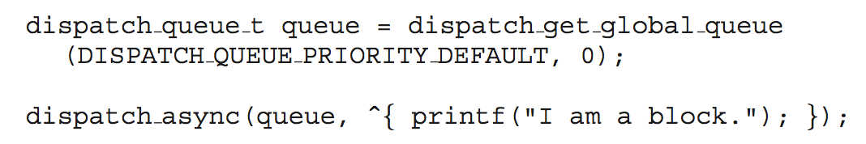
Grand Central Dispatch
Two types of dispatch queues:
serial – blocks removed in FIFO order, queue is per process, called main queue
Programmers can create additional serial queues within program
concurrent – removed in FIFO order but several may be removed at a time
Three system wide queues with priorities low, default, high
*
21CSC202J Operating Systems UNIT 2
‹#›
Notes:
‹#›

Slide 95
Threading Issues
Semantics of fork() and exec() system calls
Signal handling
Synchronous and asynchronous
Thread cancellation of target thread
Asynchronous or deferred
Thread-local storage
Scheduler Activations
*
21CSC202J Operating Systems UNIT 2
‹#›
Notes:
‹#›

Slide 96
Semantics of fork() and exec()
Does fork()duplicate only the calling thread or all threads?
Some UNIXes have two versions of fork
exec() usually works as normal – replace the running process including all threads
*
21CSC202J Operating Systems UNIT 2
‹#›
Notes:
‹#›

Slide 97
Signal Handling
Signals are used in UNIX systems to notify a process that a particular event has occurred.
A signal handler is used to process signals
Signal is generated by particular event
Signal is delivered to a process
Signal is handled by one of two signal handlers:
default
user-defined
Every signal has default handler that kernel runs when handling signal
User-defined signal handler can override default
For single-threaded, signal delivered to process
*
21CSC202J Operating Systems UNIT 2
‹#›
Notes:
‹#›

Slide 98
Signal Handling (Cont.)
Where should a signal be delivered for multi-threaded?
Deliver the signal to the thread to which the signal applies
Deliver the signal to every thread in the process
Deliver the signal to certain threads in the process
Assign a specific thread to receive all signals for the process
*
21CSC202J Operating Systems UNIT 2
‹#›
Notes:
‹#›

Slide 99
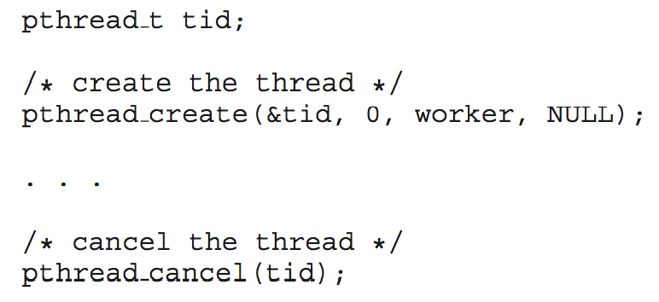
Thread Cancellation
Terminating a thread before it has finished
Thread to be canceled is target thread
Two general approaches:
Asynchronous cancellation terminates the target thread immediately
Deferred cancellation allows the target thread to periodically check if it should be cancelled
Pthread code to create and cancel a thread:
*
21CSC202J Operating Systems UNIT 2
‹#›
Notes:
‹#›

Slide 100
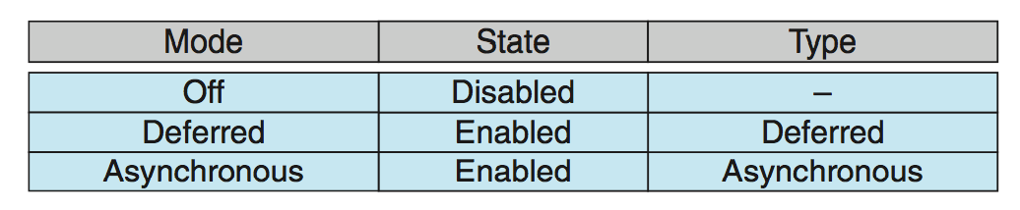
Thread Cancellation (Cont.)
Invoking thread cancellation requests cancellation, but actual cancellation depends on thread state
If thread has cancellation disabled, cancellation remains pending until thread enables it
Default type is deferred
Cancellation only occurs when thread reaches cancellation point
I.e. pthread_testcancel()
Then cleanup handler is invoked
On Linux systems, thread cancellation is handled through signals
*
21CSC202J Operating Systems UNIT 2
‹#›
Notes:
‹#›

Slide 101
Thread-Local Storage
Thread-local storage (TLS) allows each thread to have its own copy of data
Useful when you do not have control over the thread creation process (i.e., when using a thread pool)
Different from local variables
Local variables visible only during single function invocation
TLS visible across function invocations
Similar to static data
TLS is unique to each thread
*
21CSC202J Operating Systems UNIT 2
‹#›
Notes:
‹#›

Slide 102
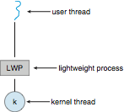
Scheduler Activations
Both M:M and Two-level models require communication to maintain the appropriate number of kernel threads allocated to the application
Typically use an intermediate data structure between user and kernel threads – lightweight process (LWP)
Appears to be a virtual processor on which process can schedule user thread to run
Each LWP attached to kernel thread
How many LWPs to create?
Scheduler activations provide upcalls - a communication mechanism from the kernel to the upcall handler in the thread library
This communication allows an application to maintain the correct number kernel threads
*
21CSC202J Operating Systems UNIT 2
‹#›
Notes:
‹#›

Slide 103
Operating System Examples
Windows Threads
Linux Threads
*
21CSC202J Operating Systems UNIT 2
‹#›
Notes:
‹#›

Slide 104
Windows Threads
Windows implements the Windows API – primary API for Win 98, Win NT, Win 2000, Win XP, and Win 7
Implements the one-to-one mapping, kernel-level
Each thread contains
A thread id
Register set representing state of processor
Separate user and kernel stacks for when thread runs in user mode or kernel mode
Private data storage area used by run-time libraries and dynamic link libraries (DLLs)
The register set, stacks, and private storage area are known as the context of the thread
*
21CSC202J Operating Systems UNIT 2
‹#›
Notes:
‹#›

Slide 105
Windows Threads (Cont.)
The primary data structures of a thread include:
ETHREAD (executive thread block) – includes pointer to process to which thread belongs and to KTHREAD, in kernel space
KTHREAD (kernel thread block) – scheduling and synchronization info, kernel-mode stack, pointer to TEB, in kernel space
TEB (thread environment block) – thread id, user-mode stack, thread-local storage, in user space
*
21CSC202J Operating Systems UNIT 2
‹#›
Notes:
‹#›

Slide 106
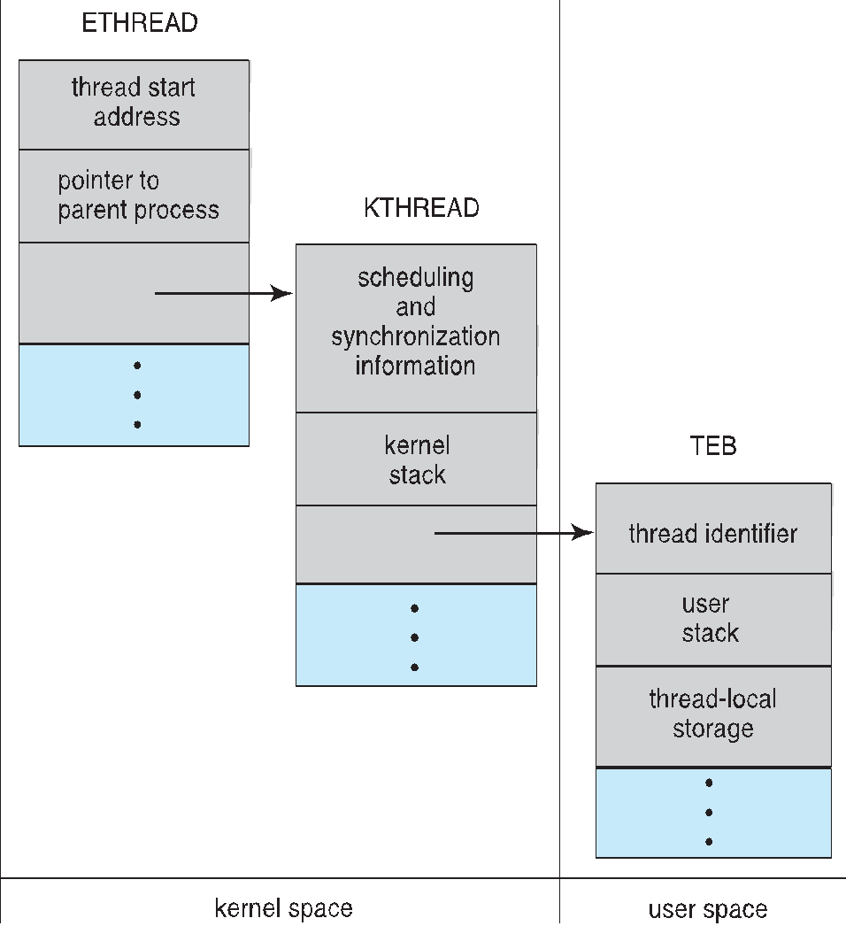
Windows Threads Data Structures
*
21CSC202J Operating Systems UNIT 2
‹#›

Slide 107
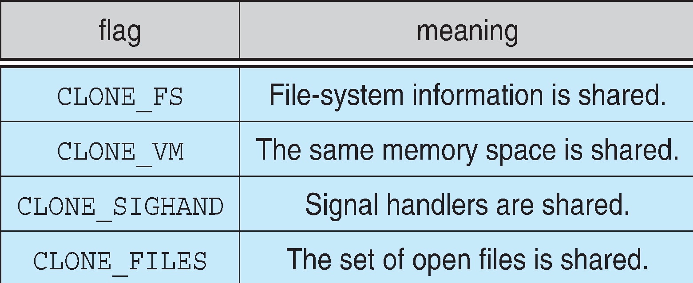
Linux Threads
Linux refers to them as tasks rather than threads
Thread creation is done through clone() system call
clone() allows a child task to share the address space of the parent task (process)
Flags control behavior
struct task_struct points to process data structures (shared or unique)
*
21CSC202J Operating Systems UNIT 2
‹#›
Notes:
‹#›

Slide 108
Process Synchronization

Slide 109
Process Synchronization
Background
The Critical-Section Problem
Peterson’s Solution
Synchronization Hardware
Mutex Locks
Semaphores
Classic Problems of Synchronization
Monitors
Synchronization Examples
Alternative Approaches
*
21CSC202J Operating Systems UNIT 2
‹#›
Notes:
‹#›

Slide 110
Objectives
To present the concept of process synchronization.
To introduce the critical-section problem, whose solutions can be used to ensure the consistency of shared data
To present both software and hardware solutions of the critical-section problem
To examine several classical process-synchronization problems
To explore several tools that are used to solve process synchronization problems
*
21CSC202J Operating Systems UNIT 2
‹#›

Slide 111
Background
Processes can execute concurrently
May be interrupted at any time, partially completing execution
Concurrent access to shared data may result in data inconsistency
Maintaining data consistency requires mechanisms to ensure the orderly execution of cooperating processes
Illustration of the problem: Suppose that we wanted to provide a solution to the consumer-producer problem that fills all the buffers. We can do so by having an integer counter that keeps track of the number of full buffers. Initially, counter is set to 0. It is incremented by the producer after it produces a new buffer and is decremented by the consumer after it consumes a buffer.
*
21CSC202J Operating Systems UNIT 2
‹#›
Notes:
‹#›

Slide 112
Producer
while (true) { /* produce an item in next produced */
while (counter == BUFFER_SIZE) ;
/* do nothing */
buffer[in] = next_produced;
in = (in + 1) % BUFFER_SIZE;
counter++;
}
*
21CSC202J Operating Systems UNIT 2
‹#›
Notes:
‹#›

Slide 113
Consumer
while (true) {
while (counter == 0)
; /* do nothing */
next_consumed = buffer[out];
out = (out + 1) % BUFFER_SIZE;
counter--;
/* consume the item in next consumed */
}
*
21CSC202J Operating Systems UNIT 2
‹#›
Notes:
‹#›

Slide 114
Race Condition
counter++ could be implemented as register1 = counter register1 = register1 + 1 counter = register1
counter-- could be implemented as register2 = counter register2 = register2 - 1 counter = register2
Consider this execution interleaving with “count = 5” initially:
S0: producer execute register1 = counter {register1 = 5} S1: producer execute register1 = register1 + 1 {register1 = 6} S2: consumer execute register2 = counter {register2 = 5} S3: consumer execute register2 = register2 – 1 {register2 = 4} S4: producer execute counter = register1 {counter = 6 } S5: consumer execute counter = register2 {counter = 4}
*
21CSC202J Operating Systems UNIT 2
‹#›
Notes:
‹#›

Slide 115
Critical Section Problem
Consider system of n processes {p₀, p₁, … p_{n-1}}
Each process has critical section segment of code
Process may be changing common variables, updating table, writing file, etc
When one process in critical section, no other may be in its critical section
Critical section problem is to design protocol to solve this
Each process must ask permission to enter critical section in entry section, may follow critical section with exit section, then remainder section
*
21CSC202J Operating Systems UNIT 2
‹#›

Slide 116
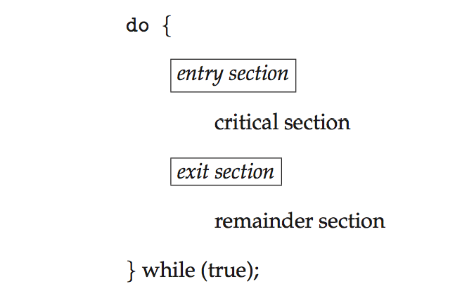
Critical Section
General structure of process P_{i}
*
21CSC202J Operating Systems UNIT 2
‹#›

Slide 117
Algorithm for Process P_{i}
do {
while (turn == j);
critical section
turn = j;
remainder section
} while (true);
*
21CSC202J Operating Systems UNIT 2
‹#›
Notes:
‹#›

Slide 118
Solution to Critical-Section Problem
1. Mutual Exclusion - If process P_{i} is executing in its critical section, then no other processes can be executing in their critical sections
2. Progress - If no process is executing in its critical section and there exist some processes that wish to enter their critical section, then the selection of the processes that will enter the critical section next cannot be postponed indefinitely
3. Bounded Waiting - A bound must exist on the number of times that other processes are allowed to enter their critical sections after a process has made a request to enter its critical section and before that request is granted
Assume that each process executes at a nonzero speed
No assumption concerning relative speed of the n processes
*
21CSC202J Operating Systems UNIT 2
‹#›
Notes:
‹#›

Slide 119
Critical-Section Handling in OS
Two approaches depending on if kernel is preemptive or non- preemptive
Preemptive – allows preemption of process when running in kernel mode
Non-preemptive – runs until exits kernel mode, blocks, or voluntarily yields CPU
Essentially free of race conditions in kernel mode
*
21CSC202J Operating Systems UNIT 2
‹#›
Notes:
‹#›

Slide 120
Peterson’s Solution
Good algorithmic description of solving the problem
Two process solution
Assume that the load and store machine-language instructions are atomic; that is, cannot be interrupted
The two processes share two variables:
int turn;
Boolean flag[2]
The variable turn indicates whose turn it is to enter the critical section
The flag array is used to indicate if a process is ready to enter the critical section. flag[i] = true implies that process P_{i} is ready!
*
21CSC202J Operating Systems UNIT 2
‹#›
Notes:
‹#›

Slide 121
Algorithm for Process P_{i}
do {
flag[i] = true;
turn = j;
while (flag[j] && turn = = j);
critical section
flag[i] = false;
remainder section
} while (true);
*
21CSC202J Operating Systems UNIT 2
‹#›
Notes:
‹#›

Slide 122
Peterson’s Solution (Cont.)
Provable that the three CS requirement are met:
1. Mutual exclusion is preserved
P_{i} enters CS only if:
either flag[j] = false or turn = i
2. Progress requirement is satisfied
3. Bounded-waiting requirement is met
*
21CSC202J Operating Systems UNIT 2
‹#›
Notes:
‹#›

Slide 123
Synchronization Hardware
Many systems provide hardware support for implementing the critical section code.
All solutions below based on idea of locking
Protecting critical regions via locks
Uniprocessors – could disable interrupts
Currently running code would execute without preemption
Generally too inefficient on multiprocessor systems
Operating systems using this not broadly scalable
Modern machines provide special atomic hardware instructions
Atomic = non-interruptible
Either test memory word and set value
Or swap contents of two memory words
*
21CSC202J Operating Systems UNIT 2
‹#›
Notes:
‹#›

Slide 124
Solution to Critical-section Problem Using Locks
do {
acquire lock
critical section
release lock
remainder section
} while (TRUE);
*
21CSC202J Operating Systems UNIT 2
‹#›

Slide 125
test_and_set Instruction
Definition:
boolean test_and_set (boolean *target)
{
boolean rv = *target;
*target = TRUE;
return rv:
}
Executed atomically
Returns the original value of passed parameter
Set the new value of passed parameter to “TRUE”.
*
21CSC202J Operating Systems UNIT 2
‹#›
Notes:
‹#›

Slide 126
Solution using test_and_set()
Shared Boolean variable lock, initialized to FALSE
Solution:
do { while (test_and_set(&lock))
; /* do nothing */
/* critical section */
lock = false;
/* remainder section */
} while (true);
*
21CSC202J Operating Systems UNIT 2
‹#›
Notes:
‹#›

Slide 127
compare_and_swap Instruction
Definition:
int compare _and_swap(int *value, int expected, int new_value) {
int temp = *value;
if (*value == expected)
*value = new_value;
return temp;
}
Executed atomically
Returns the original value of passed parameter “value”
Set the variable “value” the value of the passed parameter “new_value” but only if “value” ==“expected”. That is, the swap takes place only under this condition.
*
21CSC202J Operating Systems UNIT 2
‹#›
Notes:
‹#›

Slide 128
Solution using compare_and_swap
Shared integer “lock” initialized to 0;
Solution:
do { while (compare_and_swap(&lock, 0, 1) != 0)
; /* do nothing */
/* critical section */
lock = 0;
/* remainder section */
} while (true);
*
21CSC202J Operating Systems UNIT 2
‹#›
Notes:
‹#›

Slide 129
Bounded-waiting Mutual Exclusion with test_and_set
do { waiting[i] = true; key = true; while (waiting[i] && key)
key = test_and_set(&lock);
waiting[i] = false;
/* critical section */
j = (i + 1) % n;
while ((j != i) && !waiting[j])
j = (j + 1) % n;
if (j == i)
lock = false;
else
waiting[j] = false;
/* remainder section */
} while (true);
*
21CSC202J Operating Systems UNIT 2
‹#›

Slide 130
Mutex Locks
Previous solutions are complicated and generally inaccessible to application programmers
OS designers build software tools to solve critical section problem
Simplest is mutex lock
Protect a critical section by first acquire() a lock then release() the lock
Boolean variable indicating if lock is available or not
Calls to acquire() and release() must be atomic
Usually implemented via hardware atomic instructions
But this solution requires busy waiting
This lock therefore called a spinlock
*
21CSC202J Operating Systems UNIT 2
‹#›
Notes:
‹#›

Slide 131
acquire() and release()
acquire() { while (!available)
; /* busy wait */
available = false;;
}
release() {
available = true;
}
do {
acquire lock
critical section
release lock
remainder section
} while (true);
*
21CSC202J Operating Systems UNIT 2
‹#›

Slide 132
Semaphore
Synchronization tool that provides more sophisticated ways (than Mutex locks) for process to synchronize their activities.
Semaphore S – integer variable
Can only be accessed via two indivisible (atomic) operations
wait() and signal()
Originally called P() and V()
Definition of the wait() operation
wait(S) {
while (S <= 0)
; // busy wait
S--;
}
Definition of the signal() operation
signal(S) {
S++;
}
*
21CSC202J Operating Systems UNIT 2
‹#›
Notes:
‹#›

Slide 133
Semaphore Usage
Counting semaphore – integer value can range over an unrestricted domain
Binary semaphore – integer value can range only between 0 and 1
Same as a mutex lock
Can solve various synchronization problems
Consider P₁ and P₂ that require S₁ to happen before S₂
Create a semaphore “synch” initialized to 0
P1:
S₁;
signal(synch);
P2:
wait(synch);
S₂;
Can implement a counting semaphore S as a binary semaphore
*
21CSC202J Operating Systems UNIT 2
‹#›
Notes:
‹#›

Slide 134
Semaphore Implementation
Must guarantee that no two processes can execute the wait() and signal() on the same semaphore at the same time
Thus, the implementation becomes the critical section problem where the wait and signal code are placed in the critical section
Could now have busy waiting in critical section implementation
But implementation code is short
Little busy waiting if critical section rarely occupied
Note that applications may spend lots of time in critical sections and therefore this is not a good solution
*
21CSC202J Operating Systems UNIT 2
‹#›
Notes:
‹#›

Slide 135
Semaphore Implementation with no Busy waiting
With each semaphore there is an associated waiting queue
Each entry in a waiting queue has two data items:
value (of type integer)
pointer to next record in the list
Two operations:
block – place the process invoking the operation on the appropriate waiting queue
wakeup – remove one of processes in the waiting queue and place it in the ready queue
typedef struct{
int value;
struct process *list;
} semaphore;
*
21CSC202J Operating Systems UNIT 2
‹#›
Notes:
‹#›

Slide 136
Implementation with no Busy waiting (Cont.)
wait(semaphore *S) {
S->value--;
if (S->value < 0) { add this process to S->list;
block();
}
}
signal(semaphore *S) {
S->value++;
if (S->value <= 0) { remove a process P from S->list;
wakeup(P);
}
}
*
21CSC202J Operating Systems UNIT 2
‹#›
Notes:
‹#›

Slide 137
Deadlock and Starvation
Deadlock – two or more processes are waiting indefinitely for an event that can be caused by only one of the waiting processes
Let S and Q be two semaphores initialized to 1
P₀ P₁
wait(S); wait(Q);
wait(Q); wait(S);
... ...
signal(S); signal(Q);
signal(Q); signal(S);
Starvation – indefinite blocking
A process may never be removed from the semaphore queue in which it is suspended
Priority Inversion – Scheduling problem when lower-priority process holds a lock needed by higher-priority process
Solved via priority-inheritance protocol
*
21CSC202J Operating Systems UNIT 2
‹#›
Notes:
‹#›

Slide 138
Classical Problems of Synchronization
Classical problems used to test newly-proposed synchronization schemes
Bounded-Buffer Problem
Readers and Writers Problem
Dining-Philosophers Problem
*
21CSC202J Operating Systems UNIT 2
‹#›
Notes:
‹#›

Slide 139
Bounded-Buffer Problem
n buffers, each can hold one item
Semaphore mutex initialized to the value 1
Semaphore full initialized to the value 0
Semaphore empty initialized to the value n
*
21CSC202J Operating Systems UNIT 2
‹#›
Notes:
‹#›

Slide 140
Bounded Buffer Problem (Cont.)
The structure of the producer process
do {
... /* produce an item in next_produced */
...
wait(empty);
wait(mutex);
... /* add next produced to the buffer */
...
signal(mutex);
signal(full);
} while (true);
*
21CSC202J Operating Systems UNIT 2
‹#›
Notes:
‹#›

Slide 141
Bounded Buffer Problem (Cont.)
The structure of the consumer process
Do {
wait(full);
wait(mutex);
... /* remove an item from buffer to next_consumed */
...
signal(mutex);
signal(empty);
... /* consume the item in next consumed */
... } while (true);
*
21CSC202J Operating Systems UNIT 2
‹#›
Notes:
‹#›

Slide 142
Readers-Writers Problem
A data set is shared among a number of concurrent processes
Readers – only read the data set; they do not perform any updates
Writers – can both read and write
Problem – allow multiple readers to read at the same time
Only one single writer can access the shared data at the same time
Several variations of how readers and writers are considered – all involve some form of priorities
Shared Data
Data set
Semaphore rw_mutex initialized to 1
Semaphore mutex initialized to 1
Integer read_count initialized to 0
*
21CSC202J Operating Systems UNIT 2
‹#›
Notes:
‹#›

Slide 143
Readers-Writers Problem (Cont.)
The structure of a writer process
do { wait(rw_mutex);
... /* writing is performed */
...
signal(rw_mutex);
} while (true);
*
21CSC202J Operating Systems UNIT 2
‹#›
Notes:
‹#›

Slide 144
Readers-Writers Problem (Cont.)
The structure of a reader process
do { wait(mutex); read_count++; if (read_count == 1)
wait(rw_mutex);
signal(mutex);
... /* reading is performed */
...
wait(mutex); read count--; if (read_count == 0)
signal(rw_mutex);
signal(mutex);
} while (true);
*
21CSC202J Operating Systems UNIT 2
‹#›
Notes:
‹#›

Slide 145
Readers-Writers Problem Variations
First variation – no reader kept waiting unless writer has permission to use shared object
Second variation – once writer is ready, it performs the write ASAP
Both may have starvation leading to even more variations
Problem is solved on some systems by kernel providing reader-writer locks
*
21CSC202J Operating Systems UNIT 2
‹#›

Slide 146
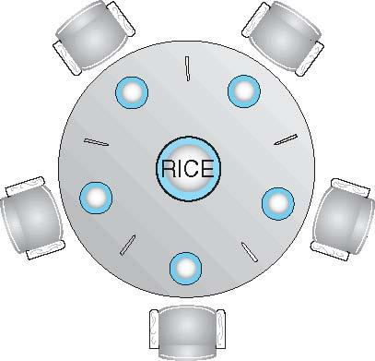
Dining-Philosophers Problem
Philosophers spend their lives alternating thinking and eating
Don’t interact with their neighbors, occasionally try to pick up 2 chopsticks (one at a time) to eat from bowl
Need both to eat, then release both when done
In the case of 5 philosophers
Shared data
Bowl of rice (data set)
Semaphore chopstick [5] initialized to 1
*
21CSC202J Operating Systems UNIT 2
‹#›
Notes:
‹#›

Slide 147
Dining-Philosophers Problem Algorithm
The structure of Philosopher i:
do {
wait (chopstick[i] );
wait (chopStick[ (i + 1) % 5] );
// eat
signal (chopstick[i] );
signal (chopstick[ (i + 1) % 5] );
// think
} while (TRUE);
What is the problem with this algorithm?
*
21CSC202J Operating Systems UNIT 2
‹#›
Notes:
‹#›

Slide 148
Dining-Philosophers Problem Algorithm (Cont.)
Deadlock handling
Allow at most 4 philosophers to be sitting simultaneously at the table.
Allow a philosopher to pick up the forks only if both are available (picking must be done in a critical section.
Use an asymmetric solution -- an odd-numbered philosopher picks up first the left chopstick and then the right chopstick. Even-numbered philosopher picks up first the right chopstick and then the left chopstick.
*
21CSC202J Operating Systems UNIT 2
‹#›
Notes:
‹#›

Slide 149
Problems with Semaphores
Incorrect use of semaphore operations:
signal (mutex) …. wait (mutex)
wait (mutex) … wait (mutex)
Omitting of wait (mutex) or signal (mutex) (or both)
Deadlock and starvation are possible.
*
21CSC202J Operating Systems UNIT 2
‹#›
Notes:
‹#›

Slide 150
Monitors
A high-level abstraction that provides a convenient and effective mechanism for process synchronization
Abstract data type, internal variables only accessible by code within the procedure
Only one process may be active within the monitor at a time
But not powerful enough to model some synchronization schemes
monitor monitor-name
{
// shared variable declarations
procedure P1 (…) { …. }
procedure Pn (…) {……}
Initialization code (…) { … }
}
}
*
21CSC202J Operating Systems UNIT 2
‹#›
Notes:
‹#›

Slide 151
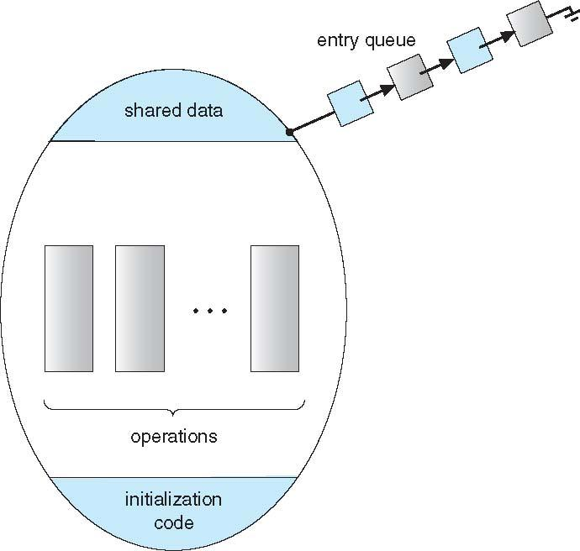
Schematic view of a Monitor
*
21CSC202J Operating Systems UNIT 2
‹#›
Notes:
‹#›

Slide 152
Condition Variables
condition x, y;
Two operations are allowed on a condition variable:
x.wait() – a process that invokes the operation is suspended until x.signal()
x.signal() – resumes one of processes (if any) that invoked x.wait()
If no x.wait() on the variable, then it has no effect on the variable
*
21CSC202J Operating Systems UNIT 2
‹#›
Notes:
‹#›

Slide 153

Monitor with Condition Variables
*
21CSC202J Operating Systems UNIT 2
‹#›
Notes:
‹#›

Slide 154
Condition Variables Choices
If process P invokes x.signal(), and process Q is suspended in x.wait(), what should happen next?
Both Q and P cannot execute in paralel. If Q is resumed, then P must wait
Options include
Signal and wait – P waits until Q either leaves the monitor or it waits for another condition
Signal and continue – Q waits until P either leaves the monitor or it waits for another condition
Both have pros and cons – language implementer can decide
Monitors implemented in Concurrent Pascal compromise
P executing signal immediately leaves the monitor, Q is resumed
Implemented in other languages including Mesa, C#, Java
*
21CSC202J Operating Systems UNIT 2
‹#›
Notes:
‹#›

Slide 155
Monitor Solution to Dining Philosophers
monitor DiningPhilosophers
{
enum { THINKING; HUNGRY, EATING) state [5] ;
condition self [5];
void pickup (int i) {
state[i] = HUNGRY;
test(i);
if (state[i] != EATING) self[i].wait;
}
void putdown (int i) {
state[i] = THINKING;
// test left and right neighbors
test((i + 4) % 5);
test((i + 1) % 5);
}
*
21CSC202J Operating Systems UNIT 2
‹#›
Notes:
‹#›

Slide 156
Solution to Dining Philosophers (Cont.)
void test (int i) {
if ((state[(i + 4) % 5] != EATING) &&
(state[i] == HUNGRY) &&
(state[(i + 1) % 5] != EATING) ) {
state[i] = EATING ;
self[i].signal () ;
}
}
initialization_code() {
for (int i = 0; i < 5; i++)
state[i] = THINKING;
}
}
*
21CSC202J Operating Systems UNIT 2
‹#›
Notes:
‹#›

Slide 157
Solution to Dining Philosophers (Cont.)
Each philosopher i invokes the operations pickup() and putdown() in the following sequence:
DiningPhilosophers.pickup(i);
EAT
DiningPhilosophers.putdown(i);
No deadlock, but starvation is possible
*
21CSC202J Operating Systems UNIT 2
‹#›
Notes:
‹#›

Slide 158
Monitor Implementation Using Semaphores
Variables
semaphore mutex; // (initially = 1)
semaphore next; // (initially = 0)
int next_count = 0;
Each procedure F will be replaced by
wait(mutex);
…
body of F;
…
if (next_count > 0)
signal(next)
else
signal(mutex);
Mutual exclusion within a monitor is ensured
*
21CSC202J Operating Systems UNIT 2
‹#›
Notes:
‹#›

Slide 159
Monitor Implementation – Condition Variables
For each condition variable x, we have:
semaphore x_sem; // (initially = 0)
int x_count = 0;
The operation x.wait can be implemented as:
x_count++;
if (next_count > 0)
signal(next);
else
signal(mutex);
wait(x_sem);
x_count--;
*
21CSC202J Operating Systems UNIT 2
‹#›
Notes:
‹#›

Slide 160
Monitor Implementation (Cont.)
The operation x.signal can be implemented as:
if (x_count > 0) {
next_count++;
signal(x_sem);
wait(next);
next_count--;
}
*
21CSC202J Operating Systems UNIT 2
‹#›
Notes:
‹#›

Slide 161
Resuming Processes within a Monitor
If several processes queued on condition x, and x.signal() executed, which should be resumed?
FCFS frequently not adequate
conditional-wait construct of the form x.wait(c)
Where c is priority number
Process with lowest number (highest priority) is scheduled next
*
21CSC202J Operating Systems UNIT 2
‹#›

Slide 162
Single Resource allocation
Allocate a single resource among competing processes using priority numbers that specify the maximum time a process plans to use the resource
R.acquire(t);
...
access the resurce;
...
R.release;
Where R is an instance of type ResourceAllocator
*
21CSC202J Operating Systems UNIT 2
‹#›
Notes:
‹#›

Slide 163
A Monitor to Allocate Single Resource
monitor ResourceAllocator
{
boolean busy;
condition x;
void acquire(int time) {
if (busy)
x.wait(time);
busy = TRUE;
}
void release() {
busy = FALSE;
x.signal();
}
initialization code() {
busy = FALSE;
}
}
*
21CSC202J Operating Systems UNIT 2
‹#›
Notes:
‹#›

