Slide 1

https://python-sprints.github.io/pandas/index.html
https://python-sprints.github.io/pandas/guide/pandas_docstring.html
https://python-sprints.github.io/pandas/index.html
https://python-sprints.github.io/pandas/guide/pandas_docstring.html
https://pandas.pydata.org/
https://pydata.org/code-of-conduct.html

Slide 2

https://python-sprints.github.io/pandas/index.html
https://python-sprints.github.io/pandas/guide/pandas_docstring.html
https://python-sprints.github.io/pandas/index.html
https://python-sprints.github.io/pandas/guide/pandas_docstring.html
https://pandas.pydata.org/
https://pydata.org/code-of-conduct.html

Slide 3
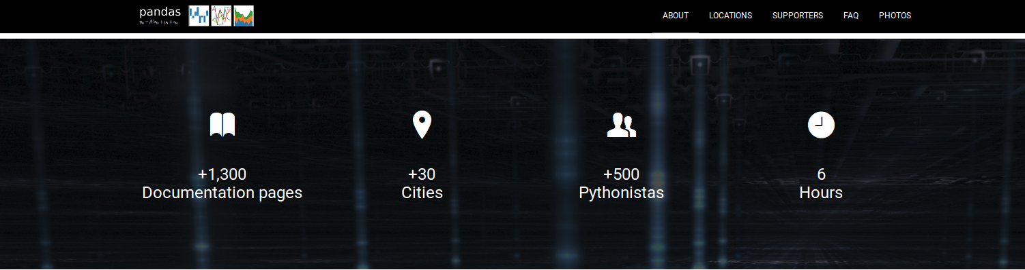
https://python-sprints.github.io/pandas/index.html
https://python-sprints.github.io/pandas/guide/pandas_docstring.html
https://pandas.pydata.org/
https://pydata.org/code-of-conduct.html

Slide 4
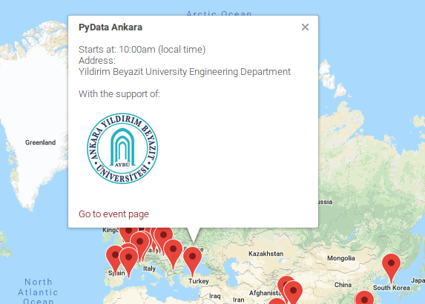
Pandas Documentation Sprint ANKARA chapter
https://python-sprints.github.io/pandas/index.html
https://python-sprints.github.io/pandas/guide/pandas_docstring.html
https://pandas.pydata.org/
https://pydata.org/code-of-conduct.html

Slide 5
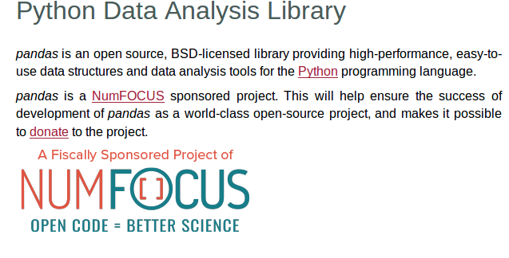
Pandas Documentation Sprint ANKARA chapter
https://python-sprints.github.io/pandas/index.html
https://python-sprints.github.io/pandas/guide/pandas_docstring.html
https://pandas.pydata.org/
https://pydata.org/code-of-conduct.html

Slide 6
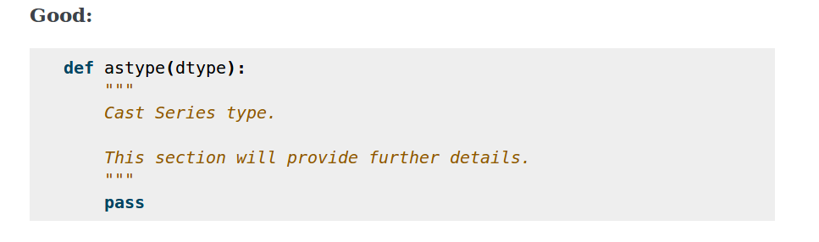
Pandas Documentation Sprint ANKARA chapter
How to docstring ?
1. Summary: What the function does?
https://python-sprints.github.io/pandas/index.html
https://python-sprints.github.io/pandas/guide/pandas_docstring.html
https://pandas.pydata.org/
https://pydata.org/code-of-conduct.html

Slide 7
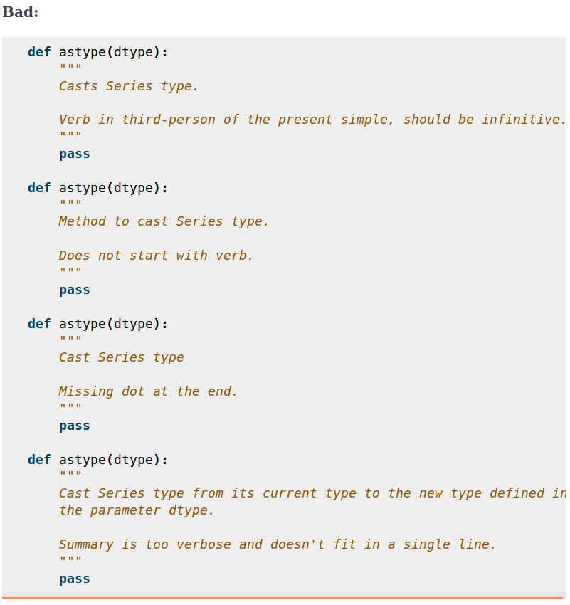
Pandas Documentation Sprint ANKARA chapter
How to docstring ?
1. Summary
https://python-sprints.github.io/pandas/index.html
https://python-sprints.github.io/pandas/guide/pandas_docstring.html
https://pandas.pydata.org/
https://pydata.org/code-of-conduct.html

Slide 8
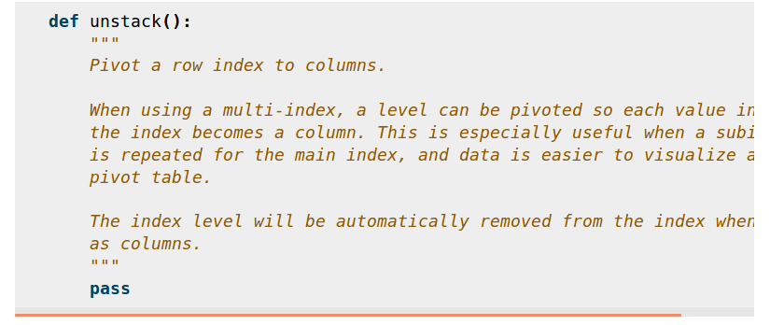
Pandas Documentation Sprint ANKARA chapter
How to docstring ?
2. Extended Summary: Not too detailed but detailed about function usage.
No parameter detail or implementation detail are allowed!!!
The extended summary should provide details on why the function is useful and
their use cases, if it is not too generic.
https://python-sprints.github.io/pandas/index.html
https://python-sprints.github.io/pandas/guide/pandas_docstring.html
https://pandas.pydata.org/
https://pydata.org/code-of-conduct.html

Slide 9
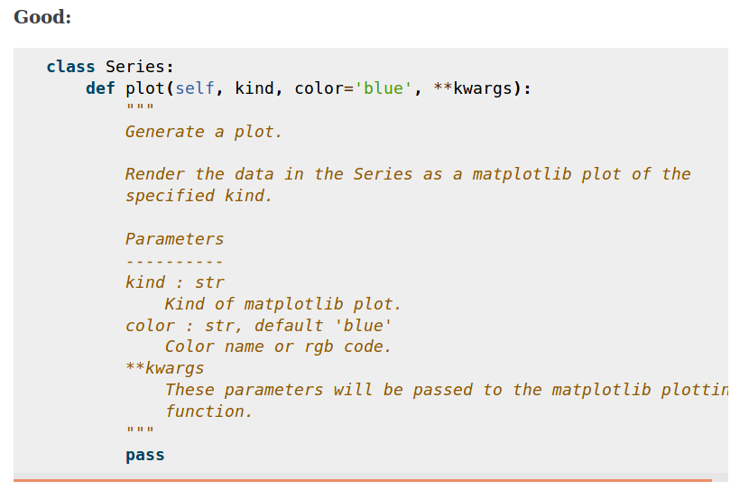
Pandas Documentation Sprint ANKARA chapter
How to docstring ?
3. Parameters: All must be documented including *args and **kwargs but not self
Types are not defined for *args and **kwargs, but must be defined for all other parameters.
Explain why there is a default value…
https://python-sprints.github.io/pandas/index.html
https://python-sprints.github.io/pandas/guide/pandas_docstring.html
https://pandas.pydata.org/
https://pydata.org/code-of-conduct.html

Slide 10
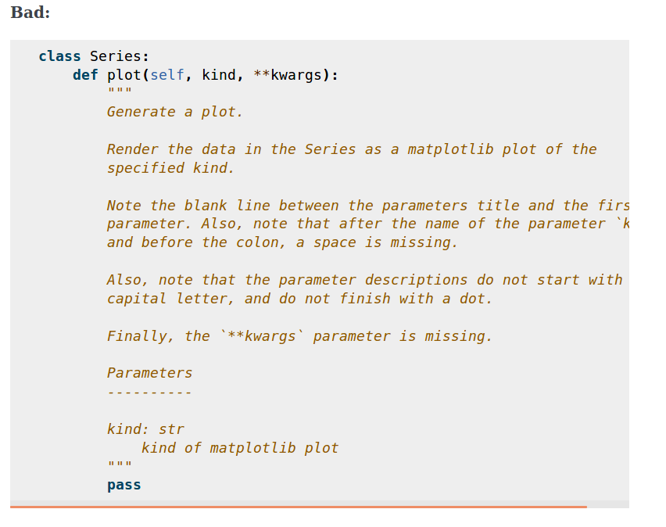
Pandas Documentation Sprint ANKARA chapter
How to docstring ?
3. Parameters: All must be documented including *args and **kwargs but not self
Types are not defined for *args and **kwargs, but must be defined for all other parameters.
Explain why there is a default value…
https://python-sprints.github.io/pandas/index.html
https://python-sprints.github.io/pandas/guide/pandas_docstring.html
https://pandas.pydata.org/
https://pydata.org/code-of-conduct.html

Slide 11
Pandas Documentation Sprint ANKARA chapter
How to docstring ?
3. Parameters: Parameter types
When specifying the parameter types, Python built-in data types can be used directly (the Python type is preferred to the more verbose string, integer, boolean, etc):
int
float
str
bool
For complex types, define the subtypes. For dict and tuple, as more than one type is present, we use the brackets to help read the type (curly brackets for dict and normal brackets for tuple):
list of int
dict of {str : int}
tuple of (str, int, int)
tuple of (str,)
set of str
https://python-sprints.github.io/pandas/index.html
https://python-sprints.github.io/pandas/guide/pandas_docstring.html
https://pandas.pydata.org/
https://pydata.org/code-of-conduct.html

Slide 12
Pandas Documentation Sprint ANKARA chapter
How to docstring ?
3. Parameters: Parameter types
In case where there are just a set of values allowed, list them in curly brackets and separated by commas (followed by a space). If the values are ordinal and they have an order, list them in this order. Otherwuse, list the default value first, if there is one:
{0, 10, 25}
{‘simple’, ‘advanced’}
{‘low’, ‘medium’, ‘high’}
{‘cat’, ‘dog’, ‘bird’}
If the type is defined in a Python module, the module must be specified:
datetime.date
datetime.datetime
decimal.Decimal
If the type is in a package, the module must be also specified:
numpy.ndarray
scipy.sparse.coo_matrix
https://python-sprints.github.io/pandas/index.html
https://python-sprints.github.io/pandas/guide/pandas_docstring.html
https://pandas.pydata.org/
https://pydata.org/code-of-conduct.html

Slide 13
Pandas Documentation Sprint ANKARA chapter
How to docstring ?
3. Parameters: Parameter types
If the type is a pandas type, also specify pandas except for Series and DataFrame:
Series
DataFrame
pandas.Index
pandas.Categorical
pandas.SparseArray
If the exact type is not relevant, but must be compatible with a numpy array, array-like can be specified. If Any type that can be iterated is accepted, iterable can be used:
array-like
iterable
If more than one type is accepted, separate them by commas, except the last two types, that need to be separated by the word ‘or’:
int or float
float, decimal.Decimal or None
str or list of str
If None is one of the accepted values, it always needs to be the last in the list.

Slide 14
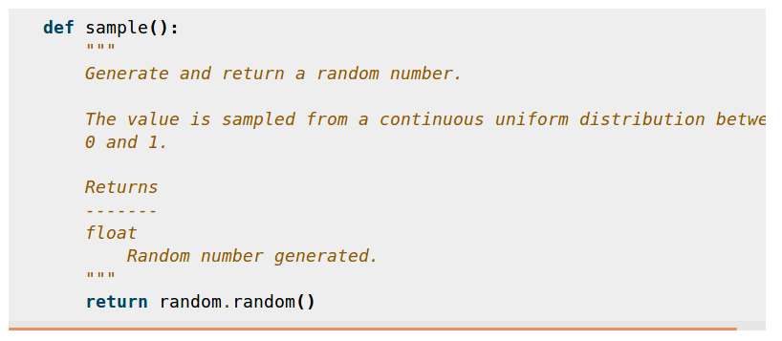
Pandas Documentation Sprint ANKARA chapter
How to docstring ?
Section 4: Returns or Yields¶
https://python-sprints.github.io/pandas/index.html
https://python-sprints.github.io/pandas/guide/pandas_docstring.html
https://pandas.pydata.org/
https://pydata.org/code-of-conduct.html

Slide 15
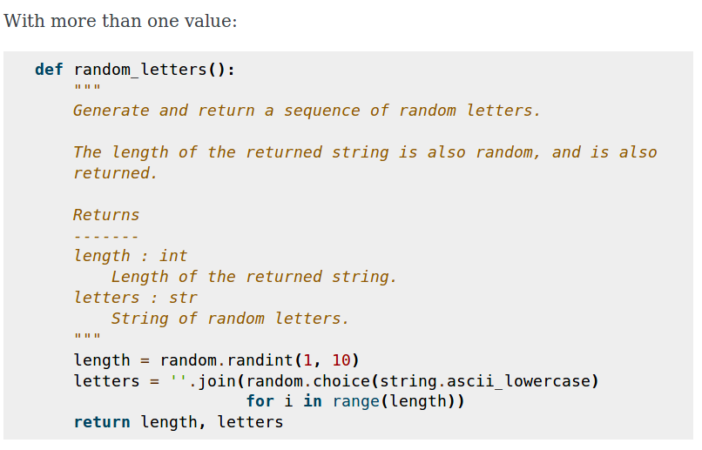
Pandas Documentation Sprint ANKARA chapter
How to docstring ?
Section 4: Returns or Yields¶
https://python-sprints.github.io/pandas/index.html
https://python-sprints.github.io/pandas/guide/pandas_docstring.html
https://pandas.pydata.org/
https://pydata.org/code-of-conduct.html

Slide 16
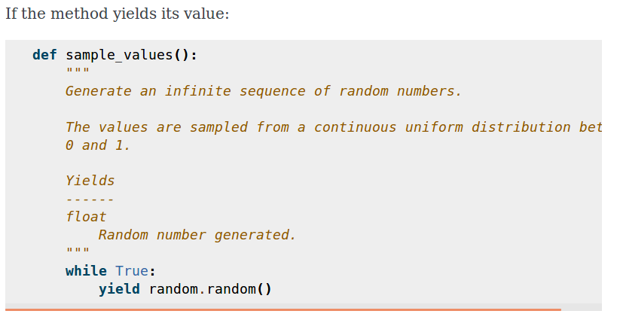
Pandas Documentation Sprint ANKARA chapter
How to docstring ?
Section 4: Returns or Yields¶
https://python-sprints.github.io/pandas/index.html
https://python-sprints.github.io/pandas/guide/pandas_docstring.html
https://pandas.pydata.org/
https://pydata.org/code-of-conduct.html

Slide 17
Pandas Documentation Sprint ANKARA chapter
How to docstring ?
Section 5: See Also
Head() and tail methods…
loc and iloc, as they do the same, but in one case providing indices and in the other position
max and min, as they do the opposite
iterrows, itertuples and iteritems, as it is easy that a user looking for the method to iterate over columns ends up in the method to iterate over rows, and vice-versa
fillna and dropna, as both methods are used to handle missing values
read_csv and to_csv, as they are complementary
merge and join, as one is a generalization of the other
astype and pandas.to_datetime, as users may be reading the documentation of astype to know how to cast as a date, and the way to do it is with pandas.to_datetime
where is related to numpy.where, as its functionality is based on it
https://python-sprints.github.io/pandas/index.html
https://python-sprints.github.io/pandas/guide/pandas_docstring.html
https://pandas.pydata.org/
https://pydata.org/code-of-conduct.html

Slide 18
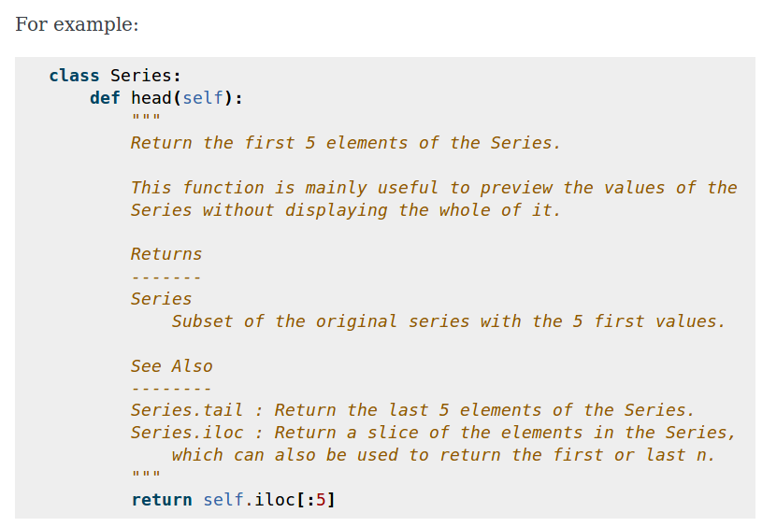
Pandas Documentation Sprint ANKARA chapter
How to docstring ?
Section 5: See Also
Head() and tail methods…
https://python-sprints.github.io/pandas/index.html
https://python-sprints.github.io/pandas/guide/pandas_docstring.html
https://pandas.pydata.org/
https://pydata.org/code-of-conduct.html

Slide 19
Pandas Documentation Sprint ANKARA chapter
How to docstring ?
Section 6: Notes
This is an optional section used for notes about the implementation of the algorithm. Or to document technical aspects of the function behavior.
Feel free to skip it, unless you are familiar with the implementation of the algorithm, or you discover some counter-intuitive behavior while writing the examples for the function.
This section follows the same format as the extended summary section.
https://python-sprints.github.io/pandas/index.html
https://python-sprints.github.io/pandas/guide/pandas_docstring.html
https://pandas.pydata.org/
https://pydata.org/code-of-conduct.html

Slide 20
Pandas Documentation Sprint ANKARA chapter
How to docstring ?
Section 7: Examples
Most important section of a docstring!!!
The way to present examples is as follows:
Import required libraries (except numpy and pandas)
Create the data required for the example
Show a very basic example that gives an idea of the most common use case
Add examples with explanations that illustrate how the parameters can be used for extended functionality
https://python-sprints.github.io/pandas/index.html
https://python-sprints.github.io/pandas/guide/pandas_docstring.html
https://pandas.pydata.org/
https://pydata.org/code-of-conduct.html

Slide 21
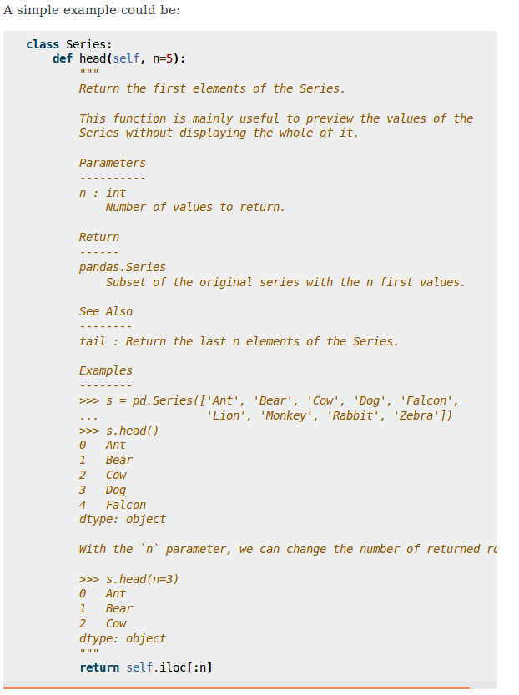
Pandas Documentation Sprint ANKARA chapter
How to docstring ?
Section 7: Examples
Most important section of a docstring!!!
https://python-sprints.github.io/pandas/index.html
https://python-sprints.github.io/pandas/guide/pandas_docstring.html
https://pandas.pydata.org/
https://pydata.org/code-of-conduct.html

Slide 22
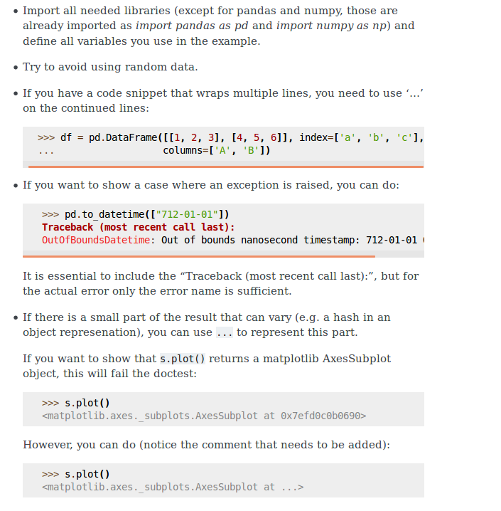
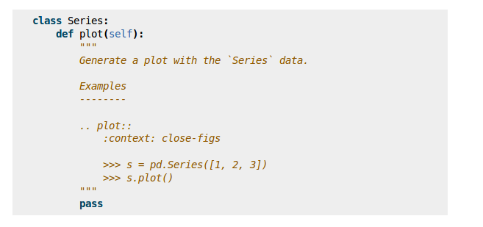
Pandas Documentation Sprint ANKARA chapter
How to docstring ?
Section 7: Examples
Most important section of a docstring!!!
https://python-sprints.github.io/pandas/index.html
https://python-sprints.github.io/pandas/guide/pandas_docstring.html
https://pandas.pydata.org/
https://pydata.org/code-of-conduct.html

Slide 23
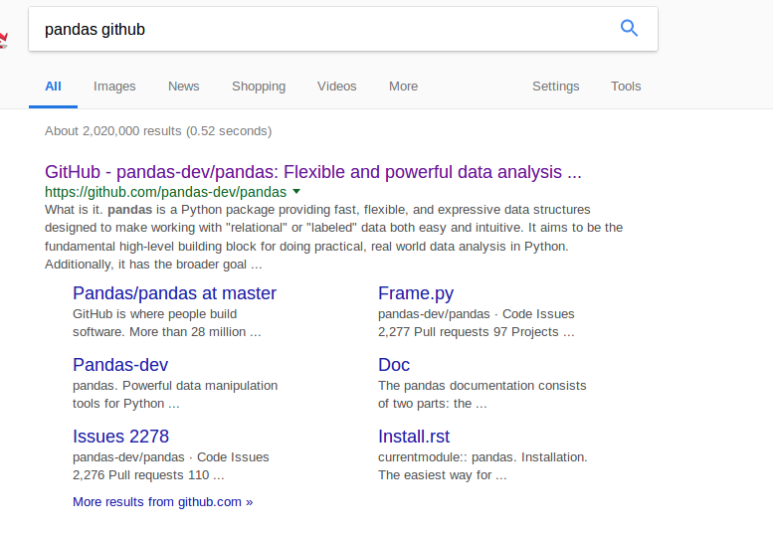
Pandas Documentation Sprint ANKARA chapter
https://python-sprints.github.io/pandas/index.html
https://python-sprints.github.io/pandas/guide/pandas_docstring.html
https://pandas.pydata.org/
https://pydata.org/code-of-conduct.html

Slide 24
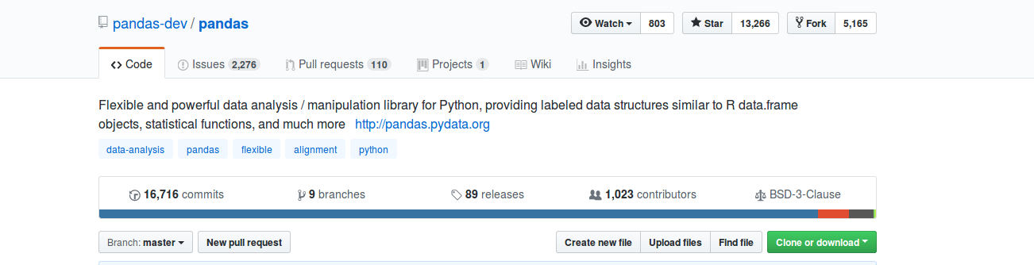
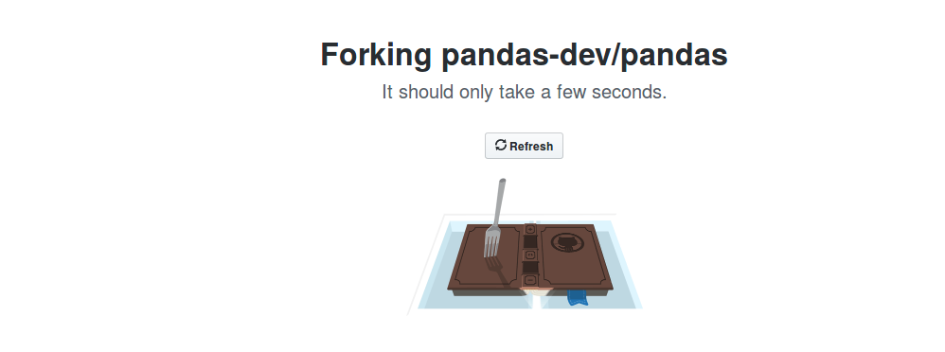
Pandas Documentation Sprint ANKARA chapter
https://python-sprints.github.io/pandas/index.html
https://python-sprints.github.io/pandas/guide/pandas_docstring.html
https://pandas.pydata.org/
https://pydata.org/code-of-conduct.html

Slide 25
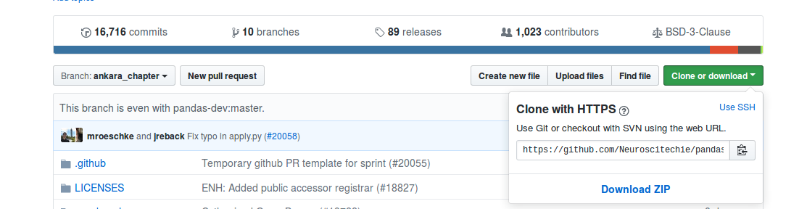
Pandas Documentation Sprint ANKARA chapter
https://github.com/Your_Github_Name/pandas.git
Command to use:
git clone…
git clone https://github.com/Your_Github_Name/pandas.git
https://python-sprints.github.io/pandas/index.html
https://python-sprints.github.io/pandas/guide/pandas_docstring.html
https://pandas.pydata.org/
https://pydata.org/code-of-conduct.html

Slide 26
Pandas Documentation Sprint ANKARA chapter
https://github.com/Your_Github_Name/pandas.git
To configure the remote fork…
cd pandas
git remote add upstream…
git remote add upstream https://github.com/pandas-dev/pandas.git
https://python-sprints.github.io/pandas/index.html
https://python-sprints.github.io/pandas/guide/pandas_docstring.html
https://pandas.pydata.org/
https://pydata.org/code-of-conduct.html

Slide 27
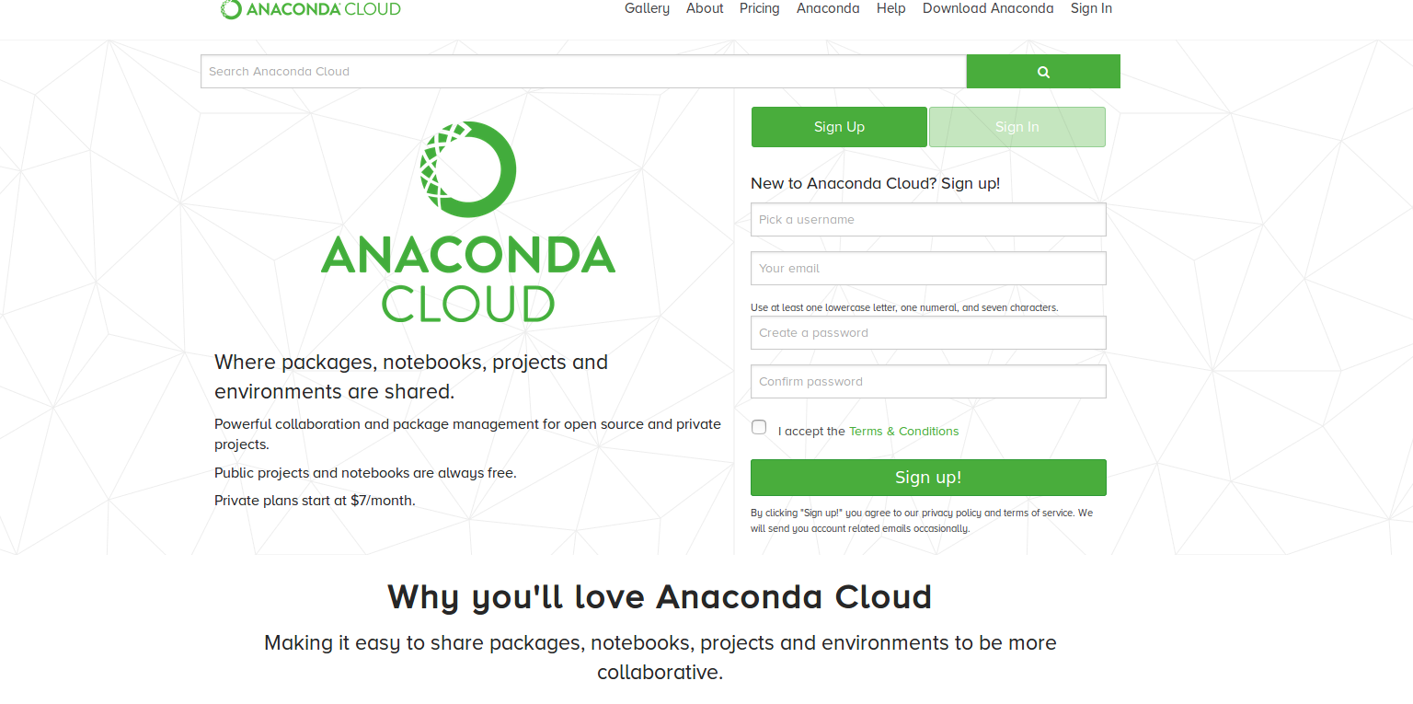
Pandas Documentation Sprint ANKARA chapter
REMAINDER!!!
Install Anaconda from https://anaconda.org/
https://python-sprints.github.io/pandas/index.html
https://python-sprints.github.io/pandas/guide/pandas_docstring.html
https://pandas.pydata.org/
https://pydata.org/code-of-conduct.html

Slide 28
Pandas Documentation Sprint ANKARA chapter
https://github.com/Your_Github_Name/pandas.git
For windows add Anaconda scripts to environment variables.
To create conda environment…
conda env create -f ci/environment-dev
It is also possible to create environment and add pandas into it...
https://python-sprints.github.io/pandas/index.html
https://python-sprints.github.io/pandas/guide/pandas_docstring.html
https://pandas.pydata.org/
https://pydata.org/code-of-conduct.html

Slide 29
Pandas Documentation Sprint ANKARA chapter
https://github.com/Your_Github_Name/pandas.git
For windows add Anaconda scripts to environment variables.
To activate conda environment…
conda activate pandas-dev
To deactivate:
Source deactivate
https://python-sprints.github.io/pandas/index.html
https://python-sprints.github.io/pandas/guide/pandas_docstring.html
https://pandas.pydata.org/
https://pydata.org/code-of-conduct.html

Slide 30
Pandas Documentation Sprint ANKARA chapter
Inside pandas-dev
To setup pandas
cd pandas
python setup.py build_ext –inplace -j 4
https://python-sprints.github.io/pandas/index.html
https://python-sprints.github.io/pandas/guide/pandas_docstring.html
https://pandas.pydata.org/
https://pydata.org/code-of-conduct.html

Slide 31
Pandas Documentation Sprint ANKARA chapter
Inside pandas-dev
To check pandas installation
print(pandas.__version__)
https://python-sprints.github.io/pandas/index.html
https://python-sprints.github.io/pandas/guide/pandas_docstring.html
https://pandas.pydata.org/
https://pydata.org/code-of-conduct.html

Slide 32
Pandas Documentation Sprint ANKARA chapter
Method Name
Information gathering of the specific method
Locating Method Docstring
Method Name:
* pandas.Series.dropna
Method Type:
* function
File location:
* pandas/core/series.py
Github link:
https://github.com/pandas-dev/pandas/blob/master/pandas/core/series.py#L2966
https://python-sprints.github.io/pandas/index.html
https://python-sprints.github.io/pandas/guide/pandas_docstring.html
https://pandas.pydata.org/
https://pydata.org/code-of-conduct.html

Slide 33
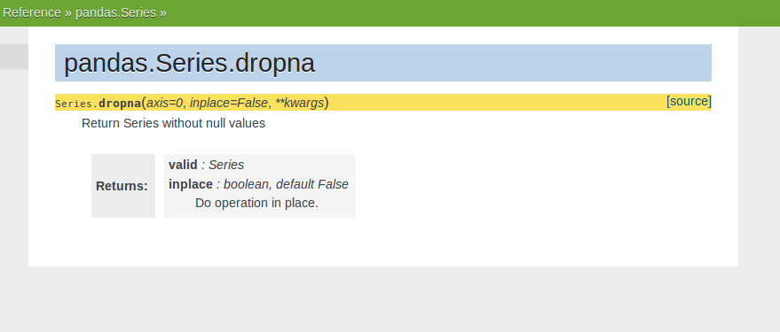
Pandas Documentation Sprint ANKARA chapter
Method Name:
* pandas.Series.dropna
https://python-sprints.github.io/pandas/index.html
https://python-sprints.github.io/pandas/guide/pandas_docstring.html
https://pandas.pydata.org/
https://pydata.org/code-of-conduct.html

Slide 34
Pandas Documentation Sprint ANKARA chapter
Method Name:
* pandas.Series.dropna
https://github.com/pandas-dev/pandas/blob/v0.22.0/pandas/core/series.py#L2972-L3001
Our marked line is L2966 which includes pandas.Series.notna
Checking with validation script and errors on pandas.Series.dropna are:
* No extended summary found
* Errors in parameters section:
Documentation needed for parameters {kwargs, inplace and axis}
* See also section not found
* No examples section found
Checking with validation script and errors on pandas.Series.notna
https://python-sprints.github.io/pandas/index.html
https://python-sprints.github.io/pandas/guide/pandas_docstring.html
https://pandas.pydata.org/
https://pydata.org/code-of-conduct.html

Slide 35
Pandas Documentation Sprint ANKARA chapter
Method Name:
* pandas.Series.dropna
https://github.com/pandas-dev/pandas/blob/v0.22.0/pandas/core/series.py#L2972-L3001
Our marked line is L2966 which includes pandas.Series.notna
Find method descriptions, using parameters, appenders, functions as keywords… and locate possible descriptions.
There might not be a method summary...
https://python-sprints.github.io/pandas/index.html
https://python-sprints.github.io/pandas/guide/pandas_docstring.html
https://pandas.pydata.org/
https://pydata.org/code-of-conduct.html

Slide 36
Pandas Documentation Sprint ANKARA chapter
Method Name:
* pandas.Series.dropna
https://github.com/pandas-dev/pandas/blob/v0.22.0/pandas/core/series.py#L2972-L3001
To check changes to github:
use
git status
To add changes:
git add
To make a branch:
git checkout -b your_branch_name
git branch also shows the branch we are working on
https://python-sprints.github.io/pandas/index.html
https://python-sprints.github.io/pandas/guide/pandas_docstring.html
https://pandas.pydata.org/
https://pydata.org/code-of-conduct.html

Slide 37
Pandas Documentation Sprint ANKARA chapter
Method Name:
* pandas.Series.dropna
https://github.com/pandas-dev/pandas/blob/v0.22.0/pandas/core/series.py#L2972-L3001
Try to fix errors one by one, and check progress with validation script…
If you are at cd scripts folder
python validate_docstrings.py pandas.Series.dropna
Or from pandas folder
python validate_docstrings.py pandas.Series.dropna
To provide examples try to find several forms
And follow the syntax, results must be shown… to check this run validation script.
Blank line separates the sections so use the blank line only!
https://python-sprints.github.io/pandas/index.html
https://python-sprints.github.io/pandas/guide/pandas_docstring.html
https://pandas.pydata.org/
https://pydata.org/code-of-conduct.html

Slide 38
Pandas Documentation Sprint ANKARA chapter
After fixing all the errors of the validation script…
Inside doc file by cd doc Run...
python make.py html –single pandas.Series.dropna
This will produce an html file to compare changes :)
To push local changes to github…
git fetch upstream
git merge upstream/master
git add .\pandas\core\series.py
git status
git commit -m “DOC: Improved the docstring of pandas.Series.dropna”
git branch
Git push -u origin branch_name (ankara_chapter_sprint)
https://python-sprints.github.io/pandas/index.html
https://python-sprints.github.io/pandas/guide/pandas_docstring.html
https://pandas.pydata.org/
https://pydata.org/code-of-conduct.html

