Slide 1


Power of Python, R &
Tableau in Data Science
(PyData Bratislava Meetup #1, Nervosa; #PyDataBA)
13. 2. 2017
Radovan Kavicky, GapData Institute (GDI)
Notes:
(30s.)
3 parts:
About our activities
Python, R & Tableau
Future activites

Slide 2


GapData Institute (GDI)
  Economic Research & Public Policy & Data Science think-tank (data-tank)
  Data. Think. Change.
  GapData Institute (GDI) is a non-profit nonpartisan research institution harnessing power of data & wisdom of economics for public good.
  Transparent account (from day #1; SK7383300000002200933920 https://www.fio.sk/ib2/transparent?a=2200933920)
  Partnership (openness, transparency)
Power of Python, R & Tableau in Data Science
1/7
Notes:
(1-2 min.)
Basic information about GapData Institute
- openness, transparent account
- Random

Slide 3





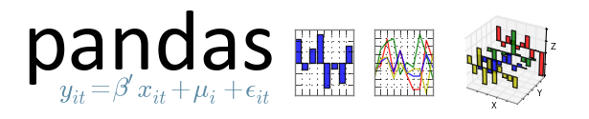
Python (best tools/Data Science)
  pandas (data manipulation, analysis)
  pandas datareader (data import)
  pandas-ply (functional data manipulation)
  datacleaner (automate clean your data)
  matplotlib (dataviz)
  SciPy (scientific Python)
  NumPy (numerical Python)
  Numba (app high-perf)
  Bokeh (dataviz)
  scikit-learn (ML)
Power of Python, R & Tableau in Data Science
2/7
Notes:
(1-2min.)
- Random
- Random

Slide 4
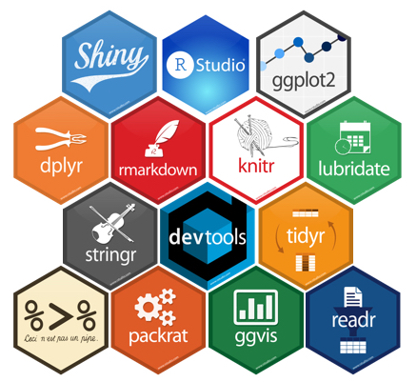
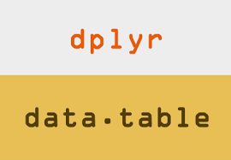


R (best tools/Data Science)
  R-Studio (IDE for R)
  Shiny (R apps/interactive tools)
  ggplot2 (dataviz, plotting tool)
  ggvis (dataviz, declarative describe)
  dplyr (data manipulation, dataframe)
  data.table (data aggregator, join+modify)
  knitr (report generation)
Power of Python, R & Tableau in Data Science
3/7
Notes:
(1-2min.)
- Random
- Random

Slide 5
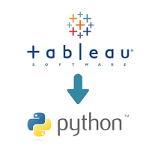



Tableau (best tools/Data Science)
  Tableau Desktop (+Public Edition)
  Tableau Server (Python +R models)
  Power Tools for Tableau
  Power Tools for Tableau Desktop
  Power Tools for Tableau Server
  Power Tools for Tableau Deployment
  Workbook SDK for Tableau (soft dev)
  DataWrangler (wrangle data took)
  Alteryx Visual Analytics Kit for Tableau
Power of Python, R & Tableau in Data Science
4/7
Notes:
(1-2 min.)
- Random
- Random

Slide 6
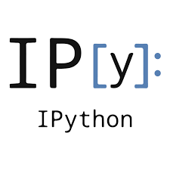


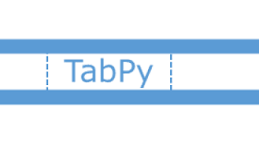


Python, R & Tableau (how to connect them)
  IPython/Project Jupyter (Julia, Python + R)
  Jupyter notebook (.ipynb rendering via web browser) +nbviewer
  rpy2 (start R in Python)
  TabPy (connect to Tableau Server from Python) +dplython (dplyr @Py)
  D3 (DataViz, JavaScript)
  Tableau +R.Data (connect .Rproj +.RData)
  PythonInR (start Python in R)
  Rserve (TCP/IP binary R server)
Power of Python, R & Tableau in Data Science
5/7
Notes:
(1-2min.)
- Random
- Random

Slide 7
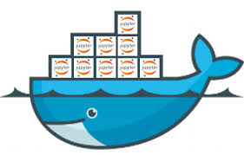





Data Science (other tools)
  JupyterHub (Jupyter for teams)
  Docker (virtualization, app deploy)
  Kafka (distributed stream platform)
  Hadoop (Apache +distributed data storage +MapReduce, Java)
  MongoDB (cross-platform document-oriented database)
  Apache Spark (cluster computing)
  +many open-source tools
Power of Python, R & Tableau in Data Science
6/7
Notes:
(2 min.)
- Random
- Random
- Random
- Random

Slide 8
Other activities (GapData Institute)
  PyData Bratislava, R <- Slovakia, skczTUG
  Open Data (only the 1st necessary step)
  Python, R, Tableau community activities
  Economic Research (studies, papers, publications)
  Quantitative & Qualitative Analyses (Data/center of it all)
  Data Visualization (Interactive DataViz Tools)
  Public Policy (Public Budget, Public Finance)
  Economic Reforms (any area)
  PyCon SK 2017 (10th-12th of March 2017, FIIT UK)
Power of Python, R & Tableau in Data Science
7/7
Notes:
(1-2 min.)
- Random.
- Random.

Slide 9






Thank you for your attention
  Contact:
  Radovan Kavicky
  radovan.kavicky@gapdata.org
  +420 776 467 159 (CZ)
  +421 949 716 214 (SK)
  http://www.linkedin.com/in/radovankavicky
  https://gapdata.slack.com/messages/py-data/
  https://github.com/radovankavicky
  https://github.com/GapData/PyDataBratislava
  @radovankavicky, @PyDataBA, @GapDataInst
In case you have any question, feel free to ask.
#PyDataBA

