Slide 1

DATA DRIVEN LITERARY ANALYSIS: AN UNSUPERVISED APPROACH TO TEXT ANALYSIS AND CLASSIFICATION
Serena Peruzzo
PhD candidate at TU/e
@sereprz
s.peruzzo@tue.nl
github.com/sereprz
Notes:
Last year I spent 3 months at the recurse centre, which is this magical place where you can go and do whatever you think is going to make you a better programmer.
While I was there I spent most of my time learning about natural language processing and python and I did that working on a pet project based on shakespeare’s body of work.
So this is more or less the story of my journey through learning about nlp and analysing Shakespeare’s plays.

Slide 2
Why and what?
Natural Language Processing (NLP)
interaction between natural and artificial languages
e.g., machine translators, sentiment analysis, spam filters
can nlp identify different genres?
Notes:
- Includes all kinds of computer manipulations of natural languages
- with ML used daily to solve various problems
- I was curious about whether I could use it to do something like literature analysis, the way

Slide 3
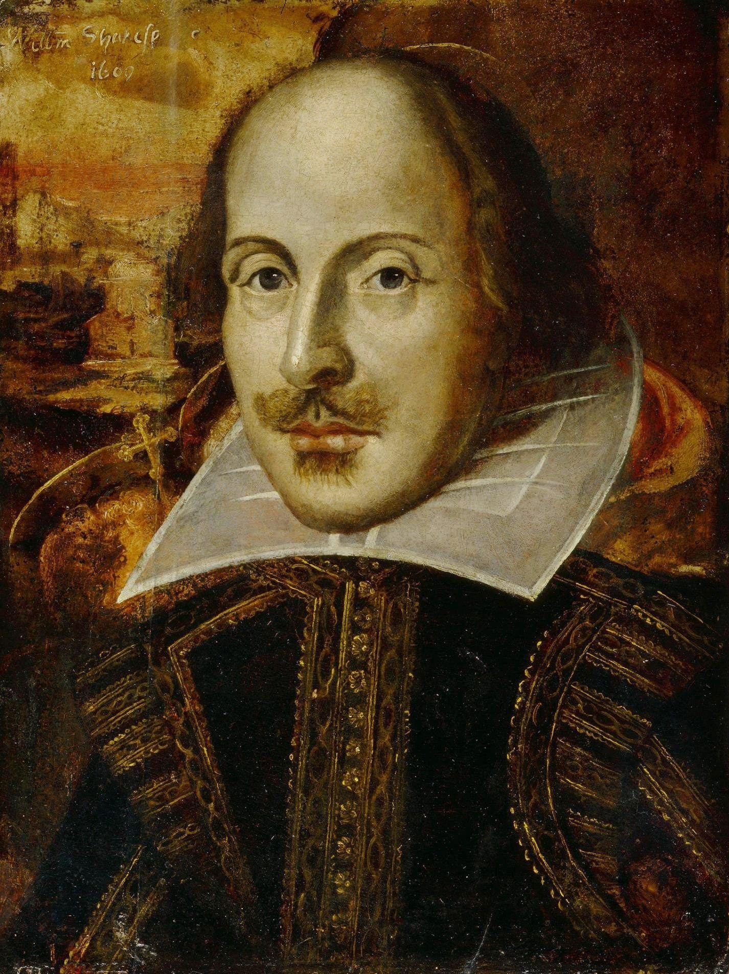
Shakespeare analysis
Two stages:
topic modelling
+
clustering
18 comedies
10 tragedies
Trials and Errors
11000+ words

Slide 4
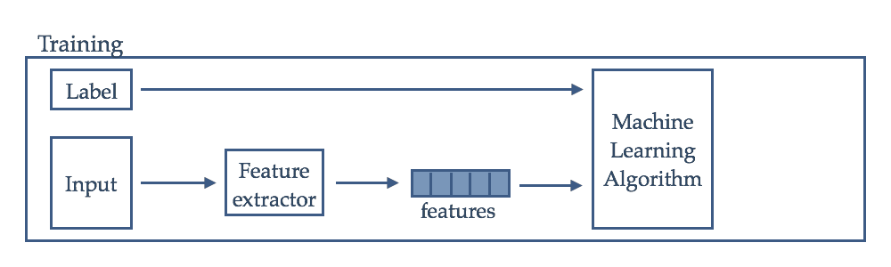
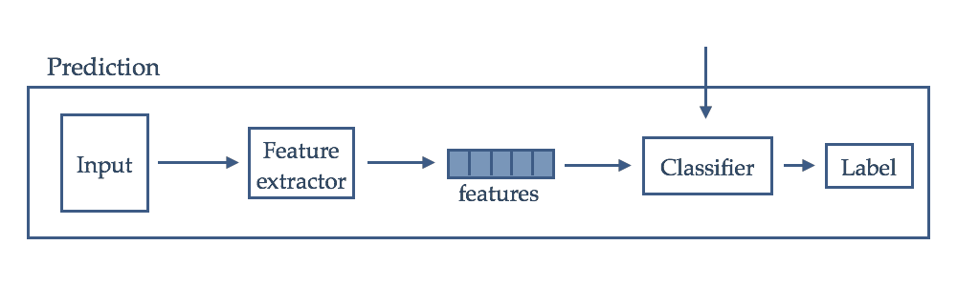
Supervised document classification

Slide 5
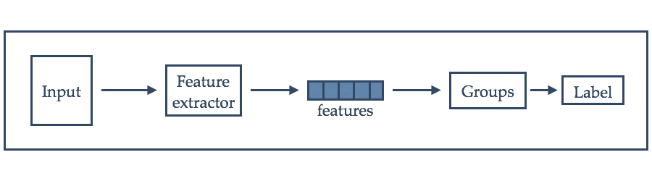
unsupervised approach

Slide 6
feature extraction
a lot of information needs to be compressed and represented in simple data types
inverse document frequency
term frequency
tfidf(‘love’, ‘Romeo and Juliet’, ‘Shakespeare’s plays’) = 100 * ln(28/25) = 11.33
tfidf(‘Juliet’, ‘Romeo and Juliet’, ‘Shakespeare’s plays’) = 100 * ln(28/1) = 333.22
Notes:
intuition: absolute frequency is not enough to catch the differences, add measure of how common is the word in the corpus

Slide 7
Latent dirichlet allocation
Unsupervised
N documents
K probability distributions over a collection of words (topics)
Formal statistical relationship
bag-of-words assumption
Notes:
Formal statistical relationship between a group of observed and latent random variables that specifies a probabilistic procedure to generate the topics

Slide 8
lda - generative model
For each document:
Select the number of words
Draw a distribution of topics
For each word in the document:
Draw a specific topic
Draw a word from a multinomial probability conditioned on the topic

Slide 9
lda - example
d is a 5-words document
Decide d will be 1/2 about cute animals and 1/2 about food
topic:food, word:’broccoli’
topic:cute animals, word:‘panda’
topic:cute animals, word: ’baby’
topic:food, word: ’apple’
topic:food, word:’eating’
d = { broccoli, panda, baby, apple, eating}
Notes:
example: how would you generate a document according to the probabilistic procedure described by LDA?

Slide 10
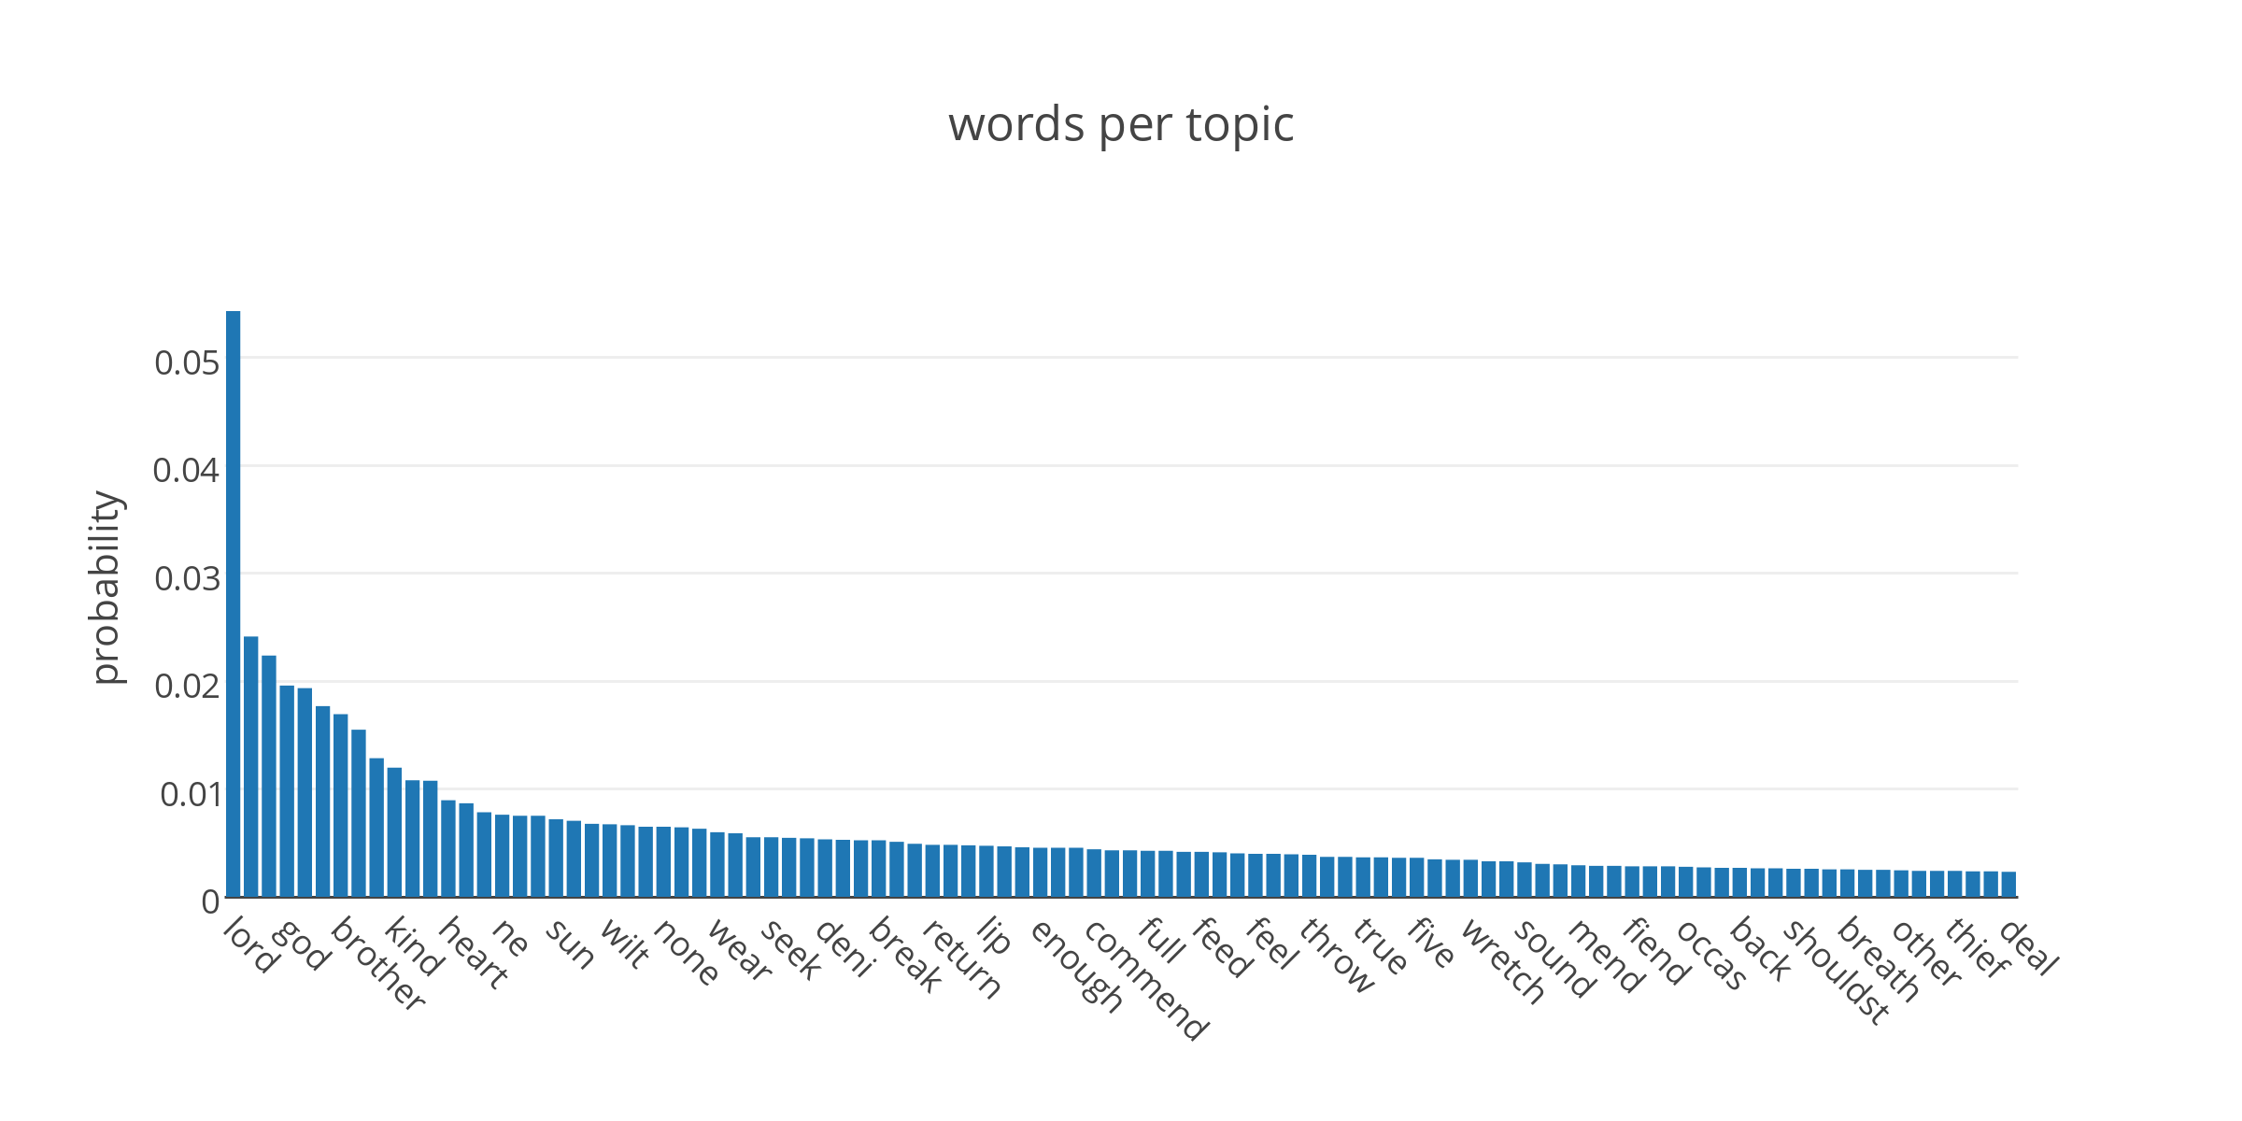
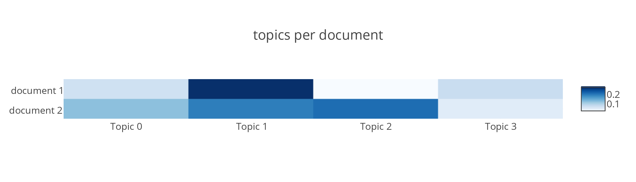
Notes:
- documents as mixtures of topics

Slide 11
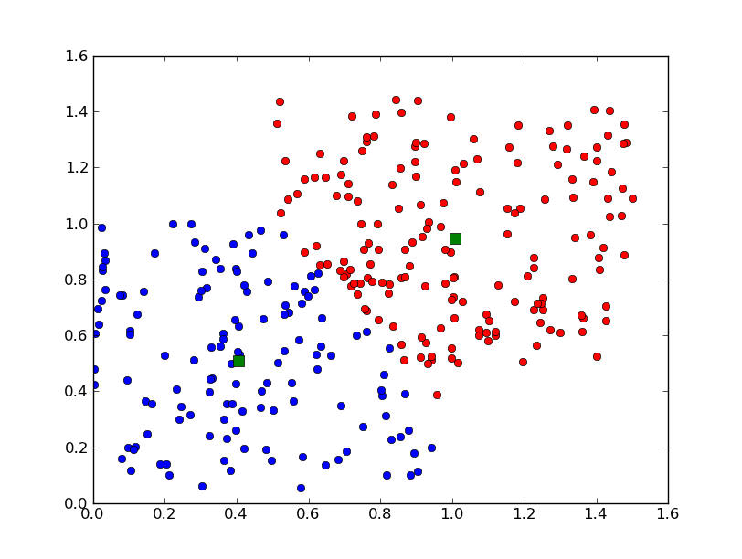
k-means
Unsupervised
K groups
minimise variability within each cluster
maximise variability between clusters
Notes:
partition the data in k groups such that the variance within clusters is minimised and the variability between clusters is max -> each observation assigned to the nearest mean
- picture: example of results. green squares are the final centroids. each point is assigned to the mean at smaller euclidian distance

Slide 12
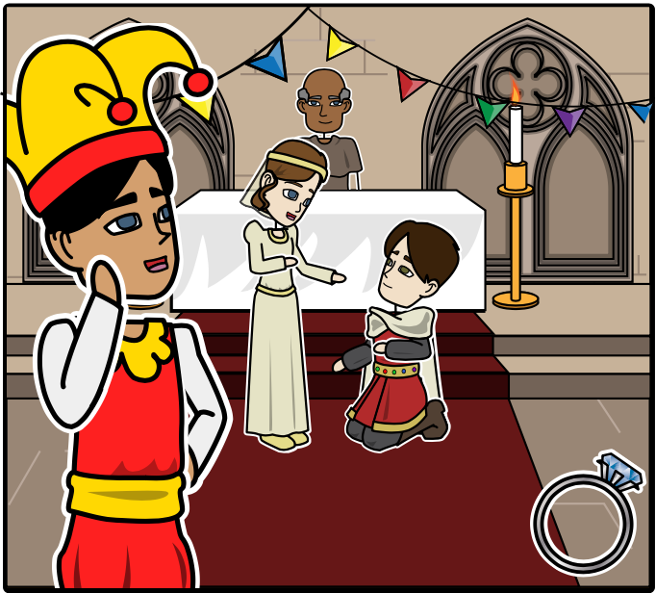
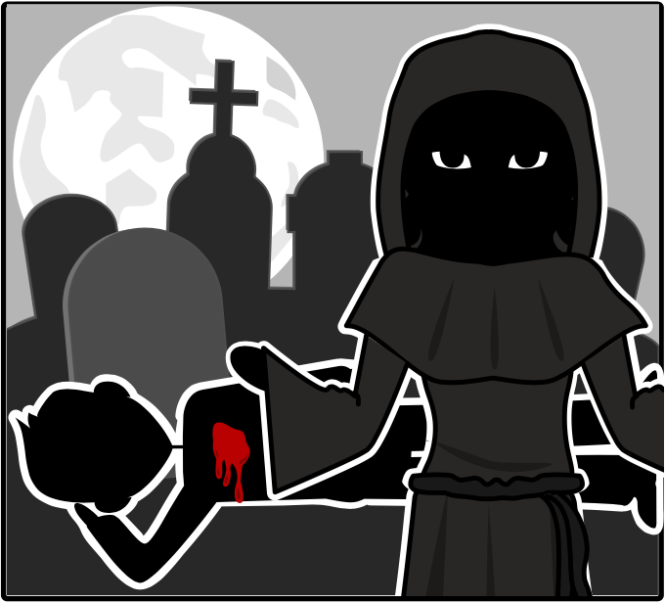
Complex plot (twists)
Mistaken identities
Language (puns, creative insults)
Love
Happy ending
Noble hero with a tragic flaw that leads to a tragic fall
Supernatural element
Death

Slide 13
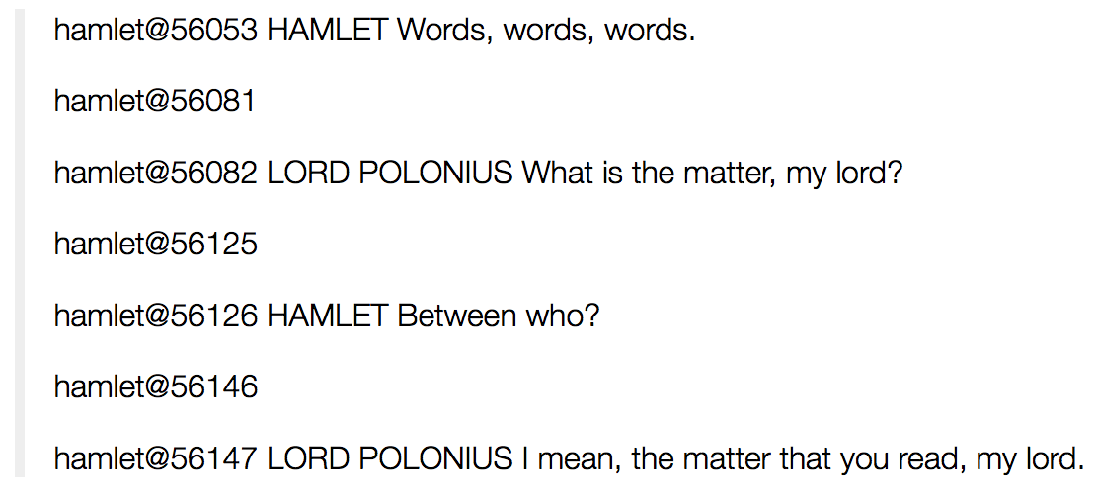
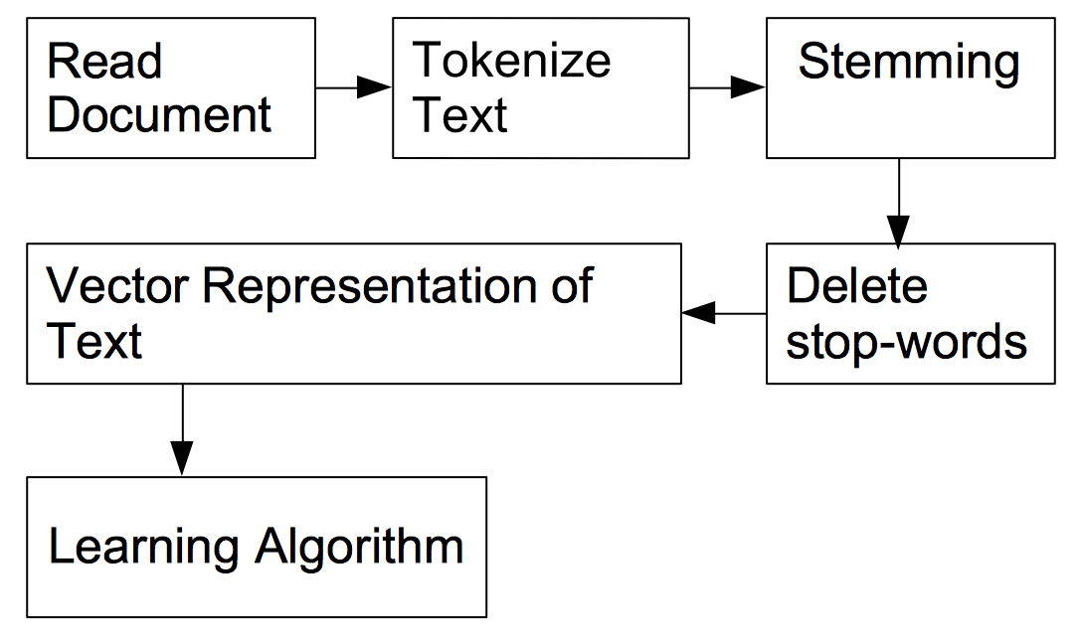
pre-processing and analysis
nltk
lda + scikit-learn

Slide 14
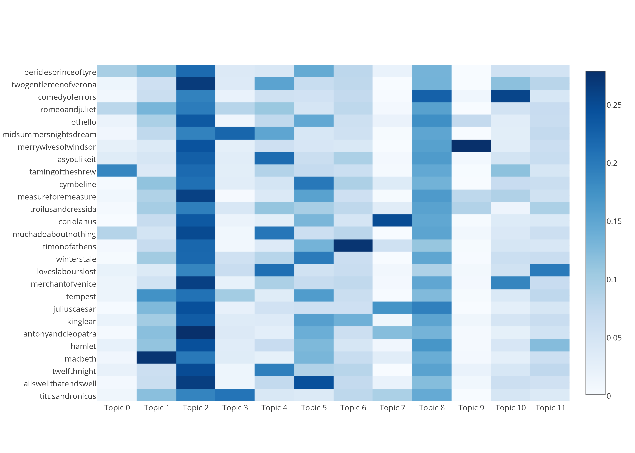
Notes:
no golden rule for choosing number of topic
this is a compromise

Slide 15
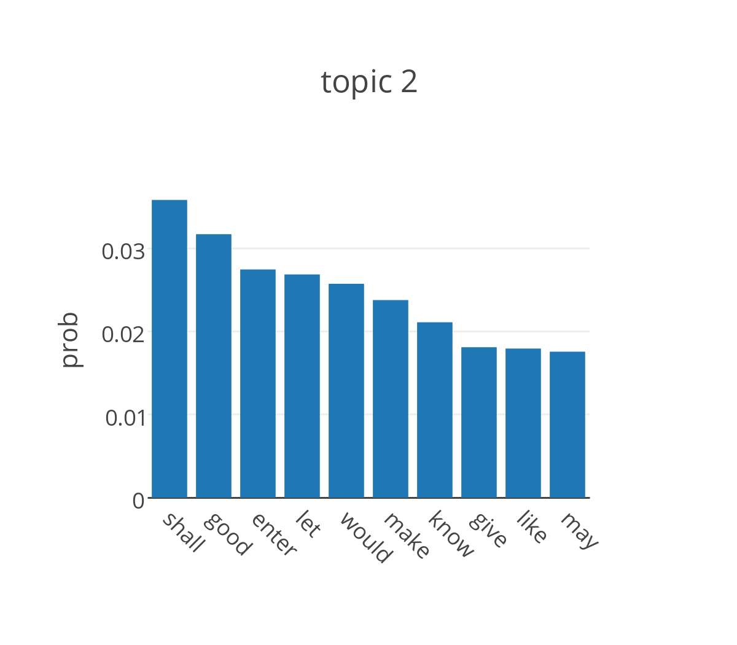
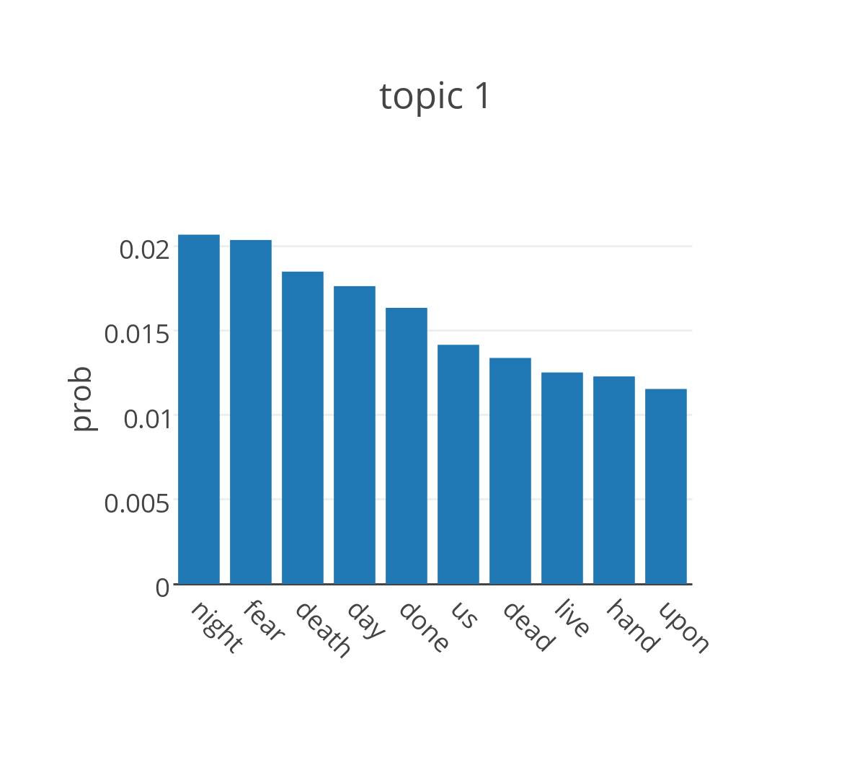
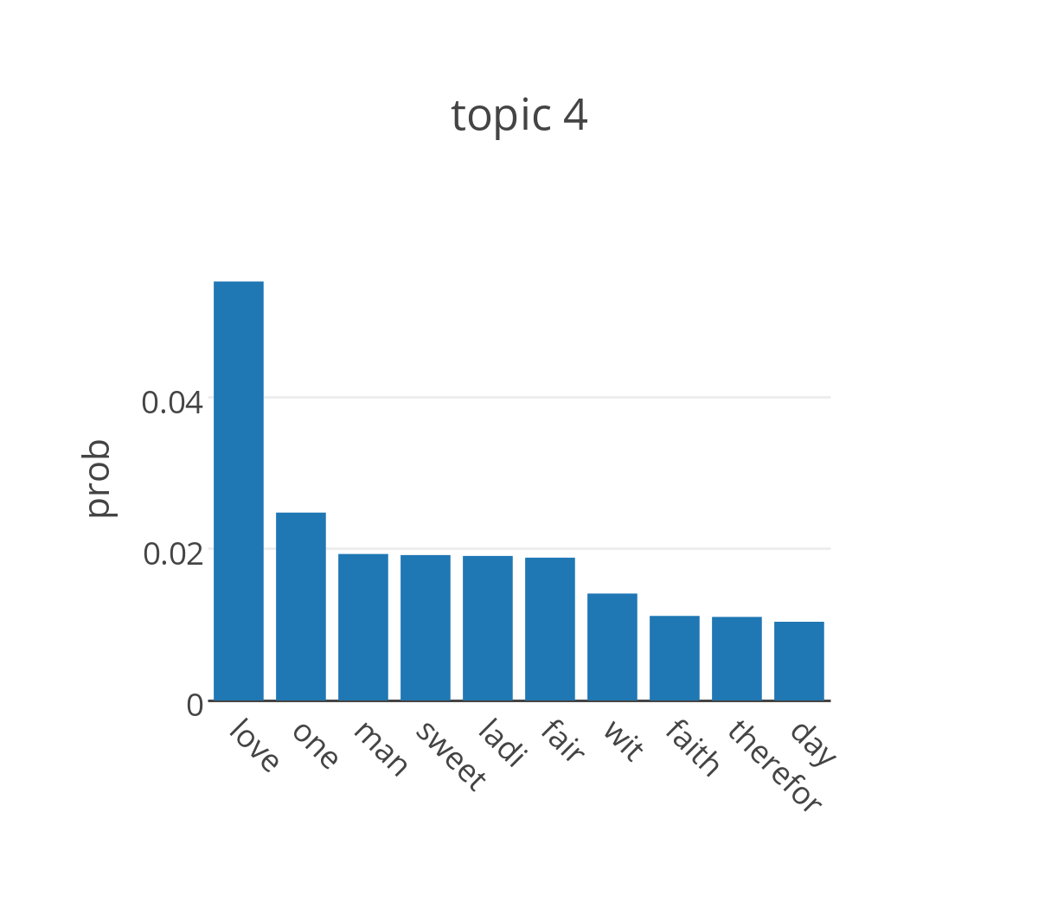
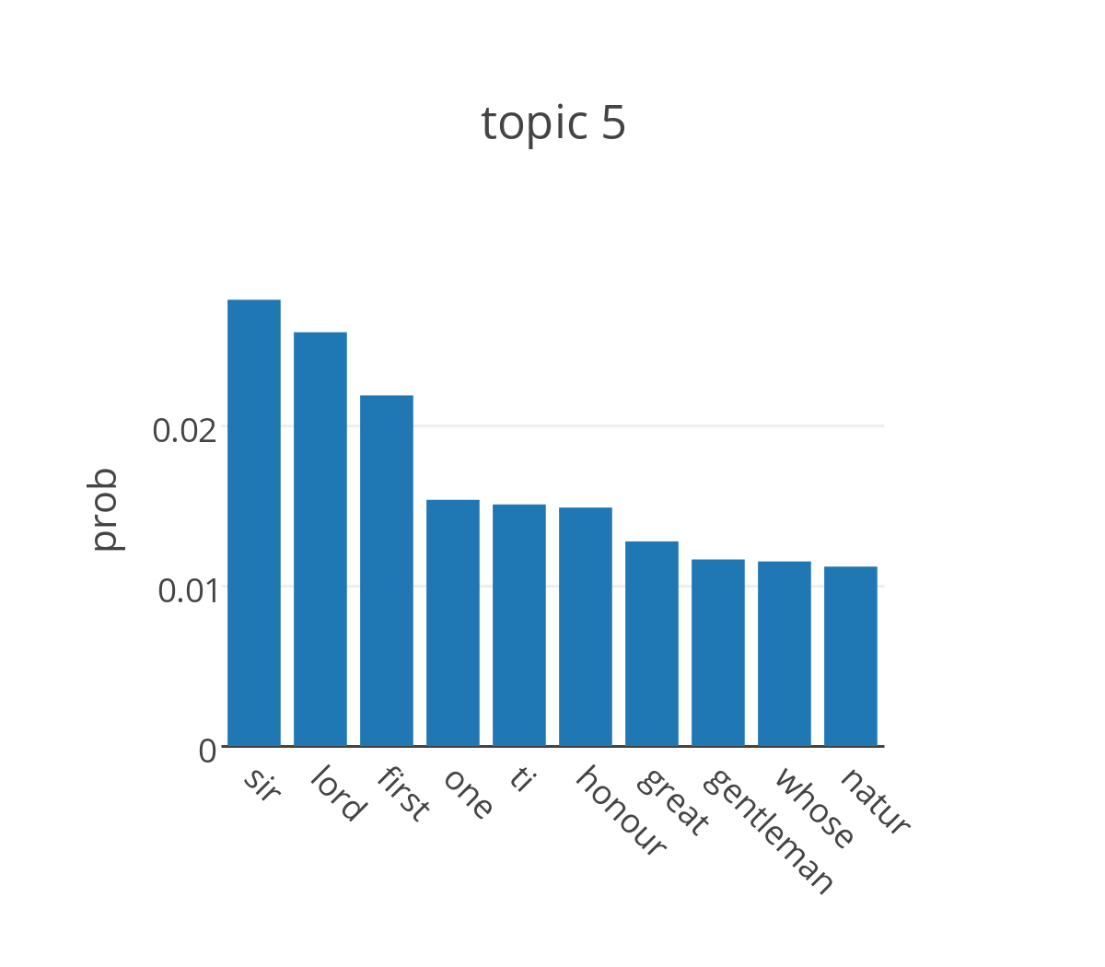
common words
death
love
hero

Slide 16
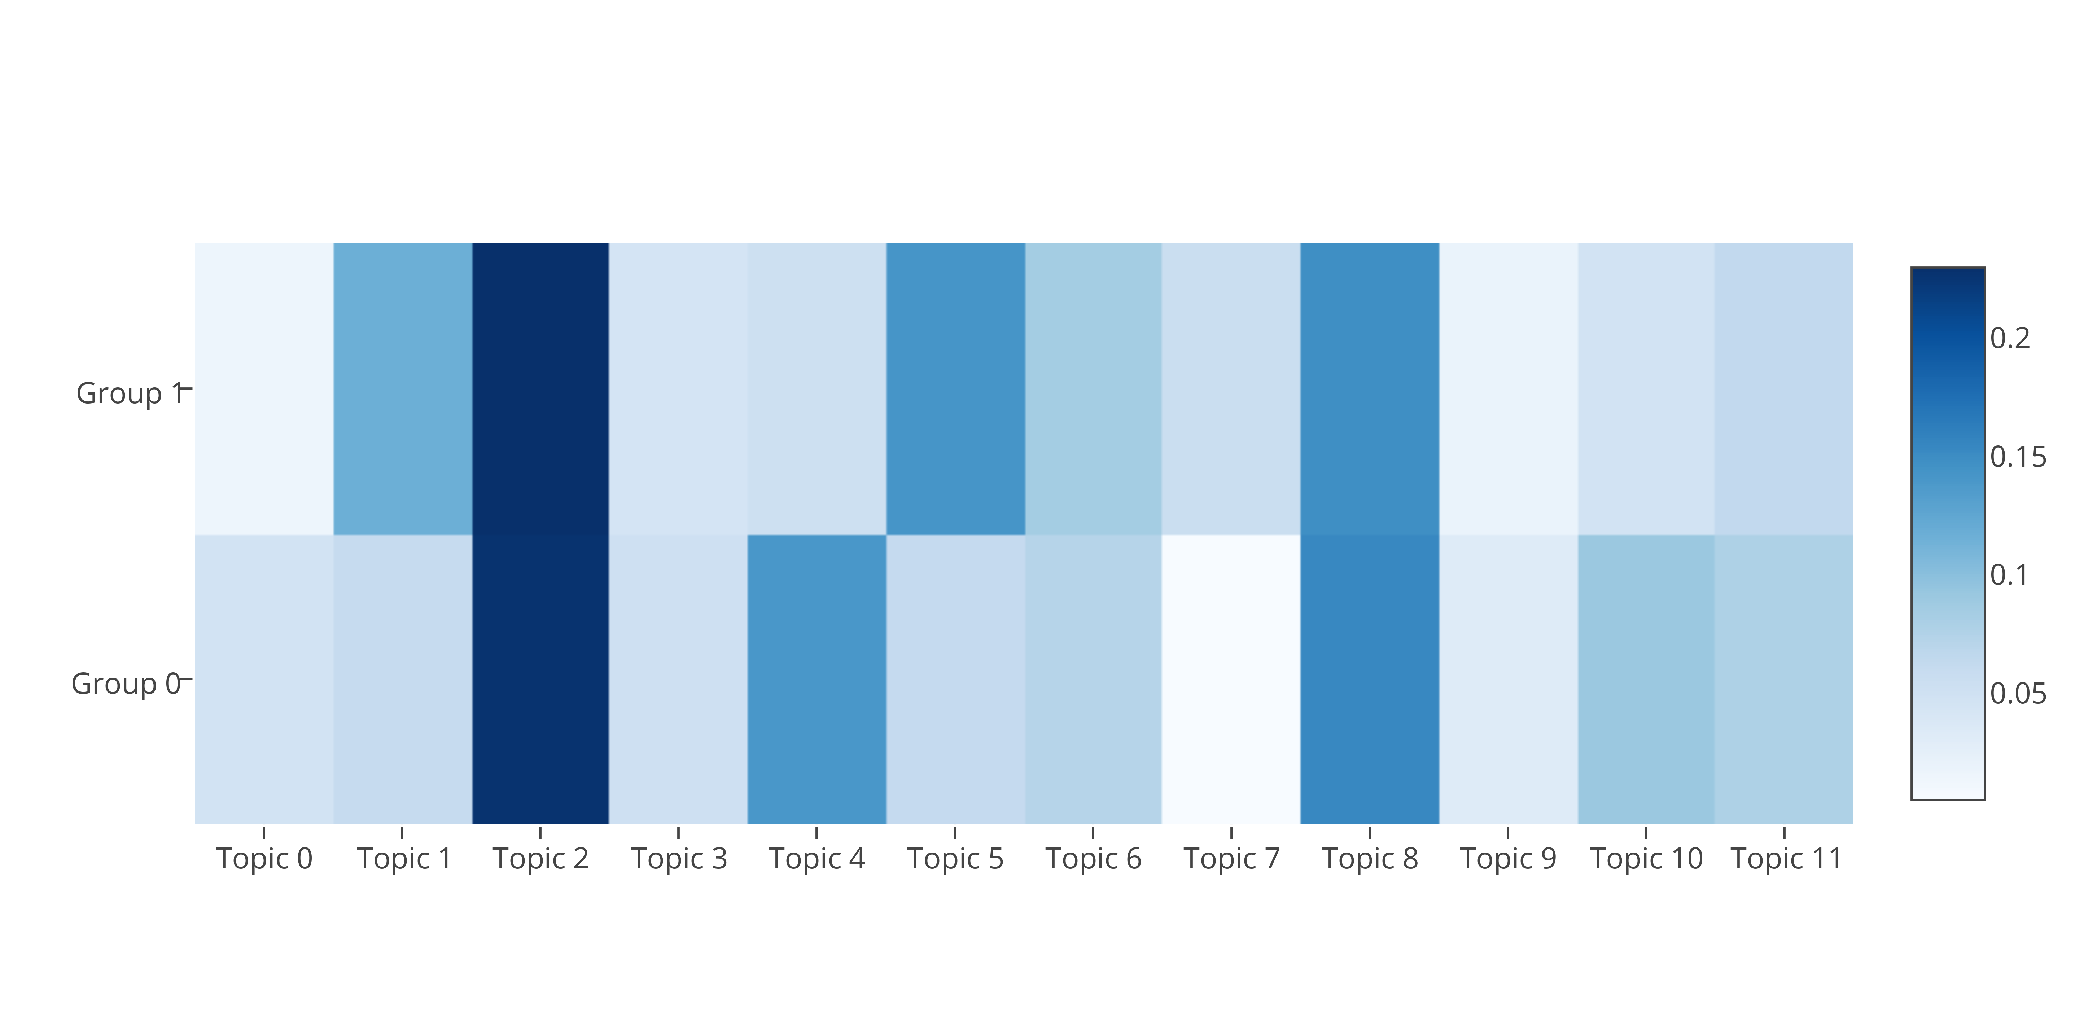
topics averages within groups
death
common
love
hero
Notes:
looks like I’m on the right track

Slide 17
k-means grouping vs traditional classification
Group 0 | Group 1
Twelfth night, The Merchant of Venice, Love’s Labour’s Lost, Much ado About Nothing, Taming of the Shrew, As You Like it, Merry Wives of Windsor, Midsummer Night’s Dream, Romeo and Juliet, Comedy of Errors, Two Gentlemen of Verona | Titus Andronicus, All’s Well What Ends Well, Macbeth, Hamlet, Antony and Cleopatra, King Lear, Julius Caesar, Tempest, Winter’s Tale, Timon of Athens, Coriolanus, Troilus and Cressida, Measure for Measure, Cymbeline, Othello, Pericle Prince of Persia

Slide 18
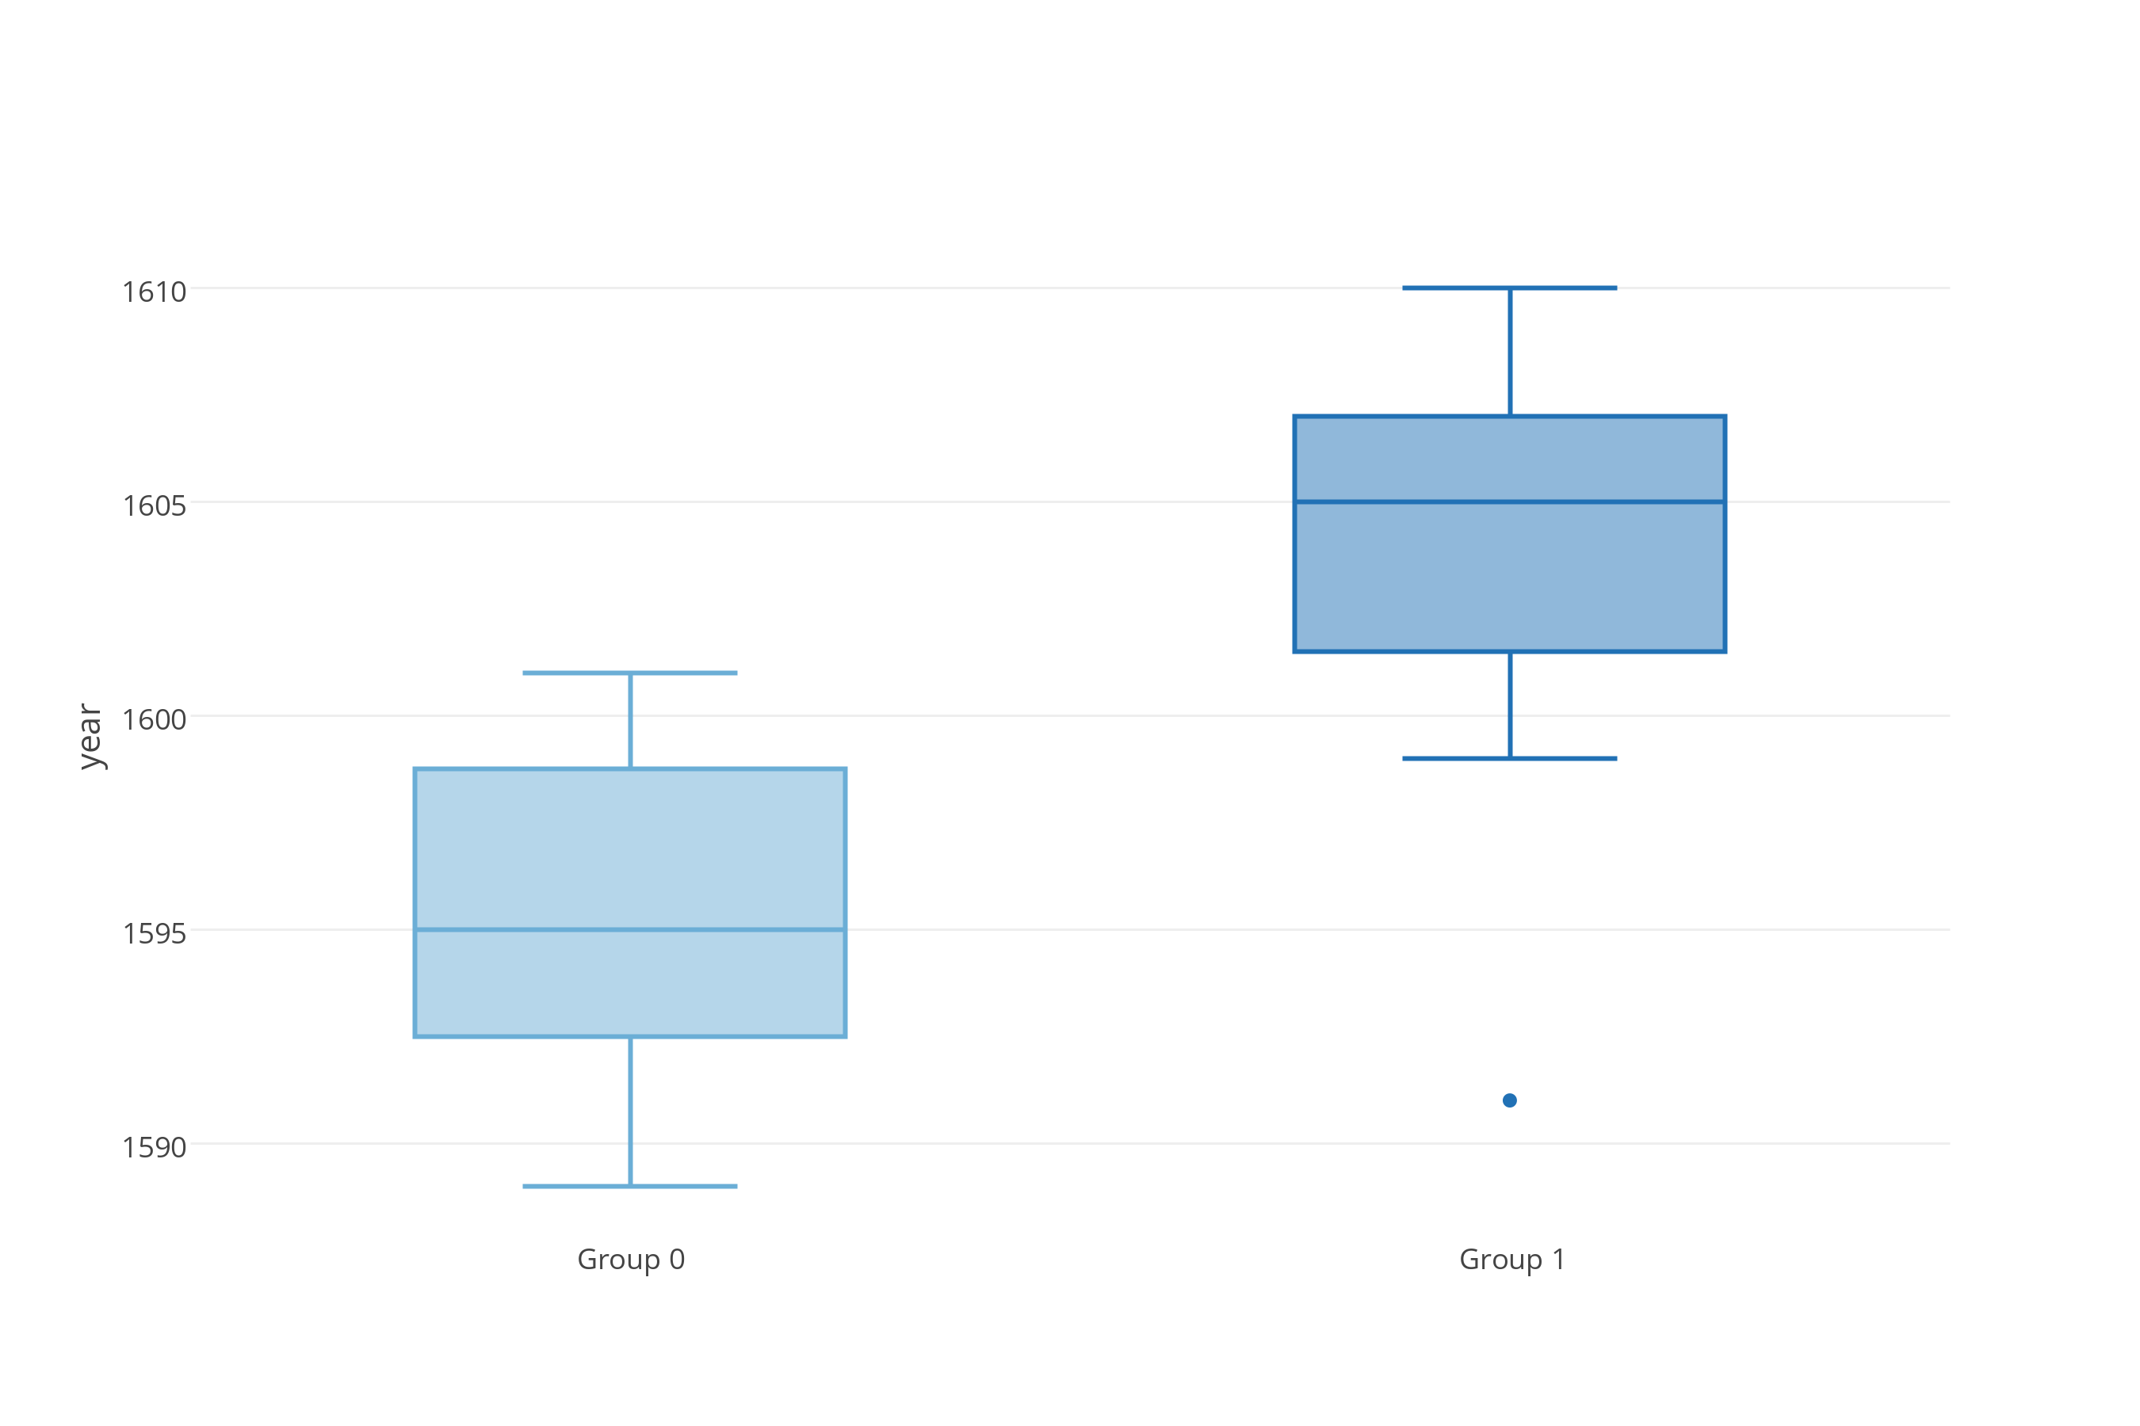
years the plays were performed for the first time
Notes:
maturity as a dramatist reach in late Elizabeth/early James
earlier = old morality drama + classical theory
later = tragedies and tragicomedy
1623 first folio

Slide 19
What i learned
Can’t find comedies VS tragedies
Can use NLP for literary analysis
Let data tell their story
Notes:
- can’t find the difference between comedies and tragedies,
- can still use NLP. split found, just not what I expected
- stopped looking at ‘common approaches’ and started looking more closely at the data I had, which helped me come up with my own approach to the problem. In this prospective the main thing I learned was letting the data tell the story, rather then telling a story using data, is a great way of gaining insight and maybe even learning something new.

Slide 20
thanks for listening
questions?
code: github.com/sereprz/ShakespeareTextAnalysis

