Slide 1
Programming In C#

Slide 2
Objectives
Strings
Regular Expressions
Lists
Collections

Slide 3
Strings
A string is an array of characters.
The string keyword is an alias for System.String class.
A string is a reference type, hence its default value is NULL.
A string is stored on Heap memory.
String has various inbuilt methods (Eg: Compare,Contains,Format, Substring, etc)
Eg: string cName; //string declaration
cName = “Xoriant”; //string initialization

Slide 4
String And StringBuilder
String is Immutable ie. When you alter a String variable, then it will create a new instance of String, instead of changing/updating the old one.
Eg:
string str = “Hello";
str += “World"; // A new instance of String is created.
StringBuilder is Mutable ie. we can perform any operation like insert, replace or append, without creating new instance every time.
Performance wise String is slow than StringBuilder, because every time it will create a new instance for change in String.
Eg:
StringBuilder sb = new StringBuilder();
sb.Append(“Hello");
sb.Append(“World");
string str = sb.ToString();

Slide 5
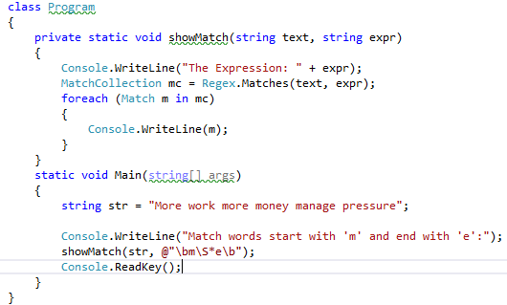
Regular Expressions
A regular expression is a pattern that could be matched against an input text.
The Regex class is used for representing a regular expression.
Regex class has multiple inbuilt overloaded IsMatch() methods, used to find a match in the specified input string.

Slide 6
Common Patterns
Pattern | Description
\w | Matches any word character.
\W | Matches any non-word character.
\s | Matches any white-space character.
\S | Matches any non-white-space character.
\d | Matches any decimal digit.
\D | Matches any character other than a decimal digit.
* | Matches the previous element zero or more times.
+ | Matches the previous element one or more times.
? | Matches the previous element zero or one time.
^ | The match must start at the beginning of the string or line.
| | Matches any one element separated by the vertical bar (|) character.
{ n } | Matches the previous element exactly n times.
$ | The match must occur at the end of the string
\b | Match the beginning or end of a word

Slide 7
Lists
A list is an object which holds variables in a specific order.
List<T> is a generic class, where T is the type.
Eg: List<int> numbers = new List<int>();
You can use Add() method to insert elements in List and Remove() to remove elements from List. Use RemoveAt() to specify an index of an item to remove from List.
Use AddRange() function to add a whole array to a list.
List is dynamic sized whereas Array is fixed size data structure.

Slide 8
Collections
Collection classes are specialized classes for data storage and retrieval.
These classes provide support for stacks, queues, lists, and hash tables.
Collection classes belong to Sysstem.Collection

Slide 9
Type of Collections
Class | Description
ArrayList | It represents ordered collection of an object that can be indexed individually.
Hashtable | It is a key/value pair collection. It uses a key to access the elements in collection.
SortedList | A sorted list is a combination of an array and a hash table. It contains a list of items that can be accessed using a key or an index.
Stack | It represents a last-in, first out collection of object.
Queue | It represents a first-in, first out collection of object.
BitArray | It represents an array of the binary representation using the values 1 and 0.It is used when you need to store the bits but do not know the number of bits in advance.

Slide 10
To Do….
Write a program to implement logging to a text file.
Write a program to verify that the phone number is in the correct format, "xxx-xxxx", where each "x" is a digit.
Write a program to replace extra white space in input string.
Write a program to create a collection, add elements to collection, update the items in collection and delete items from collection.

Slide 11

Thank You!
Name – Manoj Ambhore.
Designation – Sr. Software Engineer.
Mobile: +91 9545996222
Desk: 6287
manoj.ambhore@xoriant.com
www.xoriant.com
India
Mumbai
4th Floor, Nomura
Powai , Mumbai 400 076
Pune
5th Floor, Amar Paradigm
Baner, Pune 411 045
Kolkata
2B, 12th Floor, Tower ‘C’
Rajarhat, Kolkata 700 156
US – Corporate Headquarters
1248 Reamwood Avenue,
Sunnyvale, CA 94089
Phone: (408) 743 4400
343 Thornall St 720
Edison, NJ 08837
Phone: (732) 395 6900
UK
20 Broadwick Street
Soho, London
W1F 8HT, UK
89 Worship Street
Shoreditch,
London EC2A 2BF, UK
Phone: (44) 2079 938 955
Bangalore
4th Floor, Kabra Excelsior,
80 Feet Main Road, Koramangala 1st Block,
Bengaluru (Bangalore) 560034
Gurgaon
A/373rd Floor, Sigma Center
Gurgaon, Haryana 122 011s

