Slide 1
Programming In C#

Slide 2
Objectives
Partial and Static Class.
Extension methods.
Types Modifiers.
Interfaces.
Examples.

Slide 3
Partial Class
There are several situations when splitting a class definition is desirable.
When working on large projects, spreading a class over separate files enables multiple programmers to work on it at the same time.
When working with automatically generated source, code can be added to the class without having to recreate the source file. Visual Studio uses this approach when it creates Windows Forms, Web service wrapper code, and so on. You can create code that uses these classes without having to modify the file created by Visual Studio.

Slide 4
To split a class definition, use the partial keyword modifier, as shown here
public partial class Employee
{
public void DoWork()
{
//
}
}
public partial class Employee
{
public void GoToLunch()
{
//
}
}

Slide 5
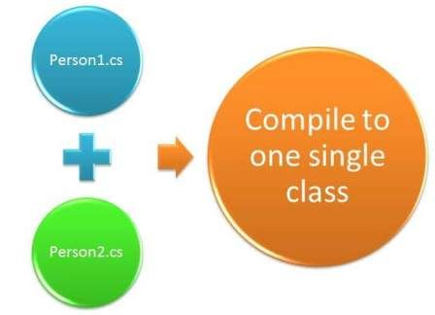
The partial keyword indicates that other parts of the class or interface can be defined in the namespace. All the parts must use the partial keyword. All the parts must be available at compile time to form the final type. All the parts must have the same accessibility, such as public, private, and so on.

Slide 6
Points That You Should be Careful about Partial Classes
You need to use partial keyword in each part of partial class.
All parts of a partial class should be in the same namespace.
Each part of a partial class should be in the same assembly or DLL, in other words you can't create a partial class in source files of a different class library project.
Each part of a partial class has the same accessibility.
If you inherit a class or interface on a partial class, then it is inherited on all parts of a partial class.
If a part of a partial class is sealed, then the entire class will be sealed.
If a part of partial class is abstract, then the entire class will be an abstract class.

Slide 7
Examples.

Slide 8
Static Class
A static class is basically the same as a non-static class, but there is one difference: a static class cannot be instantiated.
In other words, you cannot use the new keyword to create a variable of the class type. Because there is no instance variable, you access the members of a static class by using the class name itself
Ex.
UtilityClass.MethodA();

Slide 9
A static class can be used as a convenient container for sets of methods that just operate on input parameters and do not have to get or set any internal instance fields.
double dub = -3.14;
Console.WriteLine(Math.Abs(dub)); Console.WriteLine(Math.Floor(dub)); Console.WriteLine(Math.Round(Math.Abs(dub)));
// Output: // 3.14 // -4 // 3

Slide 10
The following list provides the main features of a static class:
Contains only static members.
Cannot be instantiated.
Is sealed.
Static Constructor.
A static constructor is used to initialize any static data, or to perform a particular action that needs to be performed once only. It is called automatically before the first instance is created or any static members are referenced.

Slide 11
Static constructors have the following properties:
A static constructor does not take access modifiers or have parameters.
A static constructor is called automatically to initialize the class before the first instance is created or any static members are referenced.
A static constructor cannot be called directly.
The user has no control on when the static constructor is executed in the program.

Slide 12
Examples.

Slide 13
Extension Methods.
Extension methods are a new feature in C# 3.0.
An extension method enables us to add methods to existing types without creating a new derived type, recompiling, or modify the original types.
We can say that it extends the functionality of an existing type in .NET. An extension method is a static method to the existing static class.
We call an extension method in the same general way; there is no difference in calling.

Slide 14
The following list contains basic features and properties of extension methods
It is a static method and must be located in a static class.
It uses the "this" keyword as the first parameter with a type in .NET.
An extension method should be in the same namespace as it is used or you need to import the namespace of the class by a using statement.
You can give any name for the class that has an extension method but the class should be static.
If you create extension methods that have the same signature methods as the type you are extending, then the extension methods will never be called

Slide 15
Examples.

Slide 16
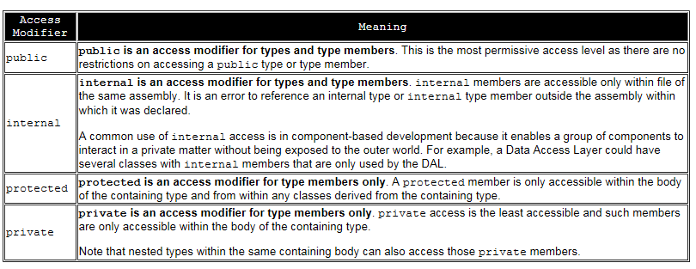
Type Modifiers

Slide 17
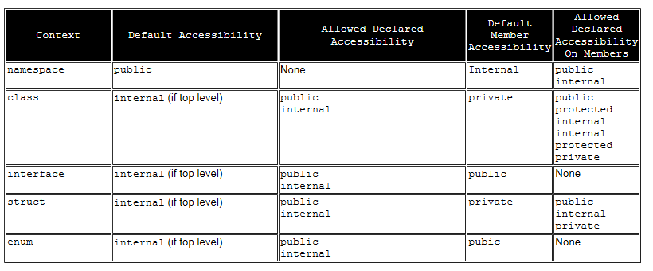

Slide 18
Interface
An interface contains only the signatures of methods, properties, events or indexers.
A class that implements the interface must implement the members of the interface that are specified in the interface definition.
An interface can be a member of a namespace or a class and can contain signatures of the following members:
Methods
Properties
Indexers
Events

Slide 19
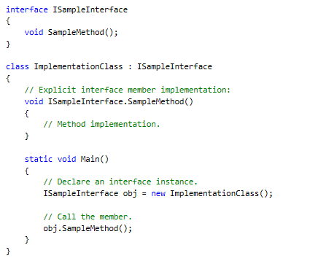
Example

Slide 20
To Do….

Slide 21

Thank You!
Name – Varun Dhume.
Designation – Sr. Software Engineer.
Mobile: +91 7276368787
Desk: 6287
varun.dhume@xoriant.com
www.xoriant.com
India
Mumbai
4th Floor, Nomura
Powai , Mumbai 400 076
Pune
5th Floor, Amar Paradigm
Baner, Pune 411 045
Kolkata
2B, 12th Floor, Tower ‘C’
Rajarhat, Kolkata 700 156
US – Corporate Headquarters
1248 Reamwood Avenue,
Sunnyvale, CA 94089
Phone: (408) 743 4400
343 Thornall St 720
Edison, NJ 08837
Phone: (732) 395 6900
UK
20 Broadwick Street
Soho, London
W1F 8HT, UK
89 Worship Street
Shoreditch,
London EC2A 2BF, UK
Phone: (44) 2079 938 955
Bangalore
4th Floor, Kabra Excelsior,
80 Feet Main Road, Koramangala 1st Block,
Bengaluru (Bangalore) 560034
Gurgaon
A/373rd Floor, Sigma Center
Gurgaon, Haryana 122 011s

