Slide 1

Litigation risk
at first report
Frontline data science assessment
Dr Gary R. Marrs 17/09/26

Slide 2
Data and modelling approach
Business question
Can intake information help Claims staff prioritise early review? The data contains 1,000 synthetic claims and 150 litigation outcomes.
Availability before accuracy
Audited six files. Used 18 original inputs and three engineered features. Excluded later activity and unverified historical totals.
Reproducible Python workflow
pandas for preparation, Seaborn for exploration and scikit-learn pipelines for preprocessing and model comparison.
Separate evaluation groups
600 training, 200 validation and 200 test claims. Compared a dummy baseline, logistic regression and random forest.

Slide 3
Validation gains weakened on test claims
Selected logistic regression with C = 0.5
The frozen cutoff of 0.643 targeted 20% validation review capacity. Test data remained outside model and threshold selection.
Measure | Validation | Test | Meaning
Claims | 200 | 200 | Evaluation size
Litigation cases | 30 | 30 | Actual positives
Flagged | 40 | 41 | Review workload
Detected | 14 | 7 | True positives
False alarms | 26 | 34 | False positives
Missed | 16 | 23 | False negatives
Precision | 35.0% | 17.1% | Correct alerts
Recall | 46.7% | 23.3% | Litigation found

Slide 4
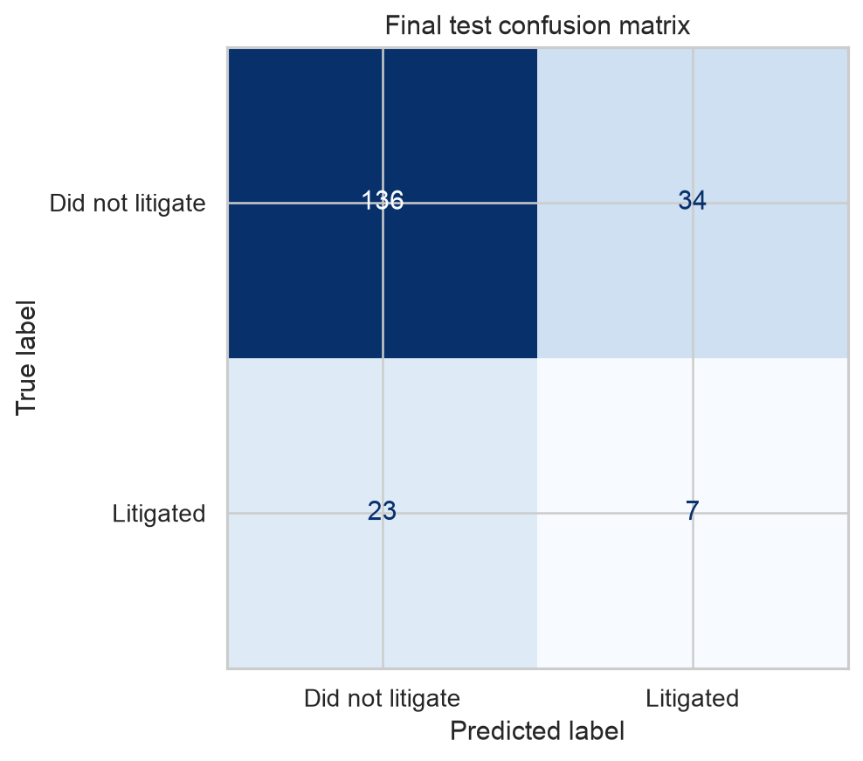
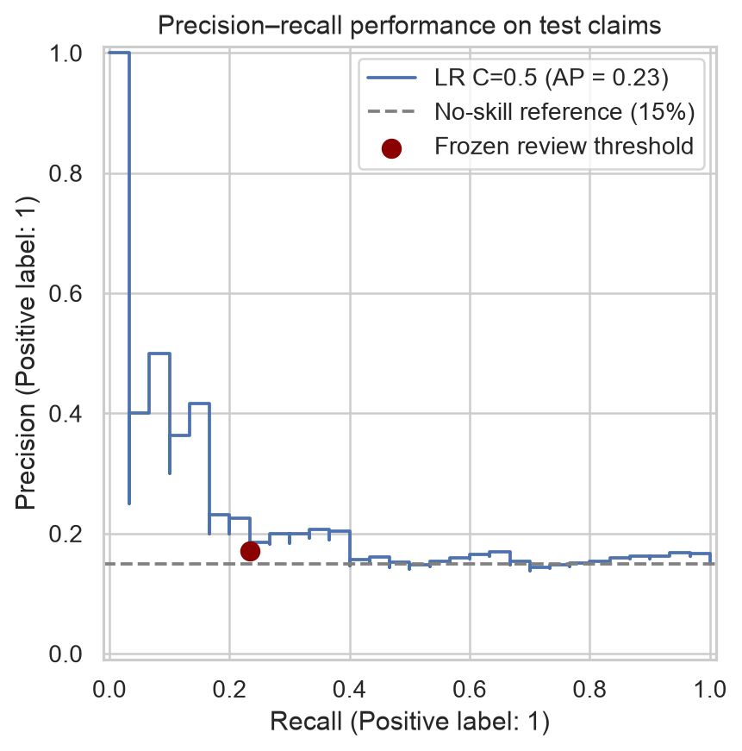
Precision and recall on test claims
Limited benefit at the chosen cutoff
41 claims flagged for review
7 litigation cases detected
34 false alarms
23 litigation cases missed
Test average precision was about 0.23, compared with a 0.15 no-skill reference.
The curve describes ranking across cutoffs. The operational cutoff remains fixed.

Slide 5
Further evidence is needed before deployment
Recommendation
Do not deploy the current model.
Validation importance highlights reporting delay, deductible relative to coverage, and cause of loss.
These explain model reliance, not causal effects.
Confirm
definitions
Verify intake availability, outcome timing and sufficient follow-up with Claims experts.
Agree review
capacity
The 20% workload is illustrative. Agree acceptable missed cases and false alarms.
Evaluate
future claims
Use representative data and chronological evaluation. Each current holdout has only 30 positives.
Plan a
monitored pilot
Only if evidence improves. AWS deployment and monitoring remain proposed work.

Slide 6
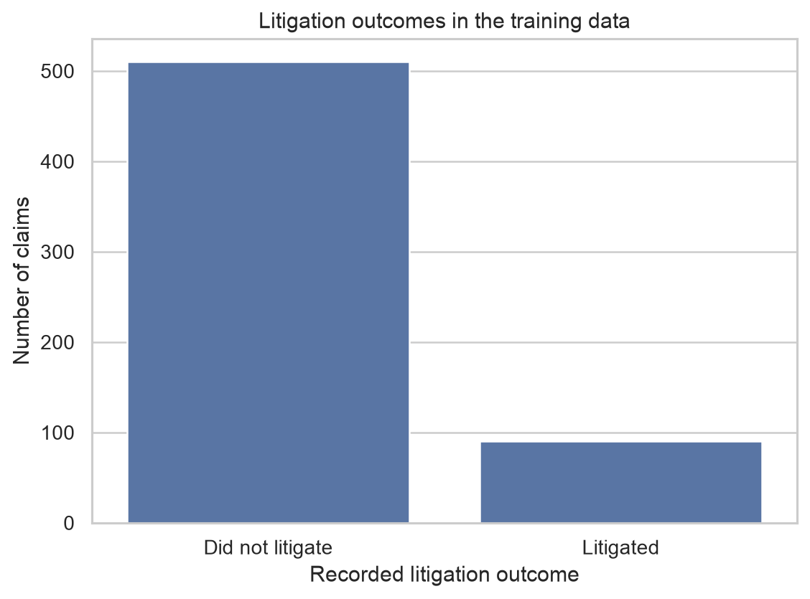
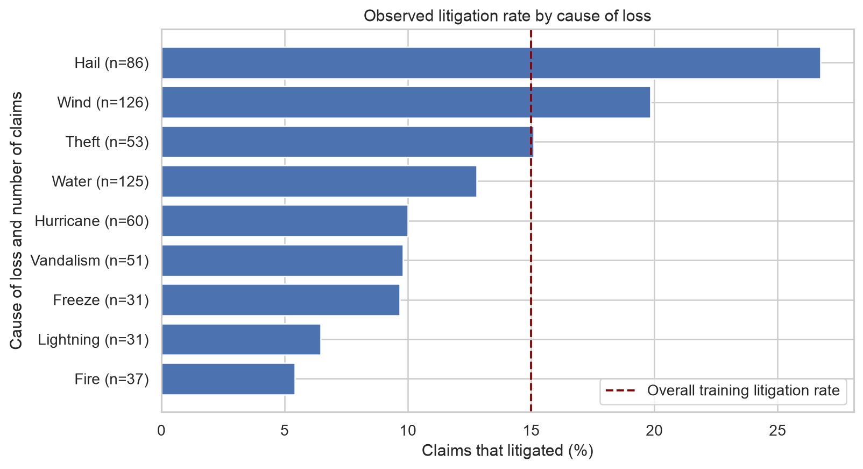
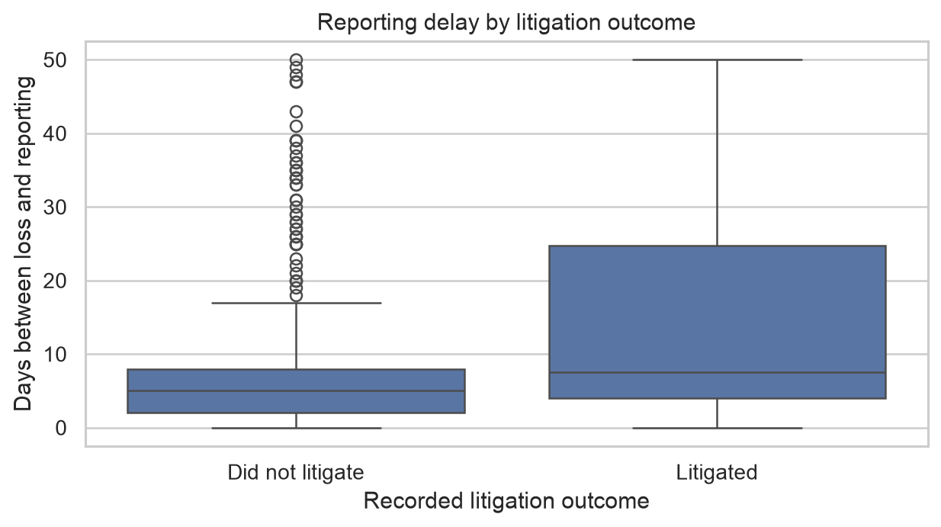
Appendix Training data exploration
Class imbalance
90 of 600 training claims litigated. Accuracy alone would hide missed cases.
Cause of loss
Hail and wind show higher observed rates. Group sizes differ.
Reporting delay
Litigated claims have a wider spread of delays, with substantial overlap.

Slide 7
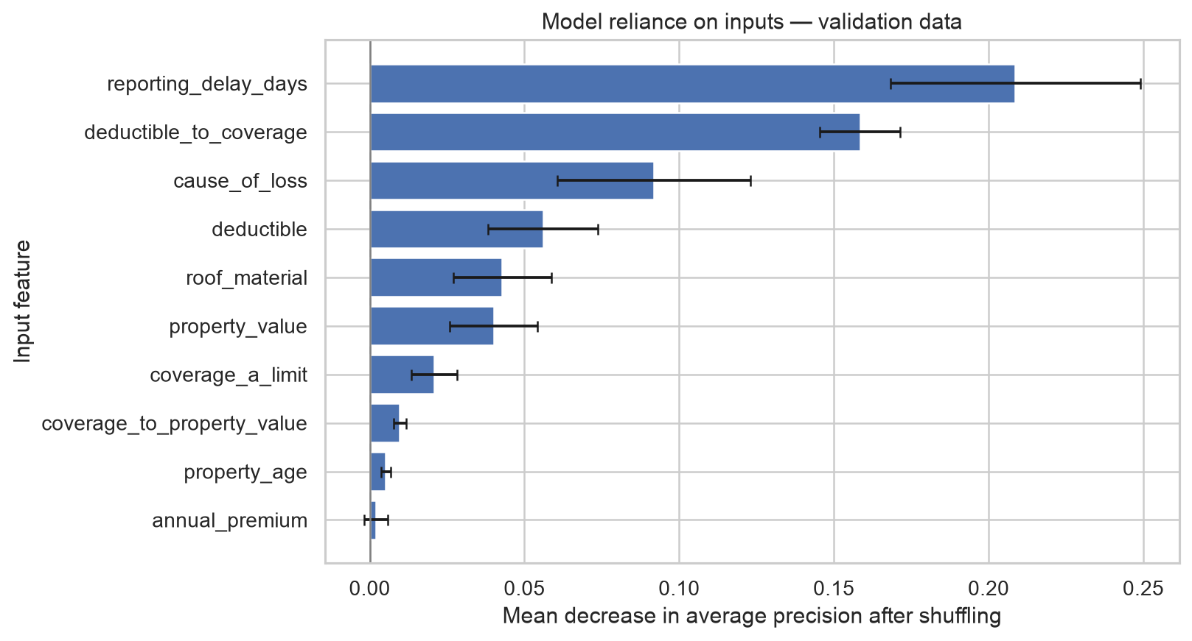
Appendix
Model interpretation
Validation permutation importance
Reporting delay and deductible relative to coverage lead.
Error bars show variation across five shuffles. They are not confidence intervals.
Related ratios complicate interpretation. No features were removed after testing.

