Slide 1
DAT SCIENCE Class 11: clustering and dimensionality reduction

Slide 2
i. Clustering (k-means and hierarchical) ii. principal components analysis iV. support vector machines
AGENDA
Notes:
All of our classes will involve some hands-on work (in the exercises section)

Slide 3
I. CLUSTERING
CLUSTERING AND DIMENSIONALITY REDUCTION

Slide 4
clustering
Clustering is an unsupervised method where observations are grouped together due to their feature similarity, but in a way not optimized to predict a certain class or feature.
You can think of clustering as jut another form of dimensionality reduction – we are reducing k features used to make the cluster to just 1 feature – the clusters themselves.
Clustering is useful for (a) recommendation algorithms (especially if the customer does not show clear intent to buy a specific product); (b) reducing dimensionality ahead of prediction, (c) grouping or binning data (such as customer behavior) in an objective, machine-driven way; and (d) visualizing data.
Notes:
Ex: geographic cluster as an input to predicted vacation region.
Binned customer behavior data to find top customer clusters.

Slide 5
clustering
There are many type of clustering depending on your application. The most common are k-Means and Hierarchical clustering.
K-means clustering creates clusters of data around centroids the ‘average’ points of all the points in the data.
Hierarchical clustering groups data together by absolute distance, and then further groups up the hierarchy when distances cross a given threshold.
Notes:
Say k-means is related to k-medoids.

Slide 6
K-means implementation
The most popular implementation of K-means (called Lloyd’s algorithm) uses the following process to ‘lock in’ on the data’s proper centroids:
Pick a number of clusters you want to create, k.
Assign a random k observations as the centroids of the data set.
Calculate the distance of each observation to each k centroids.
Assign the observation to the cluster of the nearest k centroid.
Re-calculate each centroid to the ‘average’ value of its cluster.
Reassign each observation to the cluster corresponding to its nearest centroid.
Continue steps 5-6 until no observations are re-assigned after new centroids are calculated OR the reassignment no longer decreases mean cluster loss (as defined by average Euclidian distance of all points to their centroids).

Slide 7
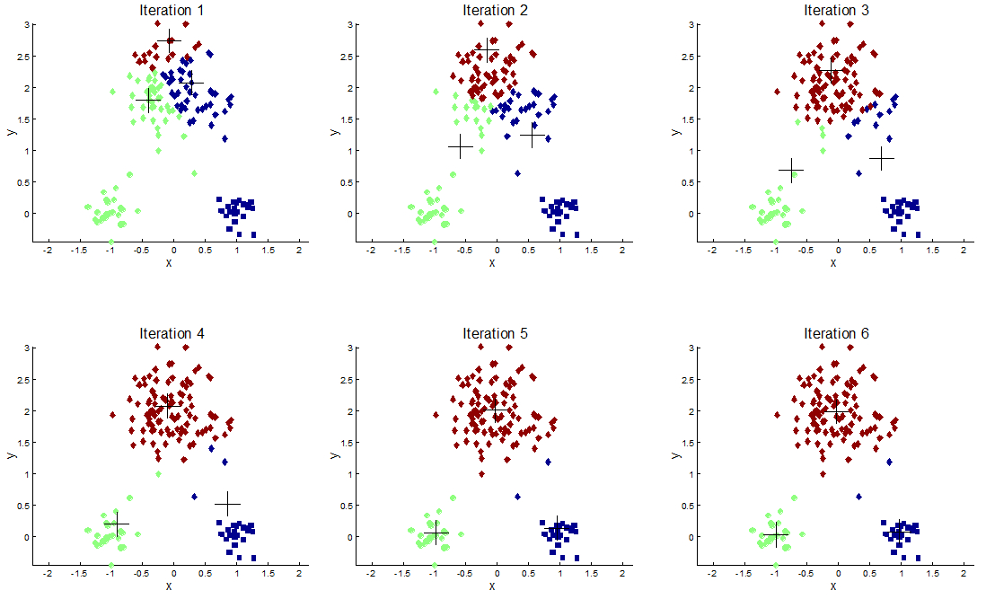
K-Means
7

Slide 8
K-means pros and cons
Pros:
Simple, intuitive algorithm
Fast execution
Effective for two-dimensional or geospatial data
Cons:
Tendency to converge to local minima or dense regions of data (especially if you pick your starting points at random)
Produces nonsensical centroids if data is not closely and tightly dispersed

Slide 9
K-means Extensions
Due to the limitations of K-means, a number of related methods are more commonly used to derive cluster meaning:
One simple extension of K-means is to repeatedly run the algorithm with different initialization sets, and average the results.
K-medoids assigns centroids to actual observations in your dataset.
Expectation-Maximization (EM) clustering derives clusters by calculating confidence that the found centroids are the ‘true’ centroids for the dataset.
Density Based Scanning (DBSCAN) looks at the median difference between points in the cluster, so is robust to non-linear cluster combinations.

Slide 10
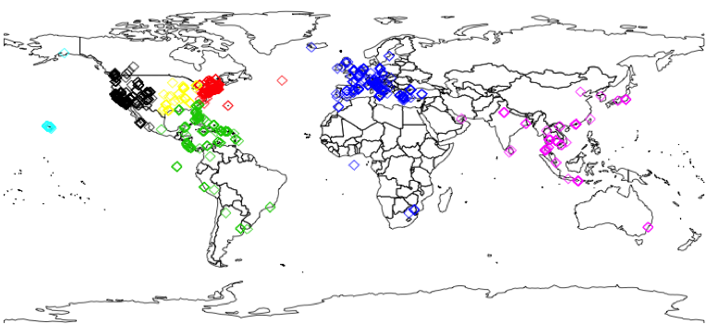
K-medoids

Slide 11
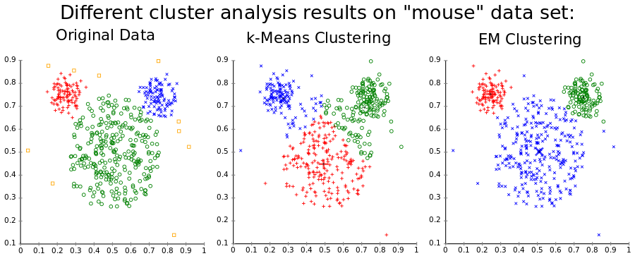
EM CLUSTERING

Slide 12
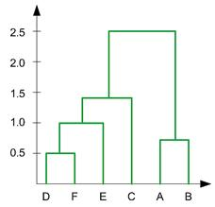
Hierarchical clustering
While k-means clustering tries to determine a given set of discrete clusters, hierarchical clustering attempts to determine the relationship between each observation and cluster.
Hierarchical clustering is typically visualized via a dendrogram (seen to your right), a representation of the relationship of each point against some sort of dissimilarity measure (typically Euclidian distance).

Slide 13
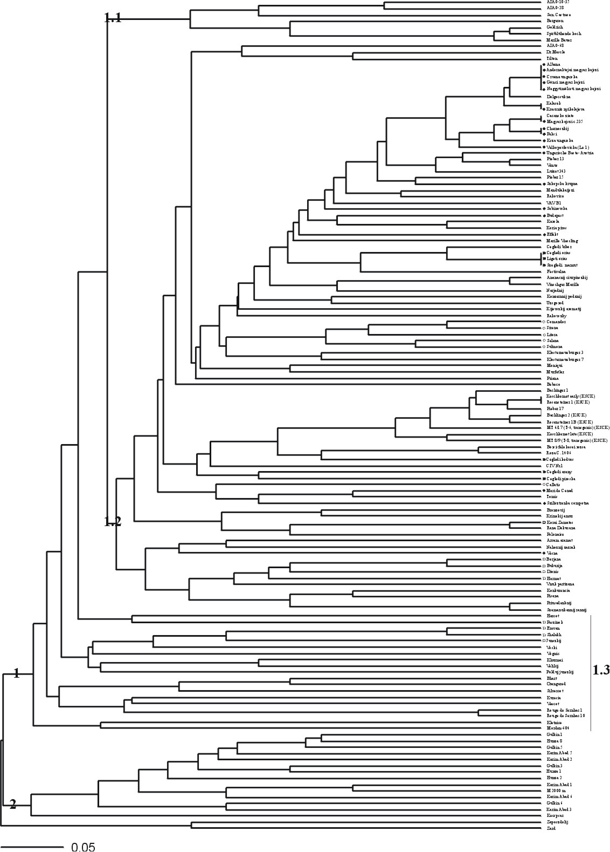
Hierarchical clustering
Hierarchical clustering typically shows you a more accurate representation of similarity between your data than most other techniques.
However, as you must chose an arbitrary cutoff point to split your data, you may get highly unbalanced clusters or markedly different numbers of clusters as the data changes through time.
Examples of use cases include identifying customer behavior groupings or similarities between genes.

Slide 14
In-class exercise: clustering
Using the Baseball dataset, we will try to cluster teams by two dimensions: their average salaries and their number of hits:
Create an annotated plot of the data showing team name.
Perform K-means clustering and plot the results.
Perform DBSCAN clustering and plot the results.
Create a hierarchical cluster of the data and plot a dendrogram.
Create a cutoff in the dendrogram to create a discrete number of clusters.
Plot the results and compare to K-means and DBSCAN.

Slide 15
II. Principal component analysis
CLUSTERING AND DIMENSIONALITY REDUCTION
Notes:
~15-20 min for this section?

Slide 16
PRINCIPAL COMPONENTS ANALYSIS
Recall that in previous classes, you learned feature selection, i.e. a recursive process to determine the bag of variables that allow your model to optimize predictive accuracy.
But, recall the problems with recursive feature elimination:
Current implementations do not explore all possible feature interactions.
Elimination is done in a rank-ordered way, which can be misleading as rank and/or significance of a feature can change as you eliminate other features.
Implementation of RFE is very computationally intensive.
There is no guarantee that you will eliminate linearly related variables if they make it through your initial preprocessing.

Slide 17
PRINCIPAL COMPONENTS ANALYSIS
Moreover, recursive feature elimination can become unstable if you have multiple correlated or related features, each of which has a weak contribution to overall accuracy.
This shows the curse of dimensionality: as you add related features to your dataset, it is march harder for a machine learning algorithm to determine which ones are truly predictive, and which are just correlated to the predictive features.
This typically gives you nonsensical results, where, for example, you see highly positive and negative coefficients if you use linear methods.
Most social science and business data suffers from this – for example, when you see a rise in revenue, most of your other features rise as well – but which one drove the rise in revenue?
Notes:
your cuttoff will likely arbitrarily eliminate a subset of them.

Slide 18
PRINCIPAL COMPONENT ANALYSIS
To get around these issues, data scientists often use principal component analysis to ‘decompose’ the data into n (typically 3 or fewer) dimensions.
However, the simpler methods you will learn today (such as PCA) will only decompose your data properly if they have a linear relationship with one another.
In addition, once you have transformed your data, it becomes un-interpretable as it no longer has a direct connection to any one feature. As such, you will have no way of identifying a problem with an underlying feature by looking at the PCA output.
In addition, PCA is dependent on the initial scaling of the variables – so if one variable is scaled to have a larger magnitude, it will dominate your decomposition.

Slide 19
Principal component analysis
Principal Component Analysis (PCA) decomposes your (sometimes-correlated) variables into a set of linearly uncorrelated variables called principal components.
Here’s how principal component analysis works:
Scale each feature around 0 by subtracting the mean from each observation.
Calculate a covariance matrix between each scaled variable in the data.
Calculate eigenvalues and eigenvectors of the matrix.
Eigenvectors effectively work like OLS regressions, by best fitting the data. Each subsequent eigenvector fits the residuals of the previous eigenvector.
Sort the eigenvectors by the size of their corresponding eigenvalues and and determine a cutoff (typically around 0) below which you discard the eigenvector.
Fit each eigenvector to your original data. The first eigenvector you fit is called your first principal component.
See http://www.cs.otago.ac.nz/cosc453/student_tutorials/principal_components.pdf for more information.

Slide 20



What’s an eigenvalue and an eigenvector?
Eigenvectors are in essence a linear system that solve each row of a matrix to zero. Eigenvalues are the scaler or ‘fit’ on the eigenvector.
Say you have the following matrix:
You can solve for your eigenvalues via the following equation:
Eigenvectors are solved this way: (using the value of lambda as zero)

Slide 21
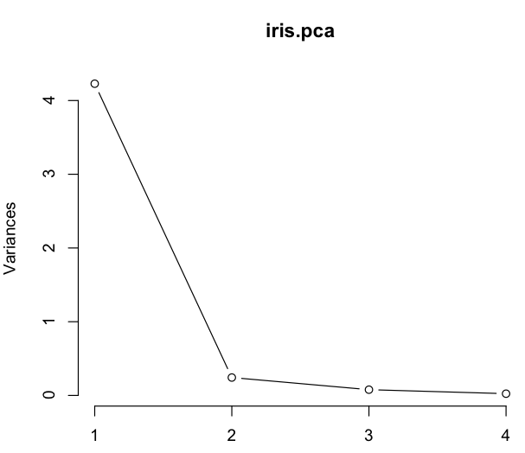
how many principal components should you keep?
A scree plot lets you look at how much variance is explained by each principal component.
Apply the elbow test to the plot: only take those components to the left of the ‘elbow’ in explained variance.

Slide 22
Related techniques
Besides PCA, there are a number of other related techniques that rely on matrix decomposition:
Singular Value Decomposition
Pros: Less prone to overfitting than PCA, faster to compute
Cons: Same as PCA: assumes linear relationships between variables, no guarantee that principal components will be fit on features that are most important to dividing classes or helping predict your regressand.
Linear Discriminant Analysis
Pros: Dimensionality reduction is supervised, so differences returned by their nature are relevant to your classification or regression problem.
Cons: Assumes input features are normally distributed, assumes output classification follows a functional (linear, quadratic. etc.) decision boundary

Slide 23
Related techniques
Multidimensional Scaling
Pros: does not assume linear relationships between variables or normal distributions among them.
Cons: longer computation time, less available documentation to properly tune, still no guarantee features extracted will be relevant to your regression/classification question.

Slide 24
In-class assignment: pca
Perform PCA on the features we used in last class’s dataset.
Plot the first two principal component of the explanatory data.
Use a scree plot to determine how many principal components you should keep.
Run a random forest classifier on the retained principal components.
Evaluate out-of-sample accuracy against non-transformed data.

Slide 25
III. Support vector machines
CLUSTERING AND DIMENSIONALITY REDUCTION
Notes:
~15-20 min for this section?

Slide 26
Support vector machines
Support Vector Machines (SVMs) as a set of classifiers that use similar techniques to PCA and other matrix-based dimensionality reduction techniques.
SVMs apply a function (called a kernel function) on the independent features and find the best interaction of the function results that separate the classes (for classification) or best follow the variance of the response feature (for regression).
SVMs work best if you have multiple ‘weak inputs’ that have some sort of strong underlying signal between them.

Slide 27
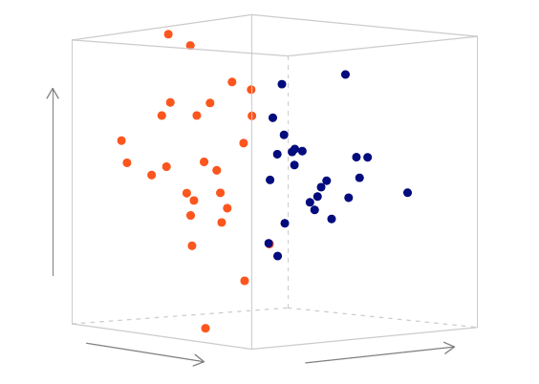
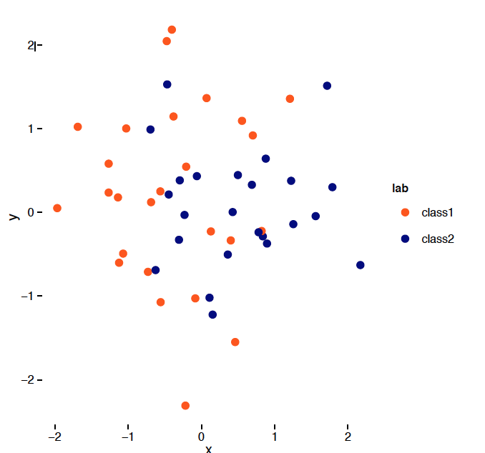
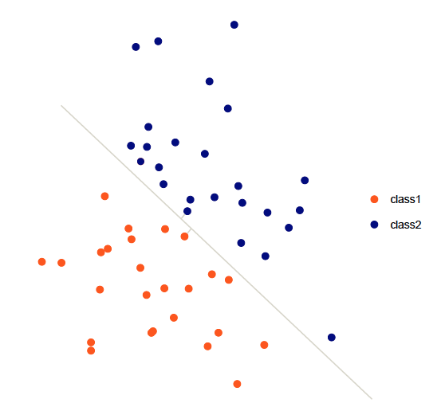
Support vector machines
Pros:
Accuracy on par with RFs GBMs
Very good for picture and text analysis
Works well with trending data (unlike RFs!)
No ‘jagged edges’ in regression.
Cons:
Computationally intensive
Hard to debug
Typically no intuition on which kernel function works best

Slide 28
Kernel functions
SVMs include the option of many different kernel functions, including:
Linear
Polynomial
RBF
Sigmoid
Any Python function you want!
You’ll have to use grid search to determine which kernel is best, which can take a very long time!

Slide 29
In-class exercise: SVMs
Run a SVM with the kernel as ‘polynomial’
Perform grid search to find the optimal kernel for our use case.
Compare the accuracy of the final model to the PCA result and the raw random forest.

Slide 30


ADIOS, AMIGOS!
CLUSTERING AND DIMENSIONALITY REDUCTION
Notes:
~15-20 min for this section?

