Slide 1
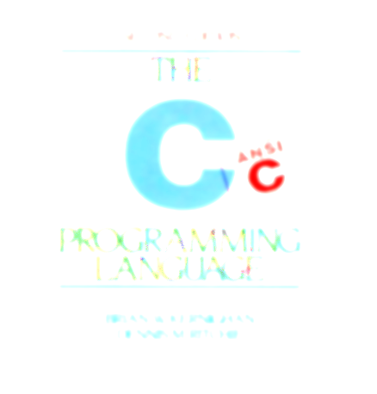
Miscellany
A little more C

Slide 2
A few other things - IO
char c; c = getchar();
putchar(c);
char a[]=“Hello,..”;
printf(“Hey!..”);
puts(a); puts(“How are”);
putf(“you?”);
int getchar(void); int putchar(int c);
int puts(const char *s); - Prints string with a newline at the end.

Slide 3
argc and argv - command line arguments
main() may be written as main(int argc, char * argv[])
When the program is run as: ./a.out hello how are you
These 5 strings are pointed to by argv[0]..argv[4]
argv[5] is NULL
argc is 5
argc is 5 argv[0] → “./a.out” argv[1] → “hello” argv[2] → “how” argv[3] → “are” argv[4] → “you”
argv[5] is NULL
printf(“argc is %d\n”,argc); for(i=0; i<argc; i++) printf(“%s\n”,argv[i]); printf(“argv[5]:%p\n”,argv[5]);
See main_argc.c

