Slide 1
Expressions, Operators, Precedence and Associativity

Slide 2
Expressions – What we know
Expressions are the most common part of statements.
Expressions give values.
Expressions comprise of
Basic value giving entities - variables, constants, function calls
Operators that combine values to give other values
We have already seen several operators
Integer and floating point operators (used to combine numbers arithmetically)
Relational(comparison) and logic operators to give us true/false values used in conditional expressions (in if-else and while statements)
We now learn more operators, but before that a core concept

Slide 3
Operator Precedence and Associativity
How do we interpret 5 – 3 * 2 – 2 ?
We can definitely use 5 – (3 * 2 ) – 2 to be really clear.
We might need to use (5 – (3 * 2 ) ) – 2 to be even clearer.
Additionally C provides precedence and associativity rules.
We introduce a table to understand this.
In the process we introduce several new operators.
We will still keep a few operators to be studies later.

Slide 4
Operator Precedence and Associativity
Precedence: Breaking the tie between two operators of different precedence – do the higher/ earlier preference first.
Multiplication is higher precedence than addition and subtraction
So 5 – 3 * 2 – 2 is by default evaluated as 5 – ( 3 * 2 ) – 2
Associativity: Break the tie between two operators of the same precedence.
Subtraction is left associative
So 5 – (3 * 2) – 2 is evaluated as (5 – ( 3 * 2) ) – 2

Slide 5
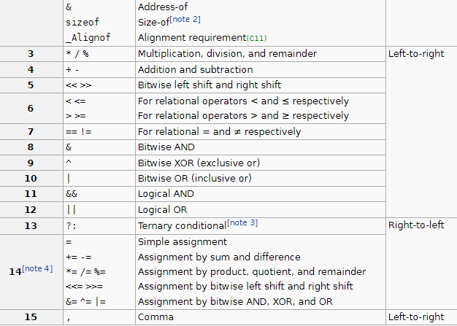

The Operators Table https://en.cppreference.com/w/c/language/operator_precedence
Revisit later Unary ops Data access ops
2

Slide 6
Bitwise operators in C – 1
These operators operate on the value representation in the machine
Since all representation is in binary, they talk manipulate bits in the data.
Shift: v << n and v >> n shift all digits left or right by one bit:
int x = 0b00010110 is an 8 bit value (this is not standard C, but just for teaching convenience)
So x << 2 will be 0b01011000 - notice how the rightmost was filled with 0s.
And x >> 2 will be 0b00000101 – notice how the leftmost was filled with 0s.

Slide 7
Bitwise operators in C – 2
0 0 0 1 0 1 0 1
& 0 0 0 0 0 1 1 1
0 0 0 0 0 1 0 1
Bitwise AND ( 1 iff both are 1 at the position)
0b00010101 & 7 gives 0b00000101
Bitwise OR ( 1 iff at least one of them is 1 …)
0b00010101 | 7 gives 0b00010111
Bitwise XOR ( 1 iff both are different …)
0b00010101 ^ 7 gives 0b00010111
Bitwise NOT (unary exchanges 0s and 1s…)
~ 0b00010101 gives 0b11101010
0 0 0 1 0 1 0 1
| 0 0 0 0 0 1 1 1
0 0 0 1 0 1 1 1
0 0 0 1 0 1 0 1
^ 0 0 0 0 0 1 1 1
0 0 0 1 0 0 1 0

Slide 8

The Operators Table https://en.cppreference.com/w/c/language/operator_precedence
Revisit later Unary ops Data access ops
2
Prefix Unary operators are all right associative
Like the unary minus

Slide 9
Some interesting uses
First note that none of these operations modify any operand! They are just like + or – which do not change their operand values.
Get the least significant 4 bits of x: x & 15
Divide x by 4 : x >> 2 (x is positive)
Multiply x by 8 : x << 3
If ( x % 2 ) printf(“odd”); is same as if ( x & 1) printf(“odd”);
Compute the number of 1s in the binary representation of x (positive): c=0; while( x != 0 ) { if ( x & 1 ) c=c+1; x = x >> 1; }
!

Slide 10
Extensions of the assignment statement
We are familiar with = as in x = b * b – 4 * a * c
C gives a shorthand for combining an arithmetic or logic operator with the assignment operator:
Eg. The operator += can be used as x += 12 to mean x = x + 12
x %= a means x = x % a
Since this is an assignment statement, the left side must be an lvalue.
Holds for all arithmetic and bitwise binary operations:
+= -= *= /= %= , <<= >>= &= |= ^=
Here is the code again to compute number of 1s in a x :
c=0; while( x != 0 ) { if ( x & 1 ) c+=1; x >>= 1; }

Slide 11
The Operators Table https://en.cppreference.com/w/c/language/operator_precedence
Revisit later Unary ops Data access ops
2
a – b – c
Prefix Unary operators are all right associative
Like the unary minus
a = b = c

Slide 12
Ternary conditional operator
condition-expression ? expression1 : expression2
If the condition-expression is true then only evaluate expression1
If the condition-expression is false then only evaluate expression2
Here are two ways to use it: We wish to assign to the variable max the maximum of a and b
( a > b ) ? (max = a) : (max = b);
max = a > b ? a : b

Slide 13
The comma operator ,
expression1 , expression2
May sound unusual, but the comma is an operator too.
The value of the expression is expression2
It is used in some specific places, otherwise rarely used.
a = ( c = d , e = f); What is the value of a ?

Slide 14
The Operators Table https://en.cppreference.com/w/c/language/operator_precedence
Revisit later Unary ops Data access ops
2
a – b – c
Prefix Unary operators are all right associative
Like the unary minus
a = b = c

Slide 15
Increment and decrement operators
Post-increment, Post-decrement a specific use of ‘=‘
x++ means increment after use.
x-- means decrement after use.
Pre-increment, Pre-decrement
++x means increment before use.
--x means decrement before use.
Examples:
y = x++; // y gets the old value of x
y = ++x; // y gets the new value of x
Just the statements ++x; and x++; are no different in effect.
Since these are assignments the operand for ++ and -- must be an lvalue.

Slide 16
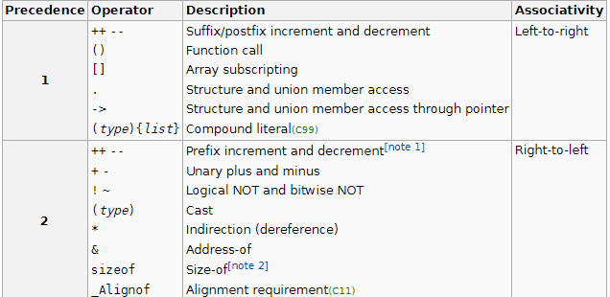

Slide 17
A few guidelines
Order of evaluation:
You can always force a certain order of evaluation by using parenthesis.
Use parenthesis liberally.
You will find use for increment and decrement operators a lot.
You probably will use the comma operator in specific cases, which we will see in some examples.
Don’t confuse the comma operator with the comma we use to separate parameters in a function call or function definition.
Don’t confuse the logical not (!) with the bitwise not (~)
!

