Slide 1
Sorting with Three Basic Sorts

Slide 2
Assumption
We assume you are fairly comfortable with
Array definition, reading into and printing out array contents
Functions with arrays as parameters
Searching for a given item in an array
Finding the position of the maximum value element in an array
Swapping elements at two positions in an array
Inserting an item into an array at a given position

Slide 3
Motivation: A simple array rearrangement exercise:
int a[ ] has n elements, each of which is 0 or 1
Rearrange them so that it has all the zeros, and then all the ones.
Discussion: What are the different ways to do this?
This can be thought of as sorting the array
It can also be thought of as splitting the array – This idea is very useful!
0s followed by 1s
All 5s in the end, others before it
Negative values followed by positive values
All numbers less than 7 followed by the rest

Slide 4
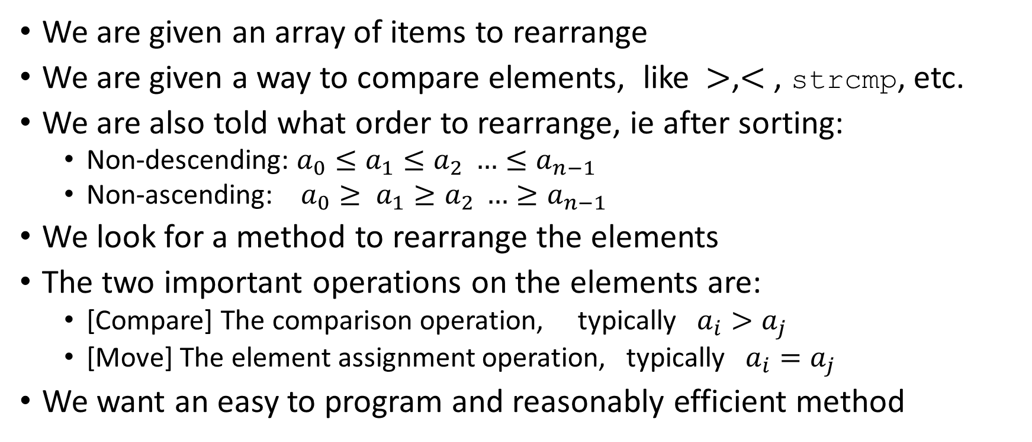
The sorting problem
We are given an array of items to rearrange
We are given a way to compare elements, like $>$,$<$, strcmp, etc.
We are also told what order to rearrange, ie after sorting:
Non-descending: $a_{0}≤a_{1}≤a_{2} …≤a_{n−1}$
Non-ascending: $a_{0}≥ a_{1}≥a_{2} …≥a_{n−1}$
We look for a method to rearrange the elements
The two important operations on the elements are:
[Compare] The comparison operation, typically $a_{i}>a_{j}$
[Move] The element assignment operation, typically $a_{i}=a_{j}$
We want an easy to program and reasonably efficient method

Slide 5
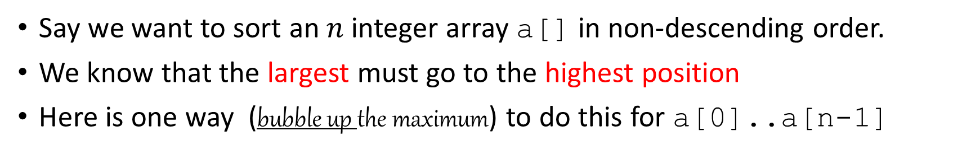
The simple bubble sort : Concept
Say we want to sort an $n$ integer array a[] in non-descending order.
We know that the largest must go to the highest position
Here is one way (bubble up the maximum) to do this for a[0]..a[n-1]
6 0 2 23 10 1
0 2 6 23 10 1
0 6 2 23 10 1
0 2 6 10 23 1
0 2 6 23 10 1
0 2 6 10 1 23
Now repeat this for the array a[0]..a[n-2], then a[0]..a[n-3] and so on….

Slide 6
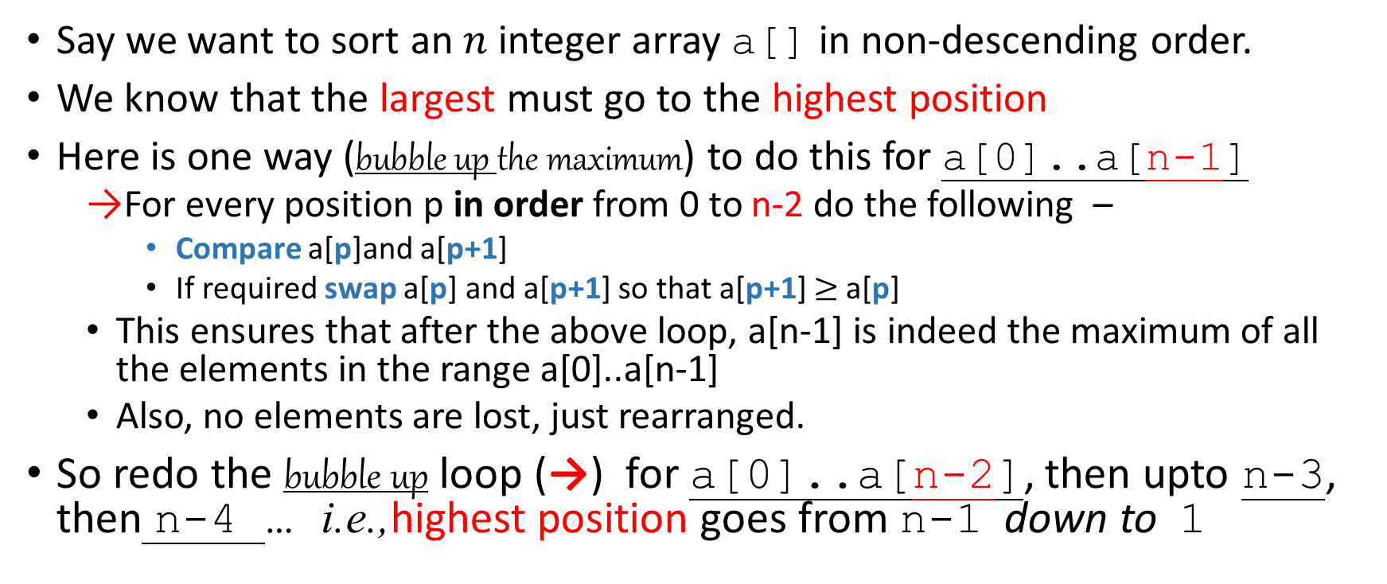
The simple bubble sort : Concept
Say we want to sort an $n$ integer array a[] in non-descending order.
We know that the largest must go to the highest position
Here is one way (bubble up the maximum) to do this for a[0]..a[n-1]
For every position p in order from 0 to n-2 do the following –
Compare a[p]and a[p+1]
If required swap a[p] and a[p+1] so that a[p+1] $≥$a[p]
This ensures that after the above loop, a[n-1] is indeed the maximum of all the elements in the range a[0]..a[n-1]
Also, no elements are lost, just rearranged.
So redo the bubble up loop (→) for a[0]..a[n-2], then upto n-3, then n-4 … i.e.,highest position goes from n-1 down to 1

Slide 7
The simple bubble sort : Trying to write the code
Try out writing the code yourself!
First, focus on the shaded box -> the bubble loop
for( p=0; p <= hp -1 ; p++) if ( a[p+1] < a[p] ) swap(a,p,p+1);
Next, focus on the outer loop to repeat the bubble loop

Slide 8
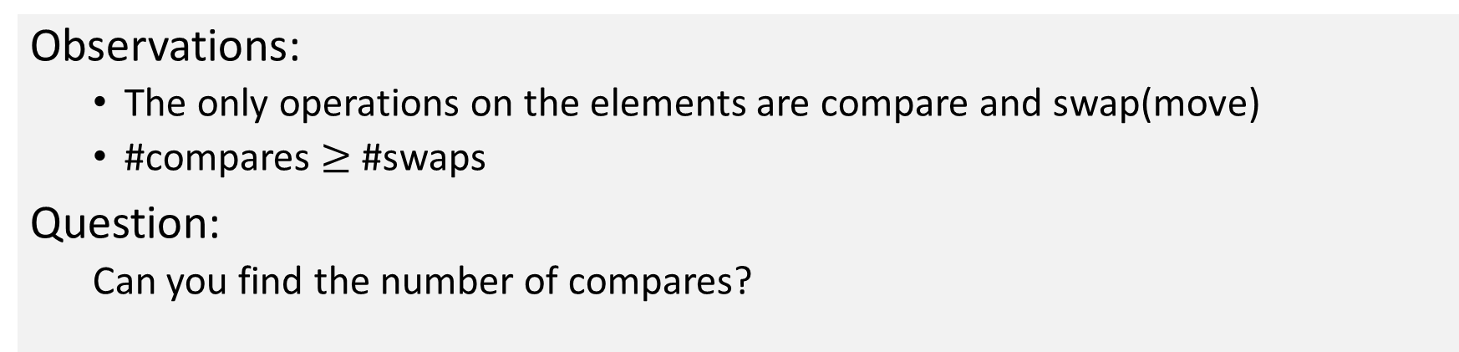
The simple bubble sort : Code
for( hp=n-1; hp > 0 ; hp --)
for( p=0; p <= hp -1 ; p++) if ( a[p+1] < a[p] ) swap(a,p,p+1);
Observations:
The only operations on the elements are compare and swap(move)
#compares $≥$ #swaps
Question:
Can you find the number of compares?

Slide 9
Similar, but slightly more efficient, selection sort: Concept
Main idea: similar scan as bubble sort, but only do the relevant swap to get the maximum element to the highest position. Don’t do any other swaps.
To do this, traverse the array very much like in bubble sort, except, just remember the position of the maximum value, then swap that position with the highest position element, initially it is n-1
6 0 2 23 10 1
6 0 2 23 10 1
6 0 2 23 10 1
6 0 2 23 10 1
6 0 2 23 10 1
6 0 2 23 10 1
Now repeat this for the highest position from n-1 down to 1….

Slide 10
Selection sort : Trying to write the Code
First focus on modifying the “bubble loop” we had for bubble sort:
Find the position of the maximum
Swap it with the highest position
Now, try writing the outer loop

Slide 11
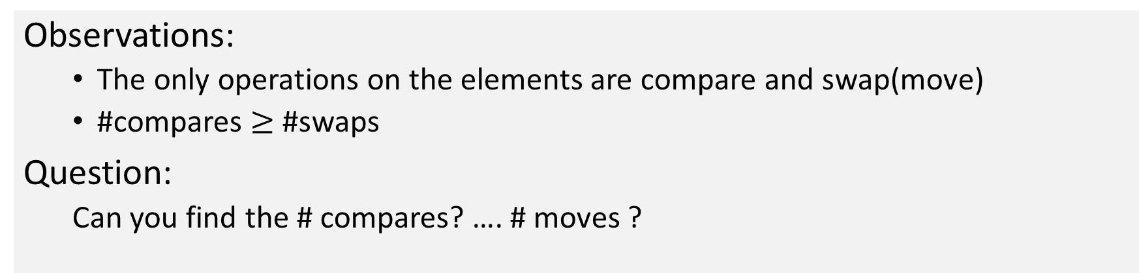
Selection sort : Code
for( hp=n-1; hp > 0 ; hp --) {
r = 0; for( p=1; p <= hp ; p++)// note small important change in array limits if ( a[p] > a[r] ) r = p; // no swapping just remember the position p swap(a,r,hp); // now the swap
}
Observations:
The only operations on the elements are compare and swap(move)
#compares $≥$ #swaps
Question:
Can you find the # compares? …. # moves ?

Slide 12
Sorting by successive insertions, insertion sort ; Concept
Think of the slightly modified problem called sorted insertion:
Given items in a[0]… a[p-1] are sorted, how to make a[0]...a[p] sorted ?
The idea is to compare and find where the value v in a[p] belongs
Then insert it there by moving other items to the higher side.
Then apply this idea starting with p as 1, then 2, then 3 … upto n-1
6 0 2 23 5 1
0 2 6 23 5 1
0 6 2 23 5 1
0 2 5 6 23 1
0 2 6 23 5 1
0 1 2 5 6 23

Slide 13
Insertion sort: Trying to write the code
First write the code for inserting a[p] into a[0]… a[p-1]
Find the position r where a[p] belongs in a[0]… a[p-1] which you should assume is sorted.
Then move all elements from r to p-1 right by one position
Now set a[r] to be what was in a[p] earlier
Now repeat the above using the highest point p being 1,2, … n-1

Slide 14
Insertion sort: Code
for( r=0; r < p ; r++) // set r
if (a[r] < v ) r++; else
break;
for(k=p-1;k>=r ;k++) // move right a[k+1]=a[k];
0 p-1 p
for( p=1; p < n ; p++)
v=a[p]; set r to position of v among a[0]..a[p] move right by 1 all elements a[r]..a[p-1] a[r]=v;
for(k=p-1;k>=0 ;k--) // move // as you set r
if (a[k] > v ) a[k+1]=a[k]; else
break;
r=k+1;
Question:
Can you find # compares? # moves ?
Alternate move & set
Resembles something?

Slide 15
See implementations
Refer Github: FCP/basic_sorts.c

Slide 16
Notion of complexity of an algorithm
An introduction to analysis of algorithms

Slide 17
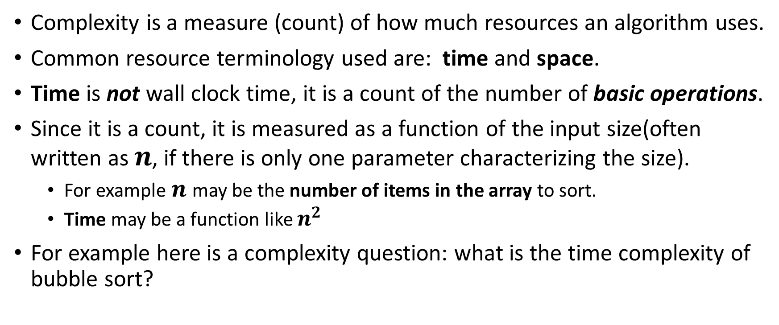
Complexity Concept 1/2
Complexity is a measure (count) of how much resources an algorithm uses.
Common resource terminology used are: time and space.
Time is not wall clock time, it is a count of the number of basic operations.
Since it is a count, it is measured as a function of the input size(often written as $n$, if there is only one parameter characterizing the size).
For example $n$may be the number of items in the array to sort.
Time may be a function like $n^{2}$
For example here is a complexity question: what is the time complexity of bubble sort?

Slide 18
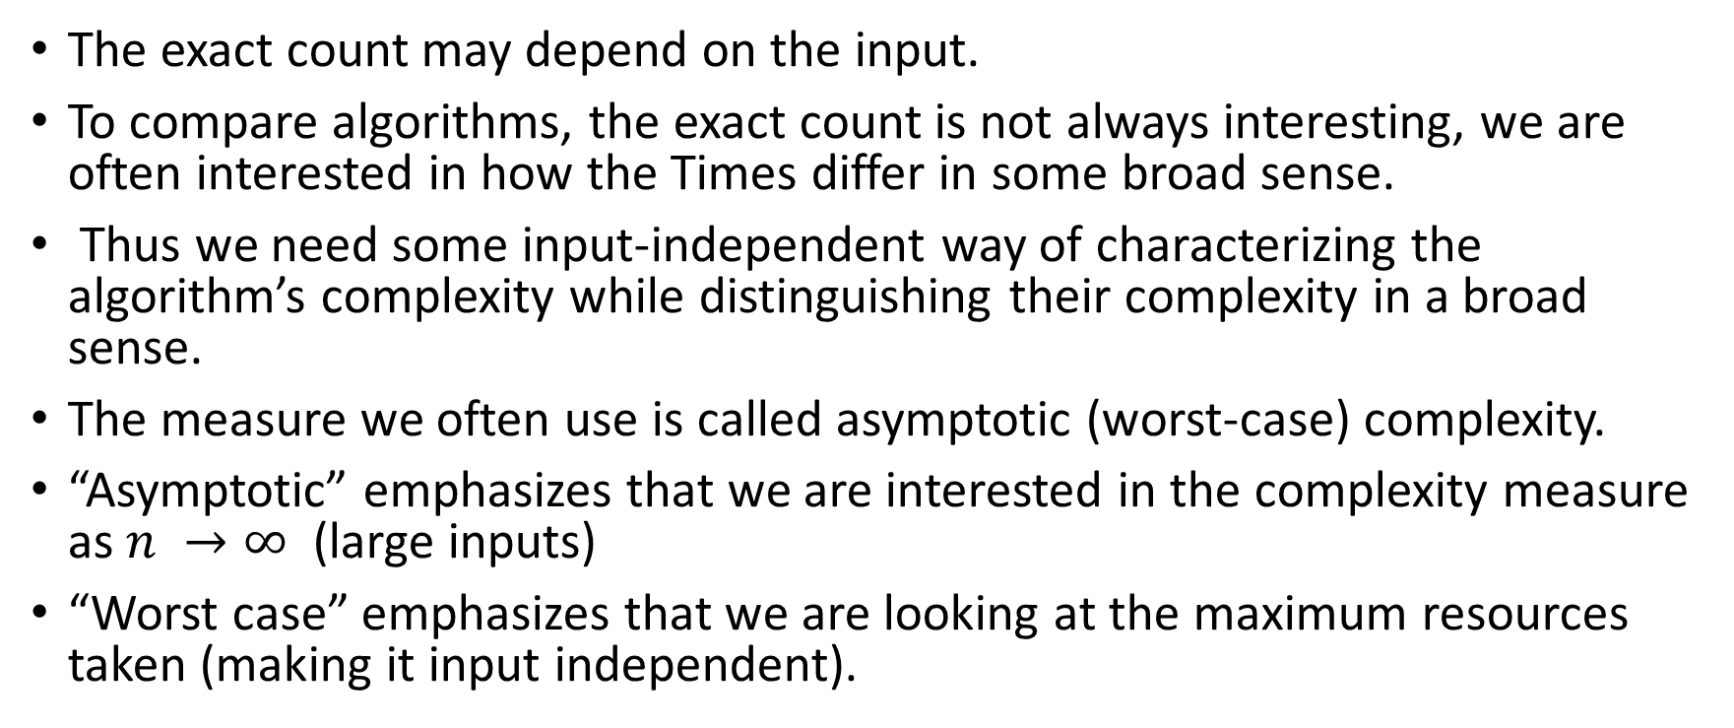
Complexity Concept 2/2
The exact count may depend on the input.
To compare algorithms, the exact count is not always interesting, we are often interested in how the Times differ in some broad sense.
Thus we need some input-independent way of characterizing the algorithm’s complexity while distinguishing their complexity in a broad sense.
The measure we often use is called asymptotic (worst-case) complexity.
“Asymptotic” emphasizes that we are interested in the complexity measure as $n →∞$ (large inputs)
“Worst case” emphasizes that we are looking at the maximum resources taken (making it input independent).

Slide 19
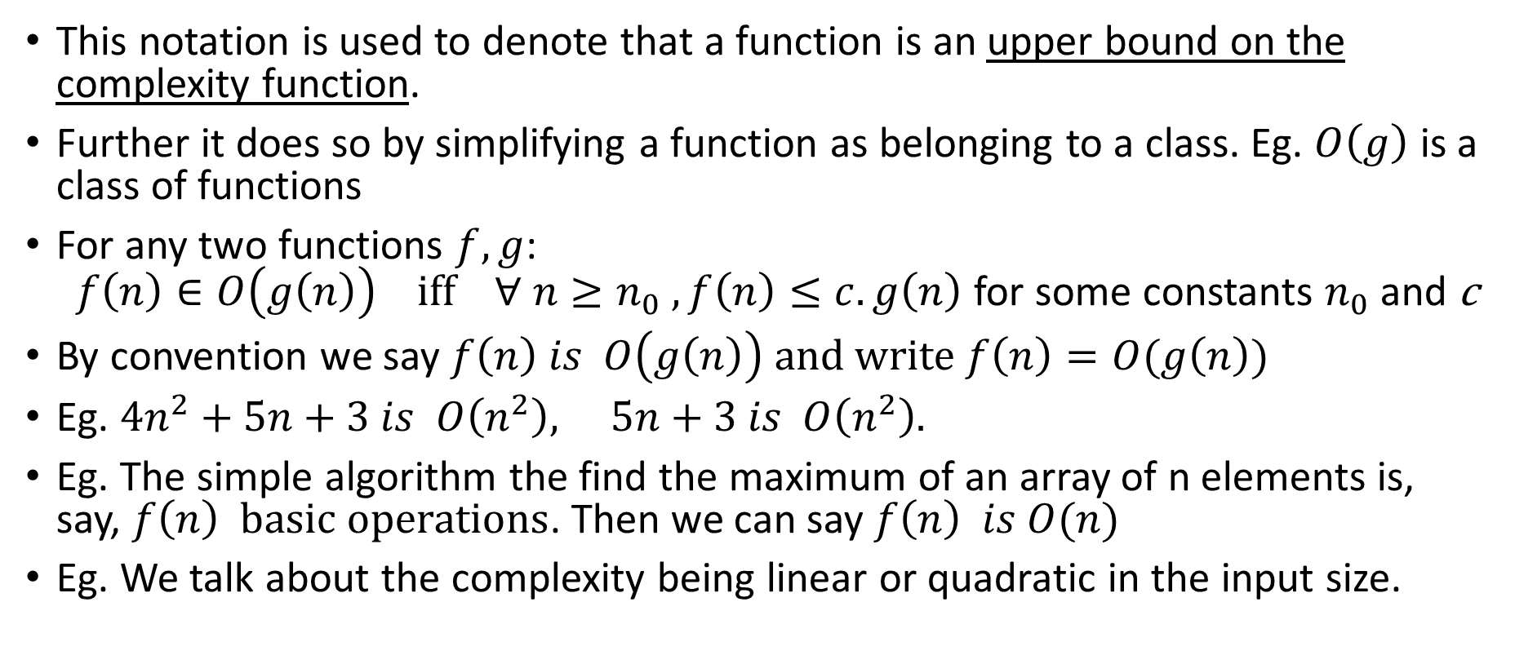
The upper bound measure: “Big-Oh” notation.
This notation is used to denote that a function is an upper bound on the complexity function.
Further it does so by simplifying a function as belonging to a class. Eg. $O\left(g\right)$ is a class of functions
For any two functions $f,g$: $f\left(n\right)∈O\left(g\left(n\right)\right) iff ∀ n≥n_{0} , f\left(n\right)≤c.g\left(n\right)$ for some constants $n_{0}$ and c
By convention we say $f\left(n\right) is O\left(g\left(n\right)\right) and write f\left(n\right)=O(g\left(n\right))$
Eg. ${4n}^{2}+5n+3 is O\left(n^{2}\right), 5n+3 is O\left(n^{2}\right).$
Eg. The simple algorithm the find the maximum of an array of n elements is, say, $f\left(n\right) basic operations$. Then we can say $f\left(n\right) is O(n)$
Eg. We talk about the complexity being linear or quadratic in the input size.

Slide 20
Exercises
In the three sorts, what are the basic operations?
Counting the total basic operations, what is the time complexity of each of them?
What is the time complexity of matrix multiplication?
What is the time complexity of checking if a given string is a palindrome?
What is the time complexity of finding if a number is in an array?
What if the array is already sorted?
What is the time complexity for finding the maximum number in an array?
What is the time complexity for finding some number in the array which is not the maximum?
What about not the second maximum?

