Slide 1
Heterogenous aggregate type: struct and union

Slide 2
Structures : Comparison with arrays
Array
All elements of the same type.
Number of elements fixed.
Elements accessed by index.
Using the [ ] operator
Structures
Element types can be different.
List of elements fixed.
Elements accessed by name
Using the . operator
Structure example:
struct student { char name[10]; int height; int age; }; struct student a;
a.height = 170; scanf(“%s”,a.name);
Definition may remind one of enum:
enum fruits{ banana, mango, orange };
enum fruit f1,f2;
f1 = banana;
f2 = mango;
Array example:
int heights[10];
..
..
heights[0]= 170;

Slide 3
Formally struct
struct structname { type name; type name; … };
struct structname varname;
Often used for related data. For example all information related to a student…
struct student { char name[10]; int height; int age; };
struct student a;
// useful typedef array of students typedef struct student Student;
Student sarray[10];

Slide 4
Other examples
Less preferred alternate def:
struct student { char name[10]; int age;
int id;
} a;
Here we defined the variable along with the structure.
Nested definition
struct nucleus{ int n_pro, n_neu; };
struct atom { int n_el; struct nucleus nuc; }; ... ... struct atom h; h.n_el=1; h.nuc.n_pro=1; h.nuc.n_neu=0;

Slide 5
structs can also be used with pointers like other variables , and the -> operator
//struct student defined earlier:
struct student a; struct student * sp;
sp = &a;
(*sp).height = 170; scanf(“%d”,(*sp).name);
// one can alternately use -> operator with pointers like this:
sp = &a;
sp->height = 170; scanf(“%s”,sp->name);

Slide 6
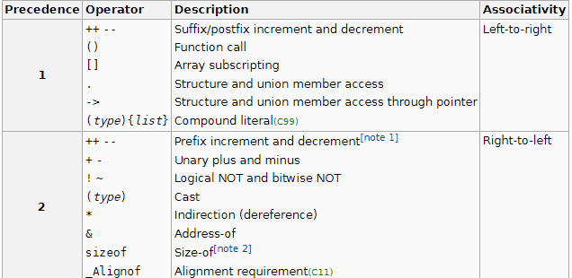

These operators in the precedence table:
Q: *a.b (*a).b
Different?

Slide 7
Arrays, structures, pointers - malloc
#define LEN 10
struct student * a;
..
a=malloc(sizeof(struct student)*LEN);
for(int i=0;i<LEN;i++) { scanf(“%s”,a[i].name);
... }
#define LEN 10
struct student *a[10];
..
for(int i=0;i<10;i++) { a[i]=malloc(sizeof(struct student));
scanf(“%s”,a[i]->name);
...
}

Slide 8
Unions
Structures
Element types can be different.
List of elements fixed.
Elements accessed by name
Using the . Operator
Total size – sum of sizes (obvious)
Unions
Element types can be different.
List of elements fixed.
Elements accessed by name
Using the . operator
Total size – max of the sizes because at any time only one of the members is valid
The only difference in definition of the union and the union variable is the use of the keyword union instead of struct

Slide 9
Union example
union id { char alnum[10]; int numeric;
};
... union id s_id;
strcpy(s_id.alnum,”IMT28”);
printf(“%s”,s_id.alnum); s_id.numeric=1729;
printf(“%d”,s_id.numeric);
// What happens if we try:
strcpy(s_id.alnum,”IMT28”);
printf(“%d”,s_id.numeric);

Slide 10
Limited Operators for structure and union variables
Both allow the ∙ and the -> for member access.
Assignment to the same type is allowed.
So a = b is valid if a and b are both of type struct student and it results in the fields being identical in value.
Copies are passed as parameters and return values. (see simple_struct.c)
Just to emphasize, this is like our basic types and (unlike arrays, where we cannot do an assignment, pass a copy as a parameter or return a copy.)
We cannot use any other operators (e.g., we cannot check a == b , or use any arithmetic operator) on a structure or union.

