Slide 1
AI Customer Feedback
Intelligence System
Turning thousands of clothing reviews into sentiment scores, complaint themes, and business action
AI Professional Diploma · Graduation Project · Project 1

Slide 2
THE PROBLEM
Manual review analysis doesn't scale
Online retailers collect thousands of written reviews across their web and mobile channels. Reading each one for sentiment and root cause is slow, inconsistent, and impossible to keep up with as volume grows.
Goal: an AI system that automatically classifies sentiment, clusters complaints, and surfaces business insights.
20,000+
Hours
Hidden
reviews to read manually per product catalog cycle
spent tagging sentiment by hand, every week
complaint themes buried in free-text, easy to miss
2

Slide 3
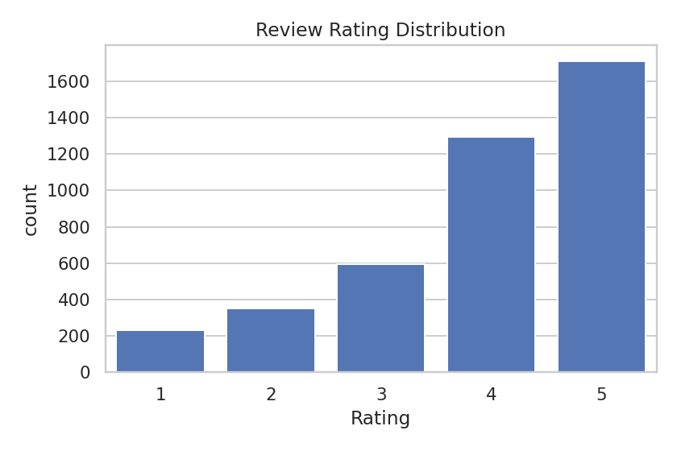
DATASET
Women's E-Commerce Clothing Reviews
Structure: Review Text, Rating (1-5), Recommended IND, Division / Department / Class Name, Age, Positive Feedback Count.
Metric | Value
Reviews collected | 4,215 rows
Duplicates removed | 15
Missing values handled | Review Text, Division Name
Final clean dataset | 4,180 reviews
Positive / Neutral / Negative split | 72% / 14% / 14%
Note: built via a structurally-identical synthetic generator (no internet access in the build sandbox). Same columns, drop-in ready for the real Kaggle CSV.
3

Slide 4
APPROACH
End-to-end pipeline
1
2
3
4
5
Clean
Engineer
Classify
Cluster
Deploy
Remove duplicates & missing values, normalize and tokenize review text, strip stopwords
TF-IDF (uni+bigrams) plus review length, exclamation count, and sentiment-lexicon features
Logistic Regression, Random Forest, Naive Bayes & Linear SVM — compared head-to-head
K-Means groups negative reviews into complaint themes (sizing, quality, shipping, price)
Gradio app for live predictions, cluster lookup, and an insights dashboard
4

Slide 5
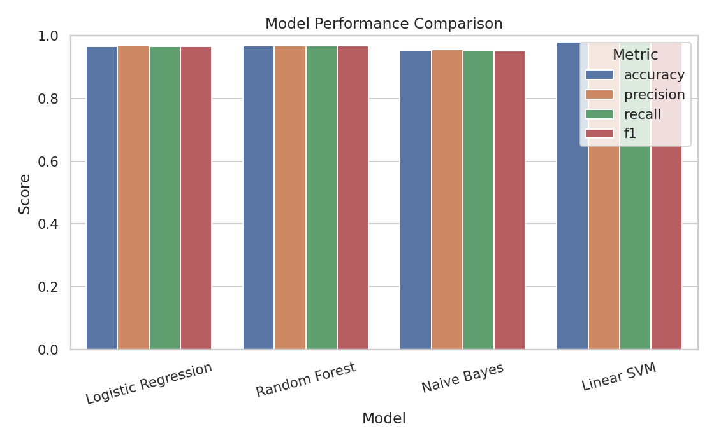
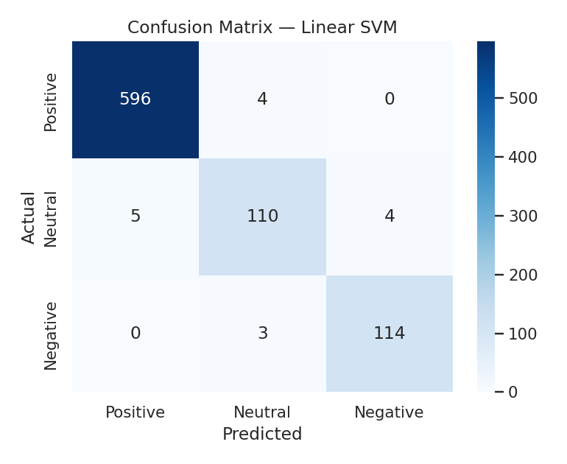
RESULTS
Model comparison & evaluation
Linear SVM was the best performer at 98.1% weighted F1 on held-out test data, ahead of Random Forest (96.9%), Logistic Regression (96.7%), and Naive Bayes (95.3%).
5

Slide 6
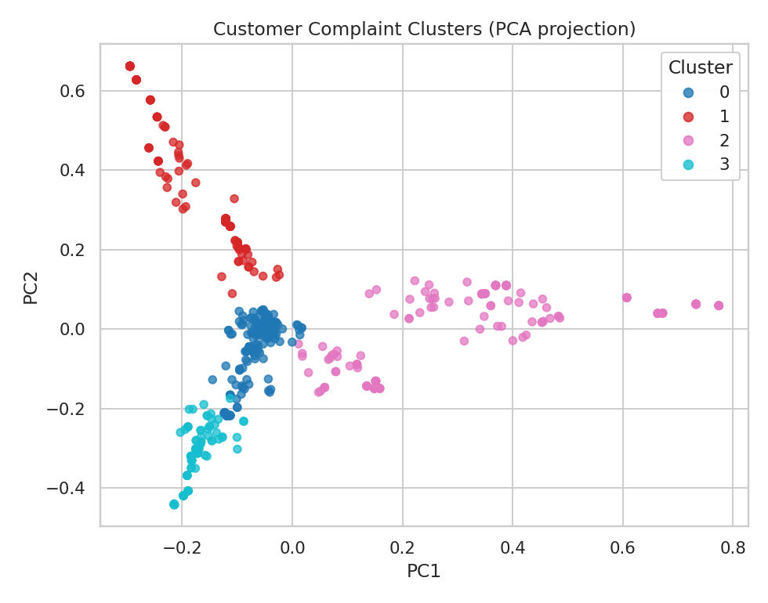
UNSUPERVISED LEARNING
What are unhappy customers saying?
Cluster 0 — Price vs. quality
"expensive", "basic material"
Cluster 1 — Shipping & packaging
"crushed", "delayed", "arrival"
Cluster 2 — Sizing & fit
"runs small", "return"
Cluster 3 — Fabric quality
"cheap", "poor quality"
6

Slide 7
BUSINESS IMPACT
From reviews to decisions
71.8% of reviews are positive and 76.5% of customers recommend what they bought — a healthy baseline to protect.
"Tops" is the lowest-rated department (3.88 avg) — a clear priority for QA and merchandising review.
Sizing and fabric-quality complaints dominate the negative-review clusters — actionable for buying & QA teams.
The sentiment model + complaint clustering can run continuously on new reviews, turning a manual audit into a live feed.
7

Slide 8
DEPLOYMENT · BONUS
Live Gradio demo + wrap-up
Sentiment Classifier
Complaint Explorer
Insights Dashboard
Paste any review, get instant Positive / Neutral / Negative + confidence scores
Negative reviews auto-matched to a complaint cluster with top terms shown
All charts from this deck, live in one interactive view for stakeholders
Bonus delivered: multiple-model comparison, advanced text feature engineering, interactive dashboard, and a live deployment demo (Gradio).
Next steps: train on the full real dataset, add a transformer-based model for nuanced/sarcastic reviews, and monitor for drift as new product lines launch.
Thank you.

