Slide 1




Perceptible Transition of Textures on Tactile Maps for Visually Impaired Users
Garance Perrot
and
Pooran Memari
Bachelor Thesis in Computer Science
Oral Defense
s
Notes:
VI people represent a significant 30 million people in geographical Europe.

Slide 2
Introduction : - What are Tactile Graphics ? - The Particularity of Blue Noise Point Patterns

Slide 3
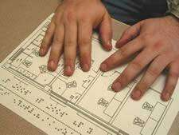
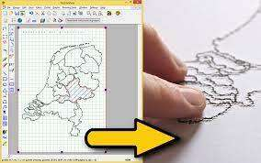
Tactile Graphics
- Raised lines and surfaces
- Non-textual information
- Educational tools
Notes:
Tactile graphics are defined as raised, textured, or embossed images specifically designed for exploration through touch. They provide a means for VI individuals to experience visual information in a tactile format using different exploration methods of finger behavior.
TG are critical for successful social integration of VI individuals in areas such as education or map navigation.
TG are composed of raised surfaces called “tactile patterns = textures”

Slide 4
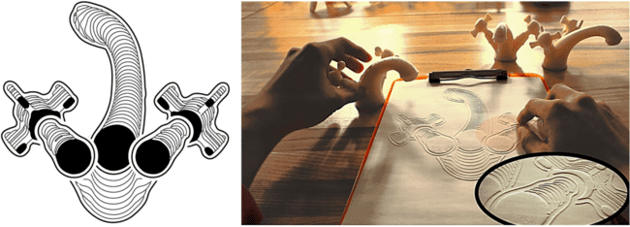
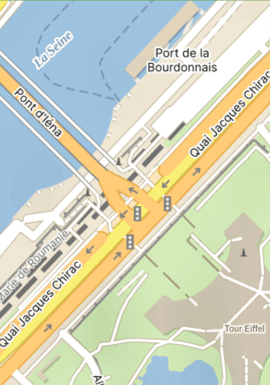
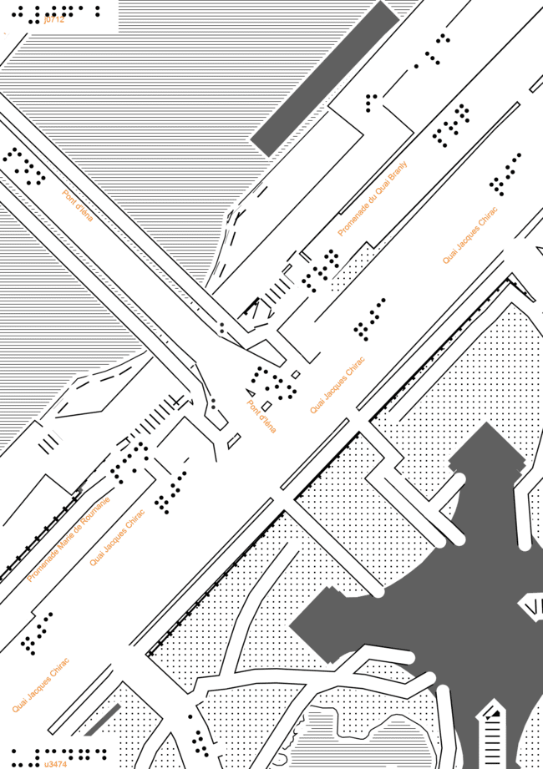
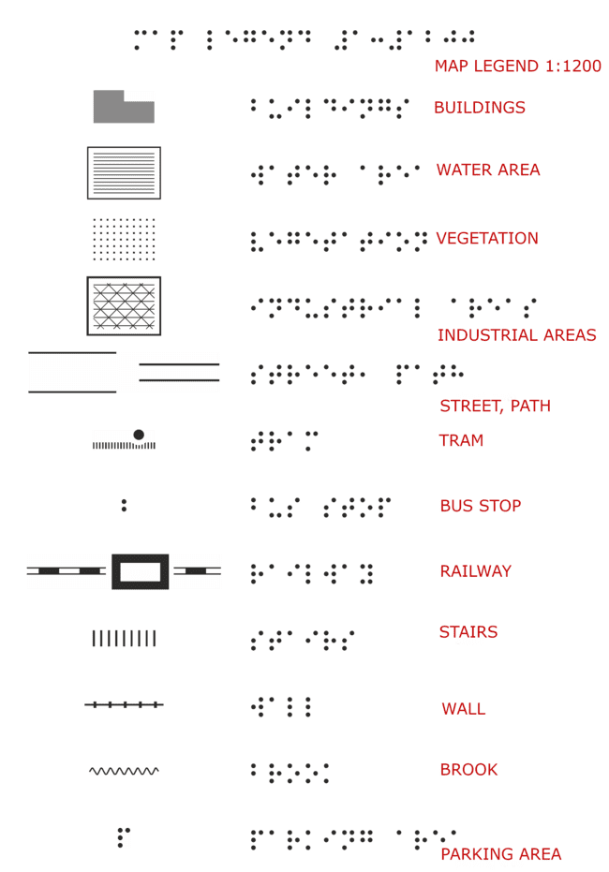
Tactile Graphics
Multi-projection line drawing Tactile map generated by Mapy.cz
Notes:
Computer science is being used to innovate in the field of tactile graphics design .
A first example is an advanced multi-projection tactile line drawing method which has been shown to improve shape understanding in raised line drawings by VI users.
A second example is a publicly accessible software Mapy.cz converting a conventional map into a simplified black-and-white graphic printed according to the principles of tactile maps. Users can choose a location to target on a world planisphere and generate a map in one of the three scales offered. (This process has some limitations : maps cannot be generated at a large scale (at country-size for example), and the area symbols are restricted to a set of four patterns. )

Slide 5
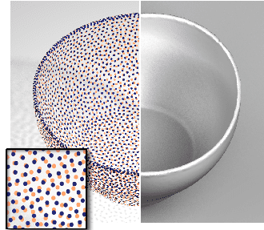
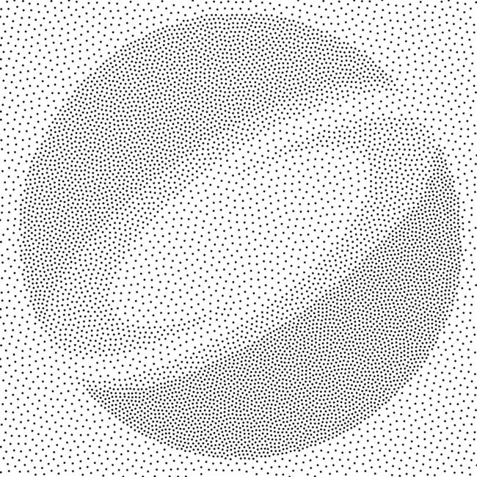
Blue Noise Point Patterns
Strategical point positioning
to reconstruct a surface
Spatially-varying density
Notes:
Point Patterns are particular type of geometric patterns that have diverse applications in Computer Graphics such as image stippling (a technique used in computer graphics and art to represent an image by using a collection of strategically placed points to convey the shape, shading, and details of the original image)
In particular, blue noise point patterns, exhibited for e.g by a Poisson disk distribution, are appreciated for their superiority in capturing relevant information visually, their balance between spatial evenness and randomness, and the facility to control density. Interesting : Research suggests that the arrangement of photoreceptors in some part of the human retina possesses blue noise characteristics, which can explain why such distributions are visually appealing and intuitive.
A blue noise point pattern is a specific arrangement of points in a space that balances two key features:
Uniform distribution: The points are spread out evenly across the space, avoiding any large gaps or clusters.
Randomness: The points are not placed in a strict grid or any other predictable pattern.

Slide 6
From Design to Fabrication of Tactile Maps
Notes:
In this study, we are specifically focusing on tactile maps, which are tactile graphics serving a visual representations of environmental or geographical spaces.

Slide 7
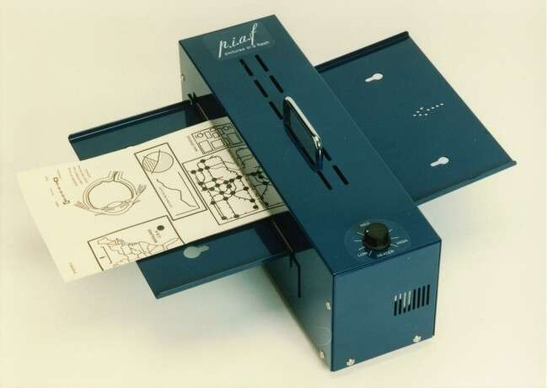
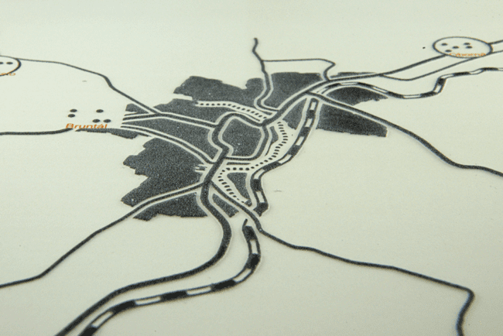
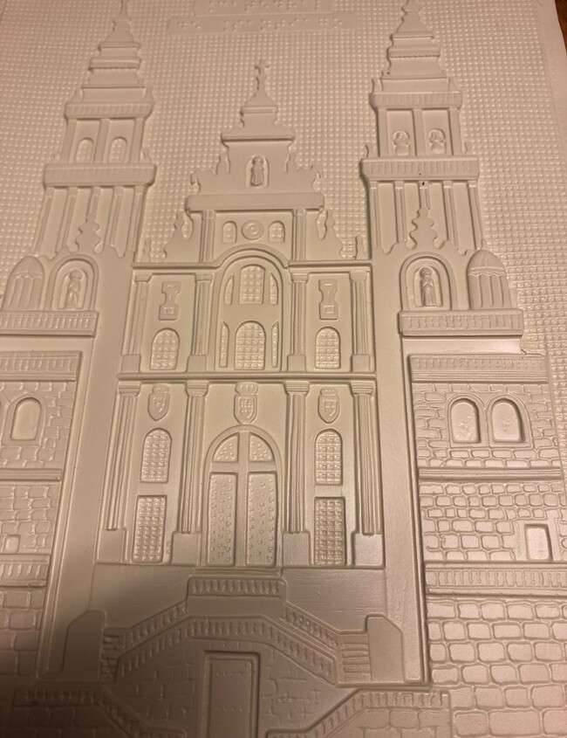
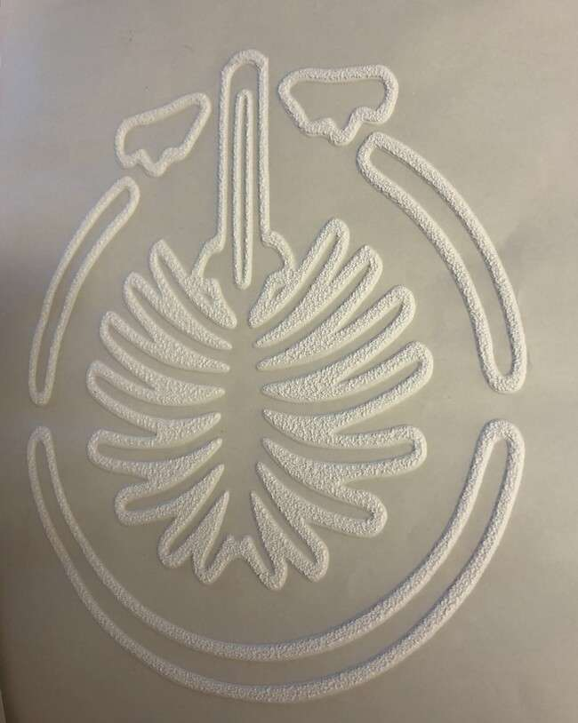
Different Fabrication Methods & Limitations
Fabrication Method | Benefits | Drawbacks
Hand-crafting | Rapid, accessible | No durability, no replicability
Braille embosser | Portable device | Limitation of details, expensive
Heat embossing | Replicability, details | Low durability, expensive
Thermoforming | Varying relief heights | Inconsistent quality, use of plastic
Resin printing | Robustness, details | Expensive, slow fabrication
Notes:
There exist different methods to create tactile maps, and they all have their limitations.
Because of time constraints , I will present only two of them but see the table for more details.
One of the most common methods for creating tactile maps is heat embossing. Maps are designed on computers and printed using a regular printer on “swell paper”, which contains microcapsules of alcohol. Upon heating the paper in a specialized oven, these microcapsules expand, creating raised relief over the black ink.
Thermoforming, involves placing a plastic sheet over a master and when heated in a vacuum, the sheet permanently conforms to the texture of the master.
Tactile maps come with several limitations and challenges such as time-consuming and costly fabrication, static nature making them quickly outdated, readability of the text displayed.

Slide 8
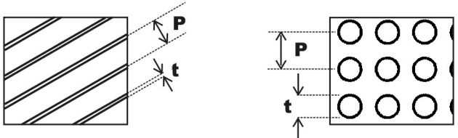
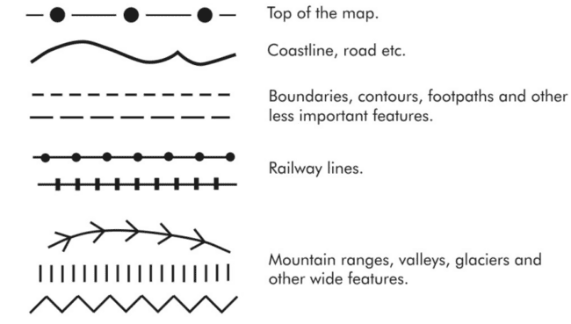
Guidelines on Tactile Symbols : Point, Line, Texture
Choice of tactile symbols :
- Realism & simplicity
- Universal & custom symbols
- Area symbols : style, pitch, thickness
Map composition & numerical parameters :
- Legends & labels
- Scaling & number of features
- Numerical parameters for symbols
Notes:
The transition from a traditional map to a tactile map raises many challenges due to differences between various production methods of tactile maps & differences of perception among VI individuals. Researchers Wabinski et al[40] provide a complete review of research and best practices regarding tactile map design. They have shown that although there exist international standards for tactile mapping, they are not adopted by map designers across countries, who all follow their own guidelines.
Three types of tactile symbols : point symbols (punctual, can be squares, triangles : bus stop), line symbols (e.g boundary or road), textures (surfaces).
Tactile symbols should be realistic and simple, their shape should suggest real-world features for example by representing railroads with two parallel lines crossed by shorter lines.
Certain symbols are common across all production methods, (for instance “simple geometric forms such as squares and circles for point symbols. ), some are more specific symbols according to their production method.
. The combination of symbols is important : point symbols should be different from the symbols used to form textures on the same map, even with distinct sizes.
Area symbols are characterized by style (geometry of texture elements, including regularity and continuity), pitch (distance between pattern elements), and thickness (width of pattern elements) and serve various purposes,( for instance basket-weave patterns are best to fill large shapes and representing solid objects, contrary to solid patterns which are limited to small areas.)
Now regarding map composition, specific rules exist on legends and labels (placement), on scaling and detail level (There is an explicit formula to determine the number of features on a map according to its scale to ensure map readability) . There are specific numerical parameters for symbols (varying across practitioners), (for example optimal point symbol size varying from 3 to 13 mm or maximum number of 5 height levels on a single map. )

Slide 9
Methodology Q1 : Identifying the most representative patterns for environments Q2 : Estimating the haptic perceptible distance between tactile patterns
Notes:
Regarding area symbols, the previous recommendations present their characteristics, the most common ones; and give advice to discriminate them from point symbols or lines, and specific numerical values to respect. However, they focus only on one texture at a time, providing very little information about the choice of the most relevant area symbols to represent environments, about how to combine them and about the haptic charge of using different patterns in a tactile map. From these observations and focusing on the context of tactile maps printed on swell paper, we derived two key research questions : questions

Slide 10



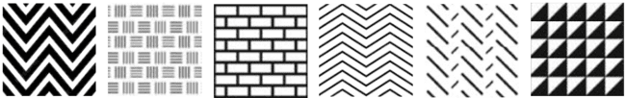
Q1 : Identifying the Most Representative Patterns
Water areas
Natural lands
Urban areas
Industrial/ agricultural areas
Notes:
We categorized different groups of environment elements, commonly present in geographical maps, and we have collected a set of geometric patterns, based on the previous recommendations, that may be used to represent each of these categories.
• Water Areas : divided into three main categories based on their movement
Waving water :large bodies of water with surface waves, including seas and oceans.
- Flowing water: continuously moving water from higher to lower elevations, such as rivers and streams. –
Still water: bodies of water with little to no surface movement, including lakes, ponds, and marshes.
• Natural Lands : categorized by prominent features such as landform and vegetation
Low elevation land - High elevation land - Vegetated land - Non-vegetated land
• Urban Areas :separated according to their dominant land use ( often host point symbols for prominent places, so should allow point symbols above to be discernable)
Residential area - Commercial or academic area - Historical area
• Peri-Urban Area :
Industrial area - Agricultural area

Slide 11
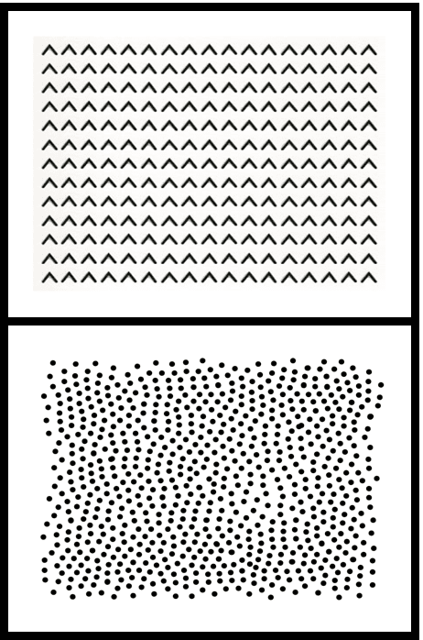
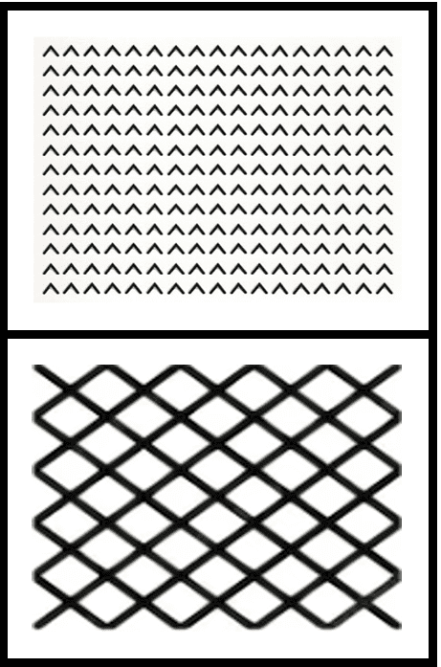
Q2 : Formalizing the Perceptible Transition of Textures
p1
- Haptic Perception Distance
- Relative Distances
-Tactile Domino Setting
p2
p3
Hypothesis : HD(p1, p2) ⪯ HD(p1, p3)
Notes:
After sampling the set of representative patterns, we need to formally analyze how they are perceived through touch. However, to the best of our knowledge there is currently no established standard haptic measure applicable to our study. To address this gap, we propose a formal framework for estimating the similarity or dissimilarity in haptic perception between the patterns.
From our data set of patterns, we introduce a metric called the Haptic Distance between pairs of patterns p1, p2 ∈ P, denoted by HD(p1, p2). It is never calculated using specific values but focuses on relative distances determined by experiments in which the users are asked to sort the so-called "Tactile Dominos" of two patterns based on the perceived contrast felt by touch. The more they feel contrast by touch on a Tactile Domino, the higher the haptic distance is between the two patterns. For e.g on the slide …
The patterns are vertically arranged to eliminate any potential bias in haptic perception resulting from the user’s right or left hand according to their exploration methods of raised-line graphics.

Slide 12
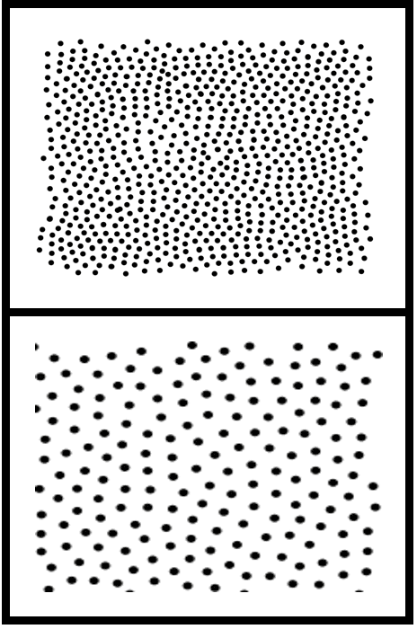
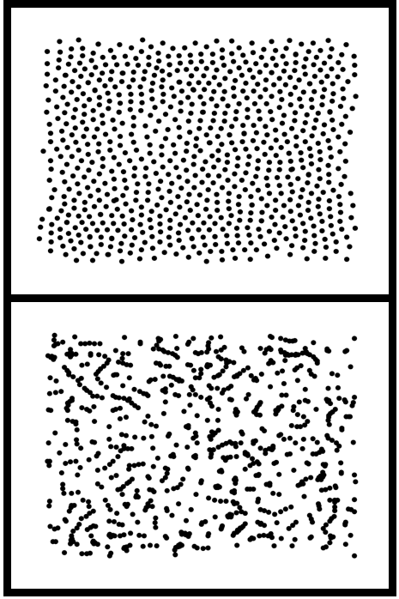
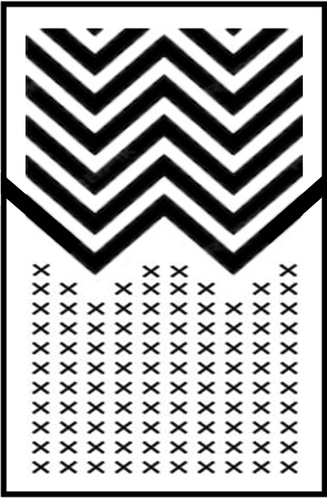
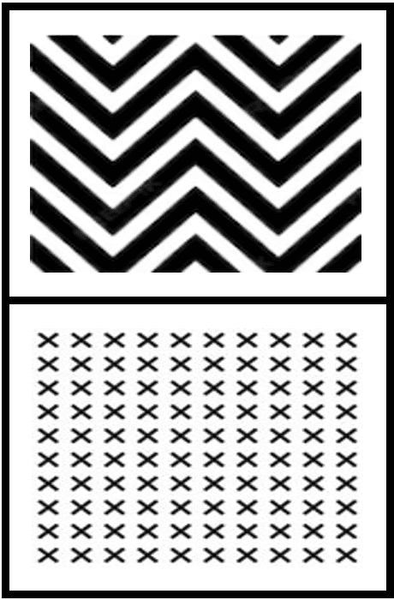
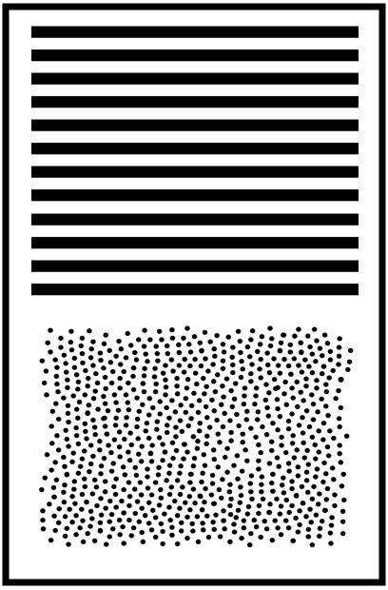
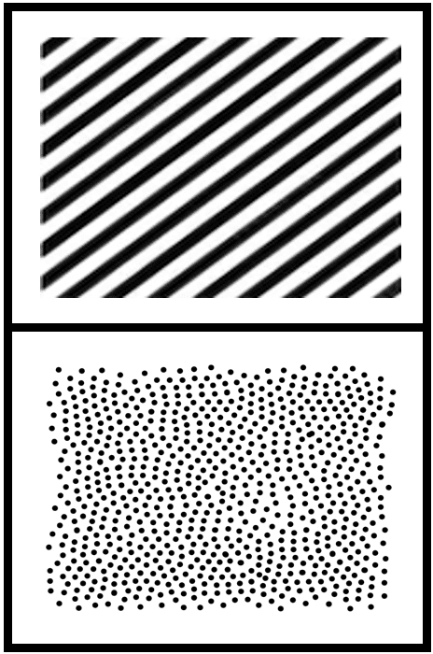
Planning of a User Study
→ PHASE 1 : patterns from different groups
1) H : Low haptic distances for same environment textures
2) H : density > correlation for point patterns
3) Threshold change of density for point patterns
4) Boundary choice for curved patterns
5) Boundary choice for hashes & optimal angle
→ PHASE 2 : within environment groups
6) Most relevant pattern for each specification
Notes:
I will describe the user study that will be conducted to answer Q2 (Due to time constraints, a second meeting with INSHEA experts could not be facilitated prior to the report submission deadline, but we have received confirmation that they will soon provide us information based on their expertise to refine our initial set of patterns ( the cultural interpretation based on the location of the user study, as well as the technology-based constraints and already adopted conventions. ) and Tactile Dominos, for e.g the dimension of these dominos. Subsequently, we will be able to conduct the user study with VI children from the French NGO Voir Ensemble and from the INJA Institute.
The user study is decomposed in two phases.
PHASE 1 : Between the two pairs of textures, which one has the greatest contrast of textures ?
Investigating among others point patterns (correlation, density), the shape and choice of the boundary (curved, linear, or none for patterns allowing one edge to define the space) might naturally have an impact on transition perception.
PHASE 2 : Associate each environment specification to one or more textures from the provided set.
Investigating the most relevant pattern for each specification (e. g natural areas, low-elevation land)

Slide 13
Applications of the Concept of Haptic Distance
Notes:
The haptic distance metric can have various applications for pattern choice, given a formalization of the setting.

Slide 14
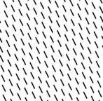
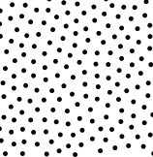
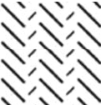
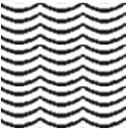
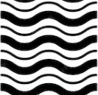
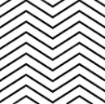
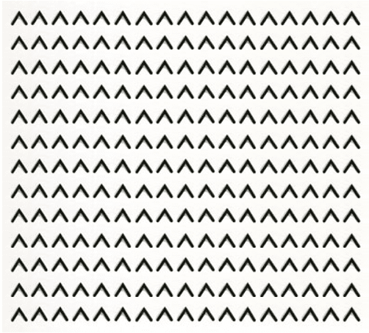
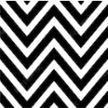
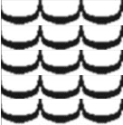
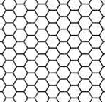
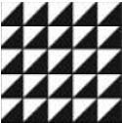
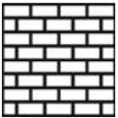
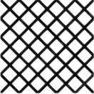
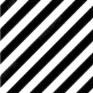
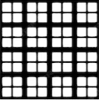
Natural land
Water area
Cluster per environment
Industrial / agricultural land
Node for a pattern
Corresponding pattern
Urban area
Notes:
Let us represent the set of selected patterns as nodes of a graph, where each environment group corresponds to a cluster of nodes. We suppose that the weight associated to each edge of the graph corresponds to the haptic distance between the two corresponding patterns.
An application of this graph formulation is to represent the set of patterns to a specific situation with a fixed map. The map provides details about the number n_e of distinct environments it contains …

Slide 15
Natural land
Water area
Cluster per environment
Industrial / agricultural land
Node for a pattern
Edge for a haptic distance
Corresponding pattern
Urban area
Notes:
… as well as the way these environments border each other. This information allows us to construct a corresponding graph with n_e clusters representing the different environments. However, unlike a complete graph, edges will only connect clusters that represent neighboring environments on the actual map. …

Slide 16
Natural land
Water area
Cluster per environment
Industrial / agricultural land
Node for a pattern
Edge for a haptic distance
Corresponding pattern
Urban area
Maximized haptic distance
Optimized pattern
Notes:
… By following adjacency paths within this graph, we can optimize for the most suitable combination of textures for the map by maximizing the edge weights representing the relative haptic distances, as shown in red on the example.
Another application of the HD would be to determine the maximal number of patterns to use on a single map, commonly agreed by TM designers to be around 5, but not validated yet by experiments.
For this, we would begin with a single pattern for each environment and increase the complexity of the map by introducing additional textures based on environment specifications. As an illustration, in the first step the map’s water areas would share a single texture. Gradually, we would introduce new textures to differentiate still water from flowing water or waving water. Our objective is to pinpoint the threshold at which VI users struggle to discriminate between textures within the same environment

Slide 17
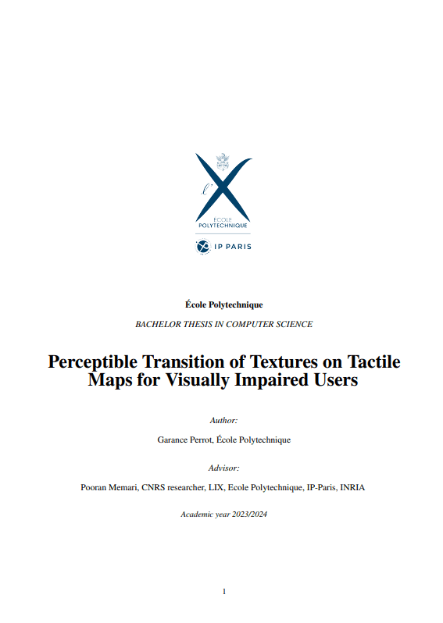
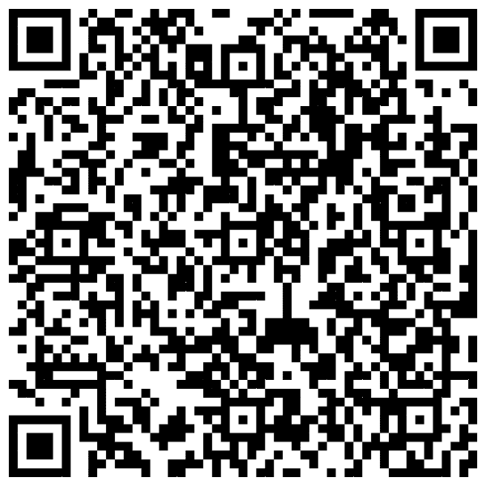
Conclusion & Future Work
Project zip file with patterns and “dominos”:
Thank you
Notes:
To conclude, we have introduced a new measure called the haptic distance. We have laid the groundwork for assessing the level of haptic distinguishability between textures and for investigating the impact of varying boundary shapes to better reflect the characteristics of tactile maps. This study may initiate a step towards optimal pattern combination for a clear transition between textures.
An interesting future direction would be to develop an algorithmic approach for calculating the haptic distance between patterns. While there exist methods for quantifying visual geometric dissimilarity, these visually computed distances do not directly translate to haptic perceptions. Most of those visual methods consist in comparing images pixel by pixel, which cannot be applied to haptic perception. Indeed, based on the experiments, the visual and haptic perception of some geometric patterns are very different (e.g : different point correlations are perfectly distinguishable visually but difficult to perceive by touch). An idea would be compare the elements composing textures. The translation from vision to haptics is currently investigated by researchers. Bridging this gap would enable efficient computation of haptic distance, paving the way for practical applications.
For more details, please refer to my thesis report.
Acknowledgements
Thank you for listening, don’t hesitate to ask questions.

