Slide 1

Managing Windows Server
Module 2

Slide 2
Objectives
Skills/Concepts | Objective Domain Description | Objective Domain Number
Managing Devices and Device Drivers | Understand device drivers. | 1.1
Managing Services | Understand services. | 1.2
Using the Control Panel | Understand remote access. | 2.3
Notes:
This should also be a review for the 70-642.

Slide 3
Server Configuration
Initial Configuration Tasks utility automatically launches when you first log on to Windows after installation
Provide Computer Information
Update This Server
Customize This Server
Control Panel is a graphical utility used to configure Windows environment and hardware devices
System and Security
Network and Internet
Hardware
Programs
User Accounts
Appearance
Clock, Language, and Region
Ease of Access
Notes:
Because the UAC is designed to make sure that unauthorized changes are not made, especially by malicious software that you may not know you are running, you need to read the warnings carefully and then make sure the name of the action or program that’s about to start is one that you intended to start.
UAC cannot be enabled or disabled for any individual user account.
Instead, you enable or disable UAC for the entire computer.
As a standard user, in Windows Server 2008 R2, you can do the following without requiring administrative permissions or rights:
Install updates from Windows Update.
Install drivers from Windows Update or those that are included with the operating system.
View Windows settings.
Pair Bluetooth devices with the computer.
Reset the network adapter and perform other network diagnostic and repair tasks.

Slide 4
DEMO: Initial Configuration Tasks
Notes:
Because configuring Windows servers can be time consuming, Windows Server 2008 and Windows Server 2008 R2 include Initial Configuration Tasks that automatically launch when you first log on to Windows after an installation.
With the Initial Configuration Tasks, you can activate Windows, set the time zone, configure networks, provide computer name and domain, update Windows, add roles and features, enable remote desktop, and configure the Windows Firewall.
Although Initial Configuration Tasks can be accessed within the Control Panel, because it launches automatically, it acts as a reminder and a quick method to access key options so that you can quickly get your Windows server up and running with minimal effort. See Figure 2-1. The Initial Configuration Tasks will appear every time you log on until you select Do not show this window at logon at the bottom of the window.

Slide 5
DEMO: Control Panel
Notes:
As with previous versions of Windows, the main graphical utility to configure the Windows environment and hardware devices is the Control Panel.
You can also display the Control Panel in any Windows Explorer view by clicking the leftmost option button in the Address bar and selecting Control Panel.

Slide 6
User Account Control
User Account Control (UAC) is a feature that started with Windows Vista and is included with Windows Server 2008 and later that helps prevent unauthorized changes to your computer
UAC is a security component that enables users to perform common tasks without using an administrator account or having to switch user accounts
Before performing actions that can potentially affect your computer’s operation or that change settings that affect other users:
Logged in as an administrator: UAC asks you for permission
Logged in as a standard user: UAC asks you for an administrator password
Notes:
Because the UAC is designed to make sure that unauthorized changes are not made, especially by malicious software that you may not know you are running, you need to read the warnings carefully and then make sure the name of the action or program that’s about to start is one that you intended to start.
UAC cannot be enabled or disabled for any individual user account.
Instead, you enable or disable UAC for the entire computer.
As a standard user, in Windows Server 2008 R2, you can do the following without requiring administrative permissions or rights:
Install updates from Windows Update.
Install drivers from Windows Update or those that are included with the operating system.
View Windows settings.
Pair Bluetooth devices with the computer.
Reset the network adapter and perform other network diagnostic and repair tasks.

Slide 7
DEMO: User Account Control

Slide 8
System Settings
Some of the most important configuration settings for a server administrator are the system settings within the Control Panel
These settings include
Gathering information about your system
Changing the computer name
Adding the computer to a domain
Accessing the device manager
Configuring remote settings
Configuring startup and recovery options
Configuring overall performance settings
Notes:
To access the system settings, you can do one of the following:
If you are in Category view, click System and Security, and click System or click View amount of RAM and processor speed.
If in classic view, double-click the System applet.
Right-click Computer and select Properties.

Slide 9
DEMO: System Settings

Slide 10
DEMO: Changing Computer Name and Domain Settings
Notes:
To help identify computers, you should name a computer with a meaningful name. This can be done within the System settings within the Control Panel. You can also add a computer to a domain or workgroup.
Every computer must have a unique computer name assigned to a network. If two computers have the same name, one or both of the computers will have trouble communicating on the network.

Slide 11
Workgroups and Domains
A workgroup is associated with a peer-to-peer network - user accounts are decentralized and stored on each individual computer
A domain is a logical unit of computers that define a security boundary, and it is associated with Active Directory Domain Services (AD DS)
Domain security is generally centralized and controlled by Windows servers acting as domain controllers

Slide 12
Remote Assistance and Remote Desktop
With Remote Assistance and Remote Desktop, you can access a computer running Windows with another computer that is connected to the network or over the Internet just as if you were sitting in front of the remote computer
You will be able to use your mouse and keyboard to access the desktop, taskbar, and Start menu
You will be able to run programs and access all of the configuration tools
RDP - 3389

Slide 13
IP Address Settings
You need to configure the following on a computer running Windows Server 2008 R2:
IP address and corresponding subnet mask: Uniquely identifies the computer using a logical address
Default gateway: Router that connects to the other networks or the Internet
DNS server: Provide name resolution
The IP address, subnet mask, default gateway, and DNS servers can be configured manually or automatically via a DHCP server

Slide 14
DEMO: Networking
Network and Sharing Center
IPv4
IPv6
Proxy Settings

Slide 15
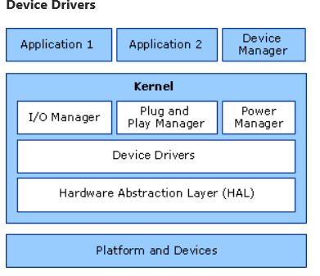
Device Drivers
Device drivers is a component that enables Windows to interact with a device
Although Windows Server 2008 R2 includes many drivers (built-in or included on the installation DVD), some drivers come with the device
To prevent you from constantly inserting the Windows Server 2008 R2 installation DVD, Windows Server 2008 R2 includes a driver store with an extensive library of device drivers
Notes:
Because these drivers are software, there may be times when you need to go to the manufacturer’s Web site to retrieve newer drivers (although sometimes older drivers work better than newer drivers) or download them through Microsoft’s updates.

Slide 16
Hardware Resources
Windows assigns system resources to the devices you are installing so that the device can operate at the same time as other devices
Devices communicate with the system using the following hardware resources
IRQ: Interrupt request used to access the device
DMA channels: Direct Memory Access enables certain components within the device to access system memory without using the Central Processing Unit (CPU)
Input/output (I/O) port addresses: Communication between the CPU and hardware devices
Memory address ranges: Range used by a device to access the computer’s primary storage memory

Slide 17
Plug and Play (PnP)
Plug and Play (PnP) technology provides a combination of software and hardware support that enables the Windows operating system to detect and configure hardware
Plug and Play (PnP) installs the appropriate driver after the hardware is detected
Plug and Play manager performs the following steps:
Verify the hardware resources the device requires (memory, I/O, DMA channels)
Verify the hardware identification for the device and installs and configures the appropriate driver
If multiple drivers are found, the driver that most closely matches the hardware is selected
The driver is installed and the OS starts the device

Slide 18
Signed Drivers
Microsoft started using signed drivers to help mitigate faulty device drivers
A signed driver includes a digital signature, which is an electronic security mark that can indicate the publisher of the software and information that can show if a driver has been altered
All drivers running on a 64-bit version of Windows must be signed before Windows will load them
Windows Server 2008 R2 is delivered only in 64-bit versions; all drivers must also be signed for Windows Server 2008
2012-2016-2022
Notes:
If you are using a newer version of Windows that is not a 64-bit version, you can use the File Signature Verification program (Sigverif.exe) to check whether unsigned device drivers are in the system area of a computer.

Slide 19
Device Manager
Device Manager is tool in Windows Server used to manage hardware devices:
Install and update drivers for hardware devices
Change the hardware settings
Troubleshoot problems
When diagnosing problems with Device Manager:
A down black arrow indicates a disabled device A disabled device is a device that is physically present in the computer and is consuming resources, but does not have a driver loaded
A black exclamation point (!) on a yellow field indicates the device is in a problem state
You also need to check whether any devices are listed under Other devices or have a generic name such as Ethernet Controller or PCI Simple Communications Controller, which indicates that the proper driver is not loaded

Slide 20
DEMO: Devices
Device Manager
Devices and Printers
Notes:
Starting with Windows Server 2008 and Windows Vista, Windows includes the Devices and Printers folder to quickly allow users to see all the devices connected to the computer and to configure and troubleshoot these devices.
It also allows you to view information about the make, model, and manufacturer and gives you detailed information about the sync capabilities of a mobile phone or other mobile devices.

Slide 21
DEMO: Administrative Tools
MMC
Administrative Tools
Computer Management
Server Manager
Services
Registry
Notes:
Administrative Tools is a folder in the Control Panel that contains tools for system administrators and advanced users.
To access the Administrative Tools, open the Control Panel, open Administrative Tools by clicking Start, Control Panel, System, and Security while in Category View or double-click the Administrative Tools applet while in Icon view.
There is also a quick link on Windows Servers that can be accessed by clicking the Start button.

Slide 22
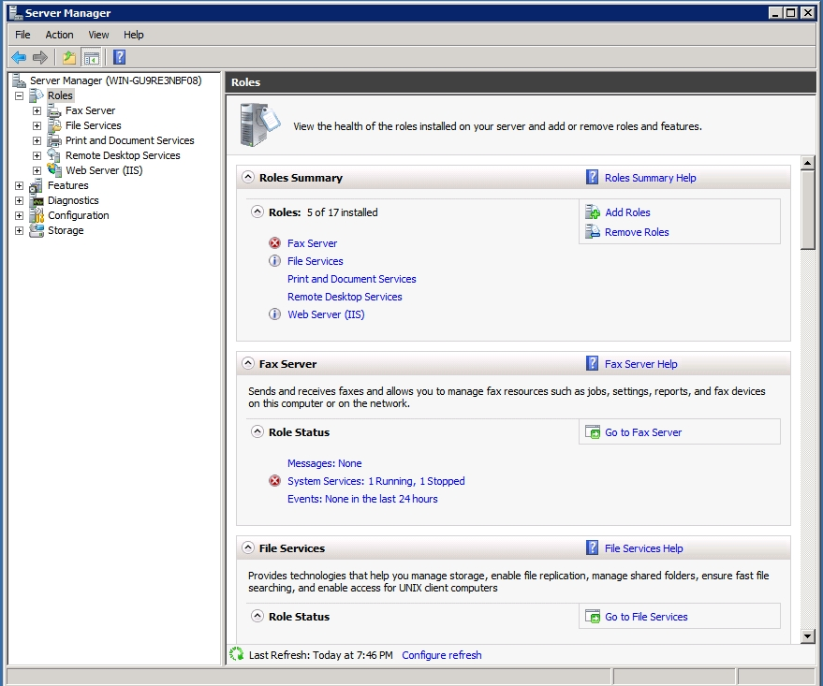
Server Roles
Notes:
A server role is a set of software programs that, when installed and properly configured, enables a computer perform a specific function for multiple users or computers within a network.
Role services are software programs that provide the functionality of a role or service.

Slide 23
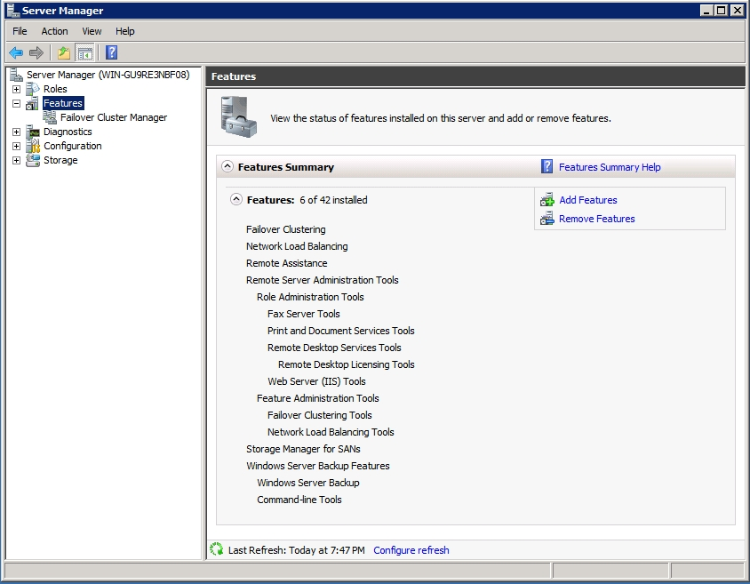
Server Features
Notes:
Features are software programs that are not directly part of a role.
Instead, they can support or augment the server.

Slide 24
Server Core
The Server Core installation provides a minimal environment with no Windows Explorer shell for running specific server roles and no Start button.
Server core can be managed locally at a command prompt or remotely using Remote Desktop Services
You can also manage the server remotely using administrative tools based on the Microsoft Management Console (MMC) including Computer Management and Server Manager consoles

Slide 25
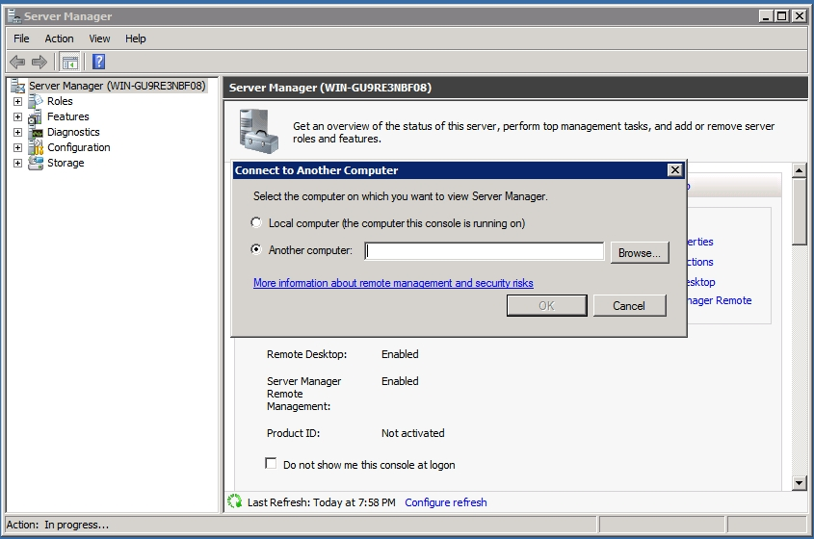
Server Core

Slide 26
Additional Resources & Next Steps
Instructor-Led Courses
40033A: Windows Operating System and Windows Server Fundamentals: Training 2-Pack for MTA Exams 98-349 and 98-365 (5 Days)
40349A: Windows Operating System Fundamentals: MTA Exam 98-349 (3 Days)
40032A: Networking and Security Fundamentals: Training 2-Pack for MTA Exams 98-366 and 98-367 (5 Days)
40366A: Networking Fundamentals: MTA Exam 98-366
Books
Exam 98-366: MTA Networking Fundamentals (Microsoft Official Academic Course)
Exams & Certifications
Exam 98-366: Networking Fundamentals

Slide 27

© 2012 Microsoft Corporation. All rights reserved. Microsoft, Windows, Windows Vista and other product names are or may be registered trademarks and/or trademarks in the U.S. and/or other countries.
The information herein is for informational purposes only and represents the current view of Microsoft Corporation as of the date of this presentation. Because Microsoft must respond to changing market conditions, it should not be interpreted to be a commitment on the part of Microsoft, and Microsoft cannot guarantee the accuracy of any information provided after the date of this presentation. MICROSOFT MAKES NO WARRANTIES, EXPRESS, IMPLIED OR STATUTORY, AS TO THE INFORMATION IN THIS PRESENTATION.

