Slide 1
UNDERGRADUATE QUANTITATIVE METHODS
Data Analysis
for Public Policy
PA 311N · Fall 2026
Sergio I. García-Ríos
LBJ School of Public Affairs
Statistical reasoning · R · Public-policy applications
Notes:
Welcome students and frame the course around substantive policy questions rather than formulas.
[Sources]
- Adapted from Sergio I. García-Ríos, GOVT 3990 Day 1 deck (topic0.tex and accompanying assets).
[/Sources]

Slide 2
PA 311N · DATA ANALYSIS FOR PUBLIC POLICY
The question that organizes this course
How can we use imperfect data to make better public-policy decisions?
Every method begins with a substantive question—and ends with an interpretation someone can use.
2
Notes:
[Sources]
- Adapted from Sergio I. García-Ríos, GOVT 3990 Day 1 deck (topic0.tex and accompanying assets).
[/Sources]

Slide 3
PA 311N · DATA ANALYSIS FOR PUBLIC POLICY
Teaching team and weekly rhythm
Sergio I. García-Ríos
Monday: substantive question + statistical reasoning
Instructor · Office hours by appointment
Wednesday: guided analysis in R
Sarah Traore
Teaching assistant
Friday: review, troubleshooting, and On Your Own support
3
Notes:
[Sources]
- Adapted from Sergio I. García-Ríos, GOVT 3990 Day 1 deck (topic0.tex and accompanying assets).
[/Sources]

Slide 4
PA 311N · DATA ANALYSIS FOR PUBLIC POLICY
Required materials
OpenIntro Statistics
4th edition · Free online at openintro.org/book/os
Software
R
Bring a laptop to Wednesday labs and Friday sections.
RStudio Desktop
Quarto
4
Notes:
[Sources]
- Adapted from Sergio I. García-Ríos, GOVT 3990 Day 1 deck (topic0.tex and accompanying assets).
[/Sources]

Slide 5
PA 311N · DATA ANALYSIS FOR PUBLIC POLICY
Six units build one analytical workflow
1
Data, measurement,
and exploration
2
Probability and
distributions
3
Sampling and
uncertainty
4
Testing and
comparisons
5
Correlation and
regression
6
Interpretation and
communication
5
Notes:
[Sources]
- Adapted from Sergio I. García-Ríos, GOVT 3990 Day 1 deck (topic0.tex and accompanying assets).
[/Sources]

Slide 6
PA 311N · DATA ANALYSIS FOR PUBLIC POLICY
Three elements stay connected
Statistical reasoning
R programming
Policy application
What does the method do?
When is it appropriate?
How do we implement it
and check the output?
What does the result mean
for the real question?
6
Notes:
[Sources]
- Adapted from Sergio I. García-Ríos, GOVT 3990 Day 1 deck (topic0.tex and accompanying assets).
[/Sources]

Slide 7
PA 311N · DATA ANALYSIS FOR PUBLIC POLICY
Assessment emphasizes sustained practice
Problem sets
25%
Guided labs
25%
Midterm
10%
Project proposal
5%
Reproducible report
20%
Poster presentation
10%
Participation
5%
7
Notes:
[Sources]
- Adapted from Sergio I. García-Ríos, GOVT 3990 Day 1 deck (topic0.tex and accompanying assets).
[/Sources]

Slide 8
PA 311N · DATA ANALYSIS FOR PUBLIC POLICY
The project ends with analysis and communication
Ask an answerable public-policy question
Analyze real data independently in R
Submit a reproducible Quarto report
Translate the evidence into a concise policy poster
Explain the finding—and its limitations—in the poster session
8
Notes:
[Sources]
- Adapted from Sergio I. García-Ríos, GOVT 3990 Day 1 deck (topic0.tex and accompanying assets).
[/Sources]

Slide 9
PA 311N · DATA ANALYSIS FOR PUBLIC POLICY
The midterm is an individual checkpoint
Monday, November 2
Units 1–4
Statistical reasoning, interpretation, and manageable calculations
No R coding
One student-prepared double-sided reference sheet
9
Notes:
[Sources]
- Adapted from Sergio I. García-Ríos, GOVT 3990 Day 1 deck (topic0.tex and accompanying assets).
[/Sources]

Slide 10
PA 311N · DATA ANALYSIS FOR PUBLIC POLICY
What usually makes students successful
Complete the reading before each unit
Be active during lectures, labs, and sections
Start problem sets early—and show your reasoning
Ask questions before confusion accumulates
Render your Quarto work often, not only before submission
Start the project well before the deadline
10
Notes:
[Sources]
- Adapted from Sergio I. García-Ríos, GOVT 3990 Day 1 deck (topic0.tex and accompanying assets).
[/Sources]

Slide 11
PA 311N · DATA ANALYSIS FOR PUBLIC POLICY
Before Wednesday
Download the free OpenIntro textbook
Install R, RStudio Desktop, and Quarto
Read the syllabus and schedule
Bring your laptop to Lab 0
Come ready to render your first Quarto report
11
Notes:
[Sources]
- Adapted from Sergio I. García-Ríos, GOVT 3990 Day 1 deck (topic0.tex and accompanying assets).
[/Sources]

Slide 12
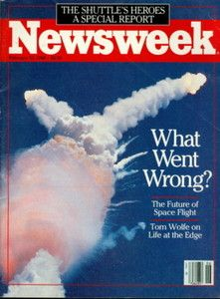
PA 311N · DATA ANALYSIS FOR PUBLIC POLICY
Why presentation and modeling matter
In 1986, the Challenger space shuttle exploded shortly after liftoff.
O-ring failure was central to the disaster. Could the risk have been seen before launch?
12
Notes:
[Sources]
- Adapted from Sergio I. García-Ríos, GOVT 3990 Day 1 deck (topic0.tex and accompanying assets).
[/Sources]

Slide 13
PA 311N · DATA ANALYSIS FOR PUBLIC POLICY
The engineers looked only at damaged flights
Flight | Temperature (°F)
2 | 70
41B | 57
41C | 63
41D | 70
51C | 53
61A | 79
61C | 58
What is missing?
Failures are meaningful only when compared with successes.
13
Notes:
[Sources]
- Adapted from Sergio I. García-Ríos, GOVT 3990 Day 1 deck (topic0.tex and accompanying assets).
[/Sources]

Slide 14
PA 311N · DATA ANALYSIS FOR PUBLIC POLICY
Selection changes the story
Looking only at failures is selection on the outcome.
Damaged flights
Successful flights
+
7 observations
15 observations
The full comparison reveals the relationship between temperature and damage.
14
Notes:
[Sources]
- Adapted from Sergio I. García-Ríos, GOVT 3990 Day 1 deck (topic0.tex and accompanying assets).
[/Sources]

Slide 15
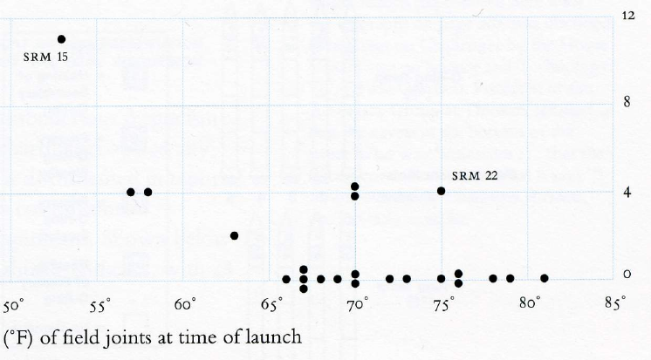
PA 311N · DATA ANALYSIS FOR PUBLIC POLICY
A graph makes the relationship visible
15
Notes:
[Sources]
- Adapted from Sergio I. García-Ríos, GOVT 3990 Day 1 deck (topic0.tex and accompanying assets).
[/Sources]

Slide 16
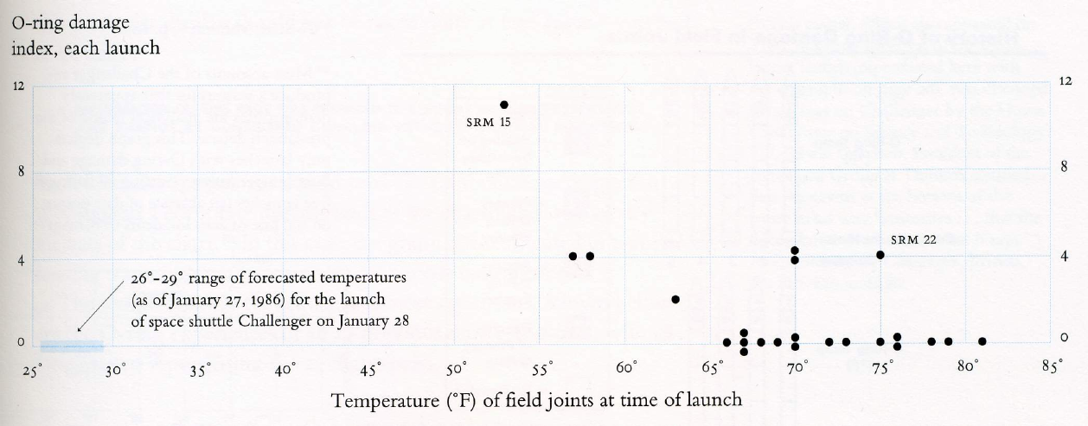
PA 311N · DATA ANALYSIS FOR PUBLIC POLICY
The launch temperature was outside prior experience
26–29°F
forecast launch
temperature
16
Notes:
[Sources]
- Adapted from Sergio I. García-Ríos, GOVT 3990 Day 1 deck (topic0.tex and accompanying assets).
[/Sources]

Slide 17
PA 311N · DATA ANALYSIS FOR PUBLIC POLICY
A model turns a pattern into a decision quantity
The practical question is not simply whether temperature matters.
What is the probability of O-ring damage
at the expected launch temperature?
Good analysis connects data, a model, uncertainty, and the decision at hand.
17
Notes:
[Sources]
- Adapted from Sergio I. García-Ríos, GOVT 3990 Day 1 deck (topic0.tex and accompanying assets).
[/Sources]

Slide 18
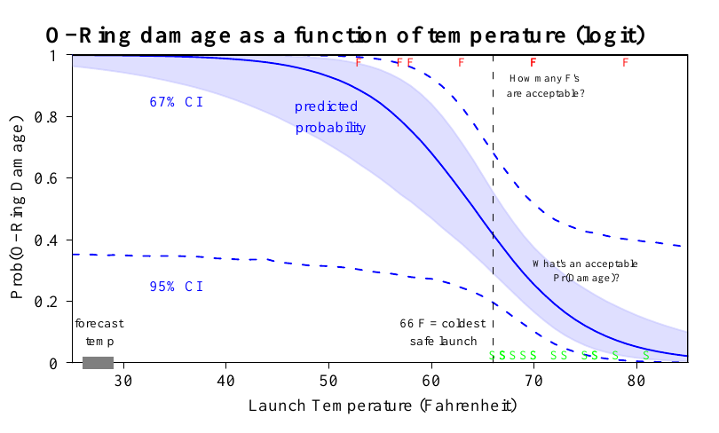
PA 311N · DATA ANALYSIS FOR PUBLIC POLICY
Clear visualization communicates risk
18
Notes:
[Sources]
- Adapted from Sergio I. García-Ríos, GOVT 3990 Day 1 deck (topic0.tex and accompanying assets).
[/Sources]

Slide 19
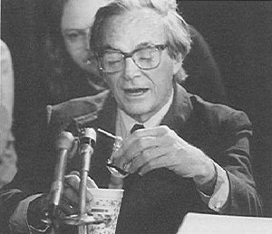
PA 311N · DATA ANALYSIS FOR PUBLIC POLICY
The course objective in one example
Use all relevant data
Choose comparisons that answer the question
Model uncertainty honestly
Present the result so others can act on it
Statistics is not a collection of formulas. It is a disciplined way to learn from evidence.
19
Notes:
[Sources]
- Adapted from Sergio I. García-Ríos, GOVT 3990 Day 1 deck (topic0.tex and accompanying assets).
[/Sources]

