Slide 1
FLAPPY BIRD
by
Team "PITT VARIEGATED"
chirp!
chirp!

Slide 2
How to play the game?
IT’S A GAME OF FLAPPY BIRD
YOU ARE A BIRD
YOUR GOAL IS TO FLY THE BIRD AS FAR AS YOU CAN WITHOUT HITTING A PIPE
YOU CAN CONTROL THE BIRD BY MOUSE
THE GAME ENDS WHEN THE BIRD FALLS DOWN

Slide 3
Elements
MAIN <DIV> WITH 4 ELEMENTS – BIRD, SKY, PIPES AND SCORE YOU ARE A BIRD
BIRD IS GIF ELEMENT IN HTML, USED IN JS WITH ID
SKY IS A BACKGROUND WHICH IS MOVED ANIMATED TO LEFT
PIPES ARE RANDOMLY SIZED BY JS
SCORE COUNTING THE PIPES YOU PASSED

Slide 4
Content
INDEX WITH IMAGE & BUTTON TO START THE GAME
GAME PAGE WITH <DIV> WITH THE GAME WITHIN
ALERT BOX WITH SCORE AT GAME OVER
CONFIRM BOX WITH PLAY AGAIN OPTION OR CLOSE THE WINDOW

Slide 5
Functions
‘START’ – RESET THE BIRD POSITION, AND START THE GAME AFTER FIRST CLICK
‘BIRDSTEP’ & ‘JUMP’ – SET AND CONTROL BIRD MOVING
‘PARALLAX’ – MOVING THE SKY LEFT
‘GAMEOVER’ – ROTATE BIRD WHEN FALLS DOWN AND ALERTS FOR SCORE AND CONFIRMS ANOTHER PLAY

Slide 6
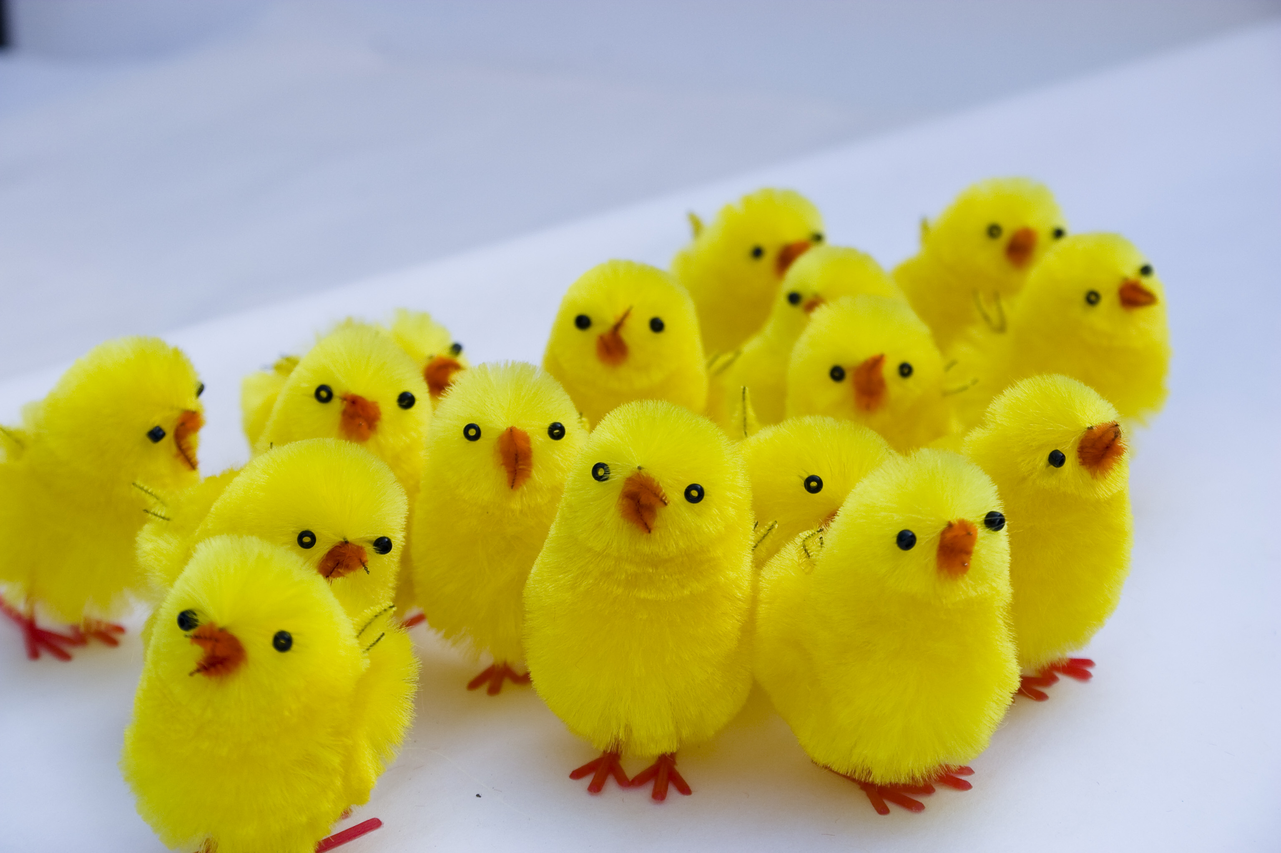
Team "PITT VARIEGATED"
Georgi
developer and project manager
Niki
developer and quality assurance
Mario
developer and graphic designer
Toni
developer and web designer

Slide 7
THANK YOU!

