Slide 1

MTP Results for AE Data

Slide 2
Contents
Features Breakdown
MTP Results
Fitness Results
A Closer Look at MTP

Slide 3
Feature Breakdown

Slide 4
The Main Features Used
TF1: Spectral flux
TF2: Root mean square
TF3-7: Central moments (x5)
TF8-10: Singular Value Decomposition (SVD) based features (x3)
TF11: Renyi entropy
* TF3 & TF5 yield 5 features each for STFT and 8 each for CWT.
Total: 19 features for STFT and 25 for CWT
Source

Slide 5
Tiling
Each spectrogram / scalogram is divided into tiles.
STFT: 9x8
CWT: 11x125

Slide 6
Total Number of Features:
6 Variables
6 make_unique methods
9x8 tiles of 19 STFT features
11x125 tiles of 25 CWT features
Total: 1 286 749 features

Slide 7
MTP Results

Slide 8
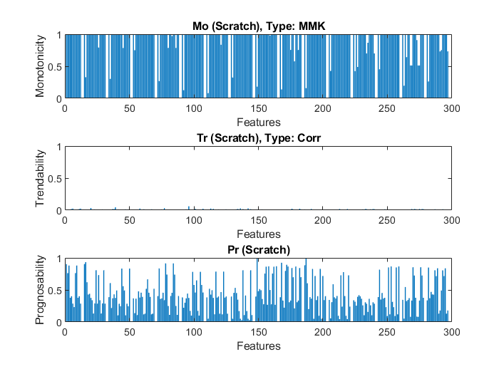
First 300 Features

Slide 9
Fitness Results

Slide 10
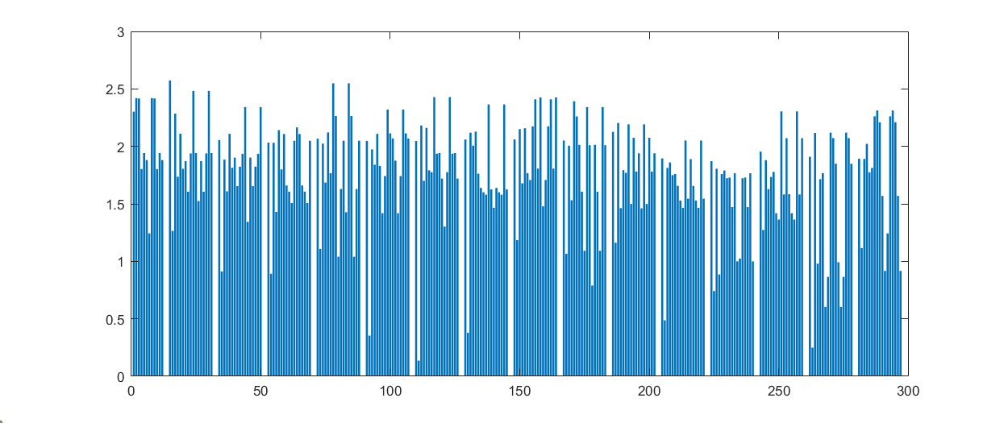
First 300 Features

Slide 11
A Closer Look at MTP

Slide 12
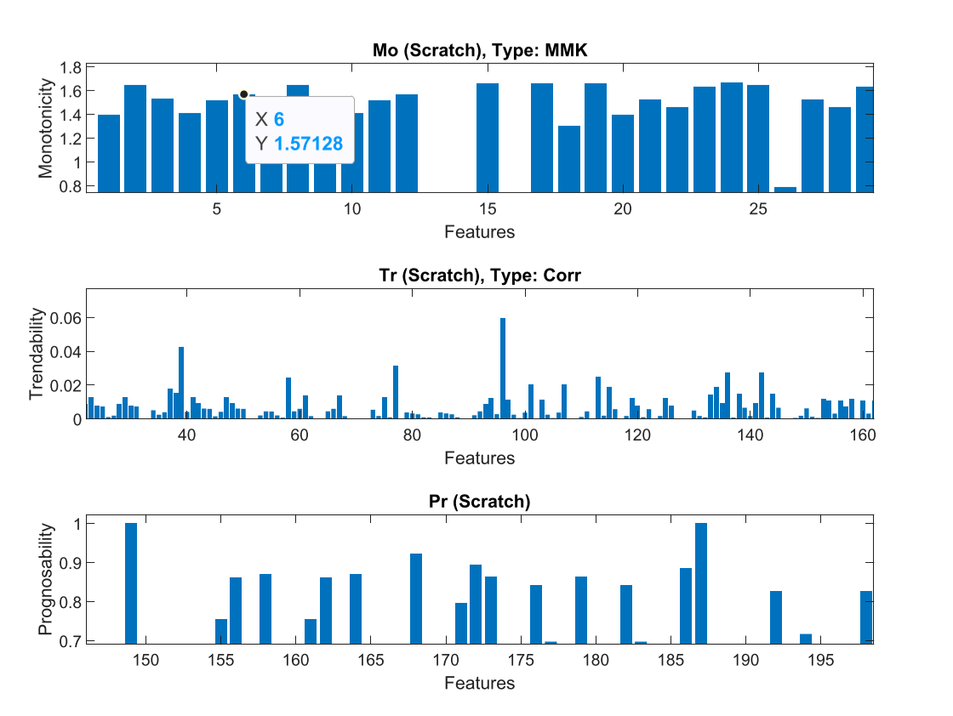
First 300 Features Zoomed In

Slide 13
Q&A

