Slide 1
Where to open a new movie theater in Toulouse
A clustering analysis

Slide 2
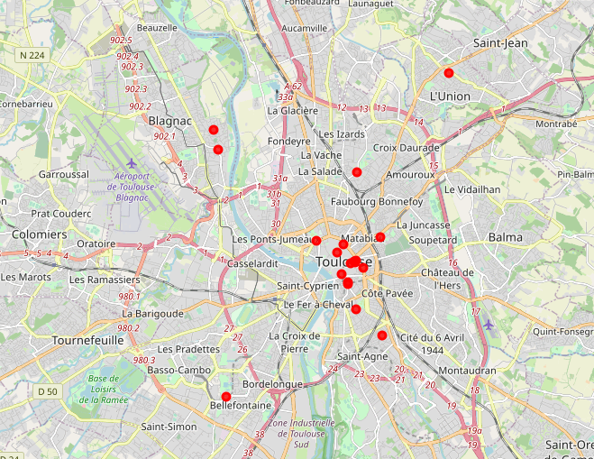
Actual situation
Already some movie theaters, especially in the city center
→ is there room for an additional one?
→ what are the conditions for implementing a new movie theater?
→ what is the best location?

Slide 3
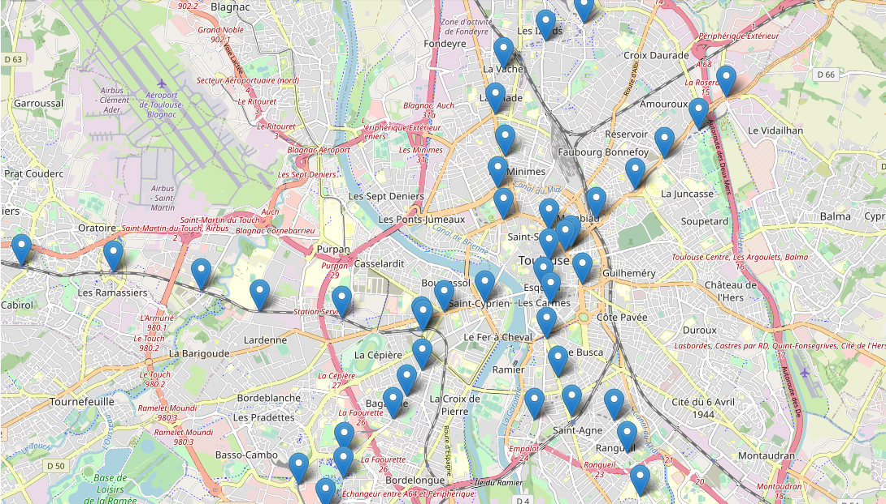
Conditions
Hypothesis:
→ movie theater should be near a metro station as to make its location more attractive to potential customers.
→ classify all metro stations into similar clusters according to the similarity of their surrounding venues.
→ identify optimal location criteria by analyzing in depth the venues surrounding existing movie theaters.
Clustering by using an unsupervised clustering method: K-Means

Slide 4
Methodology
1. find all metro station inclusive latitude and longitude
2. find all existing movie theaters
3. Get all venues near each metro station using the Foursquare API
4. Extract the category of those venues
5. Cluster all metro station according to the type of surrounding venues
6. Analyze results
6.1 find conditions for the optimal location of a movie theater based on venues categories near existing theaters
6.2 find a location that belongs to the same category that does not yet have a movie theater in its immediate surrounding.

Slide 5
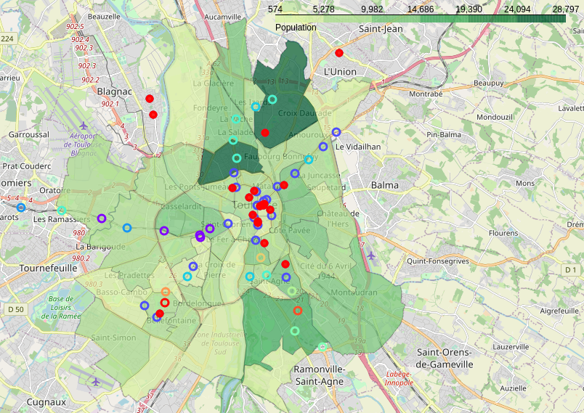
Key findings
Movie theaters are located in areas that are:
→ well-connected to the rest of the city
→ surrounded with other “entertainment” venues (bars, restaurant, brewery, etc.)
→ population density does not play a key role.
Clustering an unsupervised clustering method: K-Means

Slide 6
Results
Suggestion:
Metro station “Saint-Cyprien Republique” meets both criteria.
It is near other public transportation, and situated in an area where other entertainment offers are available.
Clustering an unsupervised clustering method: K-Means

Slide 7
Thanks for your attention!

