Slide 1

Sprint 2

Slide 2
New Architecture - RPi/NodeMCU & Changes
SPRINT 2
Backend & Server Architecture
CONTENT
Frontend & Web Client Showcase
Android App Showcase & Changes
Machine Learning Plague Detection System
6
Market & Economic Feasibility Study

Slide 3
New Architecture
Sprint 2
RPi/NodeMCU & Changes

Slide 4
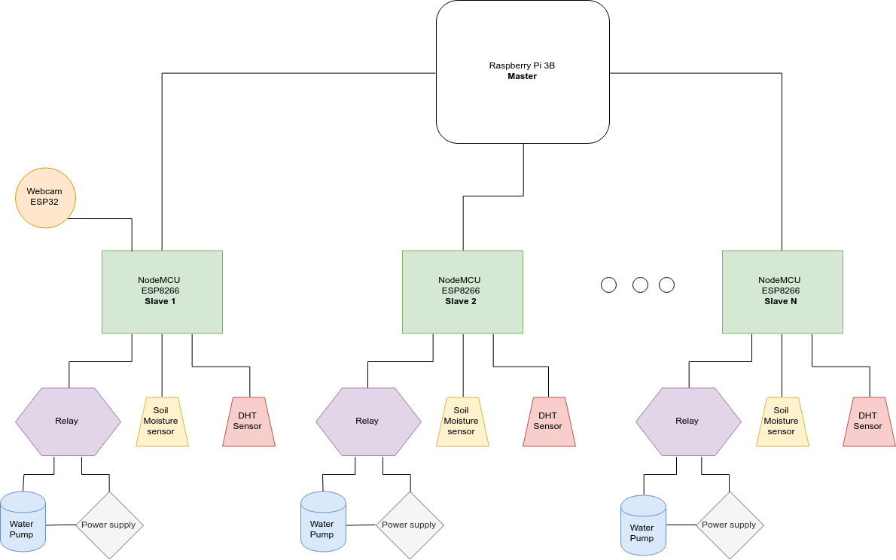

Slide 5
Backend & Server Architecture
Sprint 2

Slide 6
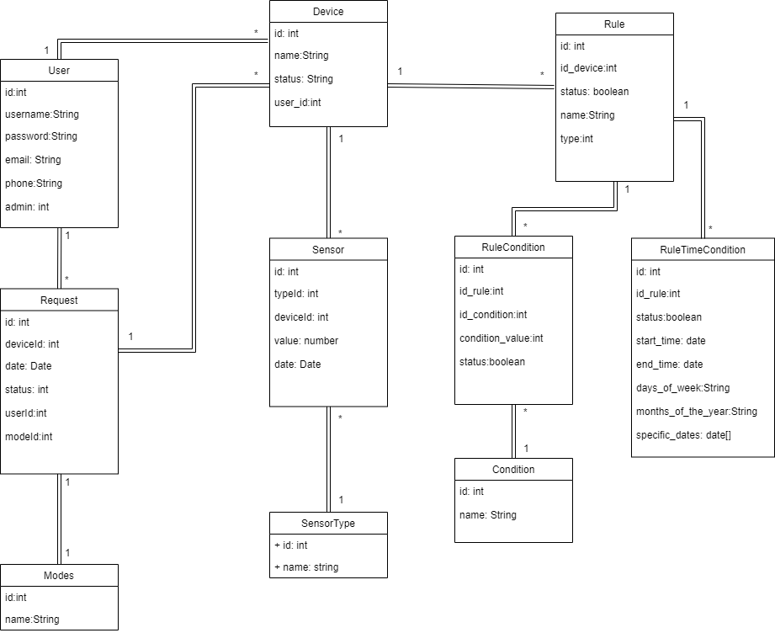

Slide 7
Frontend & Web Client Showcase
Sprint 2

Slide 8
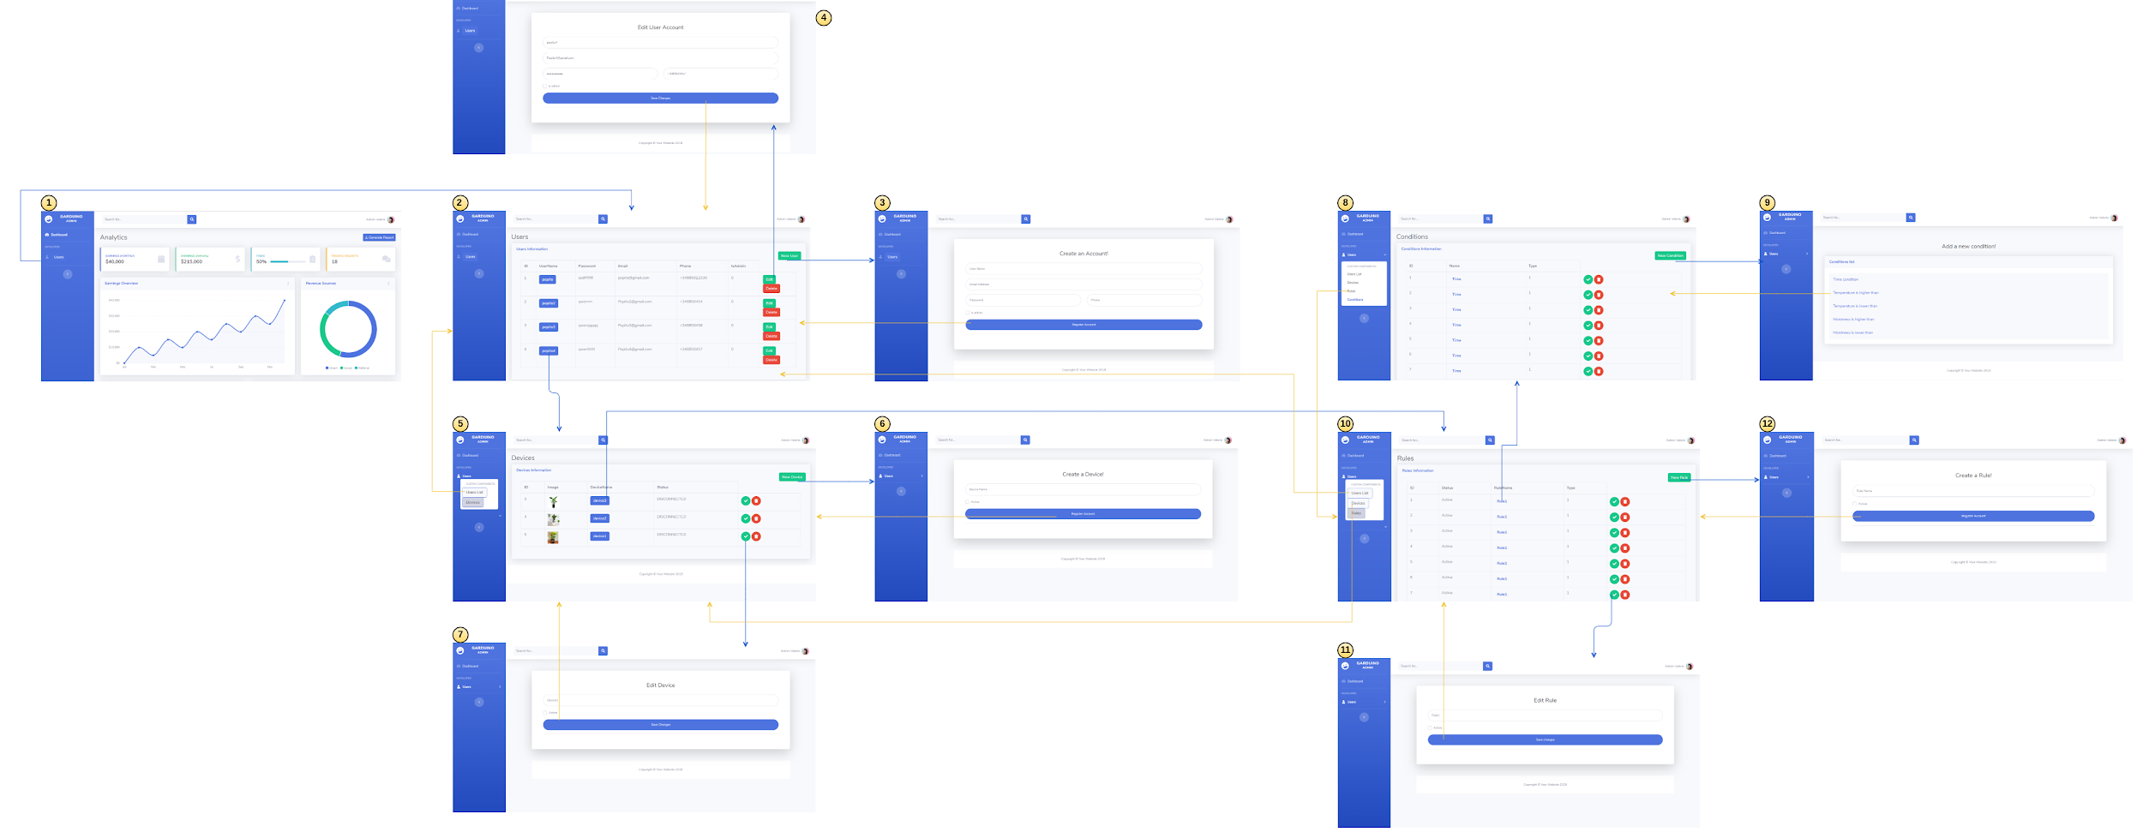
Link

Slide 9
Android App Showcase & Changes
Sprint 2

Slide 10
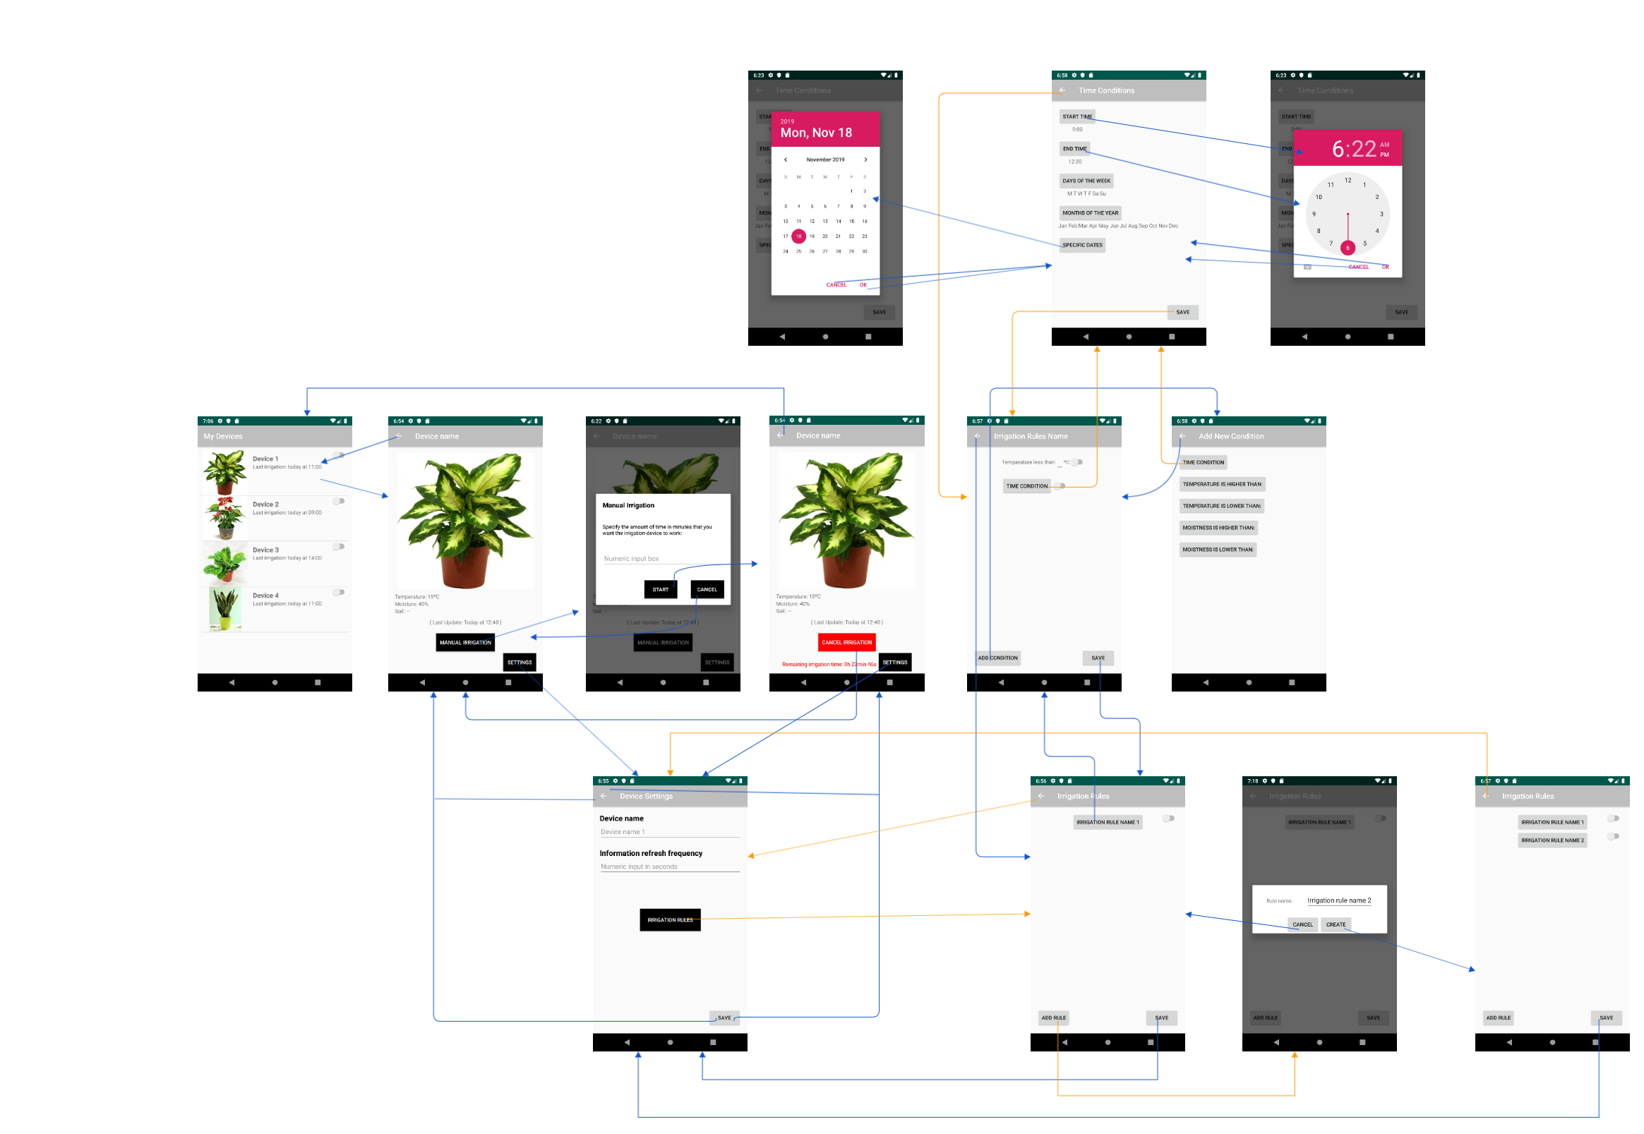
Link

Slide 11
Machine Learning
Plague Detection System
Sprint 2

Slide 12
Market & Economic Feasibility Study
Sprint 2

Slide 13
 | Number of workers | Income
Micro-enterprise | Up to 10 | < 2.000.000€
Small enterprise | Up to 50 | < 10.000.000€
Medium enterprise | Up to 250 | < 50.000.000€
Big enterprise | > 250 | ≥ 50.000.000€
Mission
Strategic objectives
Values and Corporate Responsability Policy

Slide 14
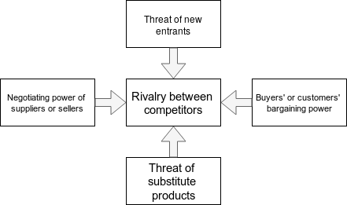
Competitors:
Companies dedicated to the development of IOT solutions in the field of gardening, domotics and / or agriculture.
Customers:
Individuals with gardening activity.
Gardening shops.
Suppliers:
Hardware suppliers.
Substitute products:
Automated irrigation systems.
Conventional forms of irrigation in greater economic feasibility.
Planting facilities with in-built technology to ease their sustenance.

Slide 15
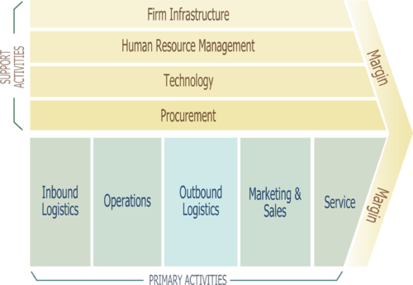

Slide 16
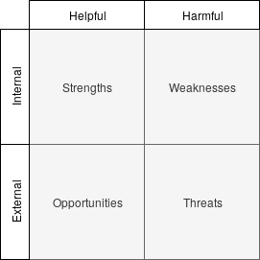
Strengths:
Small size for versatility and flexibility.
Use of cutting-edge technologies.
Professionals in the field of information technology.
Opportunities:
Establishing close relationships with customers and redistributors.
Introducing a new type of computer solution in the automation of the gardening sector.
Weaknesses:
Totally new to the sector.
Lack of a business relationship structure.
Little consolidated organization.
Low initial capital.
Threats:
By operating in the field of technology and being this so changing, possibility of a product appearing capable of replacing it.
Large companies have greater investment capacity to compete in this market.

Slide 17
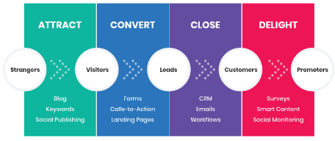

Slide 18
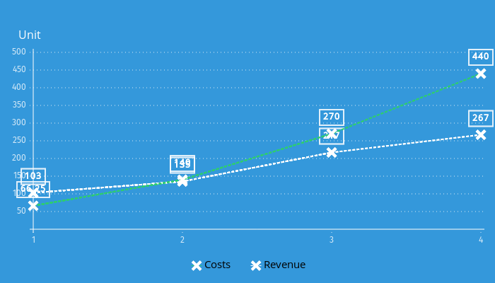
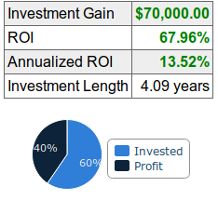
Year | 1 | 2 | 3 | 4
Employee salaries | 12.600€ | 12.600€ | 21.000€ | 21.000€
Employees | 5 | 5 | 5 | 5
Total employee costs | 63.000€ | 63.000€ | 105.000€ | 105.000€
Unit cost per device production | 100€ | 100€ | 100€ | 100€
Units produced | 300 | 600 | 1000 | 1500
FIxed costs for exploitation | 7.000€ | 7.000€ | 7.000€ | 7.000€
Production costs | 37.000€ | 67.000€ | 107.000€ | 157.000€
Marketing investment | 3.000€ | 5.000€ | 5.000€ | 5.000€
Sales price (B2C) | 400€ | 350€ | 300€ | 300€
Sales price (B2B) | 200€ | 200€ | 200€ | 200€
Sales volume (B2C) | 50 | 100 | 200 | 400
Sales volume (B2B) | 200 | 400 | 800 | 1200
Units in stock | 50 | 150 | 150 | 50
Sales revenue | 60.000€ | 115.000€ | 220.000€ | 360.000€
Maintenance revenue per sale | 25€ | 50€ | 50€ | 50€
Actual maintenance revenue | 6.250€ | 25.000€ | 50.000€ | 80.000€
TOTAL | -36.750€ | 5.000€ | 53.000€ | 173.000€
NPV = 25.704€
(disc. rate: 10%)
IRR = 15,63%

Slide 19
The end
Thank you for your attention

