Slide 1


Apple object detection
Using a pre-trained object detection model:
SSD MobileNet V2 FPNLite 320x320

Slide 2
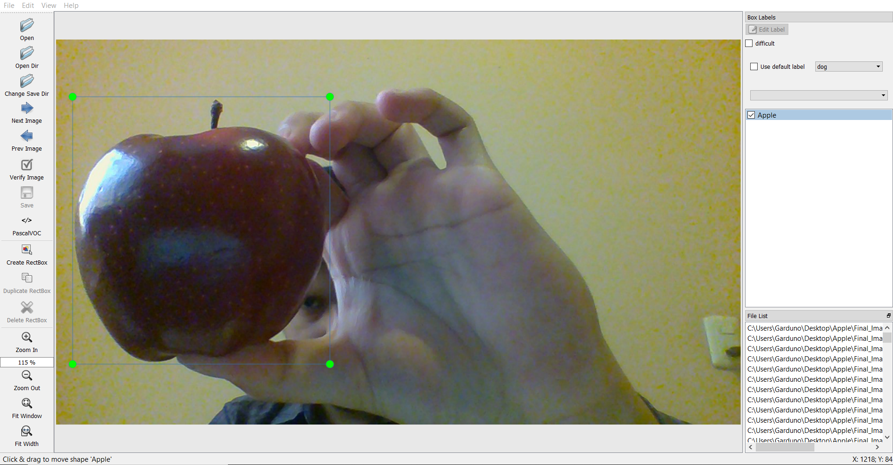
LabelImg
LabelImg is a graphical image annotation tool.
Annotations are saved as XML files
https://github.com/tzutalin/labelImg

Slide 3
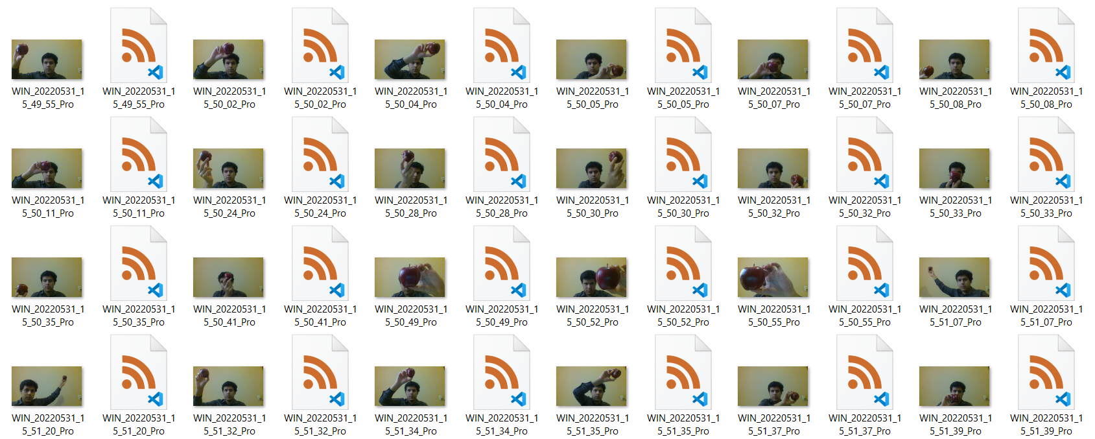
Train/Test Image Dataset
Train Dataset:
149 images
Test Dataset:
15 images

Slide 4
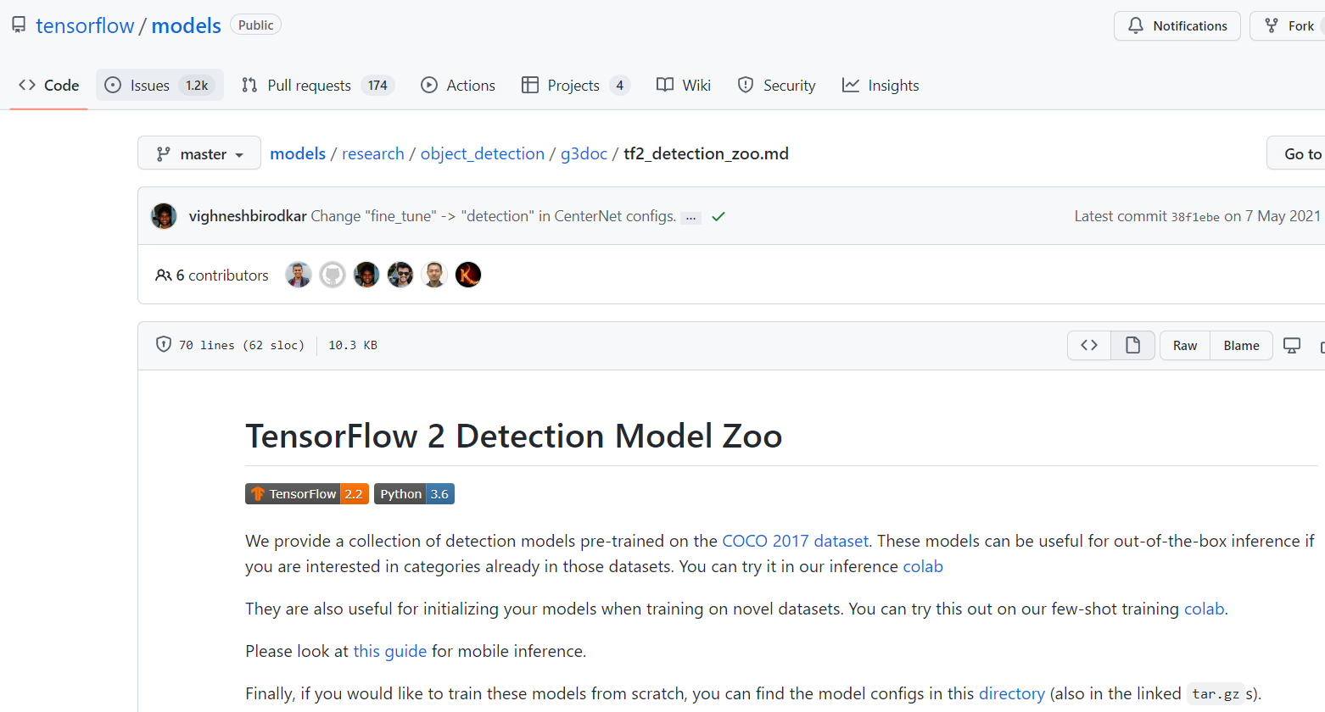
TensorFlow 2 Detection Model Zoo
A collection of detection models pre-trained
https://github.com/tensorflow/models/blob/master/research/object_detection/g3doc/tf2_detection_zoo.md

Slide 5
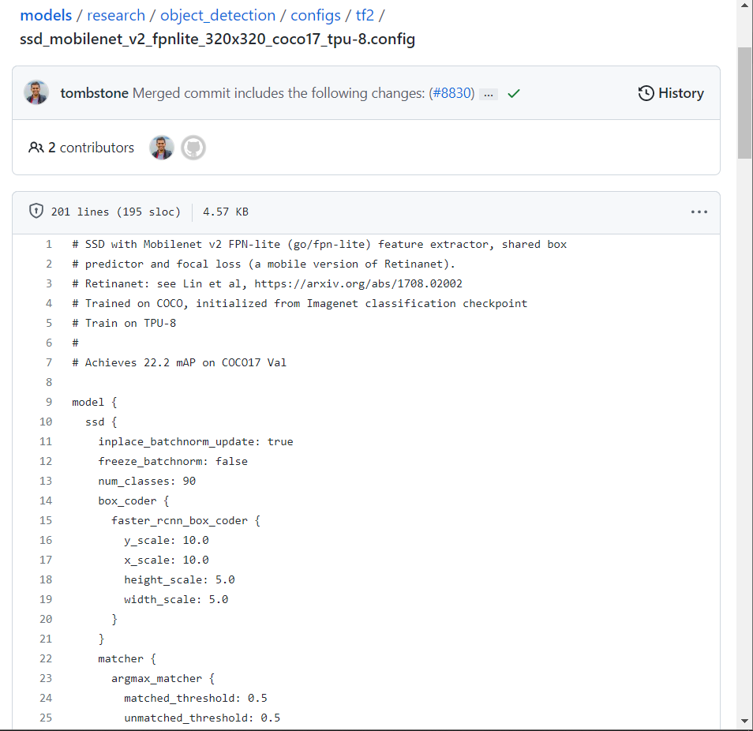
Model configs
To train these models from scratch, you can use the model configs
https://github.com/tensorflow/models/blob/master/research/object_detection/configs/tf2/ssd_mobilenet_v2_320x320_coco17_tpu-8.config

Slide 6
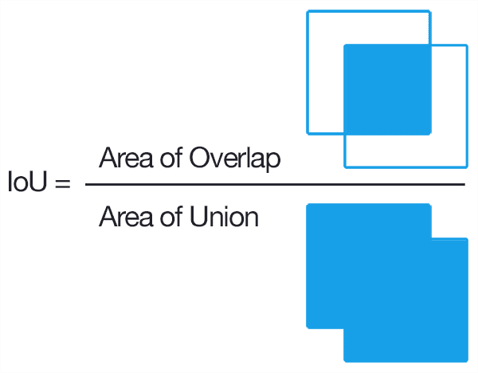
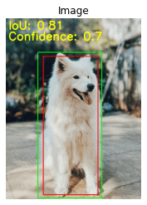
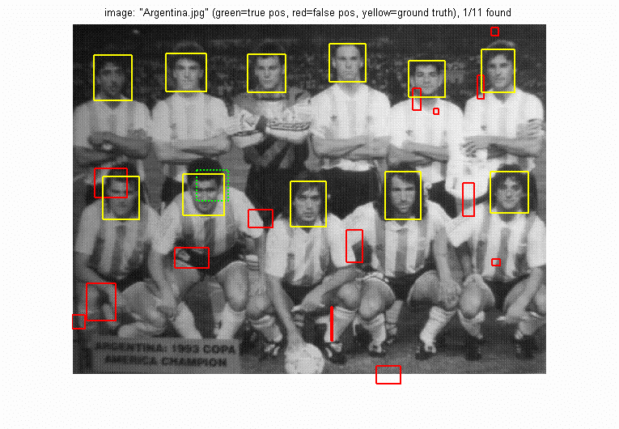
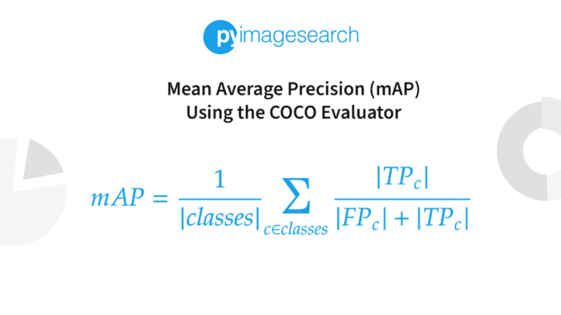
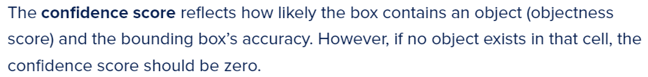
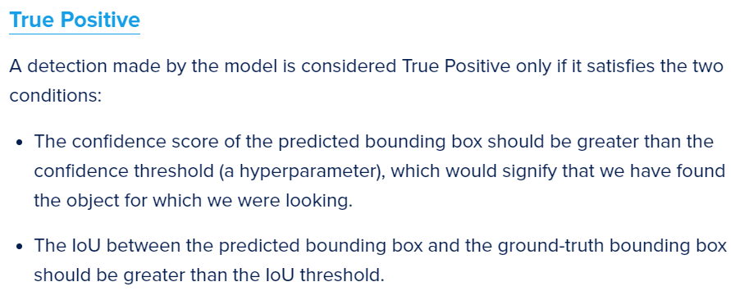
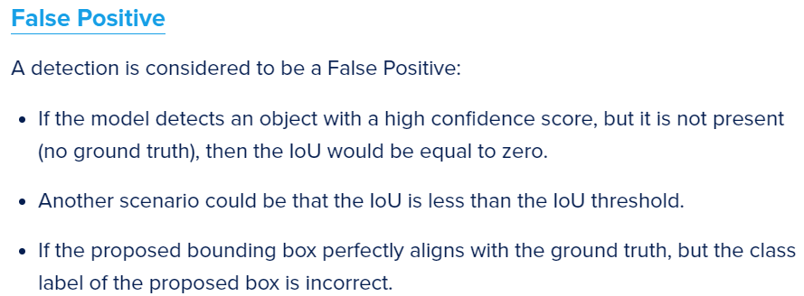
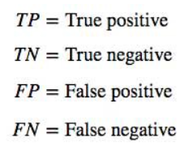
https://pyimagesearch.com/2022/05/02/mean-average-precision-map-using-the-coco-evaluator/
COCO: Is a large-scale object detection, segmentation, and captioning dataset. COCO has several features
https://jonathan-hui.medium.com/map-mean-average-precision-for-object-detection-45c121a31173
https://cocodataset.org/#home

Slide 7
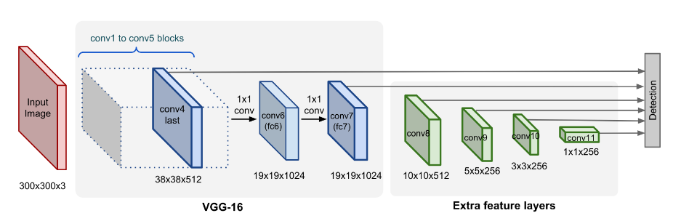
SSD: Single Shot MultiBox Detector
Image Pyramid
A pyramid representation of images at different scales
In SSD, the detection happens in every pyramidal layer, targeting at objects of various sizes.
https://lilianweng.github.io/posts/2018-12-27-object-recognition-part-4/

Slide 8
Training the model
Download TF Models Pretrained Models from Tensorflow Model Zoo
Install TF Object Detection
Create Label Map
Create TF Records (Binary file format that has a significant impact on model training time, it is optimized for use with Tensorflow)
Update Model Config File For Transfer Learning
Num_classes: 1 (Apple)
Batch_size = 5
Checkpoints paths and type(detection): Checkpoints capture the exact value of all parameters used by a model
LabelMap path for train and test
Record paths for train and test
Train Model (Using model_main_tf2.py with the model configs to train the pretrained model)

Slide 9
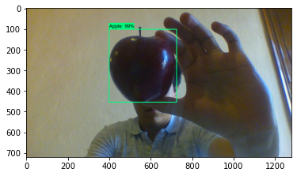
Results
Time required to train: 2 hours and 30 minutes
Train dataset
Step 2000:
Classification_loss: 0.06613
Localization_loss: 0.04084
Regularization_loss: 0.1461
Total_loss: 0.2531
Test dataset
Step 2000:
Classification_loss: 0.1638
Localization_loss: 0.07595
Regularization_loss: 0.1461
Total_loss: 0.3858

Slide 10
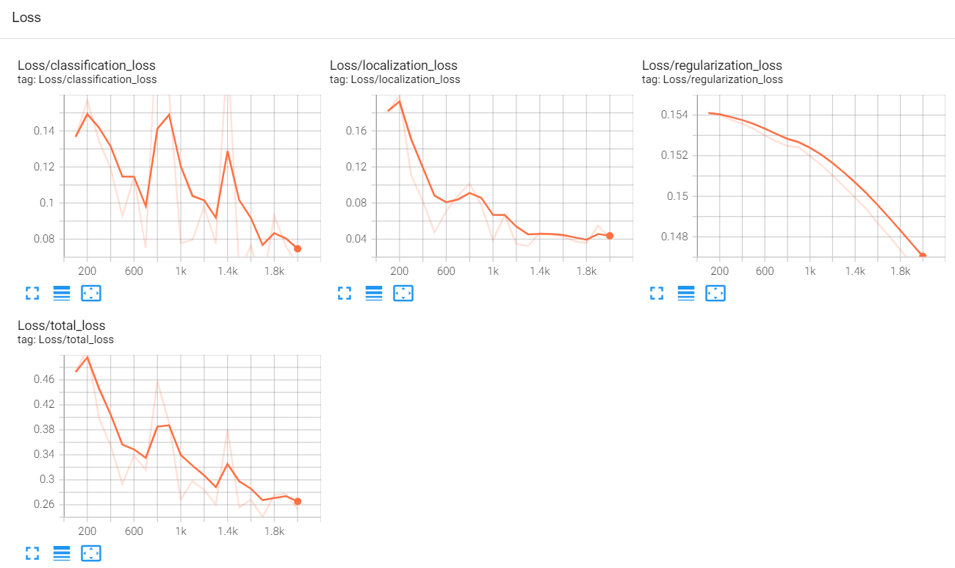
Train loss
Notes:
cd desktop/apple_object_detection/Tensorflow/workspace/models/my_ssd_mobnet/train
tensorboard --logdir=.

Slide 11
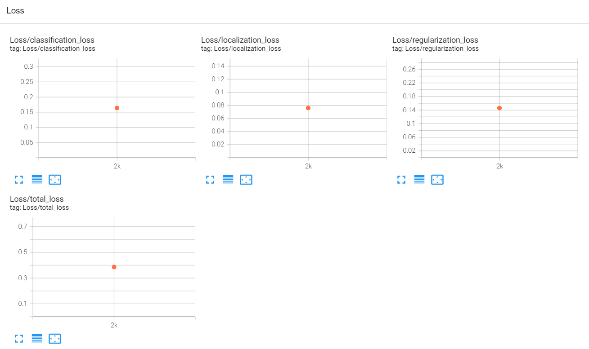
Test loss

Slide 12
References
https://github.com/tzutalin/labelImg
https://github.com/tensorflow/models/blob/master/research/object_detection/g3doc/tf2_detection_zoo.md
https://github.com/tensorflow/models/blob/master/research/object_detection/configs/tf2/ssd_mobilenet_v2_320x320_coco17_tpu-8.config
https://pyimagesearch.com/2022/05/02/mean-average-precision-map-using-the-coco-evaluator/
https://jonathan-hui.medium.com/map-mean-average-precision-for-object-detection-45c121a31173
https://lilianweng.github.io/posts/2018-12-27-object-recognition-part-4/
https://cocodataset.org/#home
Tutorial for object detection:
https://www.youtube.com/watch?v=yqkISICHH-U
https://github.com/nicknochnack/TFODCourse/blob/main/2.%20Training%20and%20Detection.ipynb

