Slide 1
Intelligent systems: Group obesity levels based on eating habits and physical condition using K-Means
Eduardo Garduño Martínez
A01209466

Slide 2
Dataset for estimation of obesity levels based on eating habits and physical condition in individuals from Colombia, Peru and Mexico
Features:
Label:
CAEC (Consumption of food between meals
SMOKE
CH2O (Consumption of water daily)
SCC (Calories consumption monitoring)
FAF (Physical activity frequency)
TUE (Time using technology devices)
CALC (Consumption of alcohol)
MTRANS (Transportation used)
Gender
Age
Height
Weight
Family_history_with_overweight
FAVC (Frequent consumption of high caloric food)
FCVC (Frequency of consumption of vegetables)
NCP (Number of main meals)
Nobeyesdad
Insufficient_Weight
Normal_Weight
Overweight_Level_I
Overweight_Level_II
Obesity_Type_I
Obesity_Type_II
Obesity_Type_III
The data was generated synthetically using the Weka tool and the SMOTE filter, 23% of the data was collected directly from users through a web platform

Slide 3
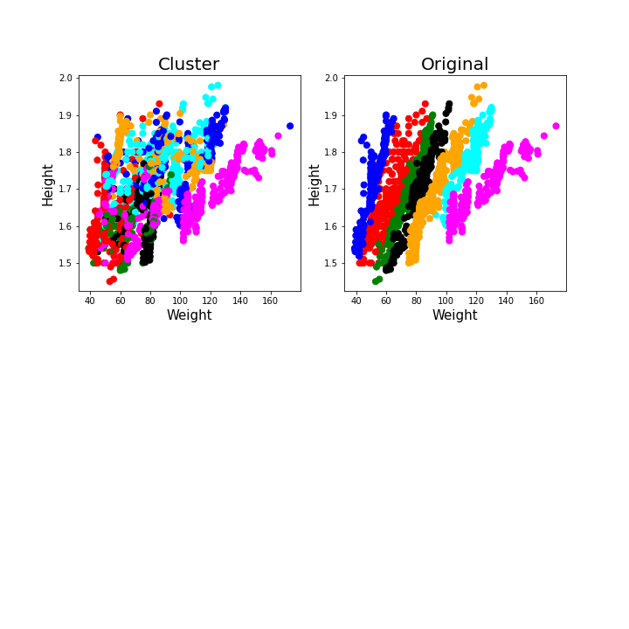

Cluster vs Original
Rand index = 0.2101
Rand index is a measure of the similarity between two data clusterings
Notes:
How correct with respect to a label

Slide 4
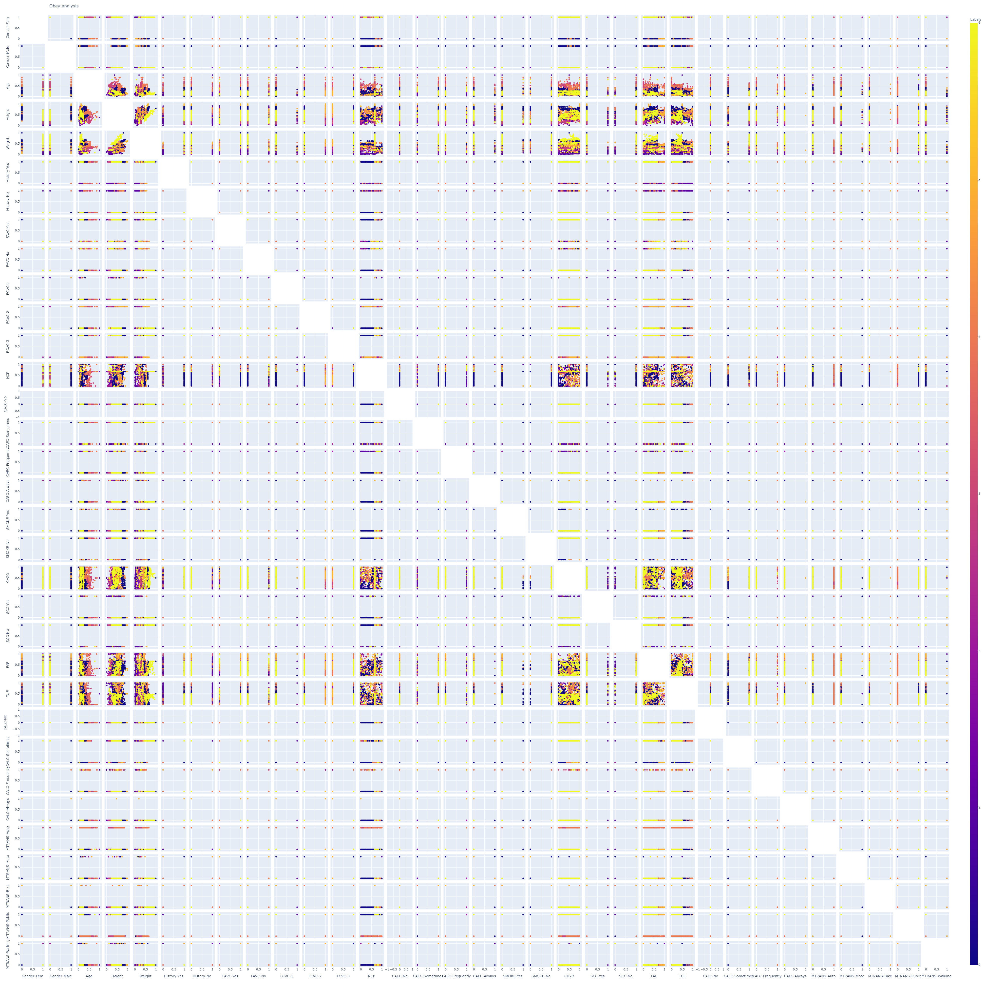
Scatter plot
Notes:
looking for trends in the data

Slide 5

“The final cluster centers are computed as the mean for each variable within each final cluster. The final cluster centers reflect the characteristics of the typical case for each cluster.”
-IBM
History : Familiar history with overweight
FAVC: Frequent consumption of high caloric food
NCP: Number of main meals
https://www.ibm.com/docs/en/spss-statistics/24.0.0?topic=customers-final-cluster-centers

Slide 6
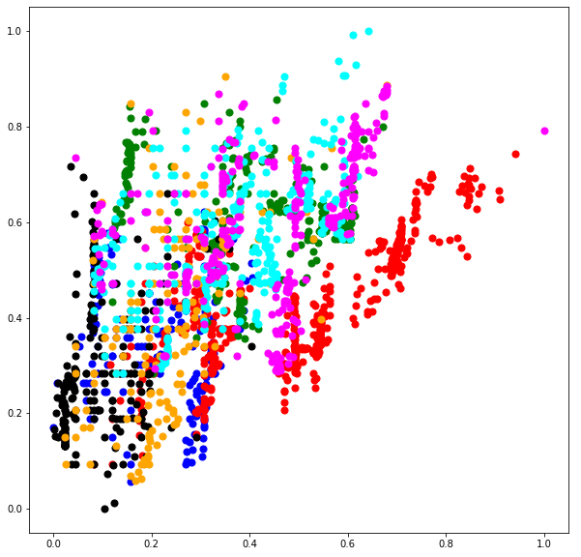

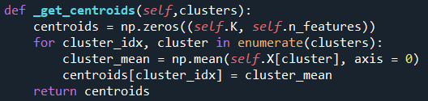
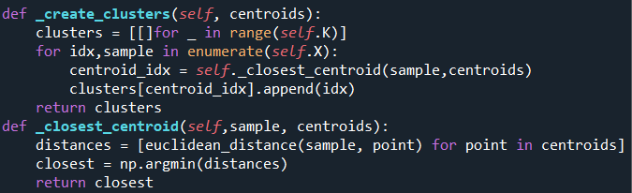
By Hand Clustering
Kmeans Clustering
Euclidean Distance Formula
Update centroids
Create clusters based on distance

Slide 7
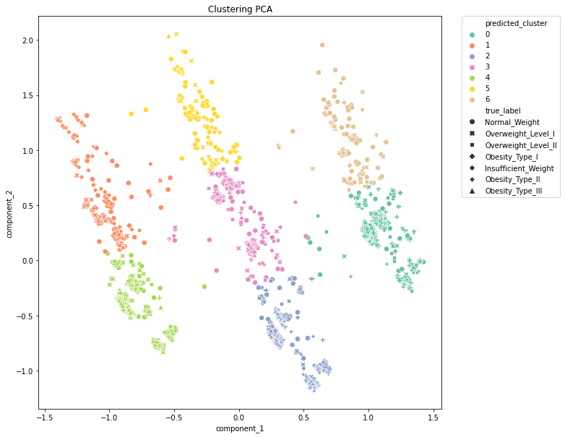
PCA Clustering
Rand index = 0.2372
Rand index is a measure of the similarity between two data clusterings
Notes:
How correct with respect to a label

