Slide 1
Security Considerations in the Web Services System Development Life Cycle
George Capehart
Capehart Associates LLC
gwc@capehassoc.us
704-678-1660

Slide 2
Toto, We’re not in Kansas any more . . .
What does this mean and what is its impact on the SDLC of Web Services-based systems?
  Web Services is a paradigm shift. The Web Services milieu is/will be a much different animal from even today’s Web applications. This has/will impact all aspects of the SDLC . . . Especially the security aspects.
The goal of this presentation is to begin focusing some attention on these issues which have not yet been addressed. To get there, we will:
  Look at how Web Services have been defined.
  Look at how Web Services-based systems are different from traditional systems.
  Identify some of the meta-issues that impact security in the Web Services paradigm.
  Step through the phases of the System Development Life Cycle and talk about the security-related issues in each phase.

Slide 3
What is a Web Service?
The Web Services paradigm is still very young and our ideas are still evolving. Having said that, some of the basic characteristics of Web Services seem to be:
Use HTTP/HTTPS as the transport protocol . . . Though the WSA also supports other protocols and IPC mechanisms like FTP, SMTP, JMS, IIOP, etc.
“XML-based RPC”
Will eventually be implemented using a Service-Oriented Architecture (SOA)
Asynchronous communication mechanism
Stateless protocol(s)
The use of a messaging protocol that supports extension
“Web Services us a loosely coupled integration model to allow flexible integration of heterogeneous systems in a variety of domains including business-to-consumer, business-to-business and enterprise application application” (ftp://www6.software.ibm.com/software/developer/library/ws-bpel.pdf)
Not “done” yet

Slide 4
Web Services: A Paradigm Shift
At one level, Web Services are yet another distributed computing environment, similar to the DCE/DCOM, CORBA and DTP. Uses WSDL as the IDL and marshals to XML rather than binary data.
Multi-tier architectures that expose services in the middle tier(s) have been around in one shape or another for fifteen years or so.
Asynchronous, business-to-business message-based communication has been around for a long time (EDI).
However, there are some ways in which systems built using Web Services are significantly different from traditional systems.
  Web Services systems are systems that are collections of loosely coupled component endpoint systems - i.e. the endpoint systems have no direct knowledge of each other, nor do they have any relationship with each other.
  The endpoint systems were not originally designed as pieces of an integrated system.
  Then endpoint systems were not originally designed to participate in the provision of a service to “strangers.”
  Web Services transactions can span significant distance and can take a considerable amount of time, involving loosely coupled systems communicating using an asynchronous protocol.
  Web Services “externalize everything.”
  Web Services systems cross trust boundaries.

Slide 5
System-level Aspects of Web Services Systems That Have Security Implications
Emergent risks
Crossing trust boundaries
Identity Management (including Federation) - “Identity federation must be predicated upon prior agreement between the identity and service providers.”
Identification, Authentication, Authorization
Trust Management - “. . . formulating security policies and security credentials, determining whether particular sets of credentials satisfy the relevant policies, and deferring trust to third parties.”
Privacy
  On the communication channel
  Of confidential information
Audit trails that document:
  Who initiated the transaction
  When it originated
  From where it originated
  Through what processes (services) it passed and when
  What transformations if any were done on the data while it was in transit
Non-repudiation
  Of origin - the sender cannot falsely deny having been the originator of the message
  Of receipt - the receiver cannot falsely deny having received the message
Provisioning
Notes:
The Web Services paradigm shift brings with it a new system architecture, new relationships among interacting agents and new business and technical operating procedures. These new aspects of “the system” induce a new risk profile for the organization and for the systems with which they interface. It is these aspects of Web Services-based systems that will drive the rest of the presentation. There is not enough time to do an exhaustive review of all of the differences. The goal here is call attention to some of the overarching ones and to get thought processes pointed in that direction. There is not enough time to cover all security-related aspects of WS-based systems for the whole SDLC. The purpose here is just to “point to the iceberg.”

Slide 6
System-level Aspects of Web Services Systems That Have Security Implications, Cont’d.
Federation
Service Choreography - (workflow) integration
Persistence
  Of the message
  Of the data
Integrity
  Of the communication channel
  Of the data in flight
  Of the semantic and referential integrity of the data
  Of the transaction (some of which can be very long-running)
  Of the session
  Of the network and the systems
Message Reliability
Assertions (SAML, XACML, etc.) “Trust me” . . . But now there are several levels of trust . . . trust the validity of the assertion and trust that the assertion hasn’t been tampered with in flight.
Asynchrony and (distributed, long-running) session management
Transaction management
End-to-end controls
Single Sign-on
Not mature . . . many different bodies - W3C, OASIS, the Liberty Alliance, WS-I
Policy, policy policy
Notes:
The Web Services paradigm shift brings with it a new system architecture, new relationships among interacting agents and new business and technical operating procedures. These new aspects of “the system” induce a new risk profile for the organization and for the systems with which they interface. It is these aspects of Web Services-based systems that will drive the rest of the presentation. There is not enough time to do an exhaustive review of all of the differences. The goal here is call attention to some of the overarching ones and to get thought processes pointed in that direction. There is not enough time to cover all security-related aspects of WS-based systems for the whole SDLC. The purpose here is just to “point to the iceberg.”

Slide 7
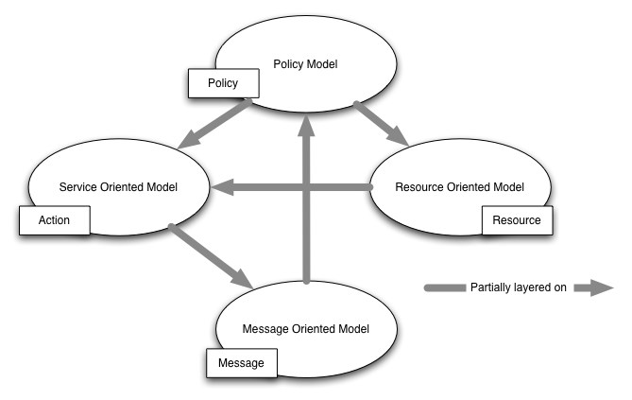
The Web Services Architecture - Meta Model (from http://www.w3c.org/TR/2004/NOTE-ws-arch-20040211/)

Slide 8
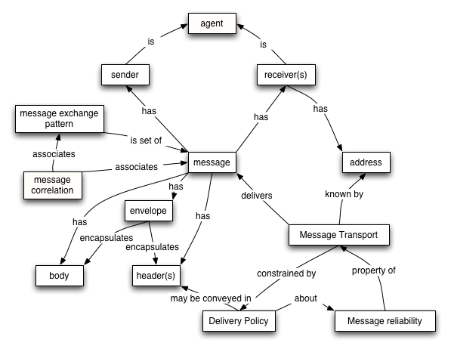
The Web Services Architecture - The Message Oriented Model (from http://www.w3c.org/TR/2004/NOTE-ws-arch-20040211/)

Slide 9
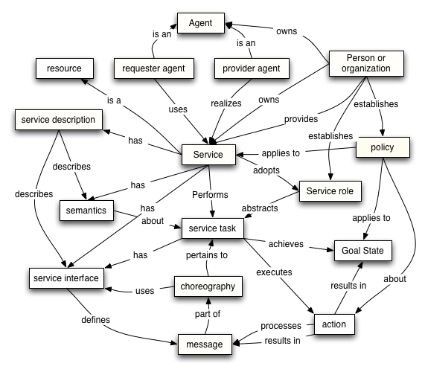
The Web Services Architecture - The Service Oriented Model (from http://www.w3c.org/TR/2004/NOTE-ws-arch-20040211/)

Slide 10
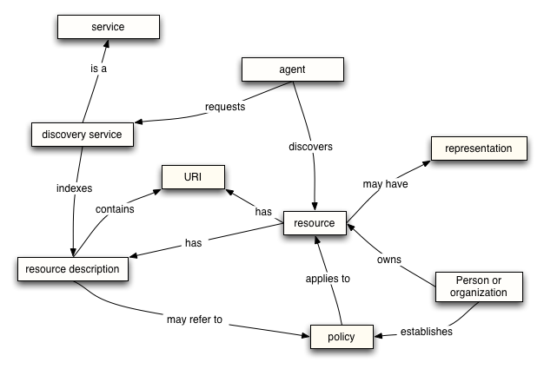
The Web Services Architecture - The Resource Oriented Model (from http://www.w3c.org/TR/2004/NOTE-ws-arch-20040211/)

Slide 11
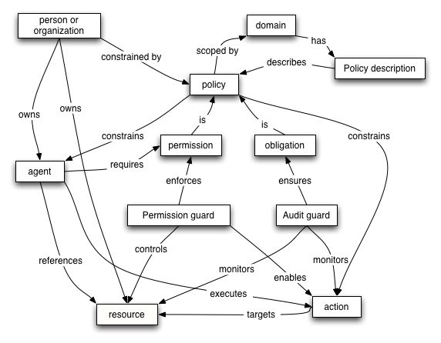
The Web Services Architecture - The Policy Model (from http://www.w3c.org/TR/2004/NOTE-ws-arch-20040211/)

Slide 12
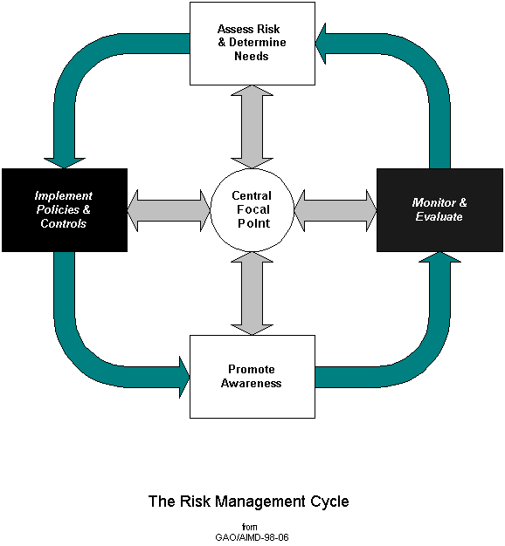
The Risk Management Process
In The Best of All Possible Worlds ™ an organization has a risk management process that looks like this:
  A central body (preferably a corporate risk management group which reports to the Board’s Risk Committee) is responsible for and oversees the process. This group is also responsible for the enforcement of the policies and implementation of controls.
  Policies and (other) controls are selected based on results of risk assessments.
  Information on the policies and appropriate use of controls is published and advertised.
  Monitoring processes are in place to determine the degree to which the policies and controls are effective. The results of the evaluation is fed back into the risk assessment process.
Policies and the selection of controls reflect the organizations tolerance for risk.
Any risk that is not explicitly covered by policies and controls, or which is incurred because policy is ignored or controls were not put in place should be explicitly acknowledged and formally accepted. This is normally accomplished through the Certification and Accreditation process.
The above is especially important with respect to Web Services-based systems because they introduce many risks which are not addressed in legacy policies and controls.
The shaded blocks are where the Risk Management process interfaces with the System Development Life Cycle.

Slide 13
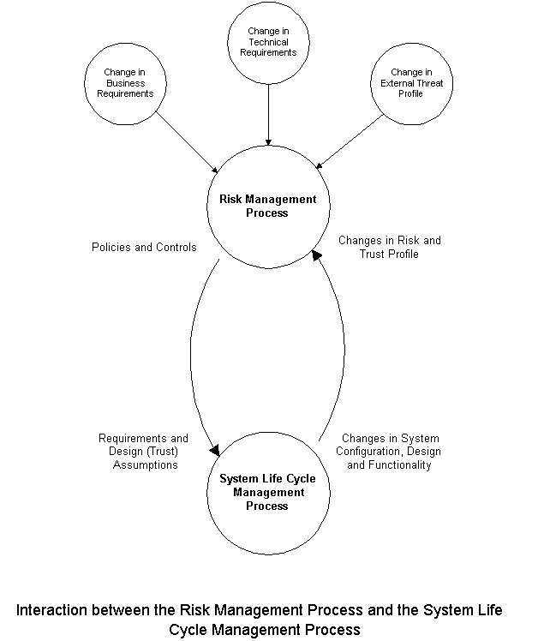
The Relationship Between the Risk Management Process and the System Development Life Cycle
At a high level, the relationship between an organization’s risk management process and the IT SDLCs is very straightforward:
  The controls and policies that are published by the risk management process are requirements for and define trust assumptions to the SDLC.
  In turn, changes in system configuration, design and functionality induce changes in the organization’s risk and trust profiles.
This relationship holds no matter how formal the risk management process and the system life cycle management processes are.
With the coming of Web Services, rigorous risk management processes and system life cycle management processes become very important.

Slide 14
Policy!
“Policy” has appeared frequently in this presentation. That’s because it is a very important aspect of Web Services, Web Services security and information security in general. Depending upon the context, it has different (but related) meanings. No matter the context, though, policies are the formal statement of the organization’s rules of engagement.
When it comes to Web Services, policy is recursive. Organizations need (enterprise business and security) policies that define Web Services policies.
For example: An organization has a policy that requires dual-factor authentication for all access from locations that are not on the organization’s internal network. That policy would then show up in the organization’s Web Services access control policies which would, in turn, show up the services’ policy database.
The important point to take away from this is that an organization’s Web Services policies must not be afterthoughts or “bolt-ons.” They should follow from the organization’s overall policy structure and should result from the same risk assessment process from which all other policies follow.
The implication for the Web Services System Development Life Cycle is this: The risk management process should be involved before any work starts on designing and building Web Services-based systems.

Slide 15
Security Considerations in the System Development Life Cycle - NIST Special Publication 800-64
There are many different ways to characterize the System Development Life Cycle. For this discussion we will use the one found in NIST SP 800-64 as a starting point.
There are two reasons for using it as a framework:
  It is a relatively simple model, and
  It specifically addresses security considerations in the SDLC.
SP 800-64 breaks the SDLC into five phases:
  Initiation
  Acquisition/Development
  Implementation
  Operations/Maintenance
  Disposition

Slide 16
NIST SP 800-64 - Security Considerations in the Initiation Phase
Needs Determination - is an analytical activity that evaluates the capacity of an organization’s assets to satisfy existing and emerging demands. The security part of needs determination will result in a high-level description of the security controls in the proposed system and the assurance requirements.
Security Categorization - defines three levels (i.e. of potential impact on organizations or individuals should there be a breach of security (a loss of confidentiality, integrity, or availability). Security categorization standards assist organizations in making the appropriate selection of security controls for their information systems.
Preliminary Risk Assessment - results in an initial description of the basic security needs of the system. A preliminary risk assessment should define the threat environment in which the system will operate. This assessment is followed by an initial identification of required security controls that must be met to protect the product/system in the intended operational environment.

Slide 17
NIST SP 800-64 - Security Considerations in the Acquisition / Development Phase
Risk Assessment - analysis that identifies the protection requirements for the system through a formal risk assessment process. This analysis builds on the initial risk assessment performed during the Initiation phase, but will be more in-depth and specific. In addition to considering the security perspective of the system being acquired, organizations should also consider the the system might affect other systems to which it will be directly or indirectly connected.
Security Functional Requirements Analysis - analysis of requirements that may include the following components: (1) system security environment, (i.e., enterprise information security policy and enterprise security architecture) and (2) security functional requirements. Because most systems have at least minimal integrity and availability requirements, care should be taken to clearly address those areas. . . . Even systems with low confidentiality requirements need security to meet integrity and availability requirements.
Security Assurance Requirements Analysis - analysis of requirements that address the developmental activities required and assurance evidence needed to produce the desired level of confidence that the information security will work correctly and effectively. The analysis, based on legal and functional security requirements, will be used the basis for determining how much and what kinds of assurance are required.
Cost Considerations and Reporting - determines how much of the development cost can be attributed to information security over the life cycle of the system. These costs include hardware, software, personnel and training.

Slide 18
NIST SP 800-64 - Security Considerations in the Acquisition / Development Phase, Cont’d
Security Planning - ensures that agreed upon security controls, planned or in place, are fully documented. The security plan provides a complete characterization or description of the information system as well as attachments or references to key documents supporting the agency’s information security program (e.g., configuration, management plan, contingency plan, incident response plan, security awareness and training plan, rules of behavior, risk assessment, security test and evaluation results, system interconnection agreements, security authorization/accreditations, and plan of action and milestones).
Security Control Development - ensures that security controls described in the respective security plans are designed, developed and implemented. For information systems currently in operation, the security plans for those systems may call for the development of additional security controls to supplement the controls already in place or the modification of selected controls that are deemed to be less than effective.
Developmental Security Test and Evaluation - ensures that security controls developed for a new information system are working properly and are effective. Some types of security controls (primarily those controls of a non-technical nature) cannot be tested and evaluated until the information system is deployed - these controls are typically management and operational controls.
Other planning components - ensures that all necessary components of the development process are considered when incorporating security into the life cycle. These components include selection of the appropriate contract type, participation by all necessary functional groups within an organization, participation by the certifier and accreditor, and development and execution of necessary contracting and processes.

Slide 19
NIST SP 800-64 - Security Considerations of the Operations / Maintenance Phase
Configuration Management and Control - ensures adequate consideration of the potential security impacts due to specific changes to an information system or its surrounding environment. Configuration management and configuration control procedures are critical to establishing an initial baseline of hardware, software, and firmware components for the information system and subsequently controlling and maintaining an accurate inventory of any changes to the system.
Continuous Monitoring - ensures that controls continue to be effective in their application through periodic testing and evaluation. Security control monitoring (i.e., verifying the continued effectiveness of those controls over time) and reporting the security status of the information system to appropriate agency officials is an essential activity of a comprehensive information security program.

Slide 20
NIST SP 800-64 - Security Considerations of the Disposition Phase
Information Preservation - ensures that information is retained, as necessary, to conform to current legal requirements and to accommodate future technology changes that may render the retrieval method obsolete.
Media Sanitization - ensures that data is deleted, erased, and written over as necessary.
Hardware and Software Disposal - ensures that hardware and software is disposed of as directed by the information security officer.

Slide 21
Policy, Again
Before an organization starts to design and build Web Services-based systems, it should have policies in place that will provide the context in which security-related decisions can be made.
In the best of all possible worlds, the organization would already have addressed the kinds of topics outlined on slides 5 and 6, and there would be policies that state the organization’s position on the system-level aspects of Web Services systems that impact security. Things like:
  What kinds of authentication mechanisms to use when the requestor is in a different trust domain than the service.
  What authorization mechanisms to employ given the nature of a service and the authentication mechanism used.
  What data should be present in audit trails and what data should be logged, how frequently, where, etc.
  Under what circumstances to require non-repudiation.
  How to provision users.
  How identity management is to be handled, registration requirements, etc.
  When to use persistent messages, how to enforce the requirement, etc.
  The “Rules of Federation,” with whom the organization will enter into “federations,” what assertions it will accept from whom, etc.
  How, and under what circumstances to participate in SSO “federations,” what levels of access the organization will tolerate given successful authentication, etc.
  What messages and what parts of messages should be encrypted, etc.
The bottom line is this: Web Services is a whole new universe that is being laid on top of existing systems. The organization has few policies that are applicable to the Web Services paradigm, and it really needs some before it starts building them.

Slide 22
System-level Security Considerations in the Web Services System Development Life Cycle
In these final few slides, we will look at some of the system-level security considerations that we discussed in the context of the System Development Life Cycle.
This will not be an exhaustive look . . . that would take days. The purpose is point out where Web Services-based systems bring unique considerations to the SDLC.
Nor will we be covering things like Java or .NET security, XSS, SQL injection, etc. There are many other venues for that.

Slide 23
Initiation Phase
Preliminary Risk Assessment - The main thrust at this stage is to:
  Understand the emergent risks.
  Understand the risks associated with crossing the trust boundaries that will be crossed.
  Understand the identity and trust management constraints.
  Understand the basic confidentiality, integrity and availability requirements.
  Understand the basic privacy requirements.
  Understand the transaction management requirements.
  Understand the audit requirements.
Go through the security categorization process.
Then, based on the results of the risk assessment and the categorization process, produce a high-level description of the
  Controls that the system will need and
  The assurance requirements for the system.

Slide 24
Acquisition / Development - Risk Assessment
Actually, this step has three parts:
  An assessment of threats with which the system will have to deal when it goes online in order to identify the protection requirements for the new system.
  An assessment of the threat that this new system will pose to the legacy systems with which it will interact. The purpose of this assessment is to identify the emergent risks and determine what controls need to be implemented in order to protect legacy systems from threats to which they will be exposed by interacting with the new system.
  An assessment of the development environment, tools and suites that could be used in the development process. Of particular importance is understanding the holes that are left by the “drag-n-drop” EAI and XML/Web Services framework tools like those from BEA, WebMethods, WebSphere, Tibco, etc. It is very important to understand how they do what they do, as well as what they don’t do.
This assessment should cover all of the items listed on slides 5 and 6 along with all of their brothers, sisters, aunts, uncles, cousins, etc.
The objective of this assessment is to determine a set of policies and controls that:
  Understand and manage the trust relationships that it has with endpoint entities and local legacy systems.
  Does not create vulnerabilities or unintended interdependencies in systems with which it interacts.
  Does not decrease the availability of the legacy systems with which it interacts.
  Does not decrease the security posture of the other systems in the enterprise.
  Is capable of withstanding assault from “the other side of the Net.”

Slide 25
Acquisition / Development - Security Functional Requirements Analysis
The purpose of this step is to insure that system requirements include controls that may be required by law, such as HIPAA, Sarbanes-Oxley, etc.
This is particularly important in Web Services systems because this may affect:
  The kind of authorization mechanism a system uses.
  The policies that are published.
  How and where data are stored.
  The impact of a loss of:
    Confidentiality
    Integrity
    Availability
  Choice of identification, authentication and authorization mechanisms.
  Etc.

Slide 26
Acquisition / Development - Assurance Requirements and Review by the Certifier and the Accreditor
The sole reason for implementing security policies and other controls is to manage risk. It does not make sense to implement a policy or control if there is sufficient question about whether or not the control will actually accomplish the purpose to which it was intended. Therefore, it is important to:
  Define assurance levels that must be met by the controls.
  Establish that the controls can provide the required levels.
One of the major functions provided by the Certification and Accreditation process is to clearly describe the residual (uncontrolled) risk faced by the system and to have the business owner of the system formally acknowledge and either accept or reject it.
This is particularly important for Web Services-based systems because the risks are typically greater than those in conventional systems, but traditionally there has been considerable reluctance to fully confront and address them. This process insures that the risks are officially acknowledged and that the owner of the risk has formally accepted them.
This step gives the system certifier and accreditor an opportunity to evaluate the controls that are being installed into the system while the system is a “work in process.”

Slide 27
Acquisition / Development - Security Control Development and Security Test and Evaluation
Due to the nature of Web Services (remember the WSA), this is much more likely to be a separate effort than is the case with more traditional systems. Especially in the beginning, bringing up a Web Services-based system will entail designing and building explicitly security-related services like:
  Identification services
  Authentication services
  Authorization services
  Policy management services
  Audit and logging services
  Etc.
In addition to the construction of controls that are intended to protect the new system, it will be necessary to design and develop controls that are necessary to manage the “emergent risks” . . . the risks that will be introduced into the risk profile of the systems with which the new system will connect. These controls could either be shims or may require doing surgery on the legacy systems themselves.
Given the complexity of the security architecture that must be present in a Web Services-based system, the testing and evaluation of the security components is very important. Therefore, having a robust testing plan is critical. The plan should provide for iterative testing - beginning to test as soon as there is something to test. “Getting security right” is hard enough as it is. Doing so with Web Services requires more rigor and discipline than ever. Plan, test, evaluate . . .

Slide 28
Acquisition / Development - Contracts!
In the discussion about Web Services being a paradigm shift, it was noted that Web Services “externalize everything.” One of the effects of this is that it neutralizes some of the enterprise policies and controls or creates monsters out of problems that might be only nightmares for an enterprise. Take identity management and provisioning for instance. Organizations respond to these problems with policies, procedures and technical solutions to manage the problem internally. It’s hard enough to get right within an organization. Now think about the problems of identity management, provisioning and access control in a Web Services environment in which the identity provider is in a completely different trust domain than is the requestor . . . and over which the requestor has no a priori control. In the absence of some kind of out-of-band control, the risk profile of the requestor is that no assumption at all can be made about the validity of the identity that is being presented. Hence, the importance of contracts among interacting parties.
The WS-Policy position is that a service’s published policy is the contract. At one level, that may be true, but there are still a couple of things missing:
  Policy can only state conditions of acceptance.
  There is no enforcement mechanism.
Thus, the need for a contract that, if nothing else, promises to honor the policy and which provides for a penalty for not doing so.
Basically, contracts become part of the enforcement mechanism of the risk management process.

Slide 29
Acquisition / Development - Implementation
Security Control Integration - It’s complex.
Security Certification - This is another part of the enforcement and evaluation function of the risk management process. The function of this step is:
  To verify that the controls that were supposed to be implemented actually were, and
  That they are effective. That is, that they work as they were intended.
Security Accreditation - This is “the authorization step.” In this step, the business owner (or whomever owns the risk for operating the system) has three options:
  Accept the system (and the residual risks) as is and authorizes it to go into production.
  Conditionally accepts the system (and the residual risks) and authorizes it to go into production under the condition that certain problems are fixed within a certain amount of time.
  Withholds approval until such time as the critical problems are fixed.
Because the security context of Web Services-based systems are so complex, not doing the Certification and Accreditation effectively means that the organization has no concept of the risks to which the system is exposing it. And it deserves whatever happens to it.

Slide 30
Operations and Maintenance
Configuration Management and Control - In a full-blown system, this will give the people wearing the beepers nightmares. Take another look at the Web Services Architecture, the Services Model and the Resource Model. So what has to be maintained?
  Services
  Policies
  Identity Servers
  Authentication Servers (including things like PKIs, KDCs, SSO systems)
  Authorization Servers
  Monitoring Processes
  Etc.
Continuous Monitoring - See above, plus
  Audit logs
  System logs
  Etc.
And the above is in addition to the “standard” monitoring of firewall logs, IDS logs, etc.

Slide 31
Disposition
Information Preservation - Preservation requirements will vary greatly depending upon many things. Some of them are:
  The nature of the information
  Where the information “lives.”
  Is an interesting problem for Web Services-based systems since it’s a new paradigm . . .
Media Sanitization - see above.

Slide 32
In Conclusion
We’re not in Kansas any more.
The interesting times are here.
We’re going to get a lot of it wrong before we figure out how to do it right.
:-}

Slide 33
Some Good Sources of Information
Organization for the Advancement of Structured Information Standards (OASIS) - http://www.oasis-open.org
The World Wide Web Consortium (W3C) - http://www.w3c.org
XML.org - http://www.xml.org
Cover Pages - http://xml.coverpages.org
The Liberty Alliance Project - http://www.projectliberty.org
Web Services Interoperability Organization - http://www.ws-i.org
The Usual Suspects - IBM, Microsoft, BEA, Verisign, Sun, etc.
Google

