Slide 1
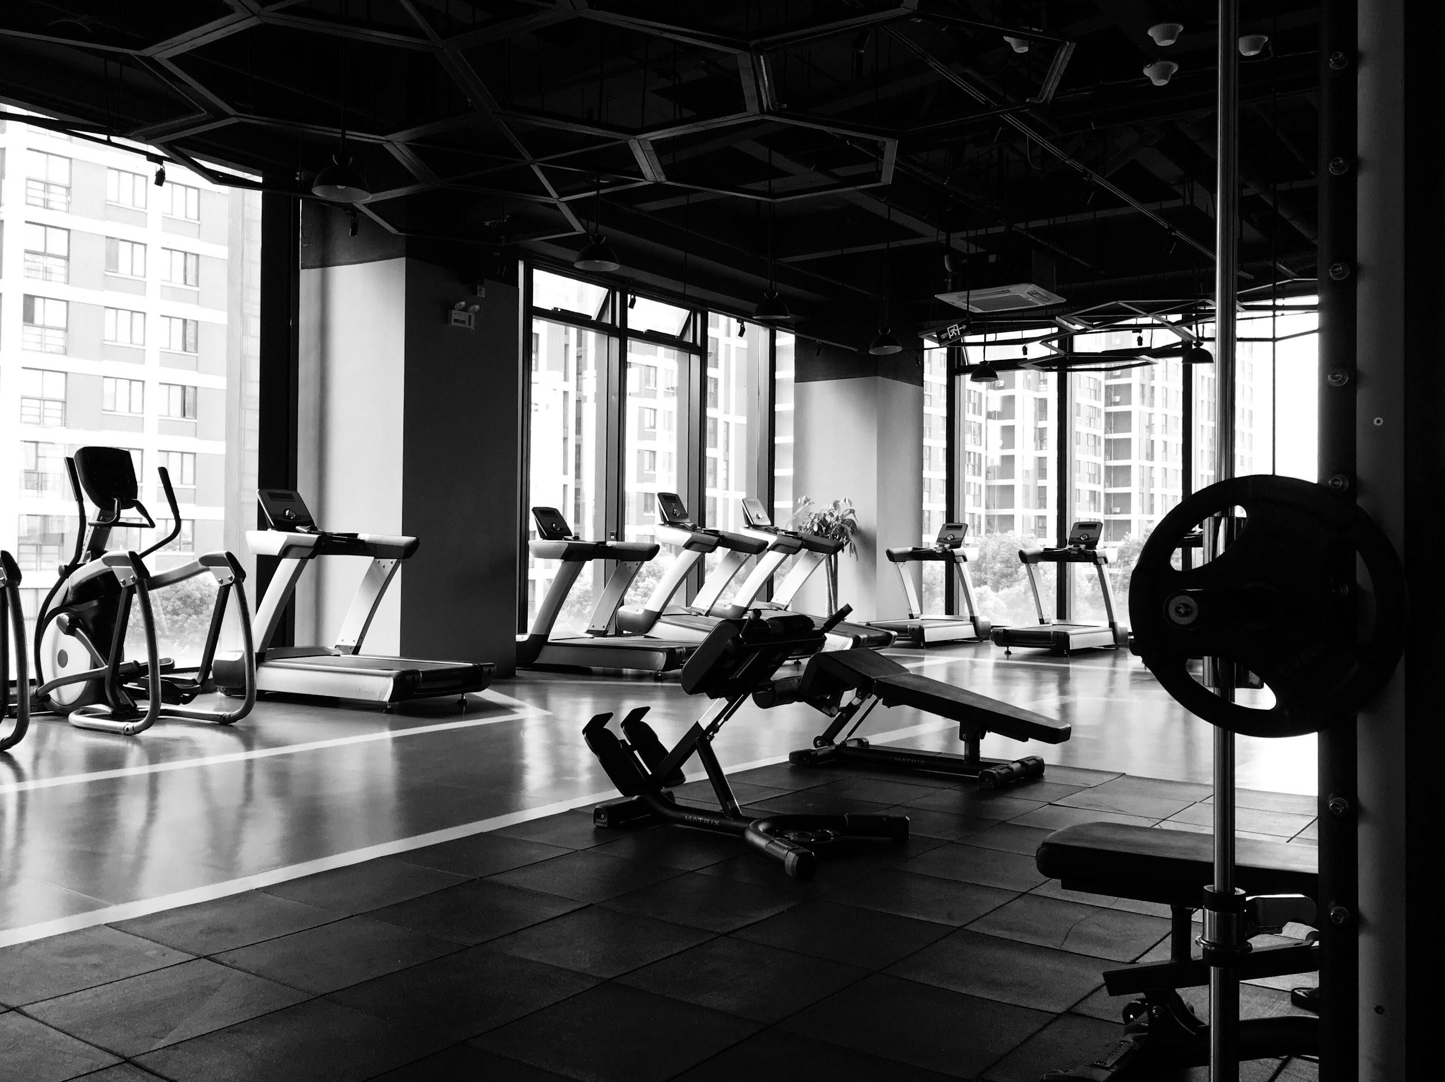
CustomFit
Project 1 | Team 3
James Cobrin, Jeff Zhang, Connie Wong, Sabrina Nawaz & Gareth Kwan

Slide 2
Agenda
Elevator Pitch
Concept
User Story
Process
Demo
Future Development
Feedback
Notes:
Elevator Pitch - Sabrina
Concept - Sabrina
User Story - Connie
Process - James
Demo - Gareth
Future Development - Jeff
Feedback - Jeff

Slide 3
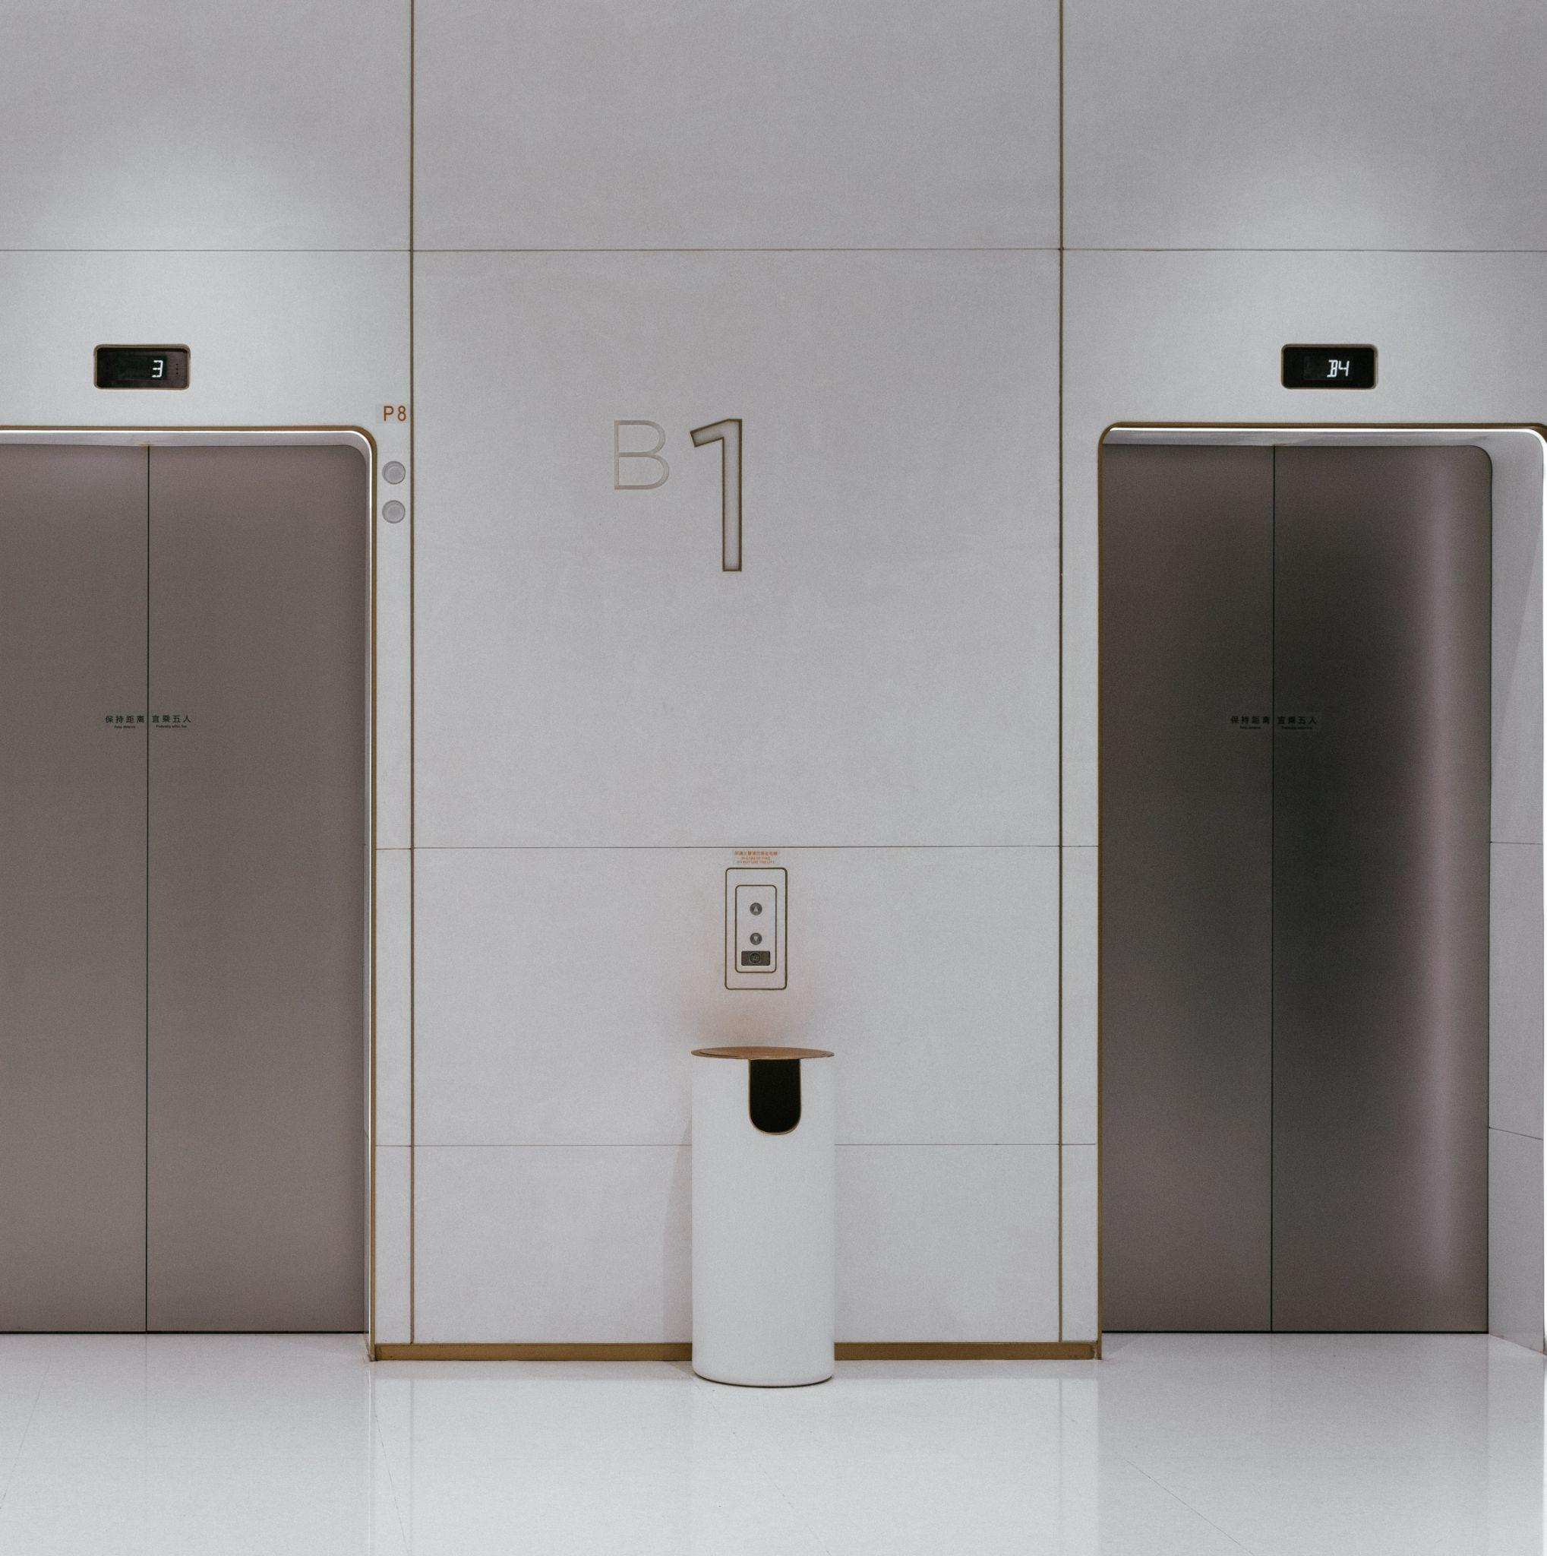
CustomFit
Rising popularity of fitness
Work from home jobs and desk jobs
Healthy body = healthy brain
Lack of free resources
Resource for Exercise Information
Body Mass Index (BMI)
The use of APIs allows CustomFit to expand quickly and easily
Notes:
Elevator Pitch

Slide 4
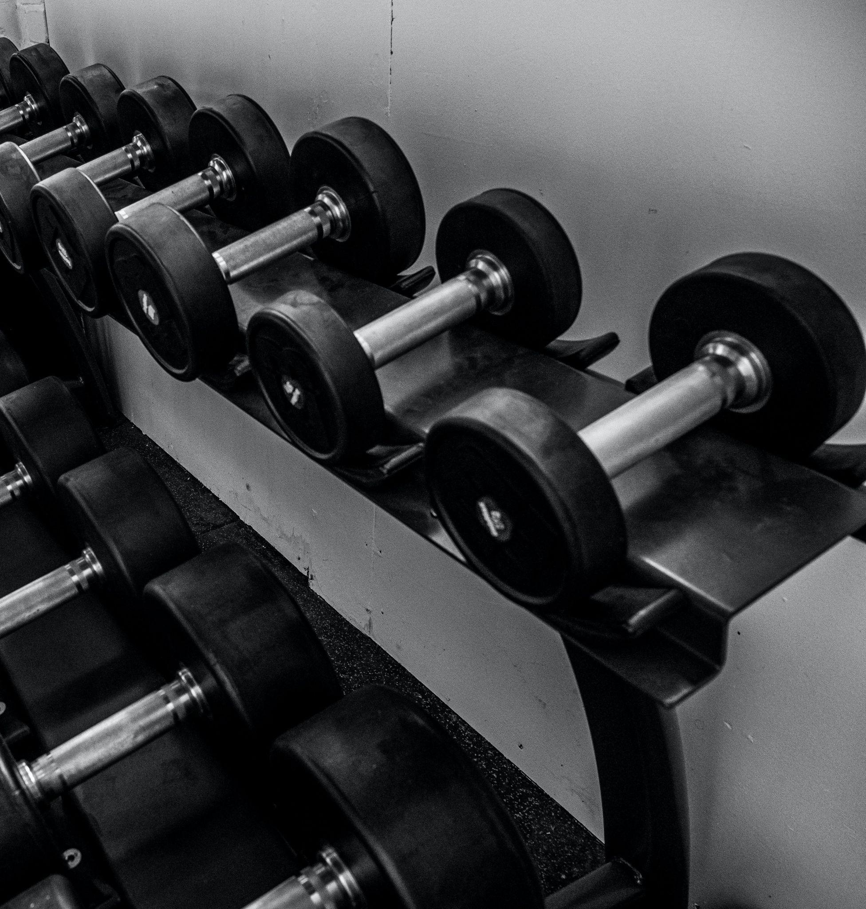
Custom(er)Fit(ness)
CustomFit

Slide 5
User Story
sadfasd
Motivation for Development
Given I need a resource to learn about exercises and to calculate my BMI
When I load the app
Then I am presented with the website’s home page, a nav bar with sections linked to additional pages
When I visit the Exercise page
Then I am presented with exercise options for different muscle groups and types to customize my workout plan
When I visit the BMI Calculator page
Then I am presented with a form to input my height & weight and it will output my BMI, health class and healthy BMI range
When I visit the contact us page
Then I am presented with a form to submit my name, contact information, questions, comments for a response
This web application was built based on a passion for fitness and health.
Many people do not feel comfortable starting off with a personal trainer at a gym or they are at a loss as to what they should be doing based off their needs.
CustomFit helps users find a workout plan and it informs them as to where their body mass fits in accordance with their measurements.
Notes:
To expand on what Sabrina shared regarding the concept for our CustomFit:
Our Motivation for development:
What drove this app to be created - is our passion for fitness & health
It can be intimidating for people to start off with a personal trainer at the gym or they just don’t know where to start, how to customize a workout to meet their specific needs
User Story
Given I need a resource that customized a workout plan and learn about different exercises, calculate my BMI
When I load the app, I will see the home page with sections to visit from the nav bar
When I visit each section - when the exercise page loads, I am presented with exercise options based on which body part I wish to focus on.
when I visit the BMI calculator page, a form is available for me to input my specifics to calculate my BMI range
When I visit the contact us page, I am presented with CustomFit’s vision and a form to submit my question/comments and will have a response via email.

Slide 6
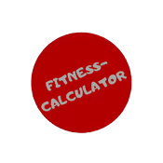
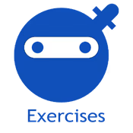
Process
Lorem 2
MVP | Minimum Viable Product
Lorem 3
Lorem 1
Challenges
Technologies & Methods
APIs Ninjas, Fitness Calculator
JavaScript
CSS
HTML
Bootstrap
Agile Approach
Features ranked:
1. Exercise Resource API
2. BMI Calculator
3. Theme/Style
Feasibility:
i) Unlimited data pull
ii) Cost Efficient
iii) Data is maintained
Fitting photos into bootstrap accordions on the exercises page
Retrieving the height and weight values for the calculator in our JS, we thought we had a scoping issue, as the values were outside of the function we needed them under
Merge conflicts, we manually had to push

Slide 7
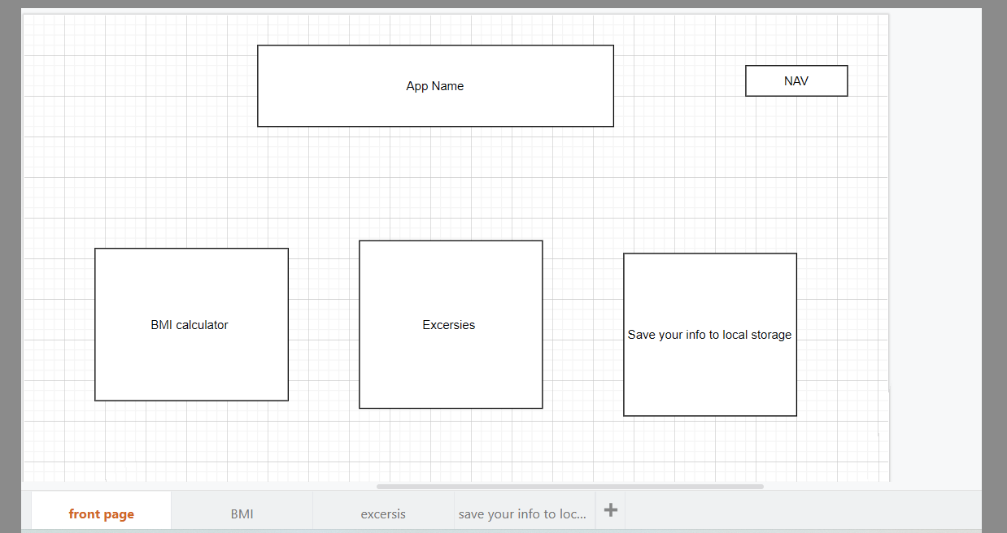
Process | wireFrame
Initial design:
Homepage
Notes:
Wire Frames

Slide 8
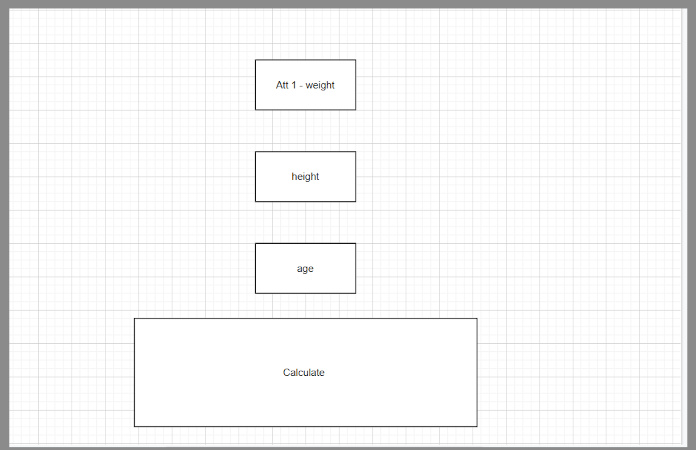
Process | wireFrame
Initial Design: BMI Calculator
Notes:
Wire Frames

Slide 9
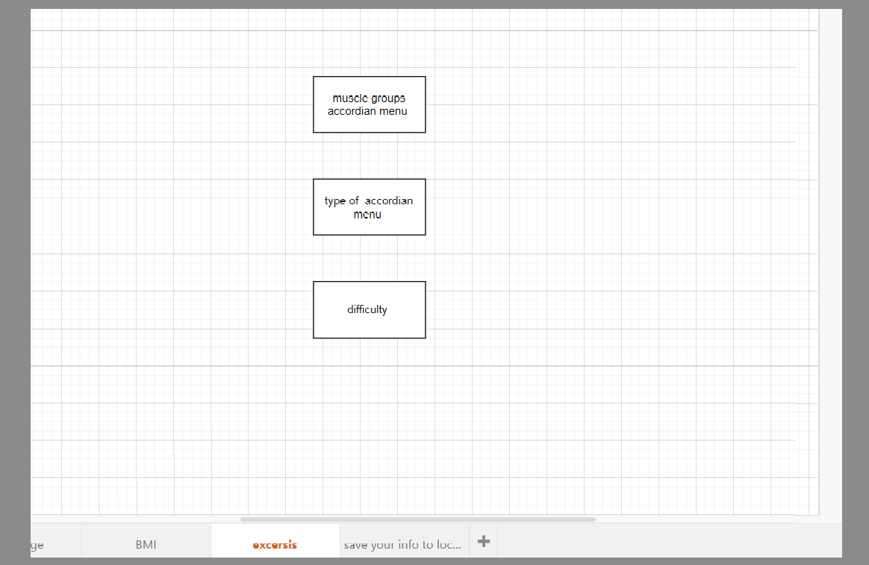
Process | wireFrame
Initial Design:
Exercises Page
Notes:
Wire Frames

Slide 10
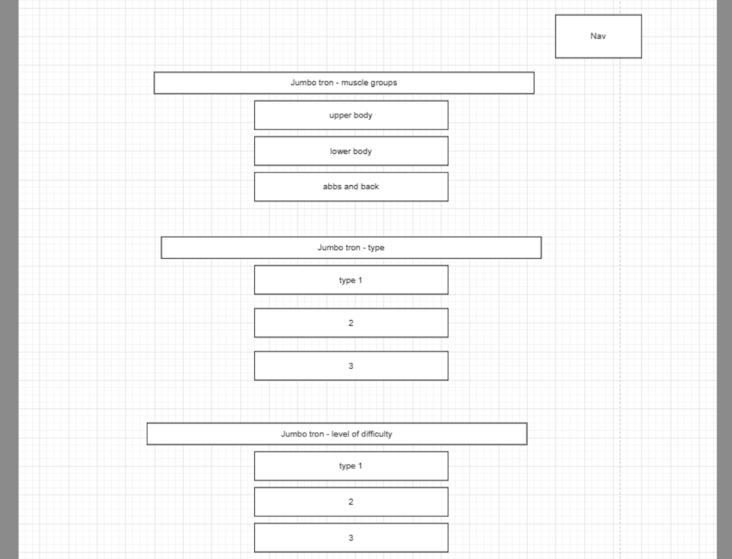
Process | wireFrame
Design 2 - Exercise Page:
Includes the jumbotrons
Notes:
Wire Frames

Slide 11
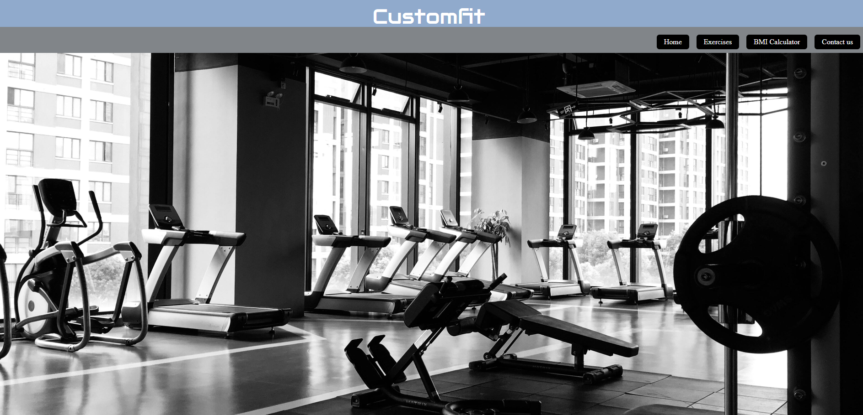
DEMO | Deploy Web Page
Notes:
Demo:
APP functions walk-through
Gareth: Home page, Exercise, BMI page ( cm, kilo, BMI score), contact us
Body mass index (BMI) is perhaps a more reliable indicator of your overall health instead of counting on a body fat scale alone. While BMI can’t measure fat, it does provide an overall picture of whether you’re in the right weight range for your height and age.
The downside to relying on BMI is that it doesn’t measure body fat. So, an athlete with a lot of muscle, for example, could have a higher BMI based on their weight and height.

Slide 12

Future Development
Add another accordion with the level of difficulty in the Exercises page
Video demonstrations of the exercises next to each one
Customer Account page
Add Nutrition Page
More Muscle Groups can be added
Connecting a trainer with the trainee for online training
Merchandise Page
Customer Reviews

Slide 13
Feedback?

