Slide 1
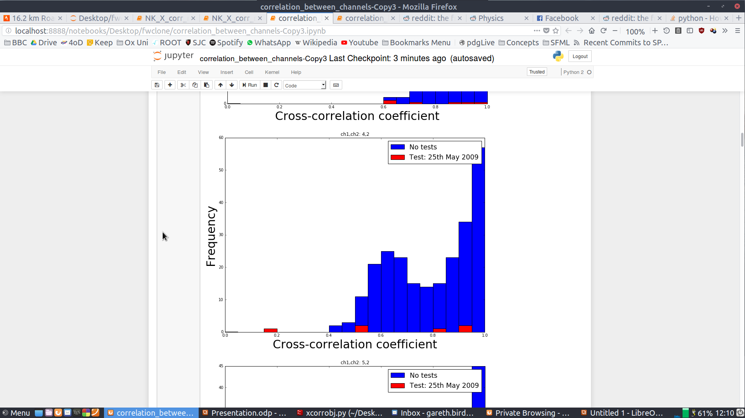
Gareth Bird : Cross Correlation update 2017

Slide 2
Who am I/ what I know
Third year undergrad @ Oxford who feel ill
Main background is in hep, but know some plasma physics
Most of my coding experience is in C++ and Matlab, but I know a little python

Slide 3
What I’ve read through
Filip’s Report and the reference of the PB matching method in the original method
The method that loads the data
Some of some old notes I have on alfven waves in the ionsphere, not sure of the utility
Most of Filip’s Jupyter notebooks on cross-correlations and nuclear testing

Slide 4
What I’ve yet to extensively look at
The matching of PBs with seismic activity code, I’m under the impression that this is Chris’s work
Limits of propagations of the waves, effects (if any) of L-shell variation and origin of background radiation

Slide 5
What I resolved to do
Re-use elements of Filip’s code to check all possible correlations between all channels
Run over larger data sets for the background to try and find better p vals for outlier cross correlation values
Try to find when and why the the outlier cross correlations occur more specifically

Slide 6
What I’ve done so far
Created a class that cross correlates all data channels for arbitrary time intervals
Run on a larger data set than the figures used on the original analysis: little useful effect
Looking at ~1 day correlation intervals around the event: it seems that only one data point is a significant outlier
Smaller

Slide 7
Places where I have had issues
Jupyter Notebook installer bugs using pip: spent a day messaging a dev
Issues replicating Filip notebooks: source class had changed since some of it had been last executed. Realitively easy to fix
The meta_search class didn’t do quite what I was expecting it to

