Slide 1
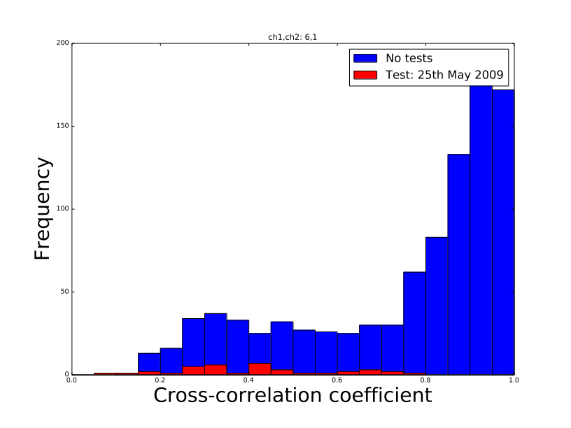
Update Wednesday 6th: Cross-correlation methods for NK test detection

Slide 2
Aims of current work
Establish what methods isolate out the NK event from background on one event before trying to run against other detected events
I’ve picked to look at 25 May 2009 test as it was ‘found’ reasonably easily

Slide 3
The Modified Method recap
We are mainly looking for the ouliers in our data: in Filip’s analysis he sampled a duration around the test itself, typically the file that contained the date range for one test and finds correlations between ch2 and all other channels and bins into histograms
The new class finds all cross correlations across arbitrary time intervals: can be ran over several intervals without reloading all the data

Slide 4
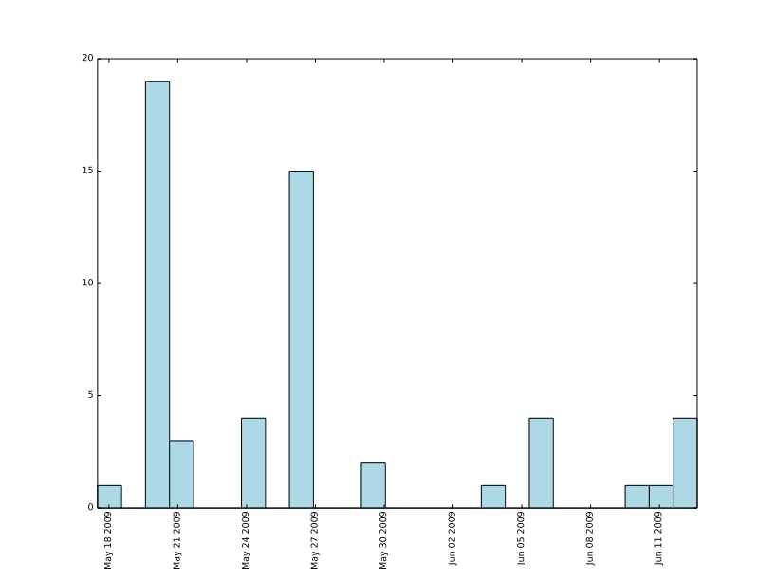
Analysing time stamps, intervals and p values
First analysis steps involve:
  Find the date of the minimum correlation value over a period of around a month through the event for each channel combination, bin these dates in a histogram alongside previous spectra plots
  Assess time interval choice to see what causes narrower distributions by generating
  When min val date is in reasonable range of actual date (i.e three days either way), find p val and display in 2d colour plot

Slide 5
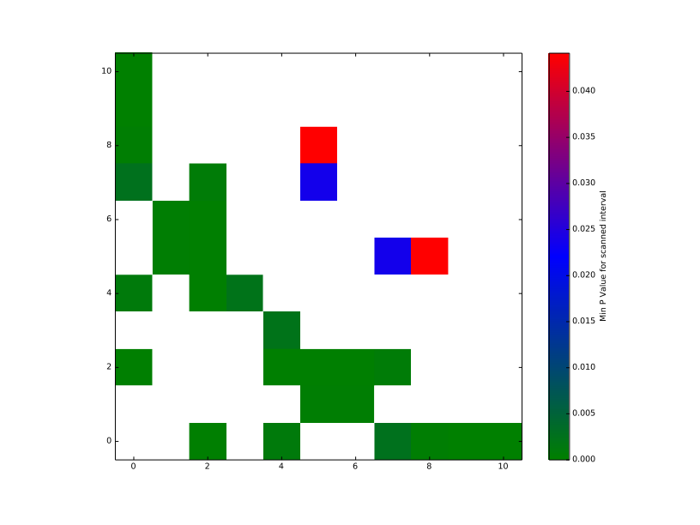
Problem with 3rd plot: inadequate data near matching time, hence removed condition for now

Slide 6
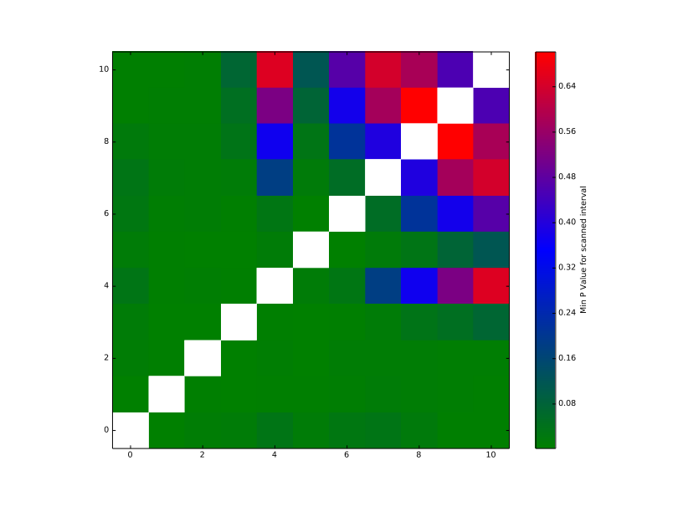
4 Hours

Slide 7
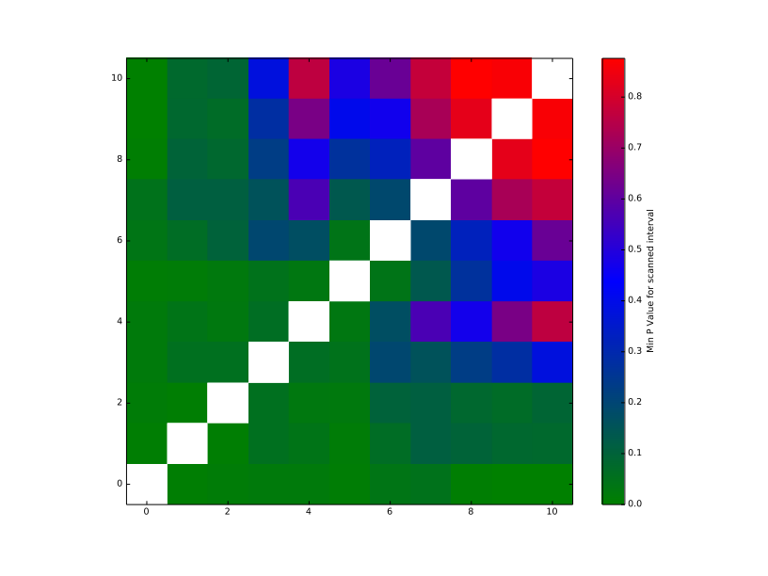
48 Hours

Slide 8
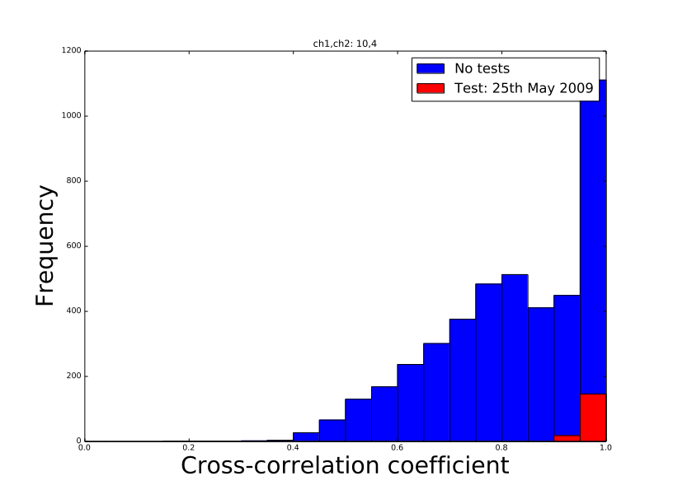
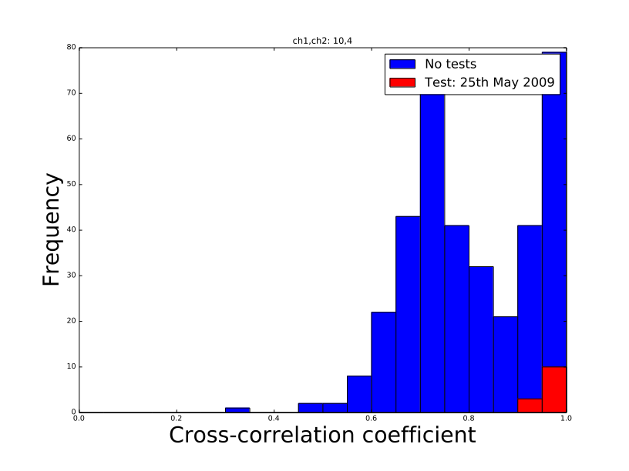
4 Hours
48 Hours

Slide 9
Results
Seems that the minimum values don’t cluster around near exact date as you’d hope or expect
Increasing interval size way beyond the typical duration of PB seems to improve outlier data quality, not so sure why yet
As a result, not entirely sure of the origin or mechanism if it’s over these longer time scales

Slide 10
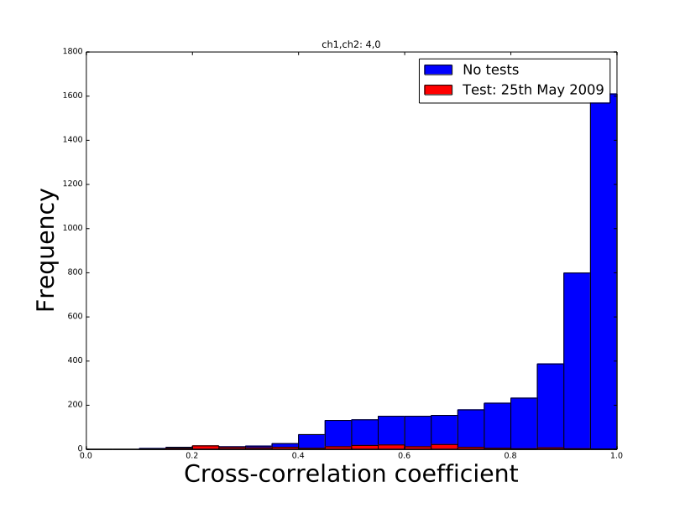

Slide 11
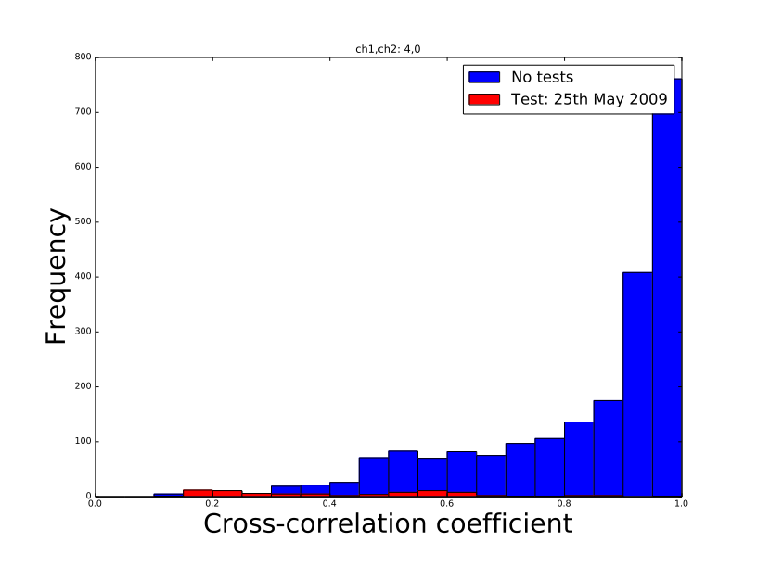

Slide 12
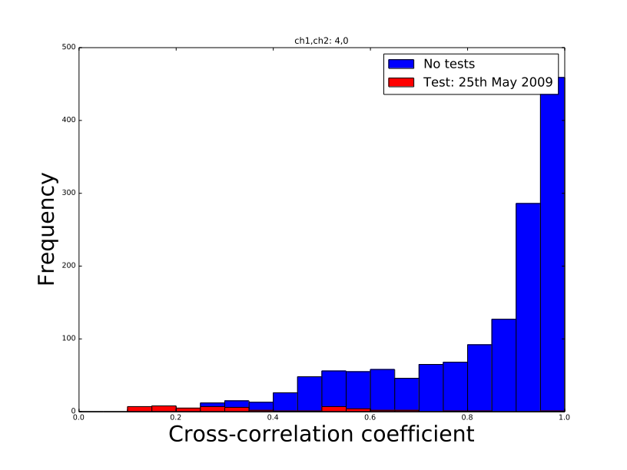

Slide 13
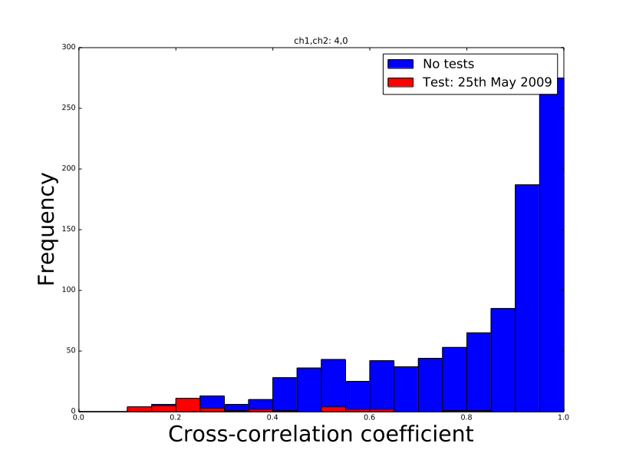

Slide 14
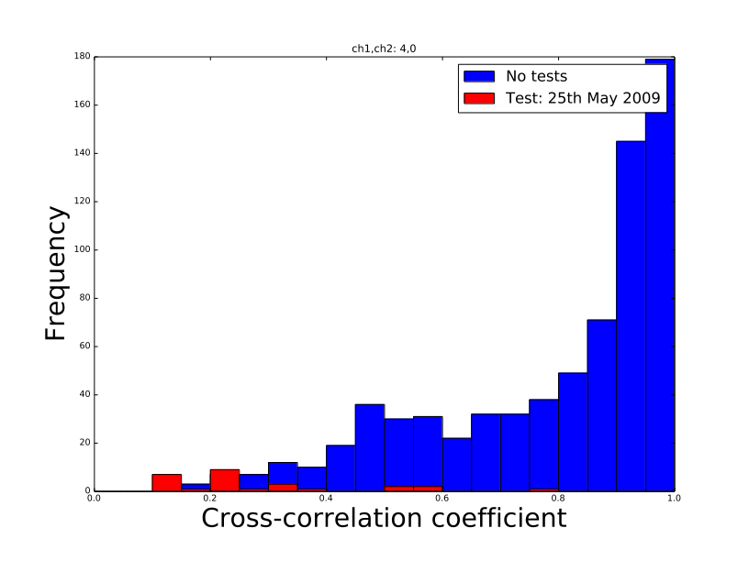

Slide 15
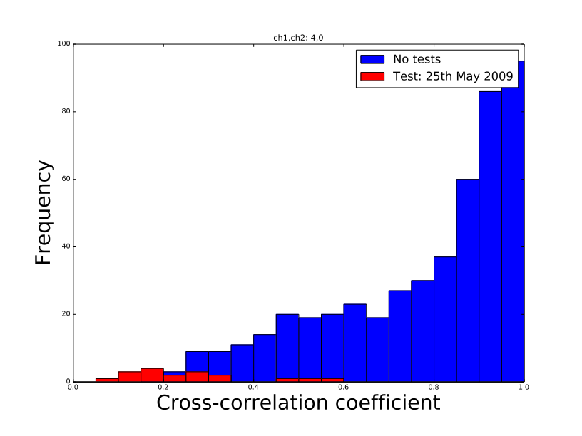

Slide 16
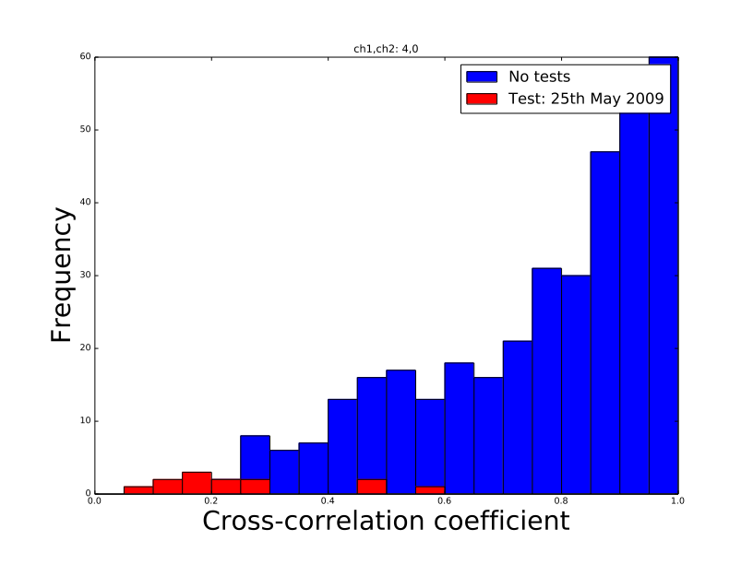

Slide 17
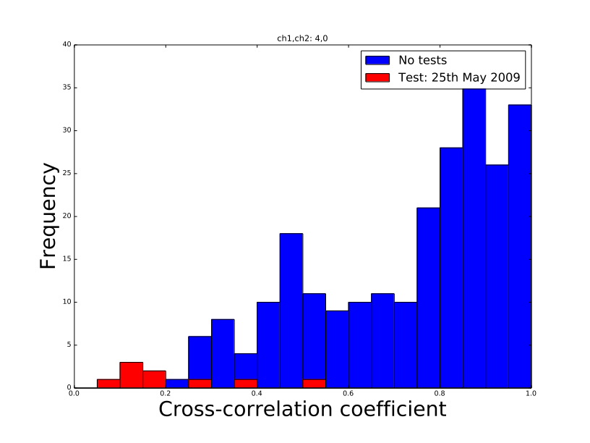

Slide 18
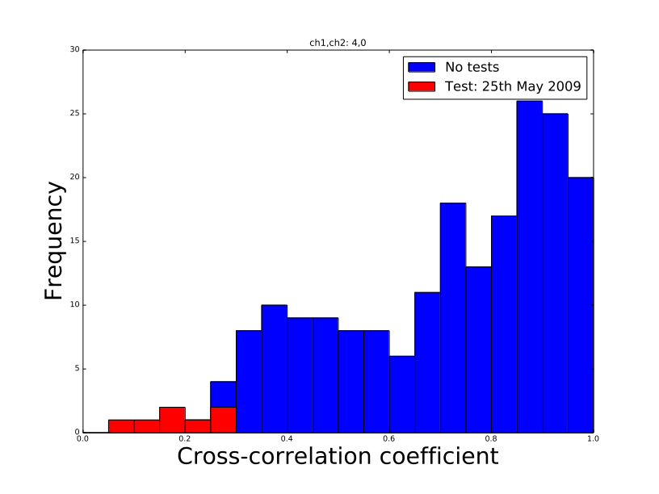

Slide 19
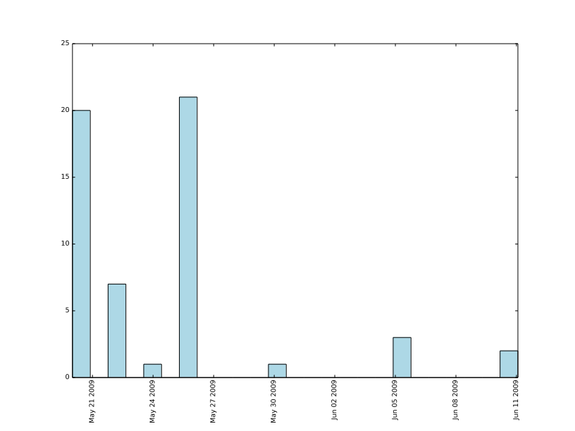
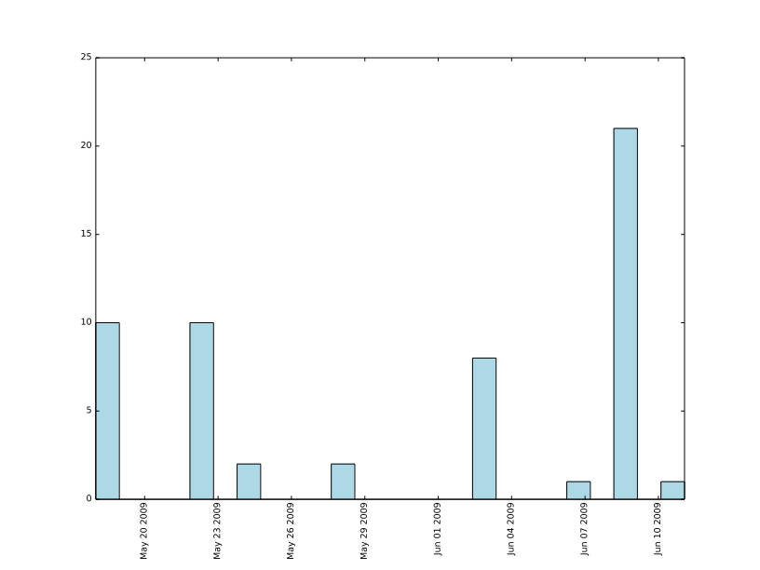
Running the analysis over several satellites
Results are not as consistent as you’d hope, tested data using ns54 and results didn’t cluster as well around the date as it did for others
Both below are 48 hour intervals on ns54 and 56

Slide 20
Technical Changes
Made intermediate methods and objects private members
Changed entire plotting route into a function with relevant variables to change with xcorrobj.py
Additional Comments, sanitised code

Slide 21
Resolve
Commit the new code version
Add a few of the smallest cross correlation values for each channel into the date histogram, see if we a see a peak or similar
Consider looking at even larger search range for NK data

