Slide 1
Going Quantum
A teaser on Quantum Mechanics
and Q#, Microsoft's Quantum Programming Language

Slide 2
Quantum Computers
What is a Qubit?
Quantum Entanglement
Quantum Gates
Walkthrough the example Code

Slide 3
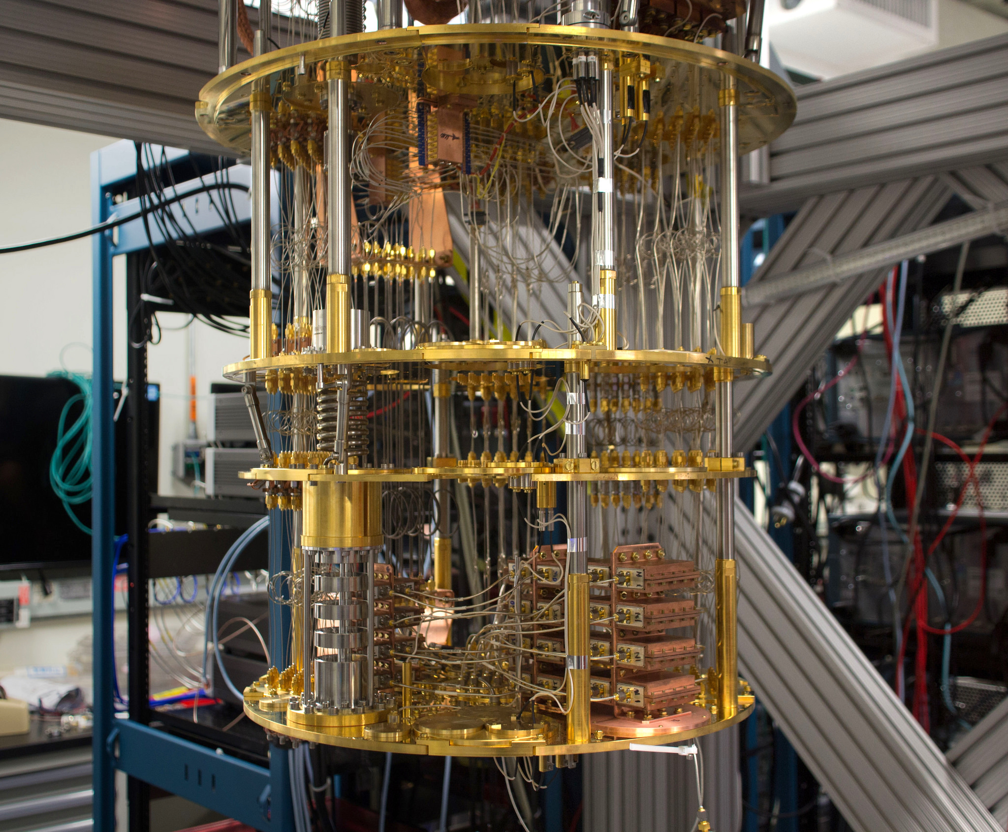
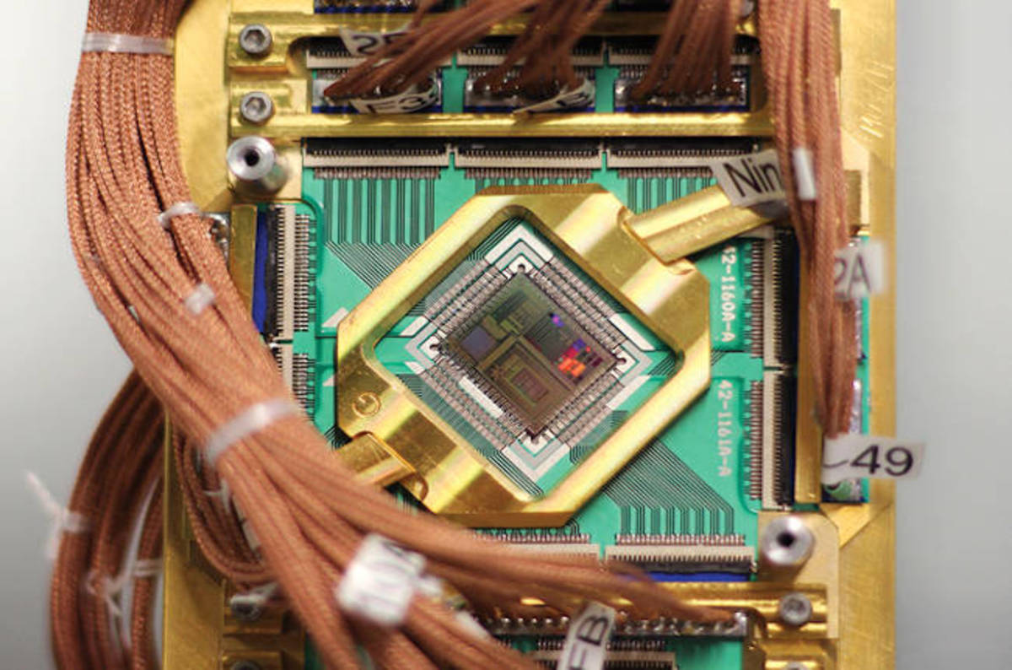
Quantum Computers
Image on Left: by IBM / Image on Right: by D-Wave

Slide 4
Use a quantum processor.
The processor is cooled to near 0 degrees Kelvin to slow molecular movement.
Contain a number of Qubits, whose values are determined by the quantum state of the qubit. Qubits can carry the information of two classical bits.

Slide 5
What is a Qubit?
Physically, can be an atom, electron or ion.
It's measured value can be 1 or 0 or a superposition of both states at the same time.
The probability of its superposition to be either a 1 or 0, for any complex number, satisfies the equation a^{^2} + b^{^2} = 1;
When measured, its value becomes a One or Zero, with a numeric coefficient to its probability of being in either state. However it will be in that state any subsequent time it is measured.

Slide 6
Quantum Entanglement
Two or more qubits are connected by the use of the H and CNOT gate. The value of one will affect the other and the other qubit will take the opposite value.
A qubit, once bonded will continue to have the opposite value of its partner, until released.
Allows values to be “tapped”: measured without causing its value to be set in stone, because its partner is still in flux in a superposition state.

Slide 7
Quantum Logic Gates and Networks
Gates perform a fixed operation on selected qubits. A Network is composed of gates whose computational steps are synchronized in time.
Gates are reversible.
Can take 1 qubit, 2 qubits, or a series of entangled qubits.
Correspond mathematically to 2x2 and 4x4 matrices and define different sets of matrix transformations.
Used to flip and control values of target qubits in entangled groups.
An ancilla qubit, or a qubit whose value is known ahead of time can be used with gate operations to either store quantum state values, or be used for error correction.

Slide 8
The Example Code
Microsoft's Q# Quickstart Page

Slide 9
SDK: https://www.microsoft.com/en-us/quantum/development-kit
Documentation: https://docs.microsoft.com/en-us/quantum/quantum-qr-intro?view=qsharp-preview
IBM 5Qubit Graphical Simulator: https://quantumexperience.ng.bluemix.net/
Quora: What is a Qubit? https://www.quora.com/What-is-a-Qubit-1
Video of the inside of a Quantum Computer: https://www.youtube.com/watch?v=60OkanvToFI&t=600s
How Quantum Computers Work: https://computer.howstuffworks.com/quantum-computer.htm
Gizmodo's Article on Quantum Computers: https://gizmodo.com/what-the-hell-is-a-quantum-computer-and-how-excited-sho-1819296509
Quantiki: https://www.quantiki.org/
A Series of Lecture Slides: https://www.cl.cam.ac.uk/teaching/0910/QuantComp/notes.pdf

