Slide 1

From Initial Design Diagrams to Sequence Diagrams
CS574 Object-Oriented Analysis & Design
In a previous lecture we went from use case descriptions to initial design diagrams.
In this lecture we’ll go from initial design diagrams to sequence diagrams, from which design class diagrams can easily be constructed. If you haven’t yet read the chapters on sequence diagrams in UML2 for Dummies – pretty easy reading.

Slide 2
CS574 Object-Oriented Analysis & Design
On the next twelve slides we repeat the use case descriptions and initial design diagrams for:
  Log In
  Open Account
  Search by Author
  Track Recent Orders
After that we discuss the construction of sequence diagrams from initial design diagrams.

Slide 3
CS574 Object-Oriented Analysis & Design
Log In Use-Case
Basic Course
The Customer clicks the Log In button on the Home Page. The system displays the Login Page. The Customer enters his or her user ID and password and then clicks the Log In button. The system validates the login information against the persistent Account data and then returns the Customer to the Home Page.

Slide 4
CS574 Object-Oriented Analysis & Design
Log In Use-Case
Alternate Courses
If the Customer clicks the New Account button on the Login Page, the system invokes the Open Account use-case.
If the Customer clicks the Reminder Word button on the Login Page, the system displays the reminder word stored for that Customer, in a separate dialog box. When the Customer clicks the OK button, the system returns the Customer to the Login Page.
If the Customer enters a user ID that the system does not recognize, the system displays a message to that effect and prompts the Customer to either enter a different ID or click the New Account button.
If the Customer enters an incorrect password, the system displays a message to that effect and prompts the Customer to reenter his or her password.
If the Customer enters an incorrect password three times, the system displays a page telling the Customer that he or she should contact customer service, and also freezes the Login Page.

Slide 5
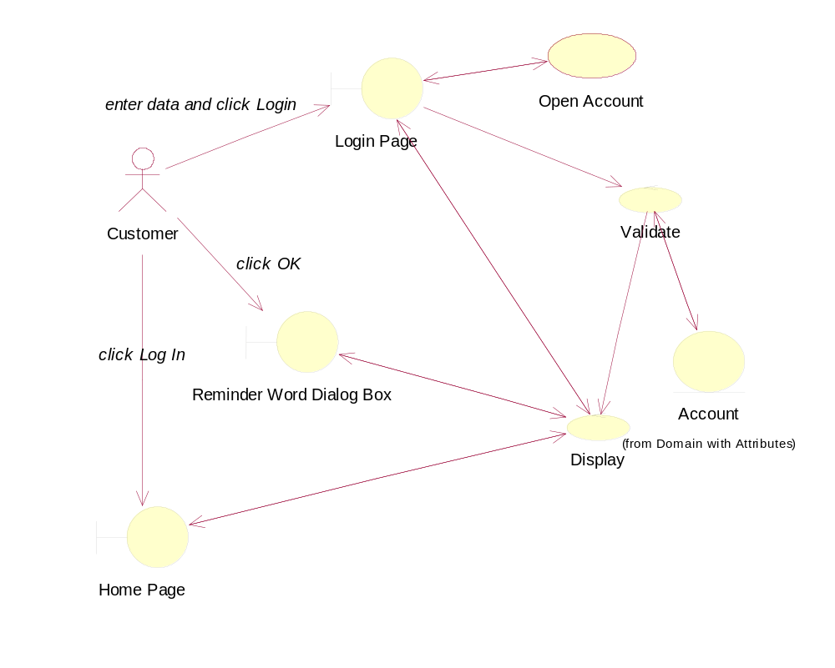
CS574 Object-Oriented Analysis & Design
Initial Design Diagram for Log In

Slide 6
CS574 Object-Oriented Analysis & Design
Open Account Use-Case
Basic Course
The system displays the New Account Page. The Customer types his or her name, an e-mail address, and a password (twice), and then presses the Create Account button. The system ensures that the Customer has provided valid data and then adds an Account to the Master Account Table using that data. Then the system returns the Customer to the Home Page

Slide 7
CS574 Object-Oriented Analysis & Design
Open Account Use-Case
Alternate Courses
If the Customer did not provide a name, the system displays an error message to that effect and prompts the Customer to type a name.
If the Customer provided an email address that's not in the correct form, the system displays an error message to that effect and prompts the Customer to type a different address.
If the Customer provided a password that is too short, the system displays an error message to that effect and prompts the Customer to type a longer password.
If the Customer did not type the same password twice, the system displays an error message to that effect and prompts the Customer to type the password correctly the second time.
If the account is already in the master account table, notify the user.

Slide 8
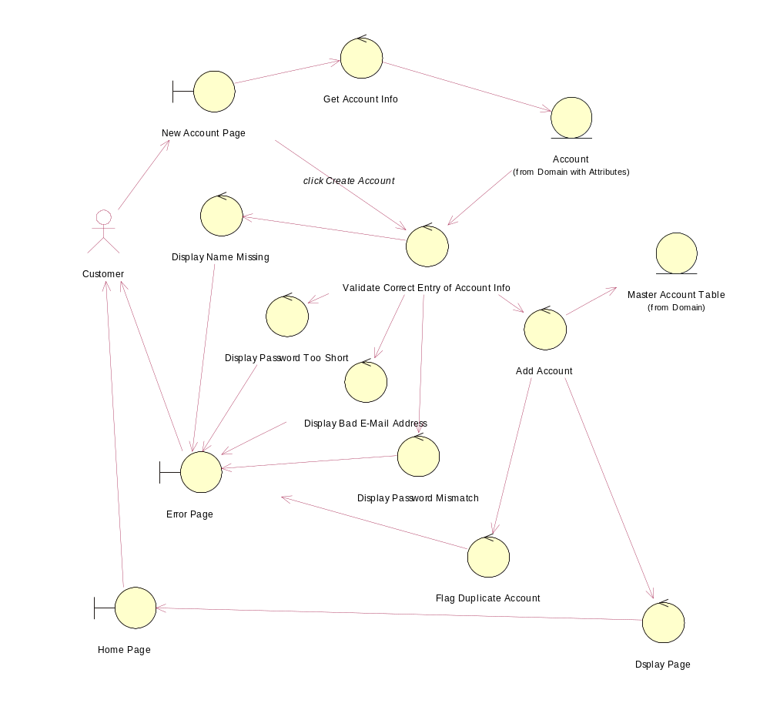
CS574 Object-Oriented Analysis & Design

Slide 9
Search by Author Use-Case
CS574 Object-Oriented Analysis & Design
Basic Course
The Customer types the name of an Author on the Search Page and then presses the Search button. The system ensures that the Customer typed a valid search phrase, and then searches the Catalog and retrieves all of the Books with which that Author is associated. Then the system retrieves the important details about each Book, and creates a Search Results object with that information.
Then the system displays the list of Books on the Search Results Page, with the Books listed in reverse chronological order by publication date. Each entry has a thumbnail of the Book's cover, the Book's title and authors, the average Rating, and an Add to Shopping Cart button. The Customer presses the Add to Shopping Cart button for a particular Book. The system passes control to the Add Item to Shopping Cart use-case.

Slide 10
Search by Author Use-Case
CS574 Object-Oriented Analysis & Design
Alternate Courses
If the Customer did not type a search phrase before pressing the Search button, the system displays an error message to that effect and prompts the Customer to type a search phrase.
If the system was unable to find any Books associated with the Author that the Customer specified, the system displays a message to that effect and prompts the Customer to perform a different search.
If the Customer leaves the page in a way other than by pressing an Add to Shopping Cart button, the system returns control to the use-case from which this use-case received control.

Slide 11
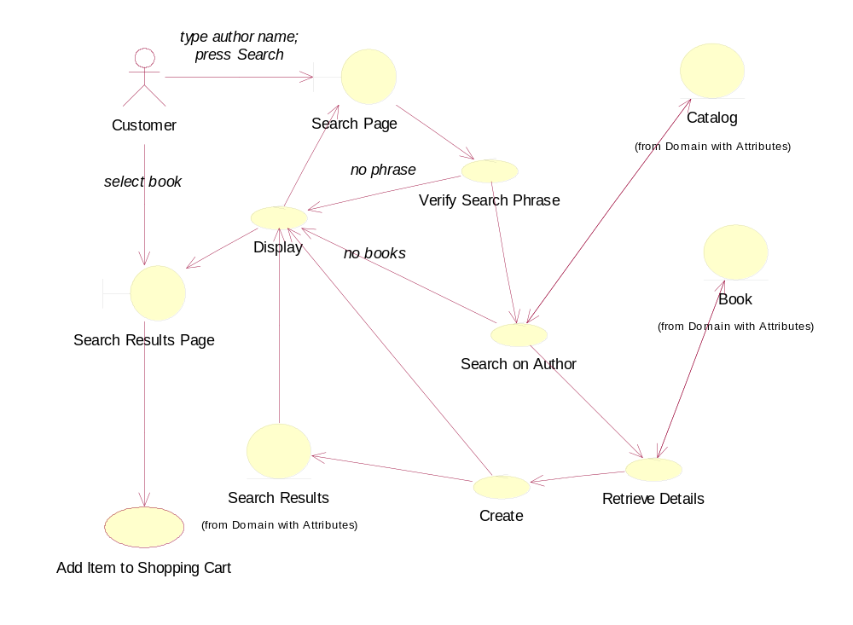
CS574 Object-Oriented Analysis & Design

Slide 12
Track Recent Orders Use-Case
CS574 Object-Oriented Analysis & Design
Basic Course
The system retrieves the Orders that the Customer has placed within the last 30 days and displays these Orders on the Order Tracking Page. Each entry has the Order ID (in the form of a link), the Order date, the Order status, the Order recipient, and the Shipping Method by which the Order was shipped.
The Customer clicks on a link.The system retrieves the relevant contents of the Order, and then displays this information, in view-only mode, on the Order Details Page. The Customer presses OK to return to the Order Tracking Page.
Once the Customer has finished viewing Orders, he or she clicks the Account Maintenance link on the Order Tracking Page. The system returns control to the invoking use-case.

Slide 13
Track Recent Orders Use-Case
CS574 Object-Oriented Analysis & Design
Alternate Courses
If the Customer has not placed any Orders within the last 30 days, the system displays a message to that effect on the Order Tracking Page.

Slide 14
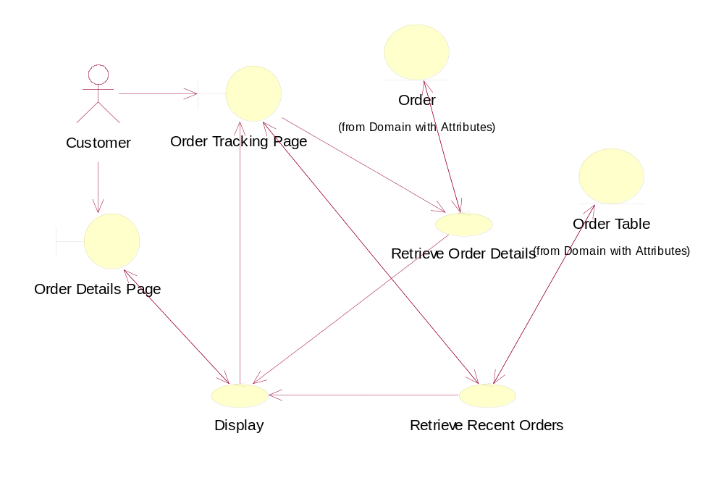
CS574 Object-Oriented Analysis & Design

Slide 15
Sequence Diagram Construction
CS574 Object-Oriented Analysis & Design
The next step in our method of OOA&D is the construction of sequence diagrams from the initial design diagrams – one use-case (initial design diagram) at a time.
The next slide shows the sequence diagram for the Log In use-case, constructed from Log In’s initial design diagram

Slide 16
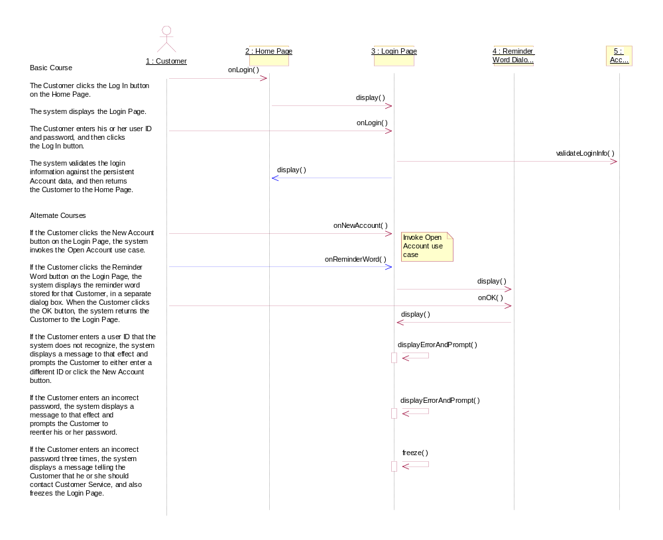

Slide 17
Sequence Diagram Construction: Items Across the Top
CS574 Object-Oriented Analysis & Design
The items across the top of the sequence diagram are:
  the actors involved in the initial design diagram, and, therefore, in the use-case; in this case, just the customer
  the interface objects created for the initial design diagram; in this case the Home Page, the Login Page, and the Reminder Word Dialog Box
  the entity objects created for the initial design diagram; in this case just the Account object
The items across the top of the sequence diagram are going to turn into objects in the application’s (system’s) design
If a control object represents a sufficiently complex control function, it may make it to the top of the sequence diagram and become an object in the design
If, on the other hand, a control object is simple enough so that it can be implemented as a method, then it doesn’t make it to the top of the sequence diagram; we’ll see in a moment where it does go in the diagram; in this case, the two control objects, Display and Validate, will become methods.

Slide 18
Sequence Diagram Construction: Items Down the Left Side
CS574 Object-Oriented Analysis & Design
The individual sentences of the use-case’s basic and alternate courses go down the left side of the sequence diagram.

Slide 19
Sequence Diagram Construction:
Messages & Methods
CS574 Object-Oriented Analysis & Design
Arrows in the sequence diagram represent messages – method calls
The source of an arrow represents the object sending the message, i.e., the object invoking the method
The target of an arrow is the object receiving the message, i.e., the object on which the method is invoked
The only (design) creativity involved in constructing a sequence diagram is in deciding:
  what the methods should be
  which object each method should belong to
  which object(s) calls which method, and at exactly what point during the course of the use-case
The decisions are made one (use-case) sentence at a time…and the process is iterated until the designer is satisfied with the results

Slide 20
Sequence Diagram Construction:
Messages & Methods (cont.)‏
CS574 Object-Oriented Analysis & Design
Read the assignments of methods, and the decisions as to who invokes each one and when, during the course of the Log In use-case.
On the next next two slides you’ll find sequence diagrams for the New Account, and Search by Author use-cases

Slide 21
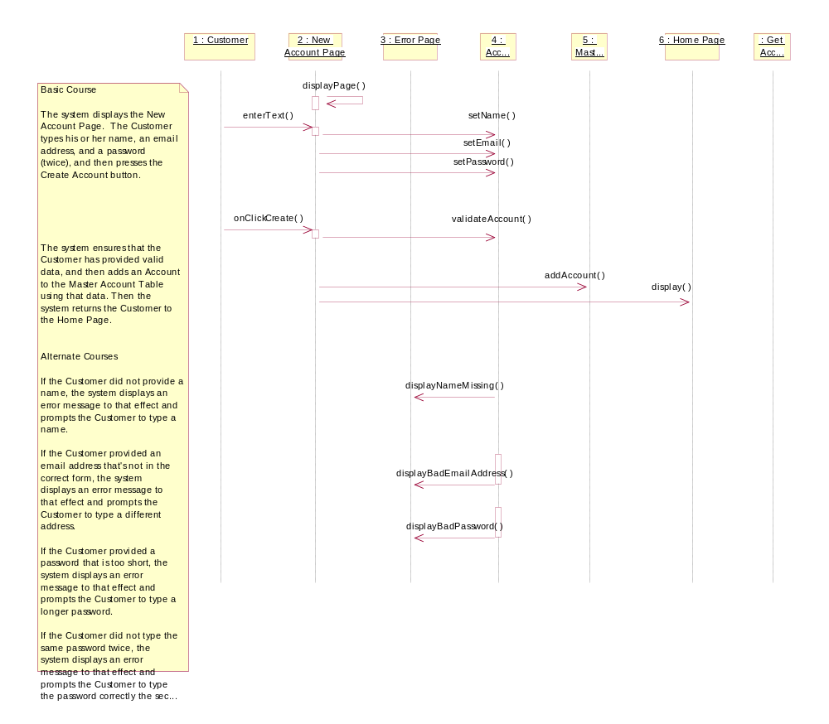

Slide 22
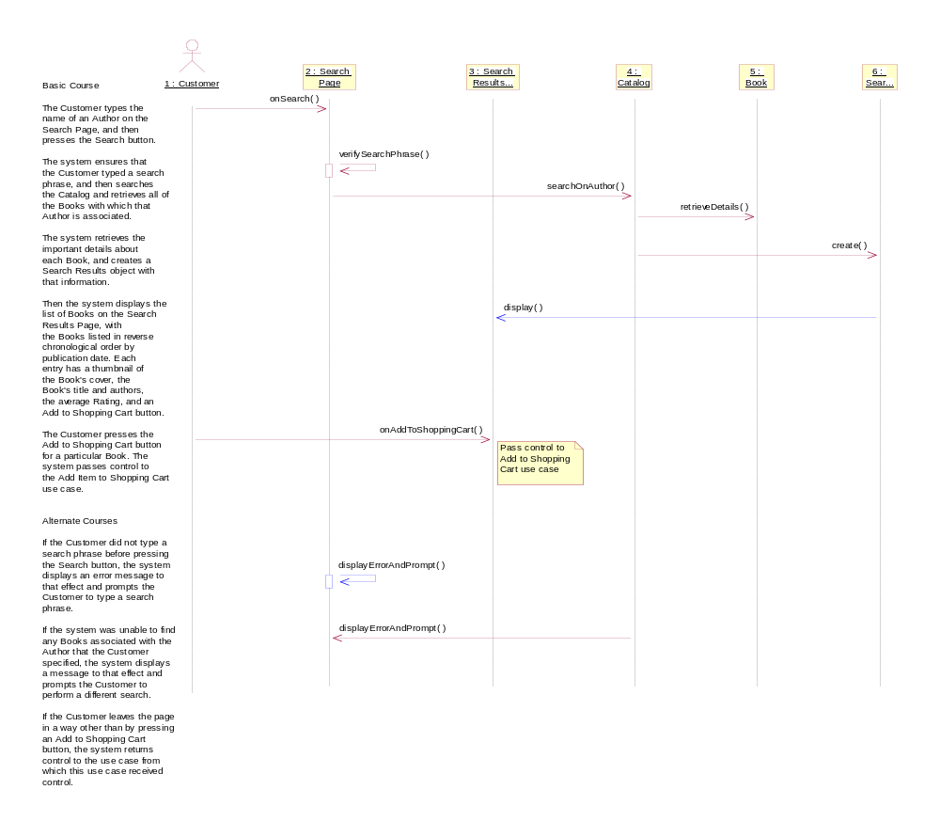

Slide 23
Homework
CS574 Object-Oriented Analysis & Design
Construct the sequence diagram for Track Recent Orders using:
  The use case description provided earlier in the lecture
  The sequence diagram construction method just described

