Slide 1
pet adoption prediction
Presented by Garett MacGowan and Areege Chaudhary

Slide 2

The problem
Petfinder.my, Malaysia’s leading animal welfare platform has collected a database of over 150,000 animals.
Animal adoption rates may be correlated to image and description metadata, animal health, cost, location, and more.
A predictor is needed so that future costs can be calculated and animals can find homes faster.
For more information, visit www.kaggle.com/c/petfinder-adoption-prediction

Slide 3
The data
~15000 entries in the training set. ~4000 entries in the testing set.
Since data is part of Kaggle competition, testing set is not labeled.
Training set needs to be split into training and testing set (90%/10%).
Generated training and test set with equal distribution of classes.
• Pet ID | • Adoption Speed | • Type (cat/dog) | • Name | • Age
• Primary Breed | • Secondary Breed | • Gender | • Primary Color | • Secondary Color
• Tertiary Color | • Size at Maturity | • Fur Length | • Vaccinated | • Dewormed
• Sterilized | • Health | • Quantity | • Fee | • State (location)
• Rescuer ID | • Video Amount | • Photo Amount | • Description | • Image Metadata
• Description Sentiment | • Animal Images | … Attribute Generation

Slide 4
pre-Processing
Need data to be in numerical format for our neural network.
Data should be normalized so that some attributes are not initially considered more important than others.
String data such as the name attribute are transformed to length of string attributes and normalized to a 0-1 range.
Nominal categorical attributes are one-hot encoded.
Ordinal categorical attributes are normalized to a 0-1 range.
We ended up with 689 attributes to use as inputs to our network.

Slide 5
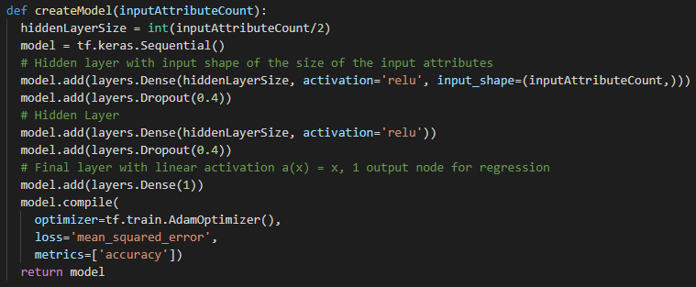
Solution A

Slide 6
Results
Averaging 30% accuracy on test set with some variation.
Accuracy given random selection is approximately 18%.
Can definitely do better.

Slide 7
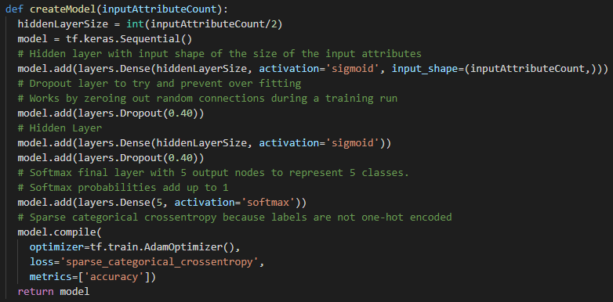
Solution B

Slide 8
results
Averaging 38% accuracy on test set with some variation.
Accuracy given a random selection is approximately 18%
Much better than previous result
Why?
Predicting class probabilities instead of forcing regression mapping
SoftMax activation function forces sum of class probabilities to be 1
Other reasons?

Slide 9
Next Steps
Our solution did not implement any components to analyze the images directly.
Using a convolutional neural network to generate useful predictors may help substantially.
Could use ensemble techniques such as bagging and boosting to reduce variance and increase prediction accuracy.

Slide 10
Questions?

