Slide 1
Scrum & TDD
Garfield Dai

Slide 2
Scrum
Founded on empirical process control
Iterative
Incremental approach

Slide 3
Scrum
Scrum Team
A Product Owner
Development Team
A Scrum Master
Scrum Events
The Sprint
Sprint Planning
Daily Scrum
Sprint Review
Sprint Retrospective
Scrum Artifacts
Product Backlog
Sprint Backlog

Slide 4
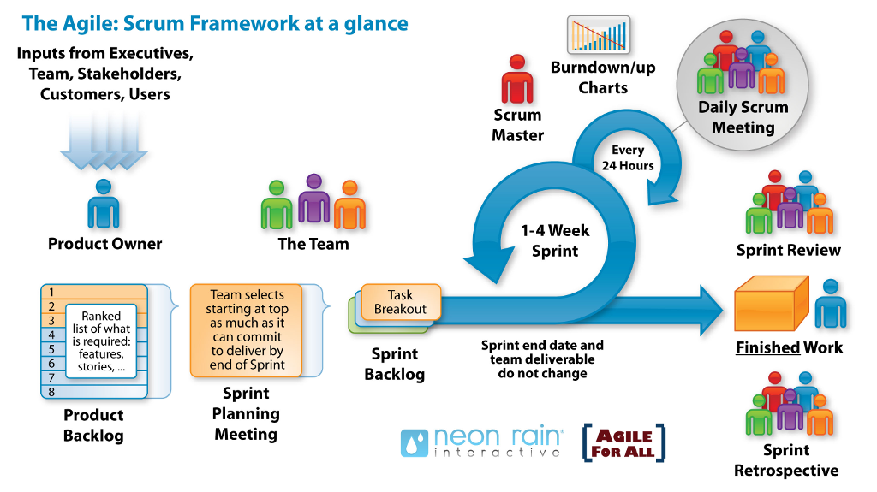
Scrum

Slide 5
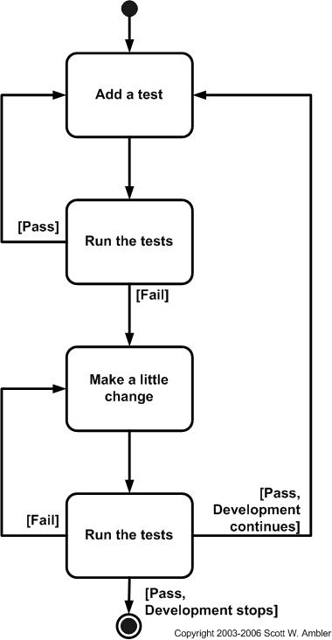
Test-Driven Development
Add a test
Run all tests and see if the new test fails
Write the code
Run tests
Refactor code

Slide 6
Thanks

Slide 7
History
2017-08-08: Set up

