Slide 1
Scrum & TDD
Garfield Dai

Slide 2
Scrum
Founded on empirical process control
Iterative
Incremental approach

Slide 3
Sprint
Sprint
Sprint
Sprint
Sprint
Requirement
Requirement
Requirement
Requirement
Design
Design
Design
Design
Coding
Coding
Coding
Coding
Testing
Testing
Testing
Testing

Slide 4
Scrum
Scrum Team
A Product Owner
Development Team
A Scrum Master
Scrum Events
The Sprint
Sprint Planning
Daily Scrum
Sprint Review
Sprint Retrospective
Scrum Artifacts
Product Backlog
Sprint Backlog

Slide 5
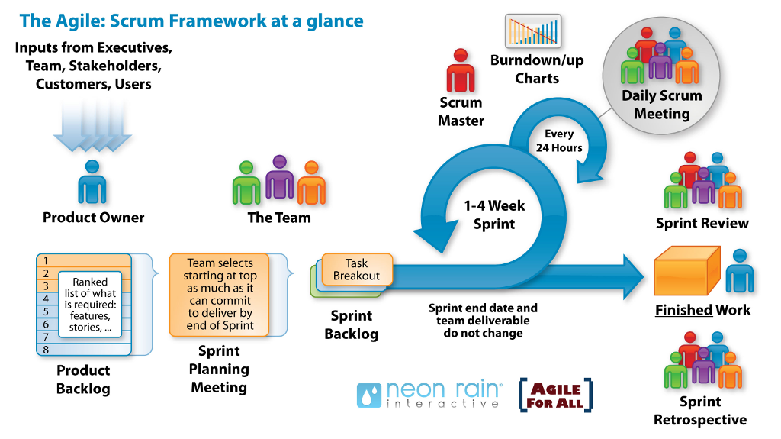
Scrum

Slide 6
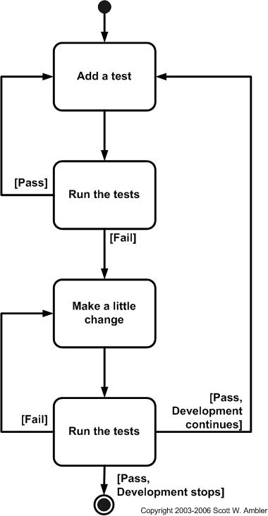
Test-Driven Development
Add a test
Run all tests and see if the new test fails
Write the code
Run tests
Refactor code

Slide 7
Thanks

Slide 8
History
2017-08-08: Set up

