Slide 1
HYBRID APP
By Garfield Dai

Slide 2

MOBILE DEV CATEGORY
Native app
Web app
Hybrid app

Slide 3
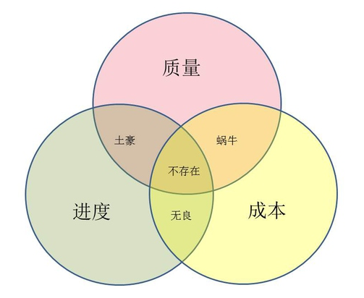
NATIVE APP
Advantages:
Good performance
Connect hardware directly
Offline use
Disadvantages:
Multiple Operation Systems: Android, IOS, WP, etc.
Resources ( Quality, Cost, Schedule )
Code not reuse

Slide 4
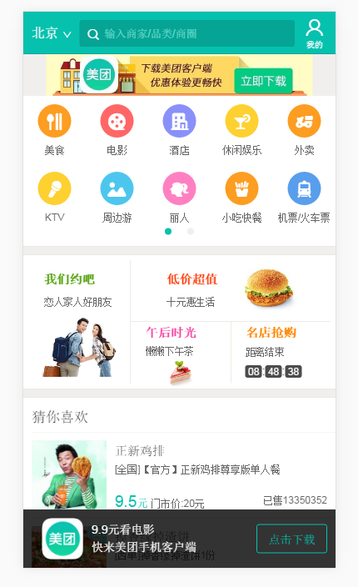
WEB APP
Advantages:
Cross platform
Save resource
Disadvantages:
Offline
Hardware
Browser ( WebView )
Store not receive

Slide 5

HYBRID APP
Advantages:
Save resources
Cross platform
Code reuse
Low update
Disadvantages:
High Performance ( Game )

Slide 6
COMPARE
 | Web App（网页应用） | Hybrid App（混合应用） | Native App（原生应用）
开发成本 | 低 | 中 | 高
维护更新 | 简单 | 简单 | 复杂
用户体验 | 差 | 中 | 优
Store或market认可 | 不认可 | 认可 | 认可
安装 | 不需要 | 需要 | 需要
跨平台 | 优 | 优 | 差

Slide 7
RELATED TECHNOLOGY
HTML + CSS + JavaScript
Apache Cordova
Ionic

Slide 8
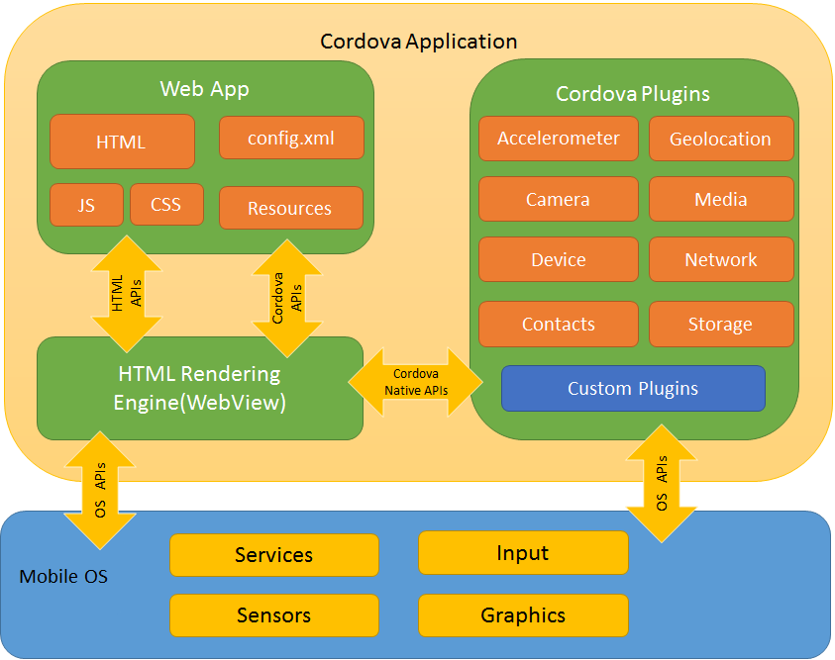
APACHE CORDOVA
Apache Cordova is an open-source mobile development framework. It allows you to use standard web technologies - HTML5, CSS3, and JavaScript for cross-platform development. Applications execute within wrappers targeted to each platform, and rely on standards-compliant API bindings to access each device's capabilities such as sensors, data, network status, etc.

Slide 9
IONIC
Many useful UI components. ( HTML + CSS )
Base on AngularJS. ( MVVM )
UI-Router ( Single Page Applications )
Created a great architecture to build on top of.
Others
jQuery mobile
Sencha Touch
Framework 7 + Knockout.js

Slide 10
PREPARATION
1. Install Nodejs
2. Install Cordova and Ionic
npm install -g cordova ionic
3. Start an App
ionic start myApp tabs
4. Run on you local browser
ionic serve

Slide 11
BUILD ANDROID HYBRID APP
JDK
Android SDK
Gradle
Setting environment variables
JAVA_HOME
ADNROID_HOME
Path
Gradle
Platform-tools
Tools
Cordova platform add android --save
Cordova build android --verbose
Cordova run android

Slide 12
PROBLEMS
Cordova build android –verbose
Gradle Downloading
http://blog.csdn.net/lovelyelfpop/article/details/52222012
Maven Repository
http://www.cnblogs.com/JT-L/p/5883602.html

Slide 13
Q&A
THANKS

