Slide 1
Scrum & TDD
Garfield Dai

Slide 2
Waterfall
Plan
Build
Test
Review
Deploy

Slide 3
Scrum
Plan
Plan
Plan
Plan
Build
Build
Build
Build
Test
Test
Test
Test
Review
Review
Review
Review

Slide 4
Sprint
Sprint
1
Sprint
2
Sprint
3
Sprint
4

Slide 5
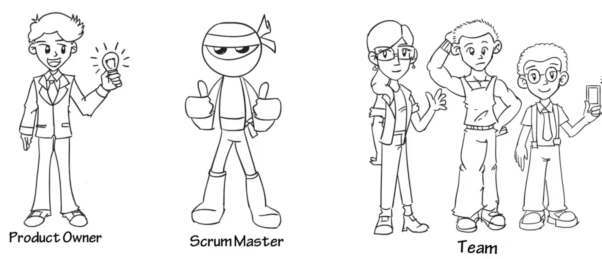
Scrum Team

Slide 6
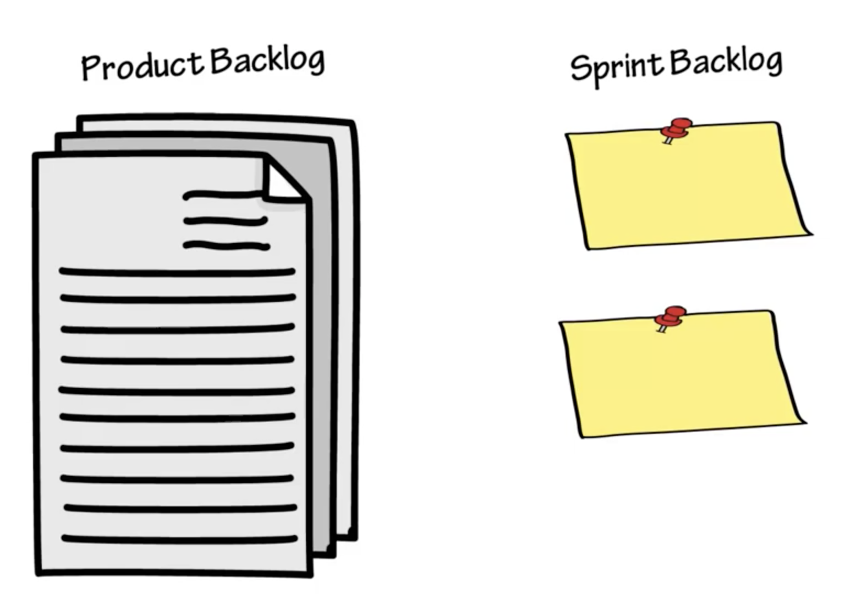
Scrum Artifacts

Slide 7
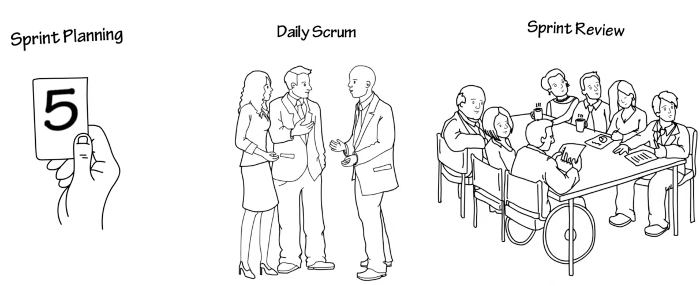
Sprint

Slide 8
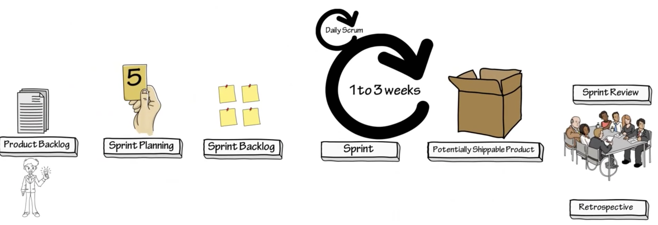
Scrum

Slide 9
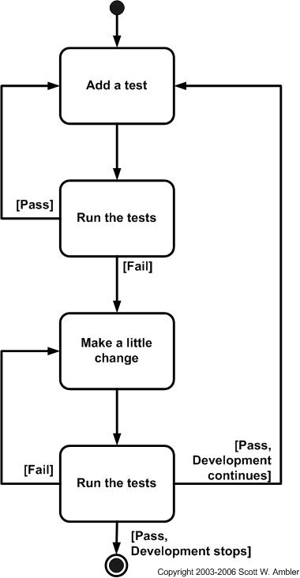
Test-Driven Development
Add a test
Run all tests and see if the new test fails
Write the code
Run tests
Refactor code

Slide 10
Thanks

