Slide 1
A story
Richard S. Sutton => TD PG
Andrew G. Barto
David Silver UCL
Deepmind MIT

Slide 2
Pipeline
Question（why）
Rough Defination（object）
Example
Defination
Exam(how)
Solution

Slide 3
Topic
RV→RP->MP
MRP->MDP(iter/direct)
DP(w/o model)(policy/value(in/out place))
MC(off/on line)(1/n 1/k 1/N)
TD
TD(n) TD(lamda)
SARAS Q-learning
PG AC
DRL

Slide 4
RV→RP->MP
Q:随机事件举例（tossing a dice ）,随机变量
为什么研究：But 只能认识到具体事件，而不能抽象到变量属性。(认知)
https://zhuanlan.zhihu.com/p/60914904
明确研究对象: variable whose values depend on outcomes of a random phenomenon. Denotes X
Application: 抽象到性质层面可以研究比较复杂的条件概率
P(A ∪ B) = P(A) + P(B) − P(A ∩ B)
Exam:(5 points) Suppose three fair, six-sided dice are rolled. Use part (a) to calculate the probability that at least one of the dice shows either 4 or 5.

Slide 5
Random process (or stochastic process)
为什么研究In many real life situation, observations are made over a period of time and they are influenced by random effects, not just at a single instant but throughout the entire interval of time or sequence of times.
：一次=>时间段（通常随时间变化，toss a die->tire）
明确研究对象：In a “rough” sense, a random process is a phenomenon that varies to some degree unpredictably as time goes on. If we observed an entire time-sequence of the process on several different occasions, under presumably “identical” conditions, the resulting observation sequences, in general, would be different.
和RV的关系：A random variable (RV) is a rule (or function) that assigns a real number to every outcome of a random experiment, while a random process is a rule (or function) that assigns a time function to every outcome of a random experiment
X(t), state.But How to model this rule?

Slide 6
Markov process
Why?simplify the random process
A random process X(t) is said to be Markov if the future of the process given the present is independent of the past
Example: 如何衡量一个句子的合理性？
a sentence->random process
Reasonable->P(S1S2...Sn)=?
“It is a paradox of the Vsislaber that they were both hard working,and through their schedule, lazy.”
“both schedule working and their paradox is a vsislaber that through...”

Slide 7



Count the number of the #(wi-1,wi) in the corpus
Divided by the volume of the corpus.
——property 1

Slide 8
Q:如何 给网页排序？
在1998年前大家用搜索工具不能搜到想要的内容，解决20年前的问题。

Slide 9
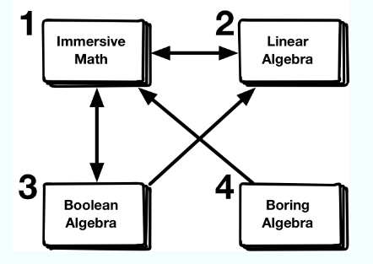
Toy example, we will look at a simplified model for ranking web pages.
The main idea is that a web page has a higher rank if many pages (with high rank) links to this page. The problem is recursive. In order to calculate the rank of one page, you need to know the ranks of the other pages.
Another way to look at this is to think of a person that randomly clicks on one of the links of a homepage. After random browsing, the page rank is the probability that you are on a certain homepage.
Markov assumption → Markov matrix

Slide 10
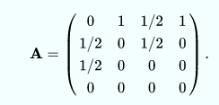
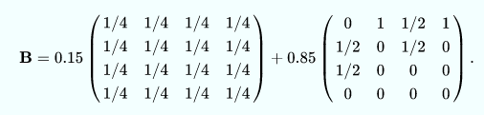
Bp=p
(B-I)p=0
n元齐次线性方程组 Am×nxn=0有非零解的充分必要条件的系数矩阵A的秩即R(A)<n，当R(A) = n时有0解,Gaussian elimination
SVD,QR
http://hk.uwenku.com/question/p-morvvmsp-uh.html

Slide 11
Iterative method(lambda=1)
m_k+1=B*m_k
m_k=B^k*m_0
convergence：
图形解释：gif mp4
推导解释：pdf
对角分解
Perron-Frobenius theorem=
=B_Kp=A(D^k)Ap0=v1
A successful algorithm or method usually has a rigorous mathematical theory behind it. In probability theory, the Pagerank algorithm is essentially a Markov chain. The Perron-Frobenius theorem is a standard
tool in the analysis of convergence in Markov chain.
——Property 2
把互联网当做一个整体来对待，符合了系统论的观点，之前的算法把每个网页作为一个个体，研究查询内容和网页的相关性，而忽略了网页和网页之间的联系。
Story:
Google凭借pagerank打败了yahoo，page、bullin（MIT）创始，MIT拥有10亿（1%股票）

Slide 12
Two properties
1The future is independent of the past given the present
The state captures all relevant information from the history.
The state is a sufficient statistic of the future
2.任意初始状态最终会收敛到稳定状态
稳定状态与初始状态无关

Slide 13
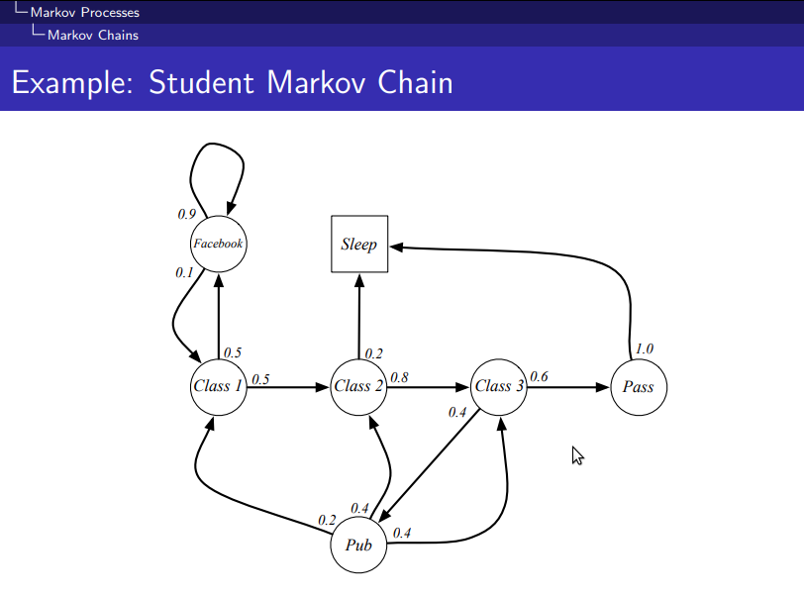

Slide 14
引入
Reward
Return
Value function
Bellman equation
Matrix:v=R+γPv
convergency
Direct method
Iterative method

Slide 15
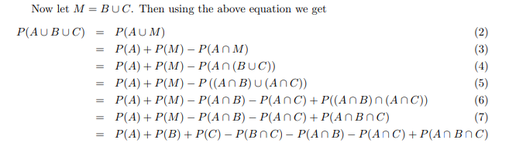
(5 points) Suppose three fair, six-sided dice are rolled. Use part (a) to calculate the probability that at least one of the dice shows either 4 or 5.
P(AUBUC)=19/27
一个硬币扔五次，连续三次正面朝上的概率（1/4）

