Slide 1
SOEN 6441 Advanced Programming Practices Winter 2021
Team 11
Build 1

Slide 2
Architecture Used
Model View Controller (MVC)
A three-tier architectural model
Model: Manages the behavior and data of application domain
View: Renders the contents of a portion of model’s data.
Controller: Receives user input and initiates a response by making calls on appropriate model objects.

Slide 3
Project includes
Functional Requirements for Map Editor and Game Play
Junits for each classes are implemented
Completed JavaDocs for all the files
Continuous Integration implemented and Software version repository maintained
Coding Conventions maintained
Goal
To develop Risk Game using given Build 1 requirements.

Slide 4
Coding Conventions
Naming Convention:
Class names in CamelCase that starts with capital letter.
Data member starts with d_
Method parameters starts with p_
Local variable starts with l_
Global variable in capital letters
Static members starts with capital letter, non static members starts with small case letters.

Slide 5
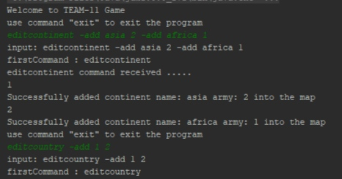
Functional Requirements:
This game includes a command prompt available throughout the game. All the commands are validated and give proper feedback on their effect or invalidity.

Slide 6
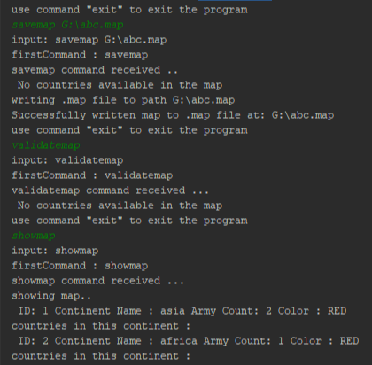
Commands for Map-Editor
editcontinent -add asia 2 -add america 3 -add africa 4
editcountry -add india asia -add china asia
editneighbor -add india china -add pak china
showmap
savemap d:\abc.map
editmap d:\abc.map
validatemap

Slide 7
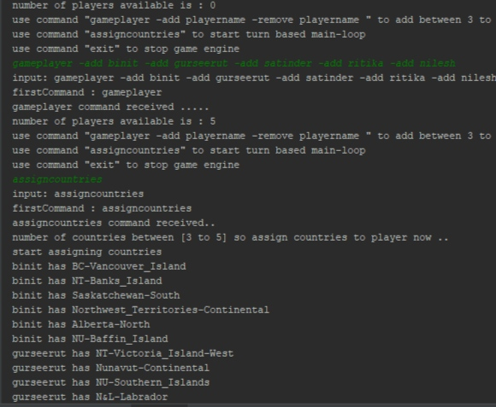
Commands for Game-Play
loadmap D:\maps\canada\canada.map
gameplayer -add binit -add gurseerut -add satinder -add ritika -add nilesh
assigncountries
showmap
deploy 1 1

Slide 8
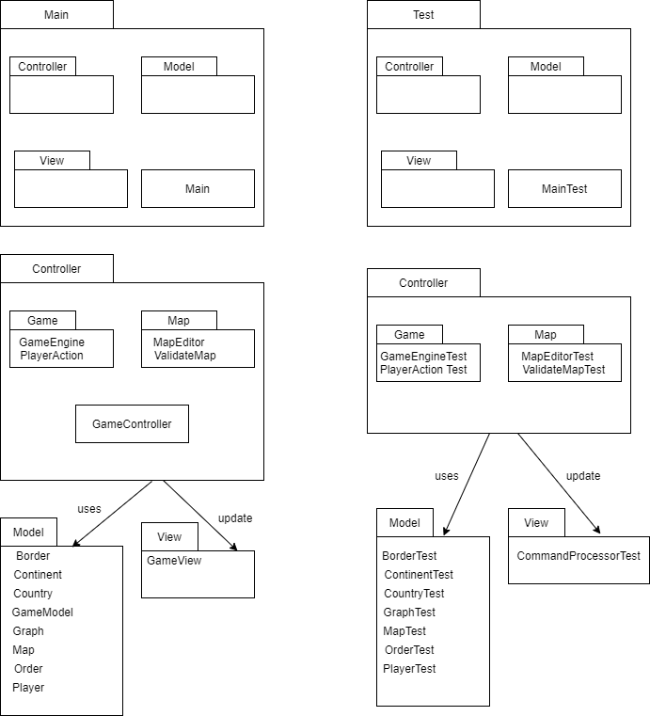
Architecture Diagram

Slide 9
Thank you!

