Slide 1
SOEN 6441 Advanced Programming Practices Winter 2021
Team 11
Build 1

Slide 2
Design Patterns Used:
“Each pattern describes a problem which occurs over and over again in our environment, and then describes the core of the solution to that problem, in such a way that you can use this solution a million times over, without ever doing it the same way twice.” - [Christopher Alexander]

Slide 3
Observer Pattern: Define a one-to-many dependency between objects so that when one object changes state, all its dependents are notified and updated automatically State Pattern: Behavioral software design pattern that allows an object to alter its behavior when its internal state changes Command Pattern: Behavioral design pattern which uses an object to represent and encapsulate all information needed to call a method at a later time.

Slide 4
Project Includes
Functional Requirements
Map Editor and Game Play
Junits for each classes are implemented
Completed JavaDocs for all the files
Continuous Integration implemented and Software version repository maintained
Coding Conventions maintained and API documentation
Refactoring operation has been applied after build-1 and refactoring Document has been maintained
Goal
To develop Risk Game using given Build 2
requirements.

Slide 5
Coding Conventions
Naming Convention:
Class names in CamelCase that starts with capital letter.
Data member starts with d_
Method parameters starts with p_
Local variable starts with l_
Global variable in capital letters
Static members starts with capital letter, non static members starts with small case letters.

Slide 6
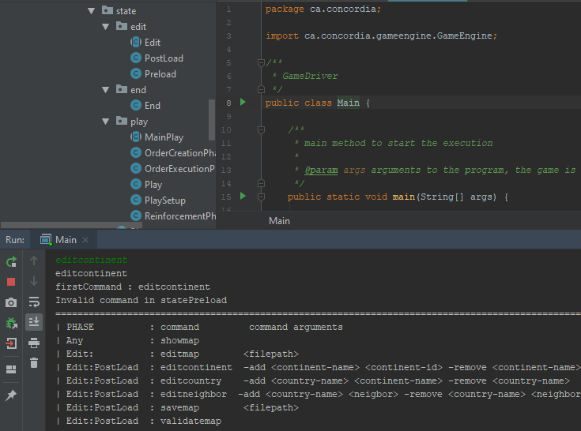
Functional Requirements:
Code has been refactored and State Pattern has been implemented. The context class of State Pattern is GameEngine class. If command is invalid, a proper message is shown.

Slide 7
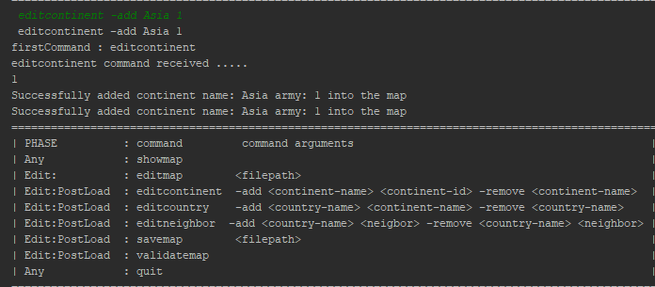
Commands for Map-Editor
editcontinent -add asia 2 -add america 3 -add africa 4
editcountry -add india asia -add china asia
editneighbor -add india china -add pak china
showmap
savemap d:\abc.map, editmap d:\abc.map
validatemap

Slide 8
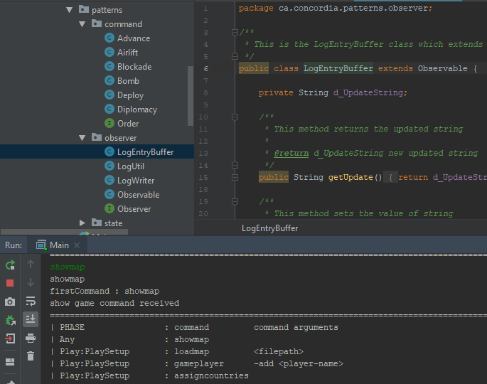
Commands for Game-Play
Implementation of Game log file using Observer pattern.LogEntryBuffer(Observable) contains information about effect of action.LogWriter (Observer) writes the contents of LogEntryBuffer to a log file.Command pattern is used to implement Orders

Slide 9
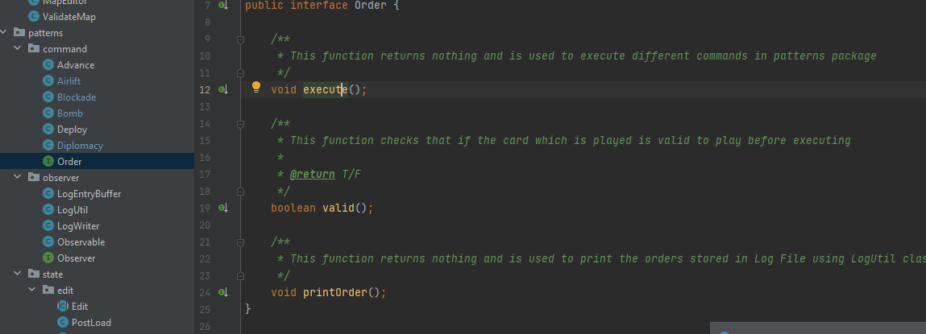
Command Pattern Implemnetation
Command pattern has been introduced to implement the order cards invoked by the Player to move forward In the game and is executed using execute() method

Slide 10
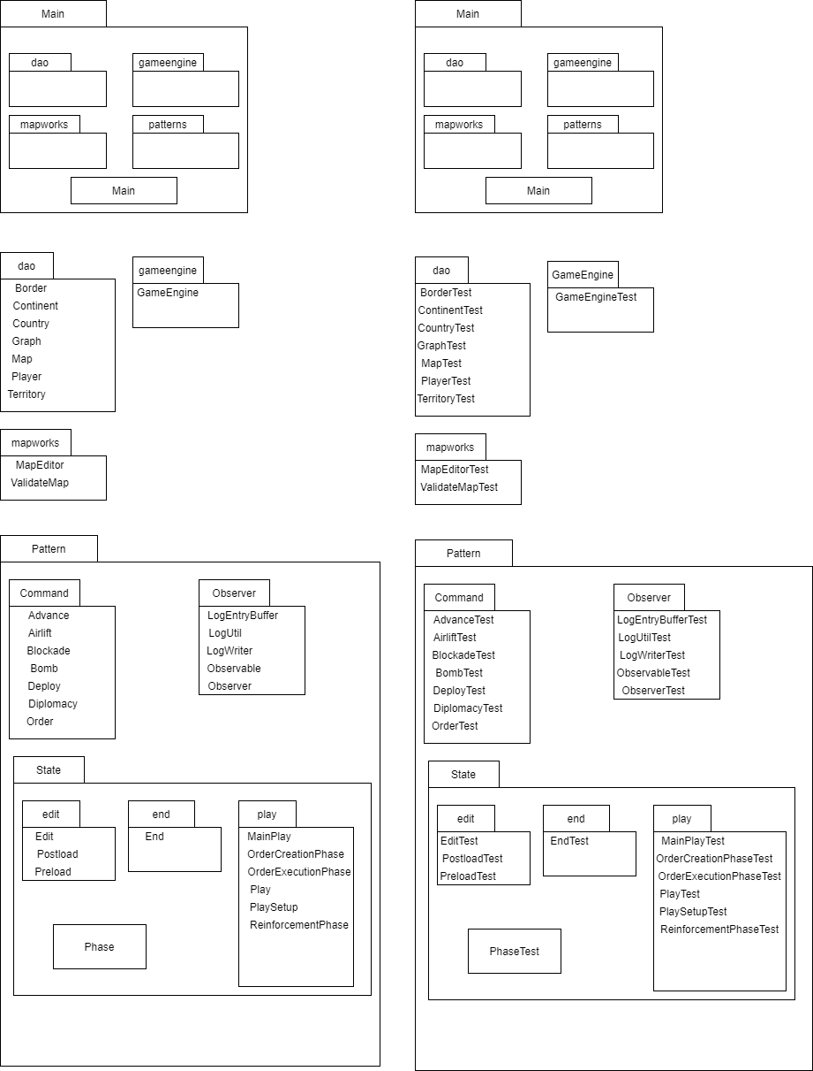

Slide 11
Thank you!

